Slide 1
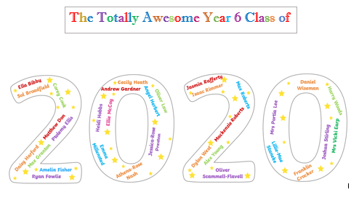

Slide 2
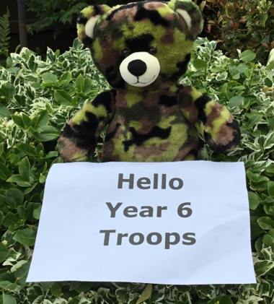
Mrs Lee has asked me to make this presentation for the Year 6 Troops, who are absolutely magnificent. We hope you enjoy it! I wore my paws away typing in all your messages and had to eat copious amounts of cookies to avoid passing out from exhaustion. Love Tim (Your loyal Captain)
Tim is exaggerating to excuse his feeding frenzy but he is sad to be saying goodbye and may go off on stealth missions to see you all.

Slide 3
Foundation

Slide 4
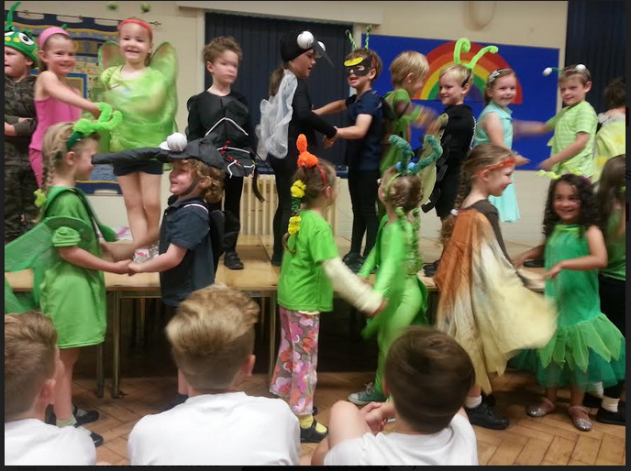
Foundation
The present Year 6 have been called many things in affection and banter – including Padawans, Jedis, Troops, cupcakes – if only I had known about the gorgeous bugs!

Slide 5
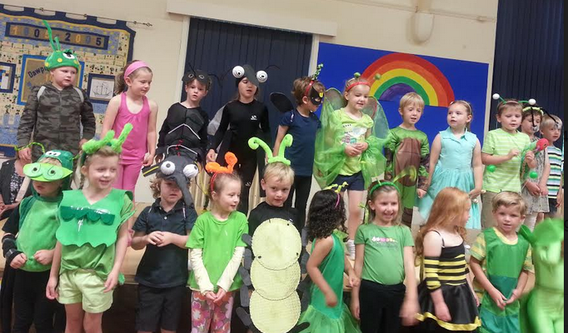
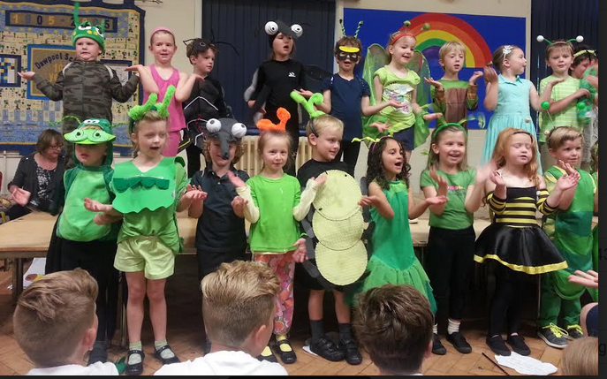

Slide 6
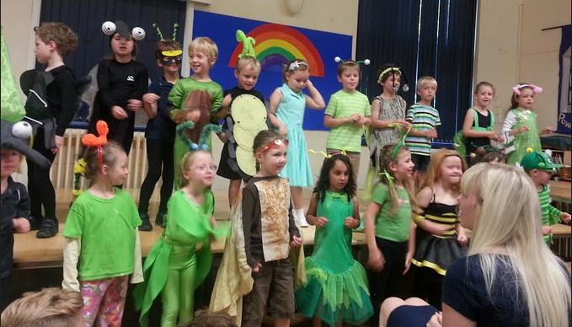
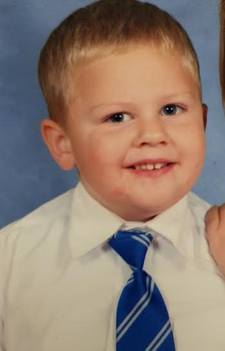
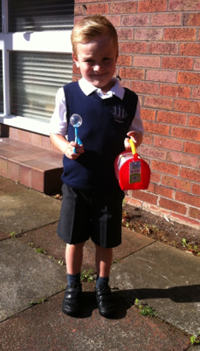
I will always remember my first day at Dawpool when I came into Foundation 2. I was quite nervous on my first day but I made some amazing friends and I had lots of fun.
(Daisy Harford)
When I arrived at Dawpool I was not scared but nervous – I didn’t want to come into Primary School. I wasn’t really a good boy in my first year as I Did not listen to the teachers – I was a rebel! The only thing I liked in reception was the space topic. We had space sweets and I was greedy for more. (Harry)

Slide 7
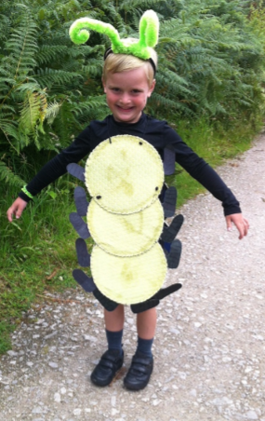
F2 My first day at school I remember walking in those doors and seeing my new class, I later discovered my new friends Daniel, Lottie, Sol, Max G and Harry. I used to love Mrs Broadbent. Our play was of the Praying Mantis. We also took part in our first ever Sports day in which my team won.(Isaac)
F2 (Sol)
One of my memories in F2, and probably the most important one too, was my first day.
I remember coming into the playground, wondering what it would be like. My special friend Ben Green led me to my classroom. I can’t remember much as it was such a long time ago. I remember Mrs Broadbent, who was Miss Johnson at the time, calling out the register. Then she told us that Mrs Webster would take us on a tour of the school. I remember seeing a few familiar faces but that was it really.
I will never forget my first day at Dawpool, walking up school lane I remember I was really nervous. What would it be like? Who would I meet? But after a few days I realised that everything would work out. Doing the caterpillar play in foundation 2, meeting my special friends, doing phonics most days showed me how fun my first year of primary school really was.
(Jasmin)

Slide 8
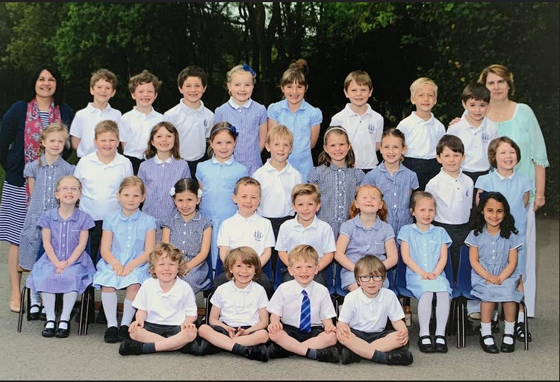
Year 1

Slide 9
In year 1 we had titanic day where we dressed up as people, like first class and second class passengers it was crazy seeing everyone in costumes but we sure had fun. Also in year 1 we made some really cool vehicles as part as our transport subject and I put some cardboard boxes together to make a pink car! And we went on a trip to see all of the different transport and learn about each one.
(Daisy Harford)
Year1
The one I remember best and was my favourite day in Year1 was Titanic Day.
Titanic day was a good day. I came as a first class gentlemen who smoked a pipe, used a cane and had a monocle.
I remember seeing everyone in their costumes. I felt so excited! It was such a brilliant day. I remember when everyone went outside to go in the life boats. We had such a good time! (Sol)
In year 1 I finally understood that I could do well. I was put in camel group and loved it there. I missed my brother who had moved to high school being there to protect me. In year 1 I did not have a cookie but my best friend Sol gave me his. I will never forget it! (Harry)
Another favourite memory was when we were pretending in year 1 we were on the titanic. We were all wearing posh clothes because we all wanted to be 1 class. We got a hot chocolate and biscuits. We rocked our boats and pretended we were sinking
(Corey)

Slide 10
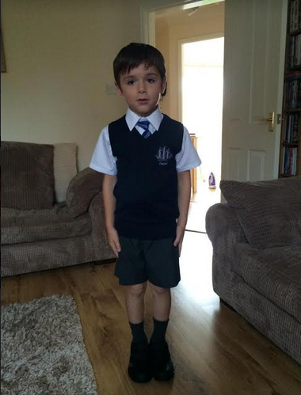
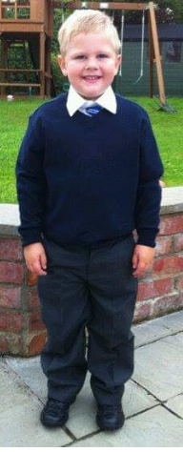
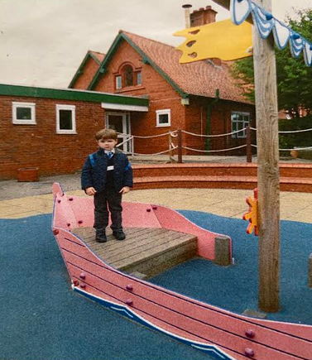
Lillie-Mae

Slide 11
Year 2

Slide 12
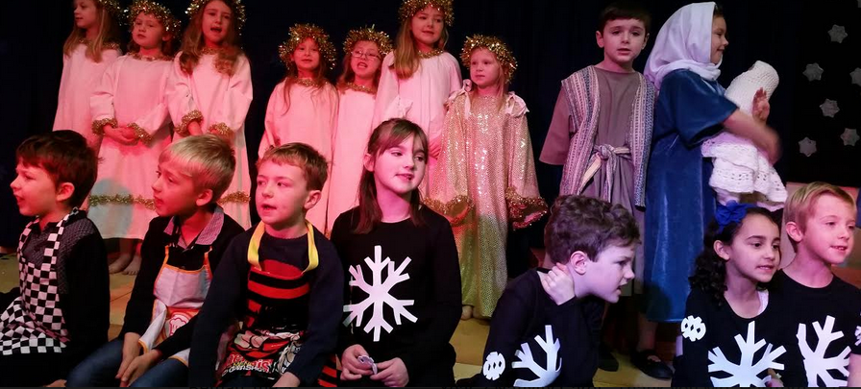
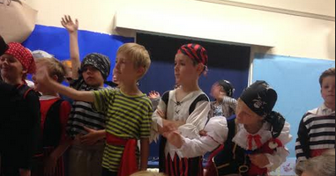
In year 2 we went to Chester Cathedral to see what they did there and how they did things, we also had a nativity in year 2 and I was Mary I also had to sing a part of a song called Holy Child. In the summer we went to Ness Gardens to look and learn about nature so plants, flowers, insects and birds I loved exploring the different parts of the garden. We also had an end of year play which was a pirate play we were all dressed up as pirates and had to be them, we also learnt a bit about pirates which I enjoyed.

Slide 13
In my time in Dawpool I have made loads of funny memories with all my friends and classmates – it was hilarious in the Year 2 school play when I was speaking and playing my role as an islander and my flower necklace got caught on my leg, sending brightly coloured flowers everywhere!
Year2 (Sol)
I remember so much of Year2. One of them was the U-Boat trip.
It was a really good trip. I enjoyed seeing the boat the most. There were lots of interesting facts about how it sank and things like that. So overall it was an amazing trip.
My favourite day was when we did the Summer play in Year 2 and Cecily was a pirate Captain. I also loved the trip to the transport museum. (Dylan)
In year 2 the trip to Ness Gardens was fun and amazing. We played hide and seek in the long grass. We did our pirate play as well. Mrs Marr and Mrs Ashton were great teachers . (Harry)

Slide 14
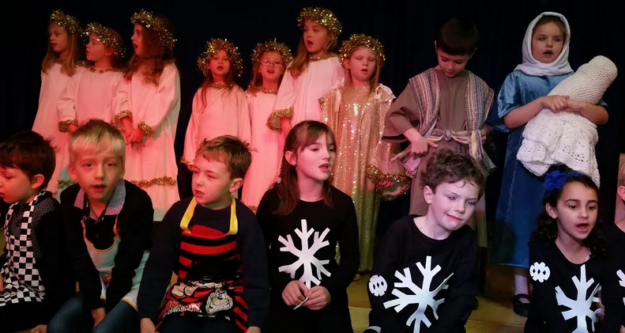
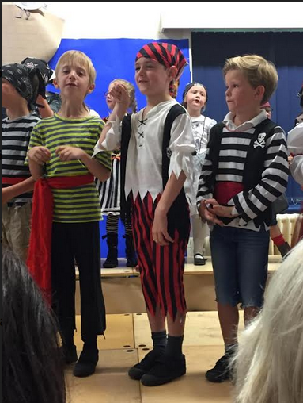
One of my funniest memories was the Pirate Play in Year 2. I was only given two words to say but for some reason I stuffed them up! At the end of the play we stood at the back and we all sang a song. But the railing moved – I nearly fell off the stage so I had to grab someone before I fell off.
(Emma Millensted)

Slide 15
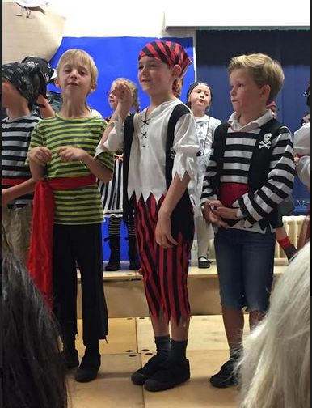
In Year 1 I enjoyed the Titanic trip and the boat trip. I have liked all the teachers because they are nice and help me. In Year 6 I have enjoyed the laughs. The best thing about school is PE. I have won the running race on Sports Day three times! I came Second in the School Championships.
(Joshua)
Lillie-Mae

Slide 16
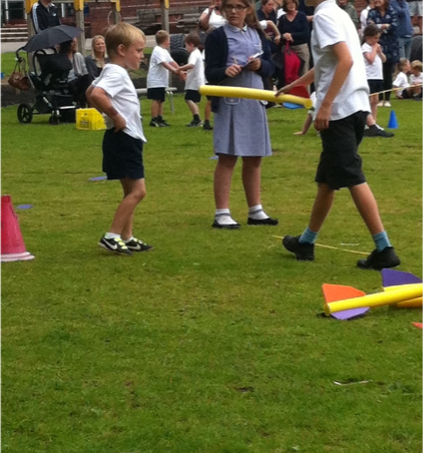
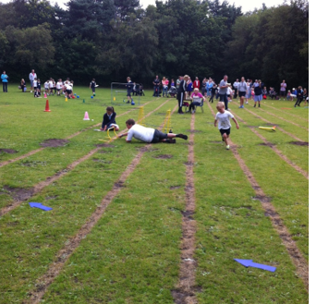
Y2 I remember on the first day Andrew came in we were all excited and extremely fascinated about his American history and his American accent. We had an exciting trip to Liverpool where we went to the transport museum where we saw busses and cars and even trains. We then took the Tram to go to the U boat Story. (Isaac)
Favourite Memory
I joined Dawpool half way through F2 and I remember everyone being really nice to me. My favourite memories are sports days even though Mackenzie and Isaac always finish in front of me! I have enjoyed all the trips we have been on. I really like all the friends I have made but my best memory overall is having a ‘special friend’ who I looked after Isaac. (Max R)

Slide 17
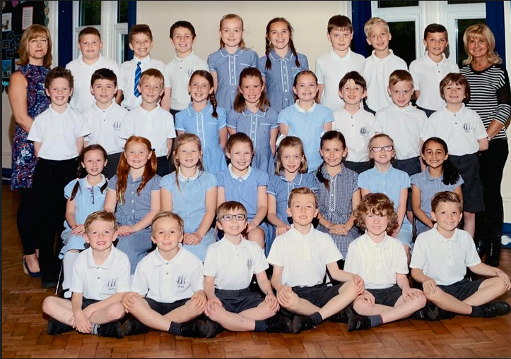
Year 3

Slide 18
My favourite memory was in year 3 when we went to John Lewis airport. It was extremely fun. We got to watch the planes land and take off.it was exiting. The floor was made of marble. We watched the security. We seen what was in the bags and about 1 in 20 beeped because people forgot to put there electronics in a different tray. We were told anything that looked like a gun for example had to be taken away because even though it is not a gun it might be. The reason why this was my favourite was because when I was little i had only been on holiday once. I wished I was going on holiday too.
(Corey Cook)
I remember six other children and I went other school to make a cross and at lunchtime I had a ham rap for lunch after I I stepped outside every girl outside surrounded me like I was Justin Bieber and Sol saved me from the hoard of girls. When we went back inside we had wet glue to paint on the cross but all the girls didn’t do that they painted it on themselves!
When I was in year5 we went to Chester to a Roman Museum . When one of the employees was telling us about the armour , she brought or a replica of one and asked me to put it on it was very heavy and bulky . For lunch I had a wrap and some water. (Andrew)
In year 3 we had our French day we tried new foods and had lots of hot chocolate. I also really enjoyed going to Claremont farm to do strawberry picking, the strawberries were really sweet and tasted delicious. In year 4 we went to Chester to learn about the Romans. It was really embarrassing when we all had to march around Chester in our vibrant yellow and red armour we did get a bit of weird looks though! (Jasmin)

Slide 19
My best memory is when I started, everybody was so nice to me . I will never forget the day I started. (Alex)
DAWPOOL IS THE BEST
In Year 3 we had just finished the school trip to Claremount farm and to make sure we didn’t come back the farmer made us squash strawberries on our heads so that he could identify us. (Ella )
In year 3 we learnt a lot about French with Mrs Earp so we had a French day we had all of the yummy French food it was tasty. We also did a few French activities and they were awesome. In year 3 we also learnt an Egyptian dance that we performed on a stage at Claremont school. (Daisy)
Year3 (Sol)
One of my favourite memories was French day. French day was such an amazing day. We were able to eat croissants and drink hot chocolate. I also think that we were able to eat baguettes as well.
We made a calendar with the Eiffel Tower and lots of other arty things.
Y3 we were in KS2 now and thought we were the biggest children. Daniel came back from Wales from when he left in Year 1 I was extremely happy. In the new KS2 sports day I came first in the sprint long run and Relay. I also made it into the school team along with Harry and Max Roberts I scored my first hat trick but sadly we were unlucky in the final as well as well as our first Christingle. I also started violin lessons. (Isaac)

Slide 20
I have two favourite memories. The first one is a school trip to a Strawberry farm in Year 3. We jumped on the bus and we sang and we talked. When we arrived, the farmer talked to us about strawberries! Then, we had a tour of the farm which was really big. At the end we were allowed to pick strawberries and just before we left, we squashed strawberries on our faces!
It was induction day and Mr G was really confused because we were all bright red.
(Daniel)

Slide 21
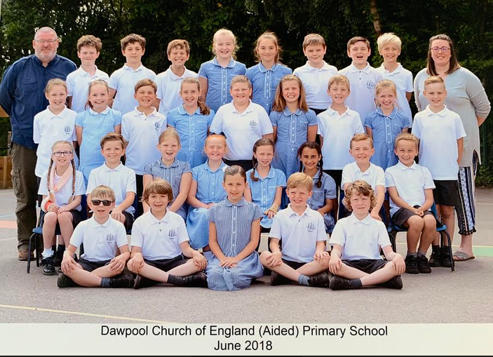
Year 4

Slide 22
Year4 (Sol)
For Year4 it would have to be the Roman trip. It was such an excellent day.
The instructor was strict but funny. I remember walking around Chester with everybody staring at us, in a nice way though. I remember going to the gift shop and buying my sisters presents.
I also remember the old amphitheatre when Harry’s Dad Steve threw snowballs at us when we were doing the turtle formation. The armour was so heavy!
In year 4 we went to Chester to learn about the Romans we held shields and swords and even had a look at one of the battlefields I think. We did a lot of ICT and even learnt how to make our own games using purple mash on the laptop. (Daisy)
Y4 the infamous Mr G and Miss Marland taught us this Year and we were given our very first Purple Mash accounts which I was awfully excited about. I also started Mike’s football and had lots of fun at Lunch Time. We later on embarked on our Roman Trip Where we discovered Ancient history and were given shields which we formed shield formations with. We also had an incredible Narnia trip. (Isaac)

Slide 23
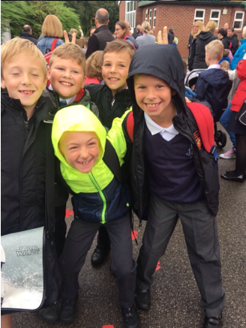
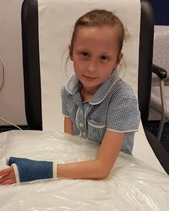

Slide 24
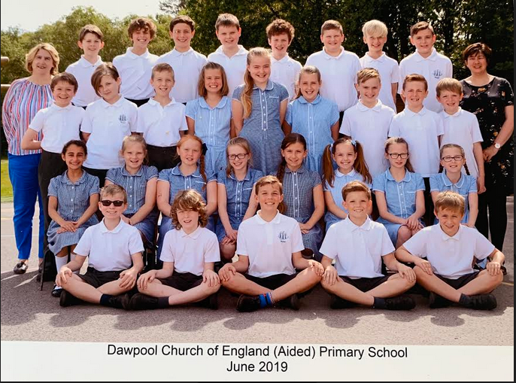
Year 5

Slide 25
My time at Dawpool has been incredible!
One of my favourite memories was when I went to the netball tournament at Wirral Grammar School in Year 5. We practised every Friday after school. We played many matches against different netball teams and our parents were on the side-lines cheering us on. We all wore pink glitter on our faces and had our own Dawpool Gazebo on the grass. I scored the first hoop for Dawpool when I was playing goal shooter, we switched positions every quarter of one match and we had subs for every game. It was so exciting! There was a tuck shop there. Yay! (Ellie McCoy)
This is also one of Amelia’s favourite memories.
Year 5
In year 5 a few of my friends and I went to the beach to help reduce plastic and made some sculptures out of plastic we stayed for the whole day and was really cool to see what you could do with plastic. (Daisy)
All the topics were great in Year 5 and the Trip to the theatre was very good. I even saw my cousin there and talked to him. When I moved to Year 6 I was sad because it was my final year but I loved the Christingle, the pottery, the China topic - it was all amazing. I am going to miss Dawpool because it has been a fun time.
Thank you to all the teachers and staff for a once in a lifetime experience! THANK YOU. (Harry)

Slide 26
I loved our trip to Barnstondale in Year 5 because we did lots of fun and amazing activities. My favourites were when we were put in groups of three and given a list of things to collect. I was partnered with Jasmin and Ella. Sadly, we came second but we still had lots of fun! I also really enjoyed the climbing and ab-sailing we did (it was very, very high). (Emma)
We did Bikeability in Year 5. It was a very exciting day when everyone came into school with their bike. The first day we rode our bikes around the playground but the next day and we needed some help. The next day, we went out of school following the man who was leading us. It was a good time and we learned new things. Everyone was enjoying it because we got to cheer on our friends when they were riding. (Mackenzie)
Year5
I remember the midsummer nights dream play starring Mrs Poston in the cast.
That play was really good. When the cast came round introducing themselves, we knew some of them because we had been studying Shakespeare that year and all of his other plays. It was also really funny!
Y5 Mrs Hall taught us and there was a lot of excitement about secondary school and the 11+. I started to go to after school club with Daniel which I thoroughly enjoyed and play more school football, athletics and swimming. As well as rounders.
(Isaac)

Slide 27
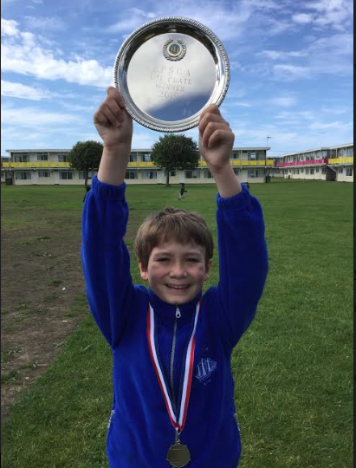
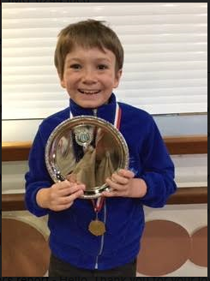
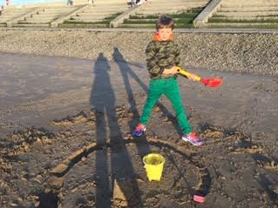
My favourite memory in school was when Mr Burrows brought eggs into school. They weren’t normal eggs though: they were chicken eggs! Mr Burrows put them in an incubator. Everyone was excited. We weren’t allowed to see them that day but we saw them in photos. A few days later we could go in and see the chicks.
A few weeks later we put some names into a hat to see what names the chicks would have. The names picked out were Sunflower, Fluffy and Patrick.
(Matthew)
The best part of Dawpool for me has been representing the Chess Team at Pontins, Prestatyn, Wales. I was able to have a holiday with my friends and the Chess Coach.
(Oliver Scammell-Flavell)

Slide 28
My favourite memory was in Year 5 when we went on a school trip to Midsummer Night’s Dream. We were learning about Shakespeare and we went with Year 6. I was excited to see the play. We walked through the woods to Royden Park where we saw a big stage with seats for the audience. We sat down and saw a game- Corey wanted a go so we waited in line and so did Mrs Hall!
We watched the play, then in the interval we spoke to the actors. Mrs Poston was Queen Titania. Angel offered Oberon a cookie but he said they were not allowed to eat so he had a few crumbs.
I really enjoyed the play because it was funny. We walked back talking about what we had seen. I would definitely go again!
(Franklin Crocker)

Slide 29
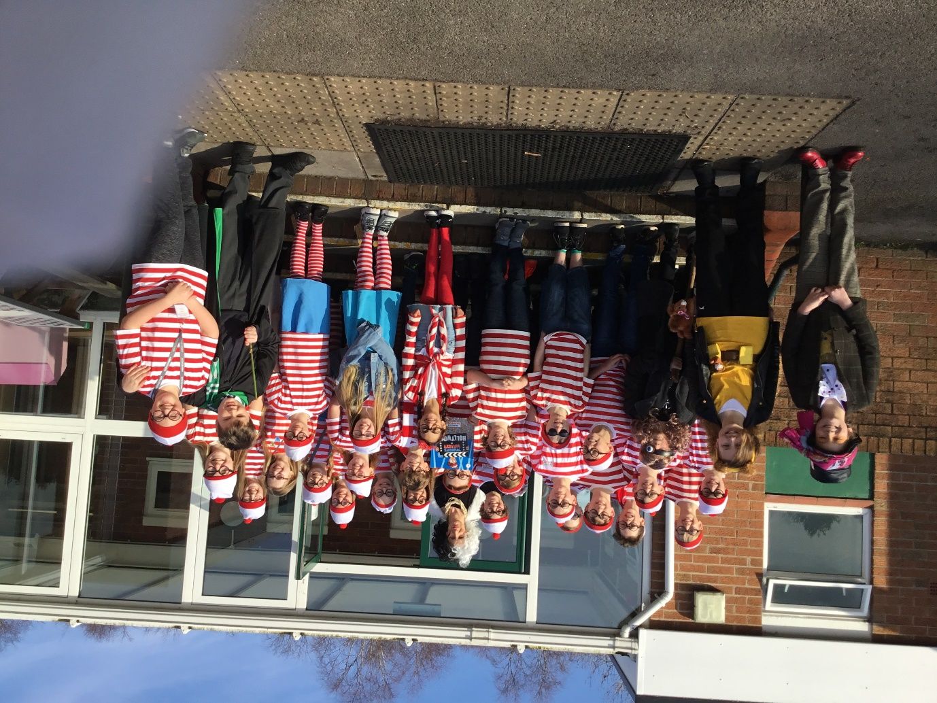

Slide 30
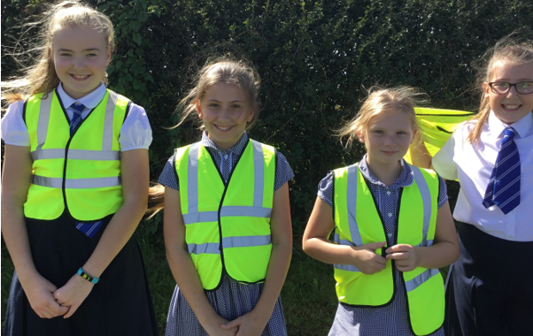
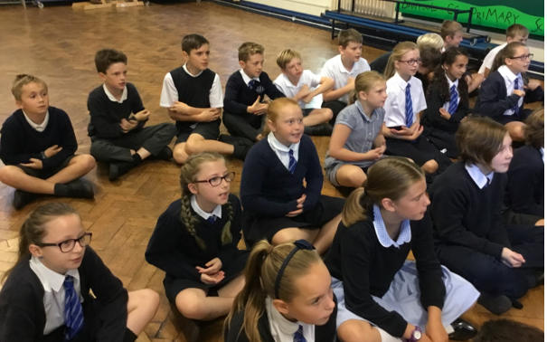
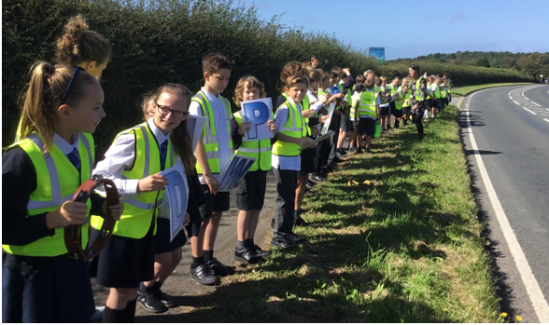

Slide 31
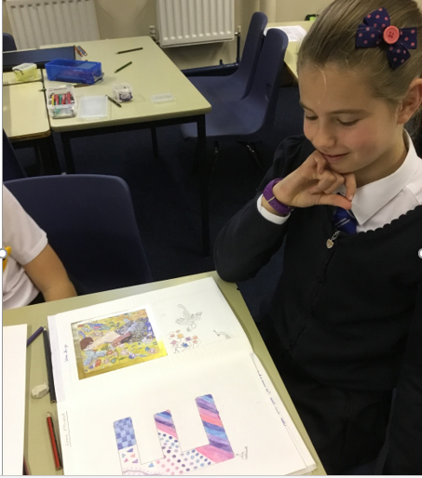
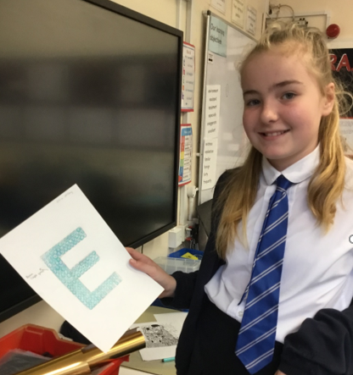
One of my favourite memories was when we did the Christmas Pottery and the year 6 classroom and door were decorated with Christmas decorations. I painted a star with colourful spots on it! We had cupcakes and juice! It was all very exciting because we were all wearing our Christmas jumpers because it was Christmas Jumper Day (Ellie McCoy)
In Year 6 we did lots of pottery, my favourite was when painted our initial letters. I painted mine in pastel pink, purple and blue. I also really enjoyed it when we painted pottery for Christmas. I painted a star which was red with black spots. (Emma Millensted)

Slide 32
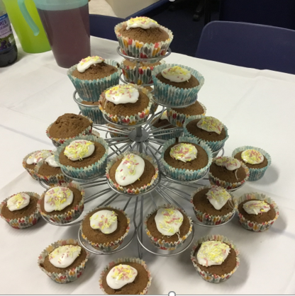
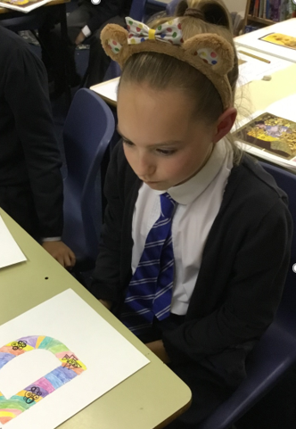
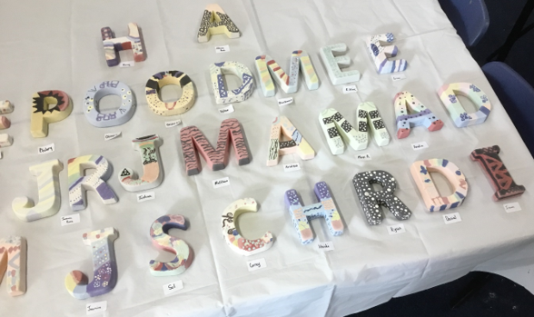

Slide 33
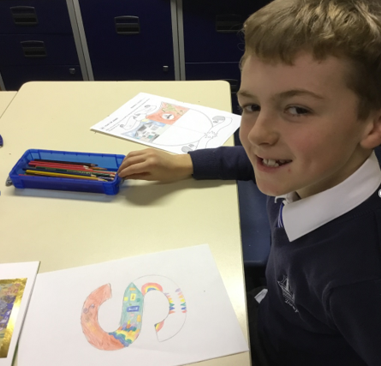
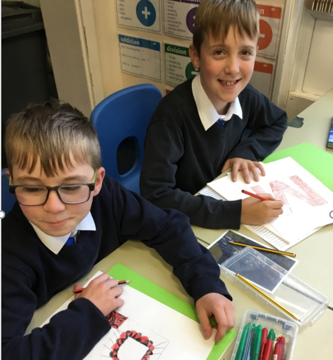
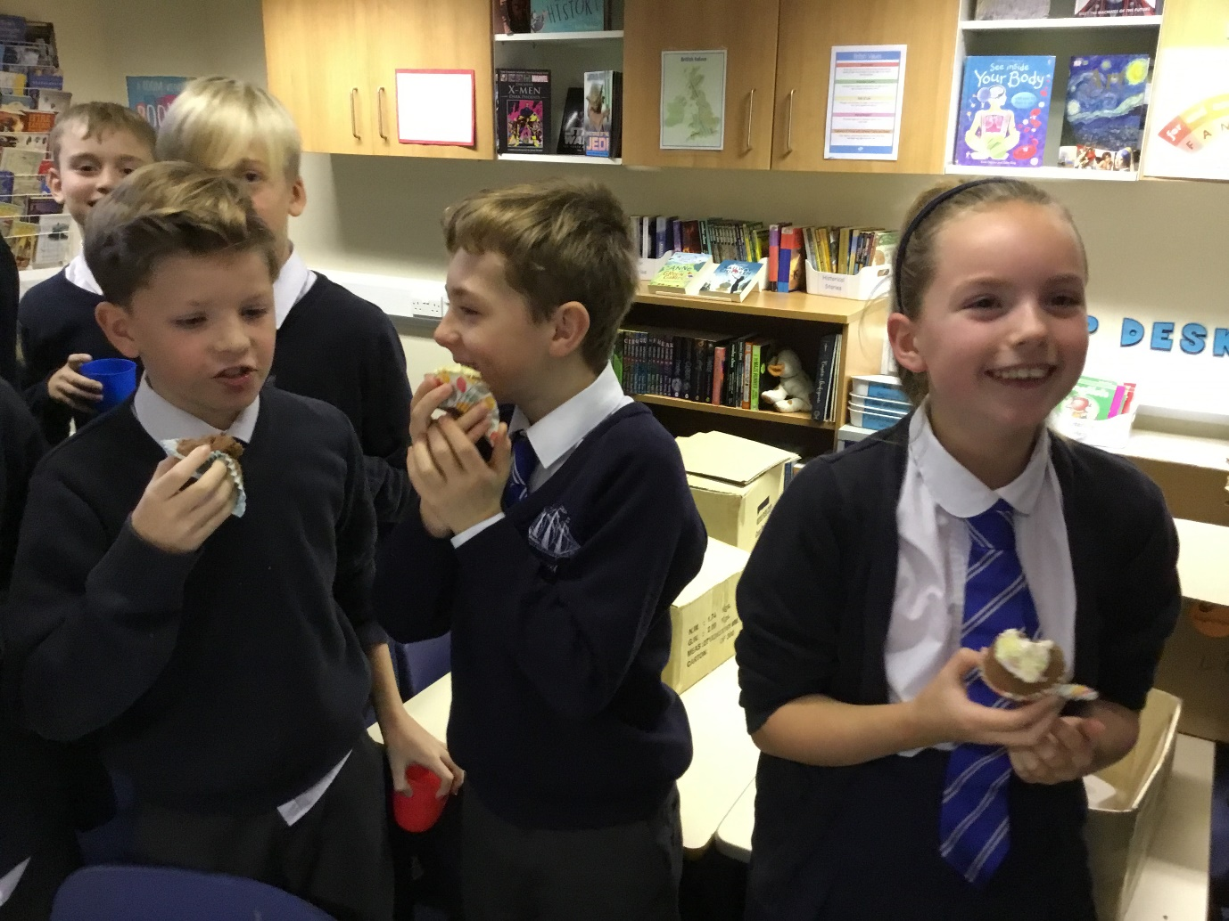
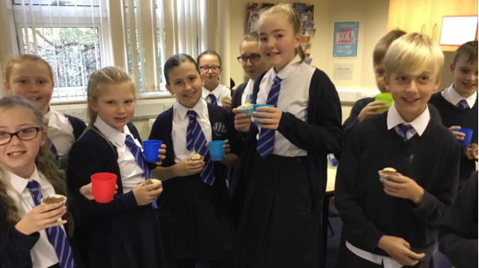

Slide 34
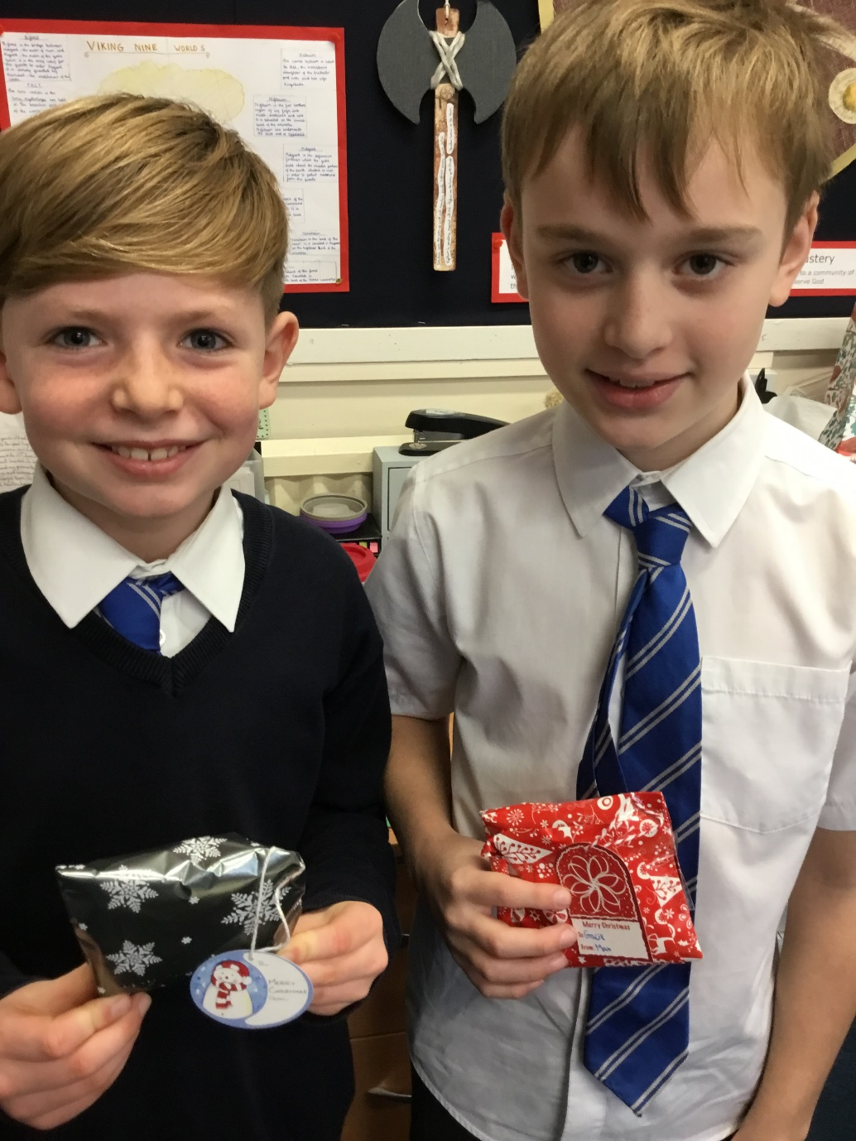
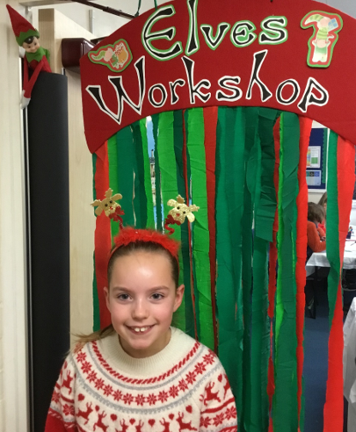
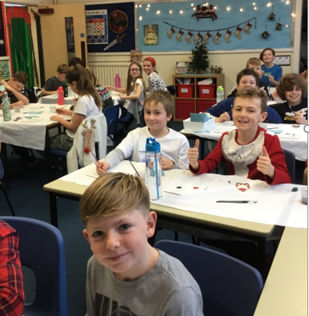
Year 6 has been my favourite because we had two wonderful teachers, Mrs Lee and Mrs Earp. My favourite memory in Year 6 has been the pottery day because we decorated the classroom, painted pottery and had cupcakes. It was so much fun! I am really going to miss everyone, especially all my friends! (Amelia)

Slide 35
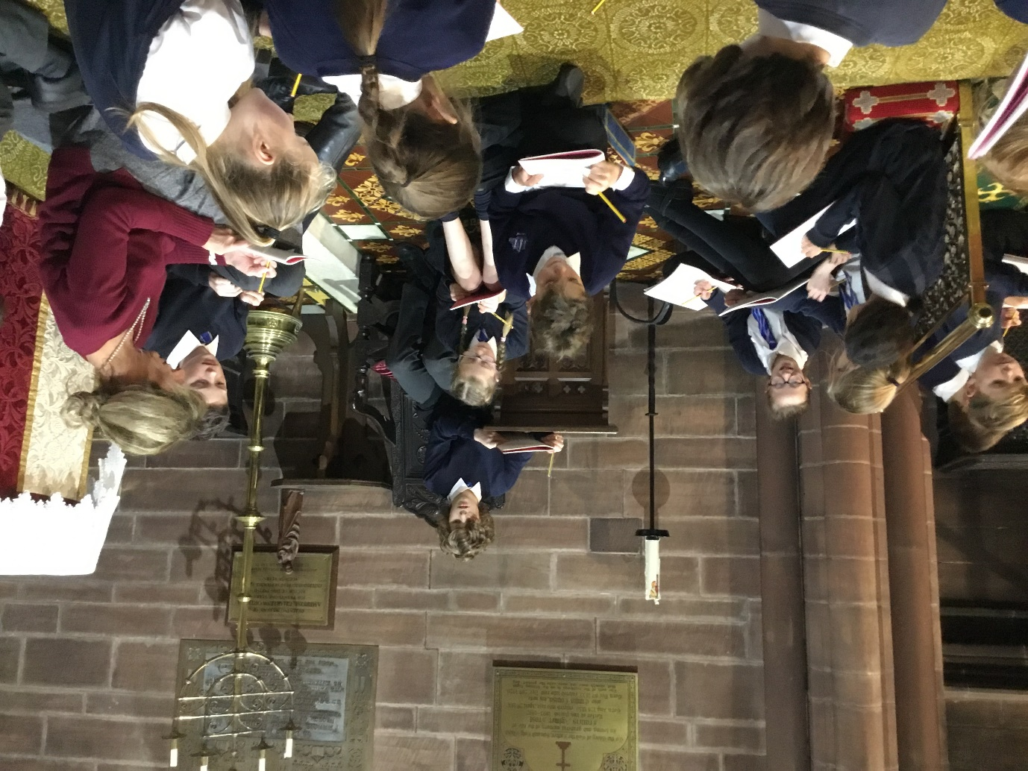
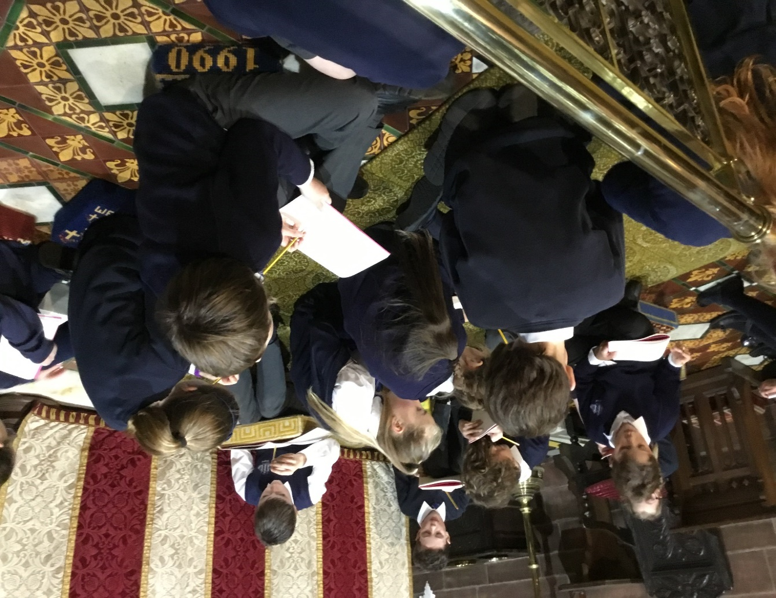

Slide 36
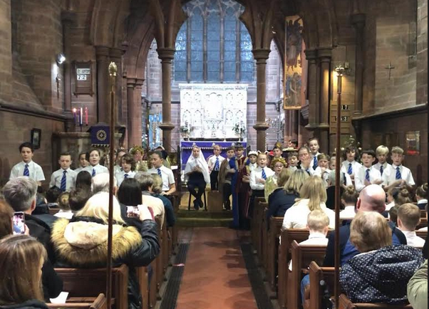
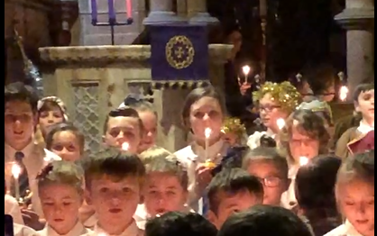
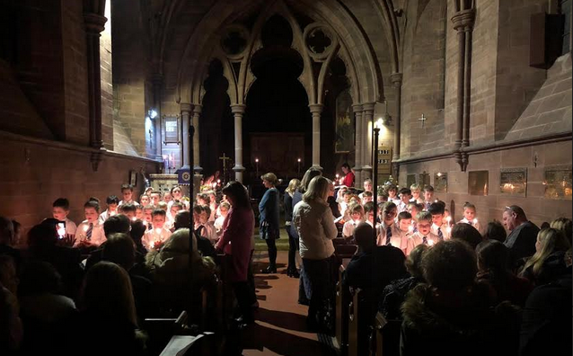
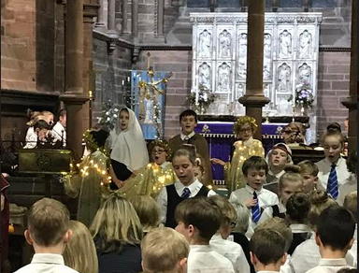
My favourite memory was Christingle and when we signed Silent Night
(Alex)

Slide 37
One of my best memories is The Christingle Service in Year 6 at St Bartholomew’s Church when I was playing the role of an angel along with Jasmin and some other girls. It was really pretty when the lights were turned off and the candles were lit.
I’ve has an amazing time at Dawpool and when I leave, I am definitely going to miss all my friends, the teachers and the wonderful opportunities at Dawpool! (Ella Bibby)
My favourite memory in Primary school was when my friend and I went to Moon Camp…. We did all kinds of activities like building flying paper missiles, 2000 steps along the Wirral Way, ate snacks, played tag.
The final activity was to de-assemble and re-assemble a go-cart. We came 2nd which was brilliant and we celebrated by snacking on some of Ptolemy’s Jammie Ds, Gold Bars, Daim and Haribo!!
(Cecily)
My final comment is: The Office,Season7, Episode 19, Minute 14:45

Slide 38
The best thing about Year 6 is having the best teachers ever. They are really cool!
In Year 6 we were the eldest and our teachers were fun and we had cake on certain days and fun with our special friends. Mrs Lee makes jokes in the middle of class.
(Franklin)
The best thing about Year 6 is the writing you do in literacy and in the Viking topic you make shields! Year 1 and Year 6 are the best years because the topics are fun and the teachers are really good. My favourite teacher is Mrs Lee because she is calm and kind and is always there to help.
(Daniel)

Slide 39
Finally year 6 - at Christmas time we had Christingle and every year we had Christingle but in year 6 you can act, read poems and read out parts I was one of the readers! I loved year 6 because we had our own special friends it is always fun meeting them and we had a day where we could learn a bit about them and give them gifts and play with them it was so much fun! We also had a day in year 6 where we set up for China so we have instruments the Chinese played we had purses, decorations and even clothes and all of the classes in the school would come one at a time to look around and learn about the different things. I also went on a camp for two days and one night and it was called Moon Camp I went with a few of my friends and we did activities based on the solar system I had a lot of fun. I am quite sad to leave all of the lovely and caring teachers behind and I have loved Dawpool! (Daisy)
My funniest memory in Primary School was when we dressed as Where’s Wally and kept it a secret and Mrs Lee laughed.
My greatest achievement is my handwriting!
(Franklin)
Y6 I pass the Anselm’s exam and the 11+. I feel really happy. We make Viking shields and play lots of football. I have Mrs Lee who is an incredible teacher who helped with my learning.
(Isaac)

Slide 40
My favourite memory of Dawpool is when did Chinese New Year in Year 6. It was a lot of fun because everyone got to pick what type of clothes they were wearing. Everyone was happy because we were given a section of the classroom and exciting things to do. Everyone chose the activity they wanted. All the classes came in, one at a time, starting with our special friends which was awesome. We got to talk to them while they tried our activity.
We were able to swap activities. We could not have done this without our INCREDIBLE teachers who helped us out when we were stuck on what to do. That was a memory I will never forget. (Mackenzie)
**Amelia also had this as a favourite memory **

Slide 45
My favourite Year was Year 6 because it was super fun and we did Viking Mythology as one of our topics. Mrs Lee is kind, funny and cheerful and always informs us of out of the ordinary activities.
I enjoyed watching the Cinderella play in Year 6 and sitting with my friends because I wasn’t expecting it to be funny and it turned out to be ridiculous and hilarious!
(Cecily)

Slide 47
The last message from Command HQ:
To my dear Troops,
You have been an incredible class: hardworking, loyal, kind, affectionate and caring – and always smiling! I could not have asked for a better Year 6. You have engaged in everything with laughter and enthusiasm and made every day of teaching you an absolute joy. This has been a hard year for you but you have given your best. You have shown resilience, perseverance and courage. You are ready for secondary school and they are lucky to have you.
Mrs Earp and I will miss you all and believe in every single one of you and that you will shine brightly. Keep in touch….
Hugs, love and laughter,
Mrs Lee and Mrs Earp

Slide 49
To all the parents and children in Year 6-
It has been many years since you first dropped your darling treasures in Reception… The whole Dawpool family sends their love and good wishes to you all.
Thank you for all the happy memories!
The Class of 2020 will be much missed.
Love and cookies to the magnificent Year 6!

