Slide 1
Maths
Addition and Subtraction
Year One
Maths | Addition and Subtraction | Difference | Lesson 1 of 2: Finding the Difference

Slide 2
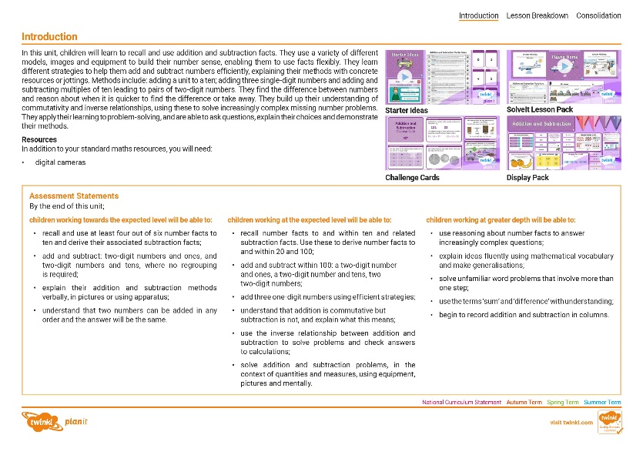
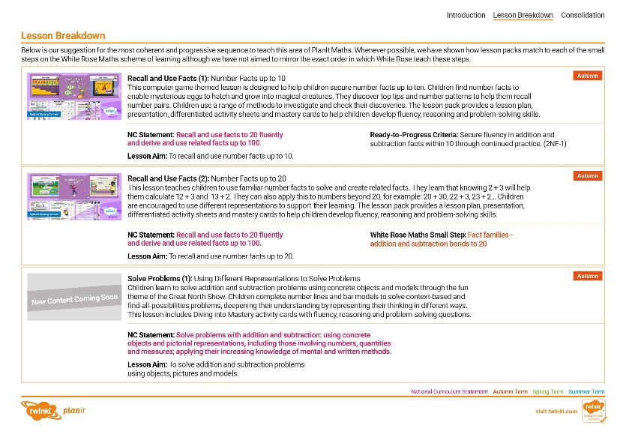
Need a coherently planned sequence of lessons to complement this resource?
See our Addition and Subtraction Steps to Progression document.
Twinkl PlanIt is our award-winning scheme of work with over 4000 resources.

Slide 4
Aim
To find the difference between two numbers.
Success Criteria
I can use a number line to find the difference.
I can use a bar model to find the difference.
I can solve problems by finding the difference.

Slide 5
Remember It
Cho had 12 stickers and Ben had 17 stickers.
Can you use a number line to find the difference?
Try counting forward and back between 12 and 17.
Why does the arrow have a point at each end?
I have 5 fewer
stickers than Ben.
To show that if we count forward or back, the gap will be the same.
I have 5 more
stickers than Cho.
5
10
11
12
13
14
15
16
17
18
19
20
The difference between 17 and 12 is 5.
Find 12 and 17 on the number line.
Draw an arrow between them to show the gap.
The difference between 12 and 17 is 5.

Slide 6
Remember It
Cho and Ben played skittles. Cho scored 29 points and Ben scored 23 points. Can you find the difference?
Can you finish these sentences?
I scored 6 more points than Ben.
I scored 6 fewer points than Cho.
6
20
21
22
23
24
25
26
27
28
29
30
6
The difference between 29 and 23 is .
Find 23 and 29 on the number line.
Draw an arrow between them to show the gap.
6
The difference between 23 and 29 is .

Slide 7
Remember It
Cho read 18 pages of her book. Ben read 22 pages.
Tell your friend 4 facts about the
difference using these words.
22 is 4 more than 18.
18 is 4 fewer than 22.
difference
more than
fewer than
4
15
16
17
18
19
20
21
22
23
24
25
The difference between 22 and 18 is 4.
Draw an arrow between them to show the gap.
The difference between 18 and 22 is 4.

Slide 8
Bar Models
11
Cho’s
Ben’s
5
6
Can you find the difference between Cho and Ben’s blocks?

Slide 9
Bar Models
Cho’s
11
Ben’s
6
5
5
The difference between 11 and 6 is .
5
The difference between 6 and 11 is .
5
6 is fewer than 11.
5
11 is more than 6.
We can show this as a bar model.
Can you complete these sentences?

Slide 10
Bar Models
Cho and Ben found some more blocks. What is the difference now?
14
6
8

Slide 11
Bar Models
We can show this as a bar model.
14
8
6
difference .
The
between 14 and 8 is 6
difference .
The
between 8 and 14 is 6
more than .
14 is 6
8
fewer than .
8 is 6
14

Slide 12
Bar Models
Help us find the difference between these numbers.
Do you know a number fact that will help?
35
10
25
?
difference .
The
between 35 and 25 is 10
difference .
The
between 25 and 35 is 10
more than .
fewer than .
35 is 10
25
25 is 10
35

Slide 13
Draw Bar Models
We’re drawing a bar model to show the difference between 30 and 15.
Draw a bar model to show the difference between 2 and 18.
Draw a bar model to show the difference between 20 and 10.
Draw a bar model to show the difference between 19 and 21.
We’re drawing a bar model to show the difference between 38 and 40.
What can you tell us about our bar model?
The difference is small, so we need to make the gap small.
How can we improve the size of the bars?
30
18
20
21
40
40
2
10
15
19
38
38
15
10
2
16
2
2

Slide 14
Difference Problems
Ben picked up 4 more pencils than Cho.
Cho and Ben tidied the classroom.
Cho picked up 19 pencils and Ben picked up 23 pencils.
?
4
15
16
17
18
19
20
21
22
23
24
How many more did Ben pick up?
23
Use bar models or number lines to find the difference.
19
?
4

Slide 15
Difference Problems
Ben put in 6 fewer puzzle pieces than Cho.
Cho and Ben completed a jigsaw puzzle.
Cho put 34 pieces in. Ben put 28 pieces in.
?
6
25
26
27
28
29
30
31
32
33
34
How many fewer pieces did Ben put in?
34
Use bar models or number lines to find the difference.
28
?
6

Slide 16
Difference Problems
The difference between 26 and 32 is 6.
The difference between 32 and 26 is 6.
Cho and Ben raced to the tree.
Cho took 32 seconds and Ben took 26 seconds.
?
6
25
26
27
28
29
30
31
32
33
34
What can you tell us about the difference?
32
Use bar models or number lines to find the difference.
26
?
6

Slide 17
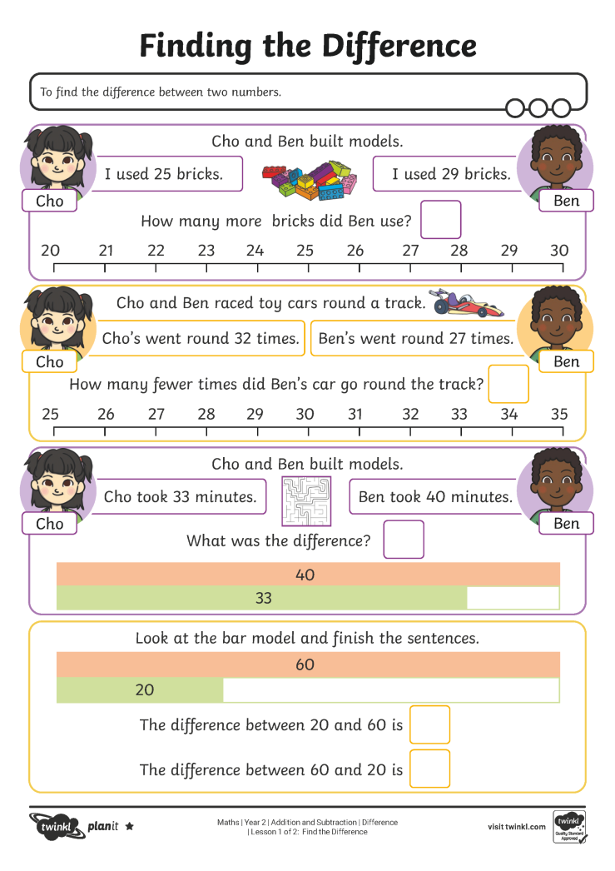
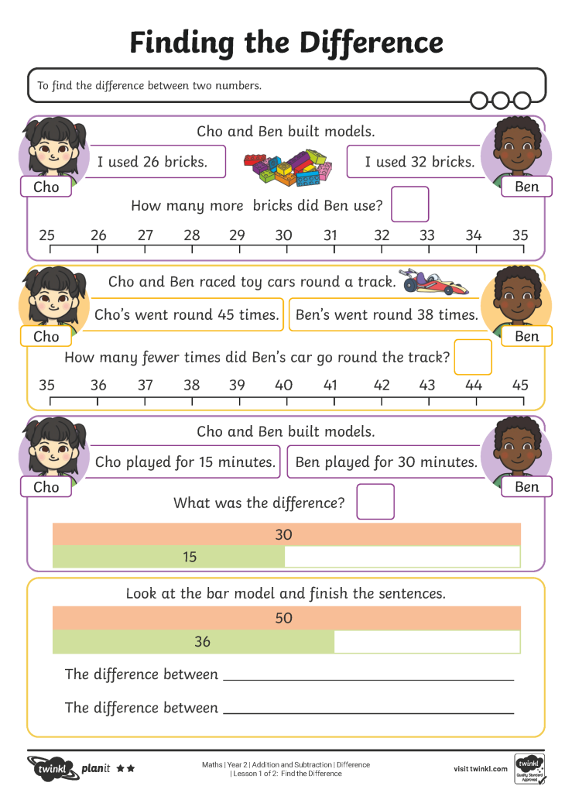
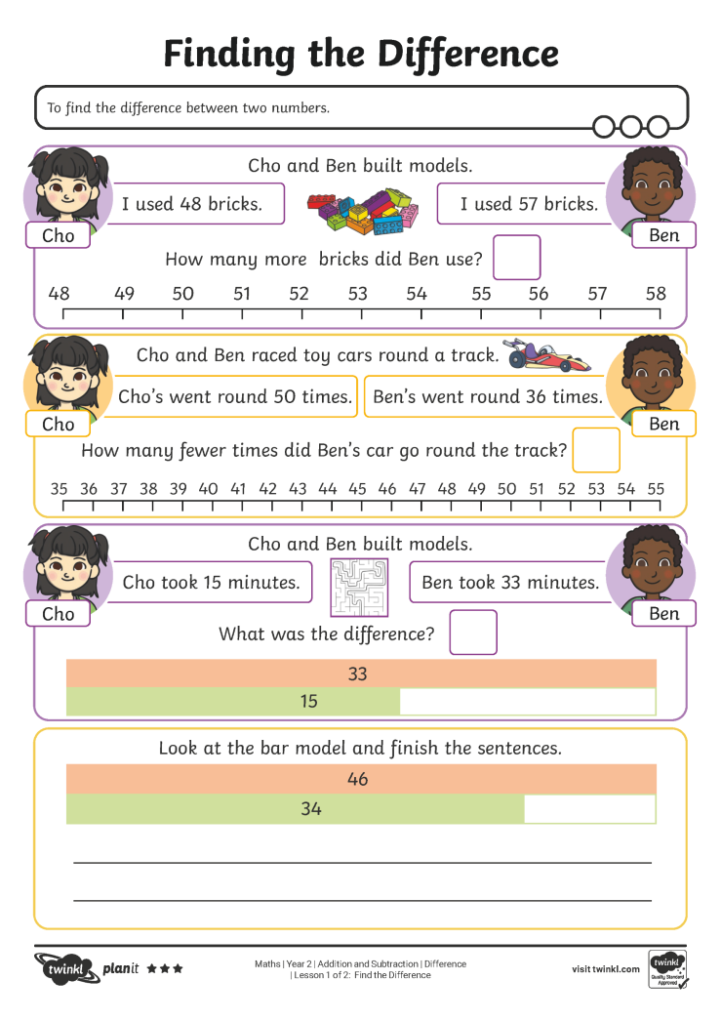
Finding the Difference

Slide 18
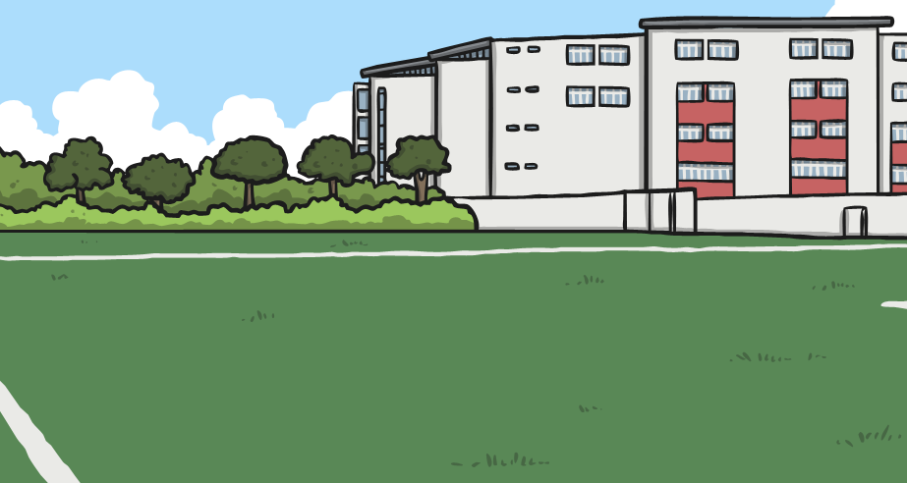
Missing Numbers
How many pairs of numbers can you find with a difference of 11?
Did you notice a pattern?
11
1
12
2
13
3
14

Slide 19
Missing Numbers
Can you find the missing numbers?
11
23
34
31
42
67
78

Slide 20
Missing Numbers
What if the difference was 12?
Did you notice a pattern?
12

Slide 21
Aim
To find the difference between two numbers.
Success Criteria
I can use a number line to find the difference.
I can use a bar model to find the difference.
I can solve problems by finding the difference.

