Slide 1
Ready-to-go Lesson Slides
Year 3
Number: Fractions
Lesson 5
Sum1

Slide 3
Success Criteria: I can compare fractions using resources I know how to compare fractions by looking at numerators and denominators
Starter:
Which pair is different?

Slide 4
Success Criteria: I can compare fractions using resources I know how to compare fractions by looking at numerators and denominators
Starter:
Which pair is different?
>
>
>
>
>
This one is the odd one out. Each of the other pairs has the greater fraction first and so can be completed using the > symbol. This pair is the only one where the smaller fraction comes first.

Slide 5
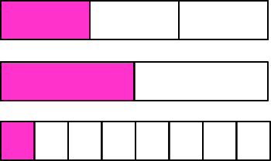
Talking time:
Jamila takes three strips of paper. She splits one into thirds, one into half and one into eighths.
She colours one section of each of her strips.
In what order should she put her strips (from smallest to greatest value fraction)?

Slide 6
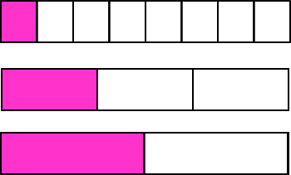
Talking time:
Jamila takes three strips of paper. She splits one into thirds, one into half and one into eighths.
She colours one section of each of her strips.
In what order should she put her strips (from smallest to greatest value fraction)?
What do you notice about the numerators in these fractions?
What do you notice about the denominators?

Slide 7
Activity 1a:
Take five strips of paper – all same size.
Fold one into half, one into thirds, one into quarters, one into sixths and one into eighths.
Colour one part of each of your strips and label the fraction.
Put your fractions in order, from smallest to greatest.

Slide 8
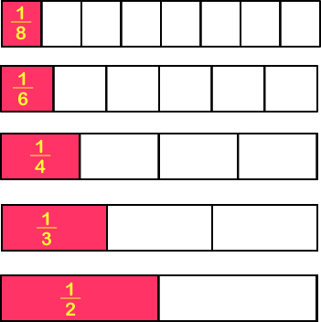
ACTIVITY 1a:
Take five strips of paper – all same size.
Fold one into half, one into thirds, one into quarters, one into sixths and one into eighths.
Colour one part of each of your strips and label the fraction.
Put your fractions in order, from smallest to greatest.

Slide 9
Activity 1b:
Use your answer to Activity 1a to complete these sentences:
If several fractions all have the same ___________, the fraction with the largest ___________ is the __________ fraction. We can order them according to their ___________.

Slide 10
Activity 1b:
Use your answer to Activity 1a to complete these sentences:
If several fractions all have the same numerators, the fraction with the largest denominator is the smallest fraction. We can order them according to their denominators.

Slide 11
Talking time:
Where would you label these fractions on this number line?

Slide 12
Talking time:
Where would you label these fractions on this number line?
What do you notice about the numerators in these fractions?
What do you notice about the denominators?

Slide 13
Activity 2a:
Put each set of fractions in order on the number lines.

Slide 14
Activity 2a:
Put each set of fractions in order on the number lines.

Slide 15
Activity 2b:
Use your answers to Activity 2a to complete these sentences:
If several fractions all have the same ___________, the fraction with the largest ___________ is the __________ fraction. We can order them according to their ___________.

Slide 16
ACTIVITY 2b:
Use your answers to Activity 2a to complete these sentences:
If several fractions all have the same ___________, the fraction with the largest ___________ is the __________ fraction. We can order them according to their ___________.
HINT: Try using the words numerator, denominator, largest, smallest…

Slide 17
Activity 2b:
Use your answers to Activity 2a to complete these sentences:
If several fractions all have the same denominators, the fraction with the largest numerator is the largest fraction. We can order them according to their numerators.

Slide 18
Activity 3:
Order each set of fractions:
In descending order:
In ascending order:

Slide 19
Activity 3:
Order each set of fractions:
In descending order:
In ascending order:

Slide 20
Activity 4:
Rhian says,
Is Rhian correct? Explain your answer.
I have written four fractions. They each have the same denominator. The greater the numerator, the smaller the fraction.

Slide 21
Activity 4:
Rhian says,
Is Rhian correct? Explain your answer.
No – Rhian is not correct. As the fractions have the same denominator, the whole has been split into the same number of pieces (which means they are all the same size). So, the greater the numerator, the more pieces there are and the greater the fraction.
I have written four fractions. They each have the same denominator. The greater the numerator, the smaller the fraction.

Slide 22
Success Criteria: I can compare fractions using resources I know how to compare fractions by looking at numerators and denominators
Evaluation:
True or False?
These fractions are in ascending order:
Several fractions all have the same denominator.
We can order the fractions by comparing the numerators (the larger the
numerator, the larger the fraction).
Several fractions all have the same numerator.
We can order the fractions by comparing the denominators (the smaller
the denominator, the smaller the fraction).

Slide 23
Success Criteria: I can compare fractions using resources I know how to compare fractions by looking at numerators and denominators
Evaluation:
True or False?
These fractions are in ascending order:
FALSE
(they are in descending order)
Several fractions all have the same denominator.
We can order the fractions by comparing the numerators (the larger the
numerator, the larger the fraction). TRUE
TRUE
Several fractions all have the same numerator.
We can order the fractions by comparing the denominators (the smaller
the denominator, the smaller the fraction). FALSE

