Slide 2
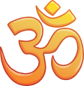
Daily News
Special Report x World News
16th January 2019
Millions of Hindus to Celebrate the Kumbh Mela
Yesterday was the start of the Kumbh Mela, one of Hinduism’s most important festivals. Millions of people will bathe where the sacred Ganges and Yamuna rivers meet.
Organisers are expecting around 120 million pilgrims over the next 49 days. That’s nearly double the number of people who live in the UK!
They will bathe in the holy waters to wash away their sins and save their souls.
It’s a colourful and joyful festival, with loud processions of Hindu monks, called sadhus, as they travel to the riverbank. People are also celebrating music, dancing and artwork throughout the city.
It’s not easy organising all these people. To make sure everyone can share in the experience, the police have said that people can only bathe for 41 seconds.
The organisers have set up a huge tent city to give travellers somewhere to sleep, as well as over 120,000 toilets. There are also 15 lost-and-found shelters for people who become lost in the busy crowds.
The festival will last from 15th January until 4th March.
Read the full article online here.
What is Hinduism?
What is the Kumbh Mela?
What are pilgrimages?
Photo: Hindus bathe during the Kumbh Mela.
“Theresa May” by [EU2017EE] is licensed under CC BY 2.0
Notes:
Teacher Note - Please do not let the next video automatically play at the end of the clip. Please check the content in this link, including any comments, is suitable for your educational environment before showing. Twinkl accepts no responsibility for the content of third party websites.

Slide 3
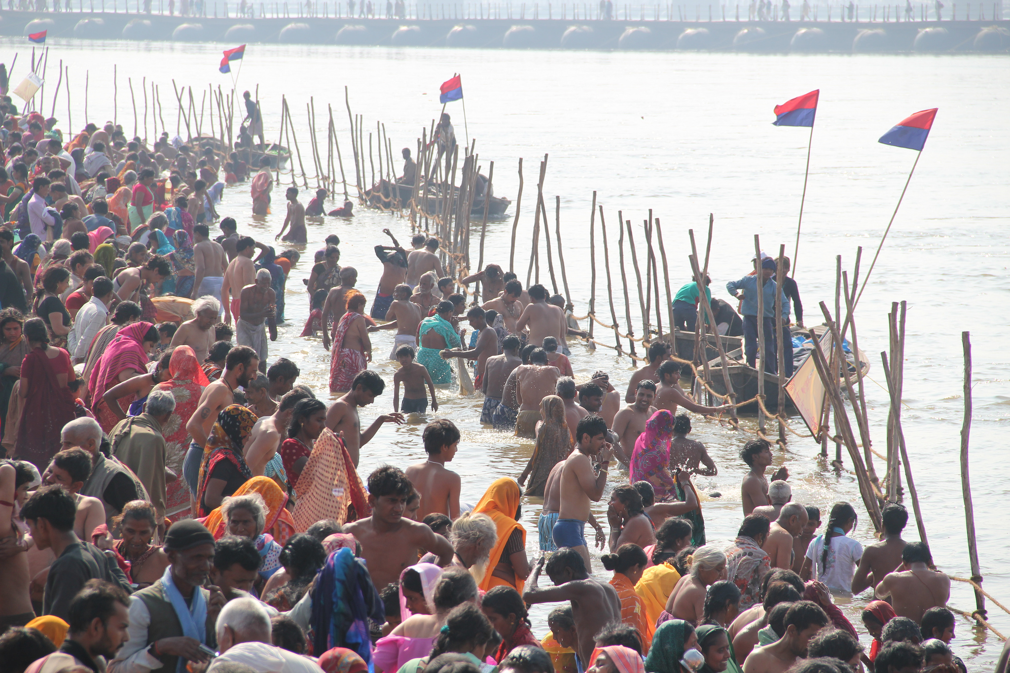

Slide 4
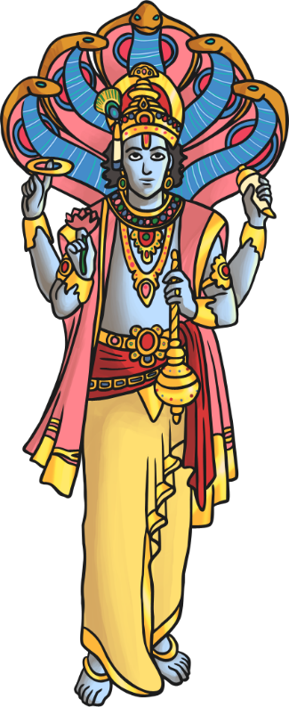
What Is Hinduism?
developed
variety
community
Hinduism is one of the oldest religions that is still practised today.
One important god is called Vishnu. He is responsible for protecting the universe.
It probably developed in south-east Asia around the river Indus, which is in modern-day Pakistan.
Hindus believe that all living things have a soul which can’t be destroyed.
Now, there are over 1.08 billion Hindus living around the world.
Instead, when a living thing dies, its soul enters a new living thing. This is called reincarnation.
Hinduism is a polytheistic religion. This means that they believe in a wide variety of different gods and goddesses.
Hindus worship in a mandir. It’s a place where the community can meet to pray.
Explore the main values of Hinduism here.
What do you know about Hinduism?

Slide 5
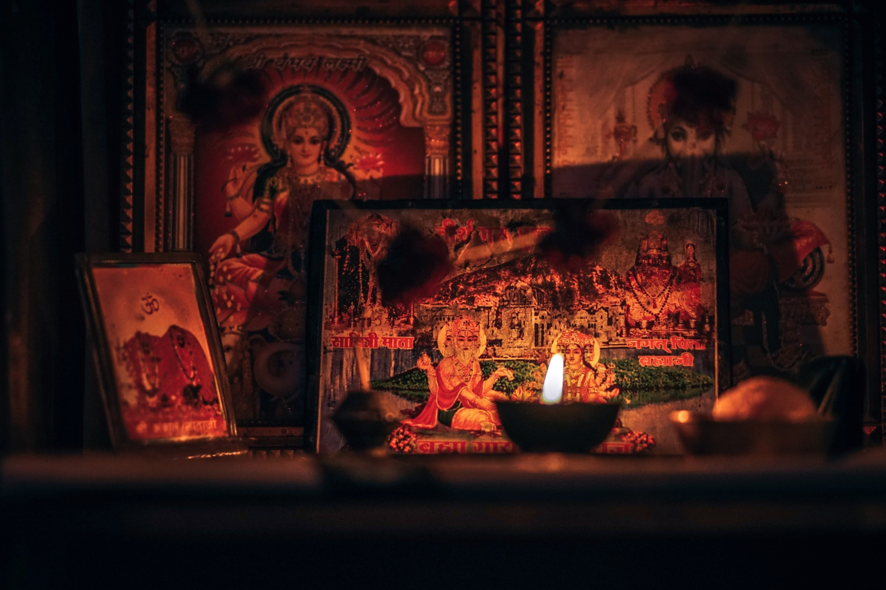

Slide 6
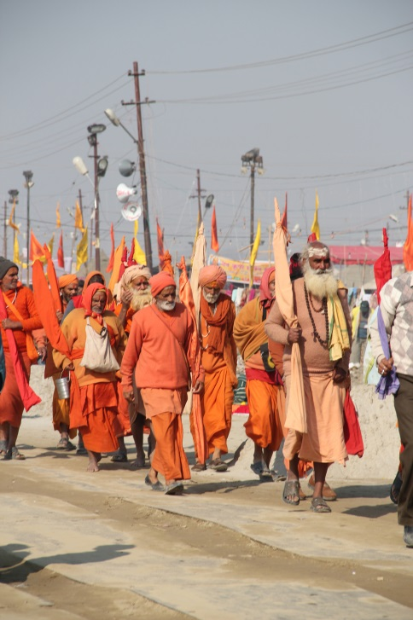
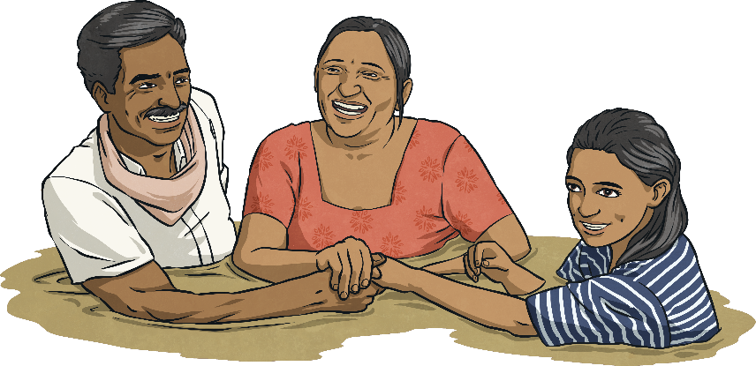
What Is the Kumbh Mela?
according
ancient
individuals
The Kumbh Mela is one of the most important festivals for Hindus.
Over 12 years, the festival is celebrated four times in different sacred rivers. This year, it is happening in Prayagraj, northern India.
Millions of people travel to wash in the sacred rivers.
According to Hindu tradition, the gods released drops of immortality in the rivers.
It’s an ancient festival and was first recorded in AD 643, nearly 1500 years ago!
Hindus believe that by washing in these rivers, they will be cleaned of their sins or wrong actions.
Individuals might travel thousands of miles to attend the Kumbh Mela.
“Kumbh Mela” by [Seba Della y Sole Bossio] is licensed under CC BY 2.0
Use an atlas to find India. Which countries does it border?
What do you know about other festivals?

Slide 8
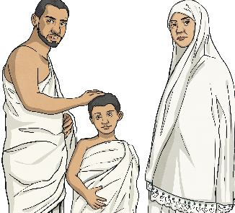
What Are Pilgrimages?
recognised
individuals
especially
For many people, the Kumbh Mela is an important pilgrimage.
As well as the Kumbh Mela, Hindus might also go on a pilgrimage to Mount Kailash, a sacred mountain.
This is a special type of journey, usually going to a place which is important for religious reasons.
Individuals of other faiths, such as Buddhism and Christianity, also go on pilgrimages.
Muslims travel from across the world to Mecca. This pilgrimage is called the Hajj, and is especially important; all adults who can are expected to make the journey during their lives.
It’s more than just a holiday. These journeys are often quite long. Pilgrims travel to a place that is recognised as being connected with God or a god.
Write a paragraph about a place which is special to you.
Where might you go on a pilgrimage to?

Slide 9
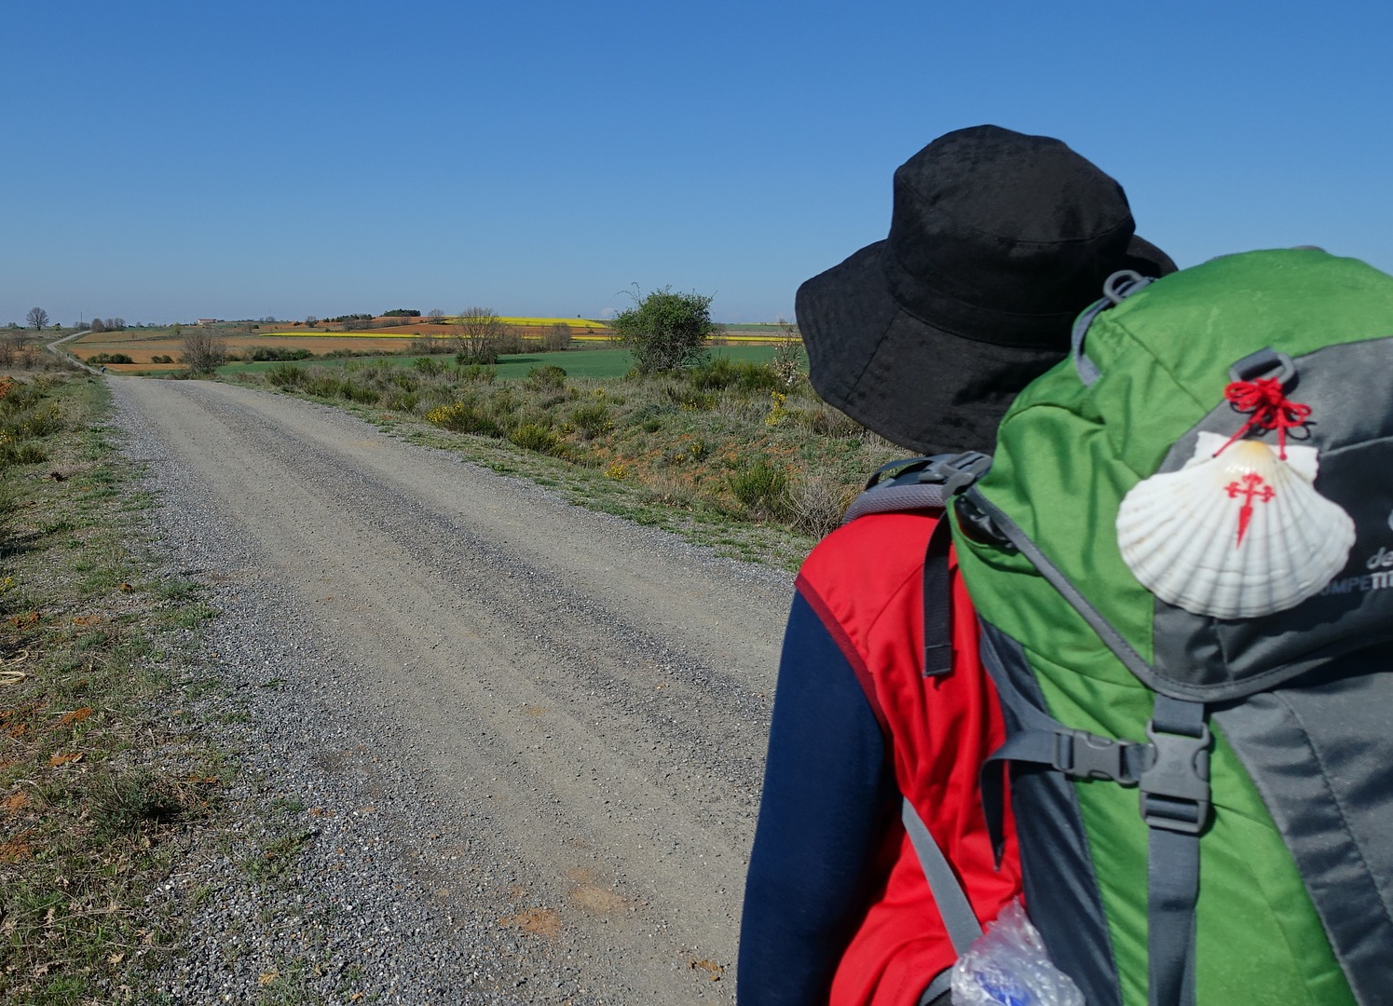

Slide 10
Glossary
Word | Definition
Hinduism | A major religion in Asia, with over a billion followers.
sacred | Holy; connected with God or a god or given to a religious purpose.
sadhus | Hindu monks or holy people, who live a life of simplicity, focusing on prayer.
procession | A number of people moving together in an organised way.

