Slide 1
Ready-to-go Lesson Slides
Year 3
Number: Fractions
Lesson 6
Sum1

Slide 3
Success Criteria: I know that when adding fractions with the same denominator, the denominator does not change I can explain why denominators do not change in these calculations
Starter:
Which one is different?

Slide 4
Success Criteria: I can compare fractions using resources I know how to compare fractions by looking at numerators and denominators
Starter:
Which one is different?
The first set of fractions is the odd one out. All of the groups of fractions are in ascending order apart from this one, which is in descending order (greatest to smallest) instead.

Slide 5
Talking time:
Kieran takes a strip of paper.
He folds it into five equal pieces and colours some of them:
Complete the missing information:
__ fifths of the strip is yellow.
__ fifth of the strip is green.
__ fifth of the strip is blue.
__ fifths of the strip is coloured in.
Can you write this as a number sentence?

Slide 6
Talking time:
Kieran takes a strip of paper.
He folds it into five equal pieces and colours some of them:
Complete the missing information:
2 fifths of the strip is yellow.
1 fifth of the strip is green.
1 fifth of the strip is blue.
4 fifths of the strip is coloured in.
Can you write this as a number sentence?

Slide 7
Activity 1a:
Cut a circle out of paper.
Fold it in half, then half again, then half again.
Colour 3 segments in red, 2 segments in yellow and 1 segment
in blue.
Complete the information about your circle and write a number sentence:
________ of the circle is red.
________ of the circle is yellow.
________ of the circle is blue.
________ of the circle is coloured in.

Slide 8
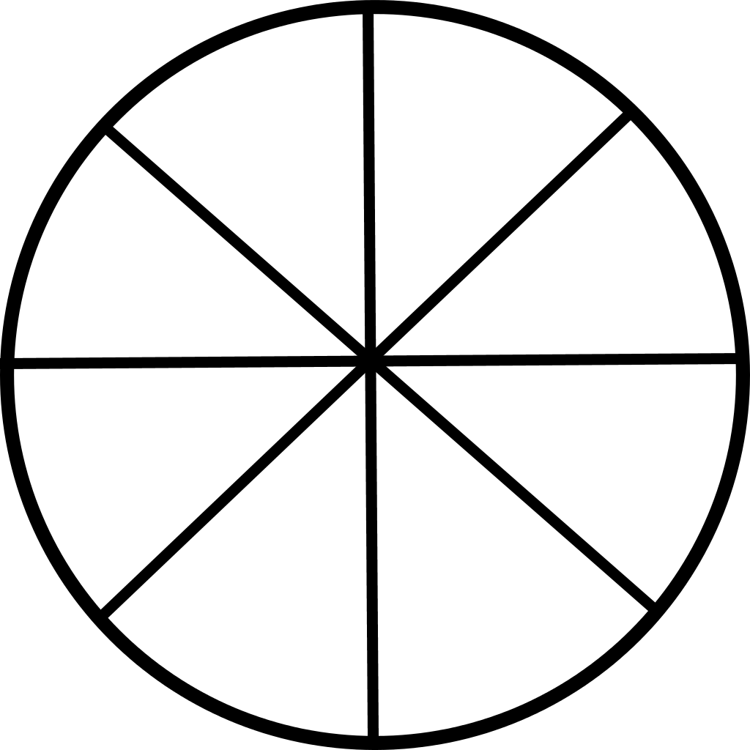
Activity 1a:
Cut a circle out of paper.
Fold it in half, then half again, then half again.
Colour 3 segments in red, 2 segments in yellow and 1 segment
in blue.
Complete the information about your circle and write a number sentence:
________ of the circle is red.
________ of the circle is yellow.
________ of the circle is blue.
________ of the circle is coloured in.

Slide 9
Activity 1a:
Cut a circle out of paper.
Fold it in half, then half again, then half again.
Colour 3 segments in red, 2 segments in yellow and 1 segment
in blue.
Complete the information about your circle and write a number sentence:
Three eighths of the circle is red.
Two eighths of the circle is yellow.
One eighth of the circle is blue.
Six eighths of the circle is coloured in.

Slide 10
Activity 1b:
Look carefully at your answers to the Talking Time slide and
Activity 1a.
Can you explain how to add fractions when the denominators
are the same?

Slide 11
Activity 1b:
Look carefully at your answers to the Talking Time slide and
Activity 1a.
Can you explain how to add fractions when the denominators
are the same?
When the denominators of fractions are the same, we can add the fractions by adding the numerators and keeping the fractions the same in the answer.
So, in the first example above, the fractions are all fifths, so the answer will be a number of fifths too. The total of the numerators is 4, so the answer is four fifths.

Slide 12
Talking time:
Use this model to complete the addition:
+ =

Slide 13
Talking time:
Use this model to complete the addition:
+ =

Slide 14
Activity 2:
Sketch models to solve these additions:
a)
b)
c)

Slide 15
Activity 2:
Sketch models to solve these additions:
a)
b)
c)

Slide 16
Talking time:
Chloe eats of a pizza.
Abdul eats of the same pizza.
How much of the pizza has been eaten altogether?

Slide 17
Talking time:
Chloe eats of a pizza.
Abdul eats of the same pizza.
How much of the pizza has been eaten altogether?
Seven fifteenths of the pizza has been eaten altogether.

Slide 18
Activity 3:
Swansborough Council are slowly filling in all the pot holes in
the city’s roads.
By the end of January, they had filled in two tenths of all the pot
holes.
By the end of February, they had filled in a further three tenths.
During March, they repaired a further two tenths.
What fraction of all the city’s pot holes had been filled in by the end of March?

Slide 19
Activity 3:
Swansborough Council are slowly filling in all the pot holes in
the city’s roads.
By the end of January, they had filled in two tenths of all the pot
holes.
By the end of February, they had filled in a further three tenths.
During March, they repaired a further two tenths.
What fraction of all the city’s pot holes had been filled in by the end of March?
Seven tenths of the pot holes were repaired by the end of March.

Slide 20
Activity 4:
A box of chocolates contains 15 chocolates.
Tilly and Oliver both eat an even number of chocolates each.
of the box is left.
Write the fractions that Tilly and Oliver could have eaten as an
addition number sentence that shows the total fraction they ate.

Slide 21
Activity 4:
A box of chocolates contains 15 chocolates.
Tilly and Oliver both eat an even number of chocolates each.
of the box is left.
Write the fractions that Tilly and Oliver could have eaten as an
addition number sentence that shows the total fraction they ate.

Slide 22
Success Criteria: I can compare fractions using resources I know how to compare fractions by looking at numerators and denominators
Evaluation:
True or False?
When we add two fractions with the same
denominator, we add the numerators, then add
the denominators.
Alfie is adding three fractions that are all a number of eighths. His answer
will also be a number of eighths.
e) Two quarters plus two quarters equals four eighths.

Slide 23
Success Criteria: I can compare fractions using resources I know how to compare fractions by looking at numerators and denominators
Evaluation:
True or False?
When we add two fractions with the same
denominator, we add the numerators, then add
the denominators. FALSE
TRUE
FALSE
Alfie is adding three fractions that are all a number of eighths. His answer
will also be a number of eighths. TRUE
e) Two quarters plus two quarters equals four eighths. FALSE

