Slide 1
Ready-to-go Lesson Slides
Year 6
Ratio
Lesson 2
To understand the relationship between ratio and fractions
Spring

Slide 2
Summary
Key Vocabulary and Sentence Stems
Hinge Question (Assessment Point)
Lesson Introduction Slide (Learning Objective and Success Criteria)
Starter – Show fractions
Key Concept Introduction
Guided Practice – Describe the image with fractions
Independent Practice 1 – Describe the image with fractions and a sentence stem
Guided Practice – Describe a three part bar model
Independent Practice 2 – Describe a three part bar model and colour a bar model
Guided Practice – Describe the content of a bag
Independent Practice 3 – Describe the content of a bag
Let’s Reflect
Support Slides – Based on previous learning – Describing fractions

Slide 3
Key Vocabulary:
Ratio | For every
Sentence Stems:
For every (number/ item) there are (number/ item).
- For every 3 red cubes there are 2 yellow cubes.
Ratios shows the relationship between two amounts.

Slide 4
Hinge Question:
Which of these describe the counters?
For every 3 red counters there are 4 yellow counters.
$\frac{\text{4}}{ \text{7} }$of the counters are yellow.
$\frac{\text{3}}{ \text{7} }$ of the counters are red.
A, B and C
Notes:
Assessment point for the lesson – ask the pupils to vote for the answer they think is correct.
A – This is correct but not the only correct answer.
B – This is correct but not the only correct answer.
C – This is correct but not the only correct answer.
D – Correct answer
If answers A, B or C are given, pupils may require extra support through small group or 1:1 discussions. There are support slides covering previous learning end of these slides. Ratio is a new topic to Year 6.

Slide 5
To understand the relationship between ratio and fractions
Success Criteria I can explain what ratio is I can describe an image using ratio language and fractions

Slide 6
Starter:
Show $\frac{\text{5}}{ \text{7} }$in a range of different ways.
Notes:
This starter recaps showing fractions.
Concrete resources – Counters, blank bar models/ squared paper, cubes
Key Questions – How many ways could you show 5/7? Does there need to be 7 parts in the whole? What fraction is equivalent to 5/7? How do you know?

Slide 7
Ratios shows the relationship between two amounts.
This image can be described in two ways.
For every 1 green counter there are 3 pink counters.
$\frac{\text{1}}{ \text{4} }$counters are green.
$\frac{\text{3}}{ \text{4} }$ counters are pink.
Notes:
Concrete resources – Counters
Key Questions – What is the same and different about the ways I can describe the counters? In the fraction, what does the denominator tell you? What does the numerator tell you?
Misconceptions/ Common Errors – Pupils may struggle to identify the fraction from the sentence stem. Pupils may write ⅓, even though they know from the picture this is incorrect.

Slide 8
Guided Practice:
Which of these fractions describes the orange cubes?
Complete the sentence stem to describe the cubes.
For every _____ orange cubes there are _____ pink cubes.
3/4
3/3
4/7
3/7
3
4
Answers
Notes:
Concrete resources – Cubes
Key Questions – Which of these fractions describes the orange cubes? How do you know? How would I complete the sentence stem to describe the relationship between the cubes?
Misconceptions/ Common Errors – Pupils may struggle to identity the correct fraction. Pupils may not see the connection between the fraction and ratio.
Further Practice – Remove one orange cube. Describe the cubes using a fraction and the sentence stem.

Slide 9
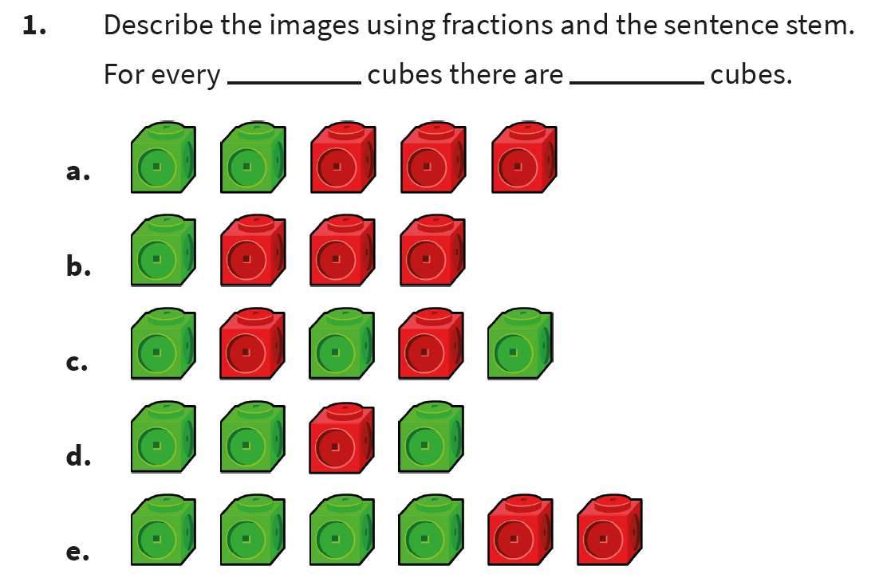
Independent Practice:
Notes:
Green cubes: ⅖, red cubes: ⅗. For every 2 green cubes there are 3 red cubes.
Green cubes: ¼ , red cubes: ¾. For every 1 green cubes there are 3 red cubes.
Green cubes: ⅗, red cubes: ⅖. For every 3 green cubes there are 2 red cubes.
Green cubes: ¾, red cubes: ¼. For every 3 green cubes there is 1 red cube.
Green cubes: 4/6 or ⅔, red cubes: 2/6 or ⅓. For every 4 green cubes there 2 red cubes. OR For every 2 green cubes there is 1 red cube.

Slide 10

Guided Practice:
This bar model shows a ratio of 3 to 5 to 2.
How can we describe the bar model using fractions?
Purple:
Orange:
Green:
$\frac{\text{3}}{\text{10}}$
$\frac{\text{5}}{\text{10}}$ = $\frac{\text{1}}{\text{ 2 }}$
$\frac{\text{2}}{\text{10}}$ = $\frac{\text{1}}{\text{ 5 }}$
Answers
Notes:
Concrete resources – Bar model to shade
Key Questions – How does the ratio describe the bar model? How can we describe the part using fractions? What will the denominator be? What is the numerator? What do you notice about the denominator and the ratio?
Misconceptions/ Common Errors – Pupils may not identify the link between ratio and fractions.
Further Practice – Colour another bar model - describe it using ratio and fractions.

Slide 11
Independent Practice:
Notes:
Striped: 2/7, solid 3/7, checked 2/7
Striped: 4/9, solid 4/9, checked 1/9
Striped: 1/5, solid 3/5, checked 1/5
3 parts in one colour, 4 parts in another colour, 3 parts in a third colour. 3/10, 4/10 (⅖), 3/10
2 parts in one colour, 1 part in another colour, 3 parts in a third colour. 2/6 (⅓), ⅙, 3/6 (½)
7 parts in one colour, 3 parts in another colour, 2 parts in a third colour. 7/12, 3/12 (¼), 2/12 (⅙)

Slide 12
Guided Practice:
A bag holds a set of green marbles and yellow marbles.
$\frac{\text{5}}{ \text{7} }$of the marbles are yellow.
Which of these other statements also describe the bag?
For every 5 yellow marbles there 7 green marbles.
For every 5 yellow marbles there are 2 green marbles.
For every 2 green marbles there are 7 yellow marbles.
For every 2 green marbles there are 5 yellow marbles.
Answers
Notes:
Concrete resources – A bag with marbles/ cubes/ counters in.
Key Questions – How many marbles are there in total? What fraction of the marbles are green? How would I write this as a ratio?
Misconceptions/ Common Errors – Pupils may believe that 7 is involved in the ratio descriptions.
Further Practice – Use a bag and fill it with two types of item. Describe one fraction. Ask pupils to write/ say sentences to describe the content of the bag.

Slide 13
Independent Practice:
Notes:
Answers will vary.
Example answers:
⅗ of the counters are blue. For every 2 green counters there are 3 blue counters.
⅓ of the counters are pink. 8/12 of the counters are yellow. For every 8 yellow counters there are 4 pink counters.
⅓ of the counters are blue. For every 5 blue counters there are 10 red counters.
For every 6 red counters there are 2 yellow counters. 2/8 of the counters are yellow.

Slide 14
Let’s Reflect:
Which of these is the odd one out?
Explain your answer.
This shows $\frac{\text{2}}{\text{ 7 }}$, the others all show $\frac{\text{2}}{\text{ 5 }}$.
Answers
Notes:
Concrete resources – Counters, cubes, block diagram, bead string
Key Questions – Which of these is the odd one out? How do you know? What do the other images show? How do you write these as ratios?

Slide 15
The following slides are based on previous learning – Describing fractions

Slide 16
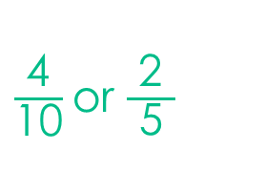
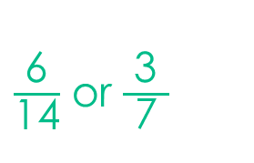
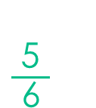
Describe the fraction shaded in each bar.
$\frac{\text{4}}{\text{10}}$or $\frac{\text{2}}{\text{ 5 }}$
$\frac{\text{6}}{\text{1}\text{4}}$ or $\frac{\text{3}}{\text{ 7 }}$
$\frac{\text{5}}{\text{ 6 }}$
Answers
Notes:
How and when to use these slides – In the main part of this lesson, pupils will be looking at describing images using fractions and ratio language. These support slides recap describing images using fractions only.
Concrete resources – Bar models to shade
Key Questions – How many parts are shaded? How do I write this as a fraction? Can you write the fraction of the non-shaded part? Can you simplify the fraction?
Further Practice – Colour a bar model, write the fraction shaded.

Slide 17
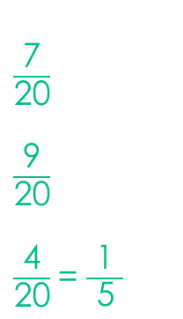
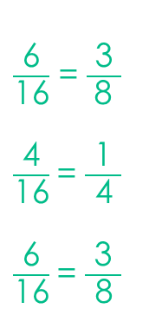
Describe the fraction shaded in each colour for the bar models.
$\frac{\text{7}}{\text{2}\text{0}}$
$\frac{\text{9}}{\text{2}\text{0}}$
$\frac{\text{4}}{\text{2}\text{0}}$= $\frac{\text{1}}{\text{ 5 }}$
Orange:
Pink:
Blue:
$\frac{\text{6}}{\text{1}\text{6}}$ = $\frac{\text{3}}{ \text{8 }}$
$\frac{\text{4}}{\text{1}\text{6}}$= $\frac{\text{1}}{\text{ 4 }}$
$\frac{\text{6}}{\text{1}\text{6}}$= $\frac{\text{3}}{\text{ 8 }}$
Orange:
Pink:
Blue:
Answers
Notes:
How and when to use these slides – In the main part of this lesson, pupils will be looking at describing images using fractions and ratio language. These support slides recap describing images using fractions only.
Concrete resources – Bar models to shade
Key Questions – How many parts are there in total? How many parts are shaded orange/ pink/ blue? How do I write this as a fraction? Can you simplify the fraction?
Misconceptions/ Common Errors – Pupils may struggle to describe the whole bar model
Further Practice – Use 3 colours to shade another bar model. Write the fraction coloured in each colour.

