Slide 1
Ready-to-go Lesson Slides
Year 6
Fractions
Lesson 13
To know how to divide fractions by integers (2)
Autumn

Slide 2
Summary
Key Vocabulary
Hinge Question (Assessment Point)
Lesson Introduction Slide (Learning Objective and Success Criteria)
Starter – Match the calculation to the answer
Key Concept Introduction
Guided Practice – Dividing unit fractions by integers
Independent Practice 1 – Dividing unit fraction by integers
Guided Practice – Dividing non-unit fractions by integers
Independent Practice 2 – Dividing non-unit fractions by integers
Guided Practice – Finding equivalent fractions to divide the numerator equally
Independent Practice 3 – Finding equivalent fractions to divide the numerator equally
Let’s Reflect
Support Slides – Recapping previous Year 6 lesson - dividing fractions by integers

Slide 3
Key Vocabulary:
Integer
Divide

Slide 4
Hinge Question:
$\frac{\text{3}}{\text{ 5 }}$ ÷ 4 =
$$\frac{\text{12}}{\text{ 5 }}$$
1 $\frac{\text{2}}{\text{ 5 }}$
$$\frac{\text{3}}{\text{20}}$$
$$\frac{\text{12}}{\text{20}}$$
Notes:
Assessment point for the lesson – ask the children to vote for the answer they think is correct.
A – The pupil has found an equivalent fraction for ⅗ where the numerator is a multiple of the integer (12/20) but has divided the denominator by the integer.
B – Correct answer
C – The pupil has multiplied ⅗ by 4.
D – The pupil has found an equivalent fraction to ⅗.
If answers A, C or D are given, pupils may require extra support through small group or 1:1 discussions. There are support slides covering lessons from the previous lesson group at the end of these slides.

Slide 5
To know how to divide fractions by integers
Success Criteria I can use diagrams to represent calculations I can why the fraction becomes smaller when I divide by an integer I can find equivalent fractions

Slide 6
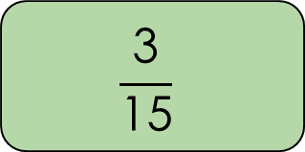
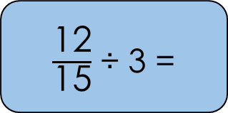
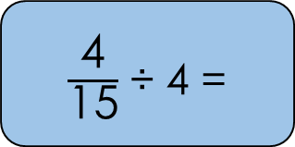
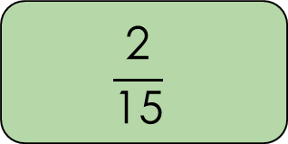
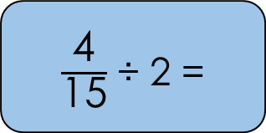
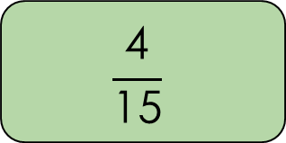
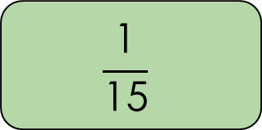
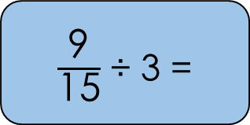
Starter:
Match the calculation to the correct answer.
$\frac{\text{12}}{\text{15}}$ ÷ 3 =
$$\frac{\text{1}}{\text{15}}$$
$\frac{\text{4}}{\text{15}}$ ÷ 2 =
$$\frac{\text{2}}{\text{15}}$$
$\frac{\text{4}}{\text{15}}$ ÷ 4 =
$$\frac{\text{3}}{\text{15}}$$
$\frac{\text{9}}{\text{15}}$ ÷ 3 =
$$\frac{\text{4}}{\text{15}}$$
Answers
Notes:
This starter recaps the previous lesson on dividing fractions by integers (focusing on fractions where the numerator is a multiple of the integer).
Key Questions – How will you find the answer? What do you notice about the fractions? Can any of the answers be simplified?
Extension – Can you prove you have the correct answer?

Slide 7

The astronaut is completing this calculation:
$\frac{\text{1}}{\text{ 5 }}$ ÷ 2
First, they draw a bar model showing $\frac{\text{1}}{\text{ 5 }}$.
Then they divide the bar model in 2 equal parts.
Each part of the bar model is now worth $\frac{\text{1}}{\text{10}}$.
$\frac{\text{1}}{\text{ 5 }}$ ÷ 2 = $\frac{\text{1}}{\text{10}}$
Notes:
This slide introduces the idea of dividing fractions where the numerator is not a multiple of the integer. Using bar models should help pupils to visualise the calculation. This slide does not have questions, instead use it to discuss the process and answer any questions pupils may have.
Key Questions – What do you notice about this question compared to the last lesson? Why has the astronaut split the bar model into 2 equal parts? Why is the answer 1/10, not 2/10?
Misconceptions/ Common Errors – Pupils may struggle to understand why the fraction is 1/10 not 2/10 as two parts are coloured in the second image. Encourage pupils to think about what ⅕ is telling them (only look at one part).
Extension – ⅕ ÷ 2 is the same as ½ of 1/10. Is this correct?

Slide 8
Guided Practice:
Use the diagrams to help complete these calculations.
$\frac{\text{1}}{\text{ 4 }}$ ÷ 2 =
$\frac{\text{1}}{\text{ 5 }}$ ÷ 3 =
$\frac{\text{1}}{\text{ 6 }}$ ÷ 3 =
$$\frac{\text{1}}{\text{ 8 }}$$
$$\frac{\text{1}}{\text{15}}$$
$$\frac{\text{1}}{\text{1}\text{8}}$$
Answers
Notes:
Concrete resources – Blank bar models
Key Questions – What do you notice about the questions and the bar models? Why have the bar models been split the way they have? What is the numerator? How do you know?
Further Practice – Complete more unit fractions divided by integers, try with and without bar models.
Extension – Write instructions for dividing fractions by an integer.

Slide 9
Independent Practice:
Notes:
1/12
1/16
1/12
1/18
1/18
1/36
1/20
1/30

Slide 10
Guided Practice:
The astronaut says,
“$\frac{\text{2}}{\text{ 5 }}$ ÷ 4 = $\frac{\text{2}}{\text{20}}$ = $\frac{\text{1}}{\text{1}\text{0}}$”
Is the astronaut correct?
Explain your answer.
The astronaut is correct.
Answers
Notes:
Key Questions – Why has the numerator not changed (before simplifying)? What do you notice about the calculation? Why is the answer not 8/20? (This could open up a discussion about equivalent fractions again).
Misconceptions/ Common Errors – Pupils may assume the numerator is 1 as the numerator was 1 in the previous task.
Further Practice – Complete more calculations involving non-unit fractions divided by integers.

Slide 11
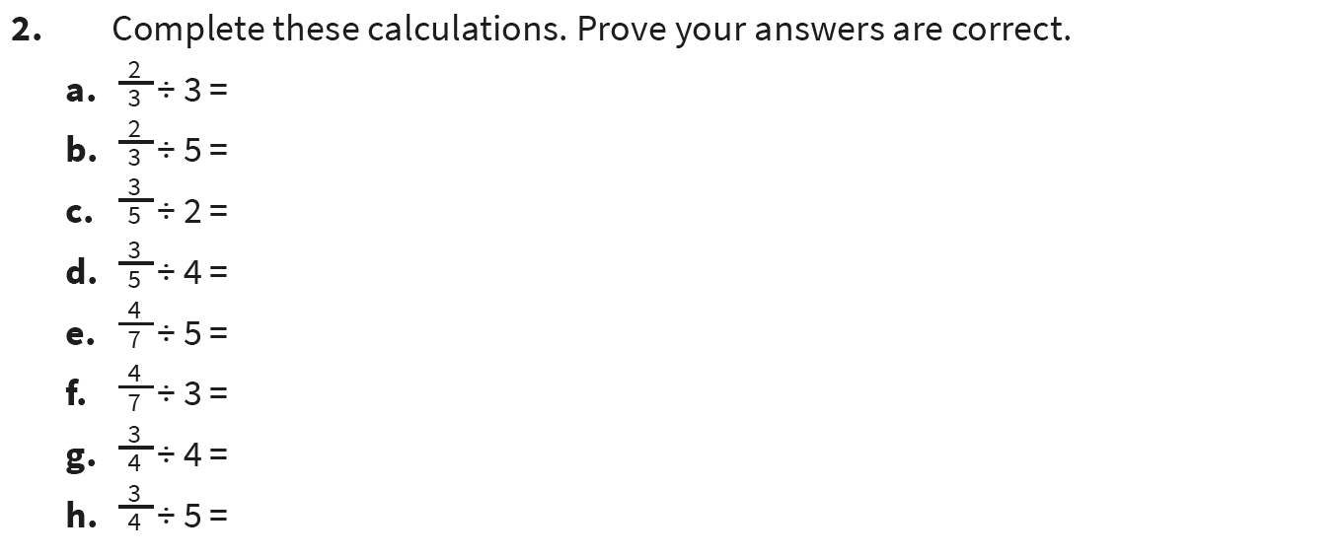
Independent Practice:
Notes:
2/9
2/15
3/10
3/20
4/35
4/21
3/16
3/20

Slide 12
Guided Practice:
If the numerator is not a multiple of the integer, you can find an equivalent fraction to help divide the numerator equally.
$\frac{\text{2}}{\text{ 5 }}$ ÷ 4 =
$\frac{\text{2}}{\text{ 5 }}$ = $\frac{\text{4}}{\text{10}}$
$\frac{\text{4}}{\text{10}}$ ÷ 4 = $\frac{\text{1}}{\text{10}}$
Notes:
Key Questions – What do you notice about this method? How is it similar/ different to the previous method? Which method do you prefer? Why?
Misconceptions/ Common Errors – Pupils could struggle as there are multiple steps to this method.
Further Practice – Complete more calculations requiring finding equivalent fractions (this is covered in the next slide).
Extension – Which method would you use to solve ⅖ ÷ 4? Why?

Slide 13

Guided Practice:
Find equivalent fractions to help divide the numerator equally.
$\frac{\text{2}}{\text{ 7 }}$ ÷ 4 =
$\frac{\text{4}}{\text{ 5 }}$ ÷ 3 =
$\frac{\text{3}}{\text{ 4 }}$ ÷ 6 =
$\frac{\text{2}}{\text{ 7 }}$ = $\frac{\text{4}}{\text{1}\text{4}}$ $\frac{\text{4}}{\text{1}\text{4}}$ ÷ 4 = $\frac{\text{1}}{\text{14}}$
$\frac{\text{4}}{\text{ 5 }}$ = $\frac{\text{1}\text{2}}{\text{15}}$ $\frac{\text{12}}{\text{15}}$ ÷ 3 = $\frac{\text{4}}{\text{15}}$
$\frac{\text{3}}{\text{ 4 }}$ = $\frac{\text{6}}{\text{ 8 }}$ $\frac{\text{6}}{\text{ 8 }}$ ÷ 6 = $\frac{\text{1}}{\text{ 8 }}$
Answers
Notes:
Concrete resources – Blank bar models
Key Questions – What do you need to do first? What do you do next? Can you show your answer using a bar model?
Misconceptions/ Common Errors – The second question may confuse pupils as the numerator has not changed.
Further Practice – Complete more calculations using the equivalent fraction method.

Slide 14
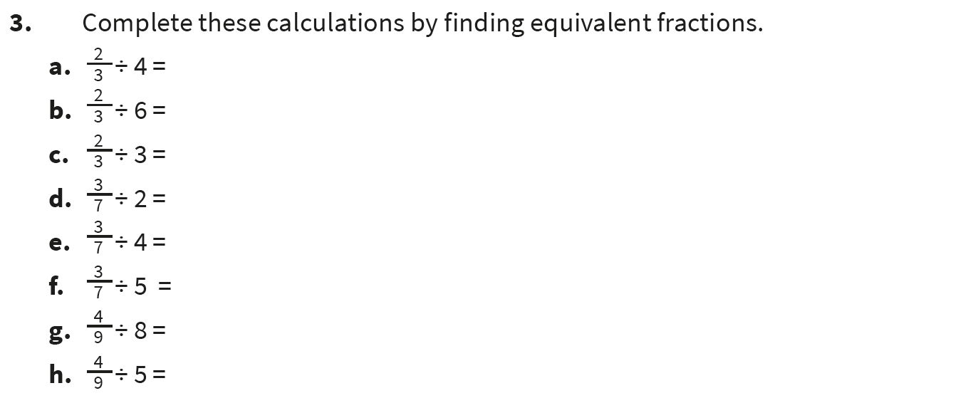
Independent Practice:
Notes:
⅔ = 4/6. 4/6 ÷ 4 = ⅙
⅔ = 6/9. 6/9 ÷ 6 = 1/9
⅔ = 6/9. 6/9 ÷ 3 = 2/9
3/7 = 6/14. 6/14 ÷ 2 = 3/14
3/7 = 12/28. 12/28 ÷ 4 = 3/28
3/7 = 15/35. 15/35 ÷ 5 = 3/35
4/9 = 8/18. 8/18 ÷ 8 = 1/18
4/9 = 20/45. 20/45 ÷ 5 = 4/45

Slide 15
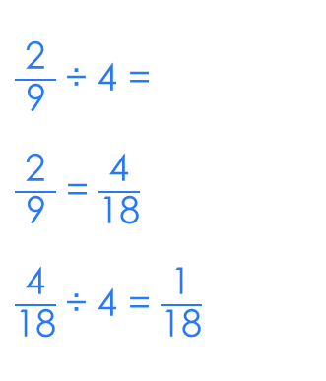
Let’s Reflect:
Whose method is the most efficient?
Explain your answer.
$\frac{\text{2}}{\text{ 9 }}$ ÷ 4 =
$\frac{\text{2}}{\text{ 9 }}$ ÷ 4 = $\frac{\text{2}}{\text{36}}$ = $\frac{\text{1}}{\text{18}}$
$\frac{\text{2}}{\text{ 9 }}$ ÷ 4 =
$\frac{\text{2}}{\text{ 9 }}$ = $\frac{\text{4}}{\text{18}}$
$\frac{\text{4}}{\text{18}}$ ÷ 4 = $\frac{\text{1}}{\text{18}}$
Notes:
Ensure pupils understand that both answers are correct. The methods are both equally valid and answers will vary depending on the preference of the pupil. Some pupils may indicate that the red astronaut needed to draw the diagram, so his method is not efficient. Other pupils may indicate that the pink astronaut’s method has more steps so could be trickier.
Key Questions – Are both methods correct? Which method do you think is the most efficient? Why?
Misconceptions/ Common Errors – Pupils may not understand that both methods are valid methods to use.

Slide 16
The following slides are based on recapping the previous Year 6 lesson - Dividing fractions by integers

Slide 17

Explain how to complete these calculations.
You can use the bar models to help you.
$\frac{\text{4}}{\text{ 5 }}$ ÷ 4 =
$\frac{\text{5}}{\text{ 7 }}$ ÷ 5 =
$\frac{\text{3}}{\text{ 5 }}$ ÷ 3 =
$$\frac{\text{1}}{\text{ 5 }}$$
$$\frac{\text{1}}{\text{ 7 }}$$
$\frac{\text{1}}{\text{ 3 }}$
Answers
Notes:
How and when to use these slides – As dividing fractions by integers is a new topic for Year 6, pupils may need more time to consolidate the basics of this concept. These slides recap the essential points from the previous lesson where numerators are multiples of the integer they are being divided by.
Concrete resources – Blank bar models
Key Questions – What do you need to do to solve these calculations? What do you notice about the calculation? Is ⅘ ÷ 4 the same as finding ¼ of ⅘ (yes)? What is the connection between the numerator and teh integer?
Misconceptions/ Common Errors – Pupils may still not identify a link between multiplication and division with fractions.
Further Practice – Complete more fractions where the numerators are the same number as the integer.

Slide 18

Complete these calculations.
$\frac{\text{8}}{\text{10}}$ ÷ 2 =
$\frac{\text{15}}{\text{17}}$ ÷ 5 =
$\frac{\text{9}}{\text{10}}$ ÷ 3 =
$\frac{\text{14}}{\text{15}}$ ÷ 7 =
$\frac{\text{4}}{\text{10}}$ = $\frac{\text{2}}{\text{ 5 }}$
$$\frac{\text{3}}{\text{1}\text{7}}$$
$$\frac{\text{3}}{\text{10}}$$
$$\frac{\text{2}}{\text{15}}$$
Answers
Notes:
How and when to use these slides – As dividing fractions by integers is a new topic for Year 6, pupils may need more time to consolidate the basics of this concept. These slides recap the essential points from the previous lesson where numerators are multiples of the integer they are being divided by.
Concrete resources – Blank bar models
Key Questions – How can you show these using bar models? What do you notice about the numerator and the integer? What do you notice about the calculation? What is the answer? Can you prove you’re right?
Misconceptions/ Common Errors – Pupils have not been provided with diagrams to use. Some pupils may still require diagrams to be provided for them.
Further Practice – 8/10 ÷ 2 is the same as ½ of 8/10. Investigate.

