Slide 1
Ready-to-go Lesson Slides
Year 3
Number: Fractions
Lesson 4
Sum1

Slide 3
Starter:
Success Criteria: I can use a fraction wall to identify and compare fractions I know that when comparing unit fractions, you compare denominators I know that when the denominators are the same, you compare numerators
Which one is different?

Slide 4
Starter:
Success Criteria: I can use a fraction wall to identify and compare fractions I know that when comparing unit fractions, you compare denominators I know that when the denominators are the same, you compare numerators
Which one is different?
Each of the fractions is equivalent to one third apart from this one. Three ninths is equivalent to one third, not three eighths.

Slide 5
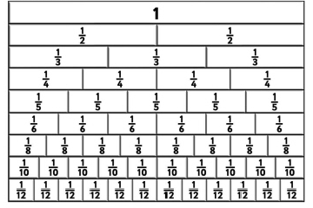
Talking time:
William uses a fraction wall to help him compare one sixth with
one quarter. Explain how he can do this.
.

Slide 6
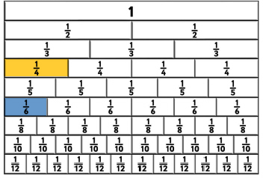
Talking time:
William uses a fraction wall to help him compare one sixth with
one quarter. Explain how he can do this.
.
First, William can use the fraction wall to find both fractions. The part that shows one quarter is larger than the part that shows one sixth.

Slide 7
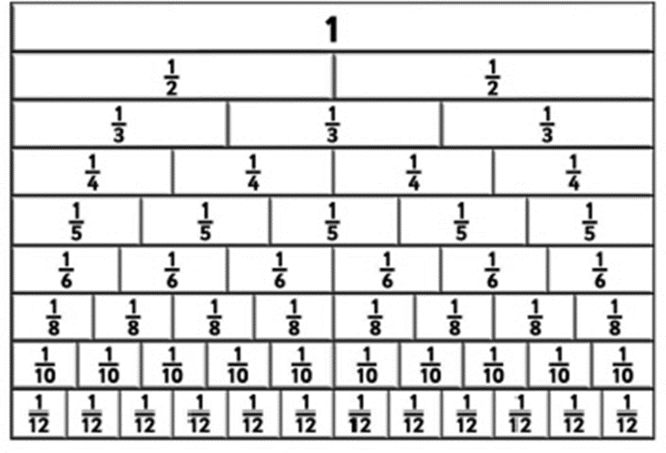
Talking time:
Use the fraction wall to compare one tenth with one eighth.

Slide 8
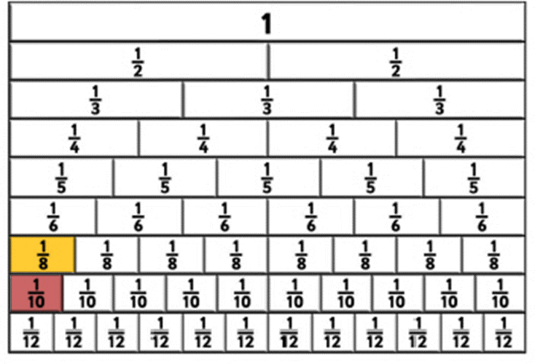
Talking time:
Use the fraction wall to compare one tenth with one eighth.
One tenth is less than one eighth.

Slide 9
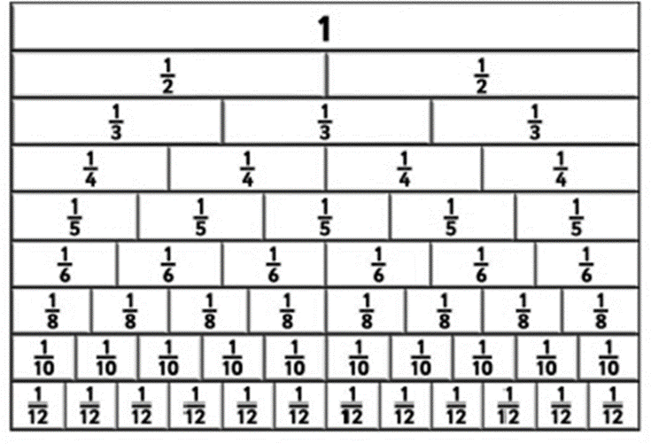
Activity 1:
Use a fraction wall to compare these unit fractions.

Slide 10
Activity 1:
Use a fraction wall to compare these unit fractions.

Slide 11
Talking time:
Use your answers to Activity 1 to complete the statement below.
When the numerators of two fractions are the same, the ______ the denominator,
the ______ the fraction (or, the ______ the denominator, the ______ the fraction).

Slide 12
Talking time:
Use your answers to Activity 1 to complete the statement below.
When the numerators of two fractions are the same, the smaller the denominator,
the larger the fraction (or, the larger the denominator, the smaller the
fraction).

Slide 13
Talking time:
How could you use strips of paper to compare three quarters
with one quarter?

Slide 14
Talking time:
How could you use strips of paper to compare three quarters
with one quarter?

Slide 15
Talking time:
Use strips of paper to compare two fifths with three fifths.

Slide 16
Talking time:
Use strips of paper to compare two fifths with three fifths.

Slide 17
Activity 2:
Use strips of paper to compare each pair of fractions.

Slide 18
Activity 2:
Use strips of paper to compare each pair of fractions.

Slide 19
Talking time:
Use your answers to Activity 2 to complete the statement below.
When the denominators of two fractions are the same, the ________ the numerator, the __________ the fraction (or, the _______ the numerator, the _________ the fraction).

Slide 20
Talking time:
Use your answers to Activity 2 to complete the statement below.
When the denominators of two fractions are the same, the smaller the numerator, the smaller the fraction (or, the larger the numerator, the
larger the fraction).

Slide 21
Activity 3:
Hatham says,
Is Hatham correct? Explain your answer.
8 is less than 9,
so I know that
is less than .

Slide 22
Activity 3:
Hatham says,
Is Hatham correct? Explain your answer.
No – Hatham is not correct. The denominator of a fraction shows the number of equal parts the whole is split into. In the fraction one eighth, the whole is split into eight parts. In the fraction one ninth, the whole is split into nine parts, so the size of those parts is smaller. So, one eighth is greater than one ninth.
8 is less than 9,
so I know that
is less than .

Slide 23
Success Criteria: I can use a fraction wall to identify and compare fractions I know that when comparing unit fractions, you compare denominators I know that when the denominators are the same, you compare numerators
Evaluation:
True or False?
Two fractions have the same numerator, which is 1.
The fraction with the largest denominator is the
smallest fraction.
b)
Two fractions have the same denominator. The fraction with the largest
numerator is the largest fraction.
6 is greater than 5, so one sixth is greater than one fifth.
.

Slide 24
Success Criteria: I can use a fraction wall to identify and compare fractions I know that when comparing unit fractions, you compare denominators I know that when the denominators are the same, you compare numerators
Evaluation:
True or False?
Two fractions have the same numerator, which is 1.
The fraction with the largest denominator is the
smallest fraction. TRUE
b) FALSE
Two fractions have the same denominator. The fraction with the largest
numerator is the largest fraction. TRUE
6 is greater than 5, so one sixth is greater than one fifth. FALSE
. TRUE

