Slide 1
Ready-to-go Lesson Slides
Year 3
Fractions
Lesson 5
Spr5

Slide 3
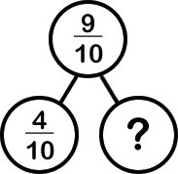
Starter:
Success Criteria: I know that $\frac{1}{10}$ can be written as the decimal 0.1 I can compare fractions and decimals as words, fractions, decimals and diagrams
Which one is different?

Slide 4
Starter:
Success Criteria: I know that $\frac{1}{10}$ can be written as the decimal 0.1 I can compare fractions and decimals as words, fractions, decimals and diagrams
Which one is different?
2 10
Each of the images should be labelled with 7 tenths apart from the doughnut shapes. This image shows 7 out of 12 shaded (or 7 twelfths) instead!

Slide 5
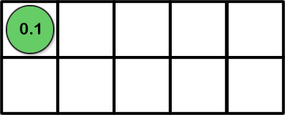
Talking time:
Complete the table:
Image | Words | Fraction | Decimal
 | one tenth

Slide 6
Talking time:
Complete the table:
Image | Words | Fraction | Decimal
 | one tenth |  | 0.1
1
10

Slide 7
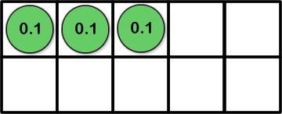
Talking time:
How would you complete this table?
Image | Words | Fraction | Decimal
3
10

Slide 8
Talking time:
How would you complete this table?
Image | Words | Fraction | Decimal
 | three tenths |  | 0.3
3
10

Slide 9
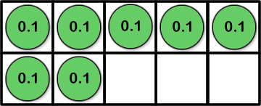
Activity 1:
Complete this table to show tenths in different ways:
Image | Words | Fraction | Decimal
 |  |  | 0.5
9
10

Slide 10
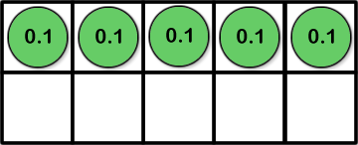
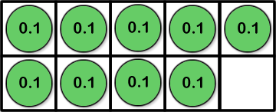
Activity 1:
Complete this table to show tenths in different ways:
Image | Words | Fraction | Decimal
 | five tenths |  | 0.5
 | nine tenths |  | 0.9
 | seven tenths |  | 0.7
5
10
9
10
7
10

Slide 11
Talking time:
What is this part written as a fraction and as a decimal?

Slide 12
Talking time:
What is this part written as a fraction and as a decimal?
8
10
= 0.8

Slide 13
Talking time:
What is this part written as a fraction and as a decimal?

Slide 14
Talking time:
What is this part written as a fraction and as a decimal?
3
10
= 0.3

Slide 15
Activity 2:
Write these values as fractions and as decimals.

Slide 16
Activity 2:
Write these values as fractions and as decimals.
6
10
= 0.6
4
10
= 0.4
9
10
= 0.9

Slide 17
Activity 3a:
This decimal has been written using a place-value grid.
How would you write it as a fraction?
How could you represent it pictorially?
Ones |  | Tenths
0 |  | 7

Slide 18
Activity 3a:
This decimal has been written using a place-value grid.
How would you write it as a fraction?
How could you represent it pictorially?
For example:
Ones |  | Tenths
0 |  | 7
7
10

Slide 19
Activity 3b:
Use a place-value grid and digit cards to play this game with a partner.
One of you should make a decimal number using the place-value grid. This should show a number of tenths and should be between 0 and 1.
The other player should then represent the decimal number as a fraction and pictorially. They get a point for each representation!

Slide 20
Activity 4:
Ryan says that one tenth of an hour is 6 minutes.
Is he correct? Why / why not?
Isla says that one tenth of 1 metre is 10 cm.
Is she correct? Why / why not?
Jessica says that 0.20 is the same as 20 tenths.
Is she correct? Why/ why not?

Slide 21
Activity 4:
Ryan says that one tenth of an hour is 6 minutes.
Is he correct? Why / why not?
Yes. Ryan is correct. There are 60 minutes in an hour and so there are ten lots of 6 minutes. So one tenth is equal to 6 minutes.
Isla says that one tenth of 1 metre is 10 cm.
Is she correct? Why / why not?
Yes. Isla is correct. There are 100 cm in 1 metre and so there are ten lots of 10cm. So one tenth is equal to 10 cm.
Jessica says that 0.20 is the same as 20 tenths.
Is she correct? Why/ why not?
No . Jessica is not correct. In the decimal 0.20, the digit 2 is in the tenths column, so it stands for 2 tenths. 0.20 is the same as 0.2.

Slide 22
Evaluation:
Success Criteria: I know that $\frac{1}{10}$ can be written as the decimal 0.1 I can compare fractions and decimals as words, fractions, decimals and diagrams
True or False?
Five tenths can be written as 50.
= 0.7
In the decimal number 0.1, the 1 digit has a value of
1 ten.
0.6 is less than 1
If there are ten children in a queue and three of them are boys, then
0.7 of the queue are girls.
7
10

Slide 23
Evaluation:
Success Criteria: I know that $\frac{1}{10}$ can be written as the decimal 0.1 I can compare fractions and decimals as words, fractions, decimals and diagrams
True or False?
Five tenths can be written as 50. FALSE
= 0.7 TRUE
In the decimal number 0.1, the 1 digit has a value of
1 ten. FALSE
0.6 is less than 1 TRUE
If there are ten children in a queue and three of them are boys, then
0.7 of the queue are girls. TRUE
7
10

