Slide 1


Language Conventions
Suffix ‘-ed’
Year One
English | Year 2 | Language Conventions | Suffix ‘-ed’

Slide 3
Suffix ‘-ed’
Introductory Activity
Independent Focused Activity
Review Activity
Consolidation Activity
Assessment

Slide 4
Aim
I can add ‘-ed’ to words to make new words.
Success Criteria
I can sort ‘-ed’ words into their different sounds.
I can say a sentence using an ‘-ed’ word.
I can work out when to put ‘-ed’ at the end of a word.

Slide 5
Introductory Activity

Slide 6







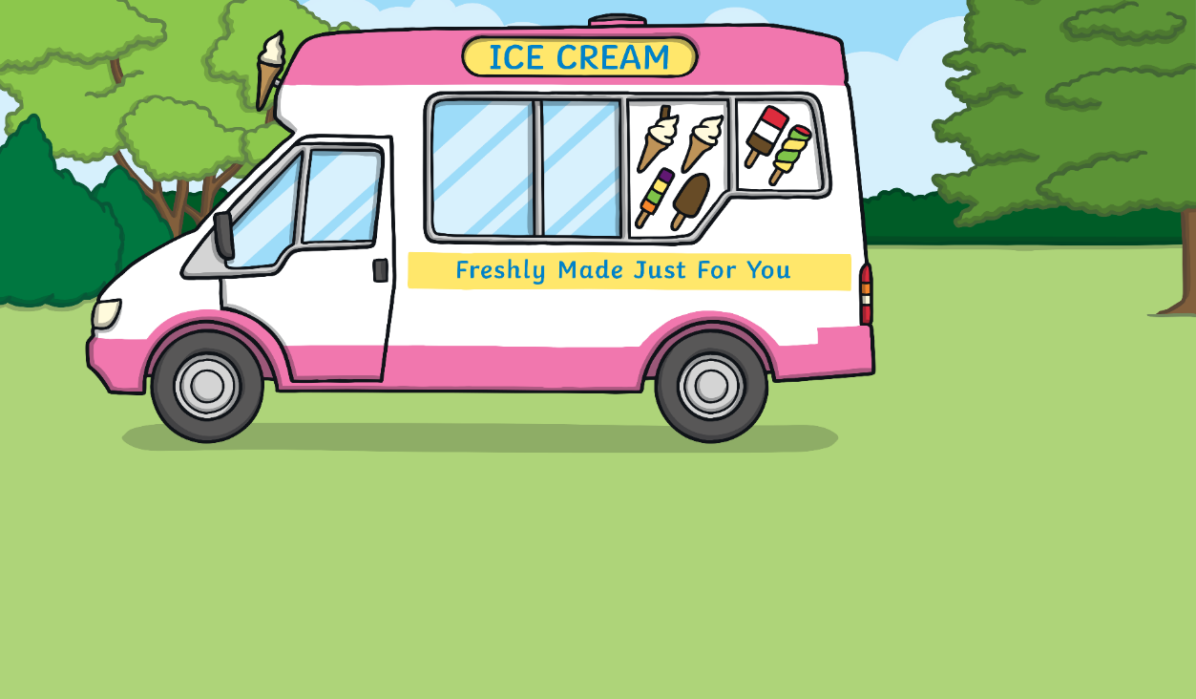
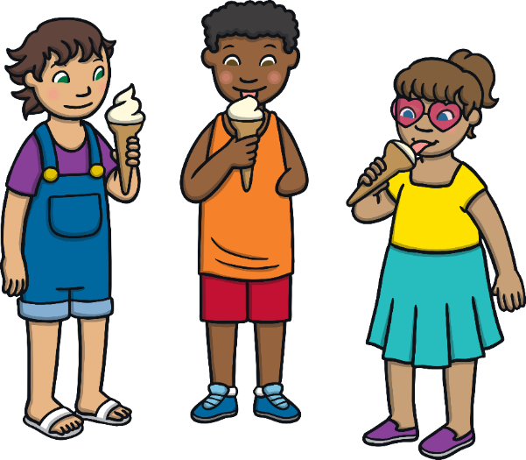
Adding ‘-ed’
Let’s read these words together:
lick
licked
What has been added to the second word?
How do we say this sound?

Slide 7


Adding ‘-ed’
Let’s read these words together:
work
worked
What has been added to the second word?
How do we say this sound?

Slide 8
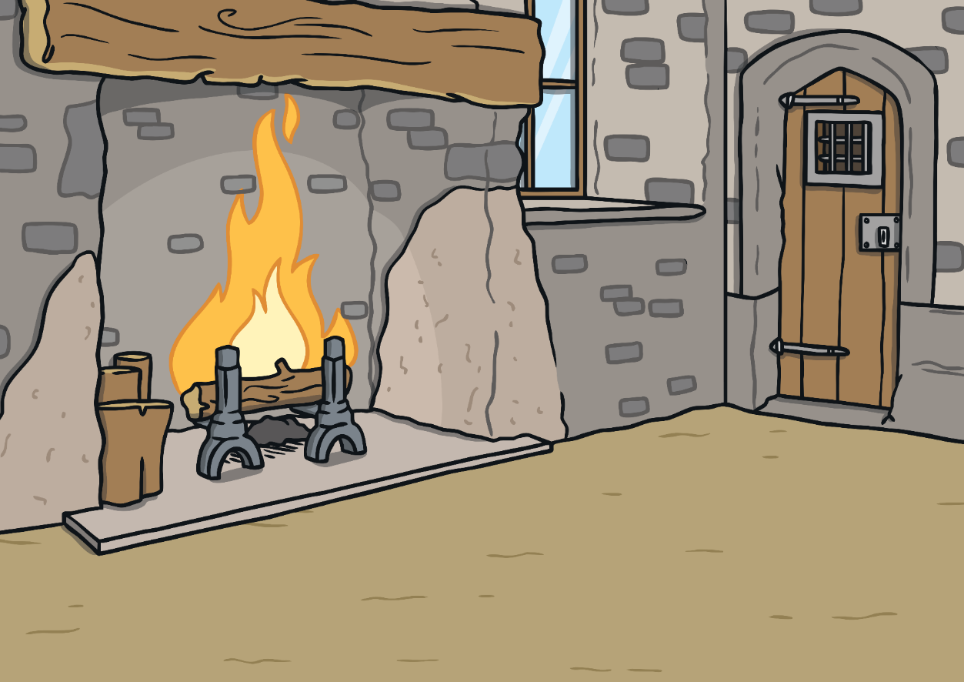

Adding ‘-ed’
Let’s read these words together:
burn
burned
What has been added to the second word?
How do we say this sound?

Slide 9
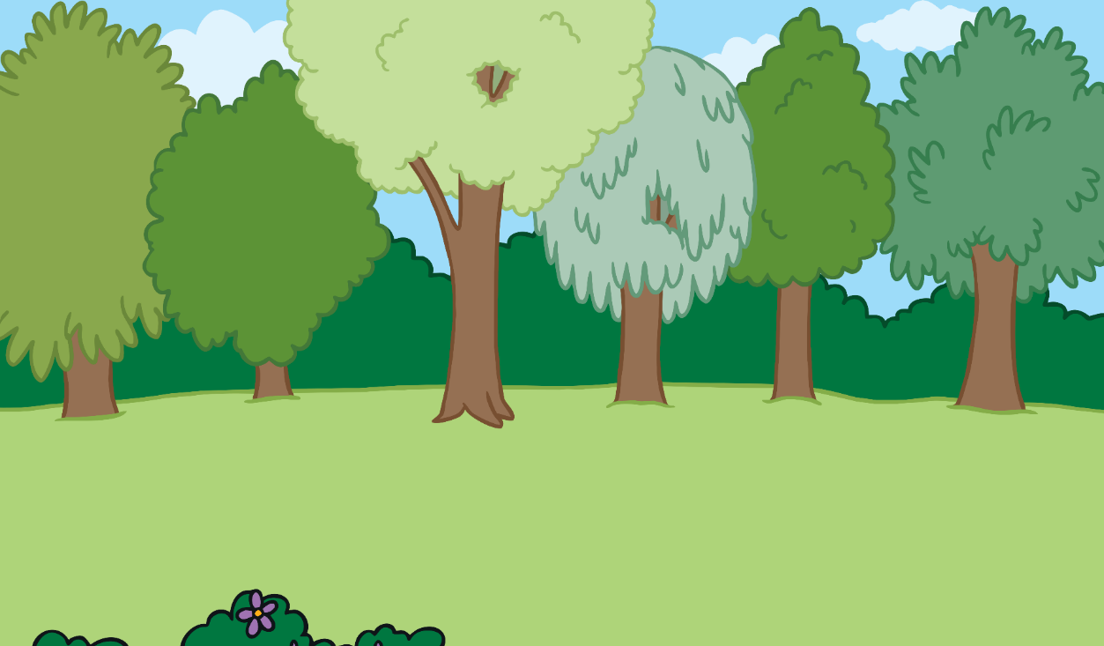
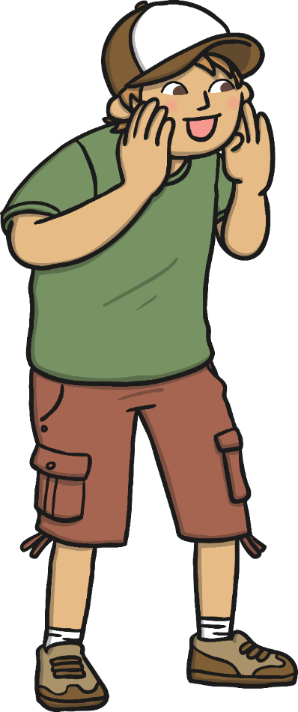

Adding ‘-ed’
Let’s read these words together:
yell
yelled
What has been added to the second word?
How do we say this sound?

Slide 10

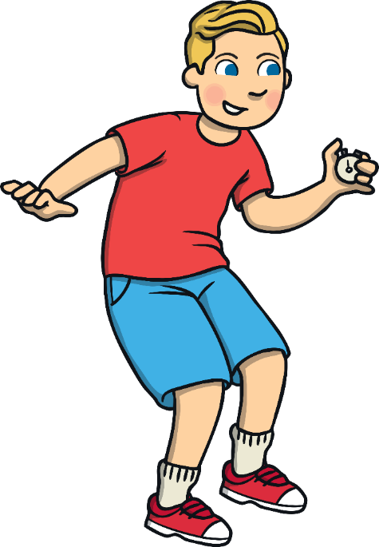
Adding ‘-ed’
Let’s read these words together:
start
started
What has been added to the second word?
How do we say this sound?

Slide 11
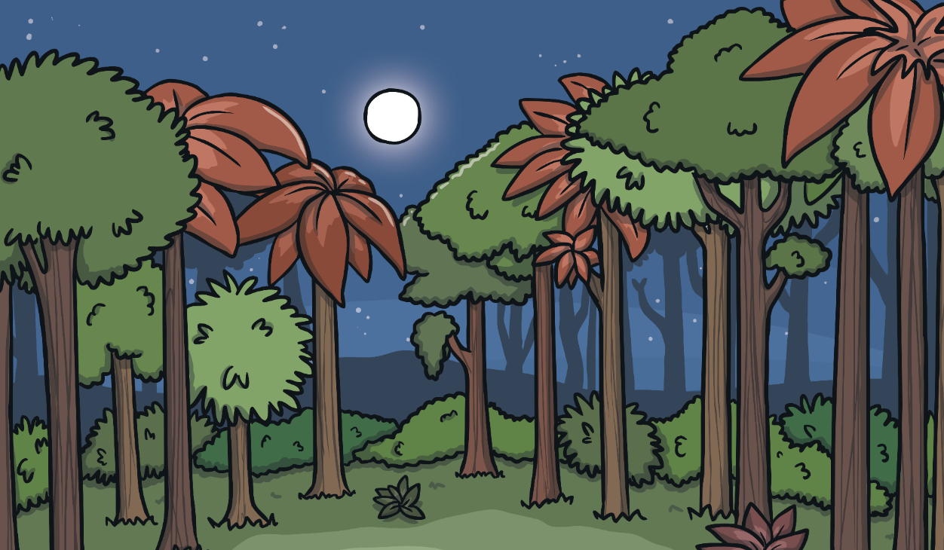
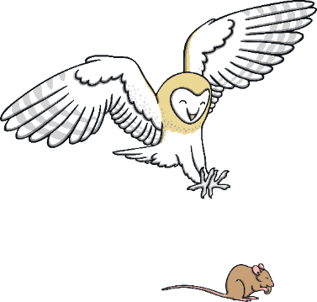
Adding ‘-ed’
Let’s read these words together:
hunt
hunted
What has been added to the second word?
How do we say this sound?

Slide 12
Independent Focused Activity

Slide 13
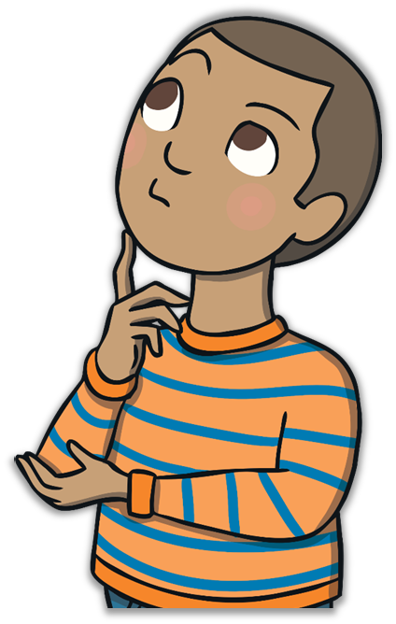
In the Past
What happens to the meaning of a word when ‘–ed’ is added?
It shows the action is happening in the past.
This is called past tense.

Slide 14
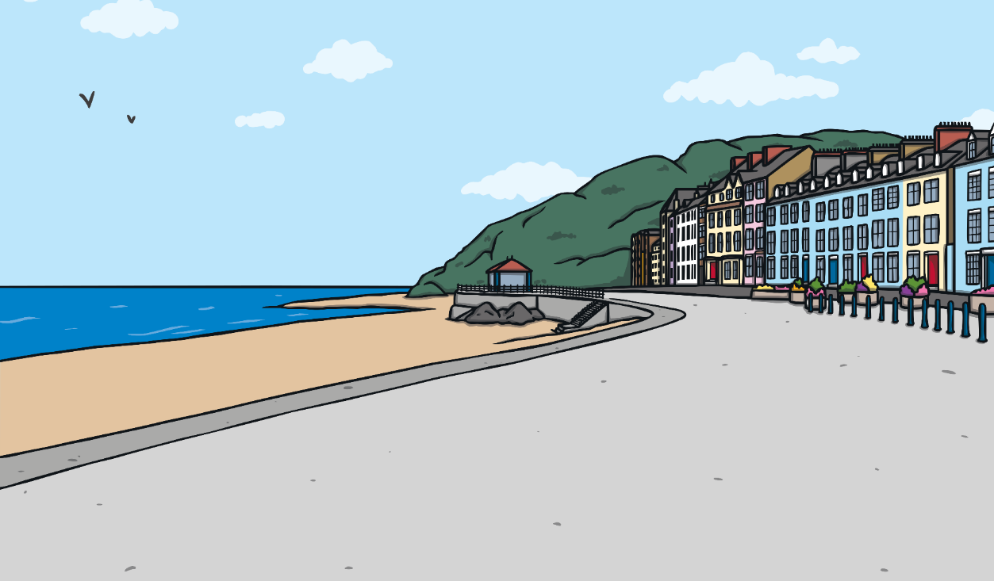
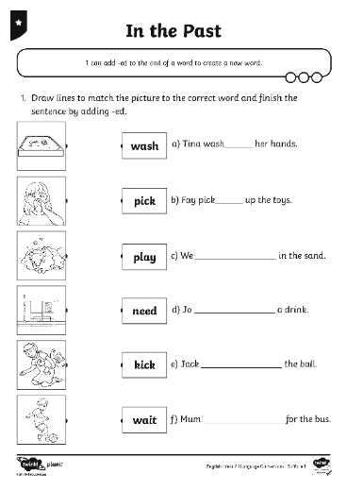
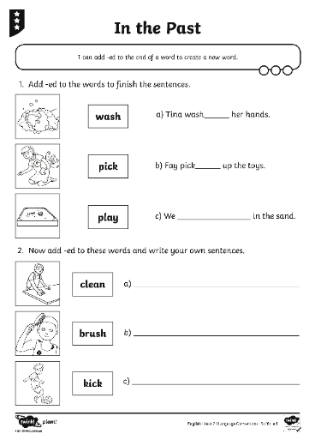
In the Past
You are going to complete the In the Past Activity Sheet to practise making ‘-ed’ words.

Slide 15
Consolidation Activity

Slide 16



When Do We Need ‘–ed’?
To show something has happened in the past.
Can you remember why we use ‘-ed’ at the end of a word?
Read this sentence together:
Ed look at the book.
What is wrong?

Slide 17
When Do We Need ‘–ed’?
We need to use ‘-ed’ if we want to show that the action has already happened (happened in the past).
Ed looked at the book.
We could say:
Read this sentence together:
Ed looks at the book.
Ed look at the book.
This shows the action is happening now.
What is wrong?

Slide 18
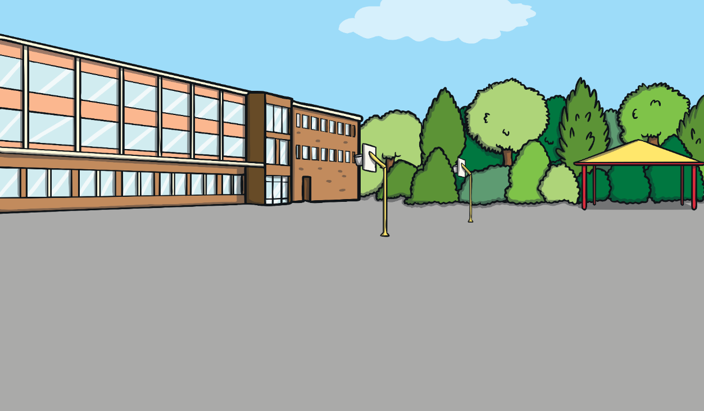
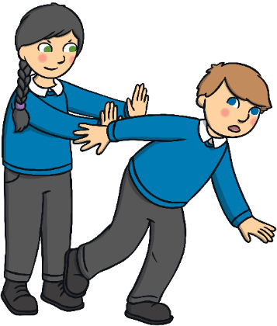
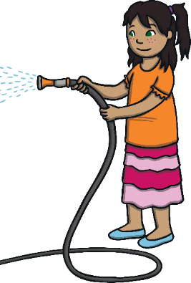
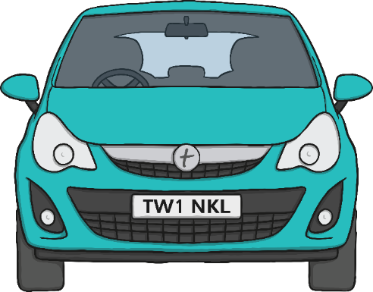
When Do We Need ‘–ed’?
Can you use ‘-ed’ to show that these sentences happened in the past? Say them to your partner.
Dee wash the car.
Steph push Sam over.

Slide 19
Assessment

Slide 20
Aim
I can add ‘-ed’ to words to make new words.
Success Criteria
I can sort ‘-ed’ words into their different sounds.
I can say a sentence using an ‘-ed’ word.
I can work out when to put ‘-ed’ at the end of a word.

