Slide 1
Ready-to-go Lesson Slides
Year 6
Fractions
Lesson 14
To know how to use the four operations when calculating with fractions
Autumn

Slide 2
Summary
Key Vocabulary and Sentence Stems
Hinge Question (Assessment Point)
Lesson Introduction Slide (Learning Objective and Success Criteria)
Starter – Order of operations
Key Concept Introduction
Guided Practice – Find the missing fraction
Independent Practice 1 – Find the missing fraction or integer
Guided Practice – Order of operations (focusing on including brackets to change a question)
Independent Practice 2 – Order of operations (focusing on including brackets to change a question)
Guided Practice – Is the astronaut correct?
Independent Practice 3 – Answer questions and add brackets to change the answers
Let’s Reflect
Support Slides – Based on Year 5 - Add and subtract fractions

Slide 3
Key Vocabulary:
Lowest common multiple
Highest common factor
Mixed number
Improper fraction
Sentence Stems:
To find an equivalent of a given fraction, multiply the numerator and denominator by the same number.
To add or subtract fractions with different denominators, first find the lowest common multiple.
(denominator) and (denominator) have a lowest common multiple of (number).
(For ½ and ⅕ ) 2 and 5 have a lowest common multiple of 10.
Multiplication is repeated addition.

Slide 4
Hinge Question:
2 x ($\frac{\text{5}}{\text{ 8 }}$ + $\frac{\text{1}}{\text{ 2 }}$) =
2 $\frac{\text{1}}{\text{ 4 }}$
3 $\frac{\text{1}}{\text{ 8 }}$
1 $\frac{\text{3}}{\text{ 4 }}$
1 $\frac{\text{1}}{\text{10}}$
Notes:
Assessment point for the lesson – ask the children to vote for the answer they think is correct.
A – Correct answer
B – The pupil has ignored the brackets and completed 2 x ⅝ first.
C – The pupil has mistaken 2 x for 2 +.
D – The pupil has calculated 2 x ⅝. Then they have added ½. They have forgotten to find a common multiple and have instead added the numerators and denominators.
If answers B, C or D are given, pupils may require extra support through small group or 1:1 discussions. There are support slides covering lessons from the previous year group at the end of these slides.

Slide 5
To know how to use the four operations when calculating with fractions
Success Criteria I can recall the order of operations I can explain how to apply the order of operations to a calculation I can explain how the order of operations affect a calculation

Slide 6
Starter:
How would you complete these calculations?
6
66
4 + 12 ÷ 6 =
2 + 4 x 4² =
31
5² + (2 x 3) =
10
5 – 2 + 35 ÷ 5 =
Answers
Notes:
This slide revises the order of operations from the Year 6 4 operations block. Discussion about the order of operations is encouraged in the next slide.
Key Questions – What do you notice about the calculations? How do you find the answers? What do you need to remember?
Extension – The answer to 52 + (2 x 3) is 81. Do you agree? Can you explain the error?

Slide 7
What do you remember about the order of operations?
Notes:
This lesson focuses on all four operations when calculating with fractions. This provides an opportunity to recap the order of operations. Encourage pupils to discuss BIDMAS at this point in the lesson.
Key Questions – What do you remember about the order of operations? Do you think the order of operations applies to fractions? Why/ why not? What do you remember about division/ multiplication and addition/ subtraction?
Misconceptions/ Common Errors – Some pupils may think that the order of operations does not apply to fractions.
Extension – Write a fraction calculation that requires you to follow the order of operations.

Slide 8
Guided Practice:
How can I find the missing numbers in these calculations?
1 $\frac{\text{3}}{\text{10}}$
$$\frac{\text{4}}{\text{ 5 }}$$ | $$\frac{\text{1}}{\text{ 2 }}$$
1 $\frac{\text{8}}{\text{21}}$
$$\frac{\text{5}}{\text{ 7 }}$$
$$\frac{\text{2}}{\text{ 3 }}$$
Answers
Notes:
Key Questions – Which operation do you need to use? How do you know? How can you add the fractions? How can you subtract the fractions?
Misconceptions/ Common Errors – Pupils may struggle with the subtraction question.
Further Practice – Complete other addition/ subtraction questions such as those above.

Slide 9
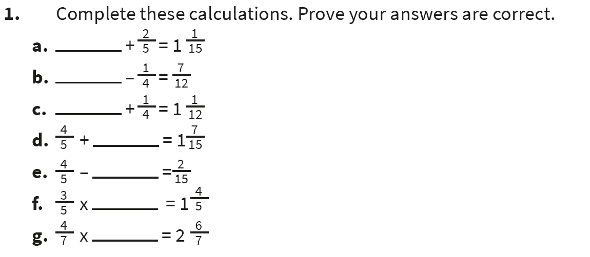
Independent Practice:
Notes:
⅔
⅚
⅚
⅔
⅔
3
5

Slide 10
Guided Practice:
How do the brackets change the way you answer these questions?
2 $\frac{\text{2}}{\text{ 5 }}$ + $\frac{\text{1}}{\text{ 2 }}$ ÷ 2 = (2 $\frac{\text{2}}{\text{ 5 }}$ + $\frac{\text{1}}{\text{ 2 }}$) ÷ 2 =
In this question, we start with division.
$\frac{\text{1}}{\text{ 2 }}$ ÷ 2 = $\frac{\text{1}}{\text{ 4 }}$
2 $\frac{\text{2}}{\text{ 5 }}$ + $\frac{\text{1}}{\text{ 4 }}$ = 2 $\frac{\text{8}}{\text{20}}$ + $\frac{\text{5}}{\text{20}}$ = 2 $\frac{\text{1}\text{3}}{\text{20}}$
In this question, we start with the brackets.
2 $\frac{\text{2}}{\text{ 5 }}$ + $\frac{\text{1}}{\text{ 2 }}$ = 2 $\frac{\text{4}}{\text{10}}$ + $\frac{\text{5}}{\text{10}}$ = 2 $\frac{\text{9}}{\text{10}}$
2 $\frac{\text{9}}{\text{10}}$ ÷ 2 = 1 $\frac{\text{9}}{\text{2}\text{0}}$
BIDMAS
Answers
Notes:
Key Questions – What do you know about the order of operation that could help you? What is different about the questions? What is the same? What do you notice? How can you check your answers?
Misconceptions/ Common Errors – Pupils may struggle to identify the difference if they struggled with BIDMAS before.
Further Practice – Complete calculations requiring BIDMAS. Use calculations involving + and – only (discussing the order these are completed within a calculation).
Extension – If the calculation contained multiplication and division only, which order would I complete the calculations? Explain.

Slide 11
Independent Practice:
Notes:
6 ⅓
2 ⅓
4 8/15
2 13/30
5 8/15
9 11/15

Slide 12
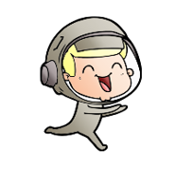
Guided Practice:
2 $\frac{\text{3}}{\text{10}}$ + $\frac{\text{1}}{\text{ 4 }}$ ÷ 2 =
Do you agree with the astronaut?
Explain your answer.
2 $\frac{\text{3}}{\text{10}}$ + ($\frac{\text{1}}{\text{ 4 }}$ ÷ 2)
The answer to this calculation is different to the original calculation.
The astronaut is incorrect.
In both calculations, $\frac{\text{1}}{\text{ 4 }}$ ÷ 2 is the first part of the calculation to be completed. The answers are the same (2 $\frac{\text{1}\text{7}}{\text{4}\text{0}}$).
BIDMAS
Answers
Notes:
Key Questions – How would you answer the original question? How would you answer the astronaut’s calculation? What do you notice about the calculations? What is the same? What is different?
Misconceptions/ Common Errors – Pupils may still struggle to remember the order of operations
Extension – Where would you put the brackets in the original question to give a different answer? Explain.

Slide 13
Independent Practice:
Notes:
3 11/12
4 7/30
7 13/28
(1 ¼ + ⅔) x 4 = 7 ⅔
(4 ⅖ – ⅓) ÷ 2 = 2 1/30
4 5/7 – (¼ + 3) = 1 13/28

Slide 14
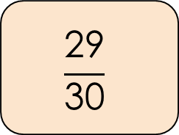
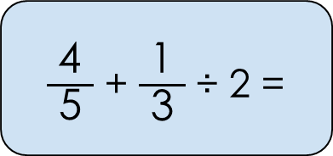
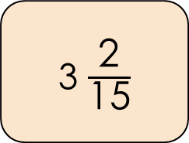
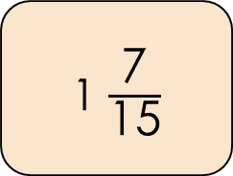
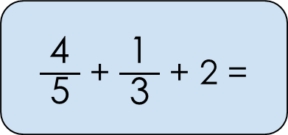
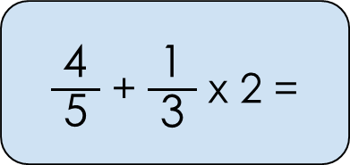
Let’s Reflect:
Match the calculation to the correct answer.
$\frac{\text{4}}{\text{ 5 }}$ + $\frac{\text{1}}{\text{ 3 }}$ ÷ 2 =
1 $\frac{\text{7}}{\text{15}}$
$\frac{\text{4}}{\text{ 5 }}$ + $\frac{\text{1}}{\text{ 3 }}$ x 2 =
3 $\frac{\text{2}}{\text{15}}$
$\frac{\text{4}}{\text{ 5 }}$ + $\frac{\text{1}}{\text{ 3 }}$ + 2 =
$$\frac{\text{29}}{\text{30}}$$
Answers
Notes:
Key Questions – How can you find the answers to these questions? Can you make an educated guess about which answers match before calculating them? What do you notice? What is the same? What is different? Which order do you need to complete the calculations?
Misconceptions/ Common Errors – Pupils may guess answers but not check them.

Slide 15
The following slides are based on Year 5 Fractions – Add and subtract fractions

Slide 16

Complete these calculations.
Prove your answers are correct.
$\frac{\text{2}}{\text{ 5 }}$ + $\frac{\text{3}}{\text{10}}$ =
$\frac{\text{4}}{\text{ 7 }}$ + $\frac{\text{5}}{\text{1}\text{4}}$ =
$\frac{\text{1}}{\text{ 4 }}$ + $\frac{\text{1}}{\text{ 8 }}$ + $\frac{\text{3}}{\text{1}\text{6}}$ =
$\frac{\text{4}}{\text{10}}$ + $\frac{\text{3}}{\text{10}}$ = $\frac{\text{7}}{\text{10}}$
$\frac{\text{8}}{\text{1}\text{4}}$ + $\frac{\text{5}}{\text{14}}$ = $\frac{\text{13}}{\text{14}}$
$\frac{\text{4}}{\text{1}\text{6}}$ + $\frac{\text{2}}{\text{16}}$ + $\frac{\text{3}}{\text{16}}$ = $\frac{\text{9}}{\text{16}}$
Answers
Notes:
How and when to use these slides – As pupils will have been learning about multiplying and dividing with fractions, some pupils may need to recap the process of adding and subtracting with fractions. These slides recap the process of adding and subtracting fractions where the denominators are multiples of each other.
Concrete resources – Blank bar models, number lines
Key Questions – What do you need to do first to add these fractions? What do you need to do next? What is the answer? How can you prove your answer is correct?
Further Practice – Add fractions where the denominators are not multiples of each other.

Slide 17
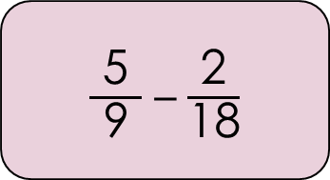
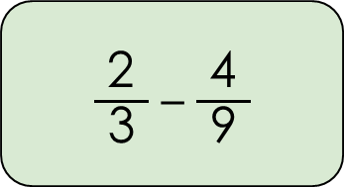
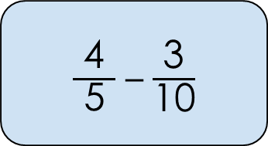
Which calculation is the odd one out?
Explain your answer.
$\frac{\text{5}}{\text{ 9 }}$ – $\frac{\text{2}}{\text{1}\text{8}}$
$\frac{\text{4}}{\text{ 5 }}$ – $\frac{\text{3}}{\text{10}}$
$\frac{\text{2}}{\text{ 3 }}$ – $\frac{\text{4}}{\text{ 9 }}$
Notes:
How and when to use these slides – As pupils will have been learning about multiplying and dividing with fractions, some pupils may need to recap the process of adding and subtracting with fractions. These slides recap the process of adding and subtracting fractions where the denominators are multiples of each other.
In this slide, encourage pupils to consider different ways to solve the questions and give reasons why each one could be the odd one out.
Concrete resources – Blank bar models, number lines
Key Questions – Which is the odd one out before finding the answers? Which is the odd one out after finding the answers? Can you find a reason for each on to be the odd one out? How many ways can you solve these calculations?
Misconceptions/ Common Errors – Pupils may not understand how each calculation could be the odd one out.

