Slide 1
Welcome to Year 6 Learning Links
2024-2025

Slide 2
Staff in Year 6
Mrs Portia Lee - Class Teacher (Tuesday to Friday)
Mrs C. McCann – Monday
Mrs C Heaps - Support Assistant (Monday to Friday am)
Organisation
Children work in the Year 6 classroom and have fluid use of the Study Bay for independent work, quiet space, reading and interventions.

Slide 3
Y6 Timetable - Autumn Term (Typical week) DT will be taught in blocks
Monday | Tuesday | Wednesday | Thursday | Friday
RR/ FF/Spell | FF/RR/X Tables | FF/RR/Spell | FF/ RR/Spell | FF/RR/XTables | 9:00
Maths | Maths | Maths | Maths | Maths | 10:30
BREAK
Grammar/Spell | Literacy | Literacy | Computing | Grammar/Spell | 10:45 12:15
LUNCH
History/ Comprehension | Literacy | Science | music | RE | 1:15
 |  |  |  | Art/Spanish | 3:20
 |  |  | PE

Slide 4
Year 6 Curriculum
Literacy:
Reading (groups and class text) Comprehension
Spelling, Punctuation, Grammar and Handwriting
Writing
Maths:
Daily Fluent in Five, Rapid Reasoning and Tables
Third Space Learning, Maths No Problem
Weekly Arithmetic and Core Skills
Science:
Light, Electricity
Humans (Heart, Blood, Lungs, Health and Diet)
Inheritance, Adaptation and Evolution (Fossils) and Habitats
Notes:
Literacy: Books- Power of Reading
Maths
Reading books: Parent helpers needed to Change on Wednesday and Friday
Spellings: Spelling tests will be on Thursdays
Handwriting: Weekly practice, possible homework activity. Need a good pen at home. Children being encouraged to use a joined fluent style of handwriting. To present work neatly in all subject areas. (End of KS2 assessments will take into account their handwriting).
Numeracy

Slide 5
Wider Curriculum
History: Anglo-Saxons, Vikings, WW1
Geography: Map Skills, Climate Zones/Habitats
RE: Questful Religious Education Scheme
PE: Thursday afternoon
Art: Mark making skills, Klimt and pattern, WWI Art Claude Monet and impressionism, The Art of Asia - Art Related to other curricular areas
Design Technology: Linked with topic: Viking Shields, Textiles (Christmas Stocking) and Kite making
Music: Charanga and I Sing Pop
Spanish: Fortnightly
Computing: Computing and cross curricular ICT opportunities.
Cross-Curricular topic: Asia – China
Heart Smart / Picture News (British Values)
Notes:
The Learning Challenge Curriculum – What do we know already, What do we want to find out?
Trips- Spring/Summer
PE: Can they bring trainers as well as pumps for the autumn term for outdoors. New pumps too big, slippy.

Slide 6
Provisional Workshops, Trips and Events
Term 1
Cake sale for charity
Stall at the Christmas Fair
Christingle Service
Term 2
Eucharist Service at Church
Leading an assembly or workshop/assembly for the school related to China Topic
Food tasting related to China topic

Slide 7
Provisional Workshops, Trips and Events
Term 3
Theatre Trip to Royden Park – Romeo and juliet
Shakespeare topic
Pottery workshop – plate/bowl design
Afternoon Tea
Year 6 Art Gallery – Open afternoon/evening
Leavers Event
Residential (Conway)
Stall at Summer Fair

Slide 8
Year 6 Homework Packs
Homework will be sent out on a Wednesday and is due in on a Monday
Homework packs contain essential support materials so please keep them safe
Weekly homework will consist of :
Maths
Literacy
Tables or learning task
Spelling or other learning task
Reading book or reading task
Projects related to topic work (half termly)

Slide 9
Spelling Homework
accommodate | ancient
accompany | apparent
according | appreciate
achieve | attached
aggressive | available
amateur | average
Nouns are words that identify a person, place, idea or thing Common – refers to things in general - dog, road Proper – a specific person/place/thing – Dawpool, Friday Abstract – intangible idea – love, friendship, time, faith Collective – groups of people or things – class, family, choir Concrete – something that exists physically – desk, chair
Remember to learn the weekly Grammar fact

Slide 10
Year 6 Curriculum
The children in year 6 will have personal writing targets and will be using the KS2 marking criteria to self and peer assess.
They will be using a green response pen to improve and correct their work.
KS2 Marking Codes For Writing
Capital Letter | CL | Check Sense | ?
Full Stop | FS | Verbal Feedback Given | VF
Handwriting | HW | Target | T
Spelling Mistake | SP | Particularly Good | √√
Punctuation Missing | PU | I wish you had . . . | *
Something Missing | ^
New Paragraph | //

Slide 11
How you can support your child
Ensure that homework is completed
Spellings are Statutory lists and will be used to track progress and ability. Please ensure they are learned.
Be aware of your child’s current writing targets and support them with it.
All handwriting should be cursive in year 6 with appropriate use of upper and lower case.
A handwriting club will take place for some children. Additional handwriting may be sent home.
Revise and learn multiplication tables and key ring facts
Read regularly.
Please contact me via the school office if you have any questions or concerns.

Slide 12
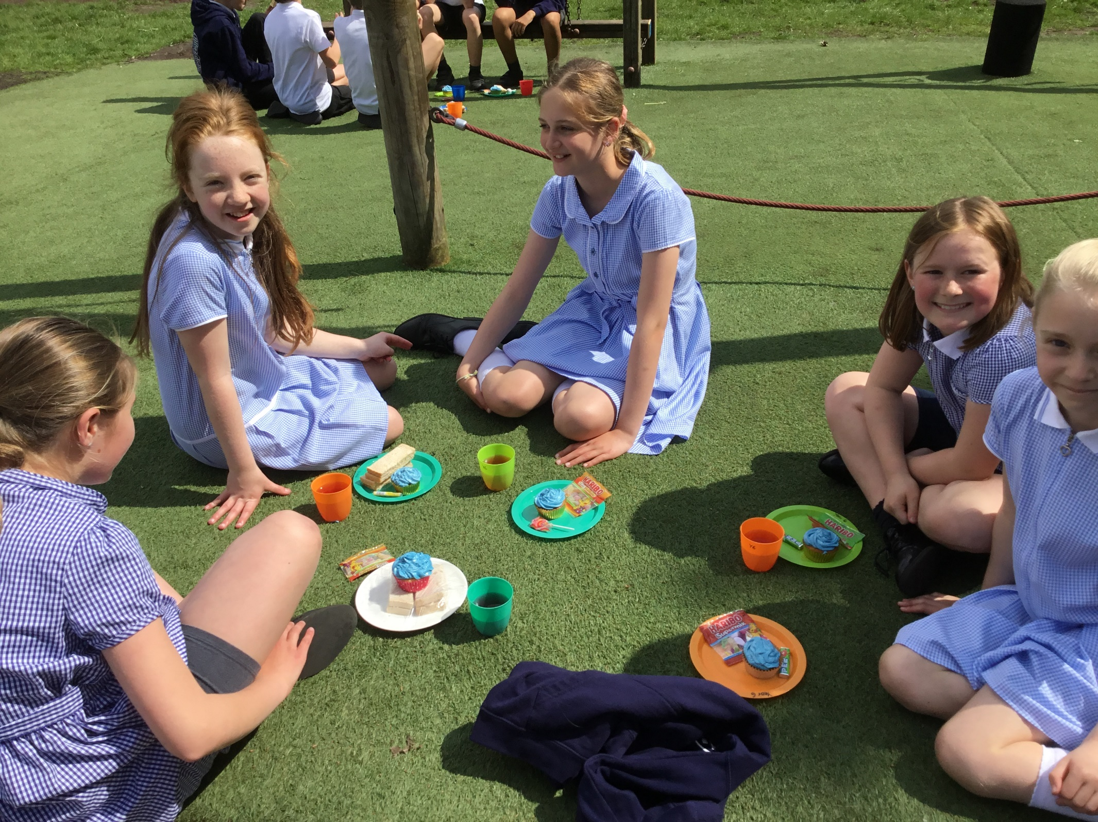

Slide 13
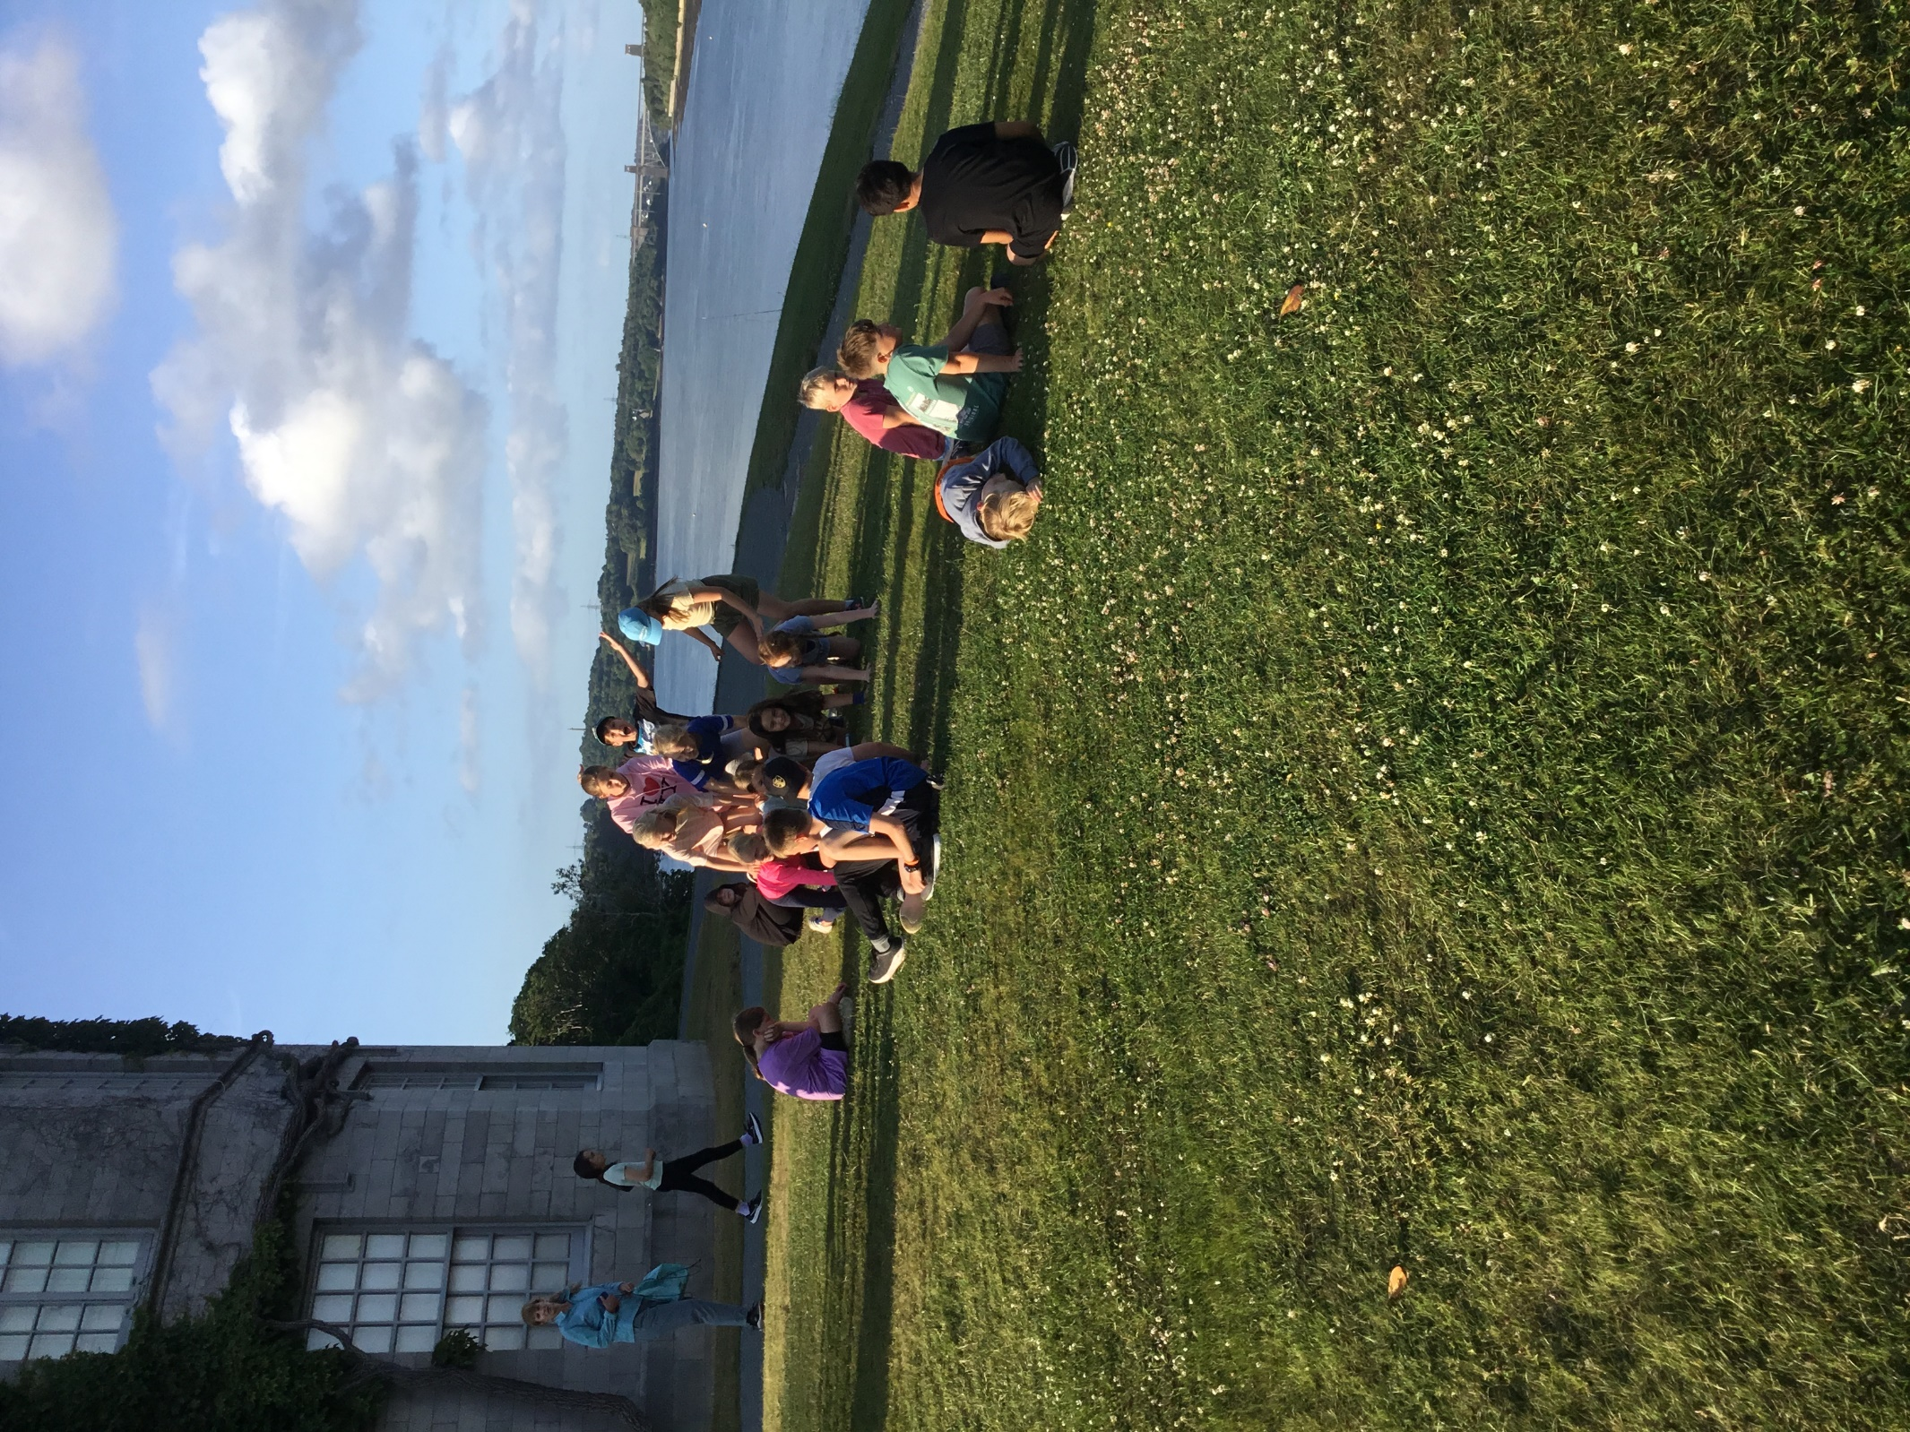

Slide 14
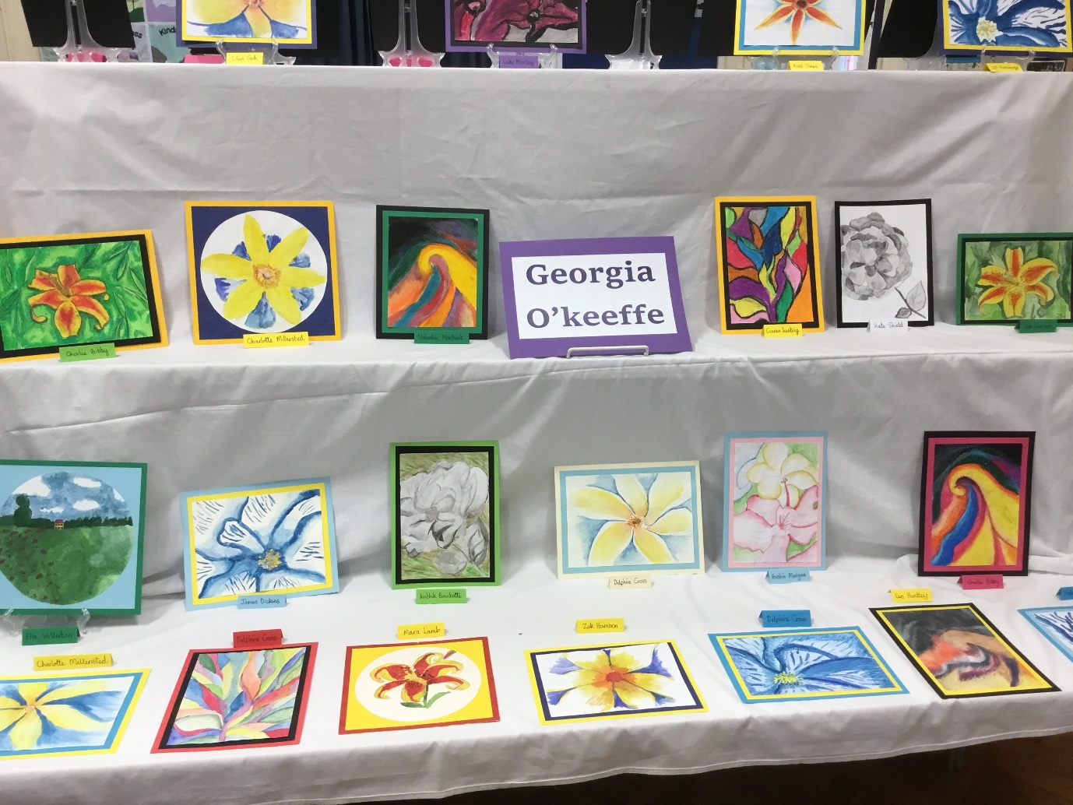

Slide 15
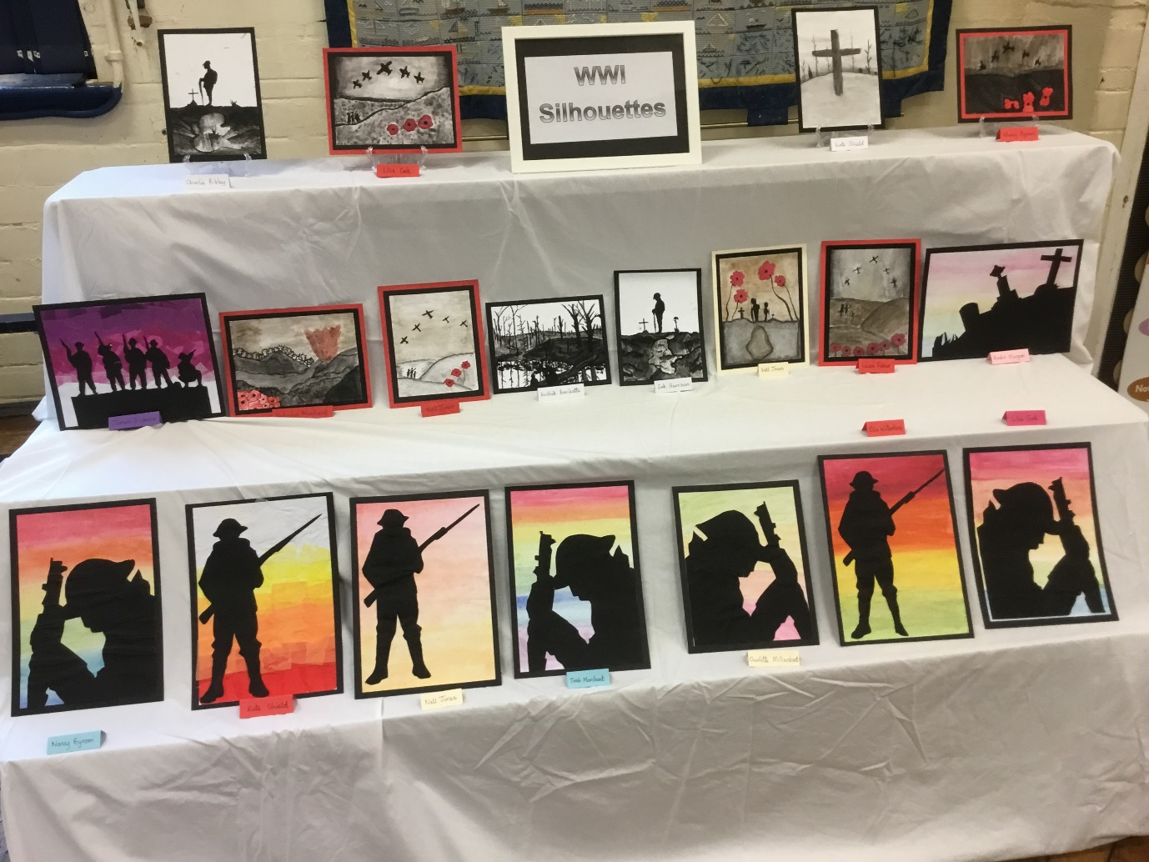

Slide 16
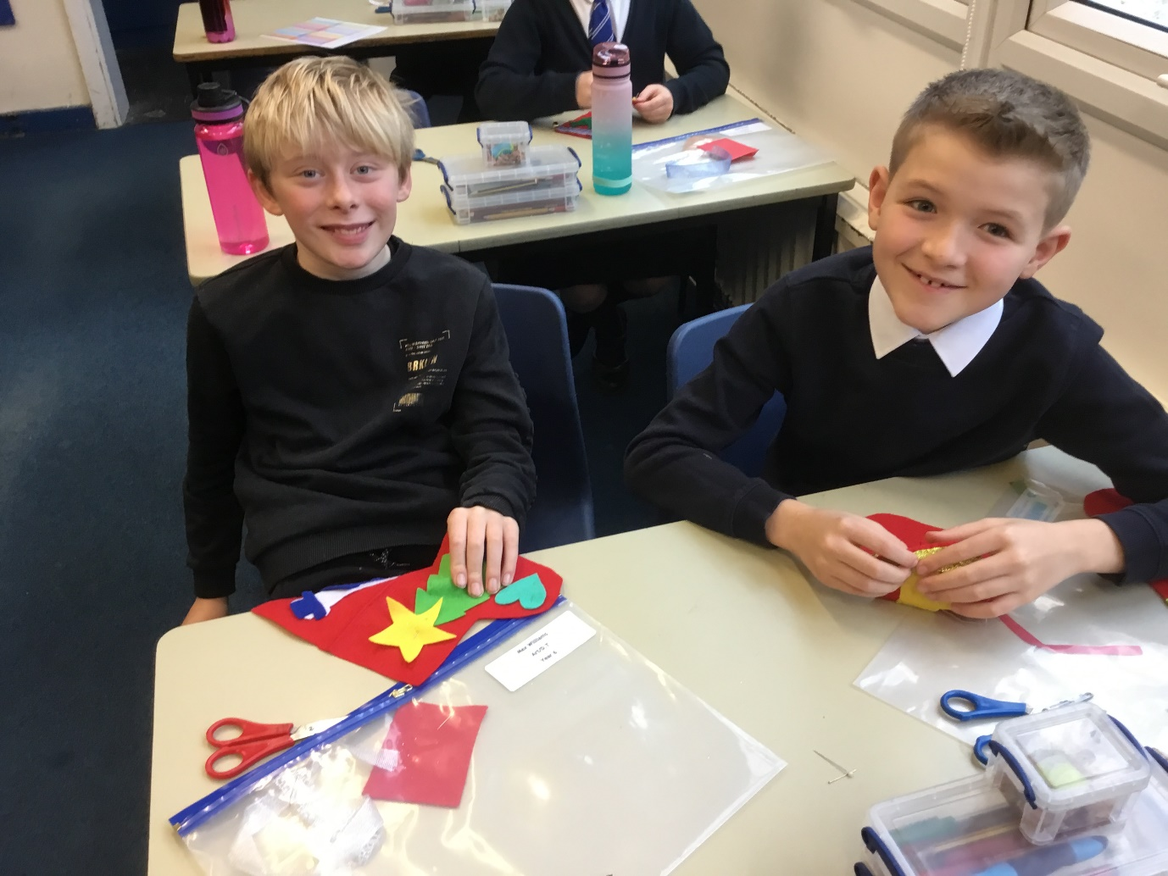

Slide 17
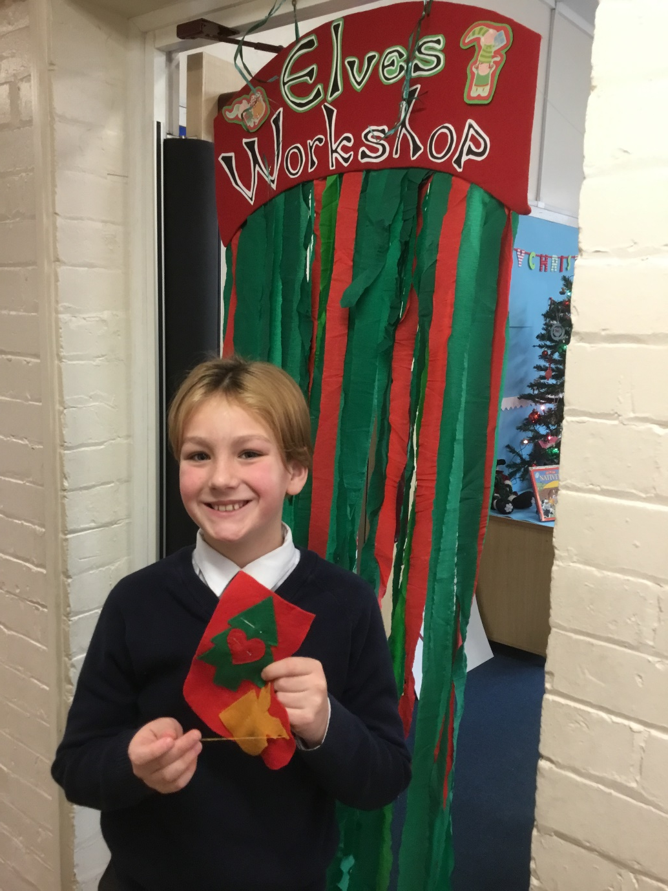
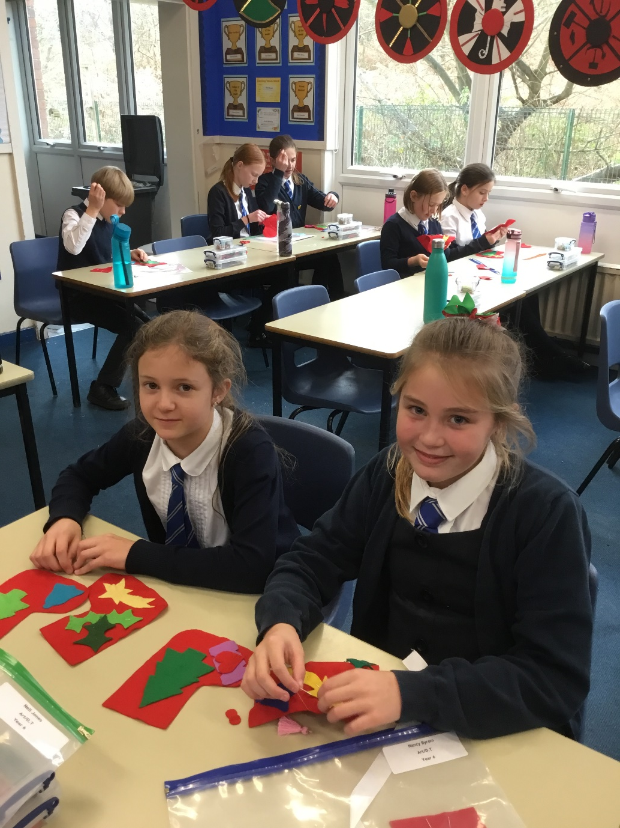

Slide 18
Awards and Progress
In Year 6 we have a “Roll of Honour” and give weekly awards for:
Best Thinker
Improver
Writer
Reader
Helper
Throughout the year children have individual targets but also a Personal Best PB system were they are always rewarded for personal progress
Children have award boxes for these as well as receiving superstars

