Slide 1
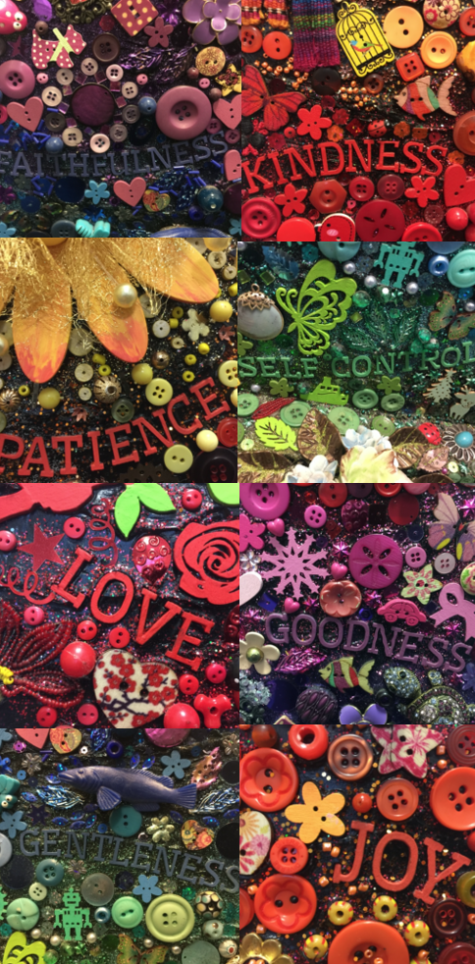
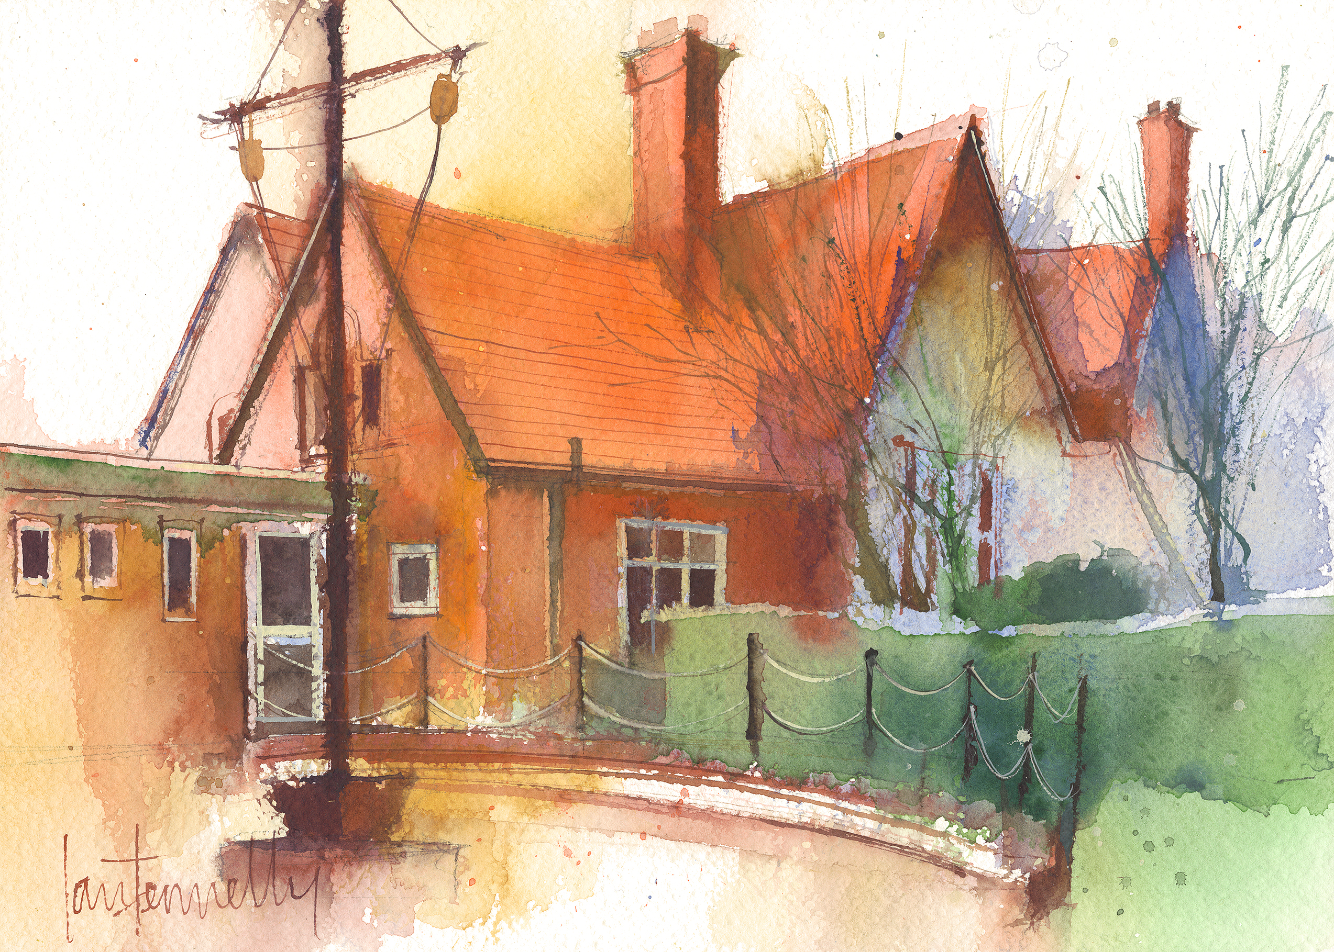
Dawpool CE (Aided) Primary School
School Information 2024-25
Vision Statement
‘The Dawpool community are united in their ambition to create a school which embodies the person, love and work of Jesus Christ: a school which enables Christian values to flourish and where all children may experience the abundant life that Jesus offers.’

Slide 2
Welcome
A warm welcome to the 2024-25 academic year.
Some helpful links
Our school website: https://www.dawpool.wirral.sch.uk/website
Our school Twitter feed: https://twitter.com/DawpoolCofE
Our school email: schooloffice@dawpool.wirral.sch.uk

Slide 3
Staff in Year 2
Mrs L Young: Teacher (Tues-Fri)
Mrs F Barrick: Teacher (Monday)
Mr Burrows: Headteacher(Wed afternoon) (PPA)

Slide 4
Arrivals & Departures
Our school will give a warm and friendly welcome to each child on arrival and ensure that they depart safely at the end of each day. A copy of our full Arrivals and Departures procedure can be viewed here.
Arrivals
The opening times for arriving at school are 8.45am – 8.55am each day for all pupils. Pupils arriving in their classroom after 8:55am will receive a late mark.
If your child is absent from school, please inform the school office by 9:00am using the pupil absence line: 0151 648 3412 (option 1). On your child’s return to school, you must provide a written explanation for the absence.
Departures
F1 and F2 classes finish school at 3:25pm. All other classes finish at 3:30pm. All classes are escorted outside by a member of staff who will be on duty in the playground until 3.40pm. No pupil will be permitted to leave school without a parent or carer, unless the pupil is in Years 5 and 6 and school has received signed parental consent. In the interests of safety, we ask that children do not play on the trim trail at home time.

Slide 5
Y2 Timetable - Autumn Term
Monday | Tuesday | Wednesday | Thursday | Friday
Fluent in five Phonics | Fluent in five Phonics | Fluent in five Phonics | Fluent in five Phonics | Fluent in five Handwriting | 9:00
English-Reading comprehension | English | English | English | Heartsmart | 9:30
 |  |  |  |  | 10:30
BREAK
Maths | Maths | Maths | Maths | Handwriting/ Maths | 10:50 12:10
LUNCH
R.E. | Science | ICT PPA | P.E. | Art/History/Geography/DT/ | 1:15 2:15
BREAK
Milk/fruit/ storytime | Picture news-British Values/Milk / Fruit | Music Milk/ fruit/ | Forest school Milk/fruit | Fruit milk storytime | 2:30 3:30

Slide 6

Curriculum Overview
We provide a subject-specific curriculum in which we have mapped out the knowledge and skills that we want children to learn at each stage. The subject-specific curriculum documents also comprise an overview of Early Years and can be viewed within the curriculum section of our website by clicking here.
Click on your child’s year group below to view the Wisdom, Knowledge & Skills documents:
Year 1
Year 2
Year 3
Year 4
Year 5
Year 6
Where possible, subjects are delivered through topics which are designed for maximum engagement and ensure all pupils benefit from a rich, broad, balanced curriculum presented in an interesting, exciting and imaginative manner with lots of opportunities for first-hand experience, practical work, investigation and learning through play. The curriculum is enriched with visits, visitors, and extensive use of our unique environment.

Slide 7
Curriculum
English:
Phonics, Reading, Comprehension, Grammar, Spelling, Writing, Joined handwriting, Power of reading texts, Poetry.
Maths:
Place value-hundreds, tens and ones, Numbers to 100 in numerals and words, Addition and subtraction to 100 and beyond. Shape, money, time, weight, length, Direction, Division, Multiplication, Fractions, Word problems.
Science:
Humans and other animals, Materials, Plants and Living things and their habitats.

Slide 8
Wider curriculum
History: Ernest Shackleton and his journey to the South Pole, The Great Fire of London.
Geography: Antarctica, Our wonderful world.
RE: The Bible, Christmas, Jesus, Easter, The church, Ascension and Pentecost.
PE: Gymnastics, Games and Dance.
Art-Linked with topic and skills based.
DesignTechnology: Puppets, Perfect pizzas, Kites.
Music: Charanga scheme
Computing: Purplemash scheme.

Slide 9
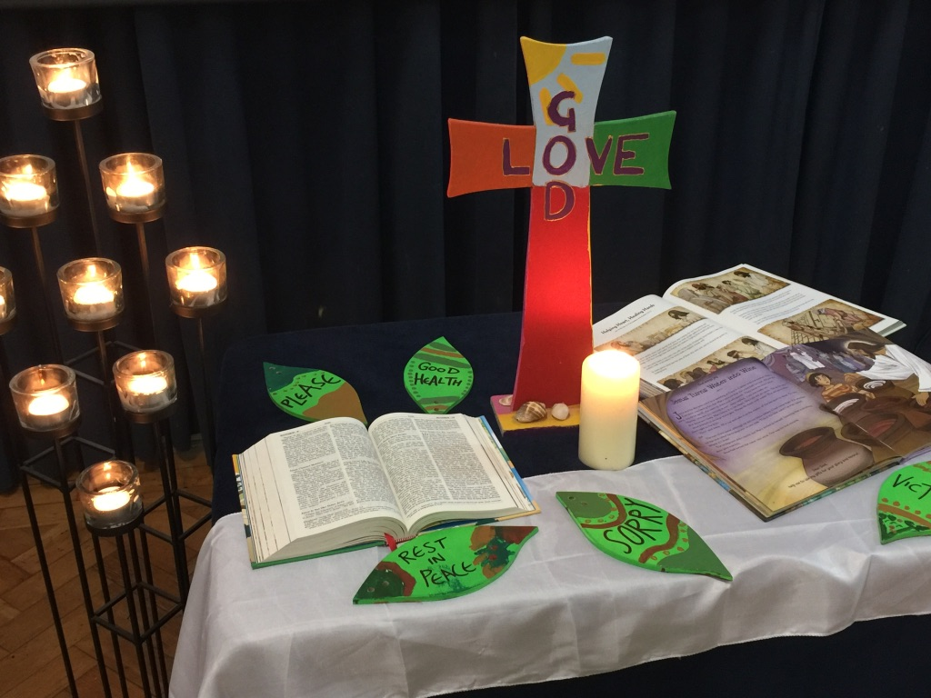
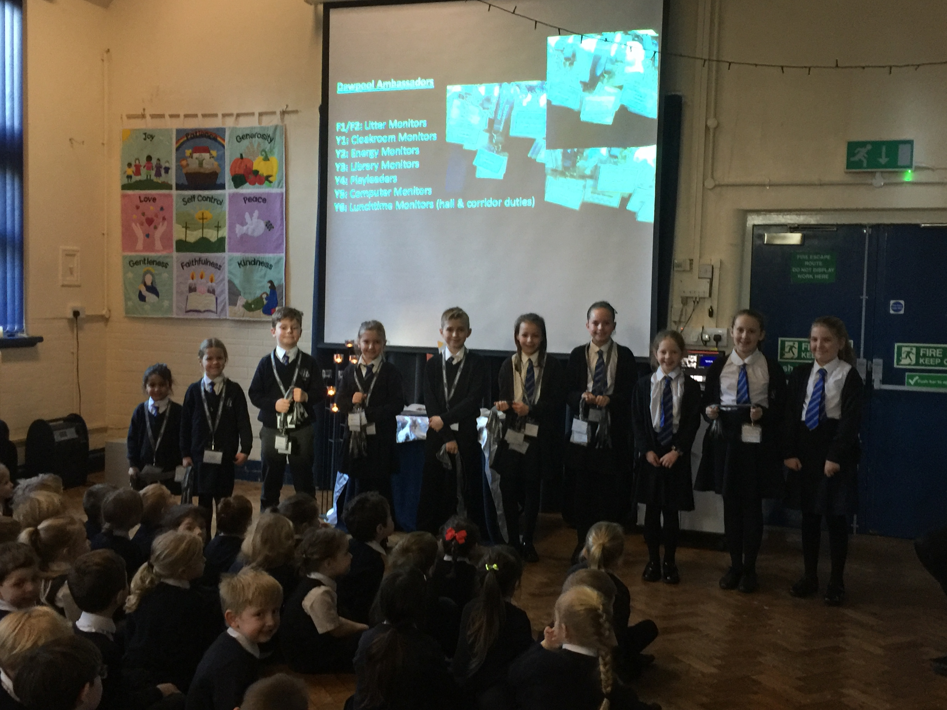
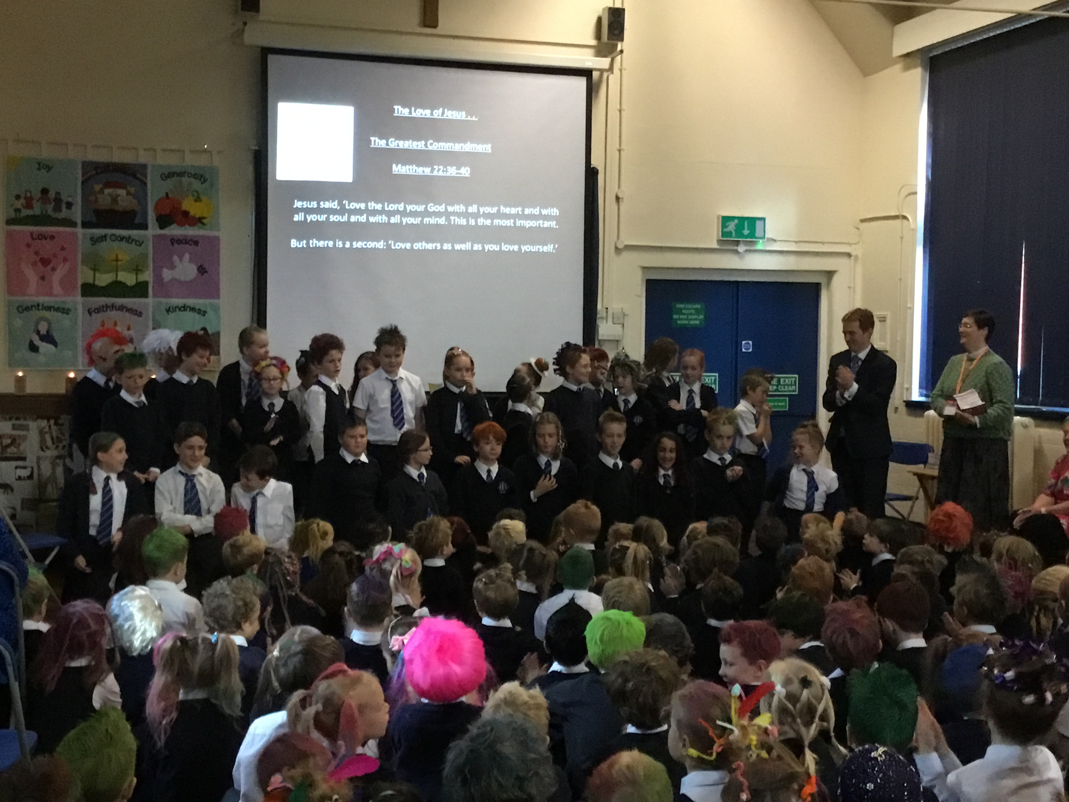
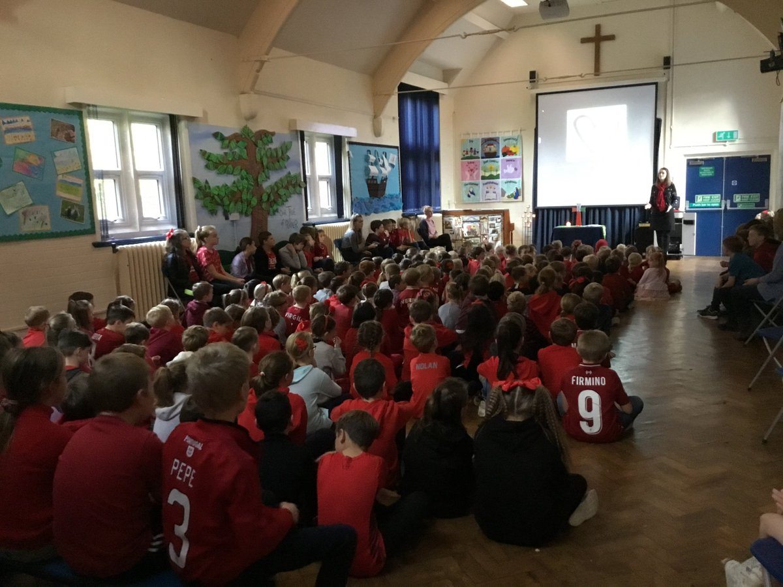
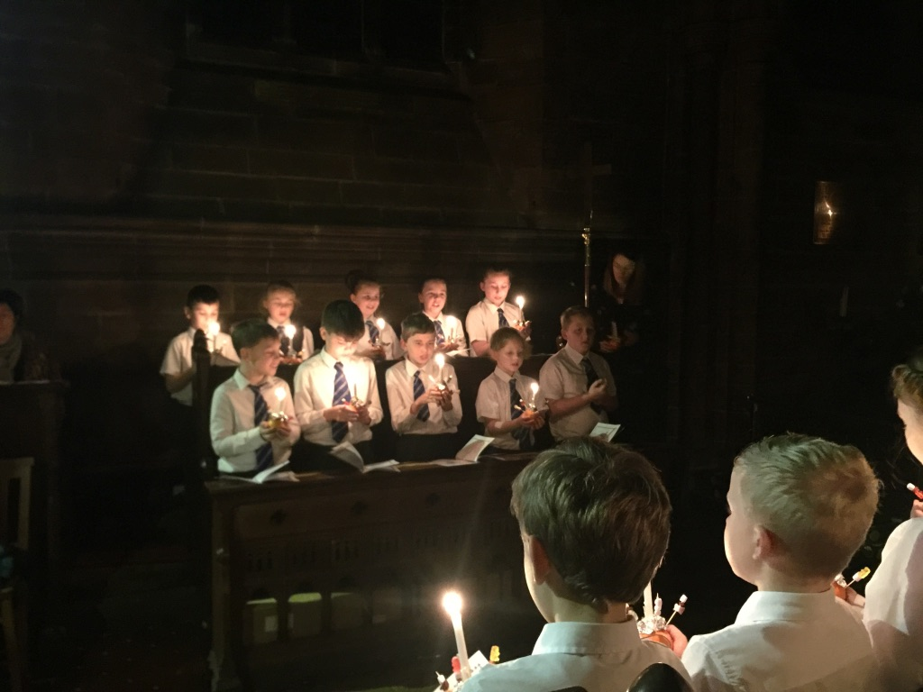
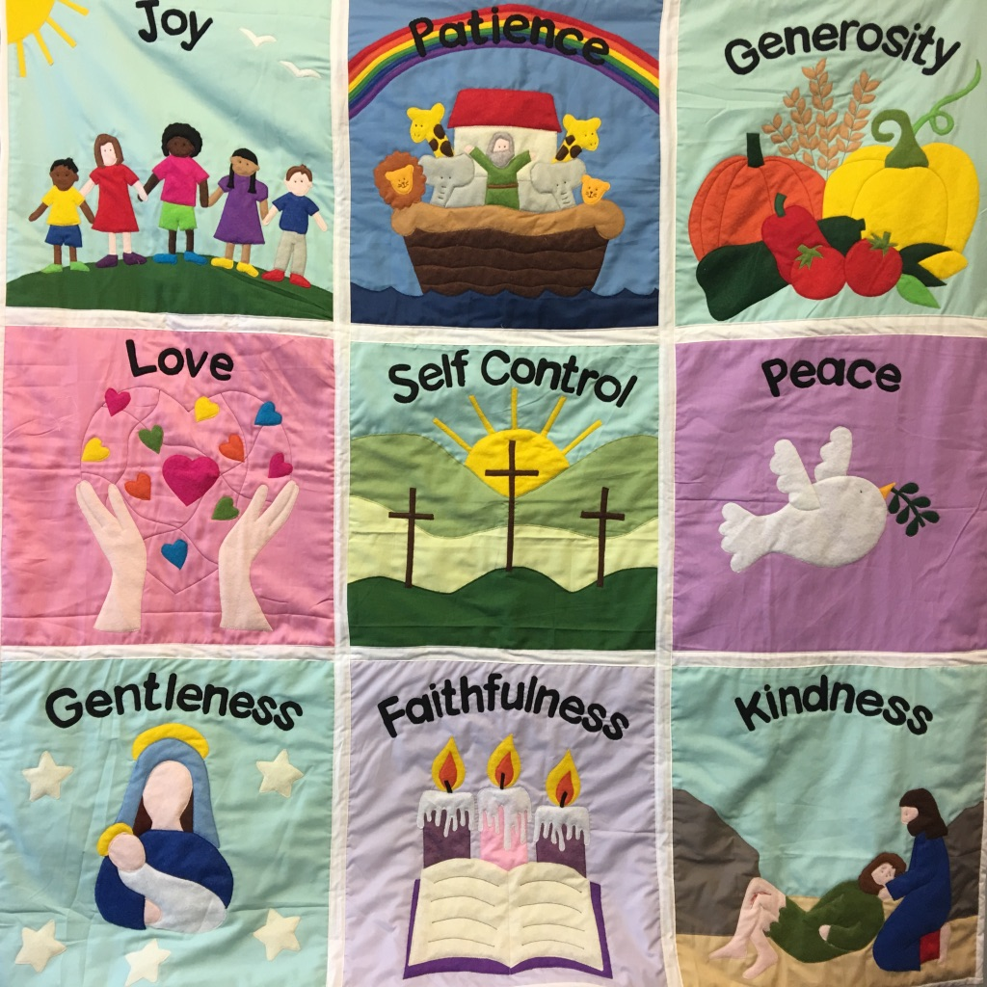
Worship
There is an Act of Worship every morning. Worship is a time where we come together to reflect on the school’s vision and values and to learn about the Person, Love & Work of Jesus which is central to the school’s vision and curriculum. The daily Act of Worship promotes the school values which permeate the ethos of the school. Worship covers such areas as:
Christian Values: Person, Love & Work of Jesus
British Values
Relationships & Health Education
Equality & Diversity
Celebration: Rewards & Certificates

Slide 10
Homework Activities
Reading – Children will be able to change their books throughout the week. Please ensure they
change it and read to you as often as you can manage.
Literacy
Handwriting, Grammar, spelling practice when required.
Maths
Practise based on revision of core skills and current topic-when
required.
History/Geography/Science
Research activities or topic related-when required.
Homework will mostly be set on Purplemash. This can be accessed through our
Class page using your child’s password, which has been sent home.
Homework set on Monday to be completed during the week.

Slide 11
Certificates and Awards
In Y2 Children are given instant rewards such as stickers, superstars or verbal praise.
Each week a ‘Learning value’ certificate is awarded to two children in our class in recognition of demonstrating the school’s ‘Learning values.’
Each week two ‘Fruit of the Spirit’ certificates are awarded to a child in our class in recognition of demonstrating the school’s core values.
.A celebration assembly takes place every Friday to acknowledge weekly achievements.
Certificates-bronze, silver, gold and Headteacher’s are awarded for superstars earned.
Role models to encourage good choices.
Earning extra minutes on the trim trail or Disco minutes.

Slide 12
Behaviour & Anti-Bullying
At Dawpool, we believe that all people are made in the image of God and are unconditionally loved by God. Everyone is equal and we treat each other with dignity and respect. Our school is a place where everyone should be able to flourish in a loving and hospitable community. Poor behaviour and bullying of any kind will not be tolerated and will be taken seriously.
Dawpool’s Behaviour Policy can be viewed here.
Dawpool’s Anti-Bullying Policy can be viewed here.
The school’s Anti-Bullying Guide for Parents can be viewed here.
The school’s Anti-Bullying Guide for Children can be viewed here.
If parents and carers have a concern about behaviour or bullying, please share your concern with the class teacher so we can resolve the situation quickly.

Slide 13
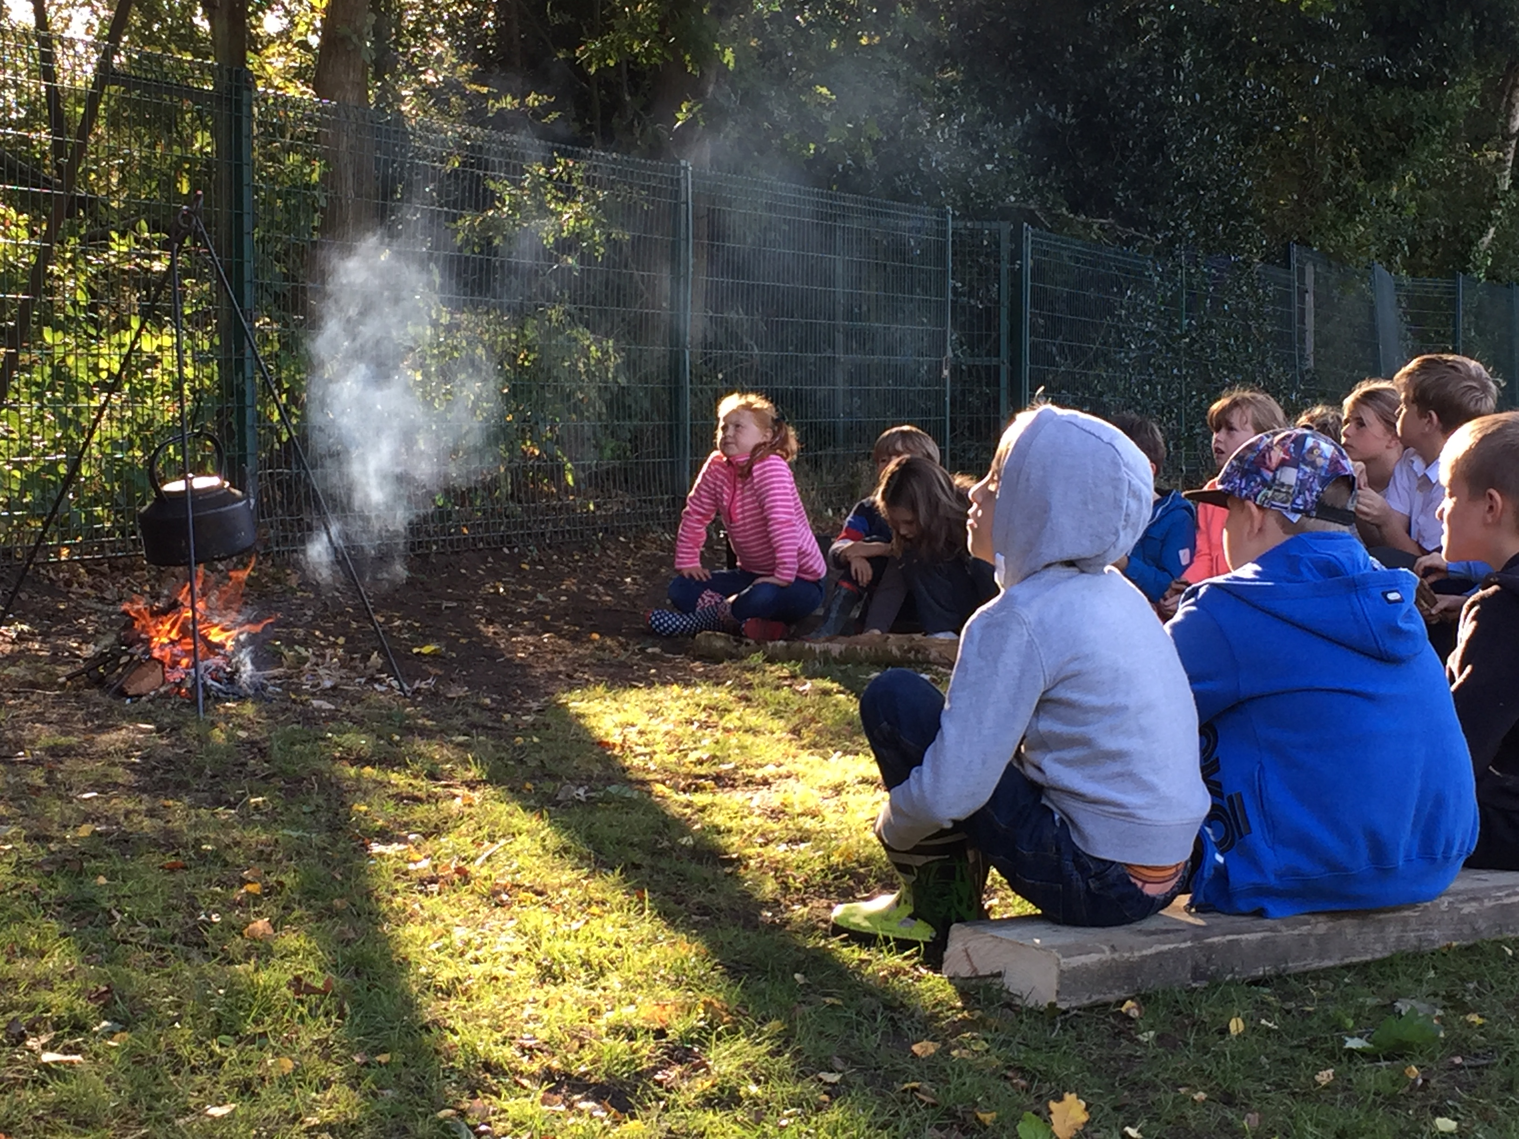
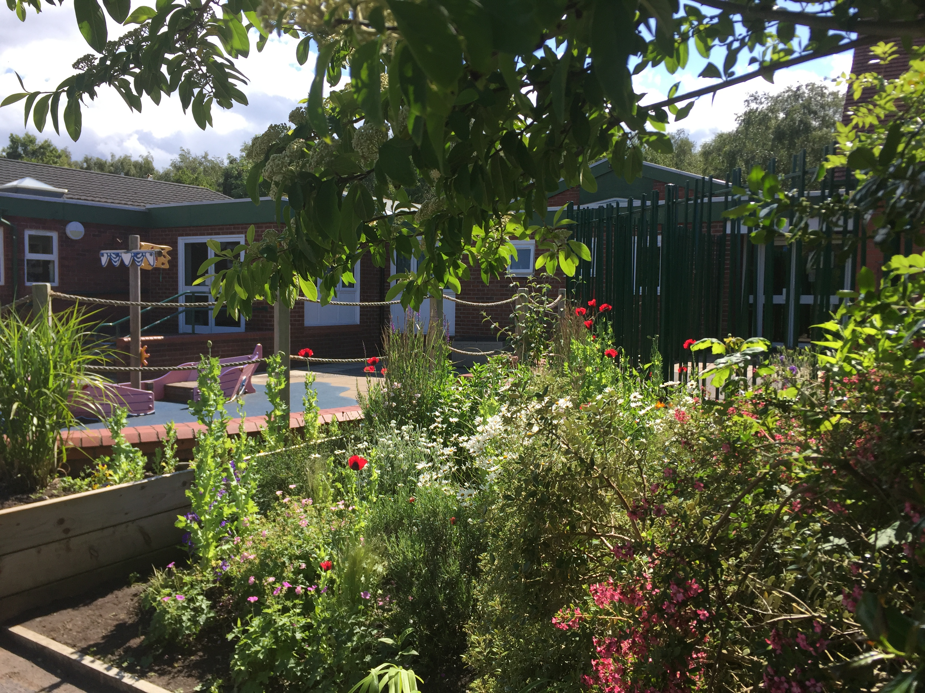
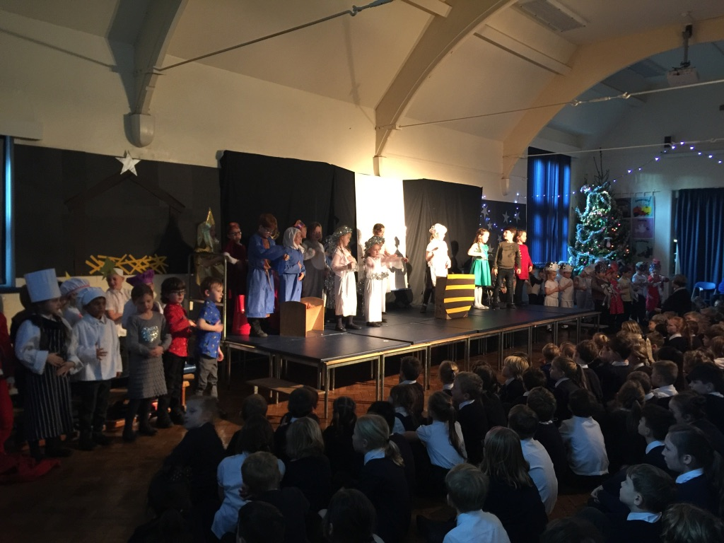
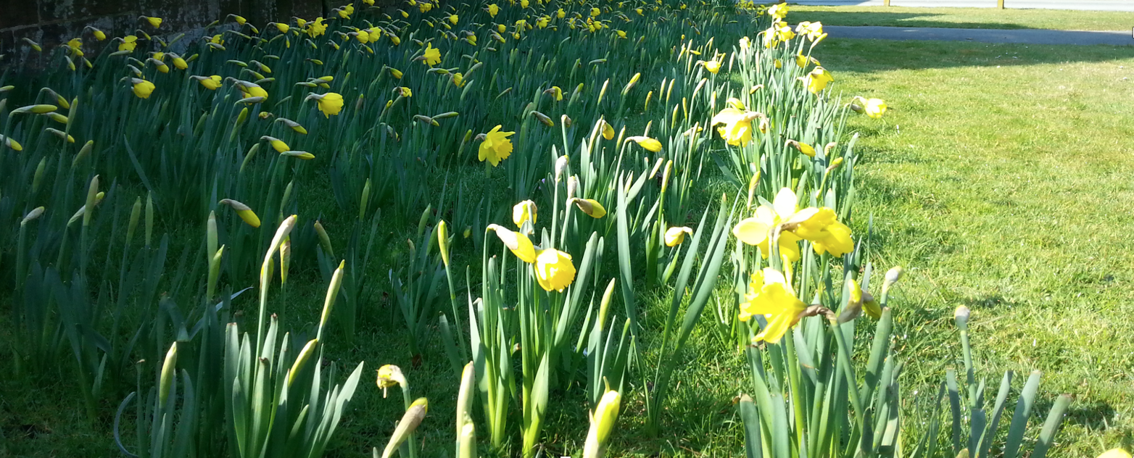
Safeguarding
We know there can be no greater importance to parents and carers than the safety of their children. It is a priority that our safeguarding procedures keep our children safe.
We have a team of staff responsible for keeping children safe and supporting those most vulnerable to harm and neglect. Our Designated Safeguarding Leads (DSL) are Mr Burrows (Head Teacher), Mrs McCann (Deputy Head Teacher) and Mrs Kenney (School Business Manager). Our safeguarding team pays particular attention to the meticulous and systematic implementation of policies and routines.
Safeguarding involves every member of the community. If you are concerned about a child’s welfare, please record your concern and report it to one of the safeguarding team as soon as possible.
The school’s safeguarding policies and procedures can be downloaded here.

Slide 14
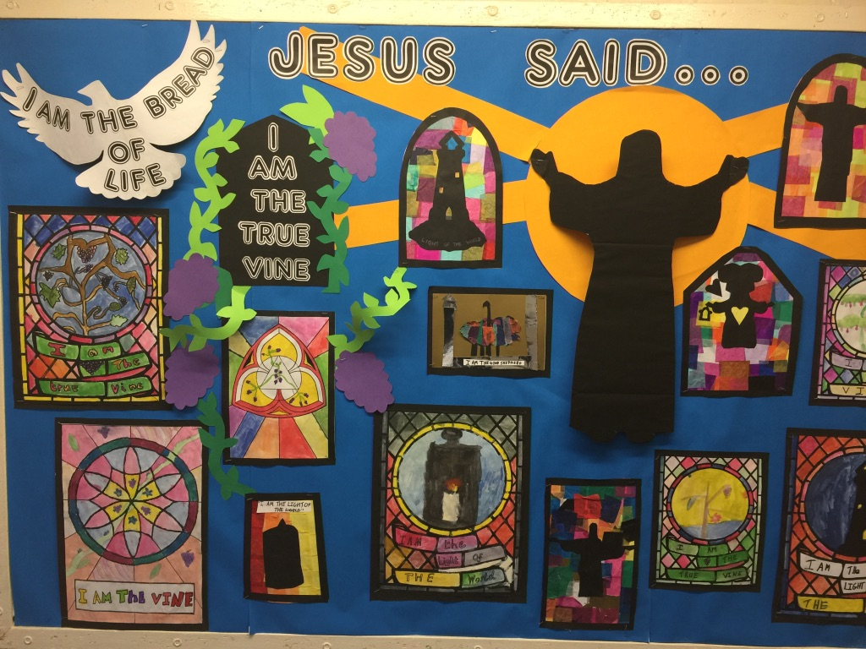
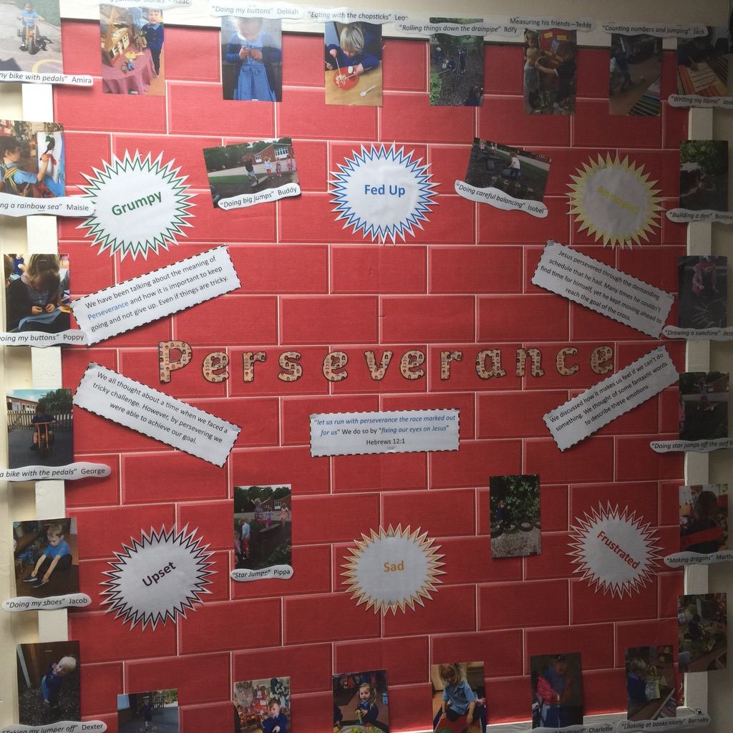
Class Pages
Each class has a webpage which provides parents and carers with an overview of the children’s learning on a week-to-week basis. Please click on your child’s Year Group to view the class page: F1, F2, Y1, Y2, Y3, Y4, Y5, Y6
Your child’s class webpage includes:
Links to important curriculum resources and online platforms
Recommended reading list
Statutory phonic / spelling lists
A timetable of lessons and objectives each week
Homework expectations

Slide 15
How to support your child
Ensure that homework is completed .
Read regularly. It does not need to be a school book. Any book your child enjoys is fantastic.
Comparing and measuring the weight, length and capacity of objects. The children do this using standard units of measurements-grams and kilograms, centimetres and metres and millilitres and litres.
Estimation of measures.
Telling the time-o’ clock, half past, quarter past, quarter to and to 5 minutes.
Coin recognition, playing shop, giving change etc.
Playing board games as this will help with number recognition and ordering.
Keep up to date with what we are doing in school by looking at the timetable on our class page. Their will also be powerpoints to look at when they have been used in class for revision purposes.
Please make an appointment to chat to us if you have any concerns or think there is information we need to know. We have an open door and any information you can give us enables us to fully care for support your child.

Slide 16
Contact us
View our Home-School Communication Procedures here.
Initially, please contact the school office who will hopefully be able to respond to your enquiry straight away. The school office can help with all general enquiries: admin, events, attendance, school dinners, clubs, payments, wrap-around care, etc. Alternatively, the school office may direct your enquiry to another member of staff, for example:
Class teachers: For enquiries relating specifically to children (learning, progress, behaviour, wellbeing, equipment, timetables etc.)
SENCo: For enquiries relating to Special Educational Needs (SEN) and Inclusion.
Designated Safeguarding Lead (DSL): For enquiries relating to pupil welfare and safeguarding.
Deputy / Head Teacher: For enquiries that have not been previously resolved by speaking with other staff members.
Staff Availability
For enquires that require a parent or carer to speak with a member of staff, the school office will arrange this for you. Staff will always try to speak with parents and carers as soon as their work schedule allows, but this may be difficult to organise quickly due to teaching and other commitments. The office staff will keep you informed of timescales regarding meetings and appointments. Staff are also available at the school gate at the start and end of each day.

