Slide 1
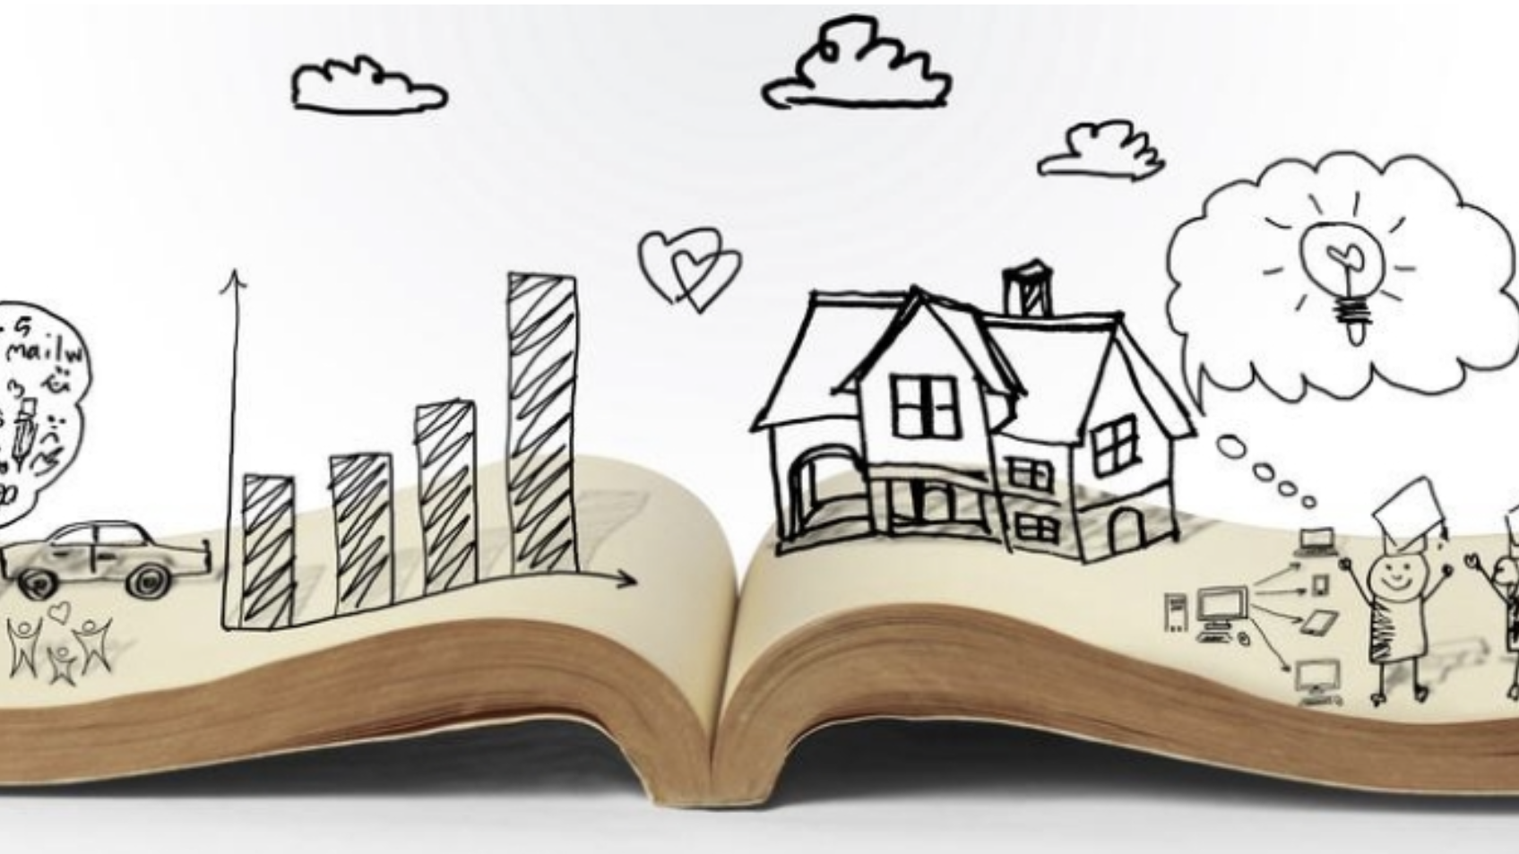
What is a Setting?
Today we will:
Learn what is a setting is
How to describe a setting

Slide 2
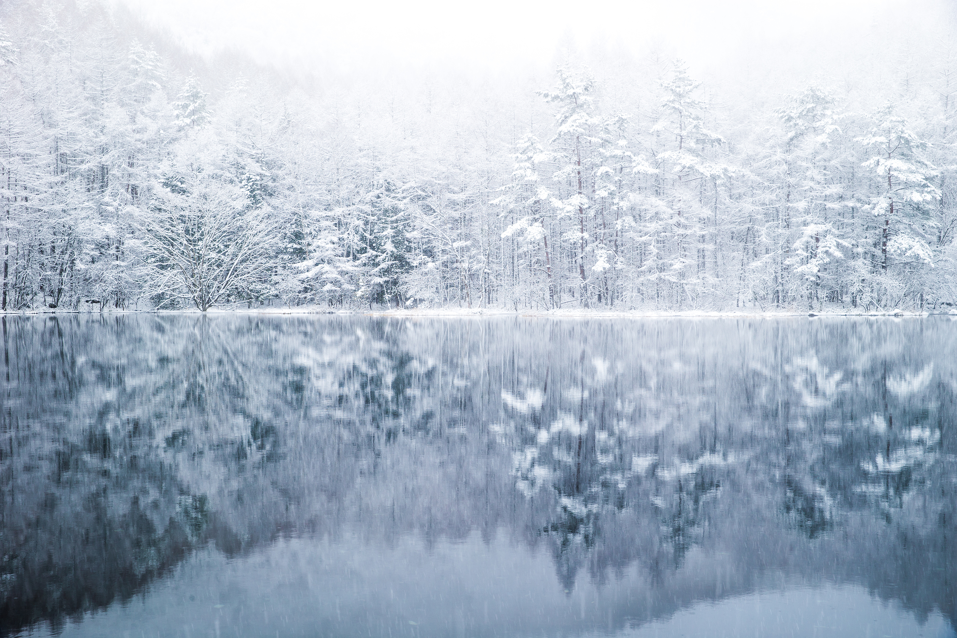
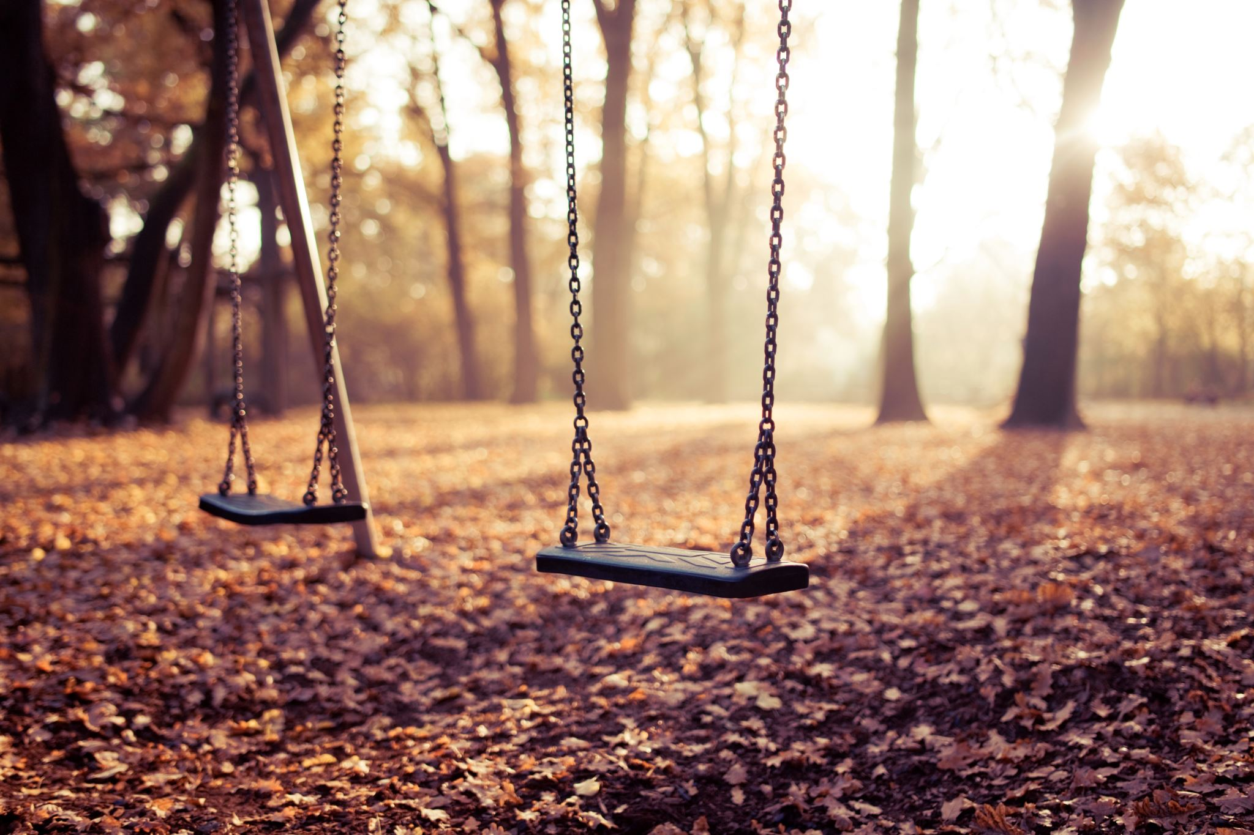
A setting is where and when a story is set. For example, in a forest, in a castle, at school or in space.
The setting of a story is where and when it takes place and usually tells the reader how it looks and feels, so they can imagine it in their minds
Settings need to be described in detail so that the reader can picture the place clearly in their mind.
Think about:
What is the setting like? Is it day-time or night-time?
Where is the setting?
Can you picture the setting clearly?

Slide 4
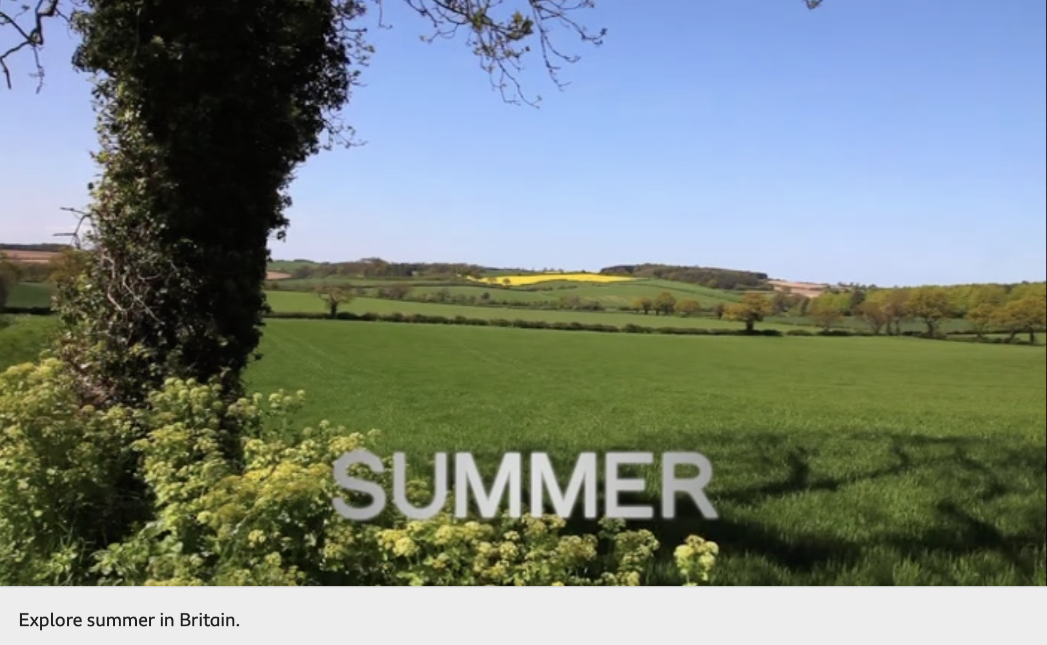
What can you:
Hear
Smell
Taste
touch
https://www.bbc.co.uk/bitesize/topics/zx339j6/articles/zdfytrd

Slide 5
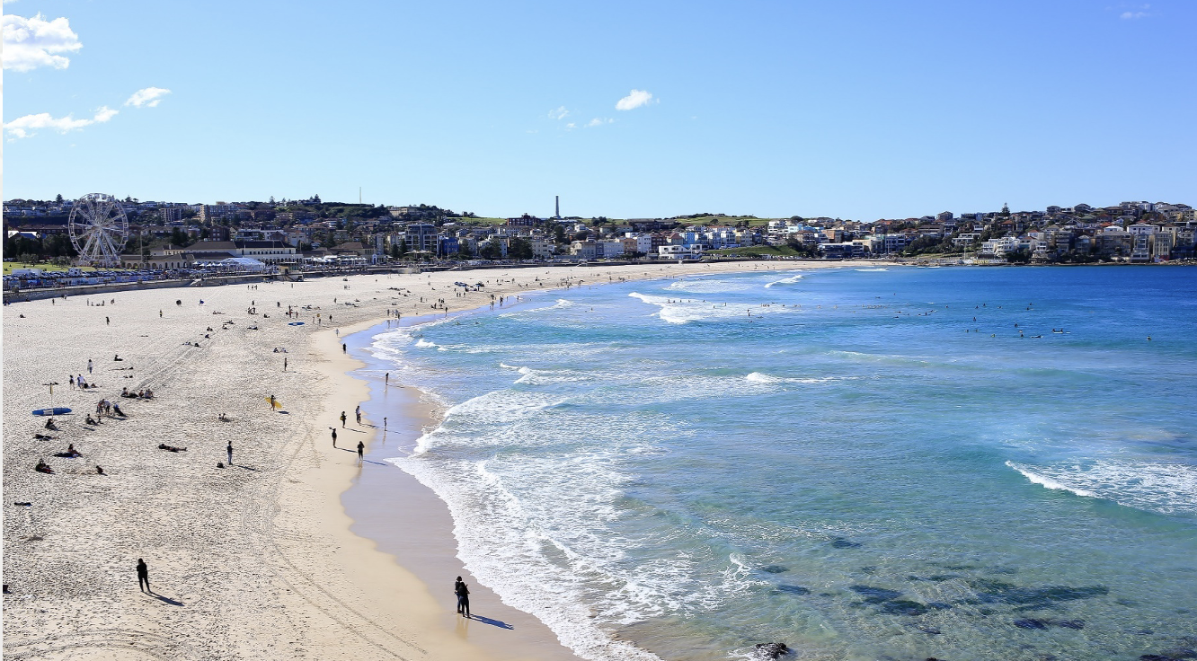
Beach

Slide 6
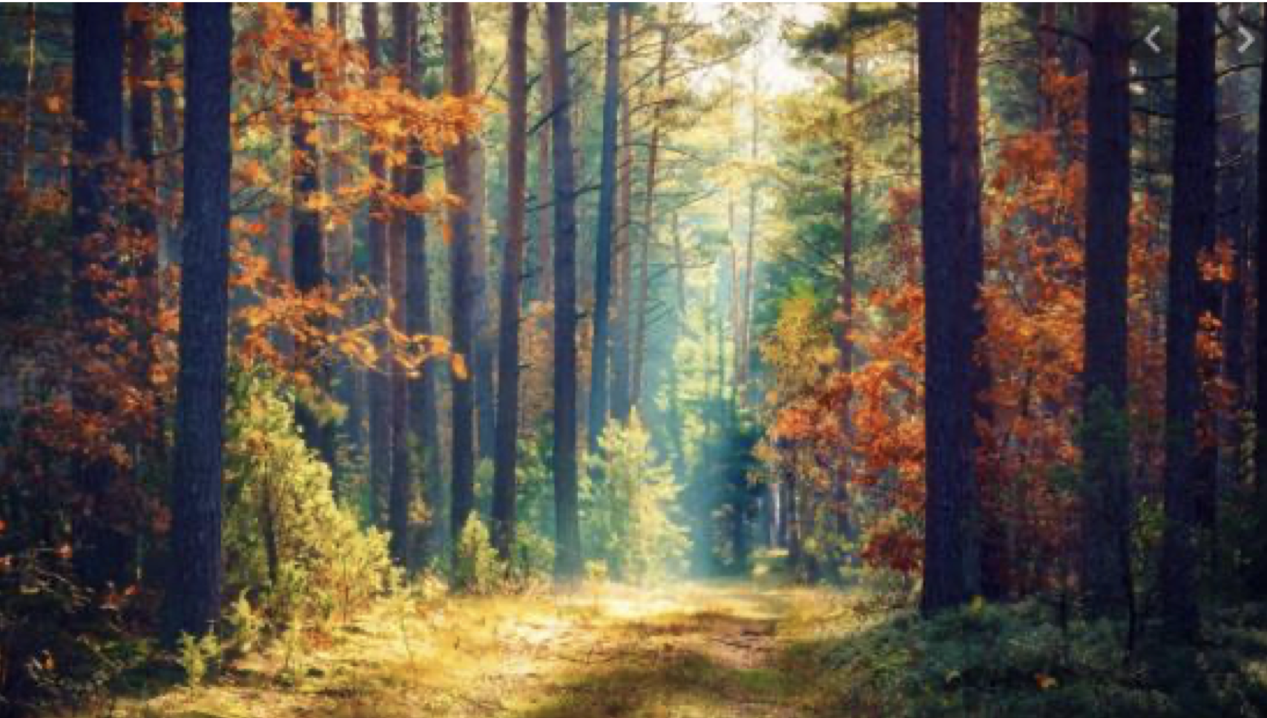
Forest

Slide 7
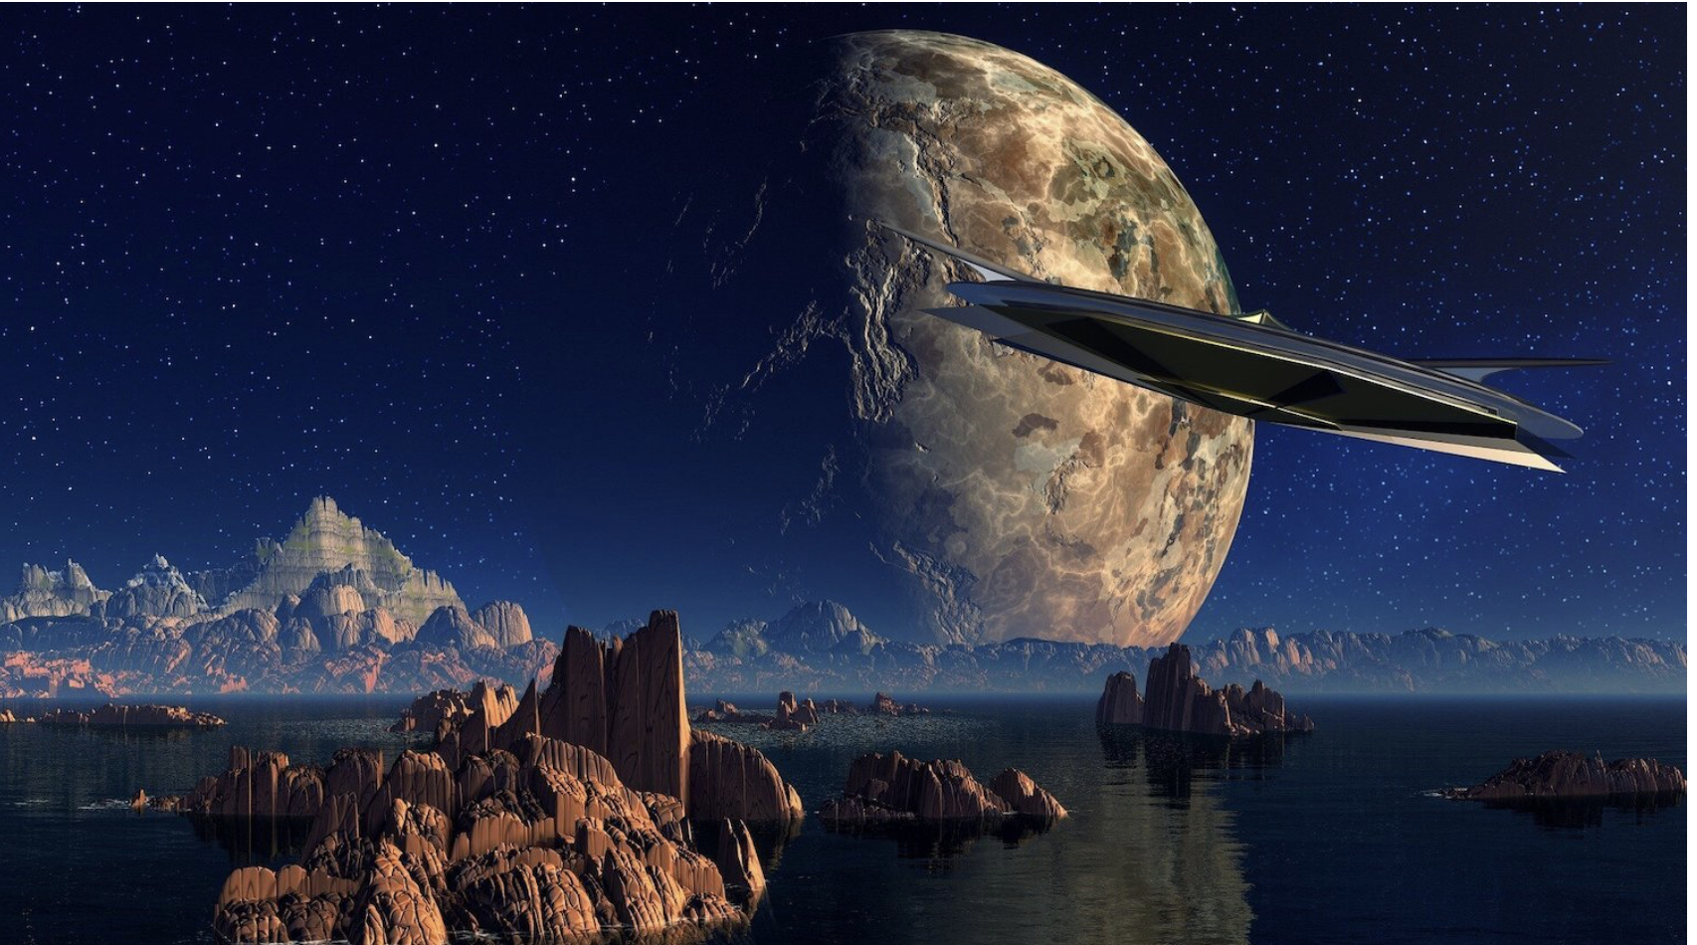
Space

Slide 8
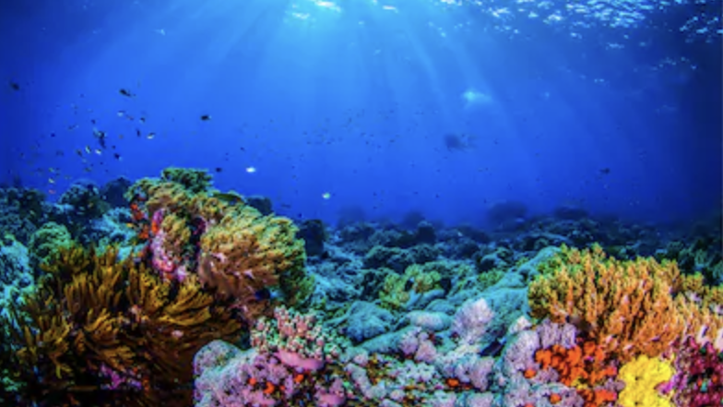
Under the sea

Slide 9
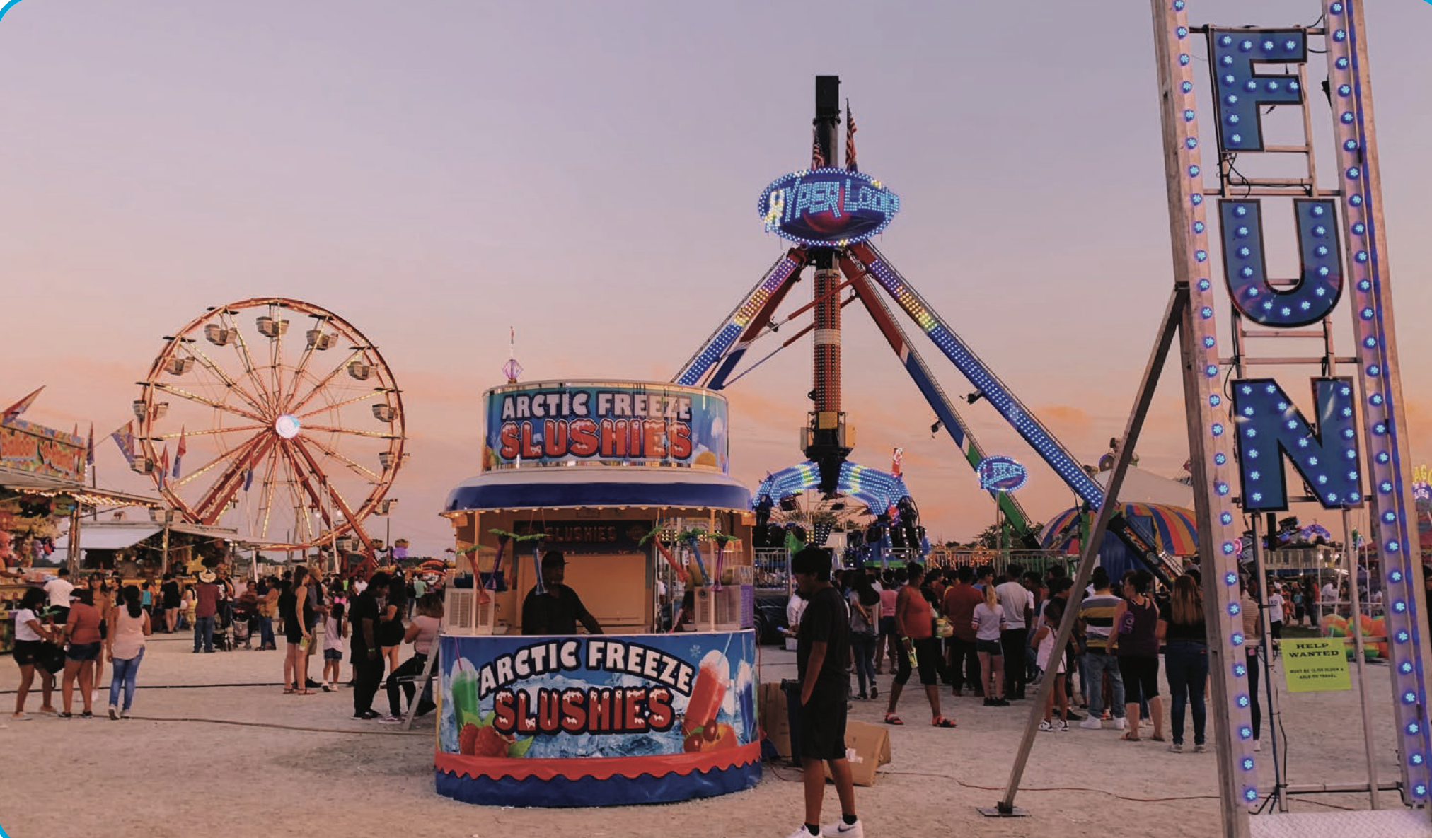
Fairground

Slide 10
