Slide 1

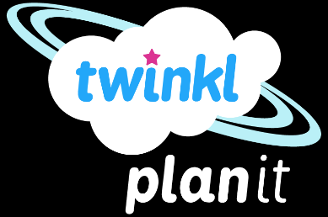
Science
Animals Including Humans
Year One
Science | Year 2 | Animals Including Humans | Animal Babies | Lesson 1

Slide 2
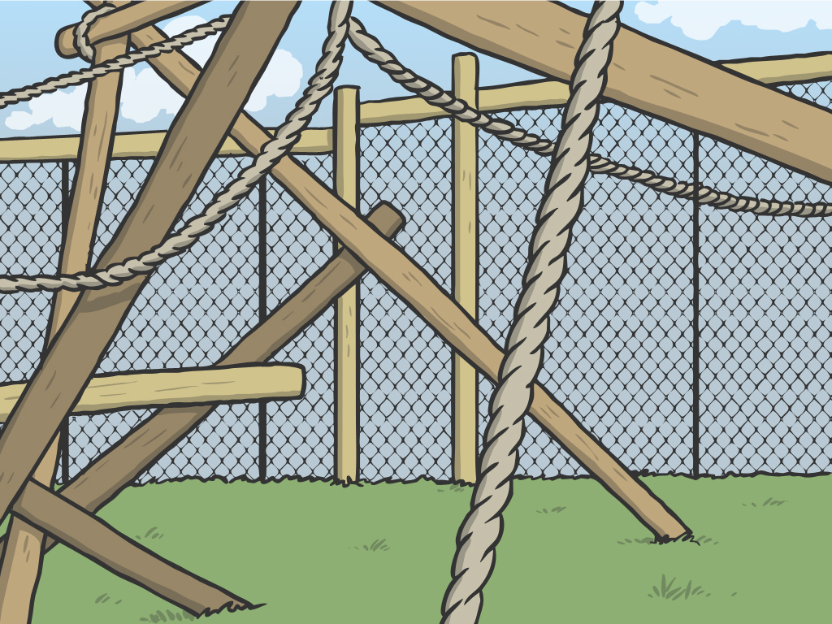
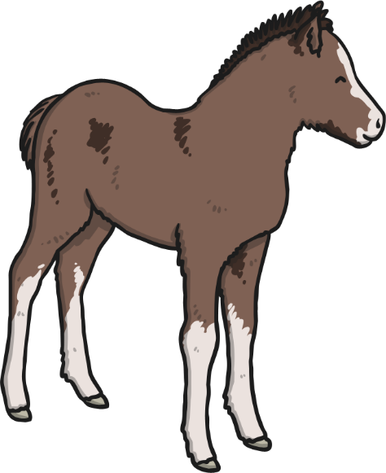
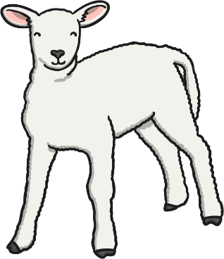
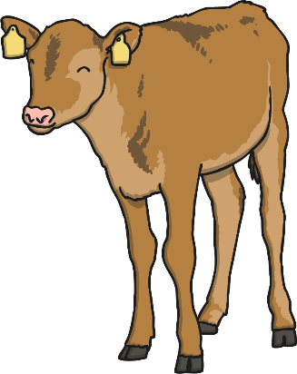
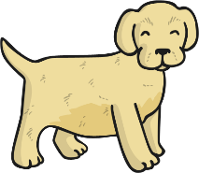
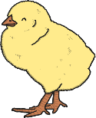
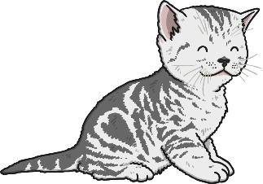
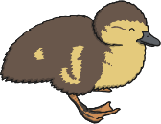

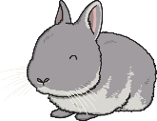
Animal Babies

Slide 3
Aim
I can describe how animals change as they grow.
I can match animals and their babies.
Success Criteria
I can draw an animal as a baby and an adult.
I can say how the animal will change as it grows.
I can name some animal babies.
I can say which animal some babies will grow into.

Slide 4
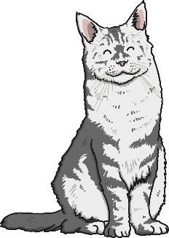
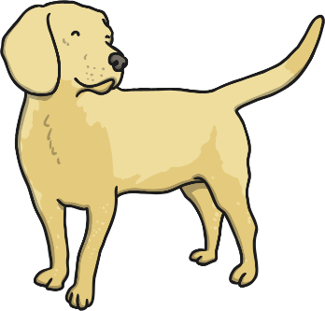
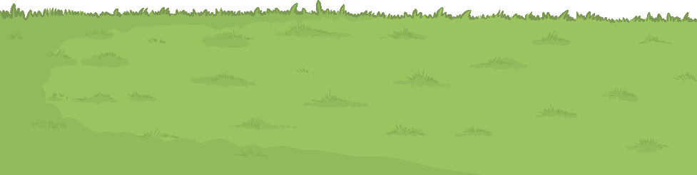



Animal Babies
All living things can reproduce. This is when a living thing, makes a new living thing (of the same kind).
Plants reproduce by bearing seeds that grow into new plants. Humans and other animals reproduce by having babies.
Some animal babies look just like their grownups but smaller. Some animal babies look very different!
We are going to learn about some different kinds of animal babies, and how they change as they grow.

Slide 5

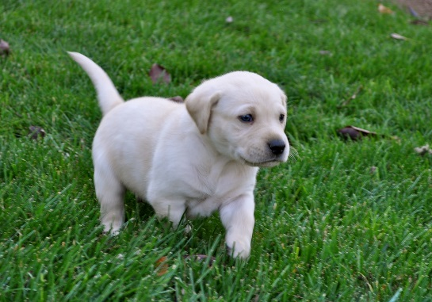
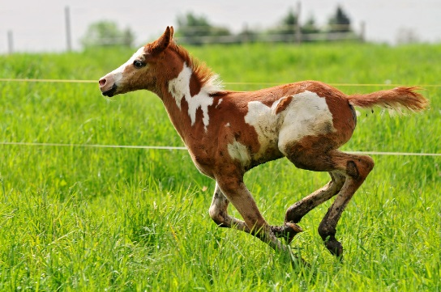
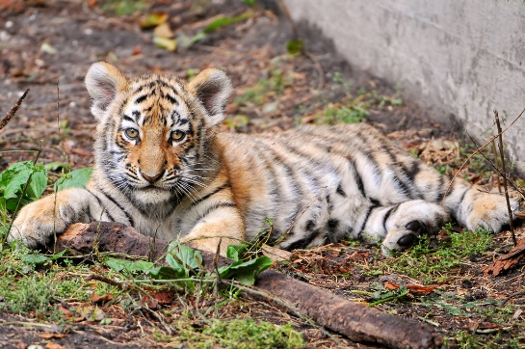
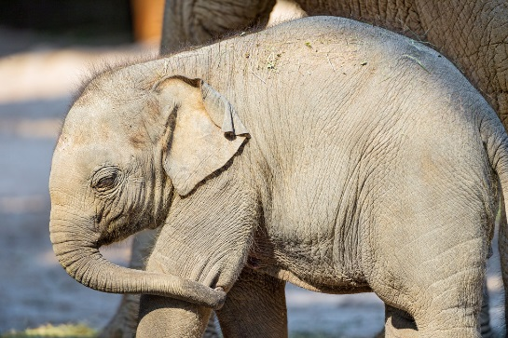
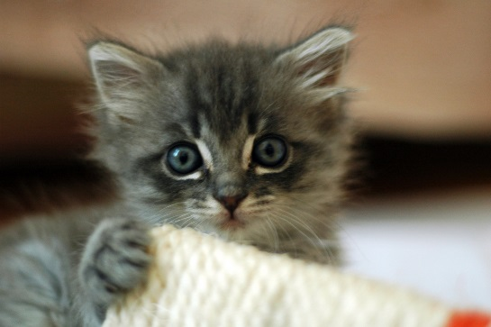
Animal Babies
These animal babies are mammals.
Do you know what these baby mammals are called?
Photo courtesy of Lisa L Wiedmeier, nicsuzor, Tambako the Jaguar @flickr.com) - granted under creative commons licence – attribution

Slide 6

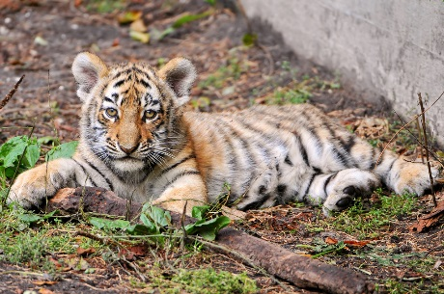
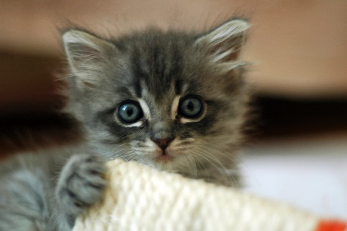

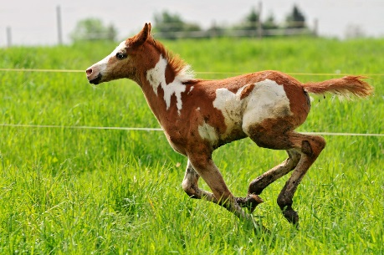
Animal Babies
Baby mammals have lots of different names.
A puppy is
a baby dog.
A baby tiger is called a cub.
A kitten is
a baby cat.
A baby elephant is called a calf.
A foal is a baby horse.
Photo courtesy of Lisa L Wiedmeier, nicsuzor, Tambako the Jaguar @flickr.com) - granted under creative commons licence – attribution

Slide 7
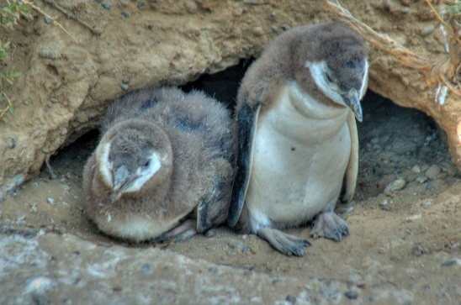
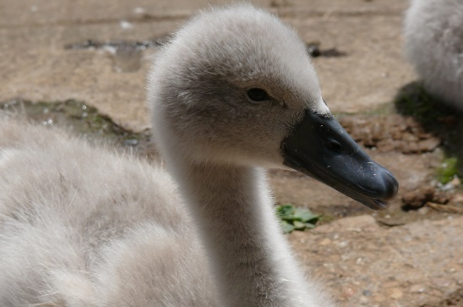
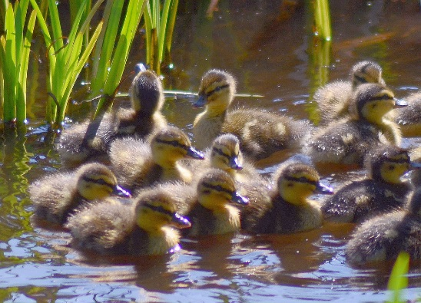
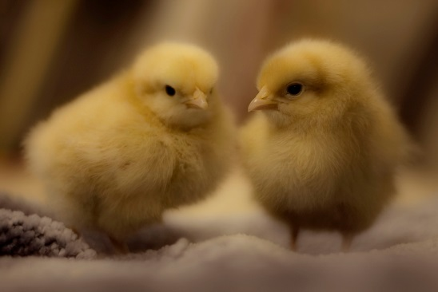
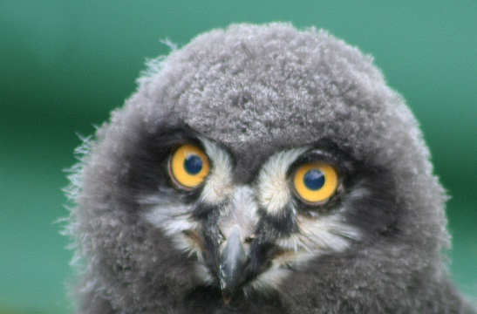
Animal Babies
These animal are baby birds. Do you know what these baby birds are called?
Which kinds of birds will these babies grow up to be?
Photo courtesy of *Jer*, generalising, Kevin Cortopassi, MICOLO J, Stevie-B, Tim Green ala atoach (@flickr.com) - granted under creative commons licence – attribution

Slide 8




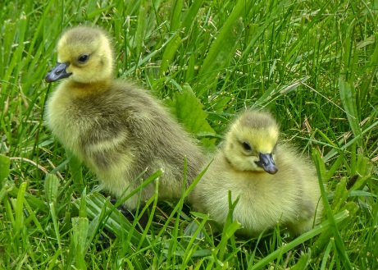
Animal Babies
Many birds are called chicks.
Baby ducks are called ducklings.
These chicks
will grow up
to be chickens.
A baby owl
is an owlet.
These are penguin chicks.
A baby goose is a gosling.
Photo courtesy of *Jer*, generalising, Kevin Cortopassi, MICOLO J, Tim Green aka atoach, Stevie-B (@flickr.com) - granted under creative commons licence – attribution

Slide 9
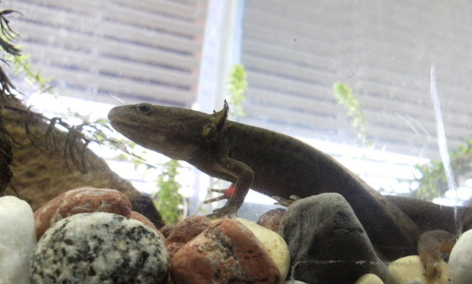
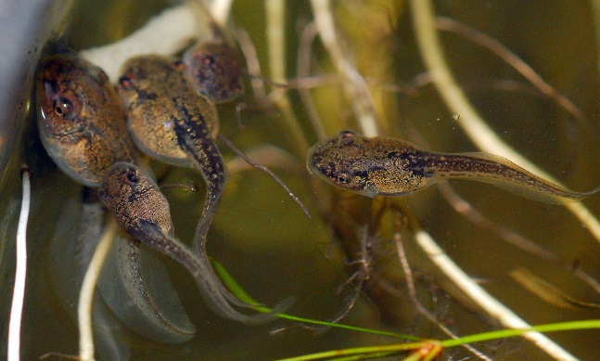
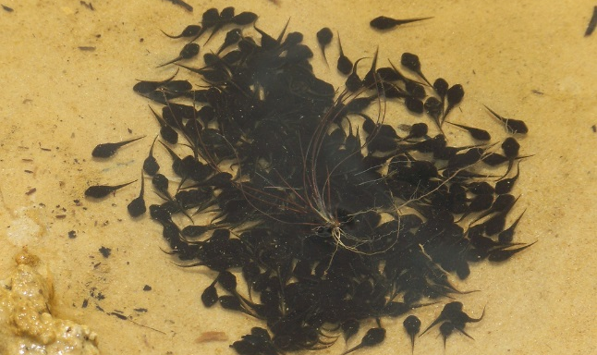
Animal Babies
These are baby amphibians. Do you know what they are called?
What do you think they will grow up to be?
Photo courtesy of trishhartmann, anyeye4wonder, born1945 (@flickr.com) - granted under creative commons licence – attribution

Slide 10
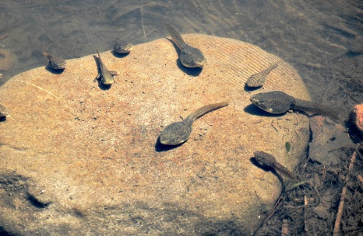
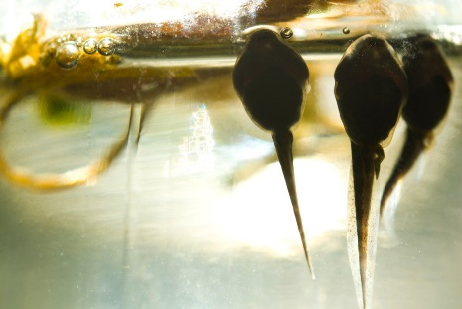
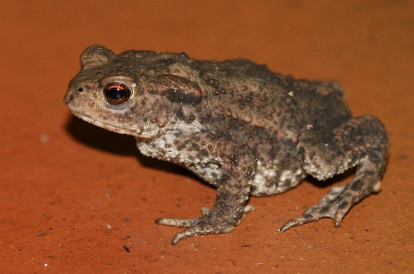
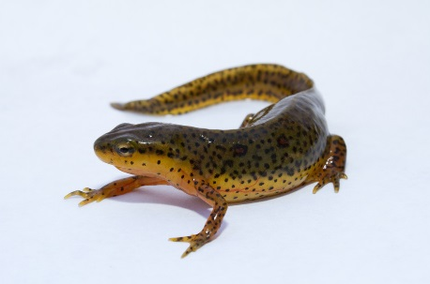
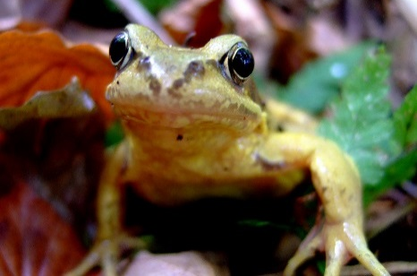
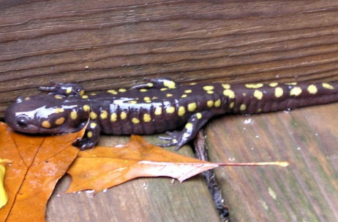
Animal Babies
Baby amphibians are called tadpoles. Most frogs, toads, newts and salamanders start their lives as tadpoles.
Tadpoles
Tadpoles
Toad
Newt
Frog
Salamander
Photo courtesy of normanack, brian.gratwicke, S. Rae, marfis75, oliver.dodd, marc falardeau (@flickr.com) - granted under creative commons licence – attribution

Slide 11
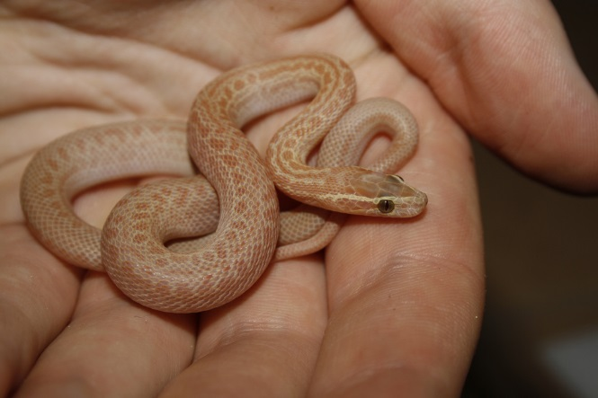
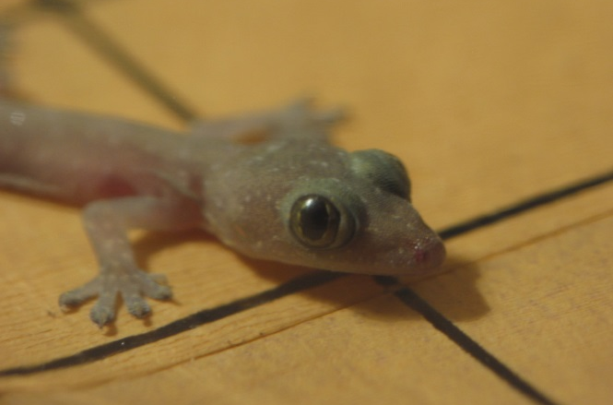
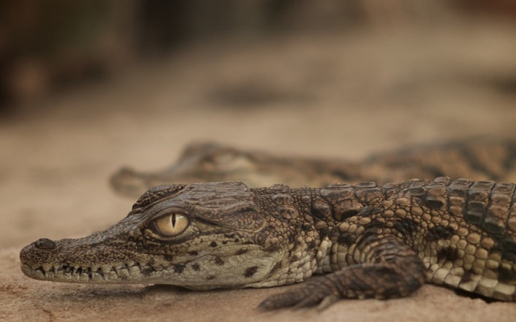
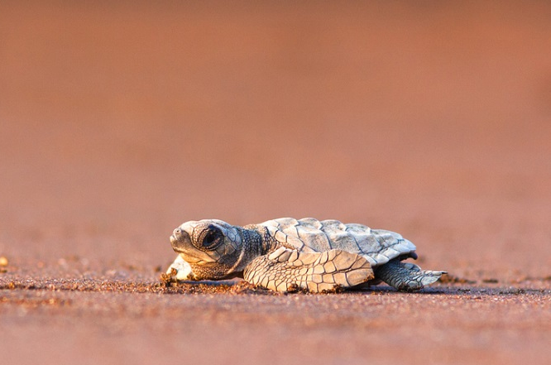
Animal Babies
These are baby reptiles. Do you know what they are called?
Photo courtesy of chadmiller, erikpaterson, _thinrhino, devstopfix (@flickr.com) - granted under creative commons licence – attribution

Slide 12


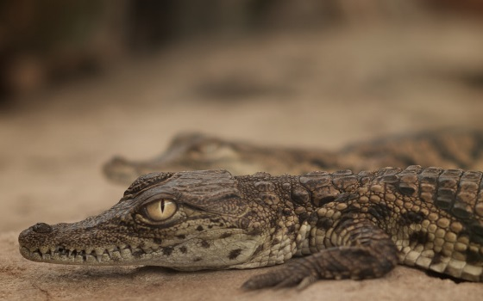

Animal Babies
Baby reptiles are called hatchlings.
This is a baby snake.
This is a
baby lizard.
This is a baby crocodile.
This is a
baby turtle.
Photo courtesy of chadmiller, erikpaterson, _thinrhino, devstopfix (@flickr.com) - granted under creative commons licence – attribution

Slide 13

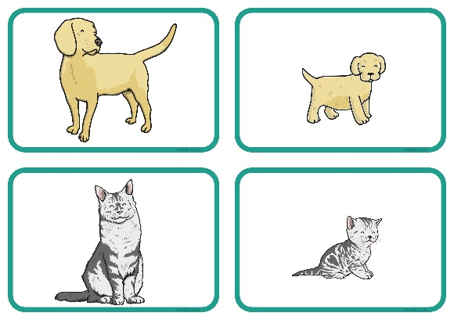
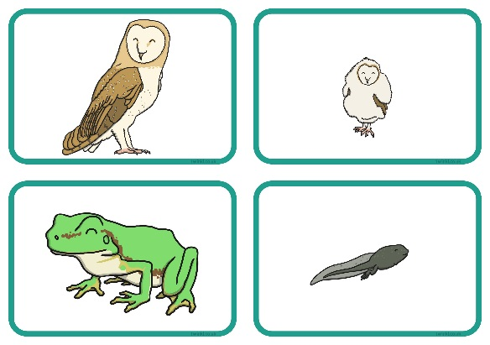
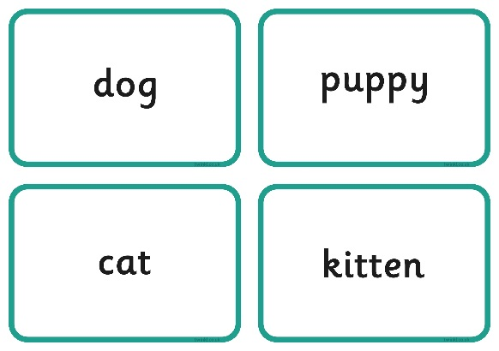
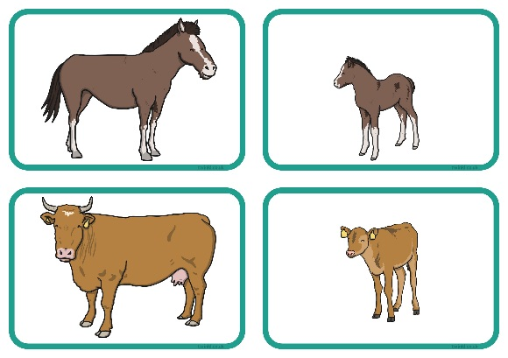
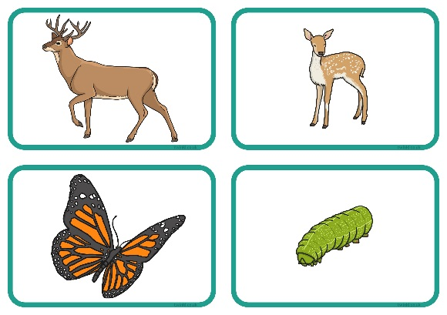
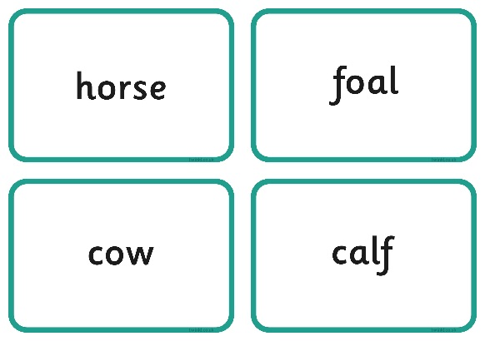
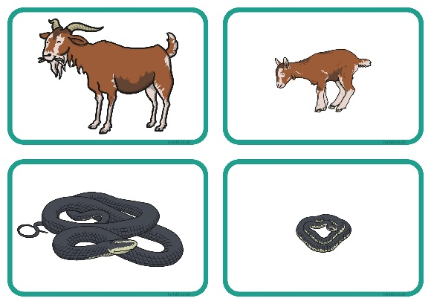
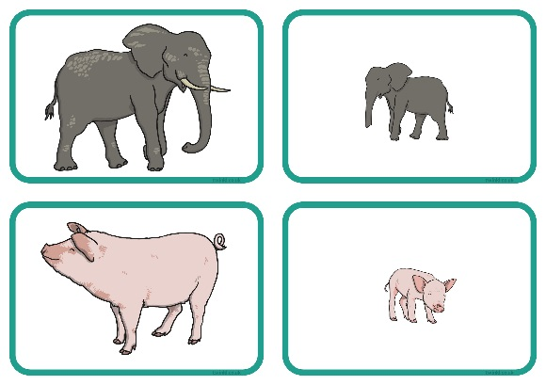
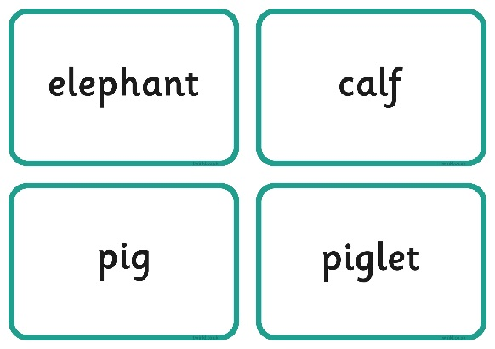











Animals and Their Young
Matching Activity
Work in a group to match the animal babies to their parents, then match the animals and their babies with their names.

Slide 14







How Animals Grow
Mammals
These animals are mammals. They grow inside their mother’s womb.
When they are born, they look quite like their parents, only much smaller!
Their mothers feed them with milk and take care of them as they grow.
Their bodies grow bigger and stronger, until they are able to take care of themselves.
This is a baby human inside its
mother’s womb.
Photo courtesy of Tambako the Jaguar, amandabhslater (@flickr.com) - granted under creative commons licence – attribution

Slide 15



How Animals Grow
Mammals
Pregnancy
Baby
Adult

Slide 16







How Animals Grow
Birds
Mother birds lay eggs. They sit on them to keep them warm, until the eggs are ready to hatch.
Baby birds are tiny, blind and weak when they hatch. Their parents keep them safe and bring them food.
The chicks grow bigger and stronger, and grow thick feathers. Soon they are able to fly away and have babies of their own.
This is a baby
chicken inside
its egg.
Photo courtesy of Jo Reeve, hedera.baltica, Kelly Colgan Azar, Tambako the Jaguar, DrPhotoMoto, wplynn (@flickr.com) - granted under creative commons licence – attribution

Slide 17




How Animals Grow
Birds
Eggs
Chick
Adult

Slide 18





How Animals Grow
Amphibians
Most amphibians lay eggs in the water. These eggs are called spawn.
When they hatch, the tiny tadpoles live in the water.
They eventually grow legs!
Finally their tails fall off, and they are able to climb out
of the water.
This is a tadpole
inside its egg.
Photo courtesy of dichohecho, berniedup, DaveHuth, a.froese (@flickr.com) - granted under creative commons licence – attribution

Slide 19



How Animals Grow
Amphibians
Spawn
Tadpole
Adult

Slide 20







How Animals Grow
Reptiles
Most reptiles are born from eggs, though some are not.
Reptile hatchlings look like their parents.
Usually reptile mothers do not look after their babies. The babies take care of themselves as they grow.
This is a baby lizard
inside its egg.
Photo courtesy of Teething-Beastie, holisticmonkey, cliff1066, Javier Ábalos Álvarez, qnr, mbarrison (@flickr.com) - granted under creative commons licence – attribution

Slide 21




How Animals Grow
Reptiles
Eggs
Hatchling
Adult

Slide 22





How Animals Grow

Slide 23





Life Cycles
A life cycle shows us the stages that a living thing goes through during its life.
All living things have a life cycle.
This is the life cycle of a chicken.
Adult
Chick
Egg

Slide 24



Life Cycles
How should we rearrange these pictures to show the life cycle of a frog?

Slide 25




Life Cycles
How should we rearrange these pictures to show the life cycle of a butterfly?

Slide 26




Life Cycles
With your partner, choose an animal.
Draw the life cycle of that animal on your whiteboard.
Label the stages if you can.

Slide 27

Aim
I can describe how animals change as they grow.
I can match animals and their babies.
Success Criteria
I can draw an animal as a baby and an adult.
I can say how the animal will change as it grows.
I can name some animal babies.
I can say which animal some babies will grow into.

Slide 28
Aim

