Slide 1

Recognising and responding to bullying
A parent/carers guide
Kayte Walsh

Slide 2

Bit about me
I was the anti bullying co-ordinator across Merseyside for 11 years
CEOP Ambassador
Youth Worker
Mediation
Mum
Wife
Friend
I’m a big believer in self esteem and resilience

Slide 3
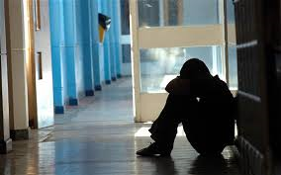
What is bullying?
Bullying can be VERBAL, PHYSICAL, CYBER/ONLINE or INDIRECT
Over the years bullying has changed dramatically
It is repeated over a period of time
It is very personal to the person being bullied!
It effects different people in different ways
It can effect a parent/carer more than the child
It is very damaging to self esteem – you start to believe what you are being called or told
If left unchallenged it can easily become the norm.

Slide 4
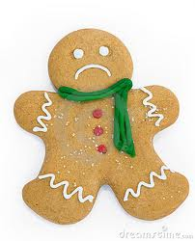
How can being bullied effect you?
Headache
Emotional/mental health
Stiff neck/tension
Face goes red
Lump in throat
Heart racing/pounding
Self harm
Stomach churning/ feeling sick
Excessive sweating
Knees knocking
Bed wetting

Slide 5
Friendship Fall outs and feuds……
They are an essential part of growing up
We need them to develop many different skills and techniques
If we prevent our children from resolving their own issues they are left with low resilience and can’t deal with life’s challenges
Offer advice….. Be realistic…… Remain calm….. Allow them to fail
Negotiation skills
Different opinions
Who are true friends are
Conflict resolution
How to overcome challenges
How to share
Disappointment

Slide 6

A few of the issues?
Bullying is always one of the biggest fears of any parent or carer, especially when their moving on to a new challenge
You are fed so many horror stories that our protective instinct kicks in
You are led to believe that your son or daughter is subjected to hurtful behaviour that you have NO CONTROL over
By law you HAVE to send your child to school – This causes frustration and anger
You can become irrational and even the most approachable parent can become very difficult to compose and reassure
Strong personalities can clash and they can find it difficult to forget/let go/ trust.

Slide 7

How to support your child if you feel they are being bullied

Slide 8
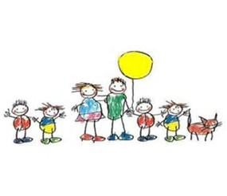
What you could do…….
Work with the school to resolve any issues
Contact your child’s class teacher and ask for a meeting to discuss the situation.
Keep a record of events
Ask for a simple strategy to support your child
A report/emotions card
Arrange to meet again
Focus on positive things when they get home from school

Slide 9

What is not advisable to do………
Tell your child to hit back
Approach other families on the school yard or in the community
Lose your temper at a member of staff
Interrogate your child
Talk about the situation on social network
We have to remember that we are dealing with children and your Head Teacher has a duty of care to ALL of the pupils in their school

Slide 10

Next steps……… formal complaint
Contact Head Teacher and request a meeting
Ask for every member of staff to be made aware of the situation.
Ask for additional support for your child
Have a home to school link
If the issue has still not been resolved, write to the Governors asking for an investigation
You have the right to take your complaint as far as the department of education

Slide 11

Can self – esteem be a solution?
Self esteem is a feeling
We need it to feel good about ourselves
It gives us confidence
It makes us want to learn and achieve
As we grow up we hear and take notice of things around us
People’s words and actions can effect our self esteem
Sometimes we take these words or actions to heart and we base our beliefs about ourselves on these words

Slide 12

What could cause low self esteem?
Safety
Environment we live in
Health
Ability
Situation
Up- bringing

Slide 13

Notes:
This is how I explain bullying can knock you down if you don’t have good self esteem

Slide 14
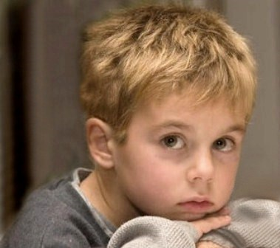
How can having low self esteem effect children?
They don’t ever feel good enough
They give up trying easily
They feel that they have to impress friends
They can become low in mood and sometimes angry
They believe bad comments but not good positive things
They want to change themselves to please others
Small problems can become MASSIVE
They don’t trust people and think everyone is against them
They don’t take responsibility for their own actions and often blame others

Slide 15

A child with good self-esteem
Have a positive image of themselves
Are confident
Can make friends easily and are not anxious with new people
Can be confident in groups or on their own
Will try and solve problems on their own, but if not able to will ask for help
Is proud of their achievements
Can admit mistakes and learn from them
Will try new things and adapt to change.
Are not overly sensitive
Has age appropriate responsibilities

Slide 16
AGE APPOPRIATE CHORES FOR KIDS!
Toddler (2-3)
Wipe cabinets
Pick up / put away
Put dirty clothes in the wash bag
Make bed - simply
Dusting
Ages 4-6
Fold towels
Feed pets
Load dishwasher
Set and clear table
Match socks
Recycle
Ages 7 -11
Prepare a lunch
Vacuum
Prep food – chop, wash, stir
Clean bathroom
Sort out laundry – hang washing on line
Make bed – put on sheets
Age 12 – 14
Mow grass
Watch younger siblings
Iron
Go on messages
Make a full meal

Slide 17

Boosting self esteem and resilience
100 happy days
Time to talk
Exercise
Family day out
Laugh, laugh and laugh
Out of school hobbies
Invite friends over
Don’t reward bad behaviour
Give age appropriate responsibilities
Try not to focus on the doom and gloom

Slide 18

I HAVE
People around me I trust and who love me, no matter what
People who set limits for me so I know when to stop before there is danger or trouble
People who show me how to do things right by the way they do things
People who want me to learn to do things on my own
People who help me when I am sick, in danger or need to learn

Slide 19

I AM
A person people can like and love
Glad to do nice things for others and show my concern
Respectful of myself and others
Willing to be responsible for what I do
Sure things will be all right
Happy with myself

Slide 20

I CAN
Talk to others about things that frighten me or bother me
Find ways to solve problems that I face
Control myself when I feel like doing something not right or dangerous
Figure out when it is a good time to talk to someone or to take action
Find someone to help me when I need it
Laugh at myself
Rule the world……….

Slide 21
Kayte Walsh kayte.walsh@me.com
@EsteemKayte

