Slide 1
Ready-to-go Lesson Slides
Year 6
Percentages
Lesson 1
To convert fractions and percentages
Spring

Slide 2
Summary
Key Vocabulary and Sentence Stems
Process Steps
Hinge Question (Assessment Point)
Lesson Introduction Slide (Learning Objective and Success Criteria)
Starter – Equivalent fractions to a hundredths
Key Concept Introduction
Guided Practice – Converting a fraction to a percentage
Independent Practice 1 – Converting a fraction to a percentage
Guided Practice – Answering worded problems
Independent Practice 2 – Answering worded problems
Guided Practice – Reasoning with true or false statements
Independent Practice 3 – Reasoning with true or false statements
Let’s Reflect
Support Slides – Based on Year 5 - Percentages as fractions and decimals

Slide 3
Key Vocabulary:
Percentage
Per cent
%
Sentence Stems:
Percentage or percent means how many parts per hundred.
Cent means hundred.

Slide 4
Process Steps:
Convert the fraction to be equivalent to a fraction with a denominator of 100.

Slide 5
Hinge Question:
Which of the answers is not equivalent to 0.40?
40%
$$\frac{\text{40}}{\text{100}}$$
4%
$$\frac{\text{4}}{ \text{10 }}$$
Notes:
Assessment point for the lesson – ask the pupils to vote for the answer they think is correct.
A – Incorrect - The pupil has not understood that 40% is equal to 0.4 (or 0.40).
B – Correct
C – Incorrect - The pupil has not understood that 40/100 is equal to 0.4 (or 0.40).
D – Incorrect - The pupil has not understood that 4/10 is equal to 0.4 (or 0.40).
If answers A, C or D are given, pupils may require extra support through small group or 1:1 discussions. There are support slides covering lessons from the previous year group at the end of these slides.

Slide 6
To convert fractions and percentages
Success Criteria I know that percent means out of 100. I can convert tenths and hundredths. I can write a fraction as a percentage.

Slide 7
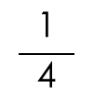
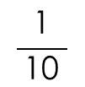
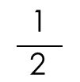
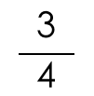
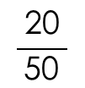
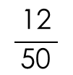
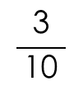
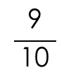
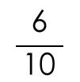
Starter:
This machine converts fractions into equivalent fractions that are expressed in hundredths. For example, $\frac{\text{3}}{ \text{10 }}$ goes in and $\frac{\text{30}}{\text{1}\text{0}\text{0}}$ comes out.
What will come from the rest of these fractions?
$$\frac{\text{3}}{ \text{10 }}$$
$$\frac{\text{20}}{ \text{50 }}$$
$$\frac{\text{1}}{ \text{2 }}$$
$$\frac{\text{1}}{ \text{ 4 }}$$
$$\frac{\text{6}}{ \text{10 }}$$
$$\frac{\text{9}}{ \text{10 }}$$
$$\frac{\text{12}}{ \text{50 }}$$
$$\frac{\text{3}}{ \text{ 4 }}$$
$$\frac{\text{1}}{ \text{10 }}$$
In
Out
$\frac{\text{30}}{\text{100}}$ $\frac{\text{4}\text{0}}{\text{100}}$ $\frac{\text{5}\text{0}}{\text{100}}$ $\frac{\text{25}}{\text{100}}$ $\frac{\text{6}\text{0}}{\text{100}}$ $\frac{\text{9}\text{0}}{\text{100}}$ $\frac{\text{24}}{\text{100}}$ $\frac{\text{75}}{\text{100}}$ $\frac{\text{1}\text{0}}{\text{100}}$
Answers
Notes:
This starter recaps equivalent fractions.
Concrete resources – A fraction wall may support pupils, a place value chart to support multiplying by 10 where appropriate
Key Questions – How will we make the fractions equivalent? What will happen to the numerator? What will happen to the denominator? Why do you think we are looking at fractions over 100?
Extension – Give pupils an amount that has come out of the machine, what could the input have been? Are there multiple answers?

Slide 8
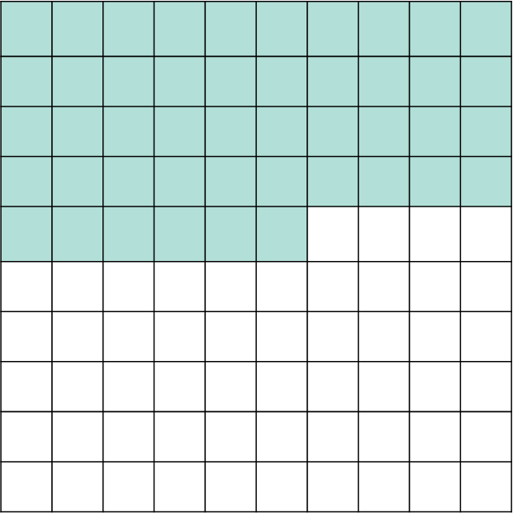
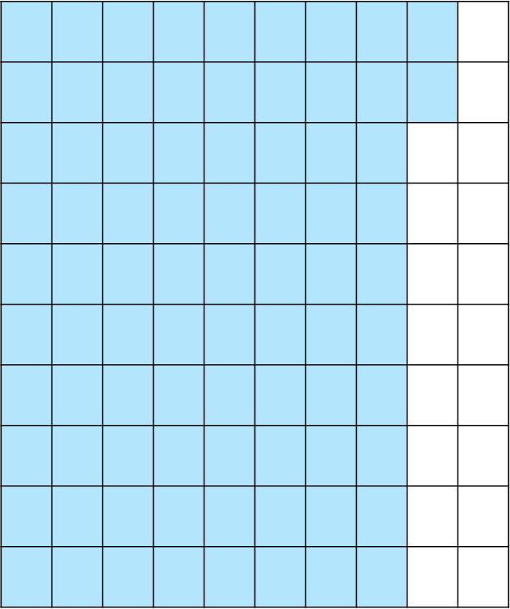
Look at these diagrams. The whole has been split into hundredths.
What fraction is shaded in each diagram?
If percent means out of 100, how would we write those fractions as percentages?
$\frac{\text{46}}{\text{100}}$ = 46% $\frac{\text{82}}{\text{100}}$= 82%
Answers
Notes:
Concrete resources – Hundred square
Key Questions – How many hundredths are shaded? What does this mean as a percentage? Why does it show that?
Misconceptions/ Common Errors – Pupils may not understand the relationship between hundredths and percentages and will scaffolding to see the pattern.
Further Practice – Change the shaded amount. Can pupils say the percentage that is not shaded?
Extension – Ask pupils to shade a given percentage, asking what fraction that is equivalent to.

Slide 9
Guided Practice:
How would we write $\frac{\text{4}}{ \text{10 }}$ as a percentage?
What do we need to do first?
How does that help us?
What percentage of this diagram is shaded?
$\frac{\text{4}}{ \text{1}\text{0 }}$ = 40% We know this because $\frac{\text{4}}{ \text{10 }}$ = $\frac{\text{4}\text{0}}{\text{10}\text{0}}$ = 40%
To convert it, we need to make the fraction equivalent to a fraction with a denominator over 100 because percent means out of 100.
60% of the diagram is shaded because $\frac{\text{6}}{ \text{10 }}$ = $\frac{\text{6}\text{0}}{\text{100}}$ = 60%
Answers
Notes:
Concrete resources – Number shapes
Key Questions – What do we need to convert 4/10 to? Why do we need to do that? What is the relationship between hundredths? What does the diagram show? How do you know?
Misconceptions/ Common Errors – Pupils may not convert to hundredths without prompting.
Further Practice – Change the shaded area, can pupils find the non-shaded and see that it totals 100%.
Extension – Change the amount of parts in the whole.

Slide 10
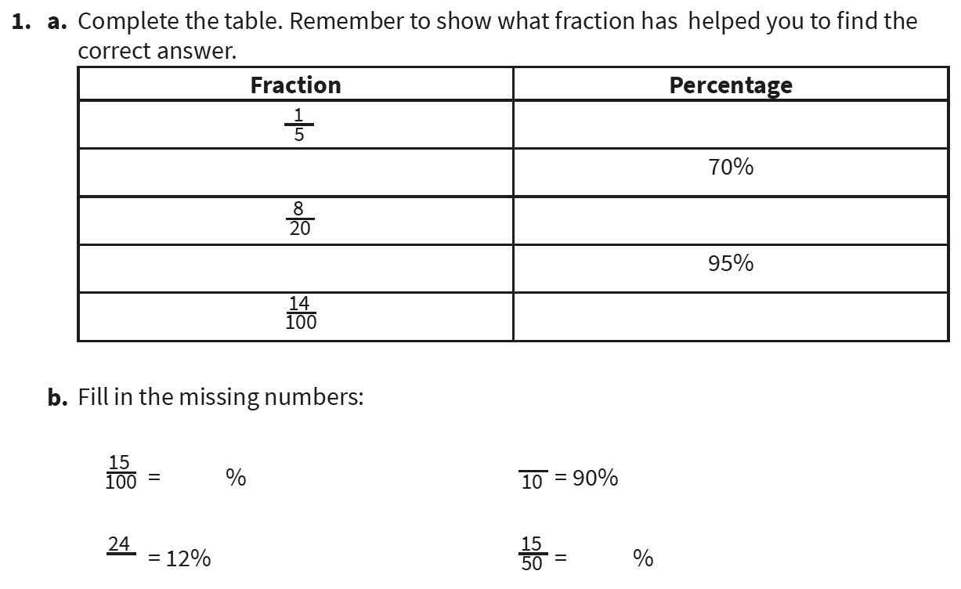
Independent Practice:
Notes:
⅕ = 20% 7/10 or 10/100 = 70% 8/20 = 40% 95/100 = 95% 14/100 = 14%
15/100 = 15% 9/10 = 90% 24/200 = 12% 15/50 = 30%

Slide 11
Guided Practice:
India, Joe and Carla have taken a maths test.
India says, “I got $\frac{\text{3}}{ \text{5 } }$ of the test correct.”
Joe says, “I got 55% of the test right.”
Carla says, “I got $\frac{\text{7}}{ \text{10 }}$ of the test right.”
Put the names of each child in order from least to most correct questions.
India = $\frac{\text{3}}{ \text{ 5 } }$= $\frac{\text{6}\text{0}}{\text{100}}$ = 60% correct
Joe = 55% correct
Carla = $\frac{\text{7}}{ \text{10 }}$ = $\frac{\text{7}\text{0}}{\text{100}}$ = 70% correct
In order: Joe, India, Carla
Answers
Notes:
Key Questions – How can we make these easier to compare? How will we decide the order?
Misconceptions/ Common Errors – Pupils may have focused on the percentages for the start of this lesson and need a reminder of the fraction learning from previous lessons.
Further Practice – Change the amounts or the context of the problem so pupils can transfer.

Slide 12
Independent Practice:
Notes:
He is incorrect. ⅗ = 60/100 = 60% and 60% is more than 40%.
5% ⅕ ¼ 40%
55% is left
Tina
Leanne
5%

Slide 13
Guided Practice:
Emma says that $\frac{\text{1}}{ \text{ 5 } }$ is the same as 5%.
What mistake has she made?
What would you tell her to do to find the correct answer?
Emma has used the denominator to find the percentage equivalent.
She should have made $\frac{\text{1}}{ \text{ 5 }}$ equivalent to a fraction with a denominator of 100. $\frac{\text{1}}{ \text{ 5 }}$ = $\frac{\text{2}\text{0}}{\text{100}}$
We know that percent means out of 100 so $\frac{\text{1}}{ \text{ 5 }}$ = 20%
Answers
Notes:
Concrete resources – Fraction wall
Key Questions – What is ⅕ as a percentage? Why does she say 5% is the same as ⅕? How do we know that it isn’t?
Misconceptions/ Common Errors – Pupils may focus on the numbers themselves rather than thinking about what they can do to them to find the answer and will need scaffolding to go through the stages.
Further Practice – Compare different fractions and percentages.
Extension – Why is it more efficient to make them both percentages than making them both fractions?

Slide 14
Independent Practice:
Notes:
False: half of a hundred square would be 50/100 which = 50%
True
True
False. Percent means out of 100 so 9/10 = 90/100 = 90%
True

Slide 15
Let’s Reflect:
Aliyah and Haania are looking at a diagram.
Aliyah says that 18% of the grid has been shaded.
Haania says that 36% of the grid has been shaded.
Who is correct?
Explain your answer.
Haania is correct. $\frac{\text{18}}{ \text{5}\text{0} }$ of the diagram is shaded. $\frac{\text{18}}{ \text{50 }}$ = $\frac{\text{36}}{\text{10}\text{0}}$ = 26%
Answers
Notes:
Concrete resources – blank versions of the diagram
Key Questions – What is shaded as a fraction? How can we convert this to find the percentage? What would it be as hundredths? How does that help us write it as a percentage?
Misconceptions/ Common Errors – Pupils may not count to find the denominator and only count the shaded, presuming it to be a hundred grid.

Slide 16
The following slides are based on Year 5 Decimals and Percentages – Percentages as fractions and decimals

Slide 17
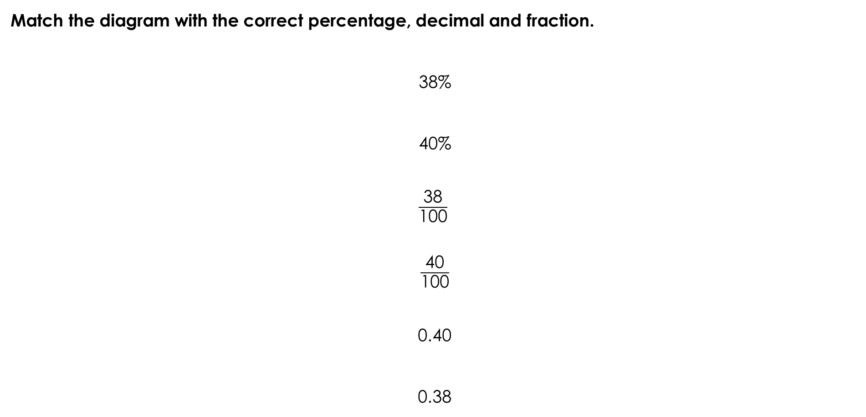
Match the diagram with the correct percentage, decimal and fraction.
38%
40%
$\frac{\text{38}}{\text{100}}$
$\frac{\text{40}}{\text{100}}$
0.40
0.38
Answers
Notes:
How and when to use these slides – Use these slides as a pre-teach or as an intervention to fill gaps identified in main teaching. Pupils may need to recap the relationship between simple fractions, decimals and percentages before moving on.
Concrete resources – Blank hundred squares
Key Questions – What is shaded? How could this be written as a fraction? What is the decimal equivalent? What is the percentage equivalent?
Misconceptions/ Common Errors – Pupils may need support in seeing the equivalences, particularly when looking at tenths as well as hundredths.
Further Practice – Use different amounts and different representations.

Slide 18
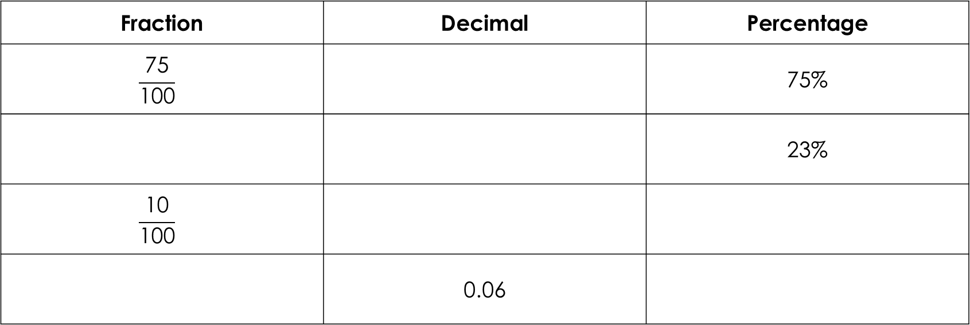
Fill in the missing numbers:
Fraction | Decimal | Percentage
$$\frac{\text{75}}{\text{100}}$$ |  | 75%
 |  | 23%
$$\frac{\text{10}}{\text{100}}$$
 | 0.06
 | 0.75
$$\frac{\text{23}}{\text{10}\text{0}}$$ | 0.23
 | 0.10 | 10%
$$\frac{\text{6}}{\text{10}\text{0}}$$ |  | 6%
Answers
Notes:
How and when to use these slides – Use these slides as a pre-teach or as an intervention to fill gaps identified in main teaching. Pupils may need to recap the relationship between simple fractions, decimals and percentages before moving on.
Concrete resources – Blank hundred squares
Key Questions – How could we represent this pictorially? How would this help us? How could this be written as a fraction? What is the decimal equivalent? What is the percentage equivalent?
Misconceptions/ Common Errors – Pupils may need support in seeing the equivalences, particularly when looking at tenths as well as hundredths.
Further Practice – Use different amounts and different representations.

