Slide 1
Ready-to-go Lesson Slides
Year 3
Number: Fractions
Lesson 2
Sum1

Slide 3
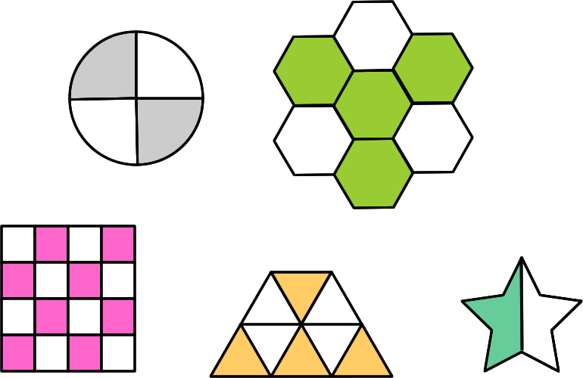
Starter:
Success Criteria: I can count up and down in fractions I know that ‘equivalent’ means ‘the same as’
Which one is different?

Slide 4
Starter:
Success Criteria: I can count up and down in fractions I know that ‘equivalent’ means ‘the same as’
Which one is different?
Each of the images show a fraction that is the same as ½ shaded apart from this one, which has 4 sevenths shaded.

Slide 5
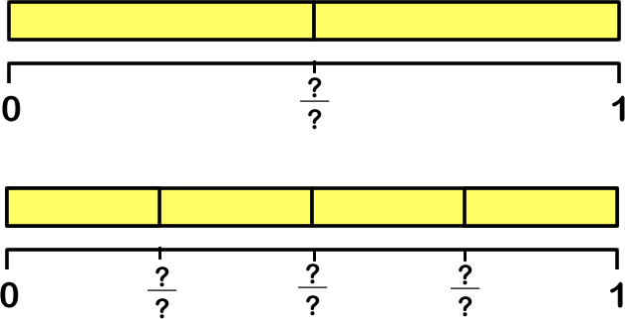
Talking time:
Complete the missing fractions on each number line.
Can you see any fractions that have the same value?
.

Slide 6
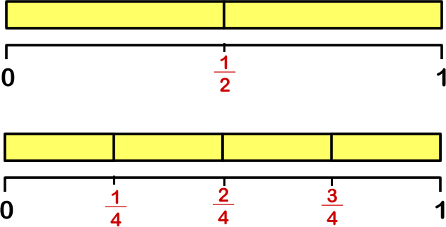
Talking time:
Complete the missing fractions on each number line.
Can you see any fractions that have the same value?
One half is the same as two quarters.

Slide 7
Activity 1:
Prove that your answer to the last question is correct by using
maths equipment to make a model.

Slide 8
Activity 1:
Prove that your answer to the last question is correct by using
maths equipment to make a model.
For example:
or…

Slide 9
Talking time:
What do you think the missing equivalent fractions are?

Slide 10
Talking time:
What do you think the missing equivalent fractions are?

Slide 11
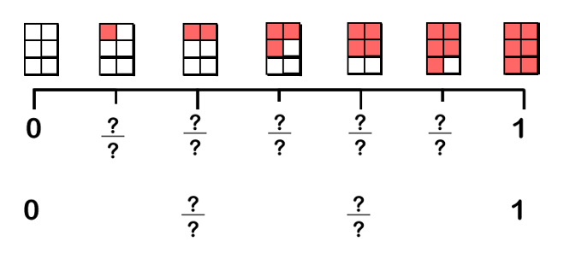
Activity 2:
Complete the number line to find the equivalent fractions.

Slide 12
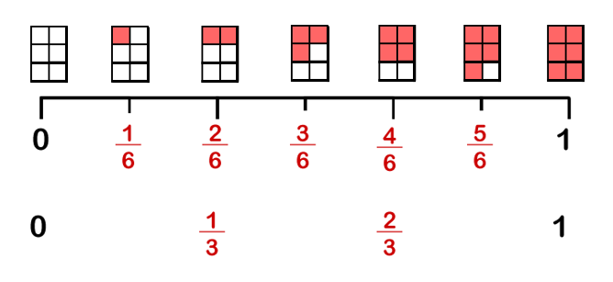
Activity 2:
Complete the number line to find the equivalent fractions.

Slide 13
Activity 3:
Find equivalent fractions by showing the number of twelfths that
are worth the same as these fractions.

Slide 14
Activity 3:
Find equivalent fractions by showing the number of twelfths that
are worth the same as these fractions.
What other equivalent fractions can you find?

Slide 15
Talking time:
Tom draws these number lines.
He says that one quarter is the same as three eighths.
Is Tom correct? Explain your answer.

Slide 16
Talking time:
Tom draws these number lines.
He says that one quarter is the same as three eighths.
Is Tom correct? Explain your answer.
No – Tom is not correct. He has not split the second number line into equal parts, so it does not show eighths. The fractions are not equivalent.

Slide 17
Activity 4:
Three children have written fractions on pieces of paper.
Ahmed says, “My fraction is equivalent to one half.”
Bryony says, “The denominator of my fraction is double the
denominator of Ahmed’s fraction and half the denominator of
Chloe’s fraction.”
Bryony and Chloe’s fractions are both equivalent to one quarter.
What could their fractions be?

Slide 18
Activity 4:
Three children have written fractions on pieces of paper.
Ahmed says, “My fraction is equivalent to one half.”
Bryony says, “The denominator of my fraction is double the
denominator of Ahmed’s fraction and half the denominator of
Chloe’s fraction.”
Bryony and Chloe’s fractions are both equivalent to one quarter.
What could their fractions be?
For example:
Ahmed = Bryony = Chloe =

Slide 19
Evaluation:
Success Criteria: I can count up and down in fractions I know that ‘equivalent’ means ‘the same as’
True or False?
One quarter = two twelfths:
b) Two thirds is equivalent to eight twelfths:
c) One half is equivalent to four eighths.
If a number line is divided into thirds and another is divided into sixths, one interval on the first number line is worth two on the second.
Rhian has a chocolate bar split into halves and eats one. Tom has the same sized bar, split into quarters and eats two. Tom has eaten more.
Notes:
You could have children use paper strips, Cuisenaire rods or bar models to prove / disprove the statements above.

Slide 20
Evaluation:
Success Criteria: I can count up and down in fractions I know that ‘equivalent’ means ‘the same as’
True or False?
One quarter = two twelfths:
FALSE
b) Two thirds is equivalent to eight twelfths:
TRUE
c) One half is equivalent to four eighths. TRUE
If a number line is divided into thirds and another is divided into sixths, one interval on the first number line is worth two on the second. TRUE
Rhian has a chocolate bar split into halves and eats one. Tom has the same sized bar, split into quarters and eats two. Tom has eaten more.
FALSE

