Slide 1
Ready-to-go Lesson Slides
Year 3
Number: Fractions
Lesson 1
Sum1

Slide 3
Starter:
Success Criteria: I know that 'equivalent' means 'the same as' I can show this using strips of paper and other equipment
Which one is different?
A square of paper folded here: then here:
A square of paper folded here: then here:
A square of paper folded here: then here:
A square of paper folded here: then here: then here:

Slide 4
Starter:
Success Criteria: I know that 'equivalent' means 'the same as' I can show this using strips of paper and other equipment
Which one is different?
A square of paper folded here: then here:
A square of paper folded here: then here:
A square of paper folded here: then here:
A square of paper folded here: then here: then here:
The third square will have been folded into thirds.
All the others will have been folded into quarters!

Slide 5
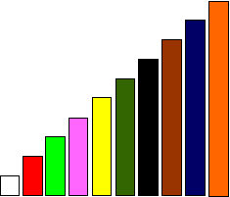
Talking time:
Look carefully at these Cuisenaire rods.
If the pink rod is worth 1, which colour rod is worth ?

Slide 6
Talking time:
Look carefully at these Cuisenaire rods.
If the pink rod is worth 1, which colour rod is worth ?
The white rod is worth .
.

Slide 7
Talking time:
If the pink rod is worth 1, which rods are worth ?
.

Slide 8
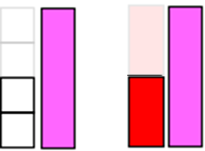
Talking time:
If the pink rod is worth 1, which rods are worth ?
Two white rods and also one red rod
are both worth .
.

Slide 9
Activity 1:
The brown rod is worth 1 whole.
How many different ways can you make ?

Slide 10
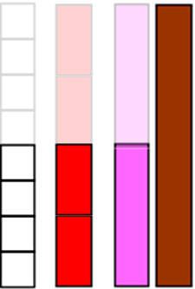
Activity 1:
The brown rod is worth 1 whole.
How many different ways can you make ?
Four white rods,
two red rods
and also one pink rod
are all ways to make .
.

Slide 11
Activity 2:
Cut two strips of paper, exactly the same size.
Fold the first strip into quarters.
Fold the second strip into eighths.
Put the quarters strip on top of the eighths strip and fold back one quarter.
How many eighths are the same as one quarter?

Slide 12
Activity 2:
Cut two strips of paper, exactly the same size.
Fold the first strip into quarters.
Fold the second strip into eighths.
Put the quarters strip on top of the eighths strip and fold back one quarter.
How many eighths are the same as one quarter?
Two eighths are the same as one quarter.
What other equivalent fractions can you find?

Slide 13
Activity 3:
Kyle draws a strip on squared paper and divides it into eight equal parts.
He then draws another strip, the same length, but divides it into four equal parts.
How many different ways can he complete this statement?

Slide 14
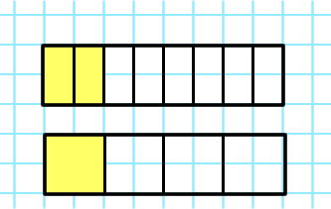
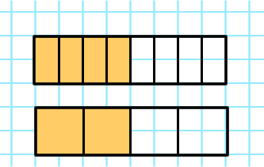
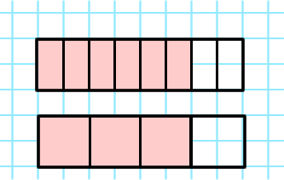
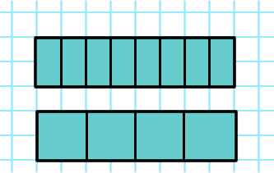
Activity 3:
Kyle draws a strip on squared paper and divides it into eight equal parts.
He then draws another strip, the same length, but divides it into four equal parts.
How many different ways can he complete this statement?

Slide 15
Activity 4:
Use squared paper to complete the same activity as Activity 3.
This time, divide one strip into thirds and the other into sixths.
How many ways can you find to complete this statement?

Slide 16
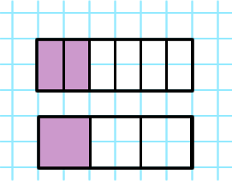
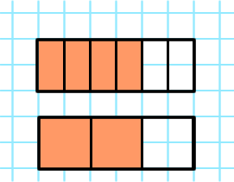
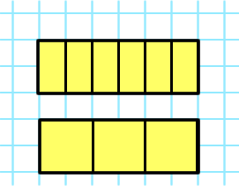
Activity 4:
Use squared paper to complete the same activity as Activity 3.
This time, divide one strip into thirds and the other into sixths.
How many ways can you find to complete this statement?

Slide 17
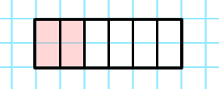
Talking time:
Ellie says she has shaded two sixths.
Leah says that Ellie has shaded one third.
Explain how they both can be correct.

Slide 18
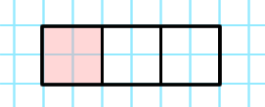
Talking time:
Ellie says she has shaded two sixths.
Leah says that Ellie has shaded one third.
Explain how they both can be correct.
If the strip is split into sixths, then two sixths has been shaded. However, if the strip is split into thirds, then one third has been shaded. One third is equivalent to two sixths:
=

Slide 19
Activity 5:
Ahmed says,
Use strips of paper or other maths equipment to show that Ahmed is correct.
I can find a fraction with a denominator of 9 that is equivalent to one third.

Slide 20
Activity 5:
Ahmed says,
Use strips of paper or other maths equipment to show that Ahmed is correct.
I can find a fraction with a denominator of 9 that is equivalent to one third.

Slide 21
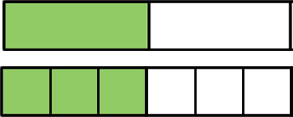
Evaluation:
Success Criteria: I know that 'equivalent' means 'the same as' I can show this using strips of paper and other equipment
True or False?
These two fractions are written the same:
b) These two fractions are worth the same:
c) One half is equivalent to one quarter.
If we colour in two squares of this strip:
we will have coloured in one quarter.

Slide 22
Evaluation:
Success Criteria: I know that 'equivalent' means 'the same as' I can show this using strips of paper and other equipment
True or False?
These two fractions are written the same:
FALSE
b) These two fractions are worth the same:
TRUE
c) One half is equivalent to one quarter. FALSE
If we colour in two squares of this strip:
we will have coloured in one quarter. TRUE

