Slide 2
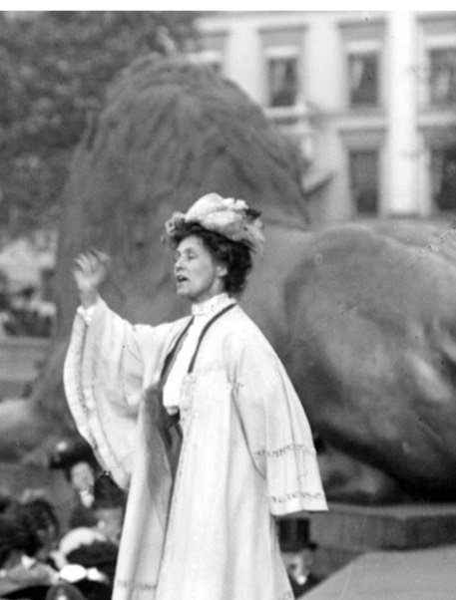
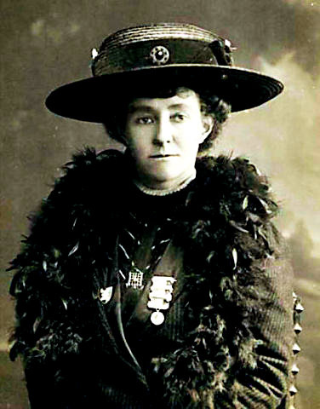
Learning Objectives
To know about the Suffragettes Emmeline Pankhurst and Emily Davison.
To know who Emmeline Pankhurst was.
To know why she was important to Britain.
Photo courtesy of BBC Radio 4 (@flickr.com) - granted under creative commons licence - attribution

Slide 3
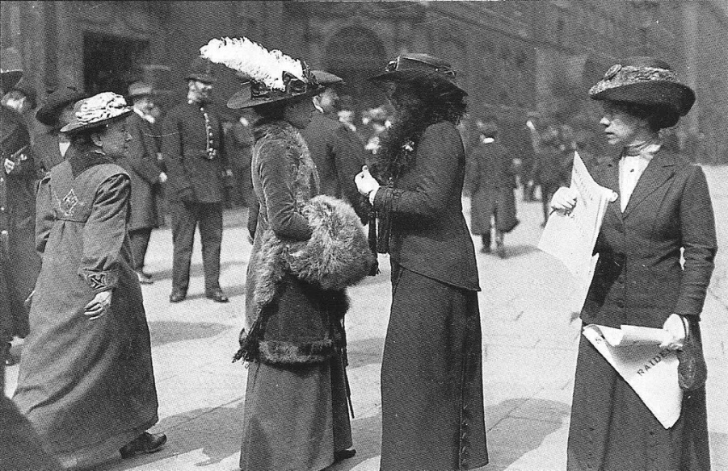
Who was Emmeline Pankhurst?
Emmeline Pankhurst was a British woman who campaigned for women's rights.
She is most famous for founding the Suffragette organization
which fought for women to have the right to vote.
Photo courtesy of Leonard Bentley (@flickr.com) - granted under creative commons licence - attribution

Slide 4
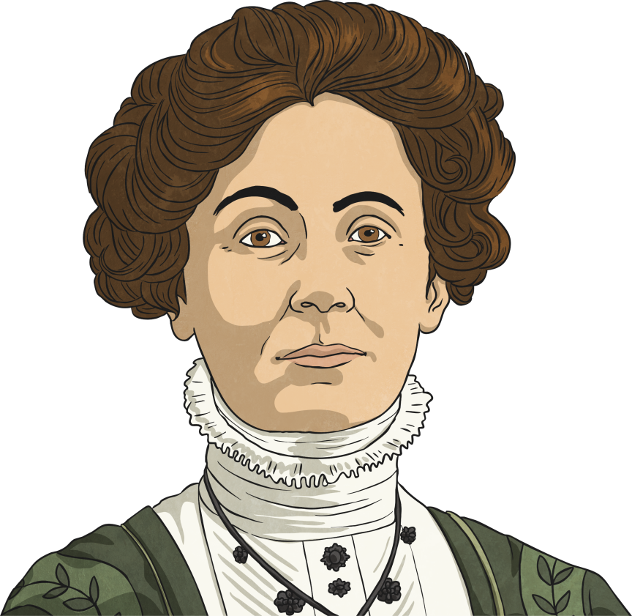
Emmeline Pankhurst’s Life
Emmeline Goulden was born on 15 July 1858 in Manchester.
Her parents were involved in politics and she was first told about the suffrage movement when she was just 8 years old.
In 1879, when she was 21, she married Richard Pankhurst. He was 24 years older than Emmeline and he was also involved in politics.

Slide 5
Emmeline Pankhurst’s Life
Children: On 22 October 1880 her eldest daughter, Christabel was born. In the years that followed Richard and Emmeline had 4 more children, 2 girls and 2 boys. Sadly the elder boy became ill and died.
In 1898 Richard died and it was left to Emmeline to look after the family. However, she still remained heavily involved in politics and women’s rights.

Slide 6
Emmeline Pankhurst’s Life
In 1905 Emmeline Pankhurst founded the Women’s Social and Political Union (WSPU) they later became known as the Suffragettes.
The WSPU was more forceful than the other women’s rights groups before it. Their motto was ‘Deeds, not words.’
The WSPU made speeches, organised rallies and protests but soon they became violent. They threw rocks, smashed windows and set fire to postboxes.
As a result of the violence Emmeline was arrested many times and was sent to prison. Like many other suffragettes in prison she protested by going on ‘hunger strike’ and was force fed through tubes, which was painful.

Slide 7
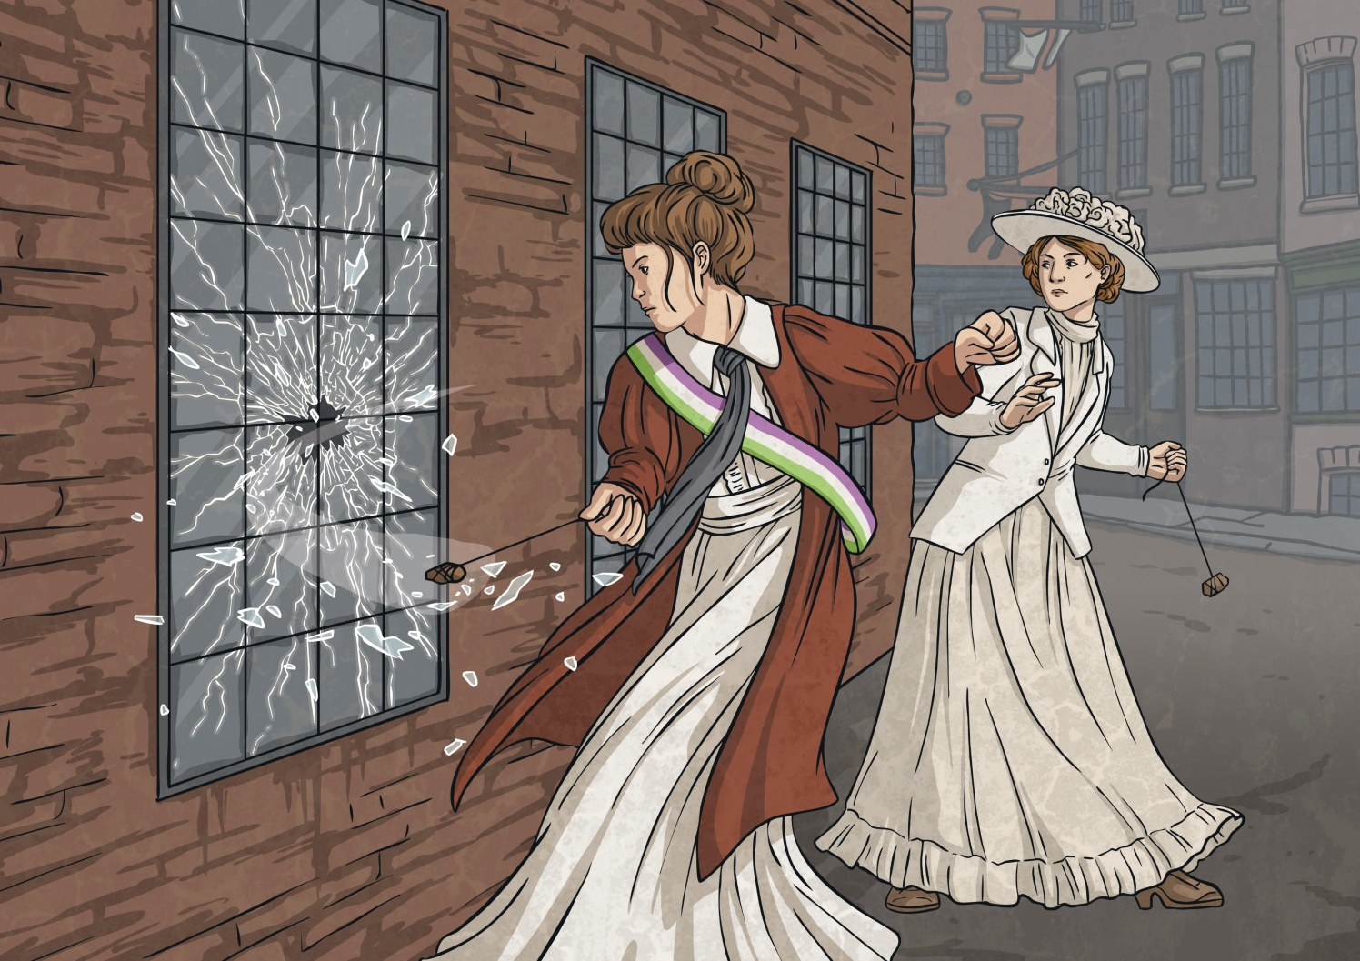
Emmeline Pankhurst’s Life

Slide 8
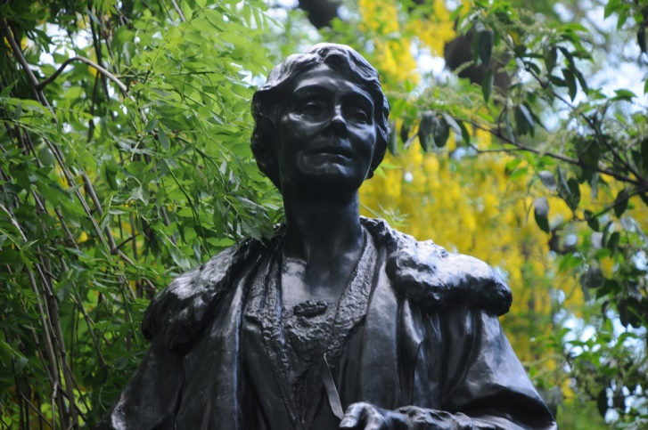
Emmeline Pankhurst’s Life
In 1914 World War I began. The Suffragettes had to stop their campaign to help with the war effort. Emmeline helped women go to work to do the jobs normally done by the men, while they were away fighting in the army.
In 1918, when the war was over, the Prime Minister David Lloyd George passed a law which allowed married women over the age of 30 to vote.
In 1928 the Equal Franchise Act was passed and became law on 2 July that all women could vote from 21 years old, giving them equal rights with men.
Just a few days later, on 14 July 1928 Emmeline Pankhurst died, aged 69 at a nursing home in Hampstead.
Photo courtesy of incurable_hippie (@flickr.com) - granted under creative commons licence - attribution

Slide 9
Who were The Suffragettes?
The word Suffrage means having the right to vote.
The Suffragettes campaigned for women to be allowed to vote by organising rallies and protests and giving speeches.
Before the first war women were not treated the same as men, they were not thought of being equal to men.
Women were not allowed to:
vote (it was thought that they weren’t intelligent enough to understand what went on in the world of politics.)
own property like houses.
do ‘important’ jobs, e.g. doctors or lawyers.
it was not seen as important for girls and young women to go to school and university.
The Suffragettes went to extreme measures to continue their campaign; they smashed windows, burned down churches and chained themselves to buildings.

Slide 10
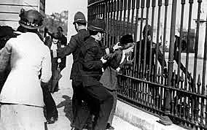
Who were The Suffragettes?
Photo courtesy of Leonard Bentley (@flickr.com) - granted under creative commons licence - attribution

Slide 11
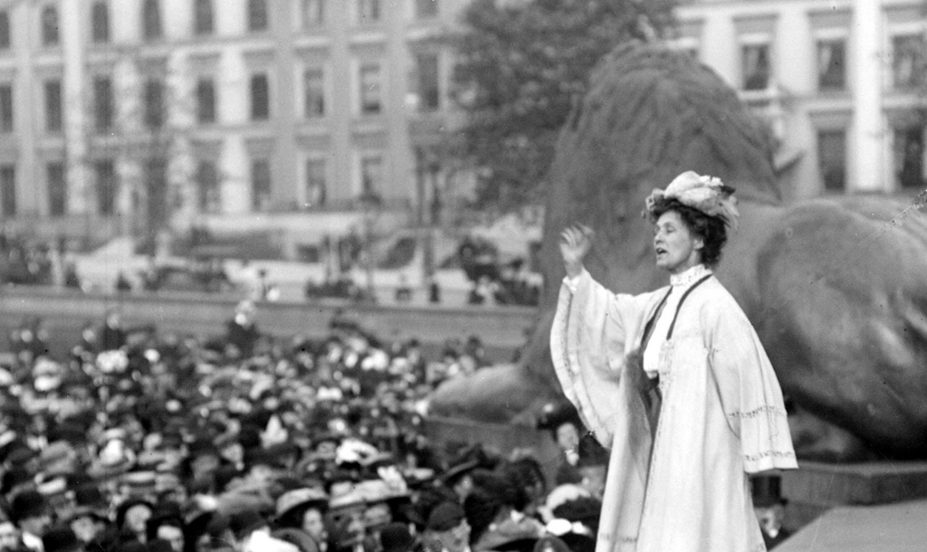
Task 2
Task 1
Design a poster that could be used by the Suffragettes on one of their
protest marches. Use the design sheet to help.
Photo courtesy of BBC Radio 4 (@flickr.com) - granted under creative commons licence - attribution

