Slide 1
Ready-to-go Lesson Slides
Year 6
Decimals
Lesson 8
To convert fractions to decimals
Spring

Slide 2
Summary
Key Vocabulary and Sentence Stems
Process Steps
Hinge Question (Assessment Point)
Lesson Introduction Slide (Learning Objective and Success Criteria)
Starter – Match fractions to equivalent decimals
Key Concept Introduction
Guided Practice – Using derived facts and equivalent fractions
Independent Practice 1 – Using derived facts and equivalent fractions
Guided Practice – Comparing fractions and decimals
Independent Practice 2 – Comparing fractions and decimals
Guided Practice – Explaining reasoning
Independent Practice 3 – Explaining reasoning
Let’s Reflect
Support Slides – Based on Year 5 Decimals and fractions

Slide 3
Key Vocabulary:
tenth | hundredth
equivalent | fraction
decimal
Sentence Stems:
The fraction (fraction) is the same as (decimal).
- The fraction 15/1,000 is the same as 0.015.
(number) hundredths is/are larger than (number) thousandths.
- 2 hundredths are larger than 2 thousandths.

Slide 4
Process Steps:
Use a known fact to derive the new fact.
Make the fraction equivalent to a fraction with a denominator or 10 or 100.

Slide 5
Hinge Question:
Which of these statements is false?
0.90 = $\frac{\text{9}}{\text{1}\text{0}\text{0}}$
$\frac{\text{75}}{\text{1}\text{0}\text{0}}$= 0.75
0.60 = $\frac{\text{6}}{ \text{1}\text{0 }}$
$\frac{\text{1}}{ \text{1}\text{0 }}$= 0.1
Notes:
Assessment point for the lesson – ask the pupils to vote for the answer they think is correct.
A – Correct
B – Incorrect - The pupil may not understand zero as a place holder in 0.60.
C – Incorrect - The pupil may not understand how to convert from a fraction to a decimal.
D – Incorrect - The pupil may not understand how to convert from a fraction to a decimal. They may also not understand the language used to describe the columns to the right of the decimal point (tenths etc) as this would give them a clue as to this answer being correct.
If answers B, C or D are given, pupils may require extra support through small group or 1:1 discussions. There are support slides covering lessons from the previous year group at the end of these slides.

Slide 6
To convert fractions to decimals
Success Criteria I can use known facts to derive a new fact. I can make equivalent fractions with denominator of 10 and 100. I can explain my reasoning in problems.

Slide 7
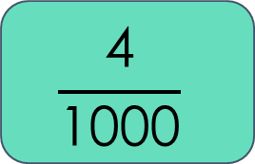
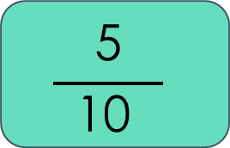
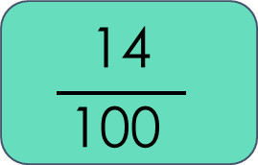
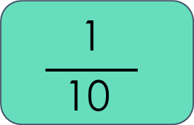
Starter:
Match the fraction cards to their equivalent fractions.
$$\frac{\text{1}}{ \text{10} }$$
$$\frac{\text{4}}{\text{1}\text{00}\text{0}}$$
0.5
$$\frac{\text{5}}{ \text{10} }$$
0.004
0.14
$$\frac{\text{14}}{ \text{1}\text{0}\text{0} }$$
0.1
$\frac{\text{1}}{ \text{10} }$ = 0.1 $\frac{\text{5}}{ \text{10} }$ = 0.5 $\frac{\text{14}}{ \text{1}\text{0}\text{0} }$ = 0.14 $\frac{\text{4}}{\text{1}\text{00}\text{0} }$ = 0.004
Answers
Notes:
This will build on the pupils knowledge of simple equivalences and support their thinking when using other fractions and decimals.
Concrete resources – Place value charts may support some pupils
Key Questions – How would we say the fraction? Which decimal shows the same as this? How can we convert between decimals and fractions?
Extension – Can the pupils think of other equivalences that they already know about.

Slide 8
Tom wants to write $\frac{\text{1}}{ \text{25} }$ as a decimal.
He says that if the denominator was 10 or 100, he would know how to write it as a decimal. Can you help him?
$\frac{\text{1}}{ \text{25} }$= $\frac{\text{?}}{\text{100}}$
How would we write this as a decimal?
$\frac{\text{1}}{ \text{25} }$ = $\frac{\text{4}}{\text{100}}$
$\frac{\text{4}}{\text{100}}$ = 0.04 so $\frac{\text{1}}{ \text{25} }$ = 0.04
Answers
Notes:
Key Questions – How would we make it equivalent? Why would a denominator of 100 help us? Why can’t we make it equivalent to a fraction over 10?
Misconceptions/ Common Errors – Pupils may need to revise making equivalent fractions, they may need support with their multiplication.
Further Practice – Use other fractions to apply the same knowledge.

Slide 9
Guided Practice:
If I know that $\frac{\text{1}}{ \text{5} }$ = 0.2, what is $\frac{\text{4}}{ \text{5} }$ as a decimal?
Explain what you have done to calculate the answer.
What method would we use to write $\frac{\text{15}}{ \text{50 }}$ as a decimal?
What would it be as a decimal?
$\frac{\text{4}}{ \text{5 }}$ = 0.8
We know this because $\frac{\text{4}}{ \text{5} }$ is four lots of $\frac{\text{1}}{ \text{5} }$ . $\frac{\text{1}}{ \text{5} }$ is the same as 0.2 Four lots of 0.2 = 0.8
First, we would make the fraction equivalent to a fraction with a denominator of 100.
$\frac{\text{1}\text{5}}{ \text{5}\text{0 }}$ = $\frac{\text{30}}{\text{100}}$
That means that $\frac{\text{15}}{ \text{50 }}$ as a decimal is 0.30 or 0.3.
Answers
Notes:
Concrete resources – Place value charts may support some learners
Key Questions – Do we know any facts that would help us with this question? If we don’t, can we make it equivalent to a tenth or a hundredth? How will this help to find the answer? How would we write this as a decimal?
Misconceptions/ Common Errors – Pupils may need resources showing facts that they should know but have difficulty in recalling.
Further Practice – Practice with other numbers.
Extension – Can pupils give a fraction to fit both methods?

Slide 10
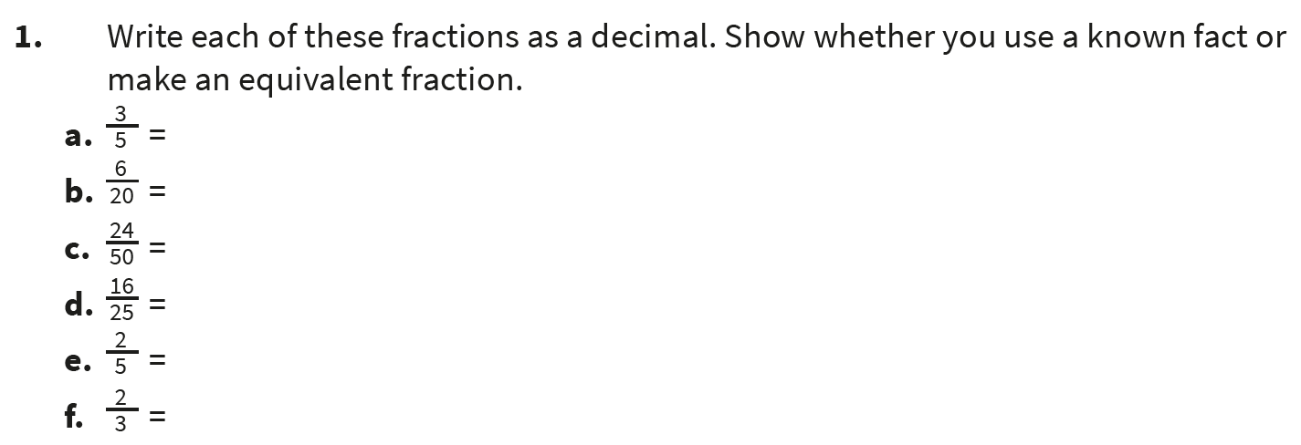
Independent Practice:
Notes:
⅗ = 0.6 (use ⅕ = 0.2)
6/20 = 0.30 or 0.3 (6/20 = 30/100)
24/50 = 0.48 (24/50 = 48/100)
16/25 = 0.64 (16/25 = 64/100)
⅖ = 0.4 (⅕ = 0.2)
⅔ = 0.66 (⅓ = 0.33)

Slide 11
Guided Practice:
Which of these is the largest?
0.68 or $\frac{\text{3}}{ \text{5 }}$
Show how you know.
Notes:
Pupils may convert the decimal or fractions in a different way. However, the most efficient would be:
3/5 = 0.60 0.68 > 0.60 so 0.68 is larger than 3/5
Concrete resources – a place value chart
Key Questions – How will we compare them? Which one should we convert?
Misconceptions/ Common Errors – Pupils may need prompting to convert one of them in order to compare.
Further Practice – Compare different sets of numbers.
Extension – increase the amount of numbers to compare - order rather than compare.

Slide 12
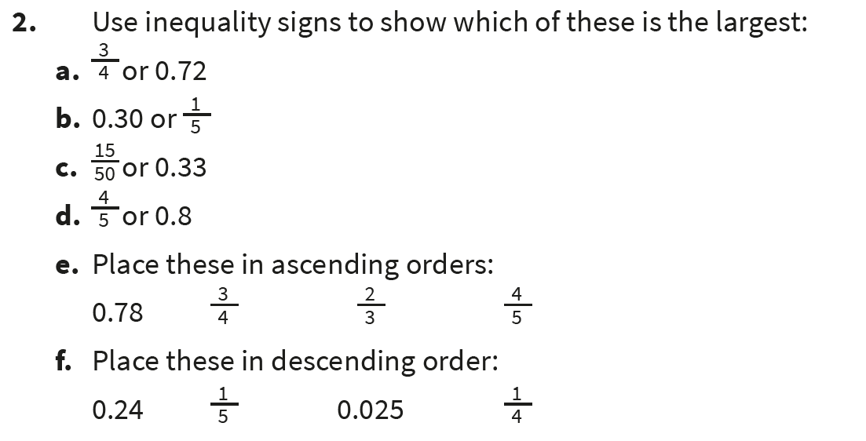
Independent Practice:
Notes:
>
>
<
=
⅔ ¾ 0.78 ⅘
¼ 0.24 ⅕ 0.025

Slide 13
Guided Practice:
Hamza says, “The decimal 0.30 can be read as 3 tenths.”
Jessica says, “It can be written as 0.3.”
Ben says, “It can be read as 30 hundredths.”
Who is correct?
Explain why.
All three children are correct.
There is only a 3 in the tenths place, so we can say that the number is 3 tenths.
The zero on the end is simply showing that there are no hundredths, so we do not need to write it.
3 tenths are the same as 30 hundredths.
Answers
Notes:
Concrete resources – Place value chart
Key Questions – Is each one correct? How do you know? Can you prove your answer? What is a place holder? How does the position of zero change the value of a number?
Misconceptions/ Common Errors – Pupils may confuse hundredths and tenths.
Further Practice/Extension – Can pupils substitute the numbers to make the problem still true?

Slide 14
Independent Practice:
Notes:
True
True
False: 4/20 = 20/100 = 0.20 or 0.2
False: 80/100 = 0.80
False: each could be divided by 5.
350/500 = 70/100 = 0.70

Slide 15
Let’s Reflect:
Alice and Nia want to convert the fraction $\frac{\text{20}}{ \text{5}\text{00 }}$ into a decimal.
Find two different ways to do this.
Method 1:
Double the numerator and denominator so that the fraction shows an amount of thousandths.
$\frac{\text{40}}{\text{1}\text{0}\text{00}}$is the same as 0.040 or 0.04.
Method 2:
Divide the numerator and denominator by 5 so that the fraction shows an amount of hundredths.
$\frac{\text{4}}{ \text{100} }$ is the same as 0.04.
Answers
Notes:
Key Questions – What two denominators could be helpful? How would we make them equivalent? How does that help us?
Misconceptions/ Common Errors – We have concentrated on simplifying and so pupils may not think to increase the denominator in the equivalent fraction

Slide 16
The following slides are based on Year 5 Decimals and Percentages – Decimals as fractions

Slide 17
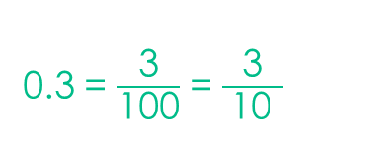
Write each of these representations as a decimal and a fraction:
Each square is 0.01
0.8 = $\frac{\text{80}}{\text{100}}$ = $\frac{\text{8}}{ \text{10} }$ = $\frac{\text{4}}{ \text{5 } }$
0.3 = $\frac{\text{3}}{\text{100}}$ = $\frac{\text{3}}{ \text{10} }$
0.40 = $\frac{\text{40}}{\text{100}}$ = $\frac{\text{4}}{ \text{10} }$ = $\frac{\text{2}}{ \text{5 } }$
Answers
Notes:
How and when to use these slides – Use these slides to revise decimals to fractions using pictorial representations to begin with. This could be used as a whole class introduction (start of this lesson or plenary of the previous lesson) or could be used in a smaller group who next extra support.
Concrete resources – The pictorial representations could be replicated with the same concrete resources.
Key Questions – What does each show? How would that be written as a fraction? What does this look like as a decimal? How would you say this out loud?
Misconceptions/ Common Errors – Pupils may confuse hundredths and thousandths and may need support with this.
Further Practice – Change what the representations show, ask the pupils to create their own question.

Slide 18
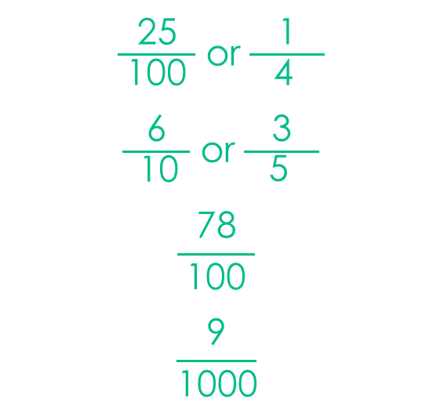
Write each number from the middle column as a decimal and as a fraction.
Decimal | Number | Fraction
 | 25 hundredths
 | 6 tenths
 | 78 hundredths
 | 9 thousandths
0.25
0.6 or 0.60
0.78
0.09
$\frac{\text{25}}{ \text{1}\text{0}\text{0} }$ or $\frac{\text{1}}{ \text{4 } }$
$\frac{\text{6}}{ \text{1}\text{0} }$ or $\frac{\text{3}}{ \text{5 } }$
$$\frac{\text{78}}{ \text{1}\text{0}\text{0} }$$
$$\frac{\text{9}}{\text{1}\text{00}\text{0}}$$
Answers
Notes:
How and when to use these slides – Use these slides to revise decimals to fractions using pictorial representations to begin with. This could be used as a whole class introduction (start of this lesson or plenary of the previous lesson) or could be used in a smaller group who next extra support.
Concrete resources – The pictorial representations could be replicated with the same concrete resources.
Key Questions – What does each show? How would that be written as a fraction? What does this look like as a decimal?
Misconceptions/ Common Errors – Pupils may confuse hundredths and thousandths and may need support with this.
Further Practice – Change what the representations show, ask the pupils to create their own question.

