Slide 1
Ready-to-go Lesson Slides
Year 3
Fractions
Lesson 1
Spr5

Slide 3



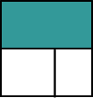
Starter:
Success Criteria: I can compare unit and non-unit fractions I know what the numerator and denominator show in a fraction
Which one is different?

Slide 4
Starter:
Success Criteria: I can compare unit and non-unit fractions I know what the numerator and denominator show in a fraction
Which one is different?
Each image shows 1 out of 3 parts shaded, but with this one
the parts are not equal, so we cannot say one third is shaded.
All the others have one third shaded.

Slide 5

Talking time:
Complete the missing values.
__ out of __ equal parts is shaded.
of the shape is shaded.
?
?

Slide 6
Talking time:
Complete the missing values.
1 out of 4 equal parts is shaded.
of the shape is shaded.
1
4

Slide 7

Talking time:
Complete the missing values.
__ out of __ equal parts is shaded.
of the shape is shaded.
?
?

Slide 8
Talking time:
Complete the missing values.
1 out of 5 equal parts is shaded.
of the shape is shaded.
1
5

Slide 9
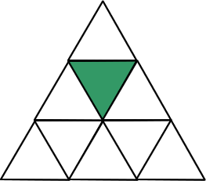


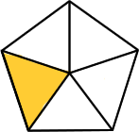
Activity 1:
What fraction of each shape is shaded?

Slide 10
Activity 1:
What fraction of each shape is shaded?
1
9
1
6
1
4
1
5

Slide 11

Talking time:
Shade Shade
What’s the same? What’s different?
1
10
3
10

Slide 12


Talking time:
Shade Shade
What’s the same? What’s different?
Both shapes have been split into the same number of equal
parts (tenths).
The first shape has one part shaded (one tenth), but the second shape has more than one part shaded (three tenths).
1
10
3
10

Slide 13

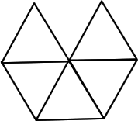
Activity 2:
Shade Shade
1
4
3
4
Shade Shade
1
5
2
5

Slide 14




Activity 2:
Shade Shade
1
4
3
4
Shade Shade
1
5
2
5

Slide 15

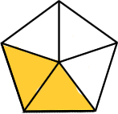

Talking time:
These are unit fractions:
These are non-unit fractions:
Complete the sentences:
A unit fraction is a fraction whose numerator equals __.
A non-unit fraction is a fraction whose numerator is ______________.

Slide 16
Talking time:
These are unit fractions:
These are non-unit fractions:
Complete the sentences:
A unit fraction is a fraction whose numerator equals 1 .
A non-unit fraction is a fraction whose numerator is greater than 1.

Slide 17
Activity 3:
Draw and write a unit and non-unit fraction that both have a denominator of 6.

Slide 18
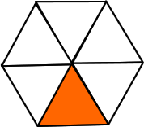
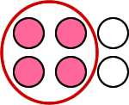
Activity 3:
Draw and write a unit and non-unit fraction that both have a denominator of 6.
For example:
UNIT FRACTION NON-UNIT FRACTION
1
6
4
6

Slide 19
Activity 4:
Complete the table using these fractions:
1
8
4
4
1
4
2
6
3
3
4
9
 | Equal to 1 | Less than 1
Unit fractions
Non-unit fractions

Slide 20
Activity 4:
Complete the table using these fractions:
 | Equal to 1 | Less than 1
Unit fractions
Non-unit fractions
1
8
1
4
Extension:
Explain why this part of the table is empty.
Can you think of a fraction that might go here? Why / why not?
4
4
3
3
2
6
4
9

Slide 21


Evaluation:
Success Criteria: I can compare unit and non-unit fractions I know what the numerator and denominator show in a fraction
True or False?
has been shaded.
has been shaded.
The numerator on a fraction is the top number.
d) A unit fraction is a fraction that has a denominator
(bottom number) equal to 1.
e) , , and are all non-unit fractions.
1
2
2
5
2
5
3
5
4
5
5
5

Slide 22
Evaluation:
Success Criteria: I can compare unit and non-unit fractions I know what the numerator and denominator show in a fraction
True or False?
has been shaded. FALSE
has been shaded. TRUE
The numerator on a fraction is the top number.
TRUE
d) A unit fraction is a fraction that has a denominator
(bottom number) equal to 1. FALSE (it is the numerator!)
e) , , and are all non-unit fractions. TRUE
1
2
2
5
2
5
3
5
4
5
5
5

Slide 23


