Slide 1
Ready-to-go Lesson Slides
Year 5
Position and Direction
Lesson 4
To translate shapes in the first quadrant
Summer

Slide 2
Summary
Key Vocabulary and Sentence Stems
Hinge Question (Assessment Point)
Lesson Introduction Slide (Learning Objective and Success Criteria)
Starter – Based on Year 5 - Regular and irregular polygons
Key Concept Introduction
Guided Practice – Describe given translations using correct convention
Independent Practice 1 – Describe given translations using correct convention
Guided Practice – Draw shapes in new positions for a given translation
Independent Practice 2 – Draw shapes in new positions for a given translation
Guided Practice – Reasoning and problem solving
Independent Practice 3 – Reasoning and problem solving
Let’s Reflect
Support Slides – Based on Year 4 - Move on a grid

Slide 3
Key Vocabulary:
coordinates
x-axis
y-axis
translate
Sentence Stems:
The x-axis is the horizontal axis.
The y-axis is the vertical axis.
Coordinates are fixed points plotted on the grid lines and are written (x-axis, y-axis).
Read the x-axis then the y-axis.
Translate means to move. Shapes do not change when translated.
Translations are described as moving units to the (left/ right) and units (up/down), for example, translate 3 units to the left and 3 units down.

Slide 4
𝑦
Hinge Question:
10
9
A triangle is drawn on the grid.
It is translated so that point A translates to point B.
What would be the coordinates of the other vertices of the translated triangle?
8
7
6
A
B
x
5
4
3
2
1
0
𝑥
0
1
2
3
4
5
6
7
8
9
10
(8,5) (5,7)
(5,2) (7,2)
(2,5) (2,7)
(5,8) (7,5)
Notes:
Assessment point for the lesson – ask the pupils to vote for the answer they think is correct.
A – Pupil has written the coordinate values in the wrong order (y,x) instead of (x,y).
B – Pupil has moved the incorrect vertex to the new position and has written the coordinate values in the wrong order (y,x).
C – Pupil has moved the incorrect vertex to the new position.
D – Correct answer
If answers A, B or C are given, pupils may require extra support through small group or 1:1 discussions. There are support slides covering lessons from the previous year group at the end of these slides.

Slide 5
To translate shapes in the first quadrant
Success Criteria I can describe how a shape has been translated on a grid given the starting and finishing positions. I can complete a multiple step translation on a grid by moving one vertex of a shape at a time.

Slide 6
Starter:
Using isometric paper, how many of these polygons can you draw?
A rectangle
A parallelogram that is not a rectangle
An equilateral triangle
A right angled triangle
A scalene triangle
An isosceles triangle that is not an equilateral triangle
A pentagon
A hexagon
A heptagon
An octagon
A rhombus
A trapezium
Notes:
Based on Year 5 Summer - regular and irregular polygons
Concrete resources – isometric paper
Key Questions – What are the properties of a _____? What’s the same and what’s different about an equilateral triangle and an isosceles triangle? What is a regular polygon? What is an irregular polygon? How many sides does a _____ have? Which shapes on this list will never contain a right angle?
Extension – Create a shape on the isometric shape for your partner to investigate. Can they name your shape and list its properties?

Slide 7
𝑦
10
This square is translated 4 squares left and 3 squares down.
Draw the new position of the square.
9
8
7
6
5
4
3
2
𝑦
1
10
𝑥
9
0
Describe the translation of:
a) Shape A to shape B.
b) Shape A to shape C.
c) Shape A to shape D.
0
1
2
3
4
5
6
7
8
9
10
8
B
A
a) Shape A has been translated 5 squares left
b) Shape A has been translated 4 squares down
c) Shape A has been translated 3 squares left and 5 squares down.
7
6
5
4
3
C
2
D
1
0
𝑥
Answers
0
1
2
3
4
5
6
7
8
9
10
Notes:
Concrete resources – squared paper
Key Questions – What does translate mean? Why should we always describe the left and right movement before describing the up and down movement in a translation? Have the dimensions of the shape changed as a result of the translation? Has the orientation of the shape changed as a result of the translation? Does it still face the same way? What has changed about the shape as a result of the translation?
Misconceptions/ Common Errors – Pupils may not count the movement of each vertex of the shape to find the new position e.g. instead of recognising that each vertex in A has moved 5 squares left to B, they may count the 2 squares between the two shapes instead. They should be reminded that they should move each vertex separately through extensive modelling.
Further Practice – Draw a square 2 squares wide on a blank grid. Ask a partner to draw your square in a new position on your grid. Can you identify the translation needed to get your square to its new position? Remember that you should describe the left and right movement before describing the up and down movement in a translation.

Slide 8
Guided Practice:
Describe the translation of:
a) Shape A to shape B.
b) Shape A to shape C.
c) Shape A to shape D.
a) Shape A has been translated 4 squares down
b) Shape A has been translated 4 squares right and 2 squares down
c) Shape A has been translated 6 squares right and 7 squares down.
𝑦
Match the translations.
10
9
8
7
𝑦
6
10
5
9
4
8
A
3
7
2
6
C
1
0
𝑥
5
B
0
1
2
3
4
5
6
7
8
9
10
4
to
to
to
3
2
D
1
3 left and 2 up
5 left and 1 down
2 right and 3 down
0
𝑥
0
1
2
3
4
5
6
7
8
9
10
Answers
Notes:
Concrete resources – squared paper
Key Questions – How will you work out how far the rectangle has moved? How can counting the squares from each vertex help you to describe the translation accurately? Have the dimensions of the shape changed as a result of the translation? Has the orientation of the shape changed as a result of the translation? Does it still face the same way? What has changed about the shape as a result of the translation?
Misconceptions/ Common Errors – Pupils may not count the movement of each vertex of the shape to find the new position e.g. instead of recognising that each vertex in A has moved 4 squares down to B, they may count the 2 squares between the two shapes instead. They should be reminded that they should move each vertex separately through extensive modelling.
Further Practice – Write more translations that could match the coloured squares on question 2. Can your partner work out which coloured squares your translations match?
Extension – Are there any other ways we could get these shapes to their new positions? How many ways can you find?

Slide 9
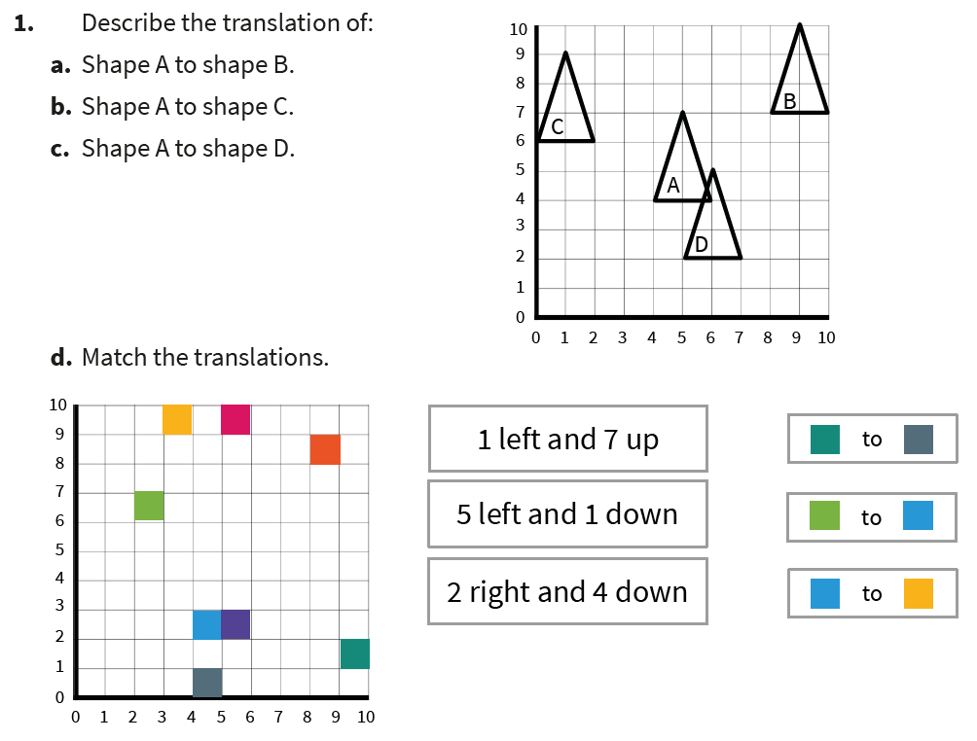
Independent Practice:
Notes:
Shape A has been translated 4 squares right and 3 squares up
Shape A has been translated 4 squares left and 2 squares up
Shape A has been translated 1 square right and 2 squares down
Turquoise to Grey: 5 left and 1 down
Green to Blue: 2 right and 4 down
Blue to Yellow: 1 left and 7 up

Slide 10
Guided Practice:
Draw shape A in the new positions on the grid after these translations and label the new shapes:
Shape A is translated 3 squares right to become shape B.
Shape A is translated 3 squares left to become shape C.
Shape A is translated 6 squares up to become shape D.
Shape A is translated 2 squares right and 4 squares up to become shape E.
Shape A is translated 2 squares left and 1 square down to become shape F.
𝑦
10
9
D
8
7
E
6
5
4
3
C
A
B
2
F
1
𝑥
0
0
1
2
3
4
5
6
7
8
9
10
Answers
Notes:
Concrete resources – squared paper
Key Questions – How will you work out how far the triangle needs to move? How can counting the squares from each vertex help you to plot the translation accurately? Have the dimensions of the shape changed as a result of the translation? Has the orientation of the shape changed as a result of the translation? Does it still face the same way? What has changed about the shape as a result of the translation?
Misconceptions/ Common Errors – Pupils may not count the movement of each vertex of the shape to find the new position e.g. instead of recognising that each vertex in A should move 3 squares right to draw shape B, they may try to count 3 clear squares between the two shapes instead. They should be reminded that they should move each vertex before drawing the shape in its new position through extensive modelling.
Further Practice – Are there any other ways we could get these shapes to their new positions? How many ways can you find?
Extension – Is it correct to write a 3 step translation e.g.3 squares left, 2 squares right, 4 squares up or can this be written more efficiently? Explain your answer with examples.

Slide 11
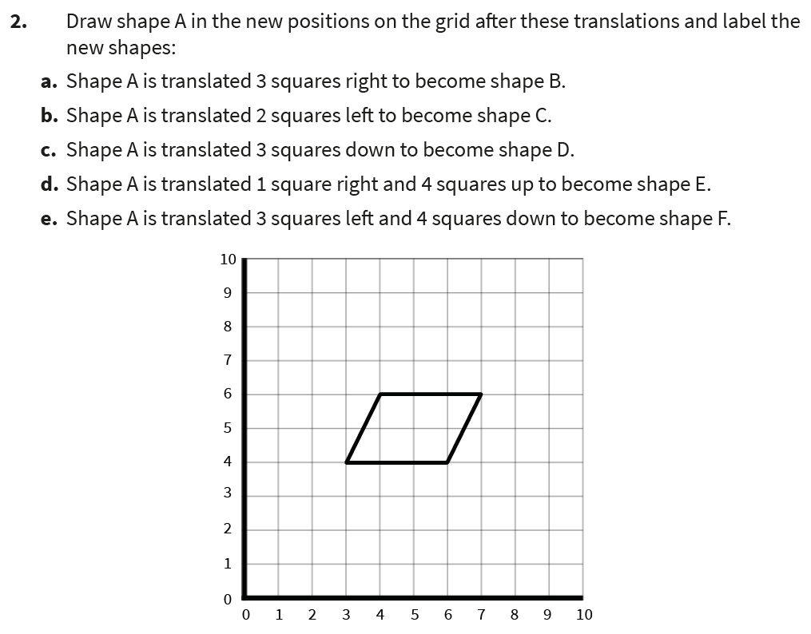
Independent Practice:
Notes:
After translation, shapes should be drawn at the following positions:
Shape B (6,4) (9,4) (10,6) (7,6)
Shape C (1,4) (4,4) (2,6) (5,6)
Shape D (3,1) (6,1) (7,3) (4,3)
Shape E (4,8) (7,8) (8,10) (5,10)
Shape F (0,0) (3,0) (4,2) (1,2)

Slide 12
Guided Practice:
Levi is translating shape ABC so that point A translates to point D. Levi says, ‘I can’t do this translation because the shape won’t fit on my grid.’
Do you agree with Levi? Explain your answer.
A trapezium is drawn on a grid.
It is translated so that the point A translates to point B. Draw the trapezium in its new position and write its new coordinates.
How would you describe the translation?
Levi is incorrect, the shape will fit in the position shown.
𝑦
𝑦
The trapezium is now at (0,6)(4,6) (3,8) (1,8). The trapezium was translated 6 squares left and 4 up.
10
10
9
B
9
x
8
8
7
7
A
6
6
5
D
5
A
4
x
4
3
3
2
B
C
2
1
1
𝑥
0
𝑥
0
0
1
2
3
4
5
6
7
8
9
10
Answers
0
1
2
3
4
5
6
7
8
9
10
Notes:
Concrete resources – squared paper
Key Questions – How will you work out how far Levi’s triangle has moved? How can counting the squares from vertex A help you to mark the other vertices accurately? How will you work out the translated positions of the other vertices of the trapezium? Will the counting squares method help? When you are describing the translation, will you give the up/down instruction or the left/right instruction first?
Misconceptions/ Common Errors – Pupils may not count the movement of each vertex of the shape to find the new position and may not recognise that vertex A has moved 2 squares right and 2 squares down to point D. They should be reminded that they should move each vertex before drawing the shape in its new position.
Extension – Describe the maximum translation Levi can make moving his shape to the left on this grid.
Describe the maximum translation Levi can make moving his shape to the right on this grid.
Describe the maximum translation Levi can make moving his shape down on this grid.
Describe the maximum translation Levi can make moving his shape up on this grid.
Can you find a translation that Levi cannot do because the triangle will not fit on the grid?

Slide 13
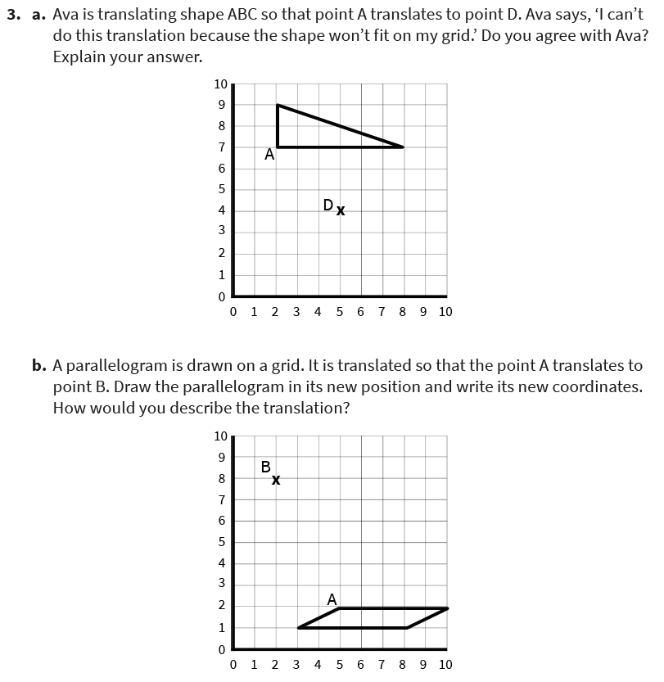
Independent Practice:
Notes:
Ava is correct, she cannot draw the shape in the new position on this grid because the base of the triangle is 6 squares long, and there are only 5 squares to the right of point D on this grid. It would be possible to translate the triangle if the x axis on this grid extended beyond 10.
The parallelogram will have these coordinates after translation: (0,7) (5,7) (7,8) (2,8). The shape has been translated 3 squares left and 6 squares up.

Slide 14
Let’s Reflect:
James has been translating a shape but he has made 2 errors. Find and correct his mistakes.
𝑦
10
James says, “I have translated shape A to a new position, shape B. My translation was 3 squares up and 2 squares to the right.”
9
8
7
B
6
5
B
James has not counted the movement from one corner to the same corner. He has actually translated the shape 5 squares to the right and 5 squares up. “ squares right and 3 squares up would be in the position shown. James has also described his translation in the wrong order. It should be left/right first, then up/down.
4
3
2
A
1
𝑥
0
0
1
2
3
4
5
6
7
8
9
10
Answers
Notes:
Key Questions – Has James performed a single step translation or a two step translation? How do you know? How will you work out how far James’ rectangle has moved? How can counting the squares from a vertex help you to work out which translation has been applied? When you are describing the translation, should you give the up/down instruction or the left/right instruction first? What would you say to James to explain his mistake and to make sure he performs the translation correctly next time? What would you say to James to explain his mistake and to make sure he describes the translation correctly next time?
Misconceptions/ Common Errors – Pupils may need squared paper and a paper rectangle to move on the grid to work out which translation James has actually carried out. They may think he is correct because they are not moving the vertices of the shape but have counted the 3 clear squares above the shape and the 2 clear squares to the right of the shape. Pupils may not recognise that the left/right movement should be described before the up/down movement.

Slide 15
The following slides are based on Year 4 Position and Direction - Move on a grid

Slide 16
You will need a small cube and a grid. Each time start at (0,0).
Move your cube 5 squares to the right, next move it 5 squares to the left. What do you notice?
Move your cube 4 squares up, next move your cube 4 squares down. What do you notice?
Move your cube 5 squares right, next move your cube 3 squares left. Is there a quicker way to reach the same position?
Your cube is translated and its finishing position is (5,5). How many different ways can you find to translate the cube so that it starts at the origin and finishes at (5,5)?
It is translated 2 squares right and 3 squares up. Write the coordinates of the cube after the translation.
It is back to the starting position
It is back to the starting position
Move 2 squares right
Many answers are possible
(2,3)
Answers
Notes:
How and when to use these slides – This slide is based on Year 4 Summer - move on a grid and provides pupils with the opportunity to move equipment on a coordinate grid following specific directions and using language such as up/down and left/right. Pupils apply their understanding of coordinates to describe the position of an object after translation.
Concrete resources – blank labelled grids, cube
Key Questions – Where is the origin? Can you describe the translation? Can you describe the translation in reverse? Why should we always describe the left and right movement before describing the up and down movement in a translation?
Misconceptions/ Common Errors – Pupils may not recognise that translations should be described as changes in the x direction before describing changes in the y direction.
Further Practice – Create a translation with your cube on the grid for your partner to solve. Give your partner the starting position and the finishing position as a coordinate. Can they describe the translation? Is it possible that they may have a different answer to yours? Why?

Slide 17
Translate the rectangle 3 squares left and 4 squares up.
Write the coordinates of each vertex before and after the translation.
Translate point A 6 left and 3 down.
Translate point B 3 right and 4 up.
Translate point C 1 right and 7 down.
Write the coordinates of each point before and after the translation.
𝑦
10
9
𝑦
C
Before: A (8,8)
B (7,2)
C (8,10)
After: A (2,5)
B (10,6)
C (9,3)
8
10
7
9
8
A
6
5
7
4
6
3
5
2
4
1
3
𝑥
2
B
0
0
1
2
3
4
5
6
7
8
9
10
1
Before: (2,3) (5,3) (2,4) (5,4)
After: (5,7) (8,7) (5,8) (8,8)
𝑥
0
0
1
2
3
4
5
6
7
8
9
10
Answers
Notes:
How and when to use these slides – This slide is based on Year 4 Summer - move on a grid, and provides pupils with practice in writing coordinates to describe the position of the vertices of shapes and specific points and in following specific directions using language such as up/down and left/right to perform translations.
Concrete resources – blank labelled grids, small cubes are required for the further practice activity
Key Questions – What is the x coordinate for this vertex? What is the y coordinate for this vertex? What do you notice about the change in the value of the x coordinate and the movement left/right? What do you notice about the change in the value of the y coordinate and the movement up/down? Can you explain your observations?
Misconceptions/ Common Errors – Pupils may not recognises that translations should be described as changes in the x direction before describing changes in the y direction.
Further Practice – Here is a game to play with a partner:
Each player needs 1 small cube and a grid.
Keep your grid hidden from your partner.
Agree a starting coordinate and both player place their cubes in that position.
Player 1 performs a translation and describes it to player 2.
Player 2 listens to the instructions and moves their cube as described by player 1.
Player 1 gives the coordinates for their cube after the translation and reveals their position..
If player 2 has correctly followed the instructions and their cube is in the same position a player 1, they score 1 point.
Now it is player 2’s turn to describe the translation from the new starting point.

