Slide 2
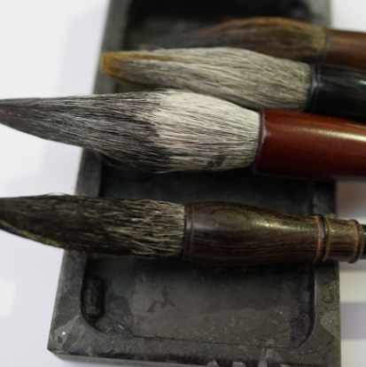
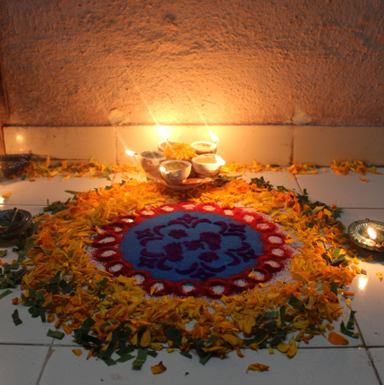
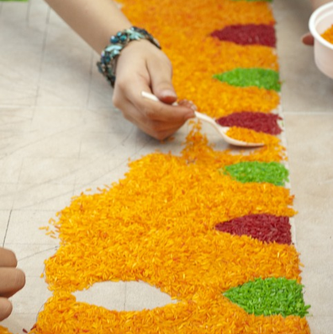
What Is Asian Art?
Asian art is a broad title.
It refers to any art originating in a country within the continent of Asia or artwork produced by an Asian artist.
There are many different types and styles of Asian art, from a variety of time periods.

Slide 3
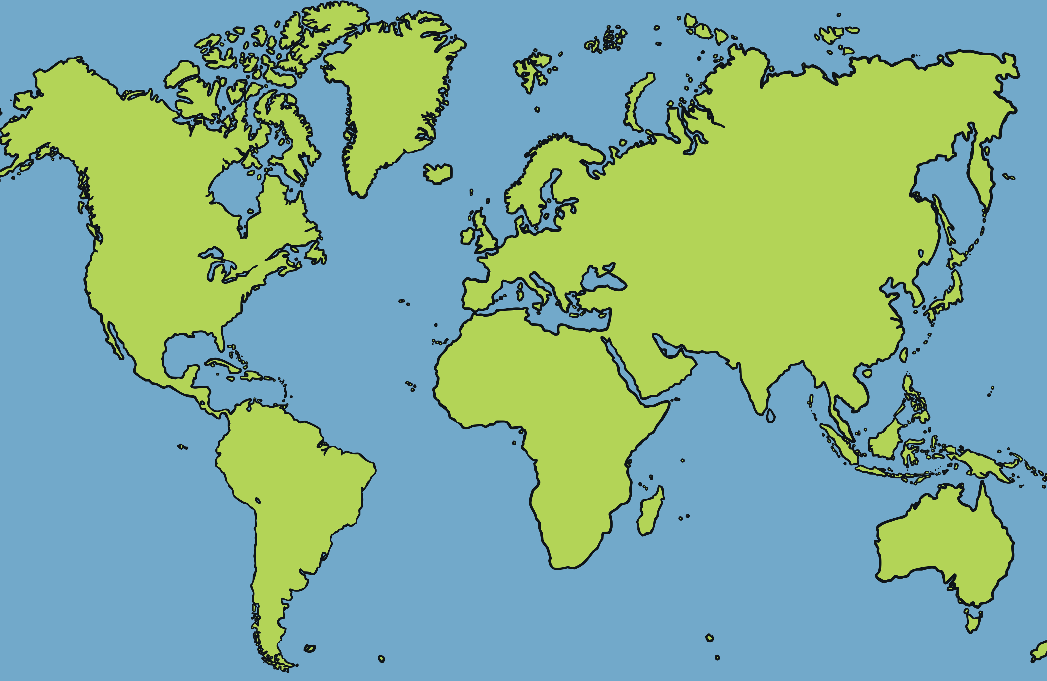
What Is Asian Art?
Asia is a continent. Can you find it on the map?
Asia includes countries such as China, Japan, Thailand, Pakistan and India, to name but a few.
Can you name some other countries that are part of Asia?
North
America
Europe
Asia
Africa
South
America
Australia
Have you ever visited a country in Asia?

Slide 4
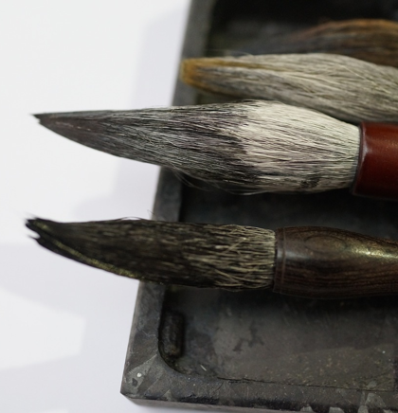
How Is Calligraphy Created?
There are many different styles of calligraphy (known as scripts) and it takes years for an apprentice to learn the techniques from a master.
Each script includes a different set of characters which need to be learnt. In China, these characters are called ‘hanzi’.
Traditional calligraphers use the ‘Four Treasures of the Study’. This expression refers to the ink, paper, ink brush and inkstone used to create the characters. Brush handles are often made of bamboo and the bristles created from animal hair.
Nowadays, modern calligraphers may use a pen to create the characters.

Slide 5
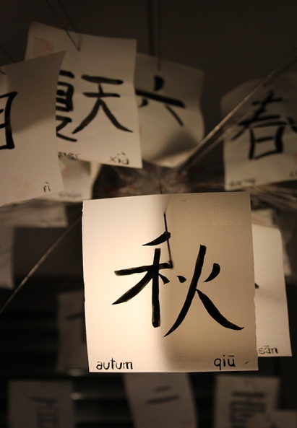
What Must a Calligrapher Learn?
In calligraphy, the way in which each character is formed is just as important as how it looks when it is finished.
There are at least eight basic rules a calligrapher must follow when writing characters. Some of these rules are:
horizontal strokes must be written before vertical strokes;
characters must be written from left to right;
characters are written from top to bottom.

Slide 6
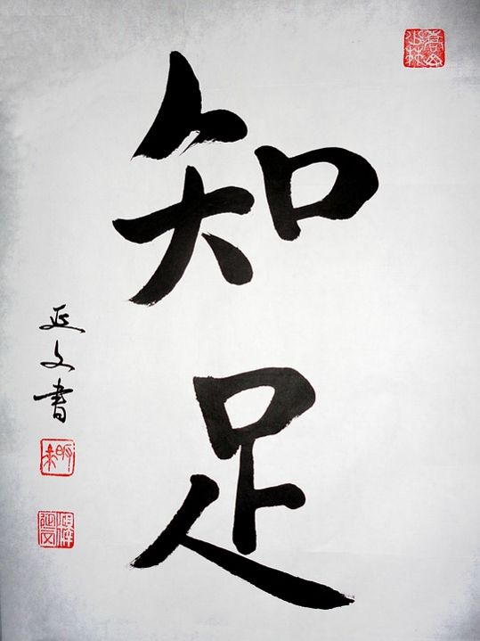
Each character must be written in a certain way.

Slide 7
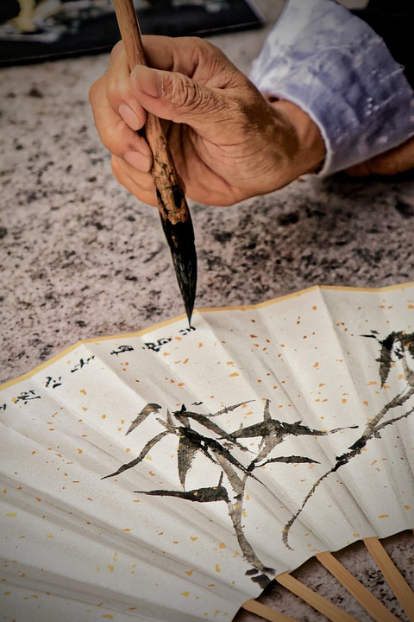
The brush must be held upright at all times.

Slide 8
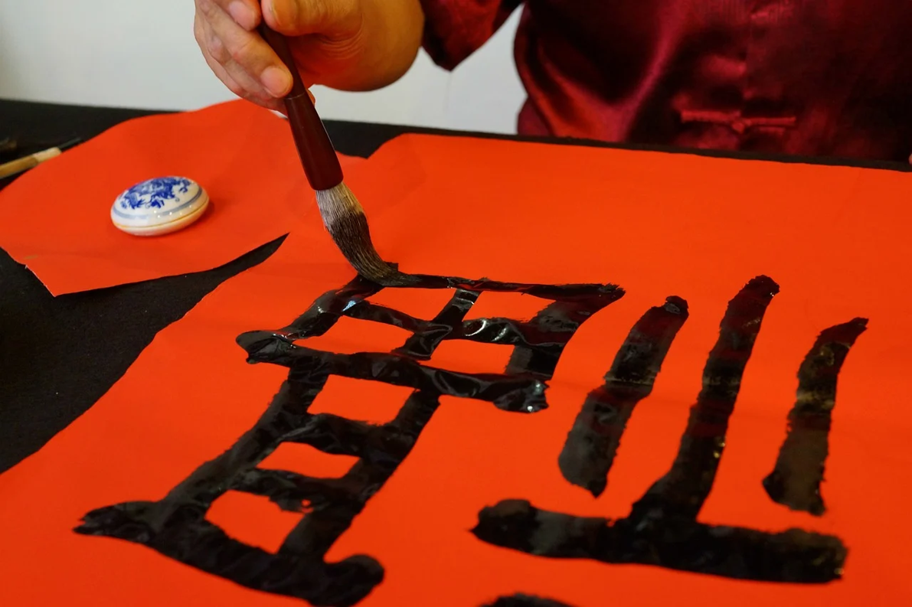

Slide 9
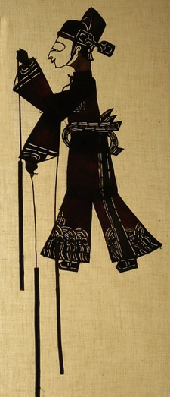
Shadow Puppets
Shadow puppets are created in many Asian countries, including Indonesia.
These intricate puppets are used in puppet theatre plays, known in Indonesia as ‘wayang kulit’. ‘Wayang’ means shadow or ghost and ‘kulit’ means leather or skin.
These puppet theatre shows are performed to entertain the audience but also to provide moral and religious teaching through traditional storytelling.
The puppets are controlled by a puppet master or ‘dalang’.

Slide 10
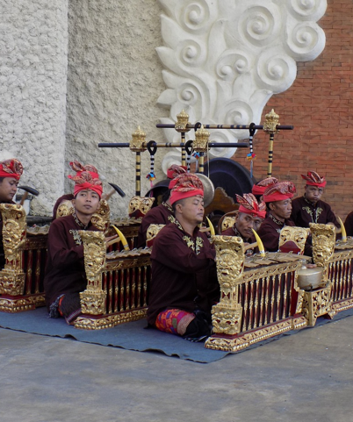
Puppet Theatre
Indonesian puppet theatre is thought to have started in about AD 860.
Performances can last up to six hours.
In Indonesia, the puppets are made from dried buffalo hide. They have moveable joints, which can be controlled by rods attached to the arms and legs of the puppet.
The puppets are held behind an illuminated screen to create shadows, which are then used to tell stories.
On the Indonesian island of Java, a puppet show may be accompanied by a gamelan orchestra, who use mallets to play percussion instruments.

Slide 11
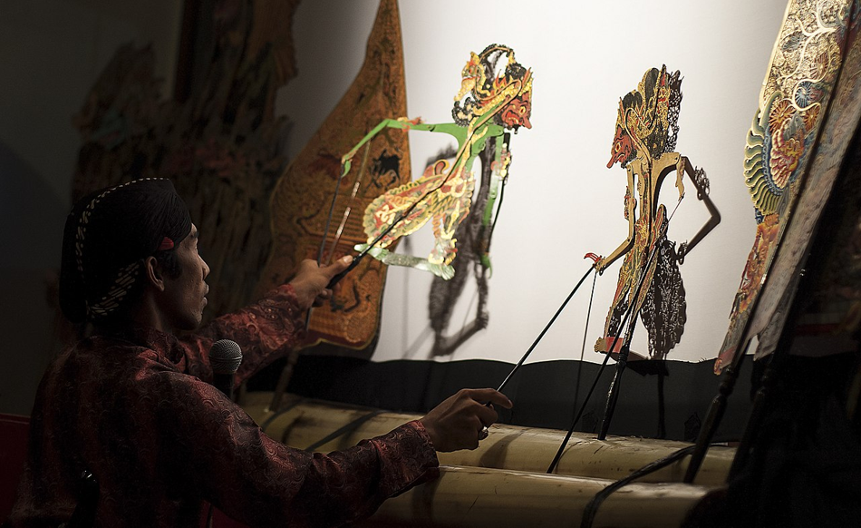
The ‘dalang’ (puppet master) skilfully manipulates the puppets using the rods attached to their limbs.
“Ki Sigit Ariyanto Dalang Wayang Kulit” by [PL 05 SIGIT] is licensed under CC BY-SA 4.0

Slide 12
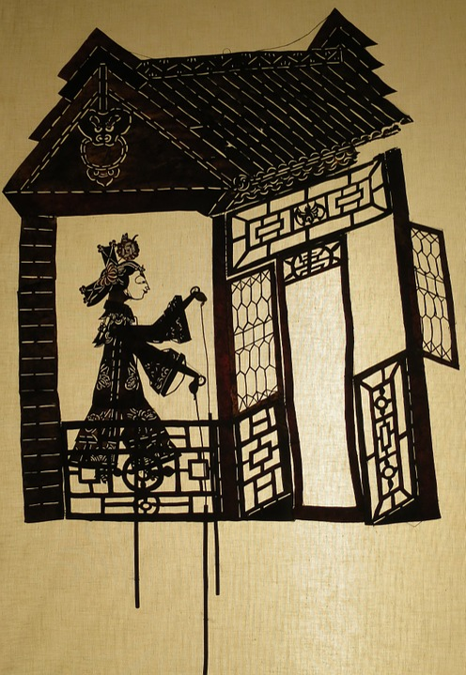
The intricate puppets are cut from buffalo hide.

Slide 13
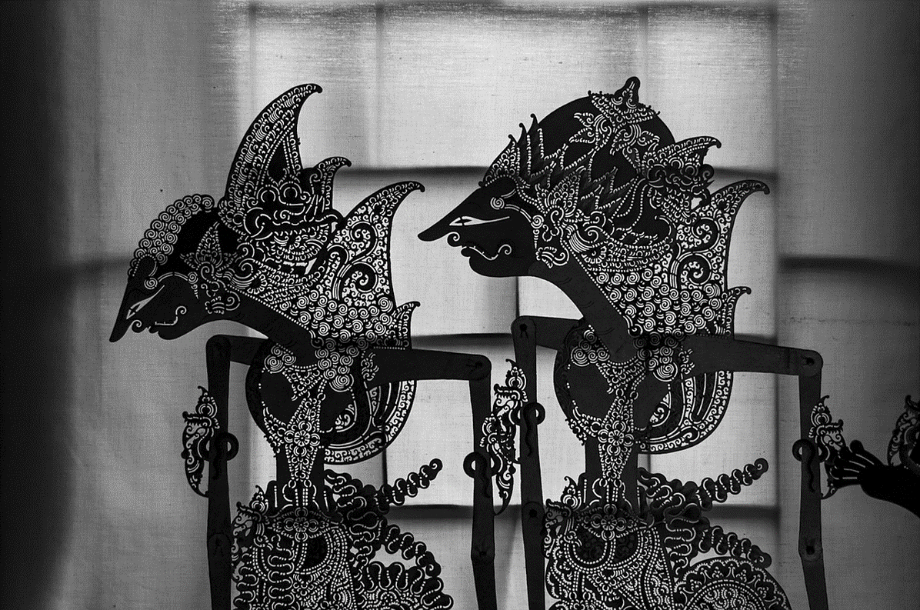

Slide 14
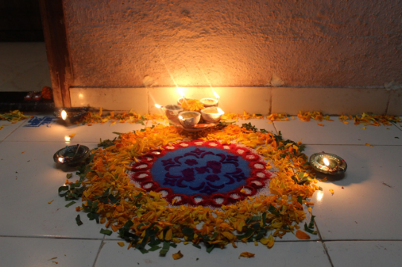
Rangoli
Rangoli is an art form originating in India.
A rangoli is a colourful pattern created on the ground using materials such as coloured sand, flower petals, flour and coloured rice.
Traditionally, they are created by girls or women.
A rangoli pattern may be created at the entrance to a house to welcome guests. They are thought to bring good luck and demonstrate strength and generosity.
Hindus often create rangolis during religious festivals, such as Diwali. Hindus believe they will encourage the goddess Lakshmi into their homes.

Slide 15
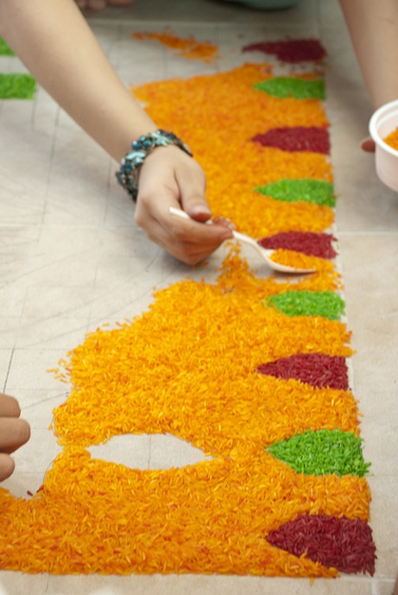
How Are Rangolis Created?
There are many different designs. Some rangolis are made using simple geometric shapes; others are formed using flower and petal outlines. The design of a rangoli pattern may be handed down through families, from one generation to the next.
Rangolis can be created using wet or dry materials. The outline of the pattern is created first using items like chalk, flour or sand. The outline is then filled with colourful materials.

Slide 16
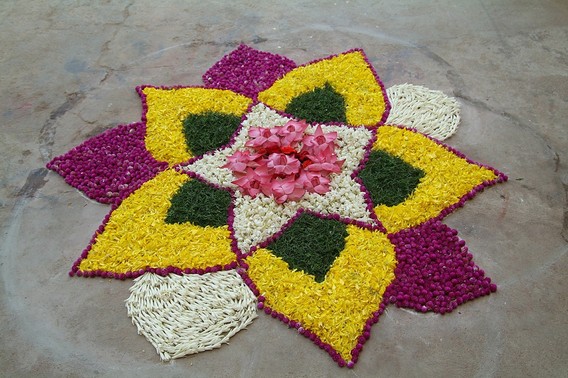
Look closely at this rangoli pattern. What natural materials have been used?

Slide 17
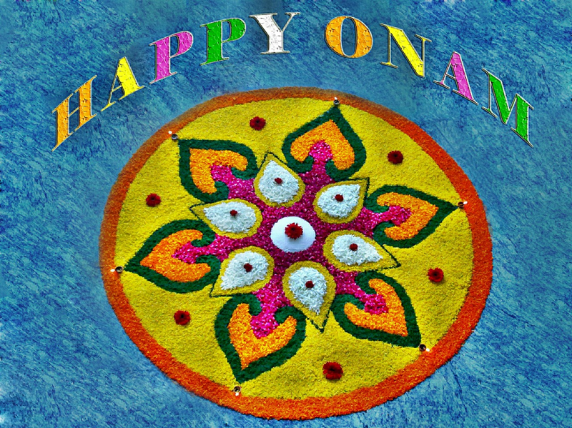
This rangoli has been created to celebrate the annual holiday and harvest festival of Onam (celebrated in Kerala, India).

Slide 18
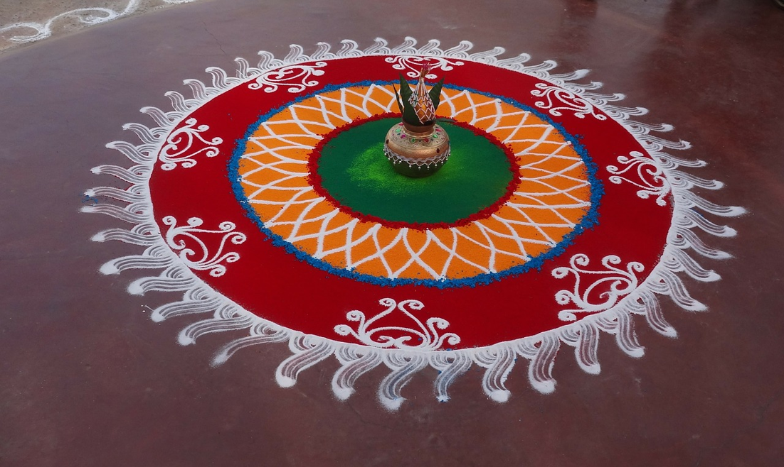

Slide 19
Manga
Manga is a Japanese art form that combines storytelling with a unique style of artwork (using simple lines and characterised features). The word manga is used to describe the comic books and graphic novels produced in this style.
Japanese manga is almost always black and white. Stories are published weekly or monthly in magazines and black and white images are cheaper and quicker to produce. Manga stories are read from right to left.
The Japanese word for a manga artist is ‘mangaka’. A mangaka will create the artwork and write the story.
Manga is widely read in Japan (by people of all ages) and is becoming increasingly popular internationally.
A best selling manga series may be made into an animated film, known in Japan as ‘anime’.

Slide 20
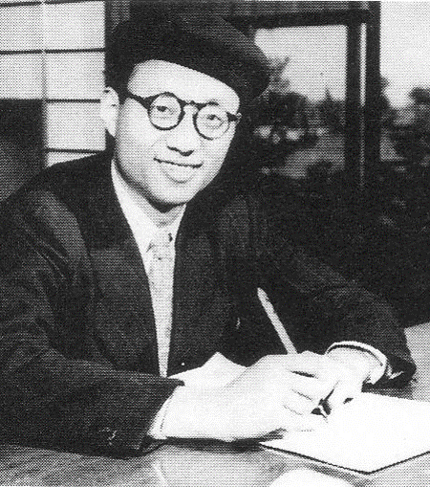
Who Made Manga Famous?
Osamu Tezuka (1928 - 1989) was a pioneering manga artist, cartoonist and animator. He is sometimes called the ‘godfather of manga’ and has been described as ‘Japan’s Walt Disney’.
He created a manga revolution in Japan with his children's books including ‘New Treasure Island’ and ‘Astro Boy’.

Slide 21
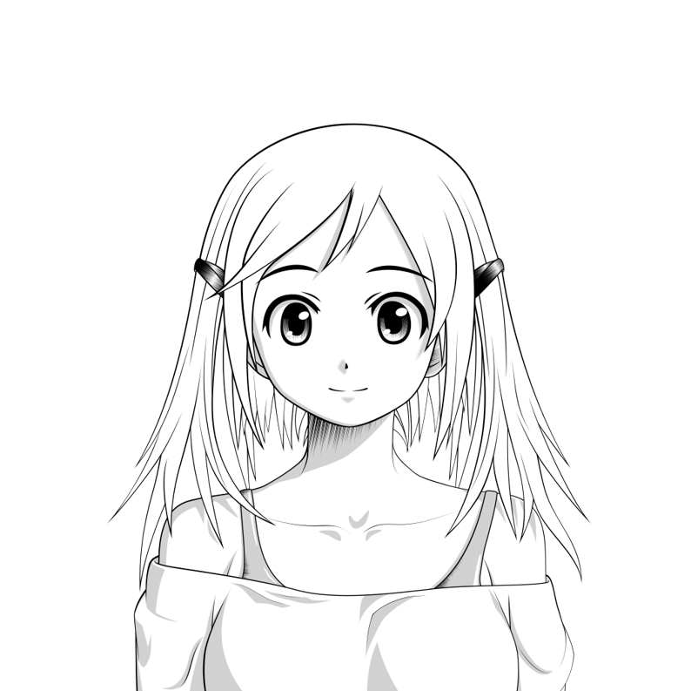

Slide 22
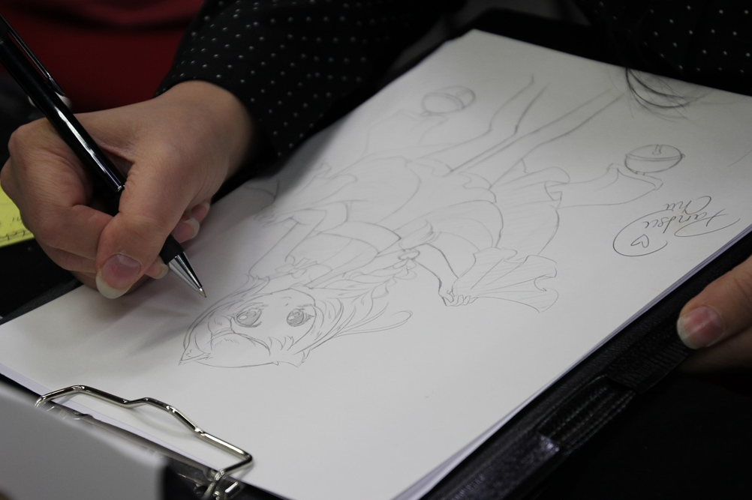
A mangaka creates the art work and the storyline for a manga.

Slide 23
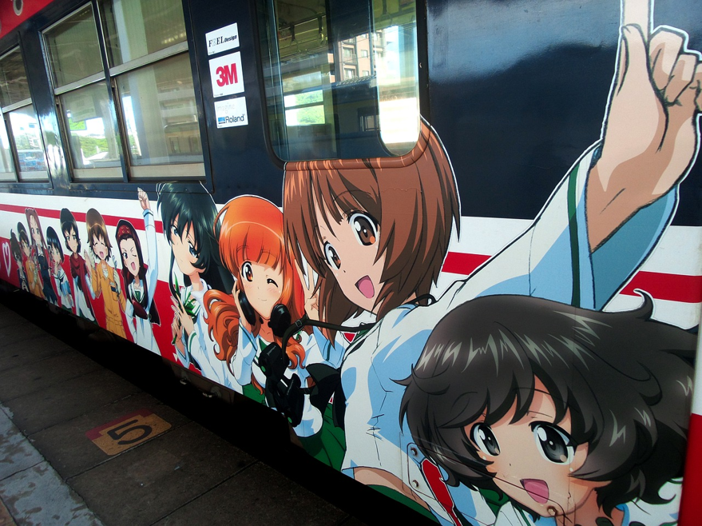
Manga and anime images have been used to decorate this train in Japan.

Slide 24
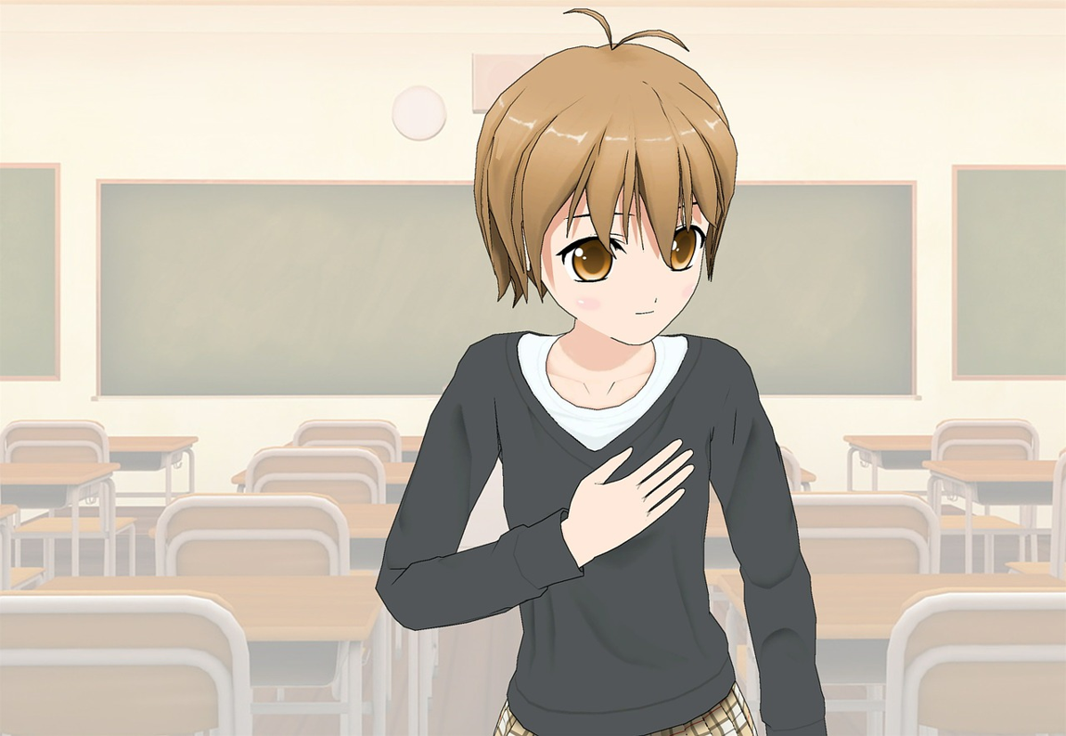

Slide 25
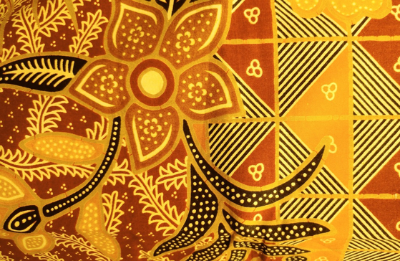
Batik
Batik is an art form originating on the island of Java, in Indonesia. It is a technique of decorating cloth using wax and dye and has been around for centuries.
The name batik comes from the Javanese word ‘tik’ and means to dot.
The products needed for batik (cotton, beeswax and plants to make vegetable dyes) are all readily available on the island of Java.
Indonesian batik patterns are very symbolic and are thought to bring good luck. Certain designs are used to create baby slings, whilst others are for wedding ceremonies.

Slide 26
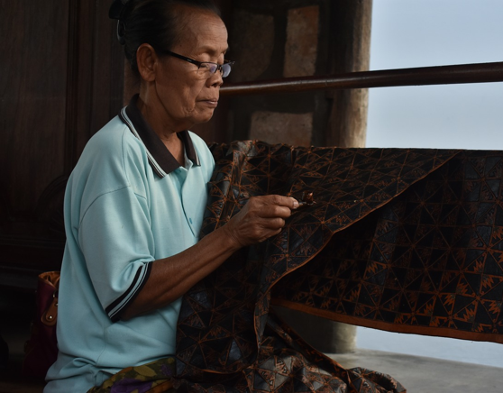
What Process Is Used to Produce Batik Cloth?
Before the batik process begins, the cloth is washed, soaked and beaten. It is hung on a frame.
A design is marked on the cloth in pencil and then redrawn, using a mix of melted beeswax and paraffin. The wax is applied using a special tool called a canting. A canting has a wooden handle and a small copper bowl with a spout. The bowl is filled with the melted wax, which is dotted or drawn onto the cloth through the spout. This highly skilled technique is mainly carried out by women.
For larger areas of cloth, a copper stamping tool may be used. It is dipped into hot wax and pressed onto the cloth. The design can then be easily repeated.

Slide 27
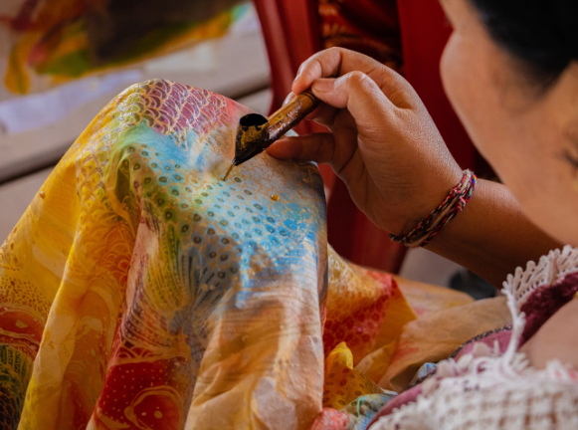
What Process Is Used to Produce Batik Cloth?
Once the wax has been applied, the cloth is dyed using the chosen colour.
After the dyeing process, the wax is removed by boiling or scraping.
The areas of wax resist the coloured dye, creating the pattern.
The process may be repeated using different designs and colours to make even more intricate patterns.
Some batik fabrics may take many months to complete.
Traditional batik colours include indigo blues and soga browns but modern dyes have now introduced a wider range of vivid colours.

Slide 28
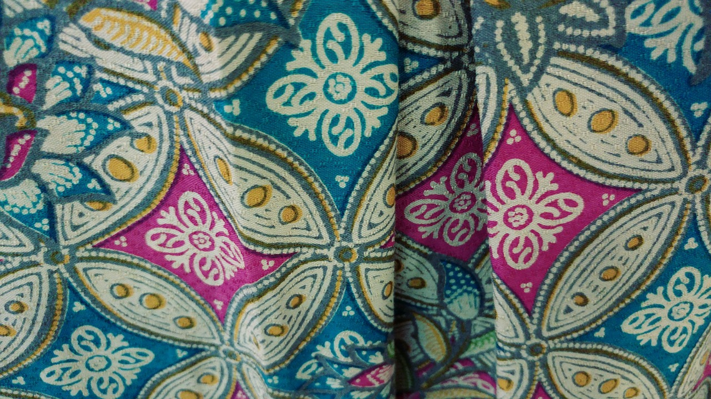
The white areas of the design show where the wax resist has been applied to the cloth.

Slide 29
