Slide 1
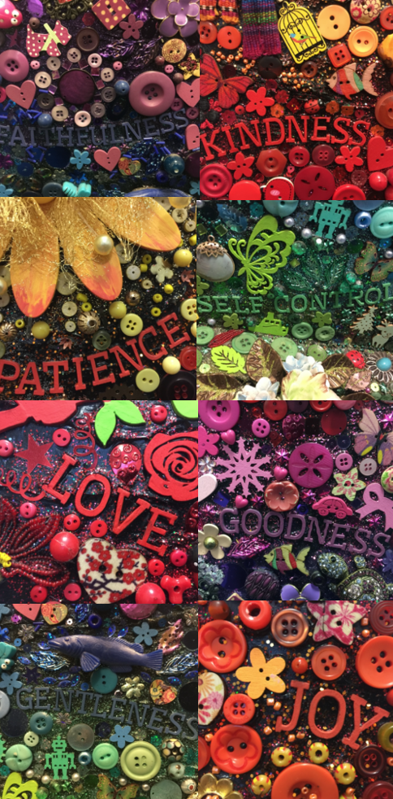
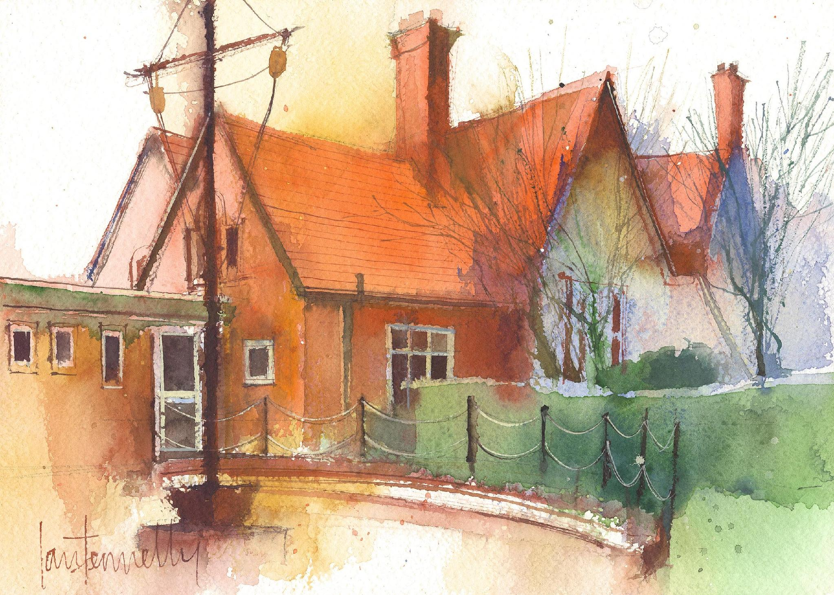
Dawpool CE (Aided) Primary School
School Information 2026-27
Vision Statement
‘The Dawpool community are united in their ambition to create a school which embodies the person, love and work of Jesus Christ: a school which enables Christian values to flourish and where all children may experience the abundant life that Jesus offers.’

Slide 2
Welcome to Year 1
Miss O’Brien (Monday, Tuesday, Friday Morning)
Mrs Ham (Wednesday, Thursday, Friday)
Mrs Vickers (Full time)
We are a flexible team, so there may sometimes be other adults in the room.

Slide 3
Welcome
A warm welcome to the 2026-27 academic year.
Some helpful links
Our school website: https://www.dawpool.wirral.sch.uk/website
Our school email: schooloffice@dawpool.wirral.sch.uk

Slide 4
Arrivals & Departures
Our school will give a warm and friendly welcome to each child on arrival and ensure that they depart safely at the end of each day. A copy of our full Arrivals and Departures procedure can be viewed here.
Arrivals
The opening times for arriving at school are 8.45am – 8.55am each day for all pupils. Pupils arriving in their classroom after 8:55am will receive a late mark.
If your child is absent from school, please inform the school office by 9:00am using the pupil absence line: 0151 648 3412 (option 1). On your child’s return to school, you must provide a written explanation for the absence.
Departures
F1 and F2 classes finish school at 3:25pm. All other classes finish at 3:30pm. All classes are escorted outside by a member of staff who will be on duty in the playground until 3.40pm. No pupil will be permitted to leave school without a parent or carer, unless the pupil is in Years 5 and 6 and school has received signed parental consent. In the interests of safety, we ask that children do not play on the trim trail at home time.

Slide 5
School Vision
'The Dawpool community is united in its ambition to create a school that embodies the person, love, and work of Jesus Christ. Rooted in this aim, we celebrate the unique dignity of every child. Each pupil is deeply known, valued, and nurtured, with bespoke opportunities to develop their gifts. Inspired by the parable of the talents, we empower children to grow academically, spiritually, and emotionally. Committed to justice and equity, we provide an education that enables every student to use their God-given potential confidently and responsibly in the service of others, experiencing fullness of life.’

Slide 6

Curriculum Overview
We provide a subject-specific curriculum in which we have mapped out the knowledge and skills that we want children to learn at each stage. The subject-specific curriculum documents also comprise an overview of Early Years and can be viewed within the curriculum section of our website by clicking here.
Science: Seasonal Changes
Geography: South Africa
Art: Colour Creations
Music: Learning the song and playing instruments to: Hey You!
Forest School: Problem solving and spotting seasonal change
Computing: How to log in to purplemash
PE: Health and Well-being
RE: Harvest
Where possible, subjects are delivered through topics which are designed for maximum engagement and ensure all pupils benefit from a rich, broad, balanced curriculum presented in an interesting, exciting and imaginative manner with lots of opportunities for first-hand experience, practical work, investigation and learning through play. The curriculum is enriched with visits, visitors, and extensive use of our unique environment.

Slide 7
Curriculum
English: Handwriting, Phonics, Reading at home & school, Cracking Comprehension, Spag.
Maths: Place Value, Shape, Length and height, Weight and volume, Money and Time.
RE: Harvest, What made Jesus special?
PE: Health and Wellbeing
Forest School: Problem Solving
Computing: Purplemash
Science: Seasonal change, Everyday materials, Plants and Animals.

Slide 8
Curriculum
Geography: South Africa, Hot and Cold Places, Local Area.
History: Toys from the Past, Significant People, Titanic.
Art: Colour creations, Animal Art, Self Portraits.
DT: Making healthy snacks, Moving Pictures, Stable Structures.
Music: Rhyming in time, singing, Music from around the world, Rhythm patterns, sounds and pictures, high and low.
Busy Learning - Time to learn through play and exploration

Slide 9
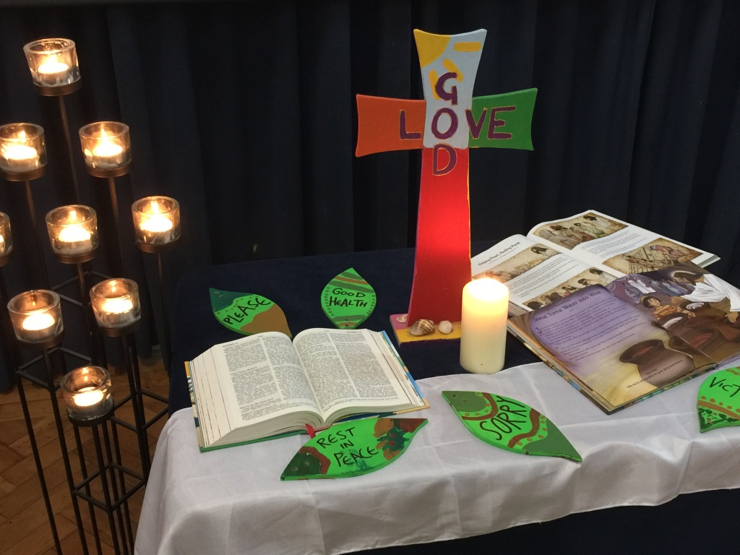
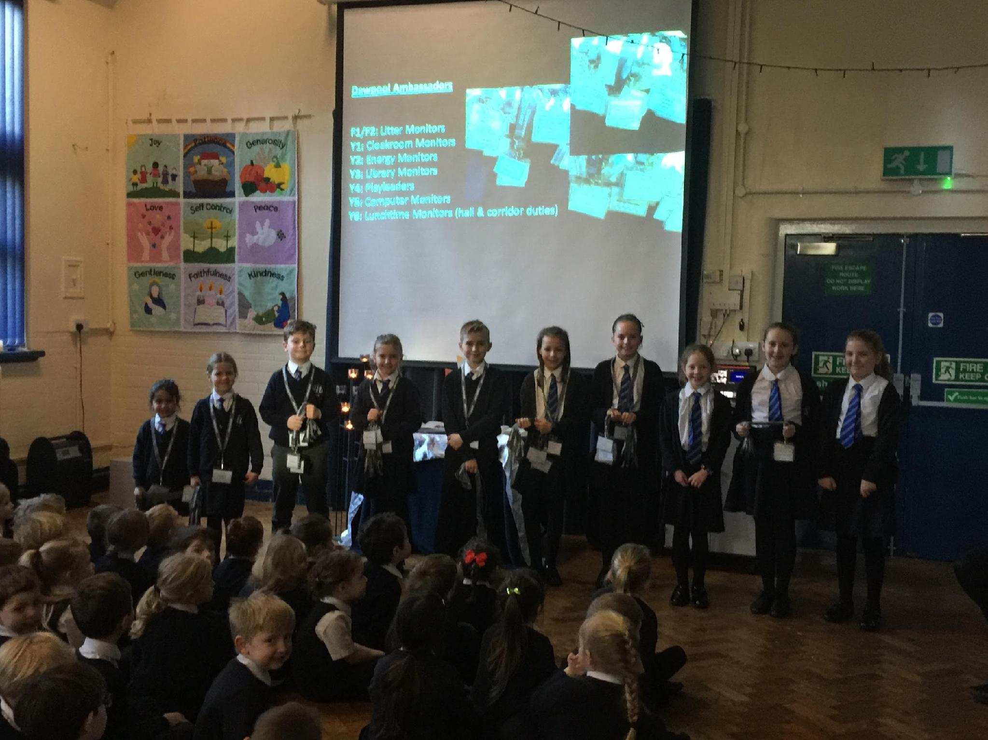
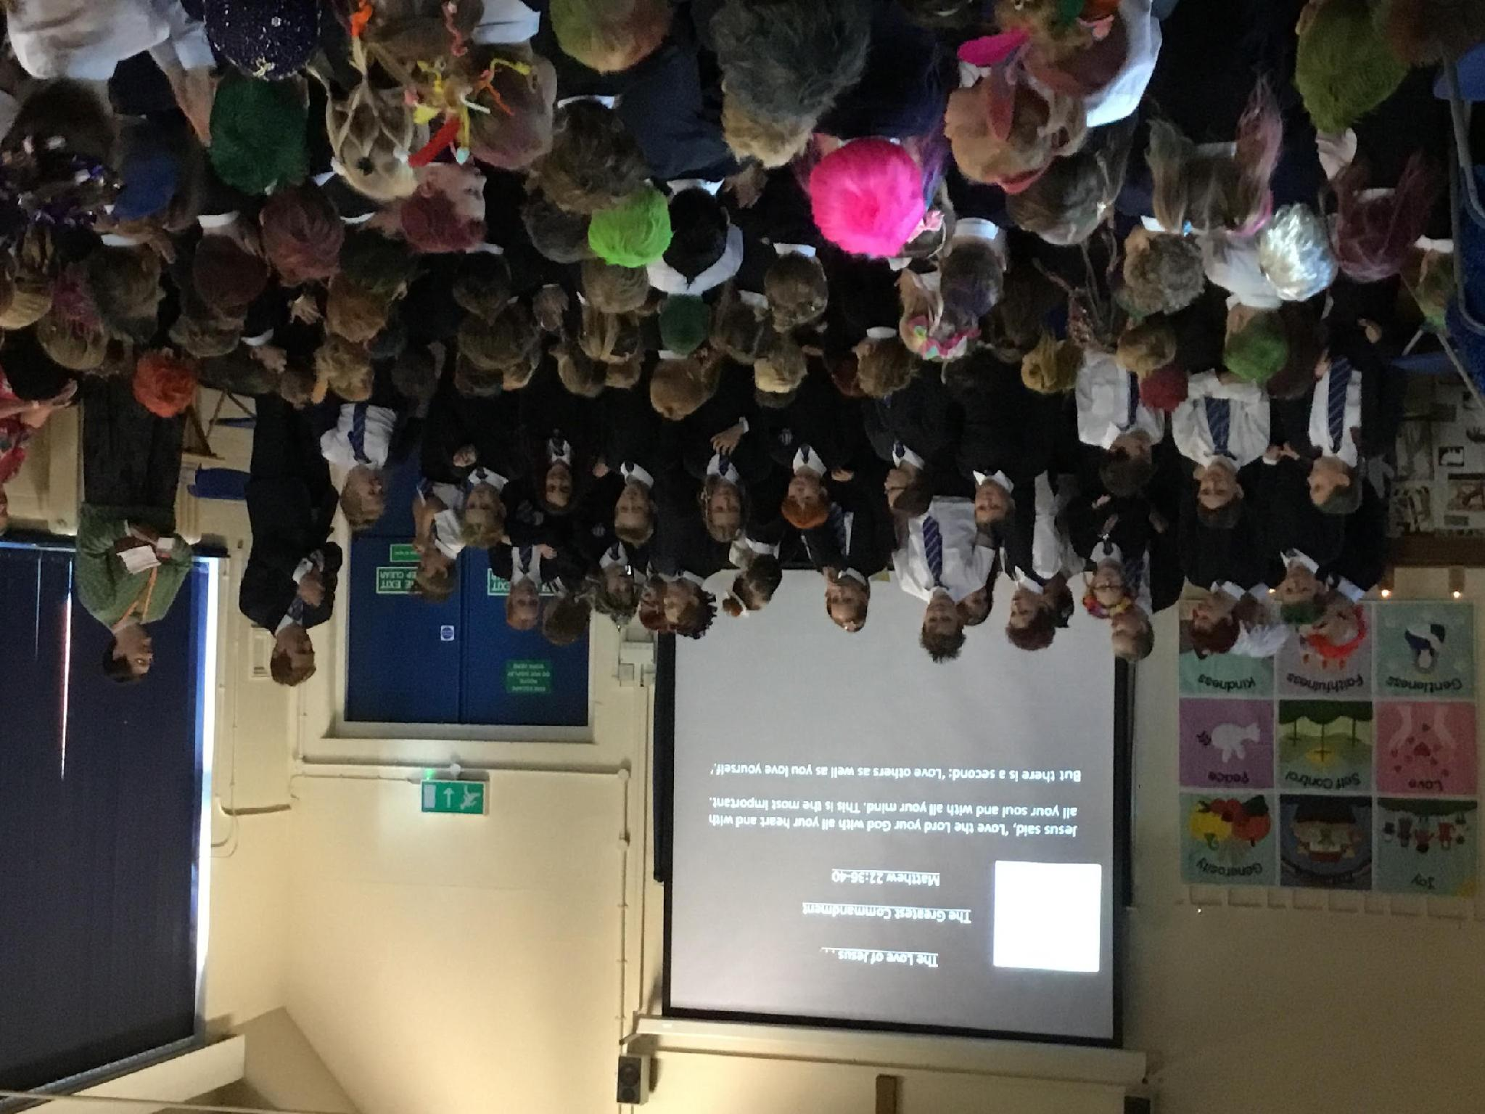
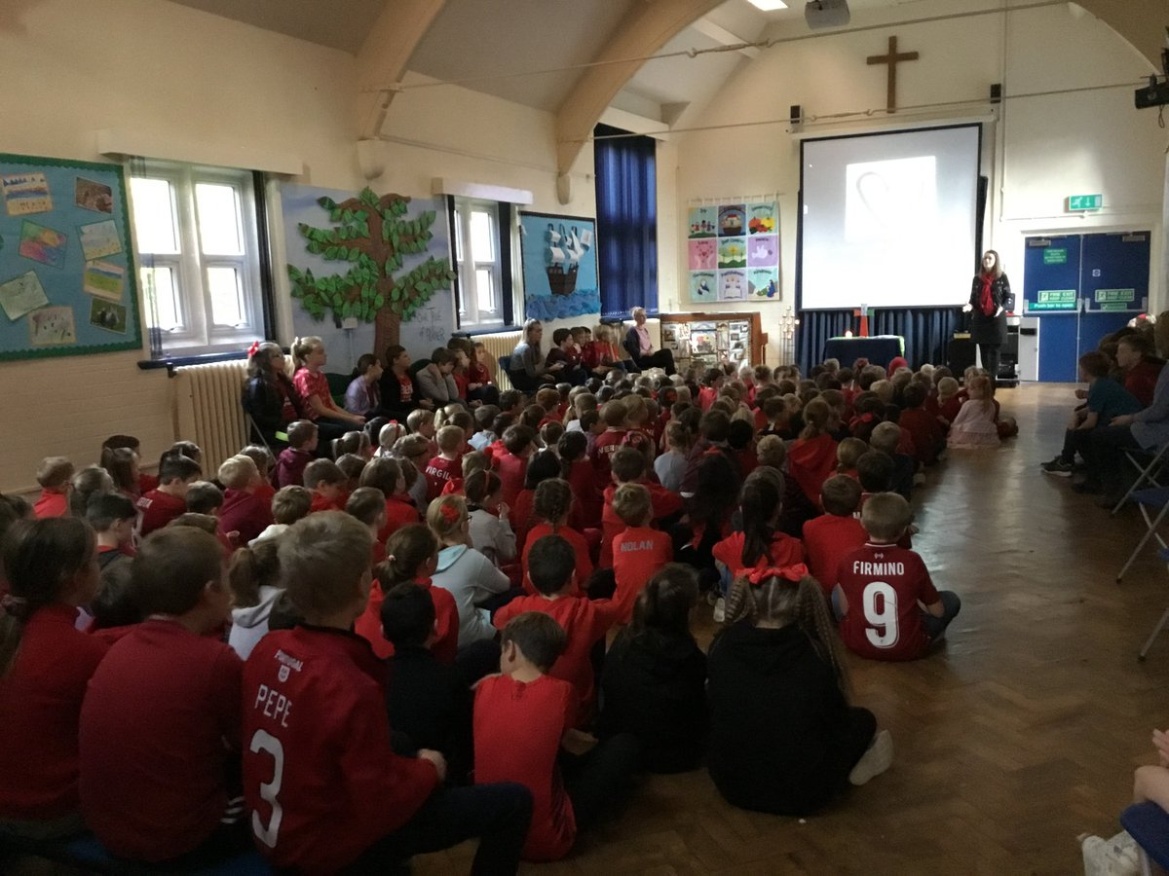
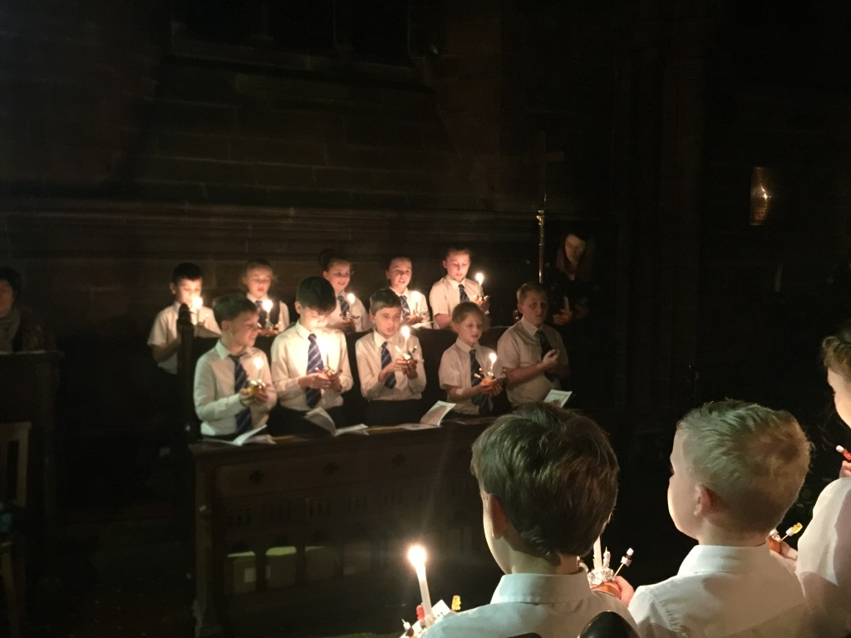
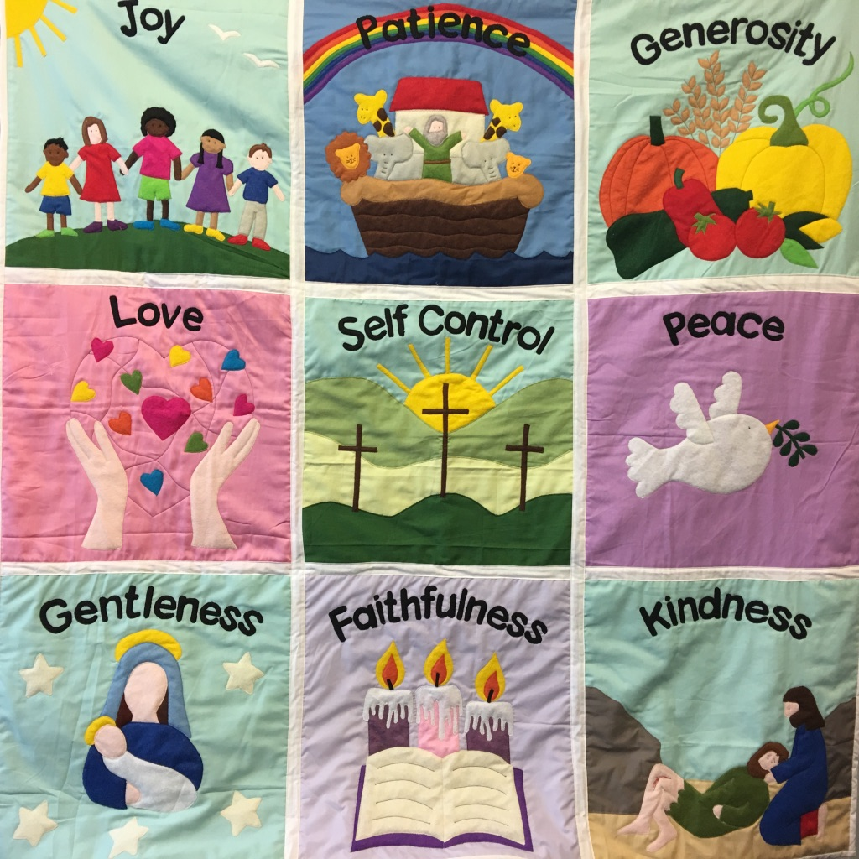
Worship
There is an Act of Worship every morning. Worship is a time where we come together to reflect on the school’s vision and values and to learn about the Person, Love & Work of Jesus which is central to the school’s vision and curriculum. The daily Act of Worship promotes the school values which permeate the ethos of the school. Worship covers such areas as:
Christian Values: Person, Love & Work of Jesus
British Values
Relationships & Health Education
Equality & Diversity
Celebration: Rewards & Certificates

Slide 10
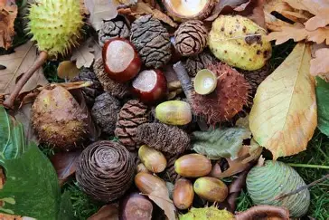


Homework Activities
Reading – Home readers and levelled books.
Phonics - Targeted sounds.
Maths - 3 questions to consolidate.
Weekend Project - Fun challenge.
Extra - collect Autumnal items (no hazelnuts, walnuts, pecans) and purplemash.

Slide 11
Certificates and Awards
In Year 1, we use class Dojos. The children can earn points for being on task, working hard, teamwork, listening, perseverance and much more. The children can set targets for themselves and can help to decide the rewards which they work towards. The children are also awarded stickers.
Bronze - 50
Silver - 100
Gold - 150
Headteachers - 200

Slide 12
Certificates and Awards
Each week a ‘Learning value’ certificate is awarded to two children in our class in recognition of demonstrating the school’s ‘Learning values.’
Each week two ‘Fruit of the Spirit’ certificates are awarded to a child in our class in recognition of demonstrating the school’s core values.
A celebration assembly takes place every Friday to acknowledge weekly achievements.
In Y1, we have a ‘treasure chest’ for the children to choose a small prize for moments of exceptional work or achievement.
Golden Boot award given to children during opal play.

Slide 13
Behaviour & Anti-Bullying
At Dawpool, we believe that all people are made in the image of God and are unconditionally loved by God. Everyone is equal and we treat each other with dignity and respect. Our school is a place where everyone should be able to flourish in a loving and hospitable community. Poor behaviour and bullying of any kind will not be tolerated and will be taken seriously.
Dawpool’s Behaviour Policy can be viewed here.
Dawpool’s Anti-Bullying Policy can be viewed here.
The school’s Anti-Bullying Guide for Parents can be viewed here.
The school’s Anti-Bullying Guide for Children can be viewed here.
If parents and carers have a concern about behaviour or bullying, please share your concern with the class teacher so we can resolve the situation quickly.

Slide 14
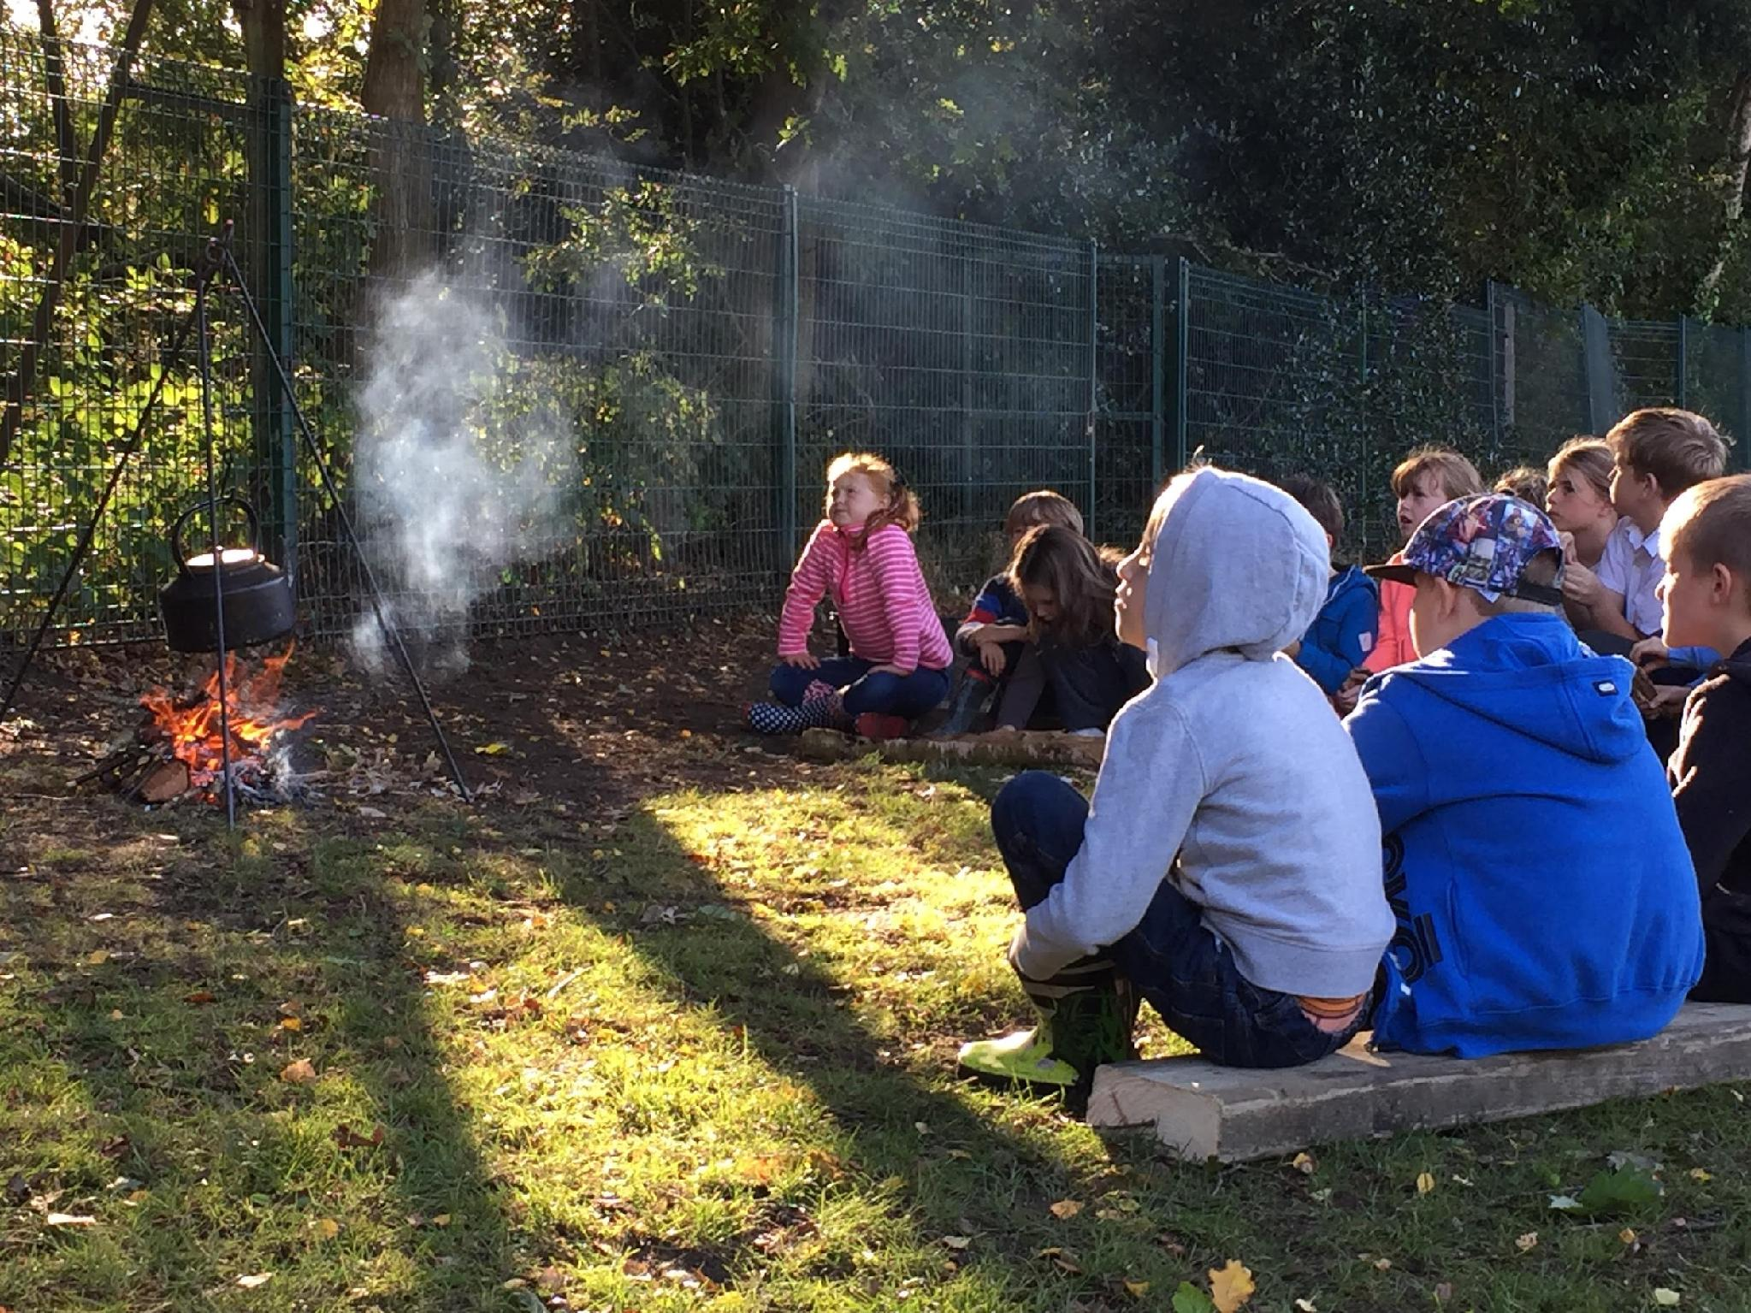
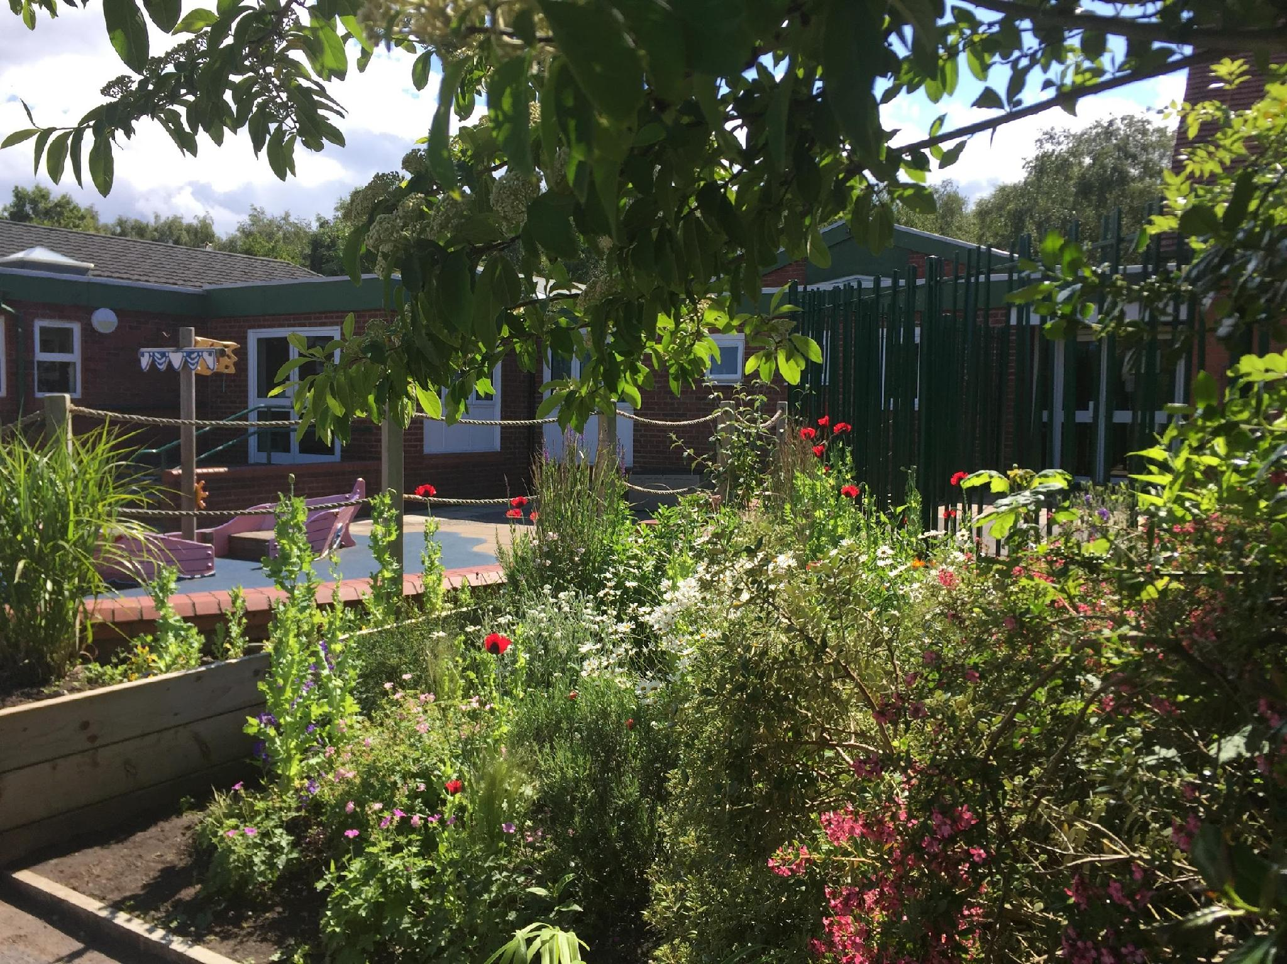
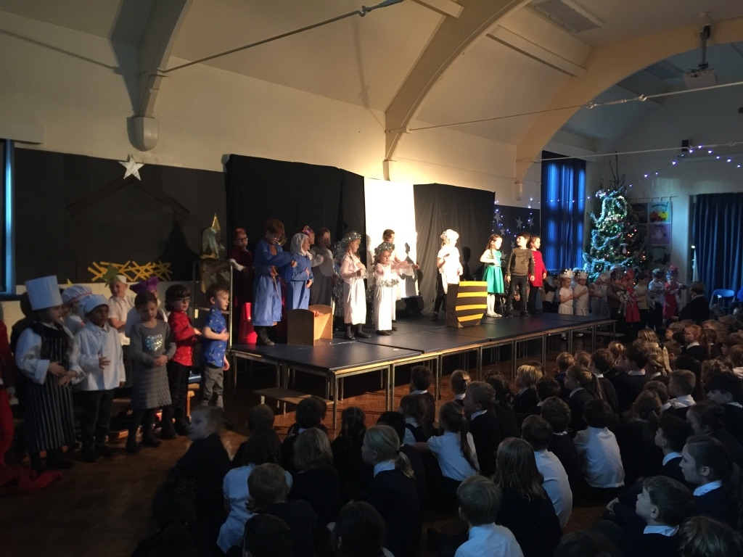
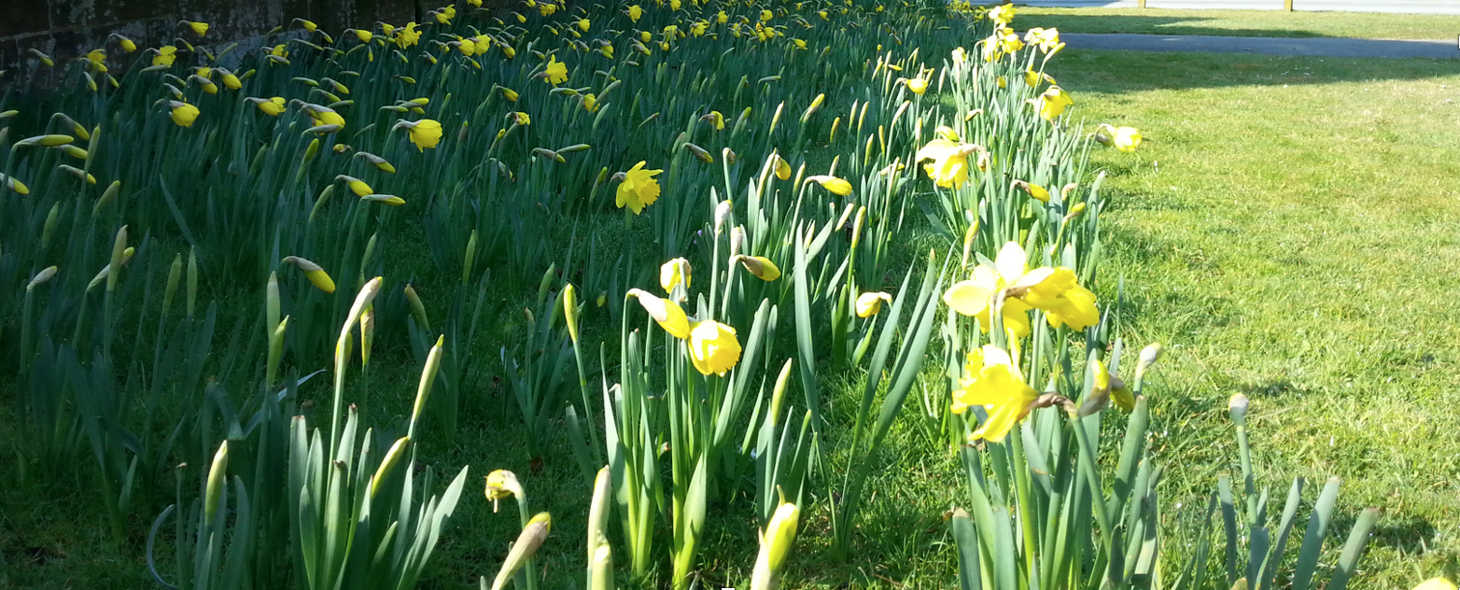
Safeguarding
We know there can be no greater importance to parents and carers than the safety of their children. It is a priority that our safeguarding procedures keep our children safe.
We have a team of staff responsible for keeping children safe and supporting those most vulnerable to harm and neglect. Our Designated Safeguarding Leads (DSL) are Mrs Griffiths (Head Teacher), Mrs McCann (Deputy Head Teacher) and Mrs Poston (EYFS lead). Our safeguarding team pays particular attention to the meticulous and systematic implementation of policies and routines.
Safeguarding involves every member of the community. If you are concerned about a child’s welfare, please record your concern and report it to one of the safeguarding team as soon as possible.
The school’s safeguarding policies and procedures can be downloaded here.

Slide 15
Snack and Lunch
We have a number of children and staff with severe food allergies, so it is really important that we carefully manage food in school to safeguard everyone.
There is a change to our snack routine:
Snack is toast, ordered through school, or one piece of fruit brought from home.
No other home snacks are permitted.
Afternoon snack is fruit or veg offered by school to encourage the children to try a range if different fruit and vegetables.
Benedict’s Law sets out legal requirements for schools to help reduce the risk of serious allergic reactions and safeguard children and staff with allergies. All staff have completed Benedict’s Law training in allergies and anaphylaxis, and school provided food is prepared and stored in accordance with this guidance.
Please also ensure that lunchboxes follow our Lunch Box Policy, available on the school website.
We ask for your support in following this change to our school day.

Slide 16
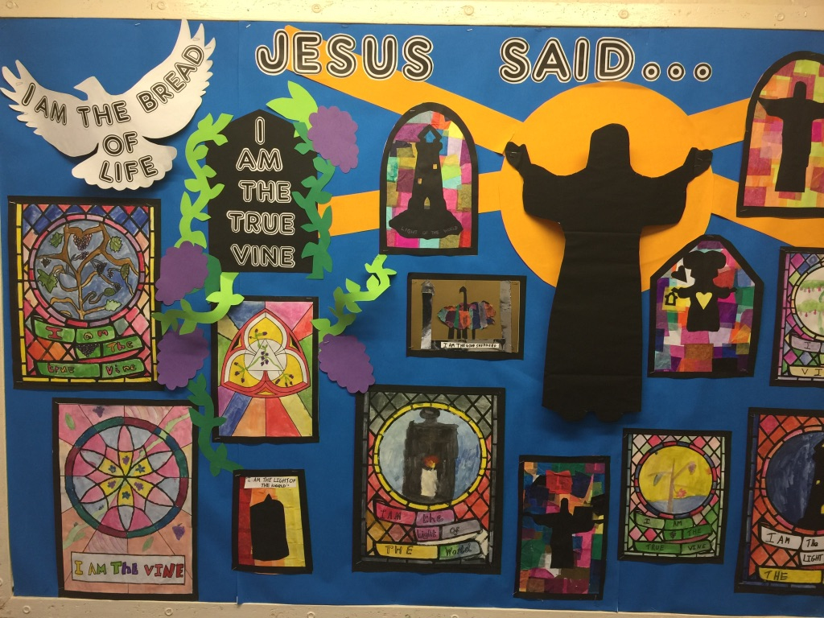
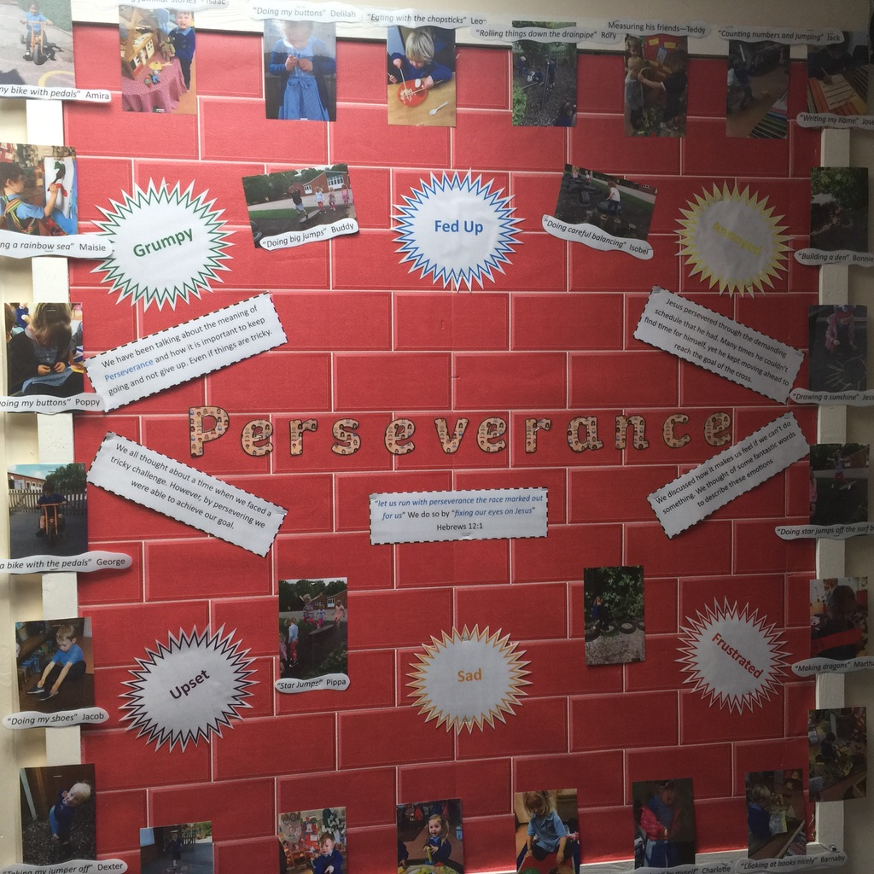
Class Pages
Each class has a webpage which provides parents and carers with an overview of the children’s learning on a week-to-week basis. Please click on your child’s Year Group to view the class page: F1, F2, Y1, Y2, Y3, Y4, Y5, Y6
Your child’s class webpage includes:
Links to important curriculum resources and online platforms
Recommended reading list
Statutory phonic / spelling lists
A timetable of lessons and objectives each week
Homework expectations

Slide 17
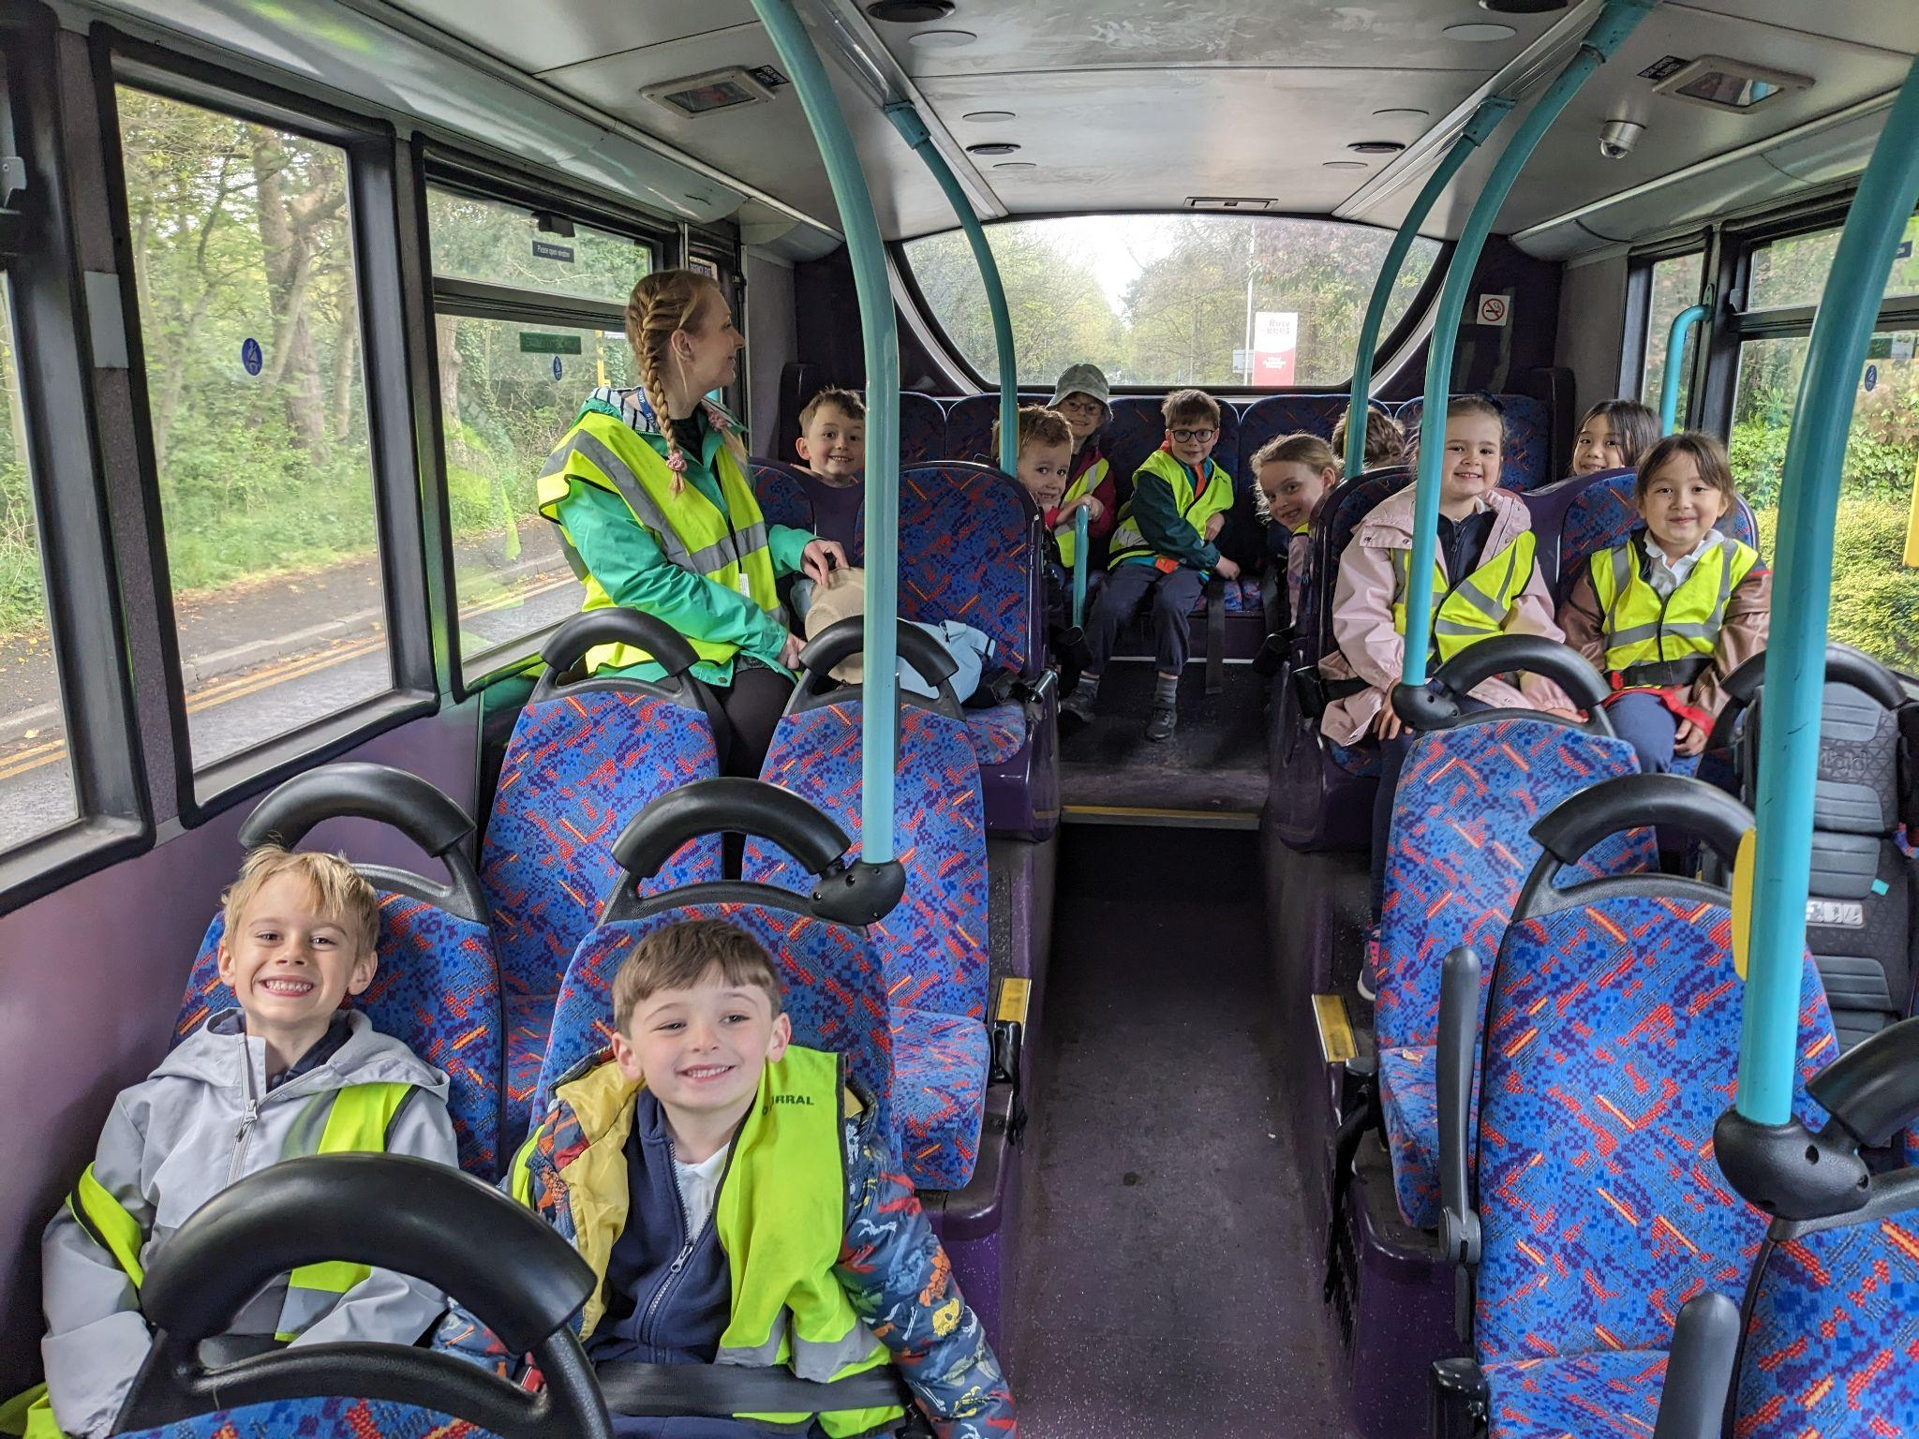
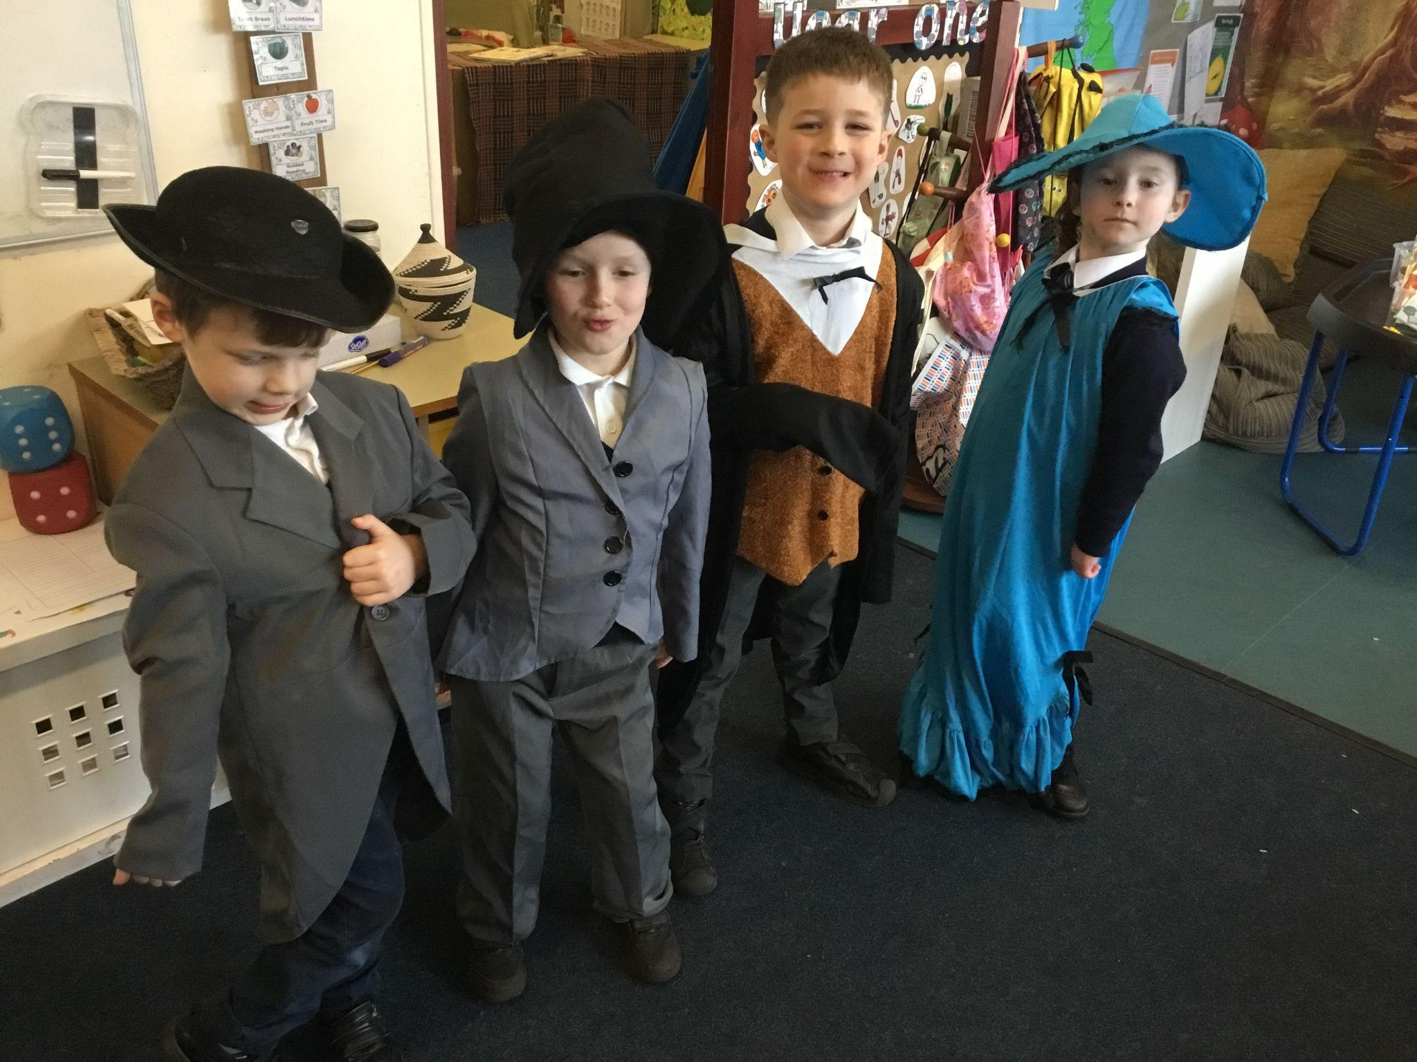
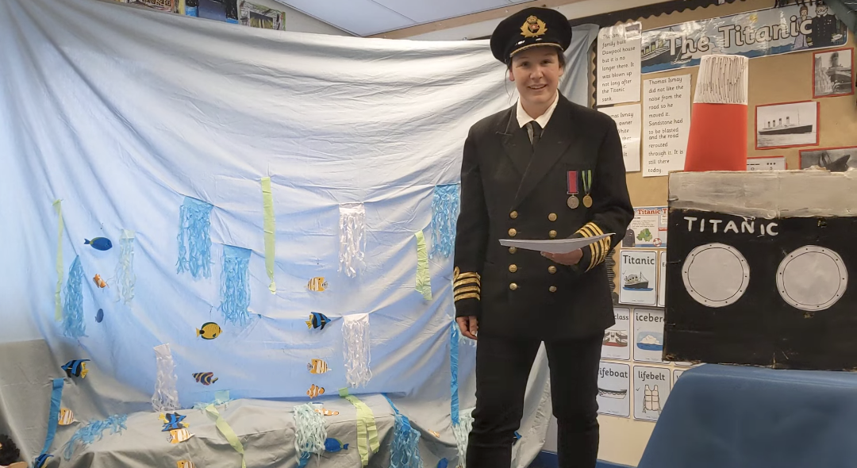
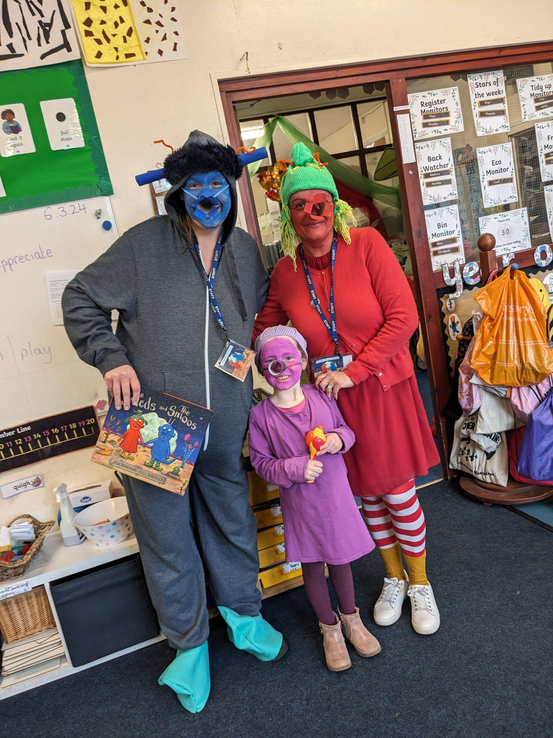
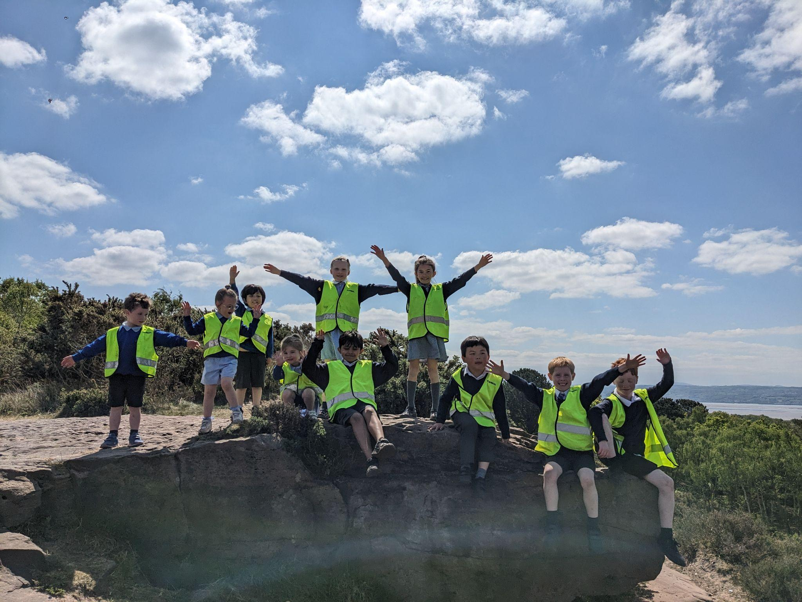
What makes Year 1 special?
Sports Day
Theatre Trip
Wellbeing walks
Church
Nativity
Titanic Day
Dan-tastic

Slide 18
How to support your child
Please read, read, read :)
Medical needs
If your child has medication during the year it should be taken to the school office where a request for school to administer medication form must be filled in. Please ensure that any inhalers are in date and an asthma passport has been completed.
Please keep communication.
Please make an appointment to chat to us if you have any concerns or think there is information we need to know. We have an open door and any information you can give us enables us to fully care for support your child.

Slide 19
Extra Information
FoDS - please support our school and offer to help throughout the year.
Please don’t bring in toys and teddies. We are not doing ‘show and tell’ this year, just ‘news’.
PE kits Thursdays and Fridays. Please wear Dawpool PE kits or unbranded navy.
No wellies needed for Forest School for now.

Slide 20
Contact us
View our Home-School Communication Procedures here.
Initially, please contact the school office who will hopefully be able to respond to your enquiry straight away. The school office can help with all general enquiries: admin, events, attendance, school dinners, clubs, payments, wrap-around care, etc. Alternatively, the school office may direct your enquiry to another member of staff, for example:
Class teachers: For enquiries relating specifically to children (learning, progress, behaviour, wellbeing, equipment, timetables etc.)
SENCo: For enquiries relating to Special Educational Needs (SEN) and Inclusion.
Designated Safeguarding Lead (DSL): For enquiries relating to pupil welfare and safeguarding.
Deputy / Head Teacher: For enquiries that have not been previously resolved by speaking with other staff members.
Staff Availability
For enquiries that require a parent or carer to speak with a member of staff, the school office will arrange this for you. Staff will always try to speak with parents and carers as soon as their work schedule allows, but this may be difficult to organise quickly due to teaching and other commitments. The office staff will keep you informed of timescales regarding meetings and appointments. Staff are also available at the school gate at the start and end of each day.

