Slide 1
Art Gallery & Messages from the Class of 2020

Slide 2
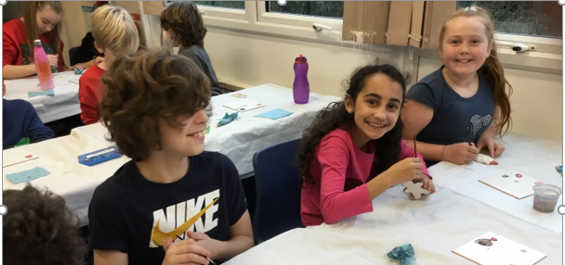
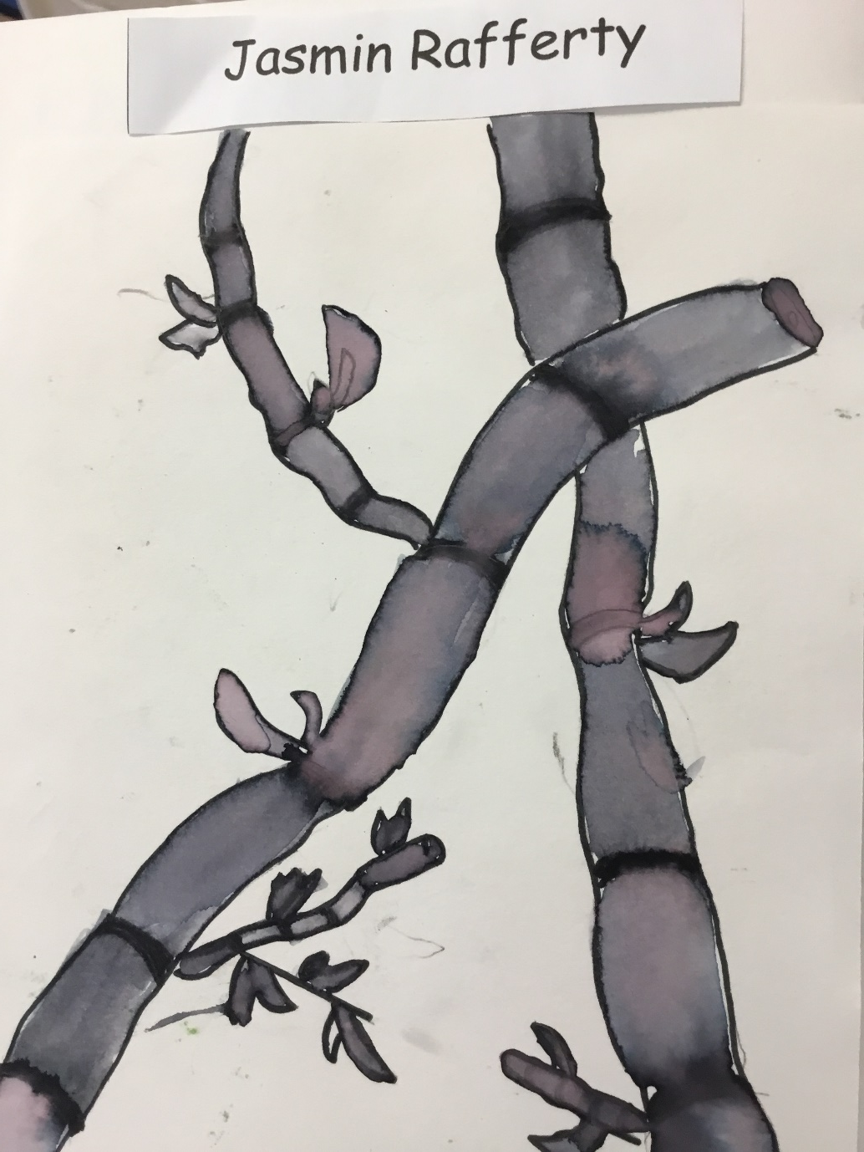
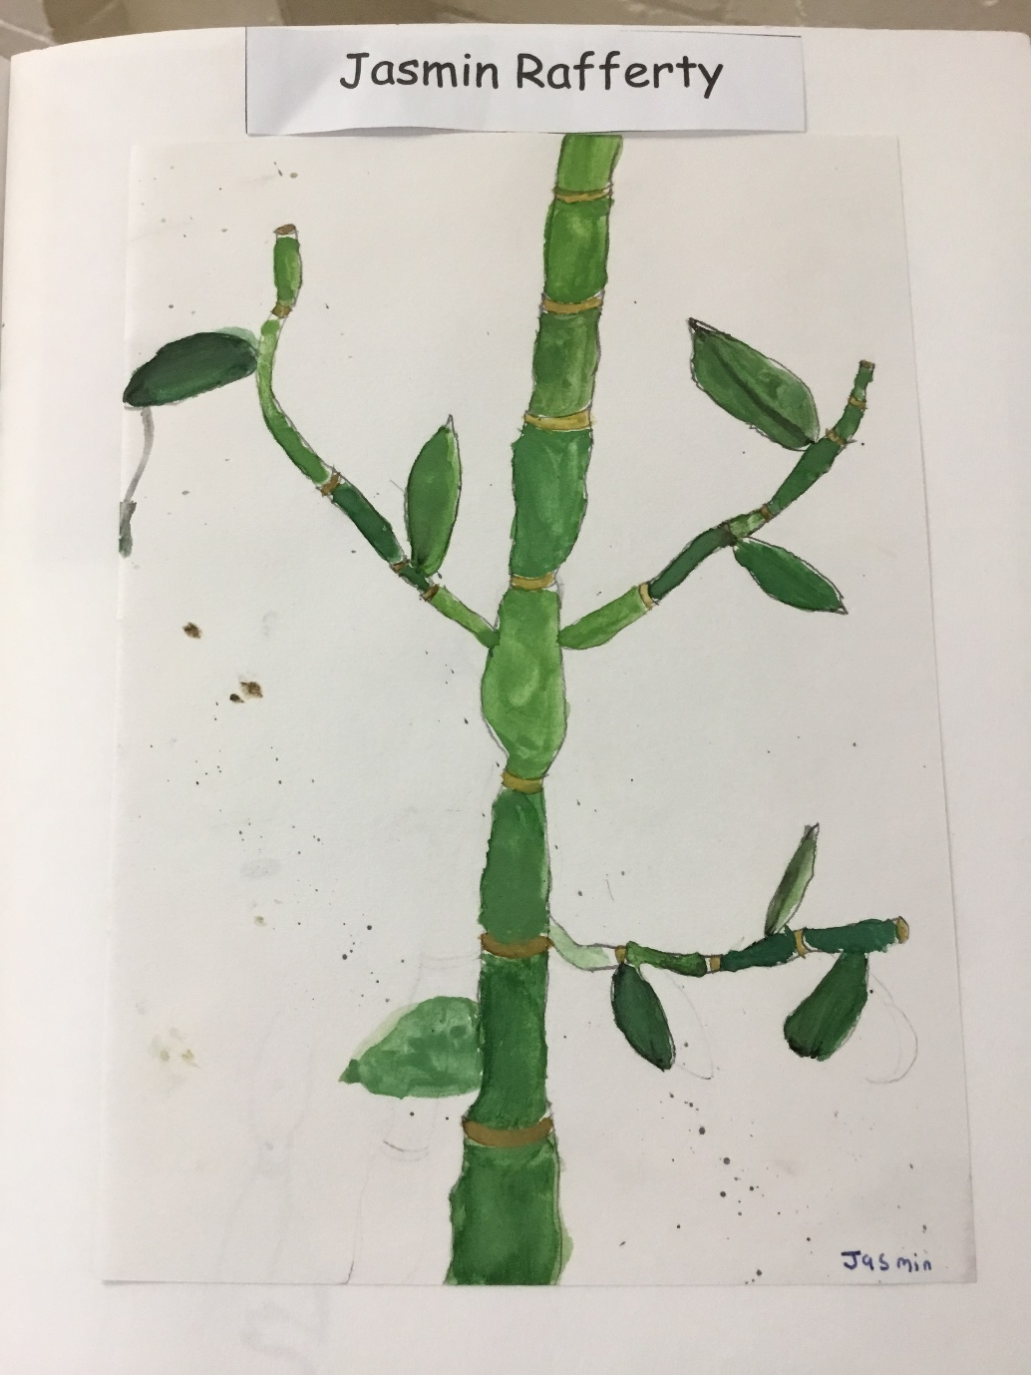
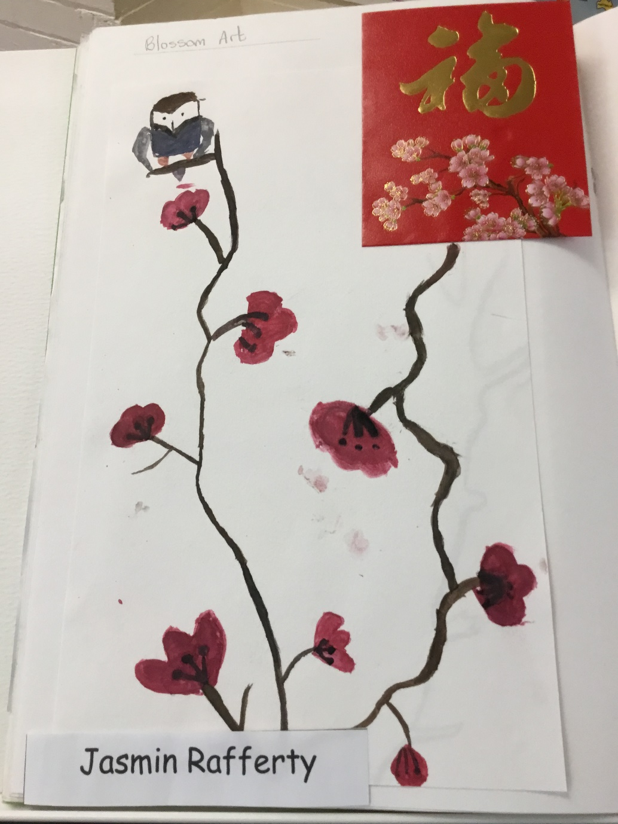

Slide 3
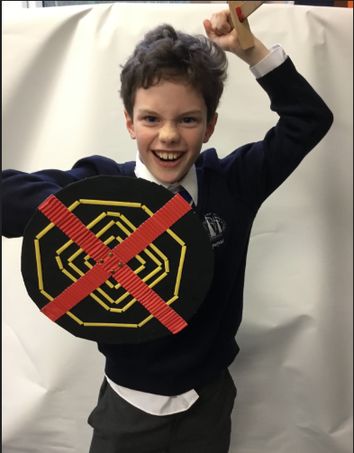
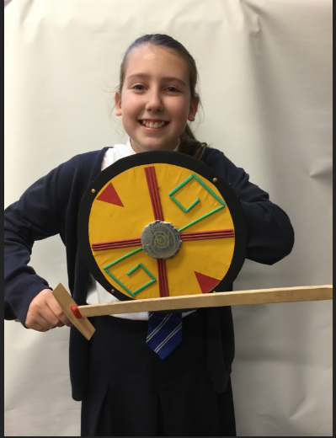
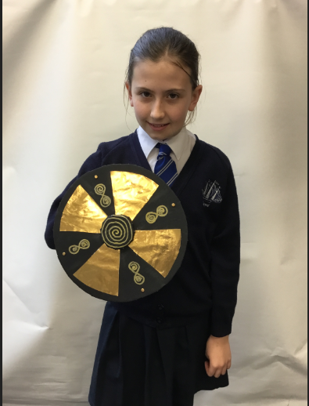
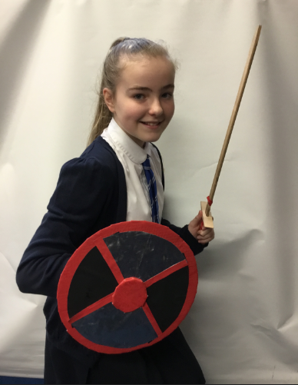

Slide 4
I really loved year 5 and 6 they were definitely the best years. In year 6 I loved everything, I have always found maths really boring but year 6 makes everything amazing! I still can’t believe that this experience is coming to an end, I have made friends who I will never forget and a best friend for life. I will miss everything about this school; the teachers, my friends etc. I will never forget about Dawpool and it will be in my heart forever but now that this class is leaving it will definitely be different!
Thank you to all the teachers and of course the year 6s for making this so special.
Jasmin Rafferty

Slide 5
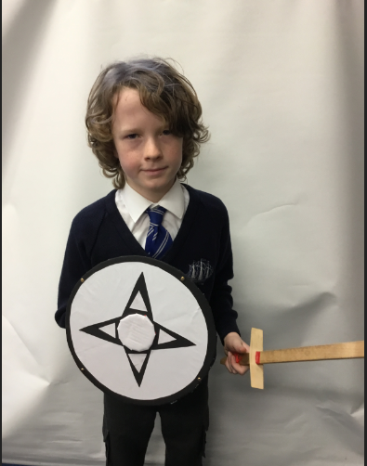
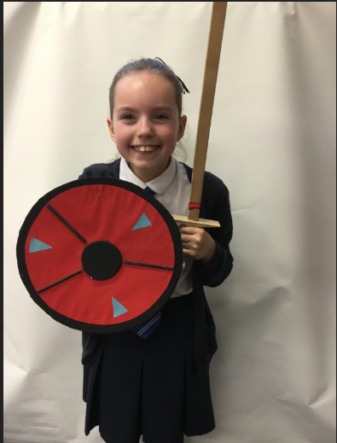
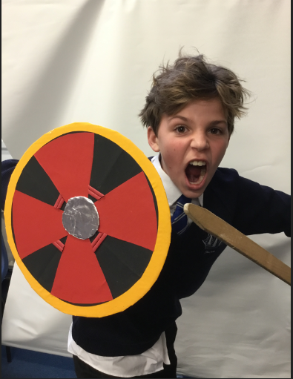

Slide 6
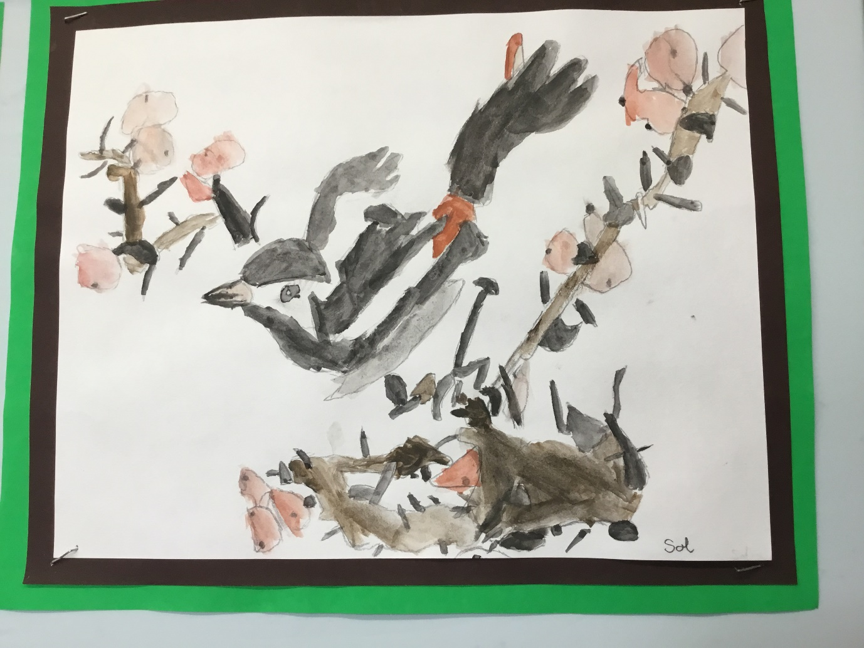
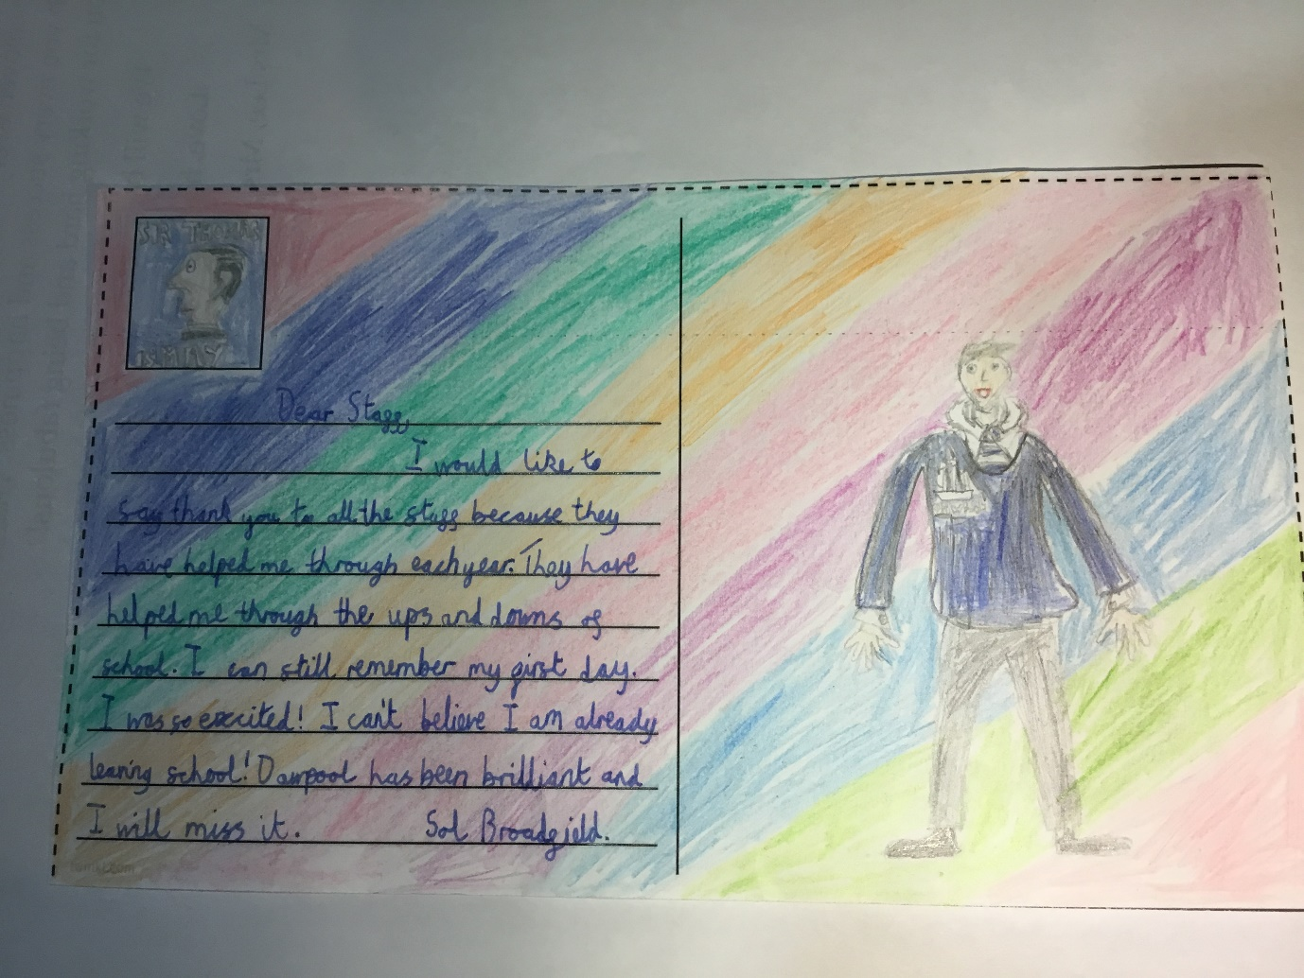

Slide 7
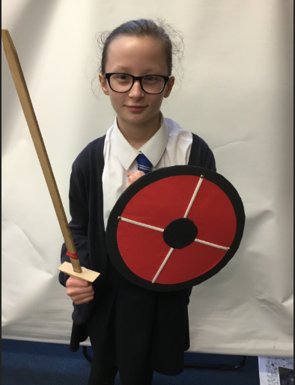
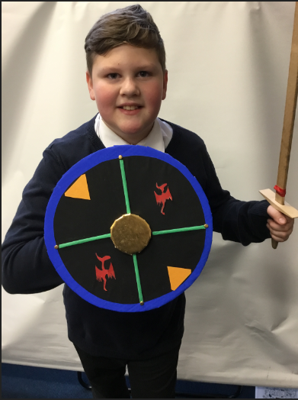
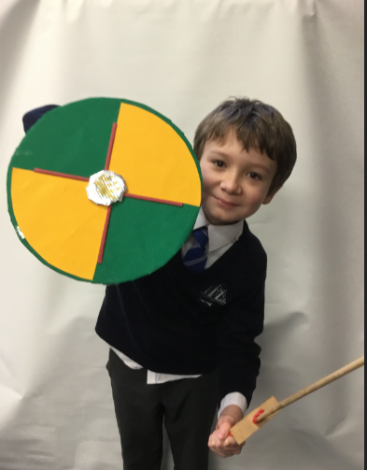

Slide 8
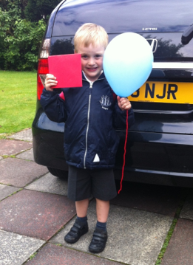
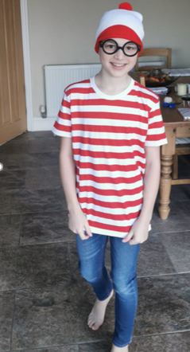
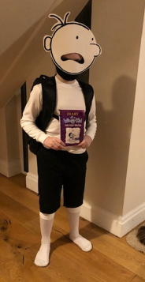
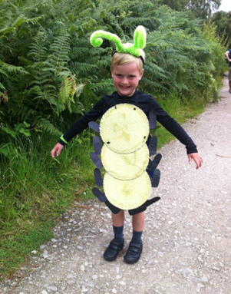
“Thank you to all the teachers at Dawpool for looking after me and making me feel safe and happy.”
“Thank you to all my class for being nice to me. I have enjoyed being in primary school with you all and wish you good luck in your new schools – I’ll see lots of you in Pensby!” (Max R)

Slide 9
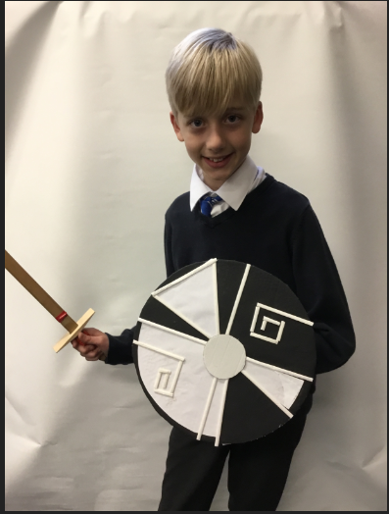
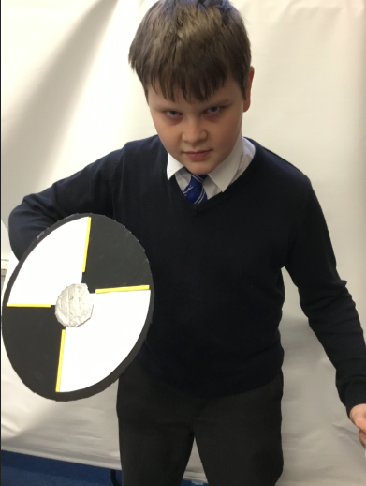
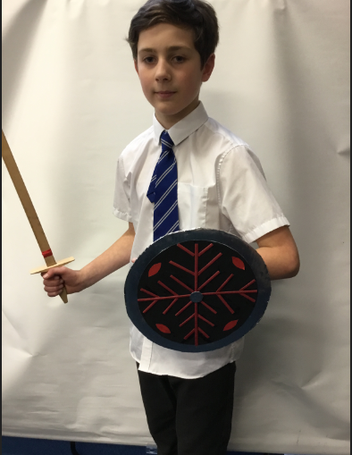

Slide 10
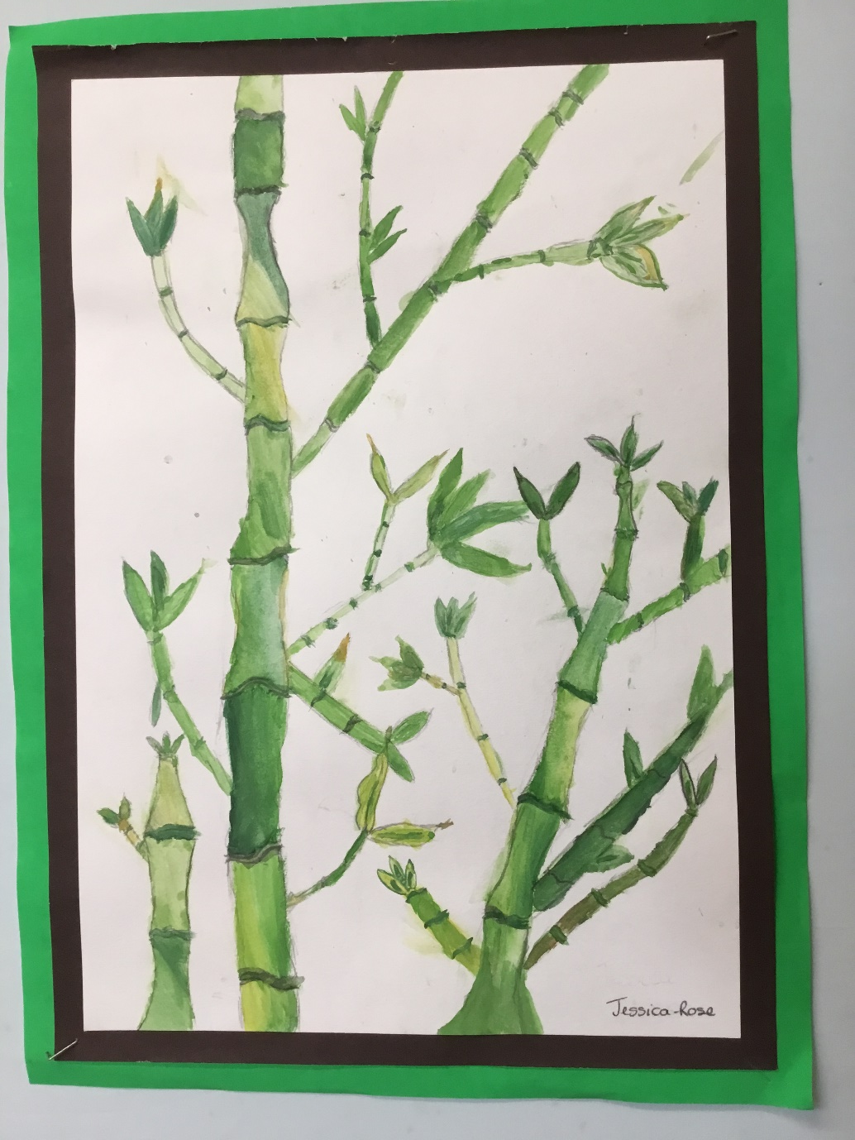
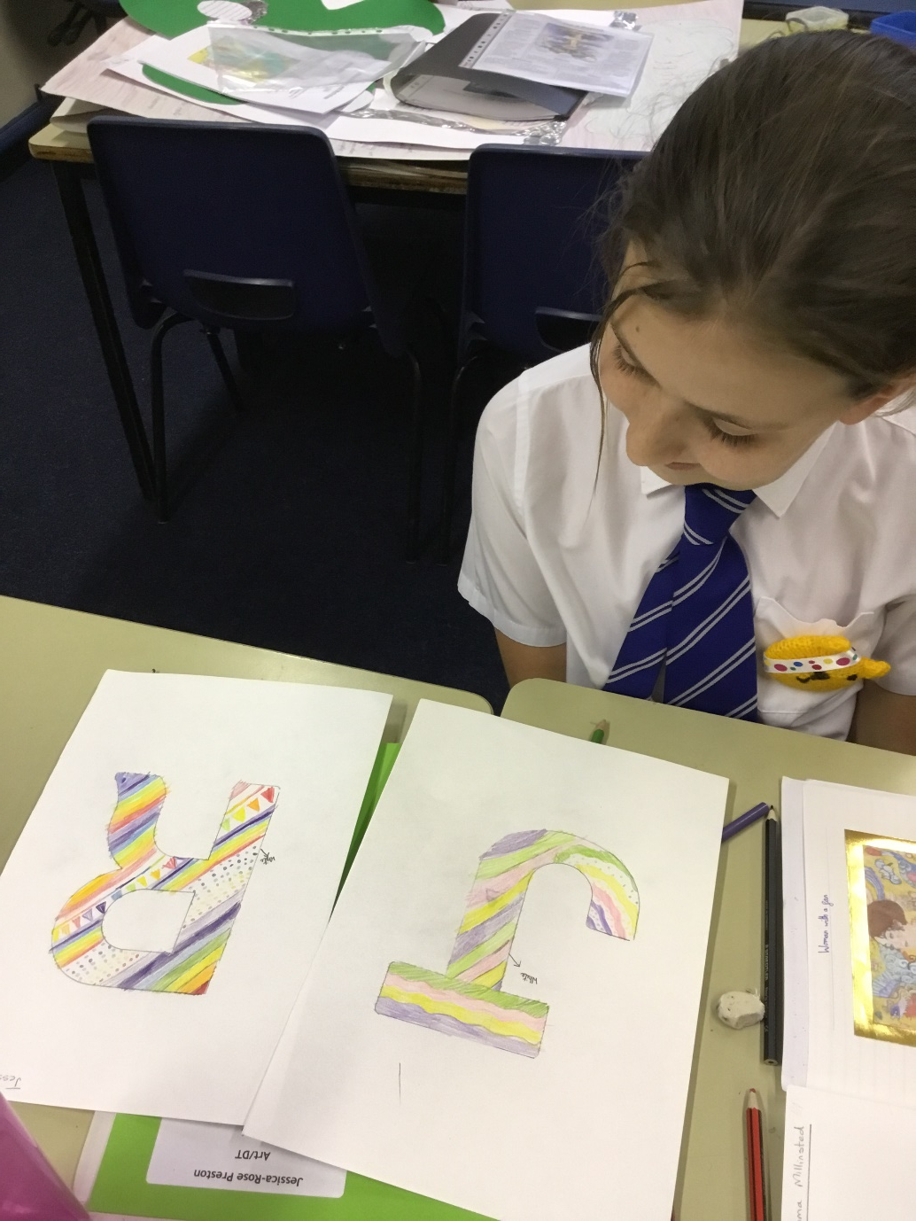

Slide 11
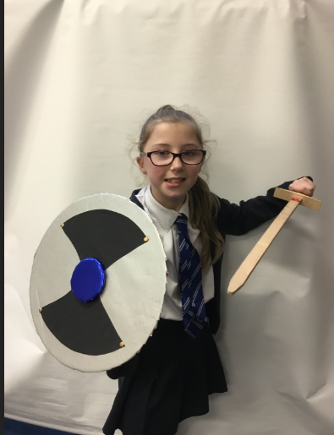
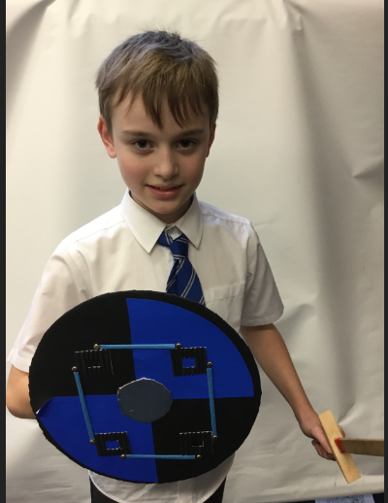
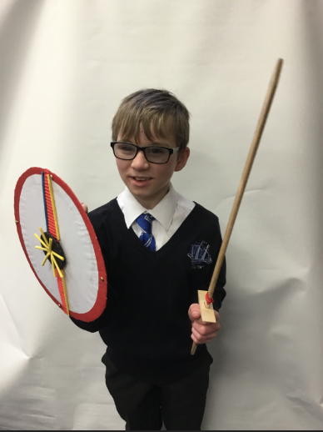

Slide 12
I loved it when we first met Mrs Lecoustre's pet hedgehog in Foundation 2 and we got to stroke her (the hedgehog, not Mrs Lecoustre!) Another special memory was when the chicks hatched at Easter. I also loved Titanic Day in Year 1, being an office monitor in Year 5 and, in Year 6, playing rounders against the Year Fives. My special memory of Year 6 was the lovely Christmas treat from Mrs Lee & Mrs Earp of painting the Christmas pottery decorations with the rest of the class. I will hang my gingerbread man on my Christmas tree every Christmas and it will always remind me of my time at Dawpool. Love from Jessica-Rose

Slide 13
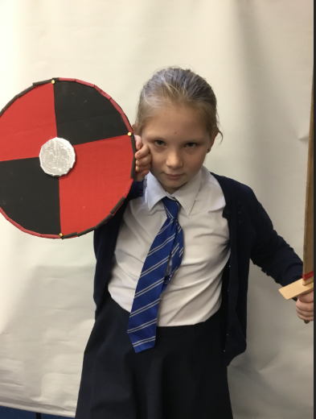
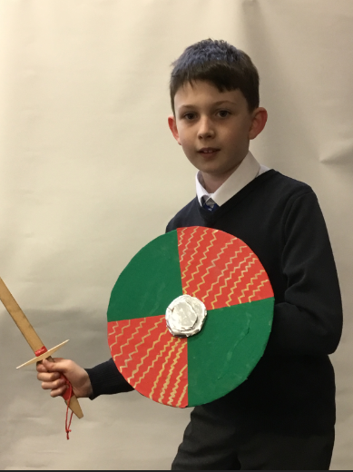
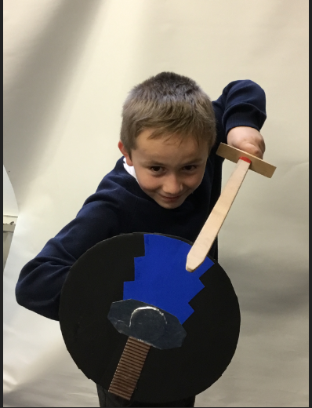

Slide 14
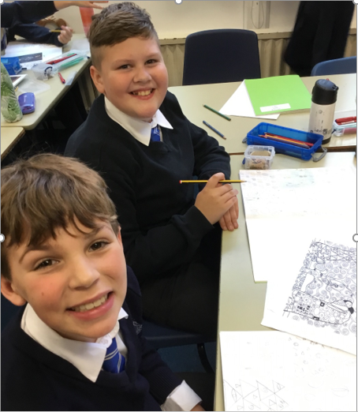
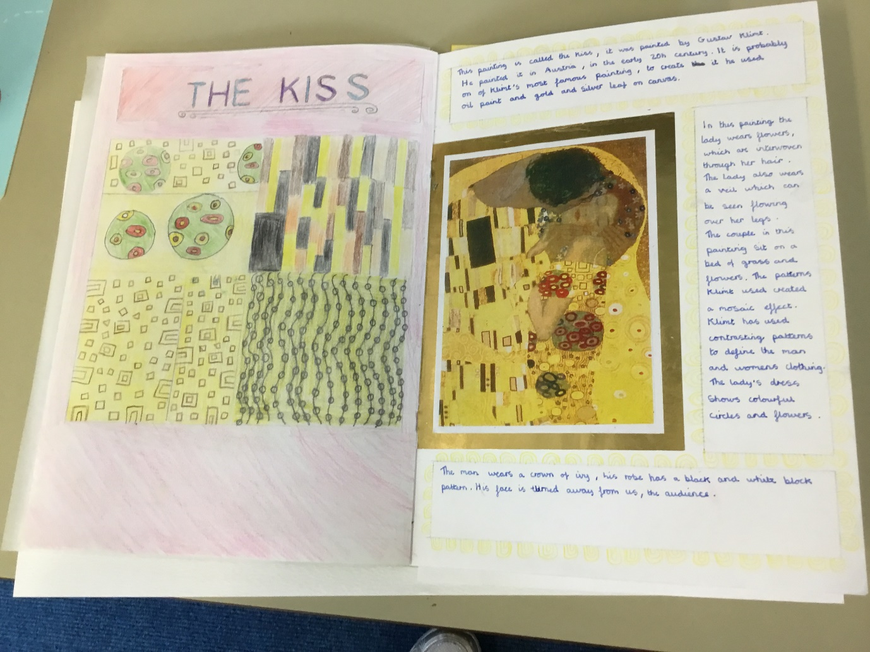

Slide 15
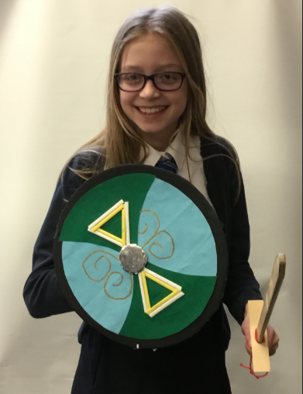
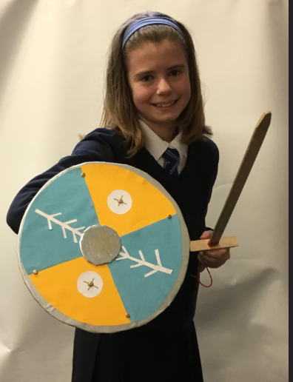
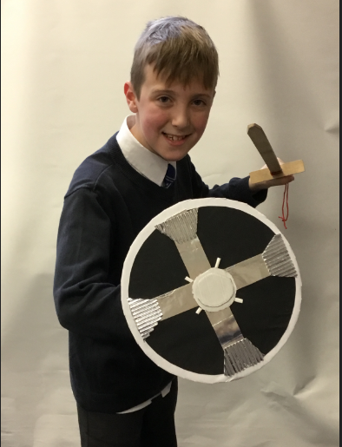

Slide 16
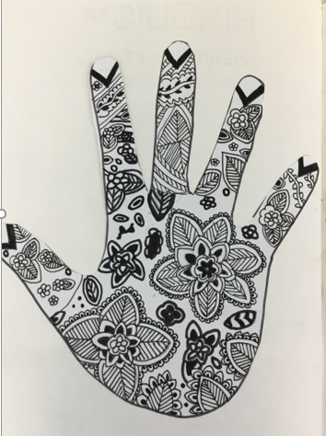
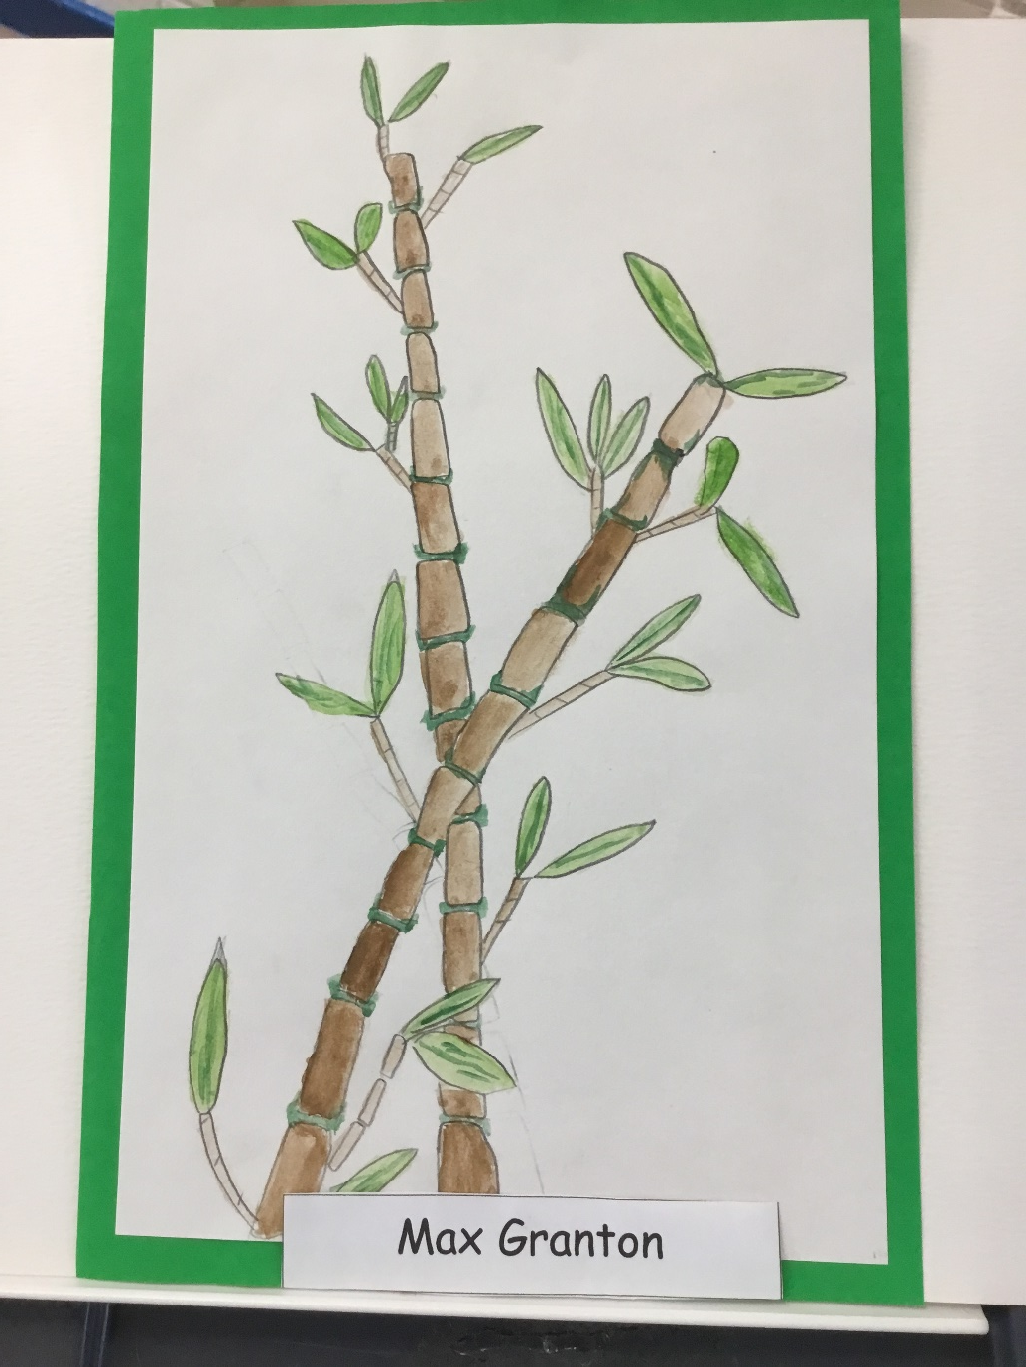
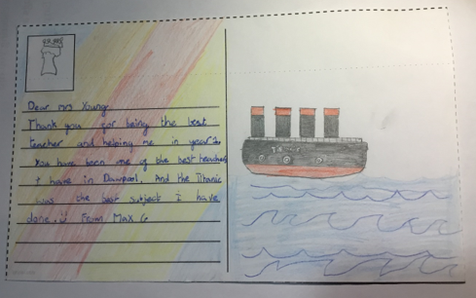

Slide 17
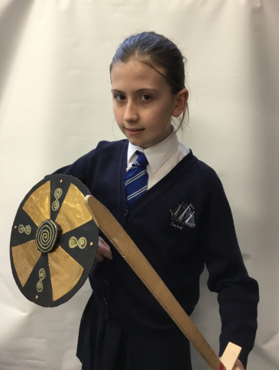
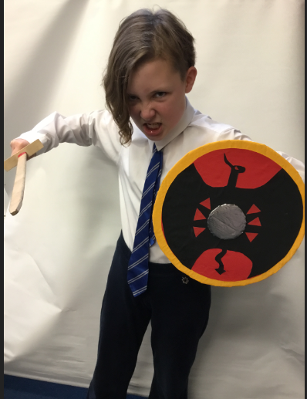
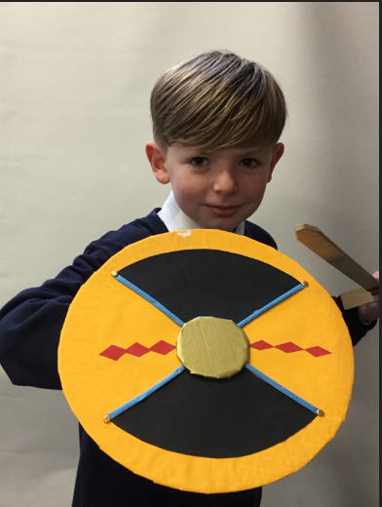

Slide 18
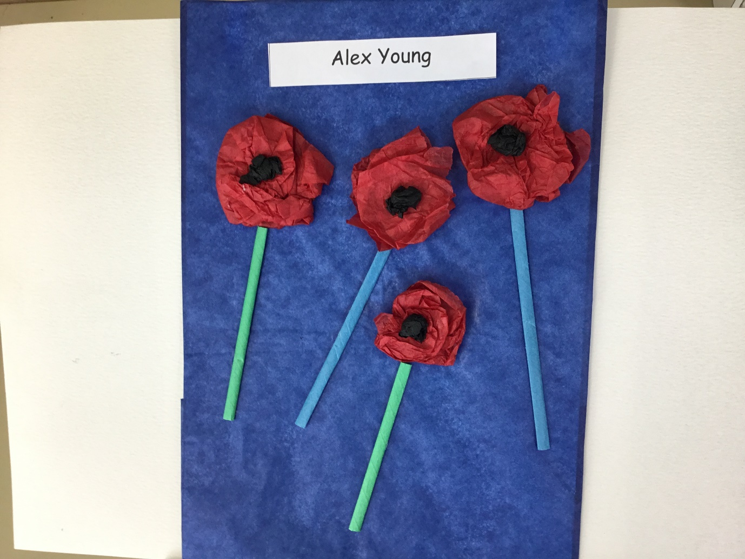
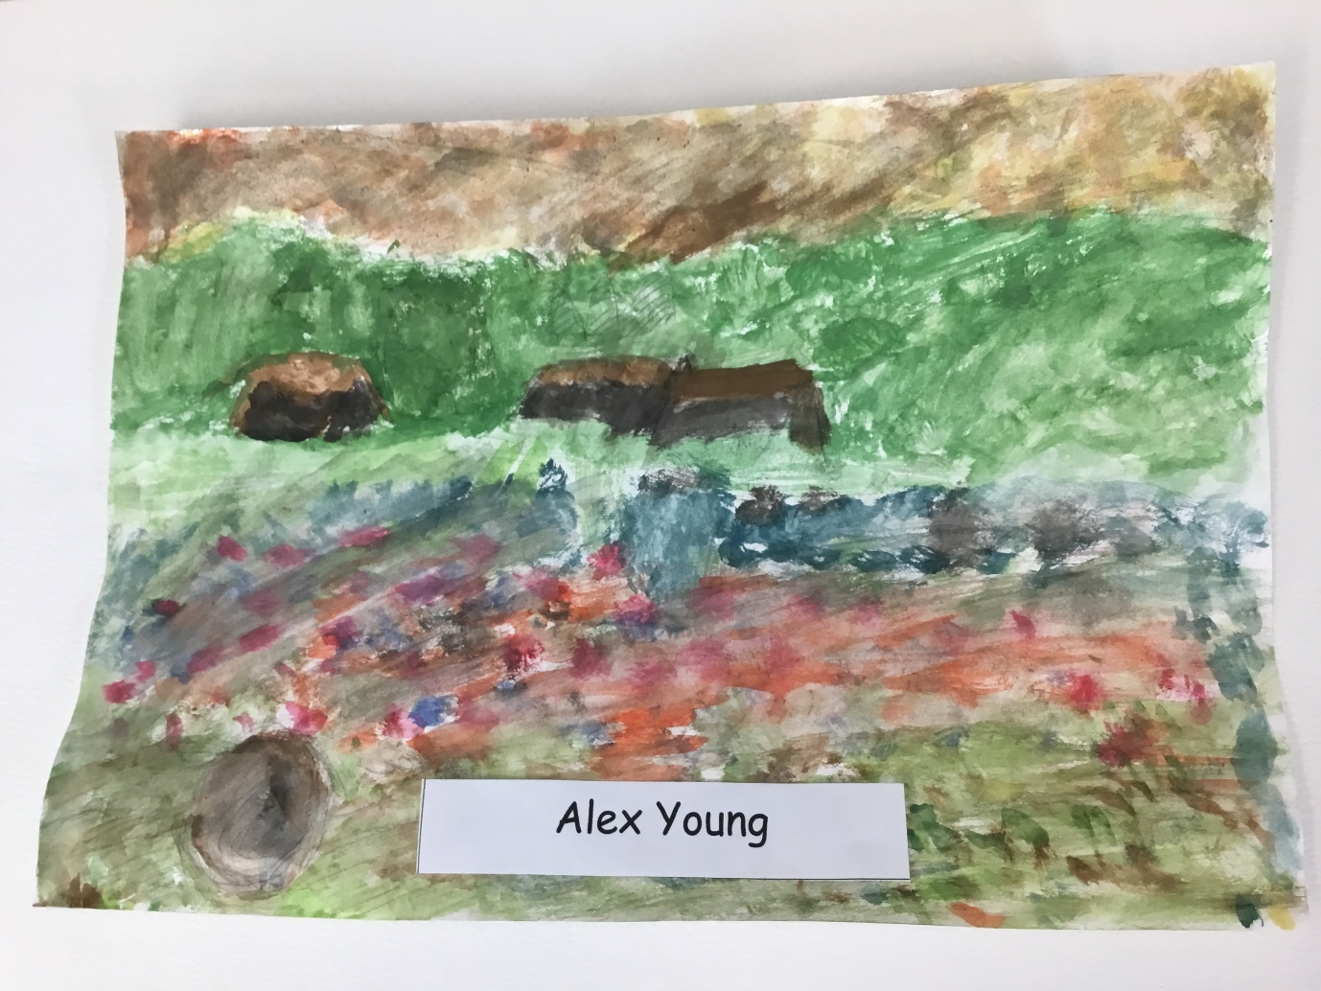
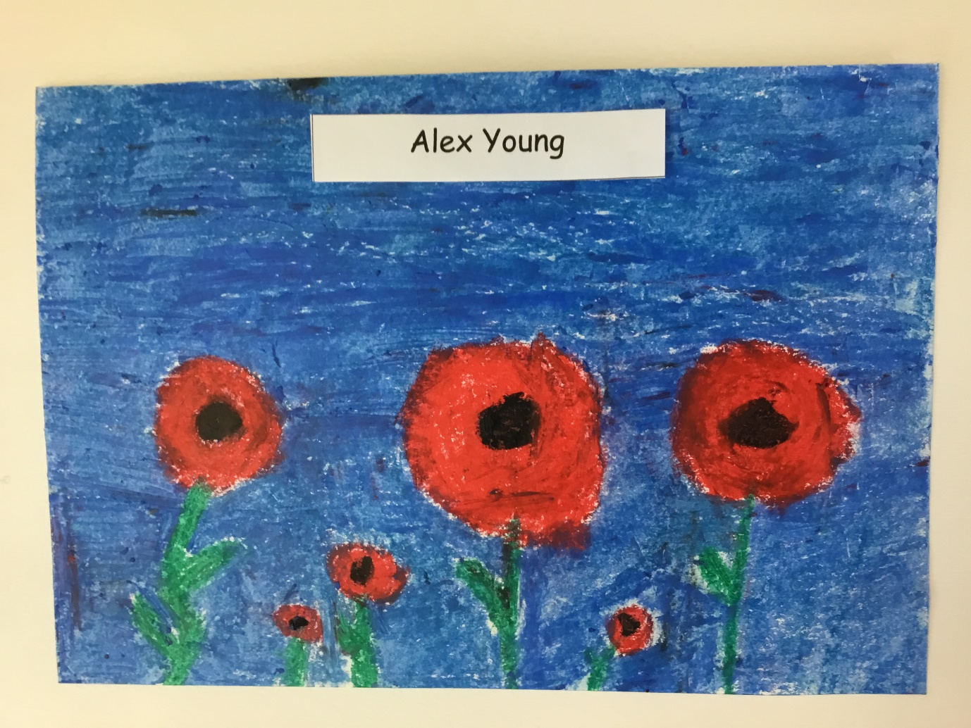

Slide 19
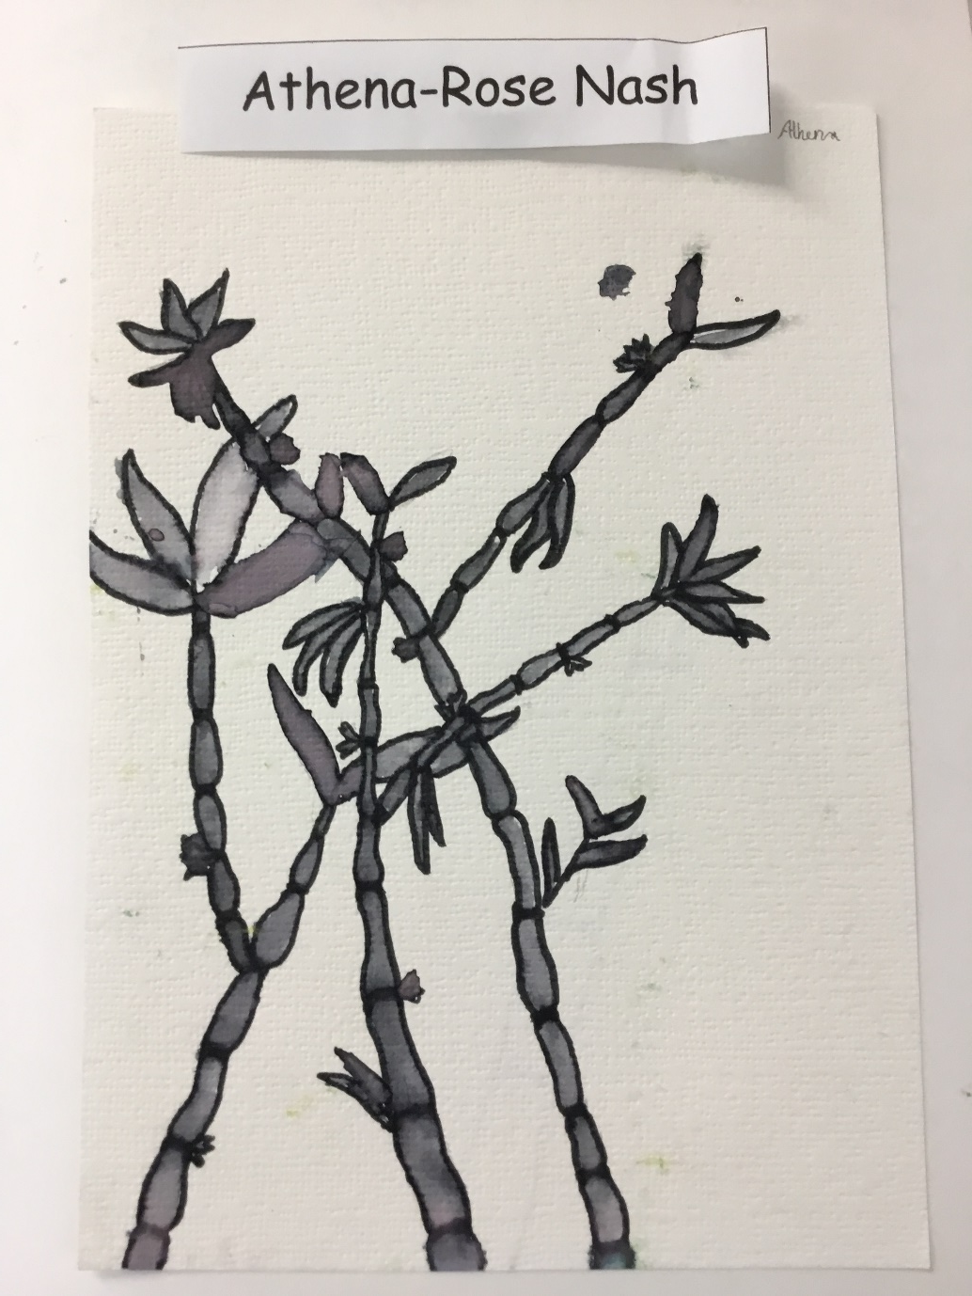
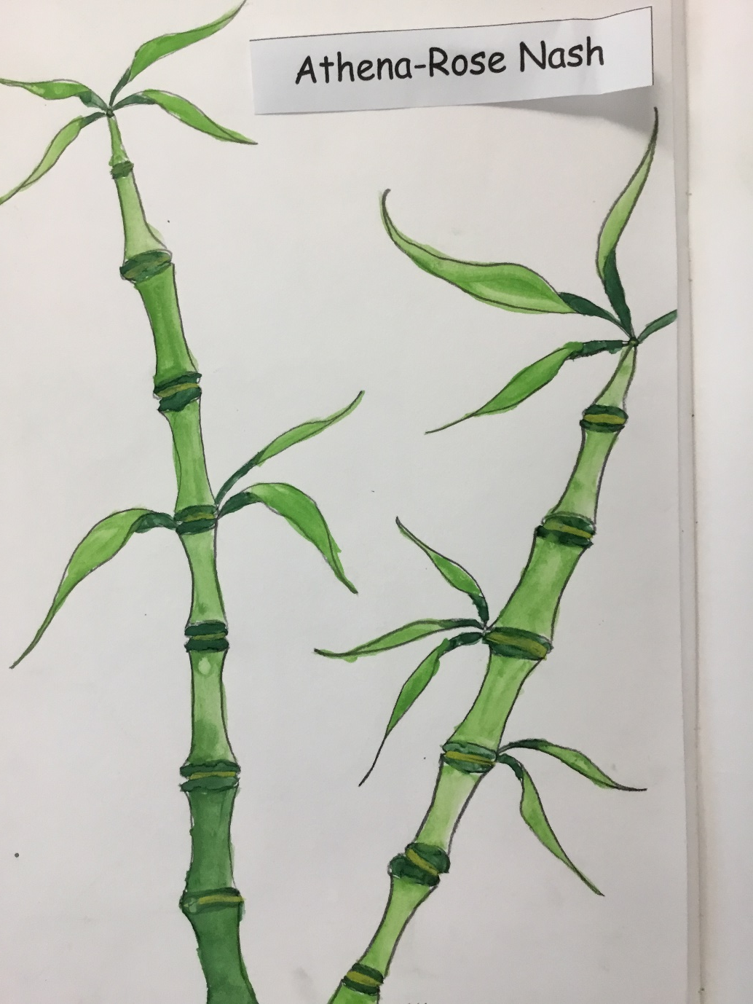
The first memory I remember is the day I came into the hall and met my special friend Poppy I even remember her handing me a biscuit. In year 1 we did The Little Angel play and we also did Titanic Day outside on the gym mats with Mrs. Young it was so fun. We also went on a ferry to Liverpool and had our lunches on very fancy tables. In year 2 MRS. Ashton taught us a really fun song called the aardvarks, I can’t remember exactly how it goes but I do remember that we did sing it a while ago. We also went to nest gardens on a trip. In year 3 I remember that Mrs. McNee was teaching us and then on the board behind her appeared the words Mrs. McNoodle and all of us started laughing and so Mrs. McNee got confused so she turned around and the board she started to laugh as well and had known that this funny doing was by the one and only Mr. G. in year 4 we went on a trip to see facts about the Romans and got dressed up like one, we were able to practice moves with our shields like the Romans did in battle. Also Mr. G used to give us dojo’s, they were really fun. We had a party in year 4 and one of the dares was that a boy (not going to say who) had to go and put on Mrs. McNee’s pink high heels and her pink scarf, it was so funny. We also started choir and went to peace proms. We went to pick strawberries at Clare-Monte farm. In year 5 we did art and painted any bird we wanted. We had so much fun learning about ancient Greece and all about the Gods and Goddesses. We also did our own birds of hope it involved: card, string, glue and GLITTER! In year 6 we have so much fun with every subject but my personal favourites are maths and art, we get to use watercolour and learn about famous artists, trying to recreate their artwork. Also in maths it’s a bit challenging but you get used to it, some of my favourite memories in year 6 are when Mrs Lee makes funny names for us in the morning and is always smiling along with Mrs Earp. I really am going to miss every teacher in Dawpool and so the school is going to get a little present of me on the last day.
Athena-Rose Nash

Slide 20
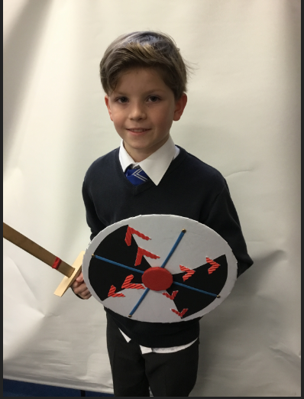
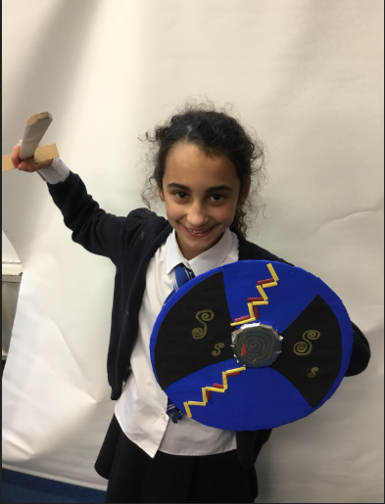
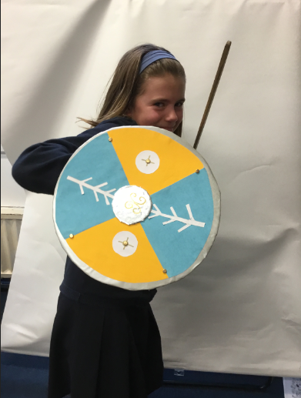

Slide 23
I loved the Titanic day because we were able to dress up in Titanic people costumes and jump into life boats in the playground.
I enjoyed The Black beard play because I was one of Blackbeard helpers and I read out my lines loud and clear.
I loved French day because we ate French food and had a lovely day
I loved the roman trip because the Dads through snowballs at us.
I also loved the play in the woods with Mrs Poston called “A Mid Summers Night Dream”.
Playing once in the school football team.
Riding on the ferry in year 1 and a having lunch on it.
Going to the tram museum and being able to ride one.
Going on a trip and being able to walk through a wardrobe in Narnia and on an a adventure. (Max G)

Slide 27
I feel sad to be leaving Dawpool because I made many memories here, even though I didn’t want to go to school at the time. I never want to leave this peaceful but sometimes loud school. I have so many memories with all the lovely teachers whose ways are different each year, but sadly 6 years have past since I joined this school….. all the meals since I joined…. all the trips which I have loved and laughed. All the awards I have earned show I have been smart. and kind in this school but it is coming to an end.
I love that I am not a silly person but I am one of the people who listen. I am sad we missed over Year 6 trip because of Covid-19. I liked Playing Star wars with Franklin, Alex, matthew and Josh. My favourite teacher is Mrs Lee
I wish I could stay but sadly I can’t. (Oliver Law)

Slide 30
My favourite Memories
I was meeting my special friend Chloe she gave me this fluffy teddy bear with sparkly eyes
In year 1 on titanic day we had tickets we needed to bring to board the pretend boat but I left mine at home so Mrs Young printed me a new one
In year 1 the fire alarm went off but I was playing dress up with my friends and I had to come out in a red Santa dress with these red toy high heels even worse it was summer then we found out it was not a fire the kitchen had burnt toast
In year 1 we used to sing a song called down in the jungle. We sang it with Mrs Lecoustre.
In year 2 we did the play called black beard.
In year 2 we used to sing this song called aardvarks with Mrs Ashton it was so fun
In year 3 on French day we had croissants they were so tasty.
In year 3 when we went to pick strawberries in Clair mount farm it was so fun
When Mrs Hosker was teaching us she Ryan and me do the register after that we thought we were the teachers.
In year 4 we dressed up as romans and marched around the Chester streets are parents that came to help out decided to throw snowballs at us
In year 5 we went to see the mid-summer night play by Shakespeare Mrs Posten played Titania
In year 6 when we made our Viking shields it was so fun at the end we got to pose with our shields
But My favourite memory was when we had been off school for ages because of lockdown when we came back in and we saw our teachers and friends for the first time in ages.

Slide 31
Being at Dawpool has been amazing. I have learned so much. I am going to miss everyone at Dawpool and Dawpool to. (Amelia)

Slide 32
From Lillie-Mae

Slide 40
Lillie-Mae
Cecily

