Slide 1
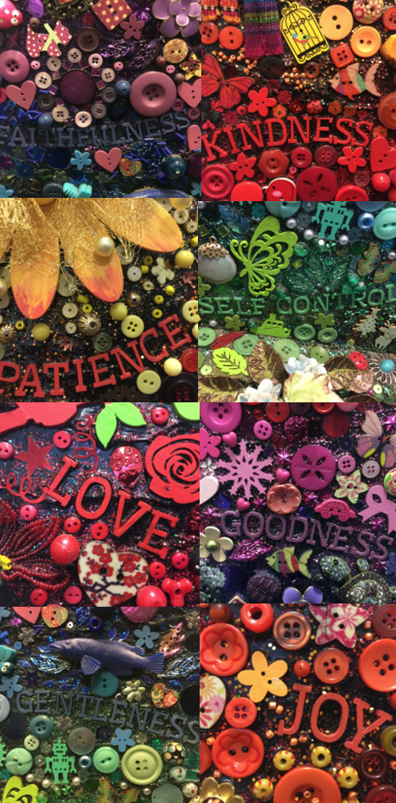
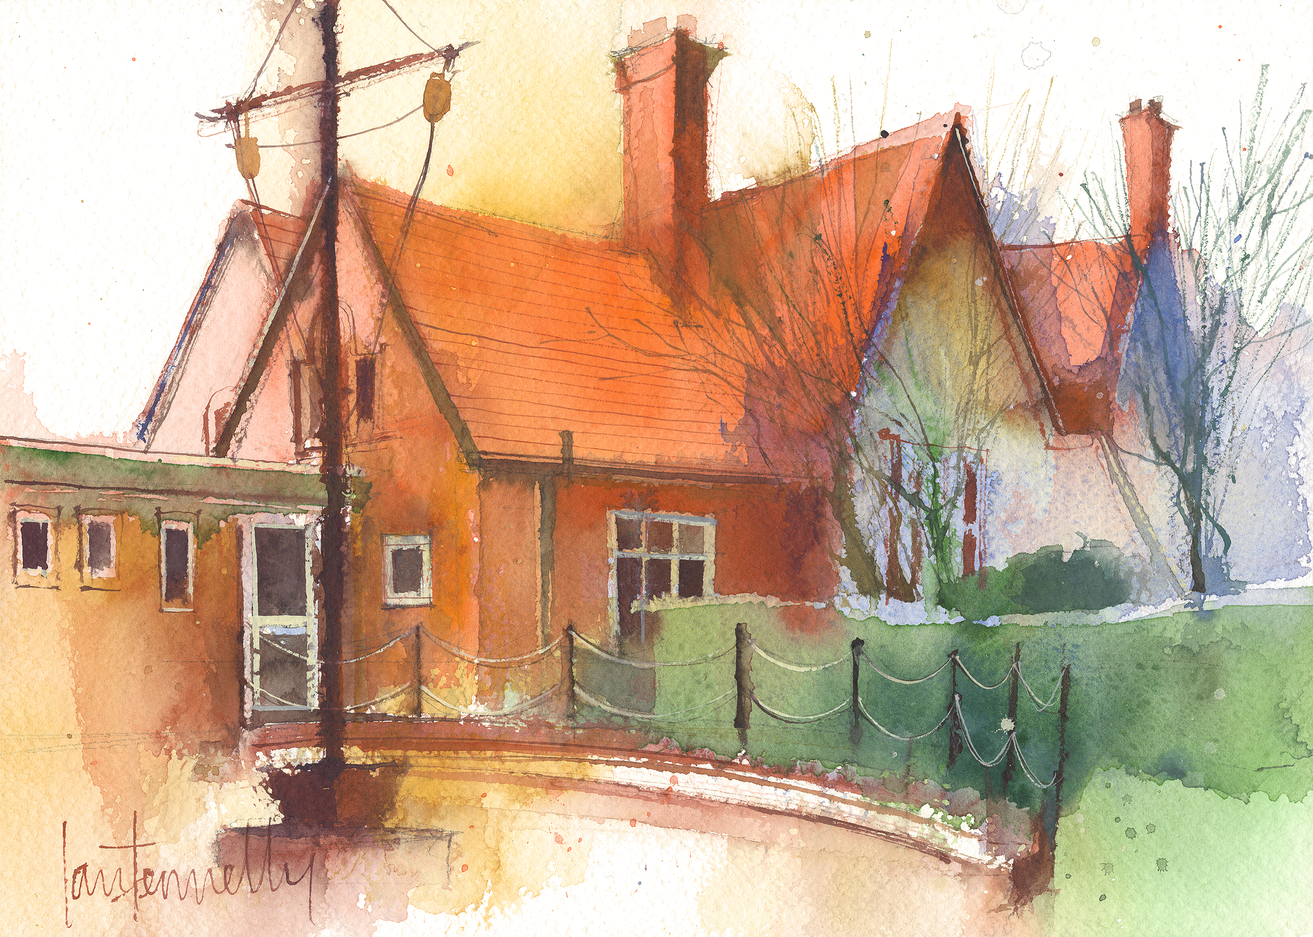
Dawpool CE (Aided) Primary School
School Information 2022-23
Vision Statement
‘The Dawpool community are united in their ambition to create a school which embodies the person, love and work of Jesus Christ: a school which enables Christian values to flourish and where all children may experience the abundant life that Jesus offers.’

Slide 2
Welcome
A warm welcome to the 2022-23 academic year.
As we embark on the start of a new academic year, our prayer is that this school year is one of new adventures and new opportunities. The chance to move forward in the knowledge that God continually makes us new. Every moment of every day brings a fresh beginning, a time not to look back but to look forward with hope and expectation for all the good that is to come.
We hope that the information contained within these pages will help you to find the information you need about your child’s class and how to contact us if you have any questions.
Some helpful links
Our school website: https://www.dawpool.wirral.sch.uk/website
Our school Twitter feed: https://twitter.com/DawpoolCofE
Our school email: schooloffice@dawpool.wirral.sch.uk

Slide 3
School Vision
Vision Statement
‘The Dawpool community are united in their ambition to create a school which embodies the person, love and work of Jesus Christ: a school which enables Christian values to flourish and where all children may experience the abundant life that Jesus offers.’
The Dawpool curriculum is designed to:
1. Embody the 'Person, Love and Work' of Jesus Christ.
2. Enable 'Christian Values to Flourish'.
3. Ensure that all pupils experience the ‘Abundant Life that Jesus offers.’
These three overarching objectives relate directly to the core principles of our vision statement.
The Person, Love and Work of Jesus are three golden threads that run through the heart of our curriculum.

Slide 4
The Person, Love & Work of Jesus

Slide 5
Curriculum Overview
We provide a subject-specific curriculum in which we have mapped out the knowledge and skills that we want children to learn at each stage. The subject-specific curriculum documents also comprise an overview of Early Years and can be viewed within the curriculum section of our website by clicking here.
Click on your child’s year group below to view the Wisdom, Knowledge & Skills documents:
Year 1
Year 2
Year 3
Year 4
Year 5
Year 6
Where possible, subjects are delivered through topics which are designed for maximum engagement and ensure all pupils benefit from a rich, broad, balanced curriculum presented in an interesting, exciting and imaginative manner with lots of opportunities for first-hand experience, practical work, investigation and learning through play. The curriculum is enriched with visits, visitors, and extensive use of our unique environment.

Slide 6
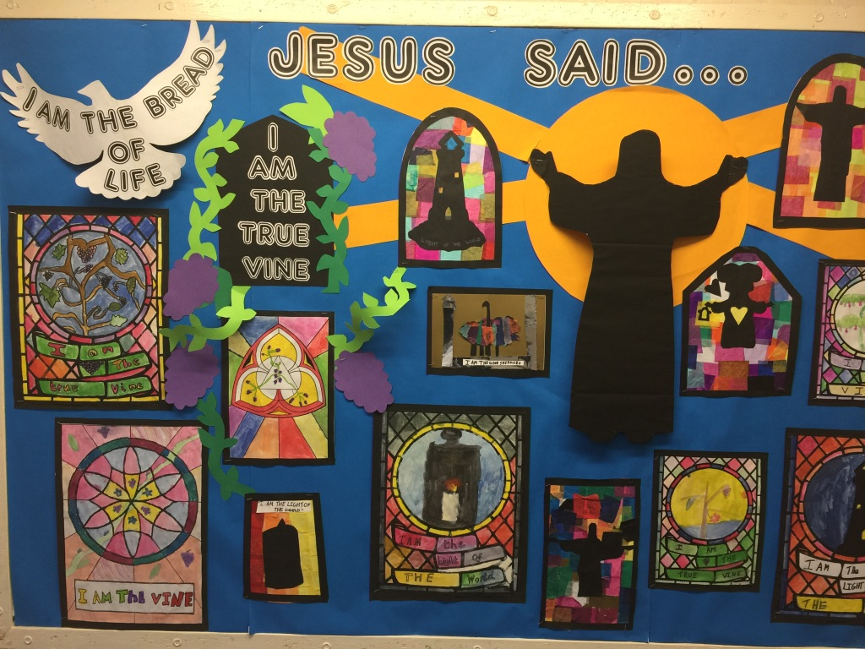
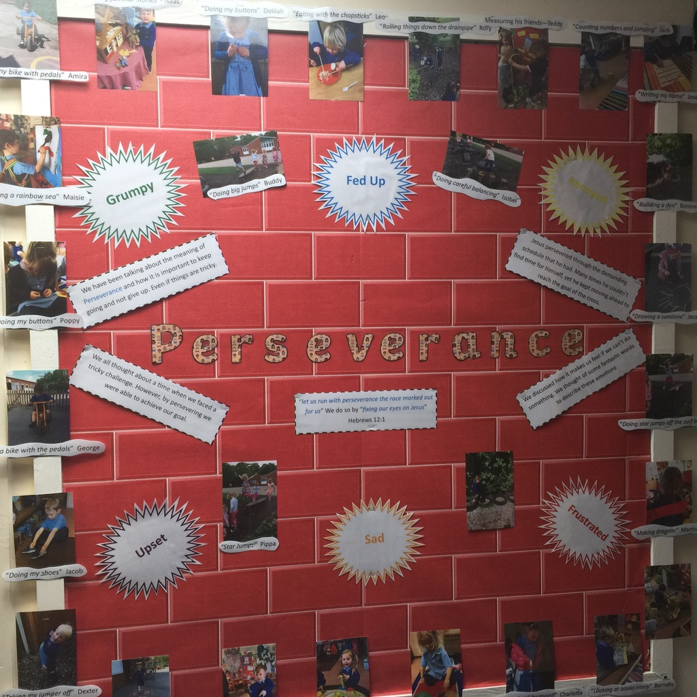
Class Pages
Each class has a webpage which provides parents and carers with an overview of the children’s learning on a week-to-week basis. Please click on your child’s Year Group to view the class page: F1, F2, Y1, Y2, Y3, Y4, Y5, Y6
Your child’s class webpage includes:
How to contact the class teacher
Links to important curriculum resources and online platforms
Recommended reading list
Statutory phonic / spelling lists
A timetable of lessons and objectives each week
Homework expectations

Slide 7
Welcome to Year 6 Learning Links

Slide 8
Staff in Year 6
Mrs Portia Lee - Class Teacher (Monday to Friday)
Mrs Vicki Earp - Teaching Assistant (Tuesday to Thursday)
Mrs Broadbent – Tuesday afternoon
Organisation
Children work in the Year 6 classroom and have fluid use of the Study Bay for independent work, quiet space, reading and interventions.

Slide 9
Y6 Timetable - Autumn Term (Typical week) DT will be taught in blocks as will Music or through other subjects
Monday | Tuesday | Wednesday | Thursday | Friday
RR/ FF/Spell | FF/RR/X Tables | FF/RR/Spell | FF/ RR/Spell | FF/RR/XTables | 8:50
Maths | Maths | Maths | Maths | Maths
 |  |  |  |  | 10:40
BREAK
Grammar/Spell | Literacy | Literacy | Literacy | Grammar/Spell | 12:15
LUNCH
Topic | Science | Computing | Arithmetic | Art/Topic | 1:15
 |  |  |  | RE/Spanish | 3:20
 |  |  | PE

Slide 10
Curriculum
Literacy:
Reading (groups and class text) Comprehension
Spelling, Punctuation, Grammar and Handwriting
Writing
Maths:
Daily Fluent in Five, Rapid Reasoning and Tables
Third Space Learning, Maths No Problem
Weekly Arithmetic and Core Skills
Science:
Light, Electricity
Humans (Heart, Blood, Lungs, Health and Diet)
Inheritance, Adaptation and Evolution (Fossils) and Habitats
Notes:
Literacy: Books- Power of Reading
Maths
Reading books: Parent helpers needed to Change on Wednesday and Friday
Spellings: Spelling tests will be on Thursdays
Handwriting: Weekly practice, possible homework activity. Need a good pen at home. Children being encouraged to use a joined fluent style of handwriting. To present work neatly in all subject areas. (End of KS2 assessments will take into account their handwriting).
Numeracy

Slide 11
Wider Curriculum
History: Anglo-Saxons, Vikings, WW1
Geography: Map Skills, Climate Zones/Habitats
RE: Chester Religious Education Scheme
PE: Thursday afternoon
Art: Mark making skills, Klimt and pattern, WWI Art Claude Monet and impressionism, The Art of Asia - Art Related to other curricular areas
Design Technology: Linked with topic: Viking Shields, Textiles (Christmas Stocking) and Kite making
Music: Charanga and I Sing Pop
Spanish: Fortnightly
Computing: Computing and cross curricular ICT opportunities.
Cross-Curricular topic: Asia - China
Notes:
The Learning Challenge Curriculum – What do we know already, What do we want to find out?
Trips- Spring/Summer
PE: Can they bring trainers as well as pumps for the autumn term for outdoors. New pumps too big, slippy.

Slide 12
Provisional Additional Workshops, Trips and Events
Term 1
Leading Macmillan Coffee(cake and juice) afternoon
Stall at the Christmas Fair
Pottery Christmas Decoration workshop
Cookies and cake
Christingle Service
Term 2
Eucharist Service at Church
Leading an assembly or workshop/assembly for the school related to China Topic
Food tasting related to China topic

Slide 13
Provisional Additional Workshops, Trips and Events
Term 3
Theatre Trip to Royden Park – Julius Caesar
Shakespeare topic
Pottery workshop – plate design
Afternoon Tea
Year 6 Art Gallery – Open afternoon/evening
Leavers Event
Residential or activity day
Stall at Summer Fair

Slide 14
Homework Packs
Homework will be sent out on a Wednesday and is due in on a Monday
Homework packs contain essential support materials so please keep them safe
Weekly homework will consist of :
Maths
Literacy
Tables or learning task
Spelling or other learning task
Reading book or reading task

Slide 15
Spelling Homework
accommodate | ancient
accompany | apparent
according | appreciate
achieve | attached
aggressive | available
amateur | average
Nouns are words that identify a person, place, idea or thing Common – refers to things in general - dog, road Proper – a specific person/place/thing – Dawpool, Friday Abstract – intangible idea – love, friendship, time, faith Collective – groups of people or things – class, family, choir Concrete – something that exists physically – desk, chair
Remember to learn the weekly Grammar fact

Slide 16
Year 6 Curriculum
The children in year 6 will have personal writing targets and will be using the KS2 marking criteria to self and peer assess.
They will be using a green response pen to improve and correct their work.
KS2 Marking Codes For Writing
Capital Letter | CL | Check Sense | ?
Full Stop | FS | Verbal Feedback Given | VF
Handwriting | HW | Target | T
Spelling Mistake | SP | Particularly Good | √√
Punctuation Missing | PU | I wish you had . . . | *
Something Missing | ^
New Paragraph | //

Slide 17
How to support your child
Ensure that homework is completed
Spellings are Statutory lists and will be used to track progress and ability. Please ensure they are learned.
Be aware of your child’s current writing targets and support them with it.
All handwriting should be cursive in year 6 with appropriate use of upper and lower case.
A handwriting club will take place for some children. Additional practise may be sent home.
Practise tables and read regularly.
Please feel free to contact me immediately if you have any questions or concerns.

Slide 18
Contact us
Please get in touch if you have any questions or concerns. We are here to help.
In the first instance, parents should initially speak to the class teacher for queries relating to learning, progress, behaviour, equipment, timetables etc. A telephone conversation or face to face meeting is probably best for this type of issue. Please call or email the school office to arrange an appointment: schooloffice@dawpool.wirral.sch.uk, 0151 648 3412 (option 4).
If the issue has not been resolved by the class teacher, or parents need more advice following these initial discussions, they should contact Mrs McCann (Deputy Headteacher) or Mr Burrows (Headteacher).
Queries regarding letters, admin, attendance, school dinners, wraparound care, clubs, and school money payments should be directed to the school office 0151 648 3412 (option 4).

Slide 19
Dawpool News
The 'Dawpool News' is our weekly newsletter which is published every Friday. It is our main form of communication and contains an overview of forthcoming events and activities, current school initiatives, curriculum work, school visits, extra-curricular activities, fundraising events, church news, community information, pupil celebrations and weekly reflections.
The Dawpool News is emailed to all parents by the end of a school day on a Friday. Please make sure any changes to email addresses are reported to the school office straight away. The Dawpool News is always uploaded to the school website and all copies can be found here.

Slide 20
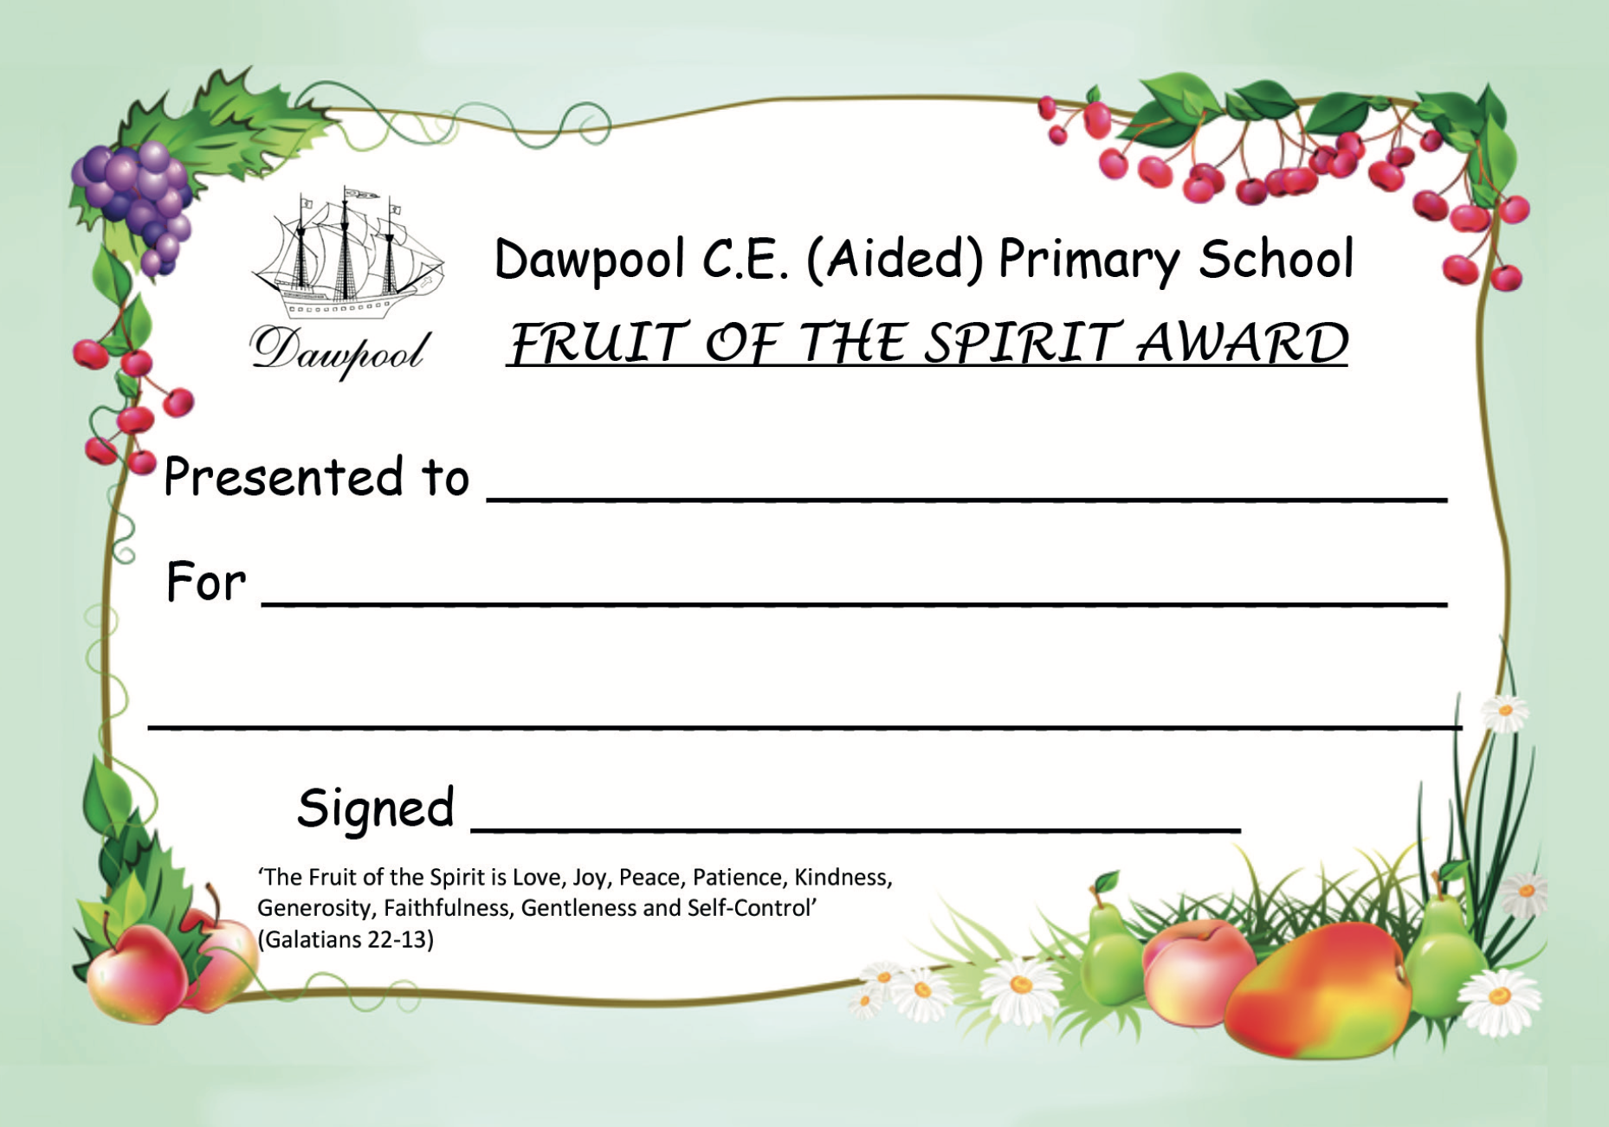
Rewards and Certificates
Positive reinforcement, rewards and certificates are an important part of our behaviour policy.
The following certificates are presented to pupils from each class during Celebration Worship on a Friday.
Learning Values Award
Fruit of the Spirit Award
Dawpool Ambassador
Pupils who bring in certificates and awards from home will have the opportunity to share them in the classroom. Staff acknowledge receipt of these achievements by writing a Dawpool Special Mention which is presented in Celebration Worship on a Friday.
Pupils in Y2-Y6 collect merits for good work which are rewarded with Bronze, Silver and Gold Achievement Certificates. Following the Gold Award, pupils can work towards the Head Teacher’s Award.

Slide 21
Awards and Progress
In Year 6 we have a “Role of Honour” wall and give weekly awards for:
Best Thinker
Improver
Writer
Reader
Helper
Throughout the year children have individual targets but also a Personal Best PB system were they are always rewarded for personal progress
Children have award boxes for these as well as receiving superstars

