Slide 1
Ready-to-go Lesson Slides
Year 3
Number: Fractions
Lesson 3
Sum1

Slide 3
Starter:
Success Criteria: I can identify equivalent fractions pictorially I can use my knowledge of times tables to find links between equivalent fractions
Which one is different?

Slide 4
Starter:
Success Criteria: I can identify equivalent fractions pictorially I can use my knowledge of times tables to find links between equivalent fractions
Which one is different?
Each of the number lines has a fraction labelled on it that is equivalent to three quarters apart from this one. Two thirds is not the same as three quarters.

Slide 5
Talking time:
What pair of equivalent fractions can you see?
.

Slide 6
Talking time:
What pair of equivalent fractions can you see?
.
What do you notice about the numerators and denominators in these fractions?

Slide 7
Talking time:
What pair of equivalent fractions can you see?
Describe how the numerator and denominator change from one fraction to the other.

Slide 8
Talking time:
What pair of equivalent fractions can you see?
Describe how the numerator and denominator change from one fraction to the other.
The numerator and the denominator are both three times larger in the second fraction (1 x 3 = 3 and 4 x 3 = 12).

Slide 9
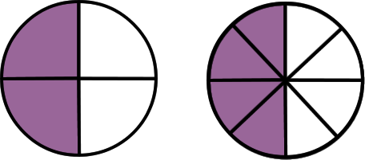
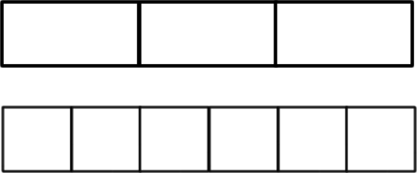
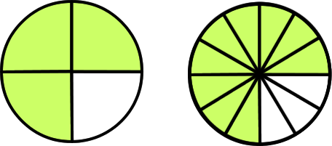
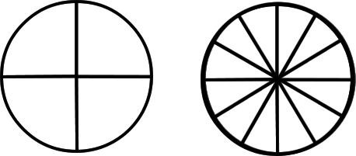
Activity 1:
Complete the table.
Pictorial representation | Fractions | Words
 |  | _________ is equivalent to _________
 |  | _________ Is equivalent to ____ sixths
 |  | _________ is equivalent to _________

Slide 10
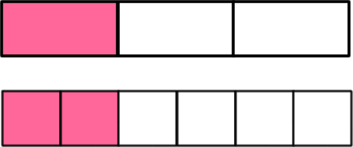
Activity 1:
Complete the table.
Pictorial representation | Fractions | Words
 |  | two quarters is equivalent to four eighths
 |  | one third Is equivalent to two sixths
 |  | three quarters is equivalent to nine twelfths
Look carefully at the pairs of fractions in the ‘Fractions’ column.
What do you notice about their numerators and denominators?

Slide 11
Talking time:
Each of these fractions is worth the same.
What are the missing numbers?
Explain your answer.

Slide 12
Talking time:
Each of these fractions is worth the same.
What are the missing numbers?
Explain your answer.
In the second fraction, the denominator has doubled from 2 to 4. This means that each ‘part’ of the fraction is now half the size as it was. For the fraction to have the same value, we now need twice as many of these ‘parts’, so the numerator has to double too (from 1 to 2). So, one half is the same as two quarters. The same thing happens when we find a number of eighths that is worth the same. The denominator has multiplied by 2 again, so we need to also multiply the numerator by 2 too.

Slide 13
Activity 2:
Complete the missing numbers in these sets of equivalent
fractions.
How could you model these answers using…
…fraction strips?
…bar models?
…diagrams of shaded shapes?

Slide 14
Activity 2:
Complete the missing numbers in these sets of equivalent
fractions.

Slide 15
Activity 3:
Khaled says,
Is Khaled right? Explain why / why not.
I know how to always find a fraction that is equivalent…
All I have to do is double the numerator and double the denominator of any fraction and the fraction I make will be equivalent to it!

Slide 16
Activity 3:
Khaled says,
Is Khaled right? Explain why / why not.
Yes – Khaled is right. Doubling the denominator of a fraction means that the whole is now split into twice as many parts. This means that each part is now half as big as it was. To keep the value of the fraction the same, we now need twice as many of these smaller parts, so the numerator needs to double too.
For example, 1 doubled is 2 and 3 doubled is 6, so one third = two sixths.
I know how to always find a fraction that is equivalent…
All I have to do is double the numerator and double the denominator of any fraction and the fraction I make will be equivalent to it!

Slide 17
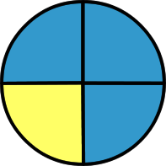
Activity 4:
Is it possible to find an equivalent fraction to the shaded area
that has a numerator of 7?
Can you find the equivalent fraction using the same instructions but for ¾ instead?
Can you think of more equivalent fractions for ¼?
Notes:
Provide counters (28 or more) or a times tables grid as support if necessary.

Slide 18
Activity 4:
Is it possible to find an equivalent fraction to the shaded area
that has a numerator of 7?
It depends on whether we are thinking about the yellow
shaded area or the blue shaded area. The yellow shaded area is worth one quarter and if we multiply the numerator and the denominator by 7, we can get an equivalent fraction with 7 as the numerator:
However, the blue shaded area is worth three quarters and we cannot multiply 3 by any number to get a numerator of 7. So, it is only possible if we are thinking about the yellow, not the blue, shaded area.

Slide 19
Evaluation:
Success Criteria: I can identify equivalent fractions pictorially I can use my knowledge of times tables to find links between equivalent fractions
True or False?
b)
Jamie is thinking of a fraction. If he doubles the
numerator and halves the denominator, it will make a
fraction that is worth the same.
Four eighths is the same as one half.
Leah is thinking of a fraction. If she multiplies the numerator by 3 and then multiplies the denominator by 3 too, she will make an equivalent fraction.

Slide 20
Evaluation:
Success Criteria: I can identify equivalent fractions pictorially I can use my knowledge of times tables to find links between equivalent fractions
True or False?
FALSE
b) TRUE
Jamie is thinking of a fraction. If he doubles the
numerator and halves the denominator, it will make a
fraction that is worth the same. FALSE
Four eighths is the same as one half. TRUE
Leah is thinking of a fraction. If she multiplies the numerator by 3 and then multiplies the denominator by 3 too, she will make an equivalent fraction. TRUE

