Slide 1
Y1 Dance: The Seasons
Year One
PE | Year 1 | Indoor | Dance: The Seasons | Ice Dancing | Lesson 1

Slide 3
Aim
To move in response to a video stimulus.
Success Criteria
I can create different shapes with my body.
I can put actions together to create a motif.
I can move my body with control.
I can watch and describe a performance.

Slide 4
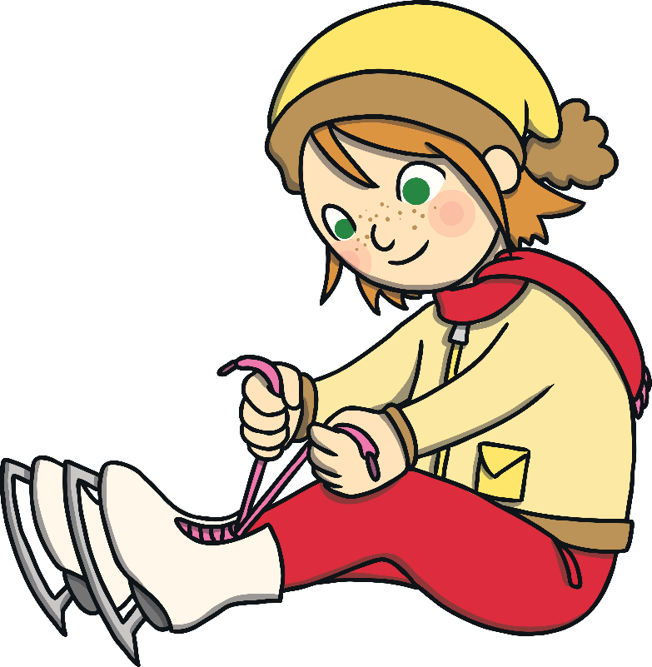
Let’s Get Ready

Slide 5
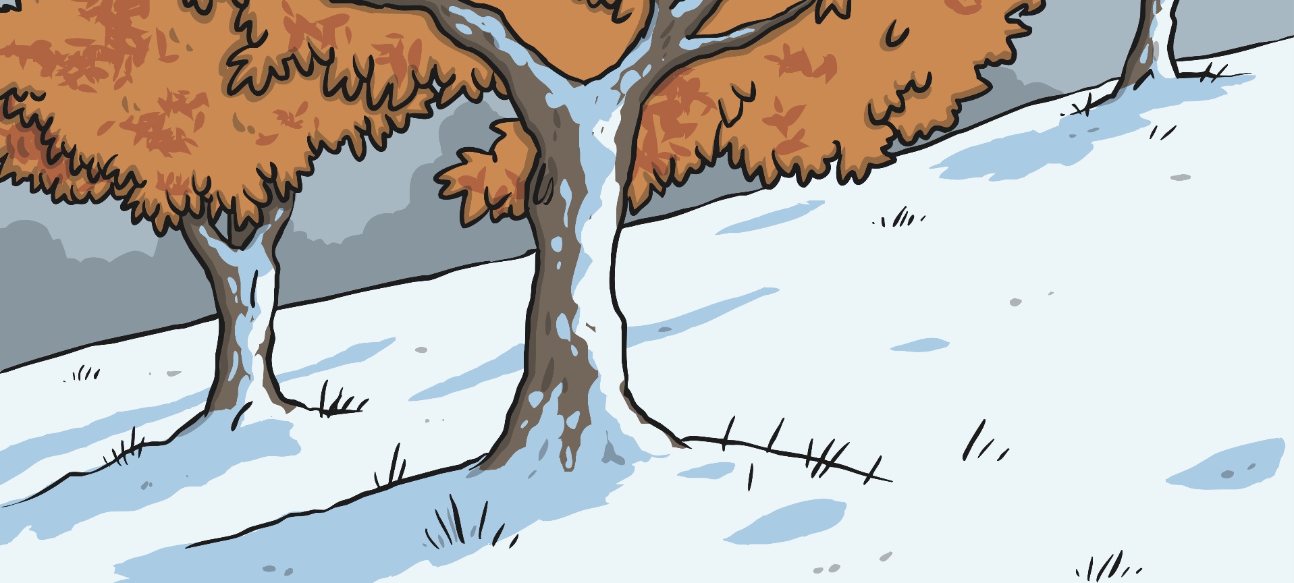
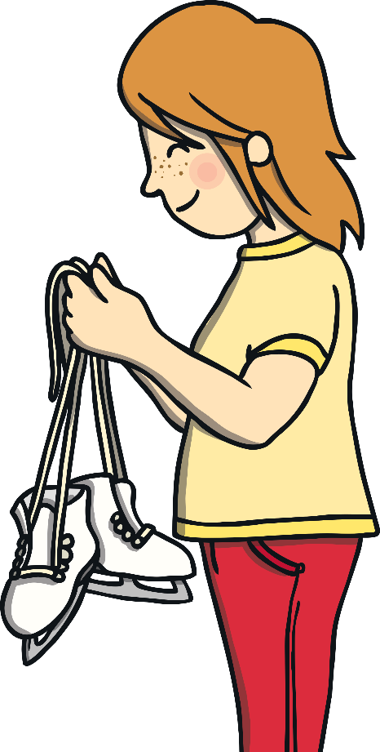
Ice Dancing
During the next six weeks, we are going to perform different types of dancing based on the different seasons of the year.
Can you name the four seasons of the year?
Spring
Summer
Autumn
Winter
Today, you are going to be an ice dancer!
Look at the title of today’s lesson. Which season of the year do you think we are going to look at first?

Slide 6
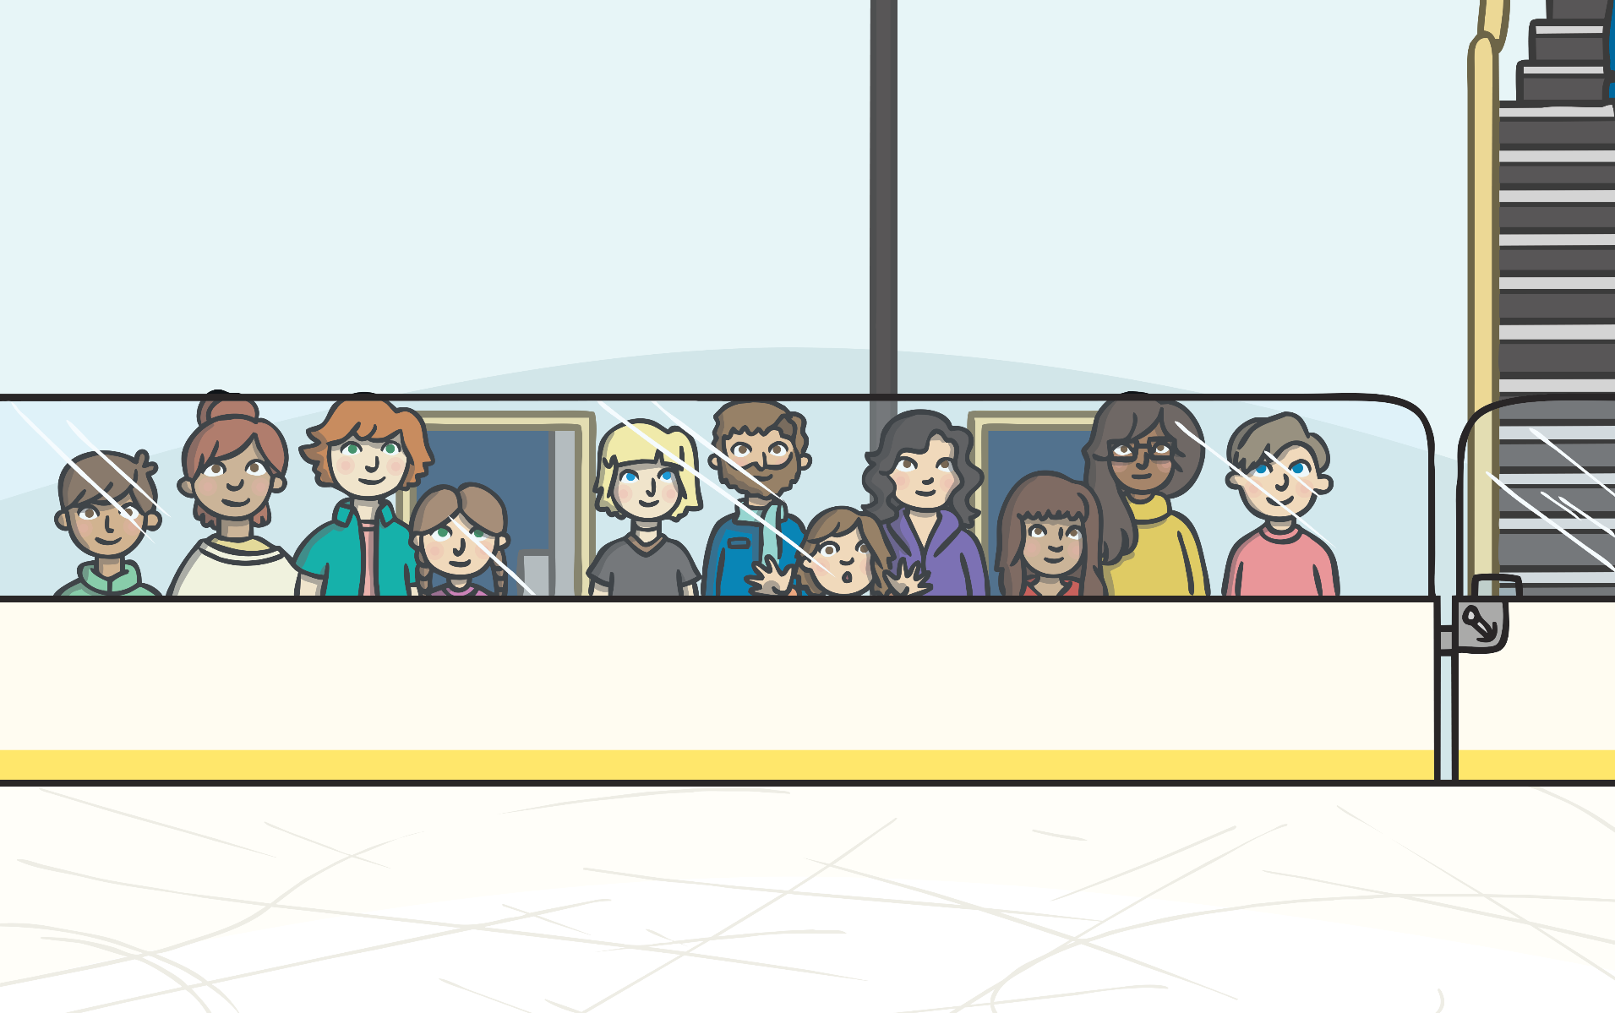
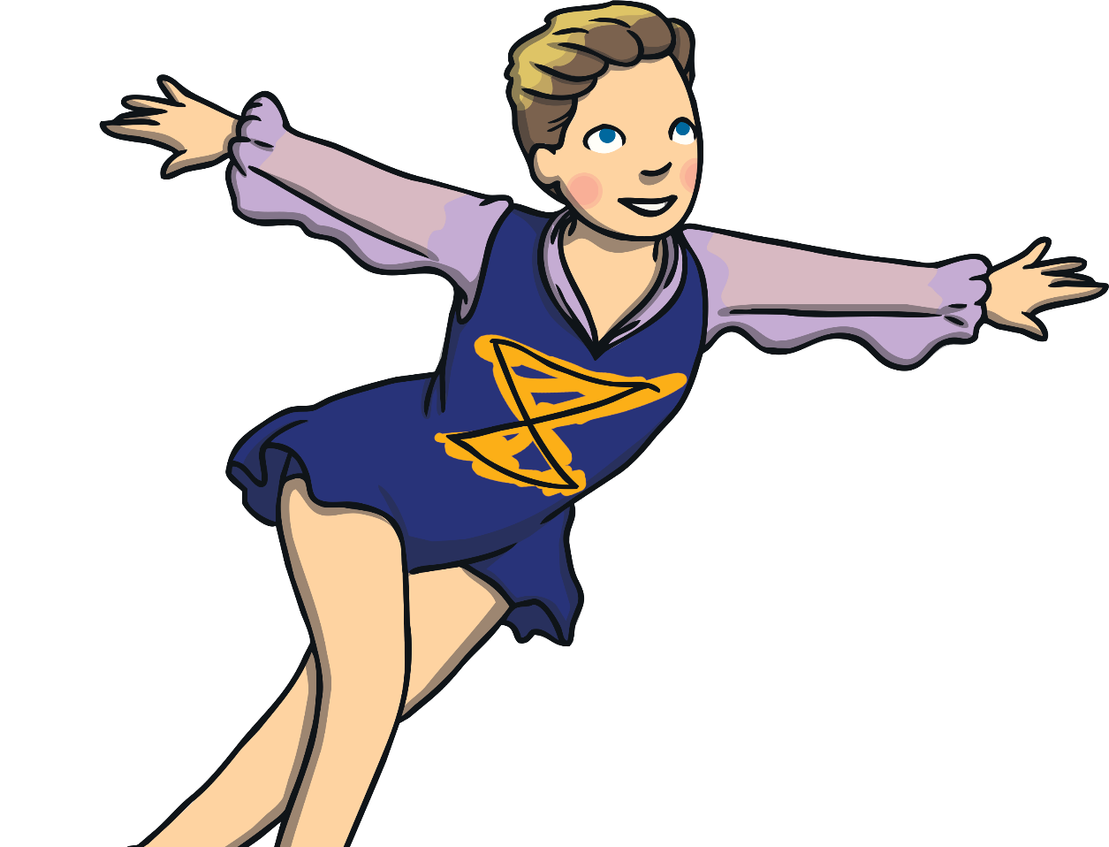
Real Ice Dancers
Does she change direction as she is skating?
You are going to watch this clip of a real ice dancer performing.
Look very carefully at the different ways the dancer moves around the ice.
Does she always skate on the same level?

Slide 7
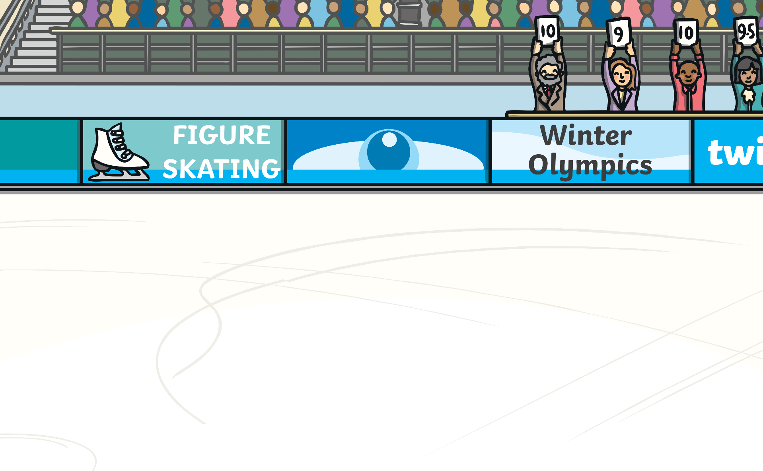
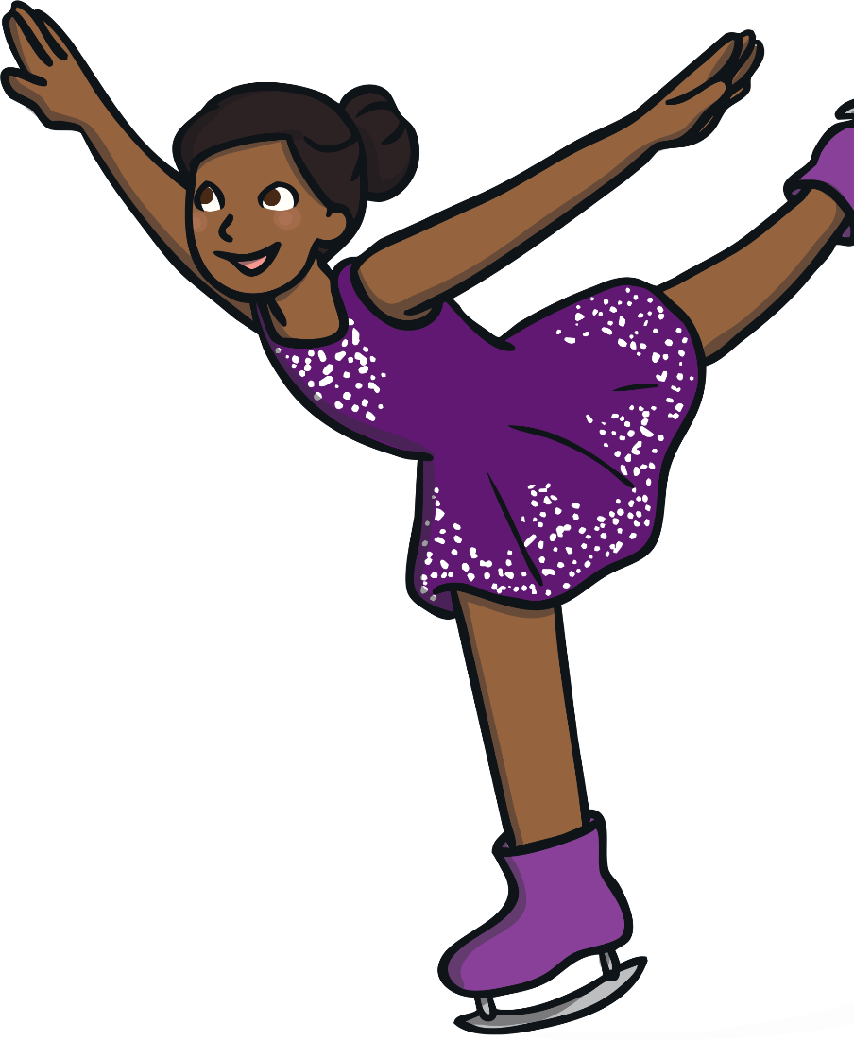
Skating Shapes
Look at the shapes that the skater is making with her body as she is moving around the ice.
Tell your talking partner what different shapes you can see.
How does she use her arms as she is skating?

Slide 8
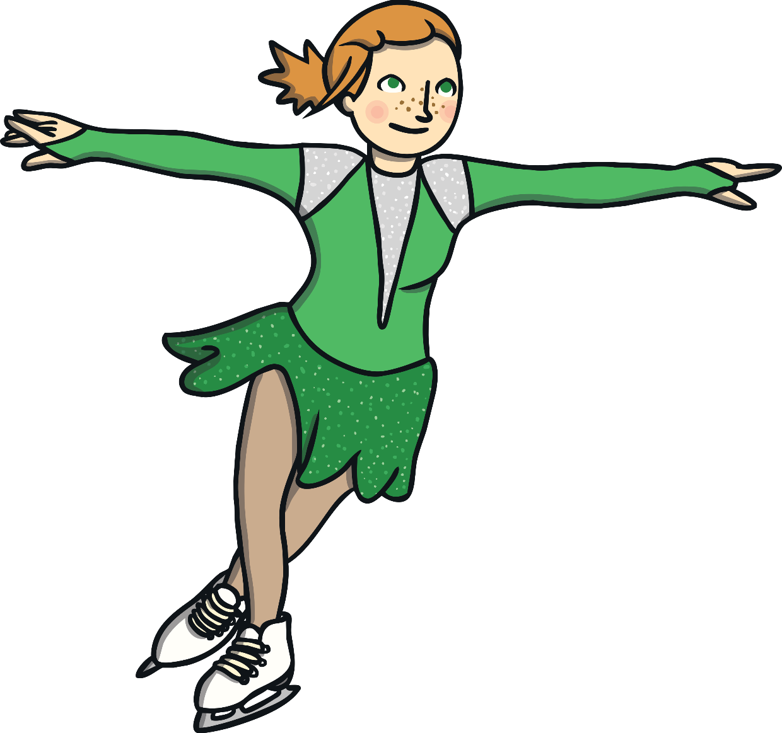
Jumping and Spinning
In her dance, the skater uses lots of different jumps and spins.
She makes different shapes with her arms. Sometimes these shapes match her body shape. Her arms also help her to control her jumps and spins.
No, sometimes she lands on one foot.
What does she do with her arms while she is jumping or spinning?
Does she always land on both feet?

Slide 9
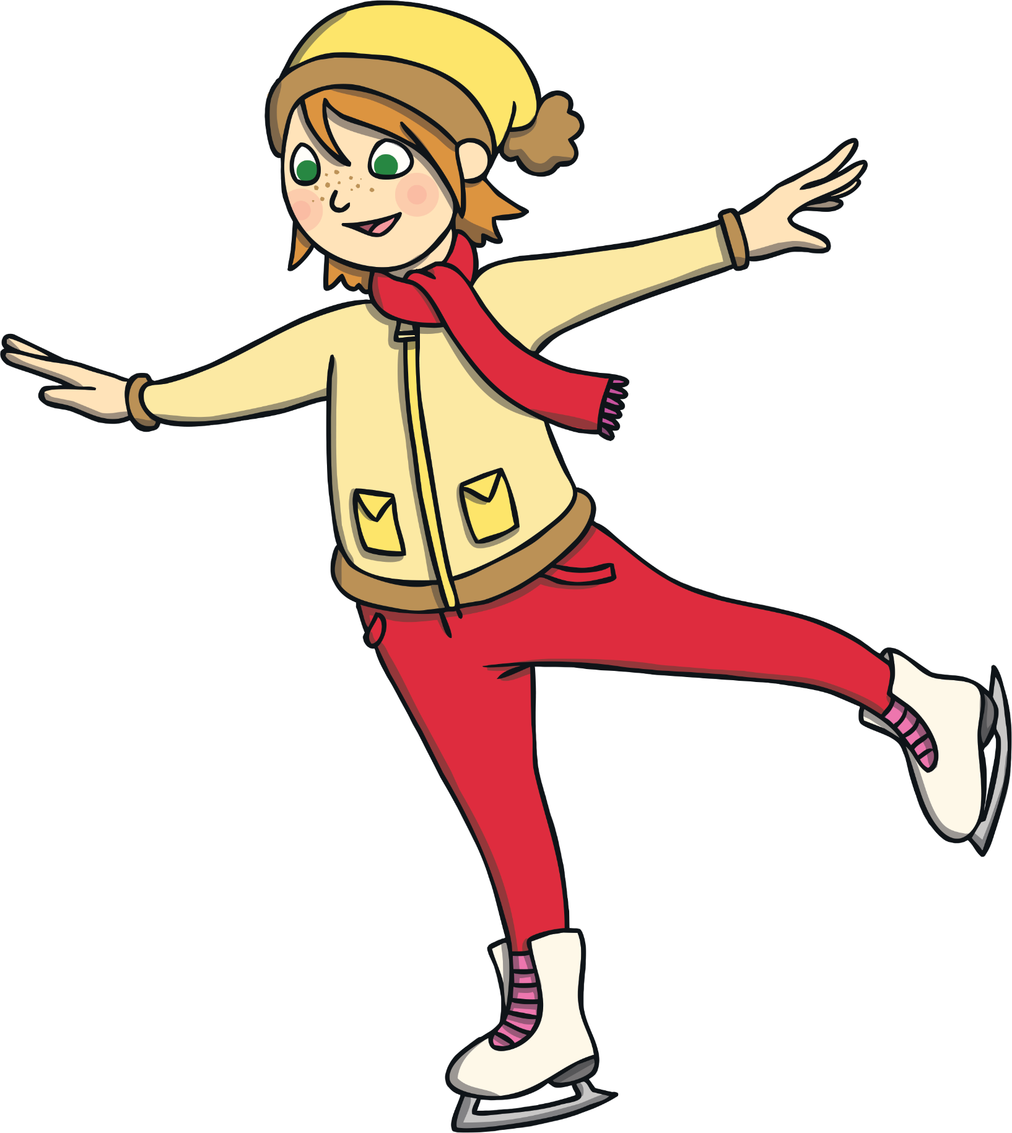
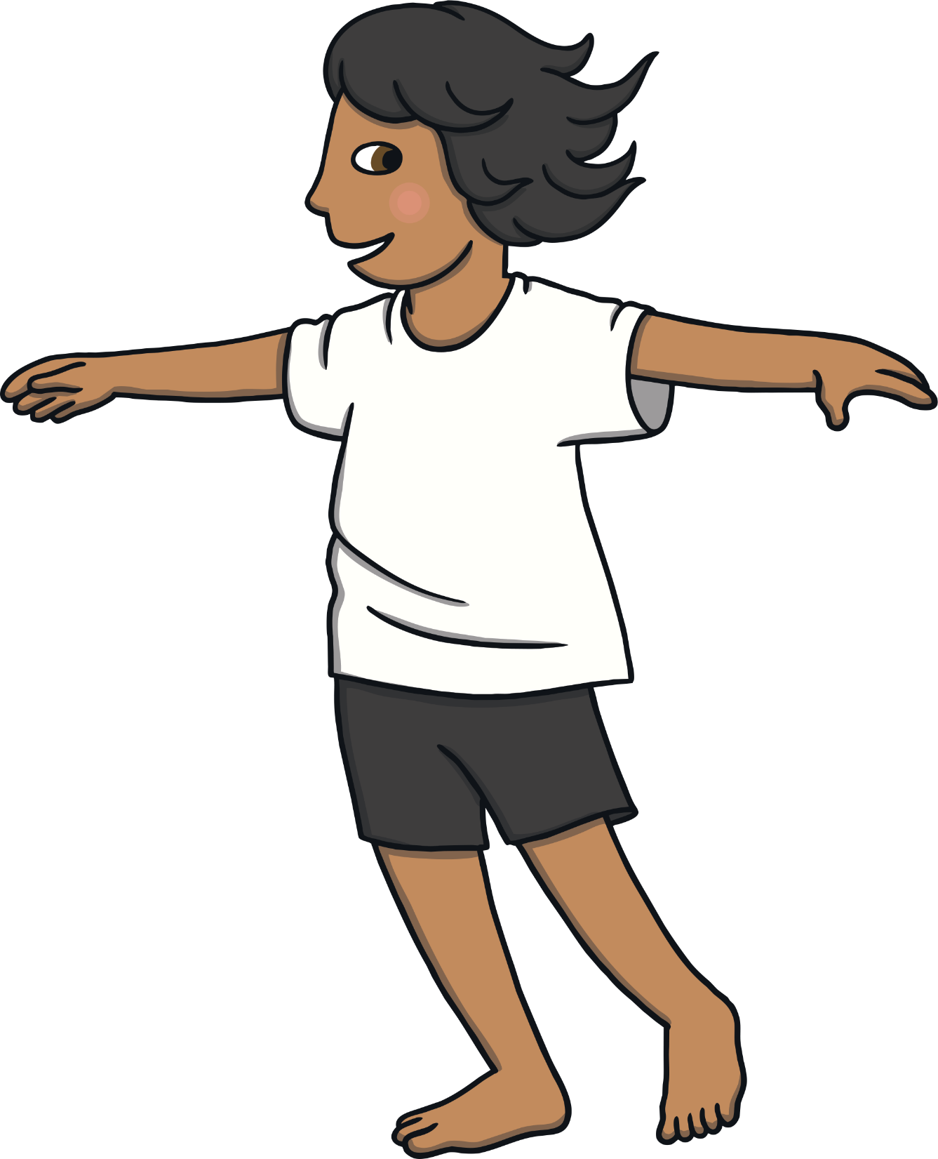
Let’s Get Moving

Slide 10
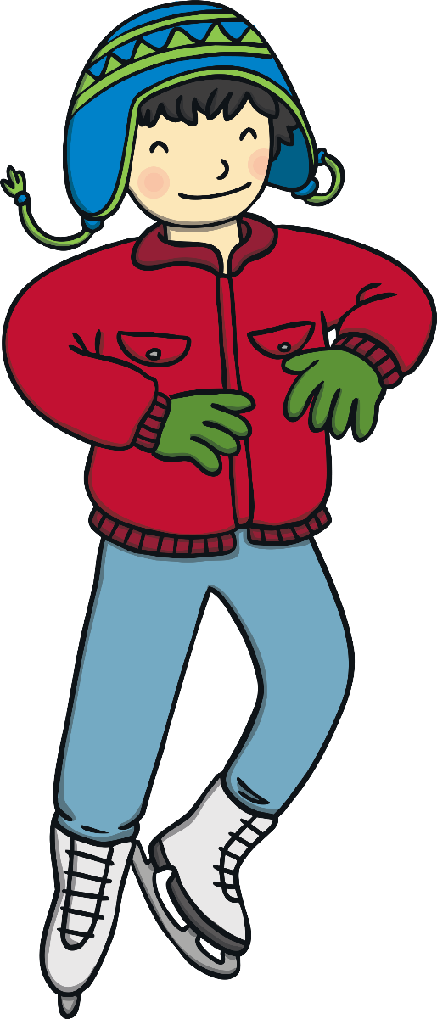
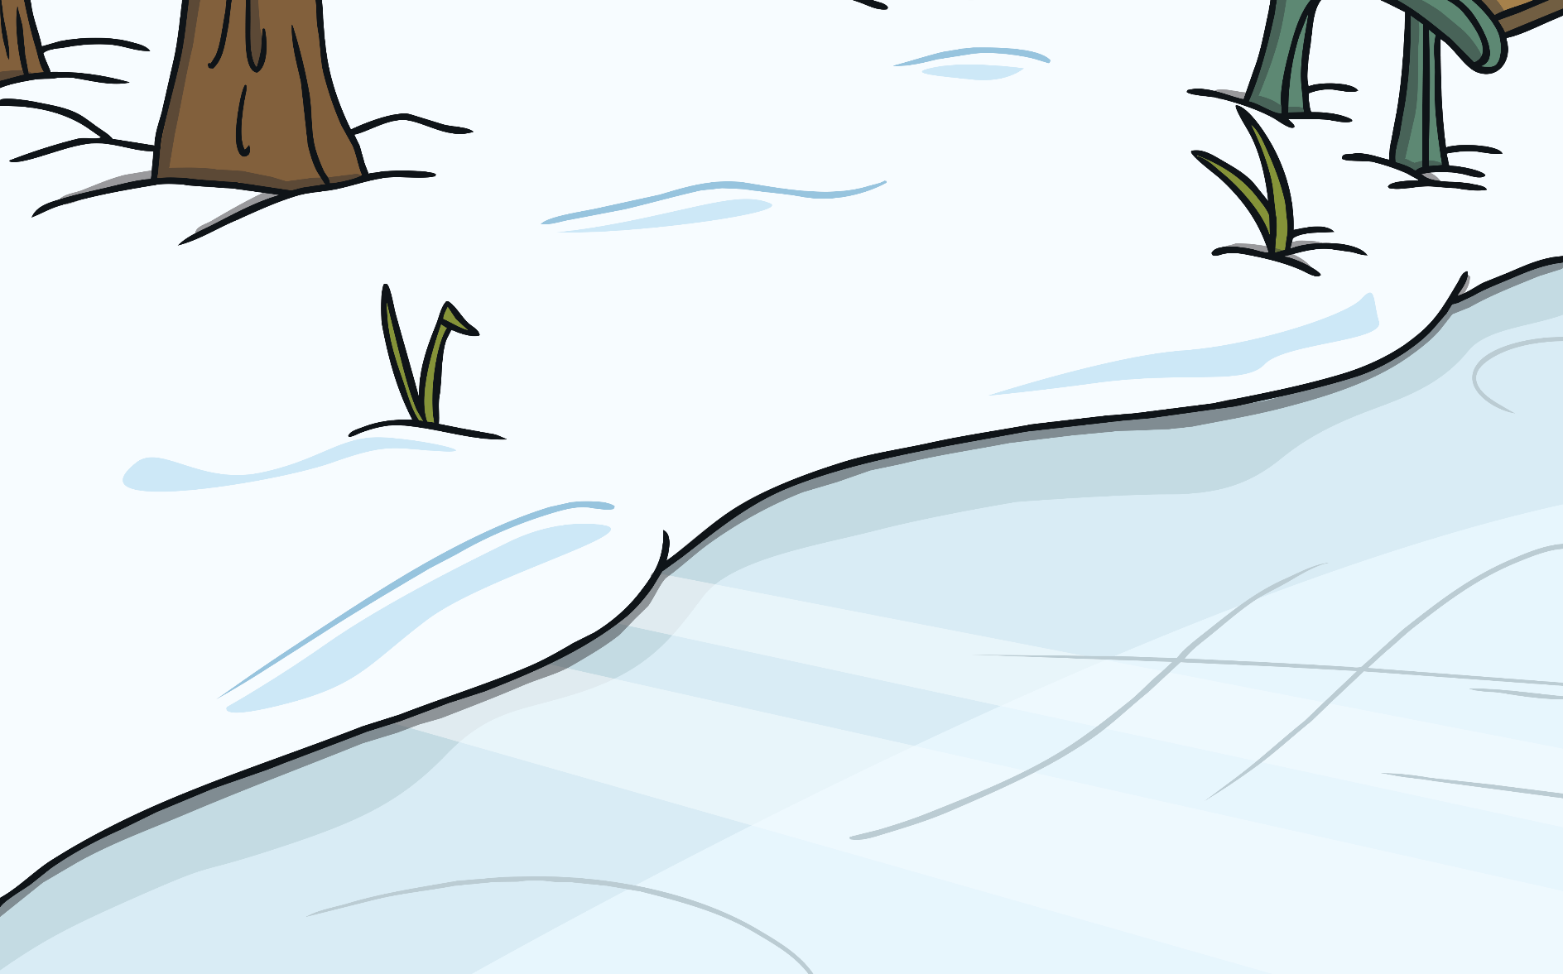
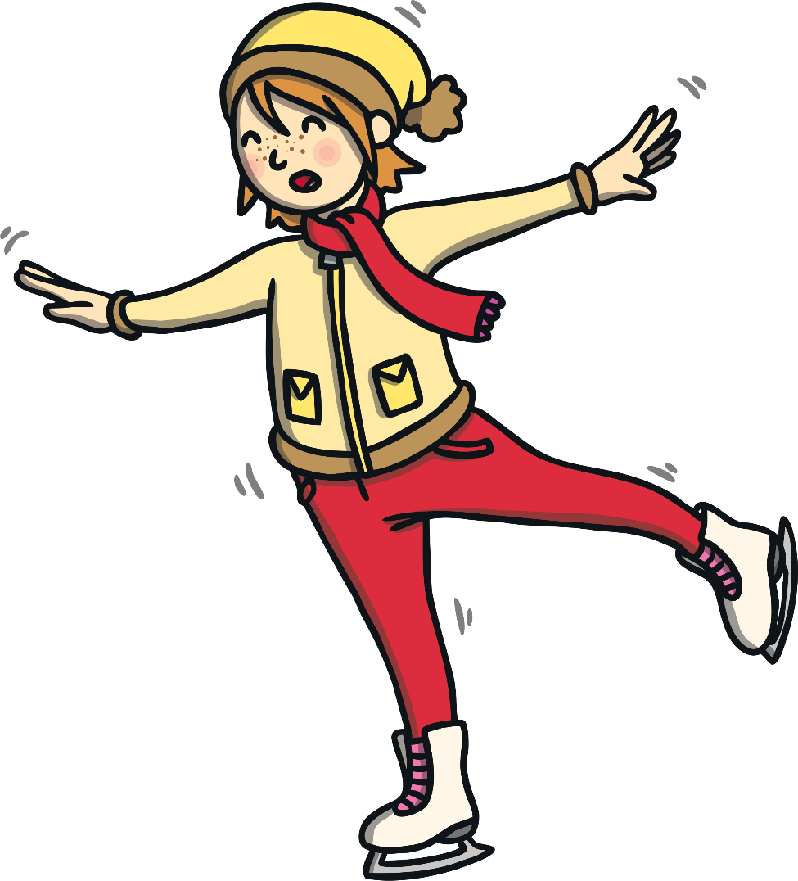
Warm-Up: Ice Statues
Before we do any dancing, we need to get our bodies ready.
You are going to skate around the room. Remember to use your arms as you are moving.
When you hear the sound of the tambourine, you are going to freeze as an ice statue.
Try to make a different shape each time. Think about some of the shapes that the ice dancer made with her body.

Slide 11
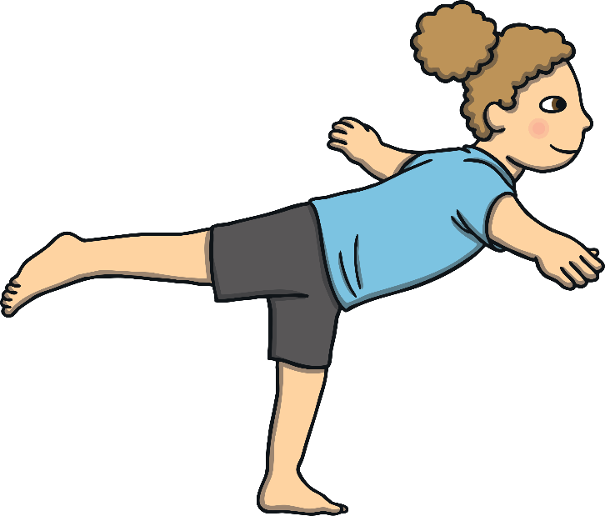
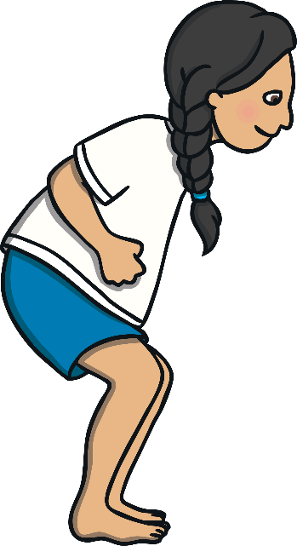
Skating Shapes
Can you balance on one leg in your shape?
Can you make a tall shape?
You are going to explore some of the different shapes that you can make with your body while you are skating. Use the ideas from the video clip to help you.
Can you make a low shape?

Slide 12
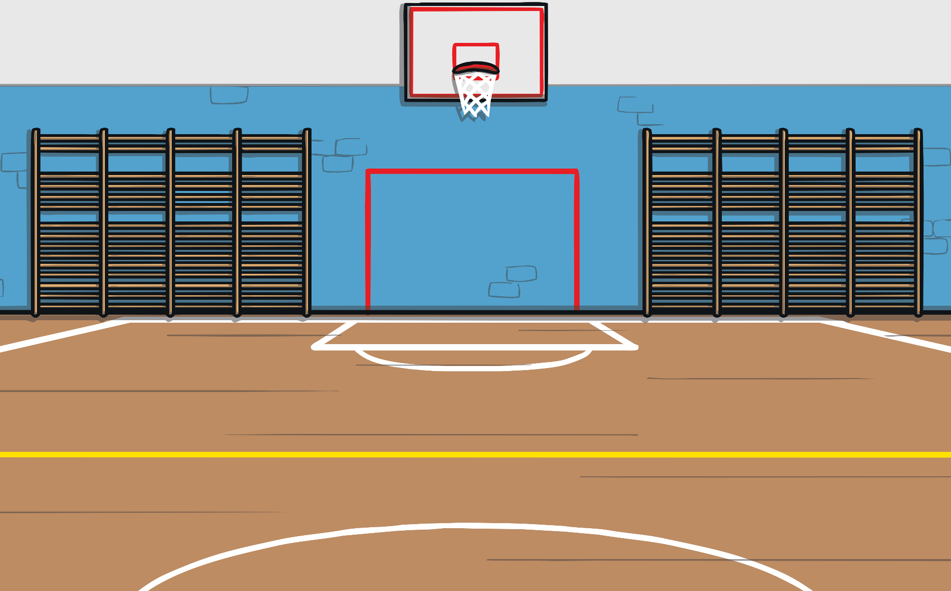
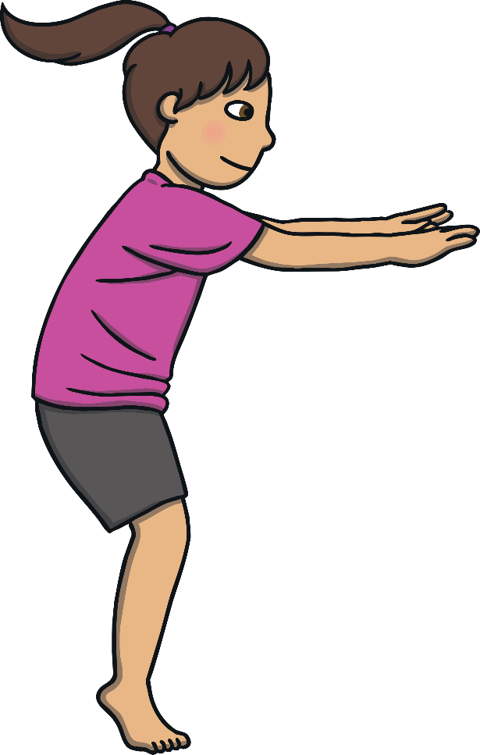
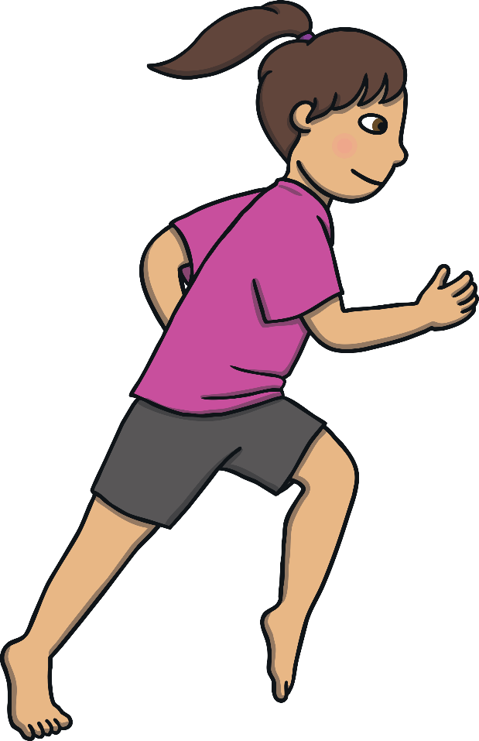
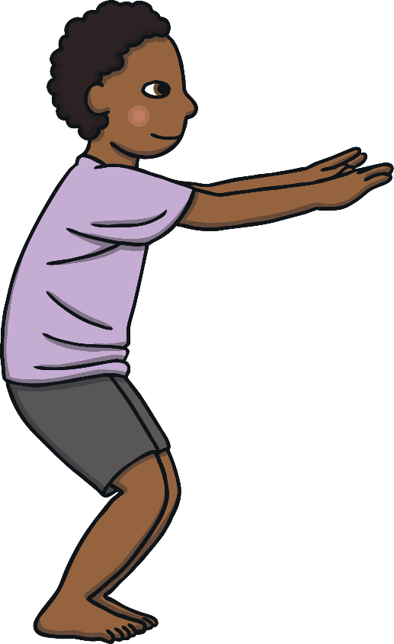
Jumping and Spinning
Now, you are going to explore some of the jumps and spins that you would like to use in your ice dance.
What will you need to do to control your jumps and spins?
You will need to use your arms to help you to stay in control. You will also need to land your jumps carefully. Remember to always take your time.
You can use some of the ideas from the video clip.
You need to choose one jump and one spin.

Slide 13
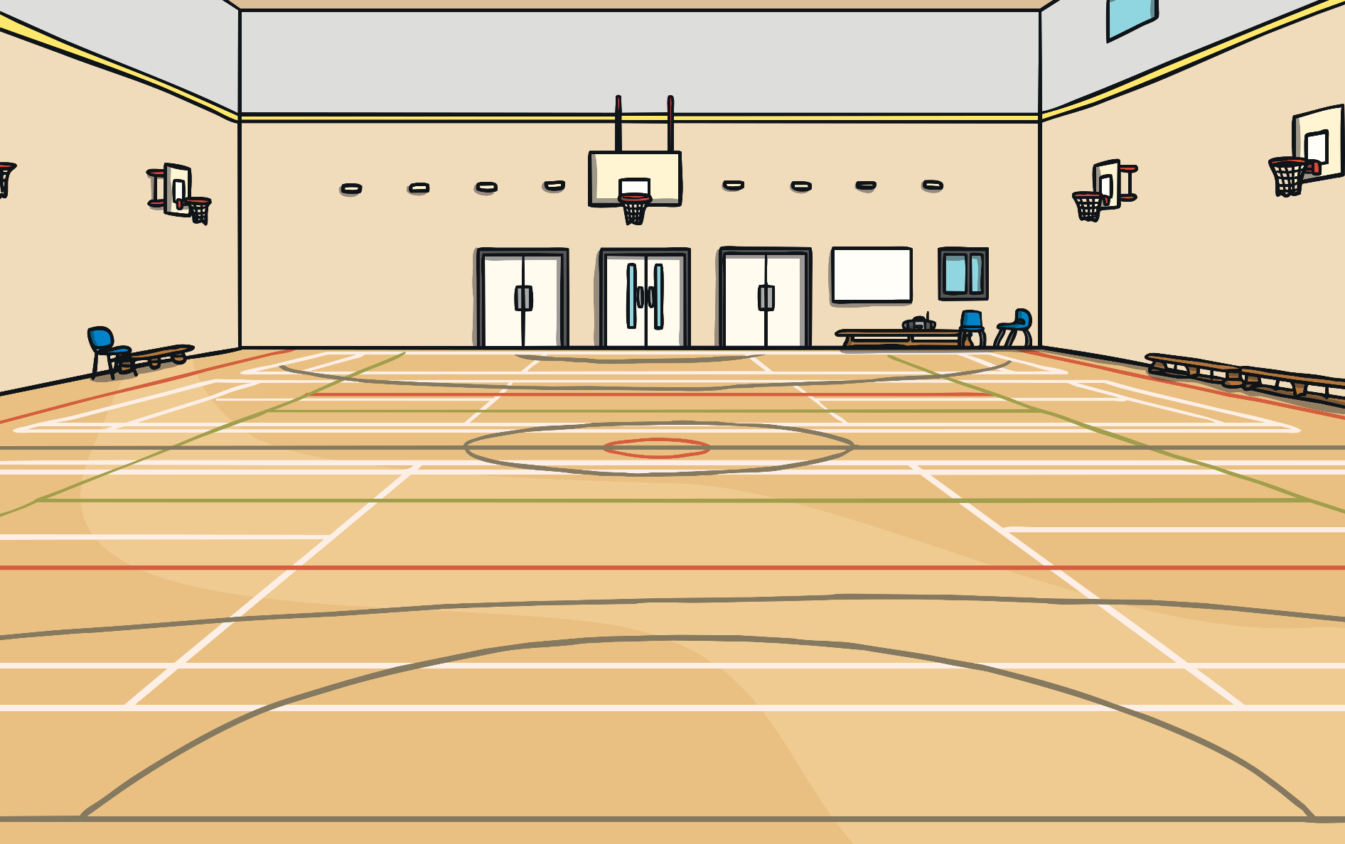
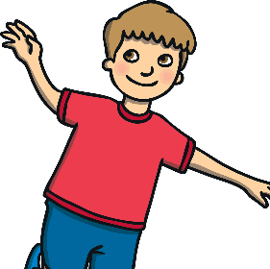
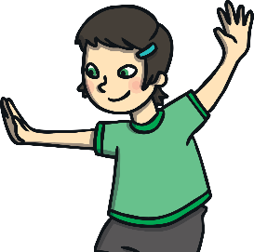
Ice Dancing Motif
Now, you are ready to put your actions together to create an ice dancing motif.
In your motif, you will need to
skate,
jump
and spin.
Skate
Jump
Skate
Spin
Skate
Remember to try and make a different shape with your body each time that you skate.

Slide 14
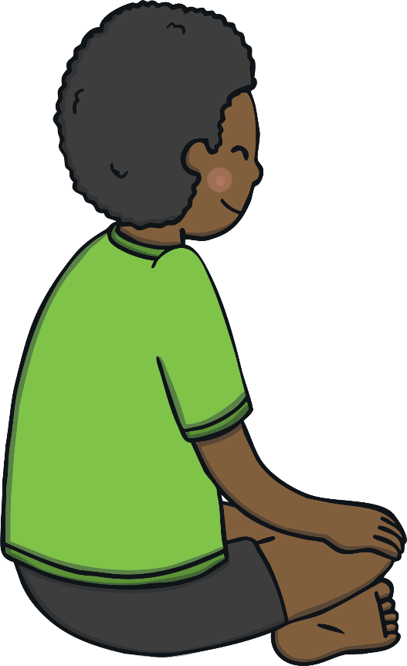
Partner Performance
You are going to watch your partner perform their ice dance for you.
What do the words evaluate and feedback mean?
Watch your partner perform their ice dance.
Can you describe what they included in their ice dance?
Which part did you like the best? Is there anything they could improve?
Evaluate means to find the good things about a performance and the things that could be improved. When you share this with your partner, you are giving them feedback.
You are going to evaluate their performance and give them some feedback.

Slide 15
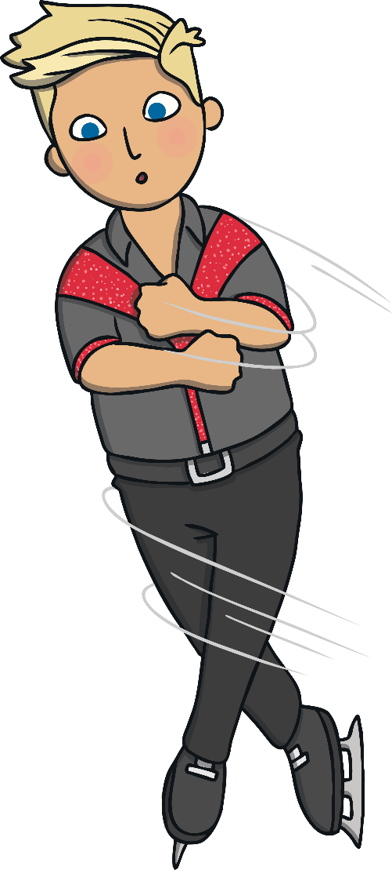
Final Performance
Before we do the final performance of our ice dance, you need to think carefully about the feedback that your partner gave you.
Is there anything that you need to improve?
Let’s get ready to perform!

Slide 16
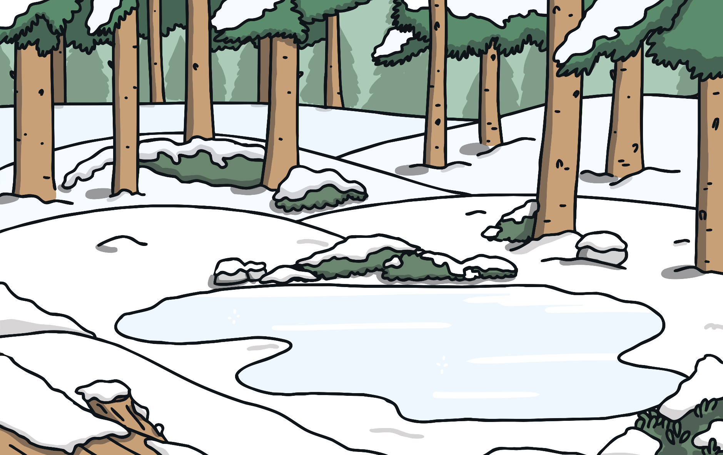
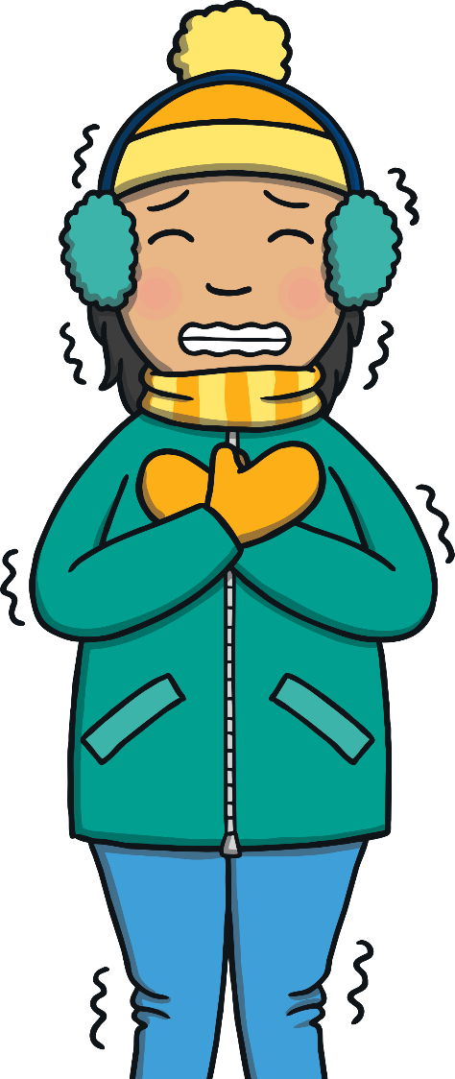
Cool-Down: Freeze Frames
It is important to cool our bodies down gradually when we have been dancing. To do this, we are going to play a game called Freeze Frames.
Your teacher is going to give you an activity that you might do in the winter and you are going to perform some actions to show that activity.
When your teacher shouts ‘freeze frame’, you must be totally still.

Slide 17
Let’s Review

Slide 18
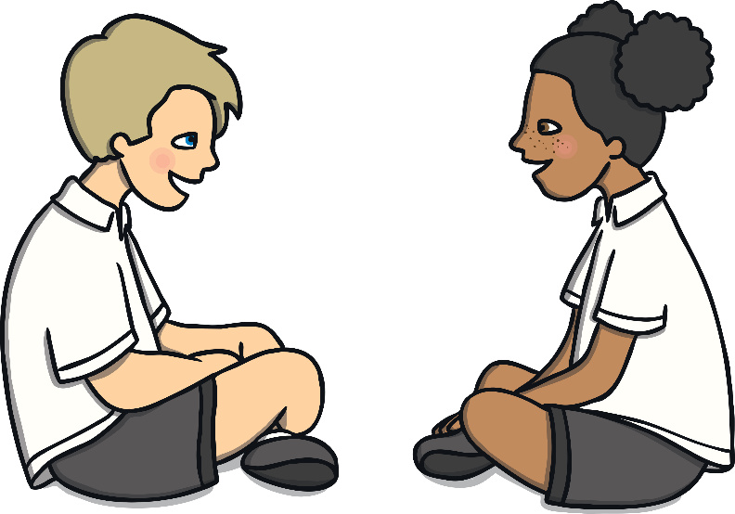
My Performance
You are going to describe your performance to a partner.
What did you do well today?
What shapes did you make with your body as you were skating?
What jumps and spins did you use in your performance?

Slide 19
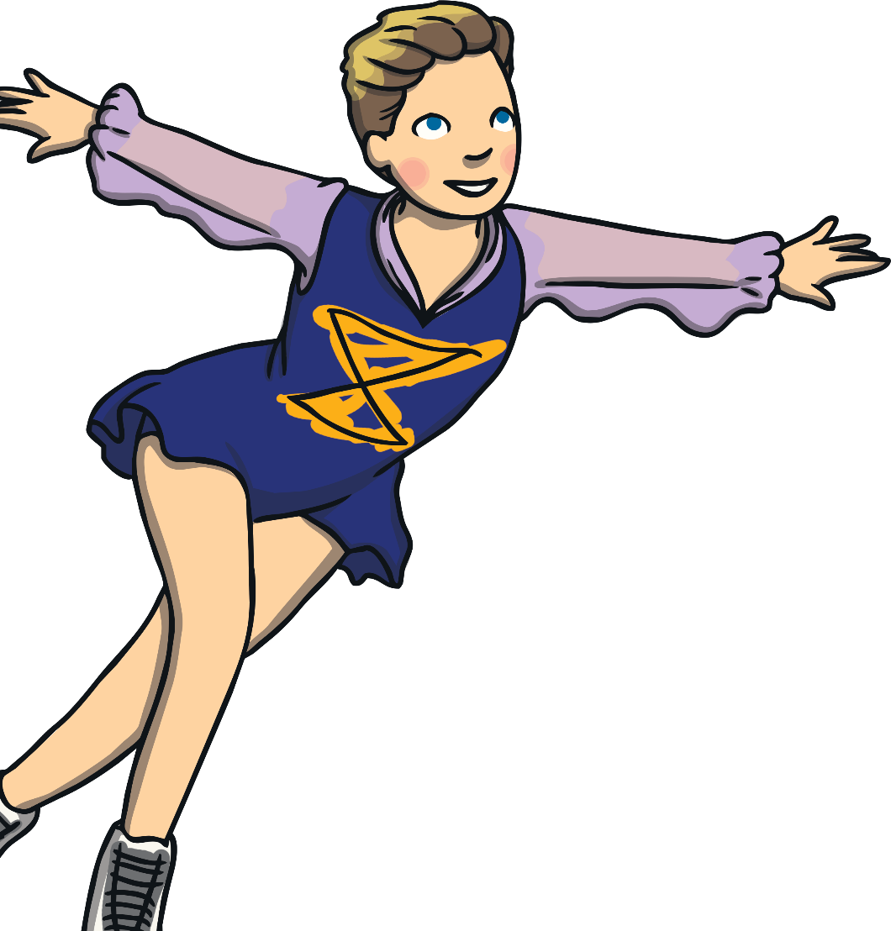
Star Rating
How well did you control your body today?
Give yourself a score out of five for your:
Skating
Jumping
Spinning

Slide 20
Aim
To move in response to a video stimulus.
Success Criteria
I can create different shapes with my body.
I can put actions together to create a motif.
I can move my body with control.
I can watch and describe a performance.

