Slide 1
Ready-to-go Lesson Slides
Year 3
Fractions
Lesson 4
Spr5

Slide 3
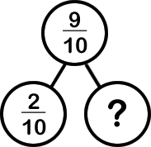
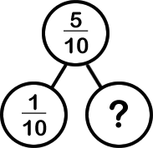
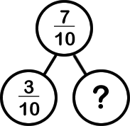
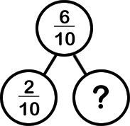
Starter:
Success Criteria: I can count up and down in tenths I know what happens when I count past 10 tenths
Which one is different?

Slide 4
Starter:
Success Criteria: I can count up and down in tenths I know what happens when I count past 10 tenths
Which one is different?
Each of the missing fractions is worth 4 tenths apart from the first one (which equals 7 tenths instead).

Slide 5
Talking time:
1
10
Start with and count forwards four tenths.
What would each fraction look like?

Slide 6
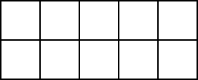
Talking time:
1
10
Start with and count forwards four tenths.
What would each fraction look like?
1
10
4
10
2
10
5
10
3
10

Slide 7
Talking time:
Continue the pattern…
4
10
5
10

Slide 8
Talking time:
Continue the pattern…
4
10
7
10
5
10
8
10
6
10
9
10

Slide 9
Activity 1:
6
10
8
10
What comes between and ?
What is one more tenth than ?
10
10

Slide 10
Activity 1:
6
10
8
10
What comes between and ?
What is one more tenth than ?
7
10
10
10
11
10
or 1
1
10

Slide 11
Talking time:
Continue counting in tenths.
What are the missing fractions?
7
10
8
10

Slide 12
Talking time:
Continue counting in tenths.
What are the missing fractions?
3
10
4
10
5
10
6
10
7
10
8
10
9
10
1
10
2
10
1
1
1

Slide 13
Activity 2:
Label each part of the counting sticks by counting in tenths.
1
4
10
3
10
1
1
1
3
10
9
10
1
10
1

Slide 14
Activity 2:
Label each part of the counting sticks by counting in tenths.
1
4
10
3
10
2
10
1
10
9
10
8
10
7
10
6
10
5
10
1
1
1
1
7
10
8
10
9
10
1
10
2
10
3
10
4
10
5
10
6
10
1
1
1
1
1
1
1
2
10
3
10
4
10
5
10
6
10
7
10
8
10
9
10
1
10
1
1

Slide 15
Talking time:
Sophie is counting in tenths. She says,
Is Sophie correct? Explain your answer.
eight tenths…
nine tenths…
ten tenths…
one eleventh…
two elevenths…

Slide 16
Talking time:
Sophie is counting in tenths. She says,
Is Sophie correct? Explain your answer.
No. When Sophie has reached ten tenths, she has changed into counting in elevenths, rather than continuing to count in tenths. The correct answer is:
“nine tenths… ten tenths… eleven tenths (or 1 and one tenth)… twelve tenths (or 1 and two tenths)…” and so on.
eight tenths…
nine tenths…
ten tenths…
one eleventh…
two elevenths…

Slide 17
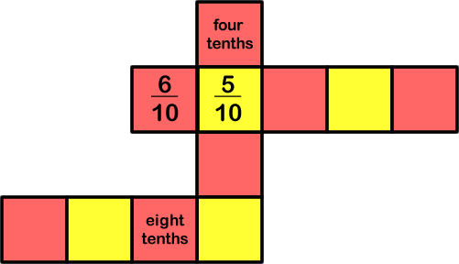
Activity 3:
Complete the chains of fractions by counting in tenths.

Slide 18
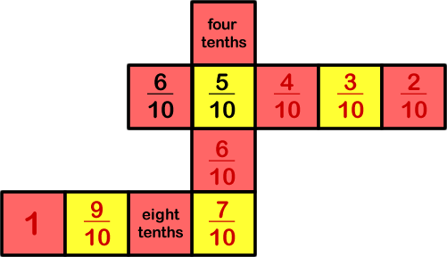
Activity 3:
Complete the chains of fractions by counting in tenths.
Extension:
Design a similar problem for your friend to solve.

Slide 19
Evaluation:
Success Criteria: I can count up and down in tenths I know what happens when I count past 10 tenths
True or False?
The fraction in between and is .
When counting forwards in tenths, the number after
nine tenths is 1 whole.
c) One more tenth than ten tenths is one eleventh.
When counting backwards in tenths, the number after one tenth is
nine ninths. We then start counting backwards in ninths.
Twelve tenths is the same as one whole and two tenths.
5
10
7
10
6
10

Slide 20
Evaluation:
Success Criteria: I can count up and down in tenths I know what happens when I count past 10 tenths
True or False?
The fraction in between and is .
TRUE
When counting forwards in tenths, the number after
nine tenths is 1 whole. TRUE
c) One more tenth than ten tenths is one eleventh. FALSE
When counting backwards in tenths, the number after one tenth is
nine ninths. We then start counting backwards in ninths. FALSE
Twelve tenths is the same as one whole and two tenths. TRUE
5
10
7
10
6
10

