Slide 1
Ready-to-go Lesson Slides
Year 3
Fractions
Lesson 8
Spr5

Slide 3
Starter:
Success Criteria: I can solve problems using fractions
2
This is of a set of books.
How many were in the whole set?
5

Slide 4
Starter:
Success Criteria: I can solve problems using fractions
2
This is of a set of books.
How many were in the whole set?
5
You can divide the amount by the numerator, then multiply the answer by the denominator.
10 ÷ 2 = 5
5 x 5 = 25
So, there are 25 books in the whole set.

Slide 5
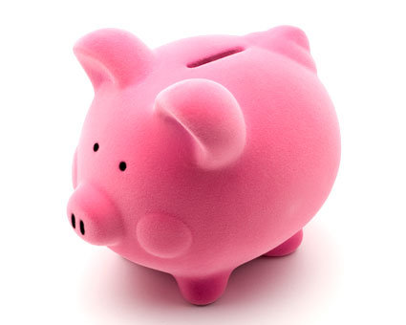
Talking time:
Anna has £4.50.
She wants to save of her money in her piggybank.
How much would she save?
3
5
First, I can work out how many pence there are in £4.50 = ___p.
Next, I can work out one-fifth of ___, which is ____.
I then multiply ___ by ___ to get the answer ___.
So, Anna will save ____.

Slide 6
Talking time:
Anna has £4.50.
She wants to save of her money in her piggybank.
How much would she save?
3
5
First, I can work out how many pence there are in £4.50 = 450p.
Next, I can work out one-fifth of 450, which is 90.
I then multiply 90 by 3 to get the answer 270.
So, Anna will save £2.70.

Slide 7
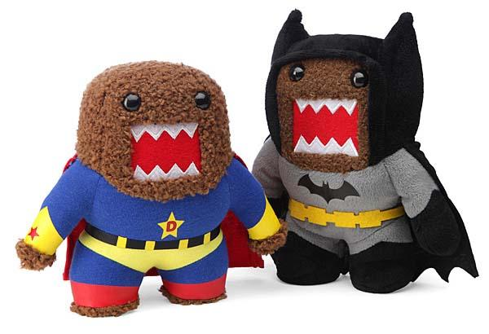
Activity 1:
Ben saves up £8.60.
He wants to spend on a new toy.
How much would he spend?
3
4
First, I can work out how many pence there are in £8.60 = ___p.
Next, I can work out one-fifth of ___, which is ___.
I then multiply ___ by __ to get the answer ___.
So, Ben will spend ___.

Slide 8
Activity 1:
Ben saves up £8.60.
He wants to spend on a new toy.
How much would he spend?
3
4
First, I can work out how many pence there are in £8.60 = 860p.
Next, I can work out one-quarter of 860, which is 215.
I then multiply 215 by 3 to get the answer 645.
So, Ben will spend £6.45.

Slide 9
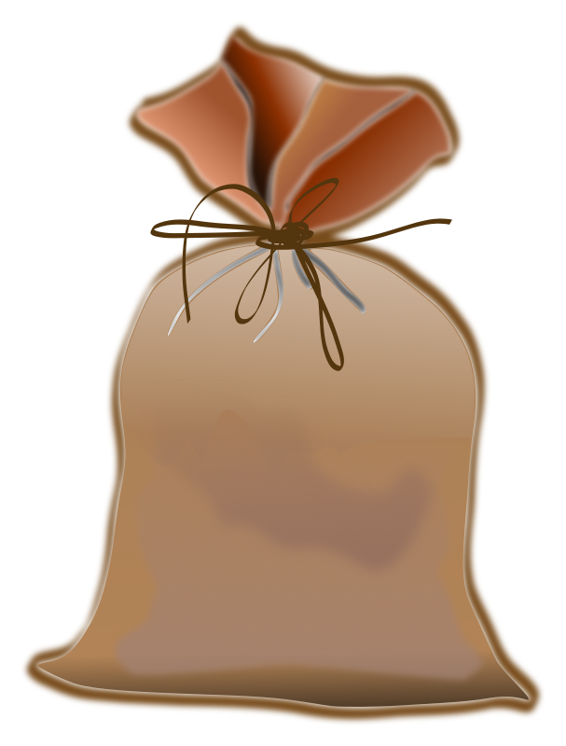
Talking time:
A bag of apples weighs 1kg and 600g.
Beth uses of the bag to make a pudding.
How much of the bag has she used?
3
4
First, I can work out how many grams there are in 1kg and 600g = ___g.
Next, I can work out one-quarter of ___, which is ____.
I then multiply ___ by ___ to get the answer ___.
So, Beth used __kg and ___g.

Slide 10
Talking time:
A bag of apples weighs 1kg and 600g.
Beth uses of the bag to make a pudding.
How much of the bag has she used?
3
4
First, I can work out how many grams there are in 1kg and 600g = 1600g.
Next, I can work out one-quarter of 1600, which is 400.
I then multiply 400 by 3 to get the answer 1200.
So, Beth used 1kg and 200g.

Slide 11
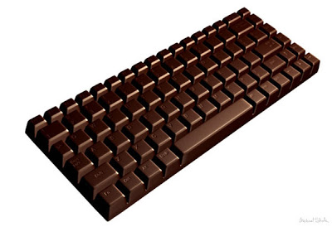
Activity 2:
A giant bar of chocolate measures 1.25m in length.
5 children each get of the bar.
What length of the bar does each child get?
1
5
First, I can work out how many centimetres there are in 1.25m = ___cm.
Next, I can work out one-fifth of ___, which is ___.
So each child will receive ___cm of chocolate.

Slide 12
Activity 2:
A giant bar of chocolate measures 1.25m in length.
5 children each get of the bar.
What length of the bar does each child get?
1
5
First, I can work out how many centimetres there are in 1.25m = 125cm.
Next, I can work out one-fifth of 125, which is 25.
So each child will receive 25cm of chocolate.

Slide 13
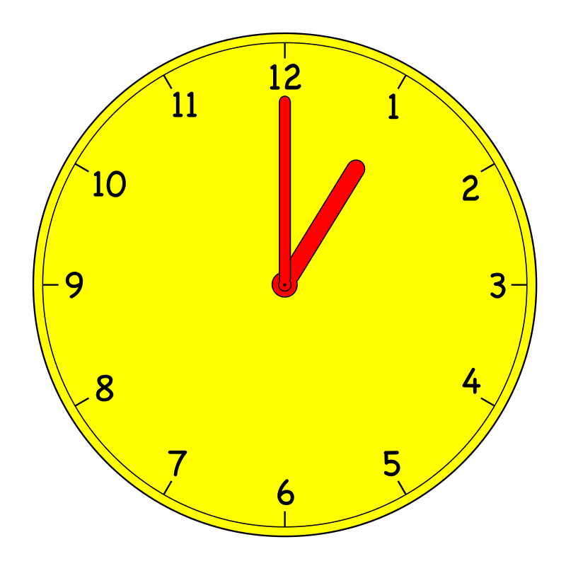
Talking time:
4
Find of 2 hours.
2 hours = ___ minutes.
of ___ minutes = ___.
of ___ minutes = ___ minutes.
6
1
6
4
6

Slide 14
Talking time:
4
Find of 2 hours.
2 hours = 120 minutes.
of 120 minutes = 20.
of 120 minutes = 80 minutes.
6
1
6
4
6

Slide 15
Activity 3:
A film lasts 3 hours and 10 minutes.
Jenny has to go to bed and misses the last of the film.
How many minutes of the film does she miss?
3 hours and 10 minutes = ___ minutes.
of ___ minutes = ___ minutes.
of ___ minutes = ___ minutes.
So, Jenny misses ___ minutes or ___ hour and ___ minutes.
2
5
1
5
2
5

Slide 16
Activity 3:
A film lasts 3 hours and 10 minutes.
Jenny has to go to bed and misses the last of the film.
How many minutes of the film does she miss?
3 hours and 10 minutes = 190 minutes.
of 190 minutes = 38 minutes.
of 190 minutes = 76 minutes.
So, Jenny misses 76 minutes or 1 hour and 16 minutes.
2
5
1
5
2
5

Slide 17
Activity 4:
Connor makes 3 football banners.
Each banner uses 250cm of material.
He has a 10 metre roll of material.
How much material is left after making the 6 banners?
What fraction of the original roll is left?

Slide 18
Activity 4:
Connor makes 3 football banners.
Each banner uses 250cm of material.
He has a 10 metre roll of material.
How much material is left after making the 6 banners?
What fraction of the original roll is left?
3 x 250cm = 750cm
10 metres = 1000cm
1000 – 750 = 250cm, so 250cm of material is left.
250cm is of the original roll.
1
4

Slide 19
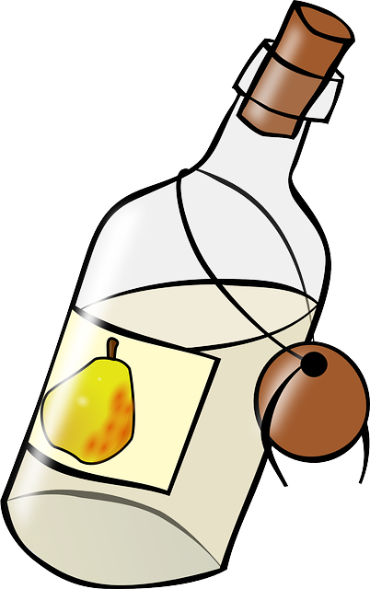
Evaluation:
Holly has a bottle of pear juice.
She drinks of the juice.
Her sister, Grace drinks 300ml.
One fifth of the juice is left in the bottle.
How much did Holly drink?
What fraction of the bottle did Grace drink?
How much juice did the bottle contain?
Success Criteria: I can solve problems using fractions
3
5

Slide 20
Evaluation:
Holly has a bottle of pear juice.
She drinks of the juice.
Her sister, Grace drinks 300ml.
One fifth of the juice is left in the bottle.
How much did Holly drink?
What fraction of the bottle did Grace drink?
How much juice did the bottle contain?
Success Criteria: I can solve problems using fractions
3
5
Holly drinks 900ml of juice.
Sarah drinks one-fifth of the juice.
The bottle contained 1.5 litres of juice.

