Slide 1
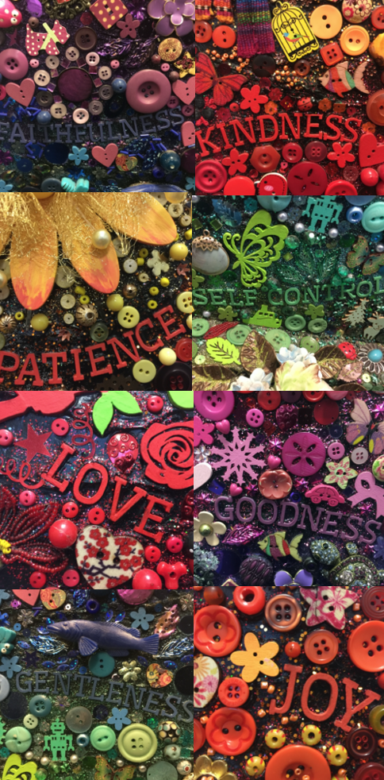
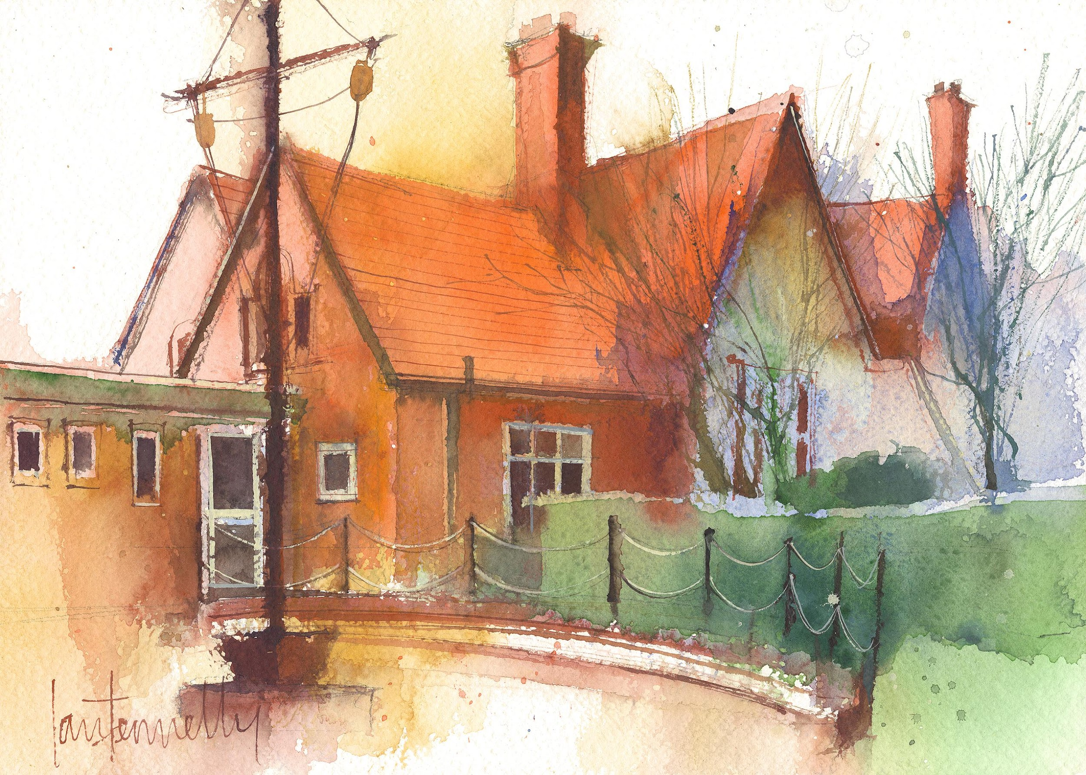
Dawpool CE (Aided) Primary School
School Information 2025-26
Vision Statement
‘The Dawpool community are united in their ambition to create a school which embodies the person, love and work of Jesus Christ: a school which enables Christian values to flourish and where all children may experience the abundant life that Jesus offers.’

Slide 2
Welcome
A warm welcome to the 2025-26 academic year.
Some helpful links
Our school website: https://www.dawpool.wirral.sch.uk/website
Our school email: schooloffice@dawpool.wirral.sch.uk

Slide 3

Staff in Year 6
Mrs Portia Lee - Class Teacher (Monday to Friday)
Mrs C. McCann – Friday
Mrs S Thompson (Monday and Tuesday)
Mrs C Wood- Support Assistant (Wednesday to Friday am)
Organisation
Children work in the Year 6 classroom and have fluid use of the Study Bay for independent work, quiet space, reading, learning support and extension tasks.

Slide 4
Arrivals & Departures
Our school will give a warm and friendly welcome to each child on arrival and ensure that they depart safely at the end of each day. A copy of our full Arrivals and Departures procedure can be viewed here.
Arrivals
The opening times for arriving at school are 8.45am – 8.55am each day for all pupils. Pupils arriving in their classroom after 8:55am will receive a late mark.
If your child is absent from school, please inform the school office by 9:00am using the pupil absence line: 0151 648 3412 (option 1). On your child’s return to school, you must provide a written explanation for the absence.
Departures
F1 and F2 classes finish school at 3:25pm. All other classes finish at 3:30pm. All classes are escorted outside by a member of staff who will be on duty in the playground until 3.40pm. No pupil will be permitted to leave school without a parent or carer, unless the pupil is in Years 5 and 6 and school has received signed parental consent. In the interests of safety, we ask that children do not play on the trim trail at home time.

Slide 5

Curriculum Overview
We provide a subject-specific curriculum in which we have mapped out the knowledge and skills that we want children to learn at each stage. The subject-specific curriculum documents also comprise an overview of Early Years and can be viewed within the curriculum section of our website by clicking here.
English: Class texts: Moondial and Beowulf,SPaG
Maths: Daily Arithmetic, Reasoning and Tables, Science:Light and Electricity
History: Anglo-Saxons & Vikings
Art: Line, Tone and Shading, Gustav Klimt and Pattern
Design Technology Viking Shields, Textiles (Designing and Making a Christmas Stocking)
RE: Life is a Journey
Where possible, subjects are delivered through topics which are designed for maximum engagement and ensure all pupils benefit from a rich, broad, balanced curriculum presented in an interesting, exciting and imaginative manner with lots of opportunities for first-hand experience, practical work, investigation and learning through play. The curriculum is enriched with visits, visitors, and extensive use of our unique environment.

Slide 6
Curriculum
English
Writing (Narrative, News Reports, Poetry, Persuasive, Diary Letter,
Non-chronological Reports
Spelling, Punctuation, Grammar and Handwriting
Reading (groups and class text) Comprehension
Term 1: Poetry, Moondial and Beowulf
Term 2: Poetry, Beowulf
Term 3: The Silver Sword
Maths:
Daily Arithmetic, Reasoning and Tables
Term 1: Place Value, Number, Mixed Operations, Fractions, Decimals
Term 2: Percentages, Position/Direction, Algebra, Converting Units,
Perimeter / Area / volume, Ratio
Term 3: Shape, Statistics

Slide 7
Curriculum
R.E.
Term 1: Life is a Journey,
The Exodus, Advent, Christingle
Term 2: Who was Jesus?, God
Ascension and Pentecost
Term 3: People of Faith, Eucharist
Science:
Term 1: Light and Electricity
Term 2: Humans (Heart, Blood, Lungs, Health and Diet)
Term 3: Inheritance,
Adaptation (and Habitats)
Evolution (Fossils)

Slide 8
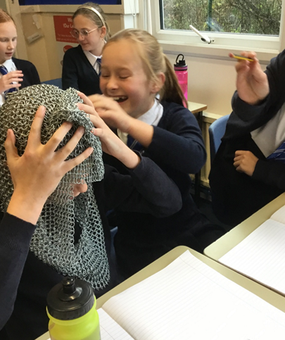
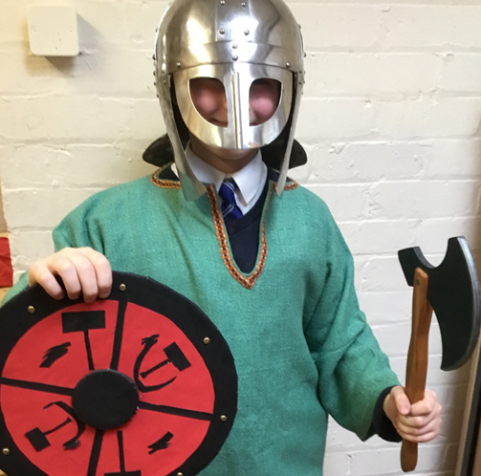
Exploring artefacts in history
Viking shield and replica costume

Slide 9
Wider curriculum
History: Anglo-Saxons, Vikings, WW1
Geography: Map Skills, Climate Zones/Habitats
PE: Tag Rugby, Hockey, Athletics, Basketball, Cricket, Dance, Gymnastics
Art: Line, Tone and Shading, Klimt and pattern, The Art of Asia, (Blossom, Bamboo, Calligraphy, Mehndi, Mandala, Manga)
Georgia O’keeffe, WWI Art, Claude Monet and Impressionism
Design Technology: Linked with topic: Viking Shields, Textiles
(Designing and Making a Christmas Stocking) Kite Making
Music: Charanga and Liverpool Philharmonic
Computing: E Safety, Coding and cross curricular ICT opportunities.

Slide 10
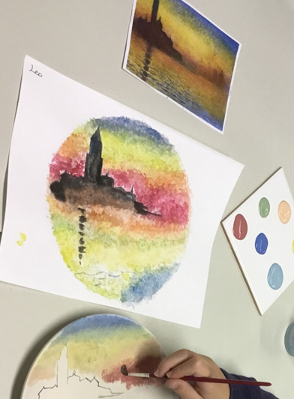
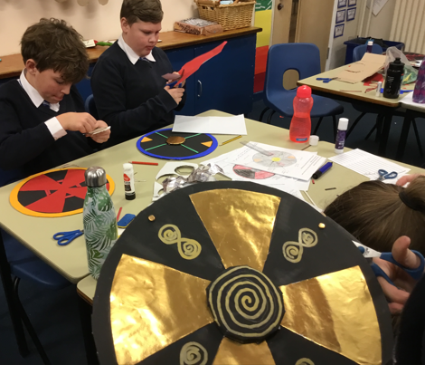
Art and D.T

Slide 11
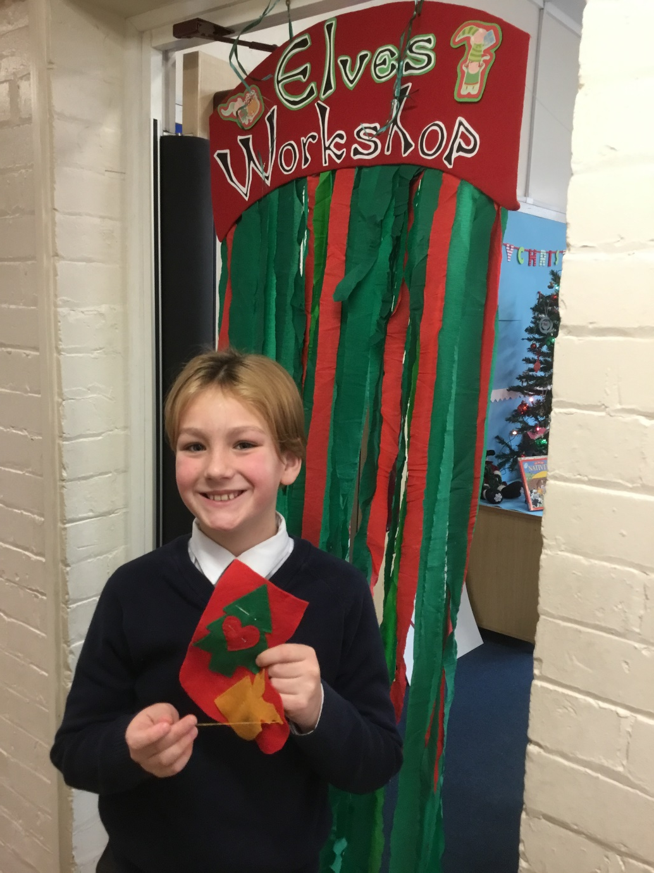
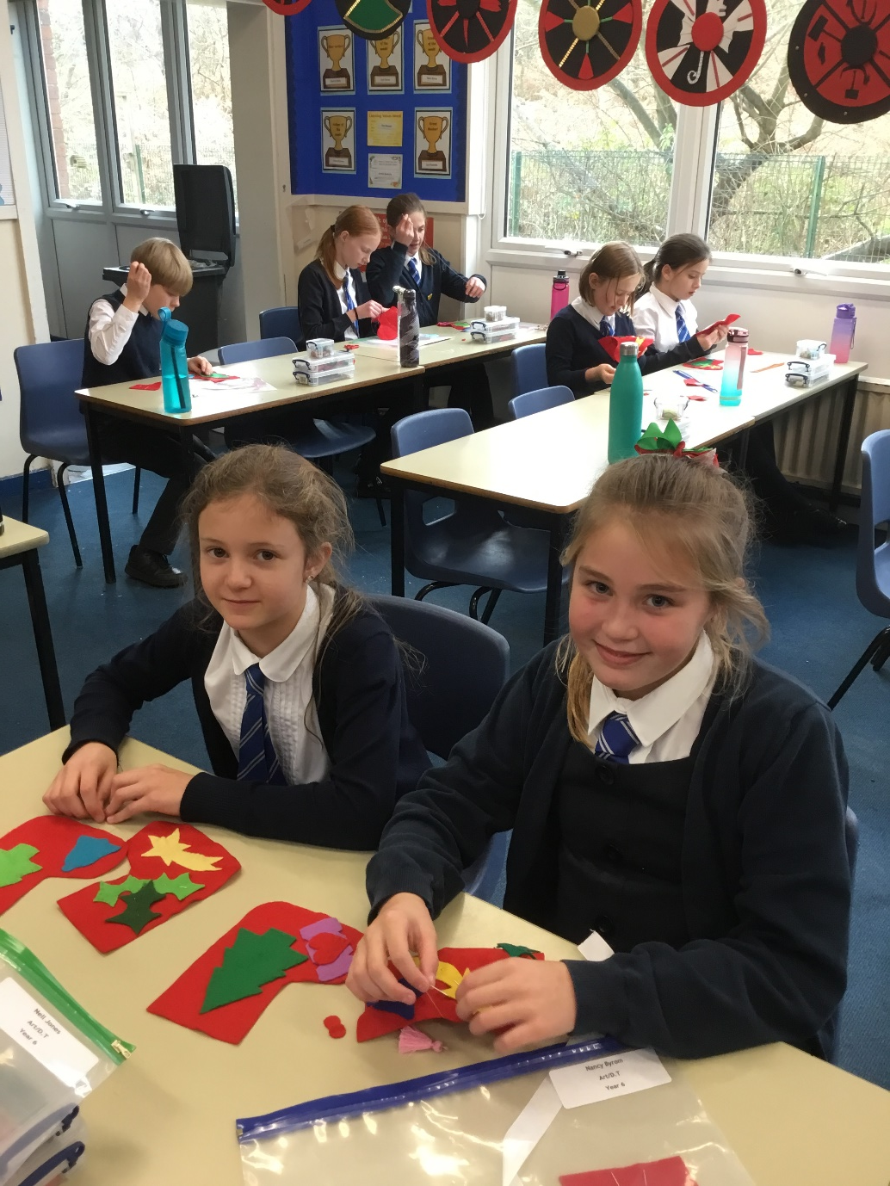

Slide 12
Y6 Timetable - Autumn Term (Typical week)
Monday | Tuesday | Wednesday | Thursday | Friday
RR/ FF/Spell | FF/RR/X Tables | FF/RR/Spell | FF/ RR/Spell | FF/RR/XTables | 9:00
Mathematics | Mathematics | Mathematics | Mathematics | Computing/RE | 10:30
BREAK
Grammar/ Spelling | English | English | Grammar/ Spelling | Computing/RE | 10:45 12:15
LUNCH
Arithmetic/Core Skills | Music | Science | English | PE | 1:15
History | Picture News | Art/D.T (Half Termly) |  | Spanish (Fortnightly) | 3:20

Slide 13
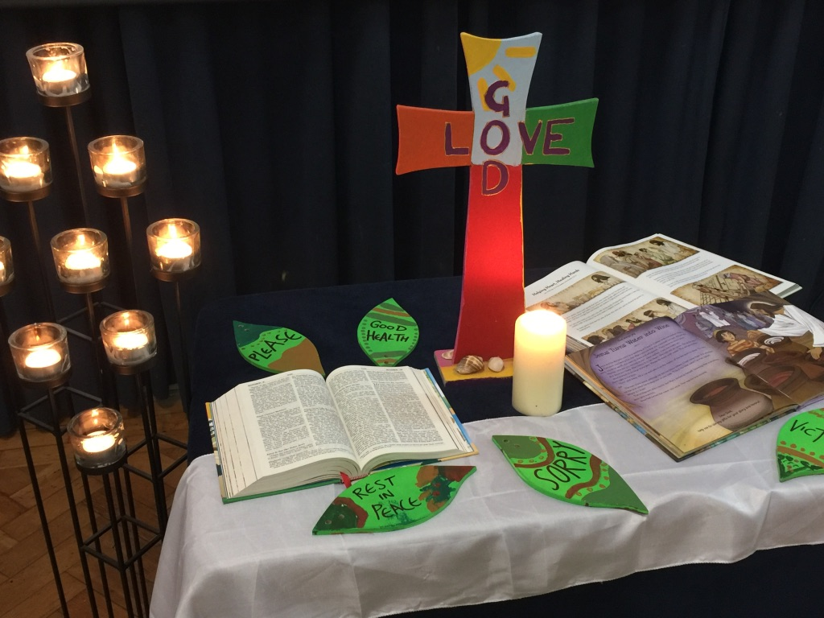
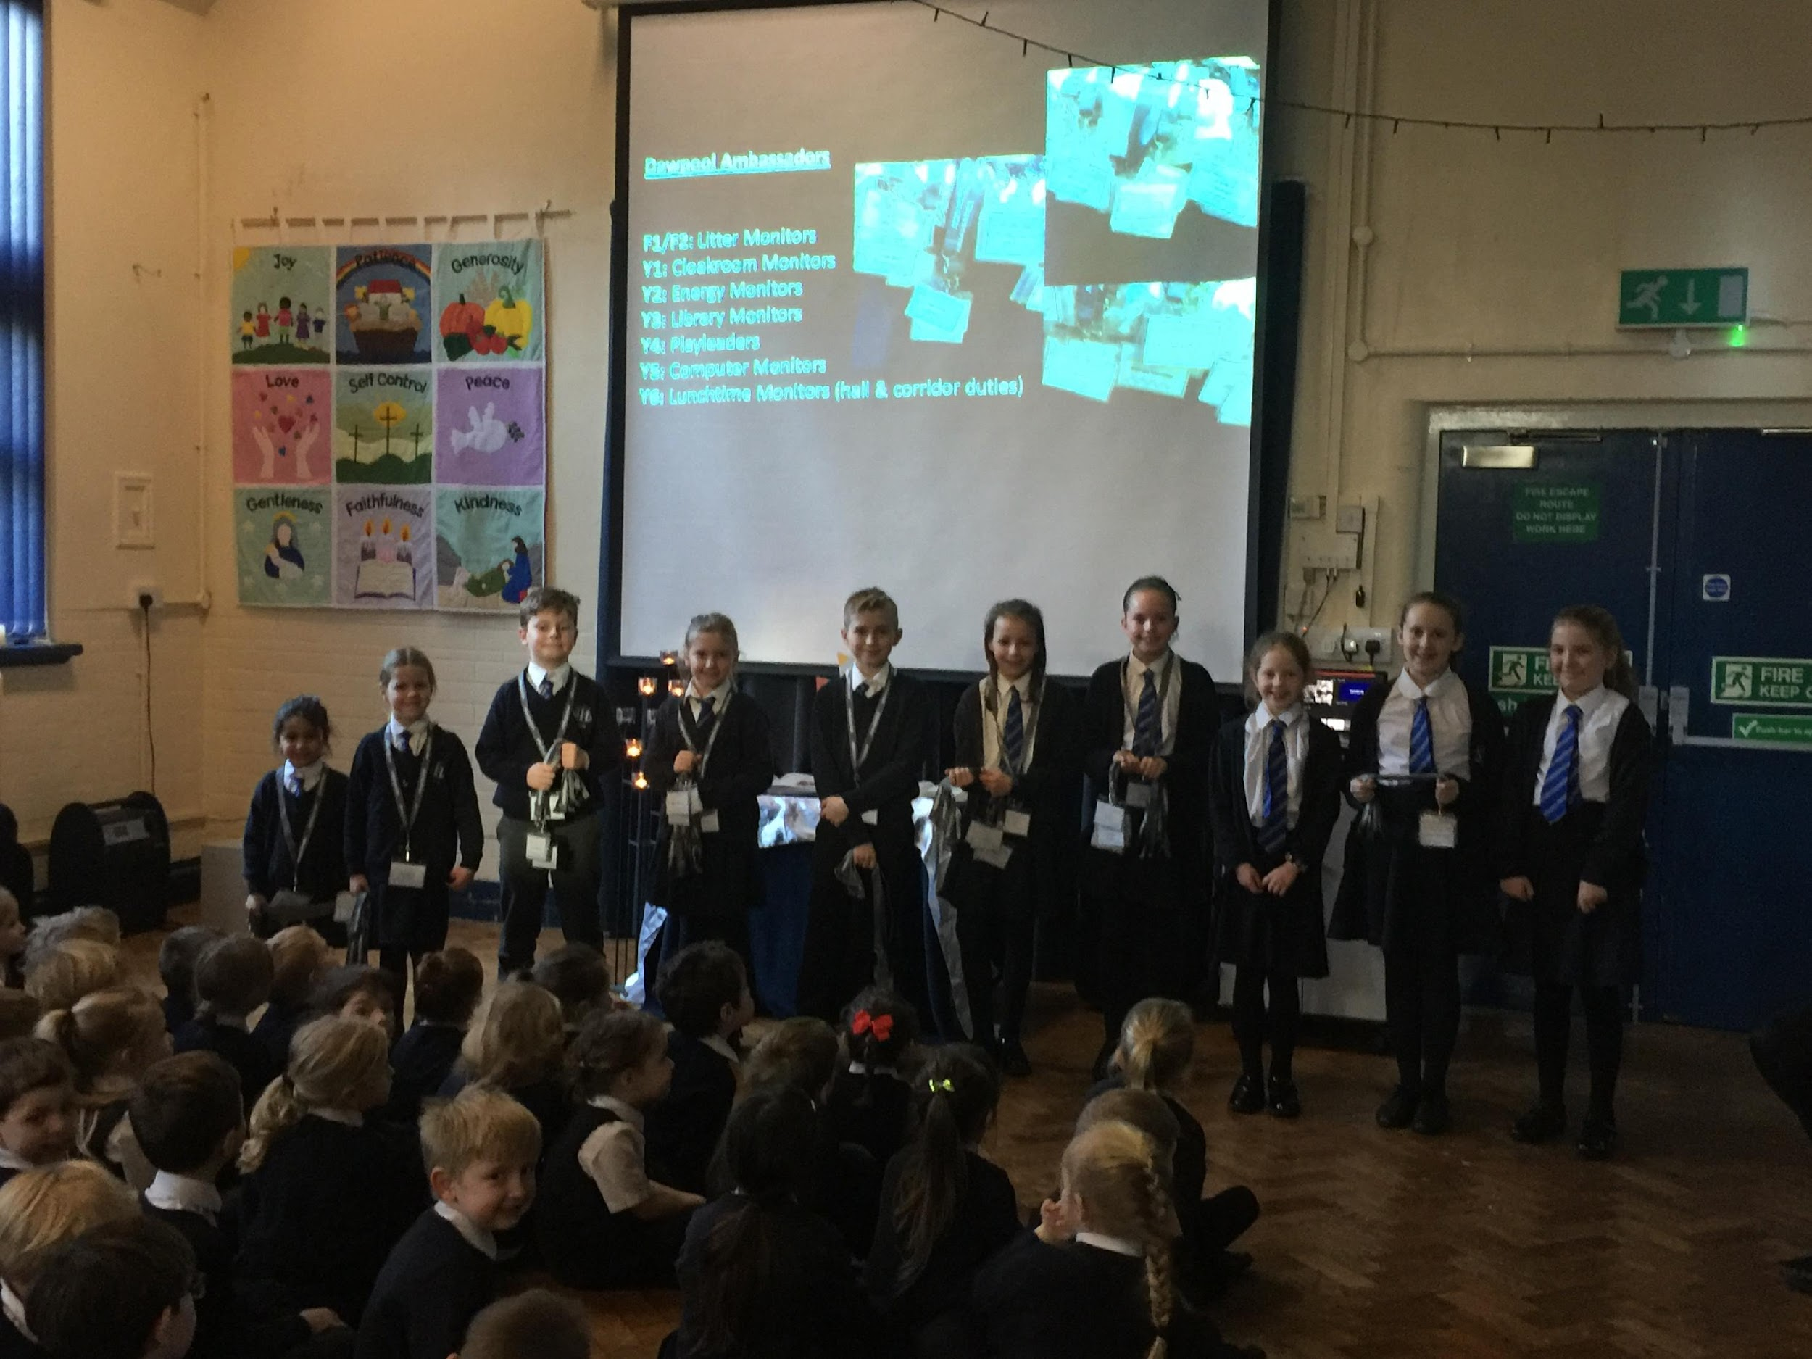
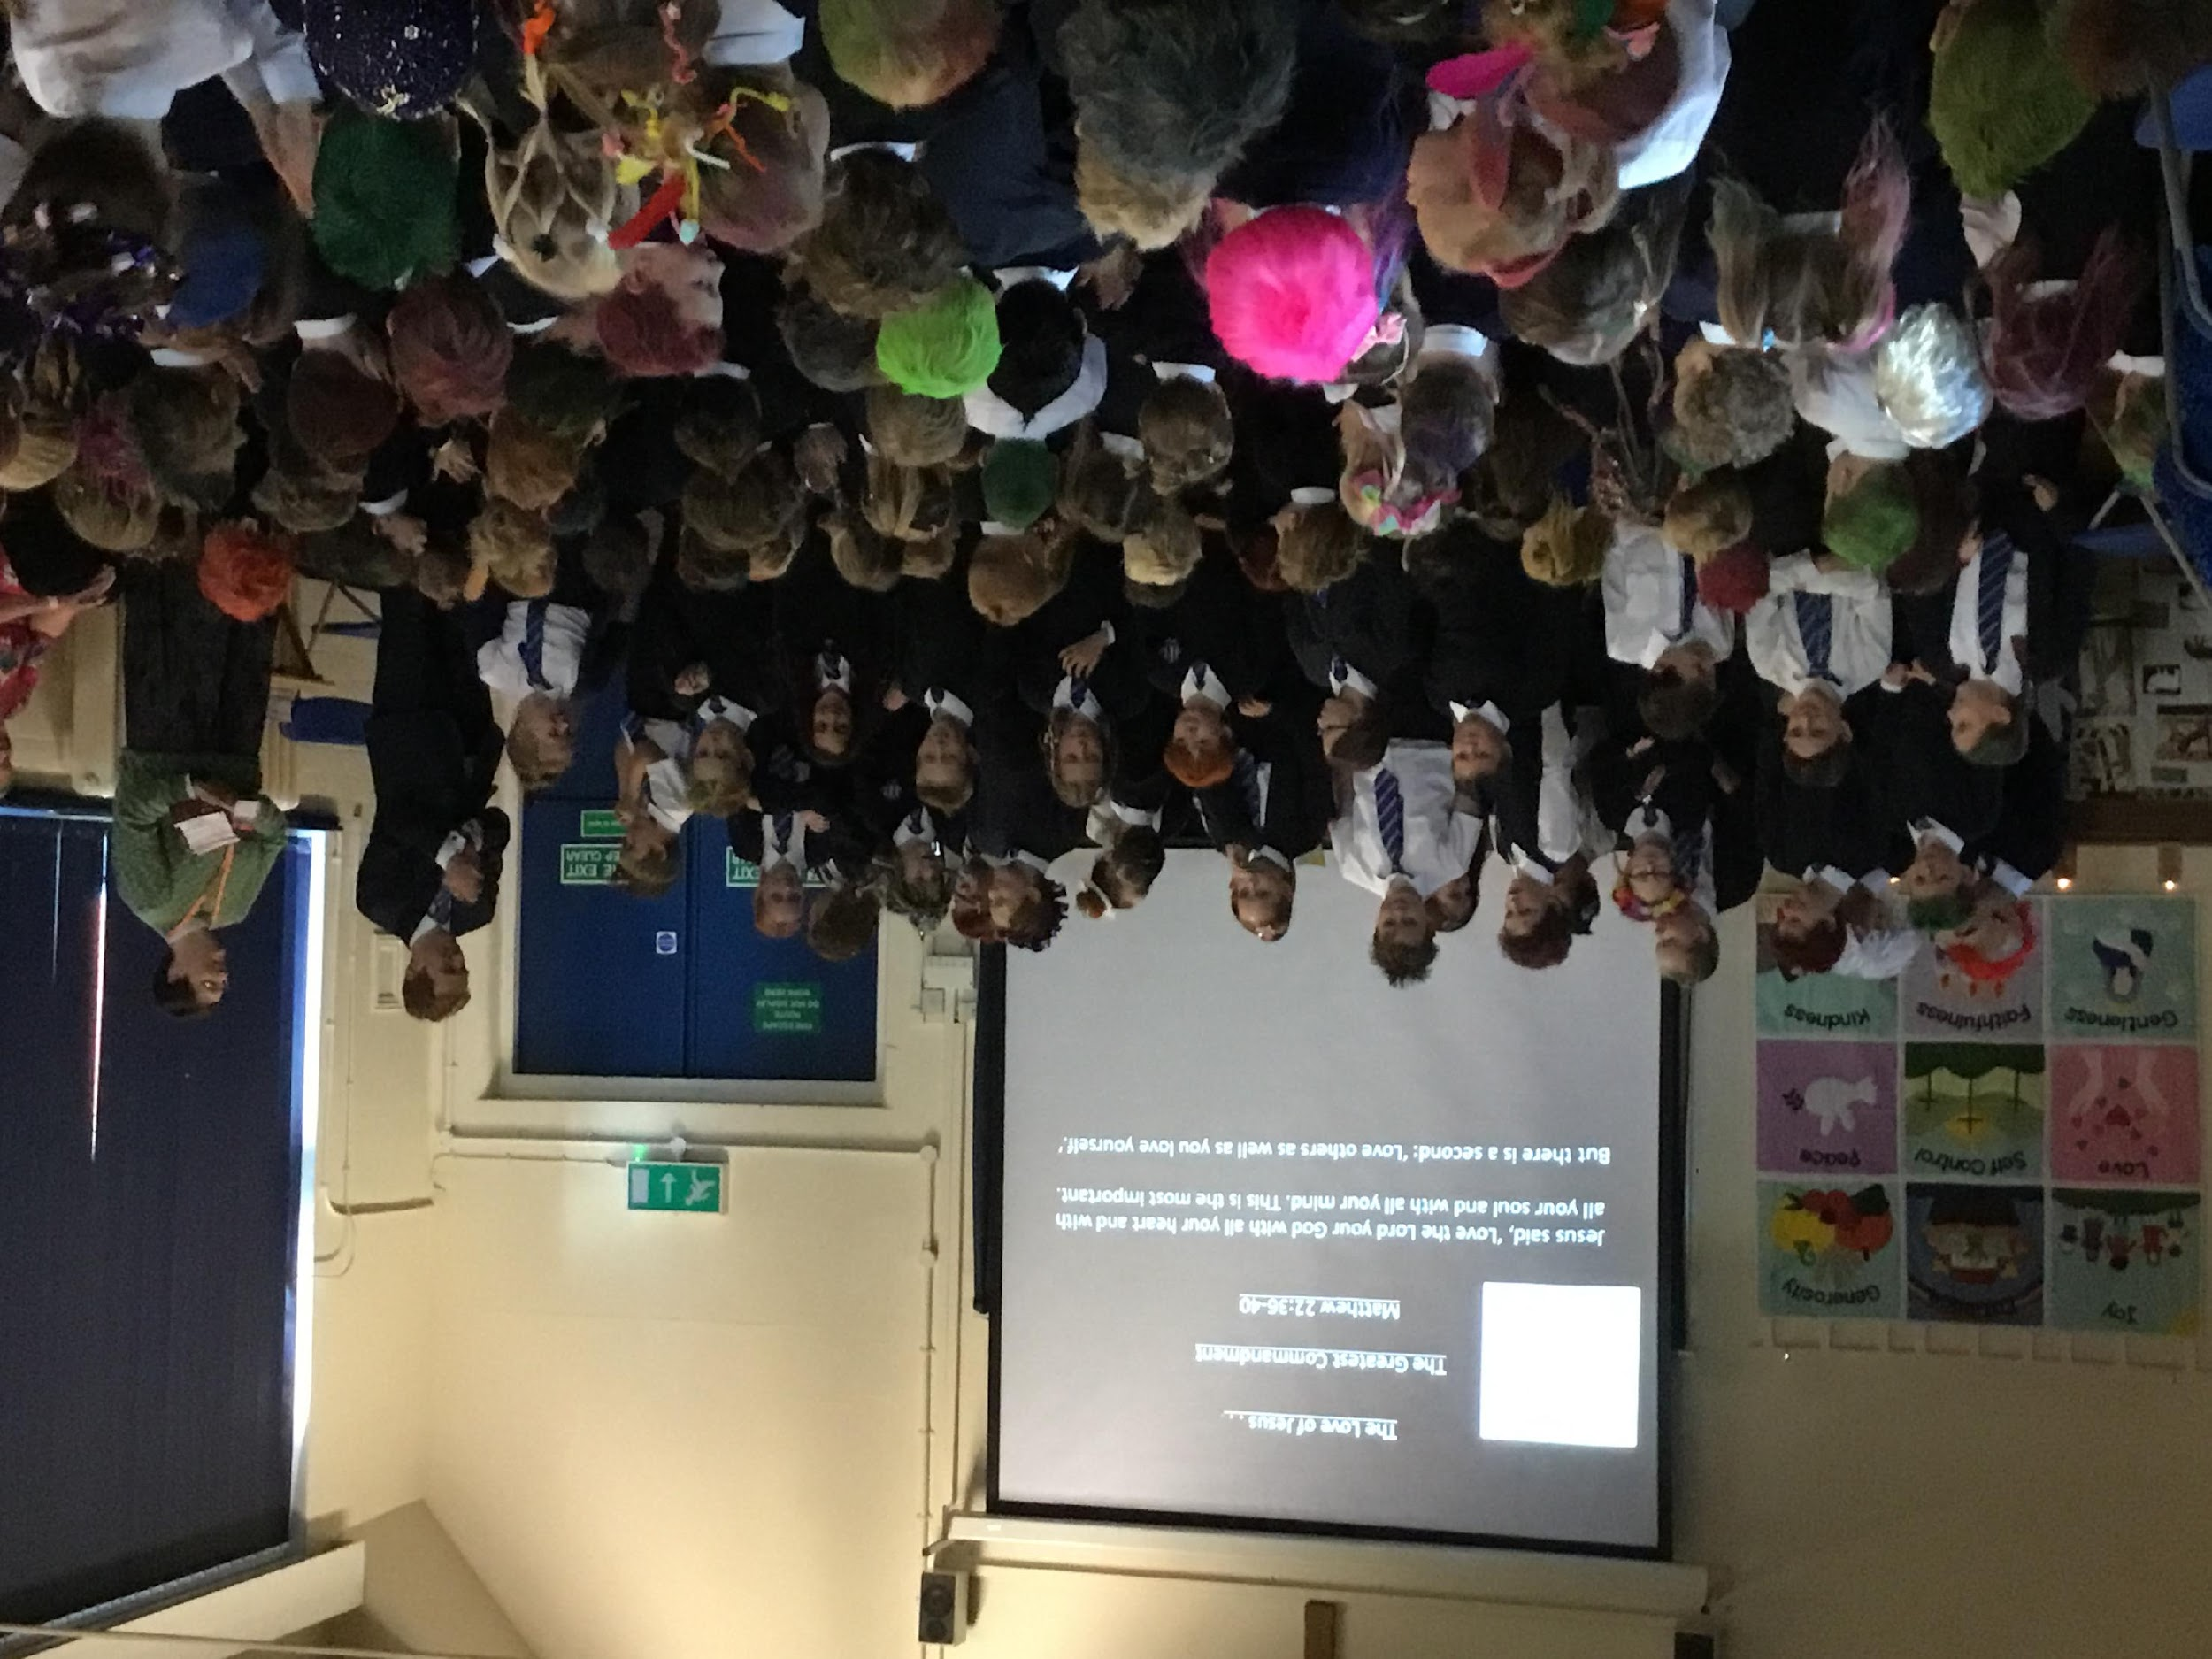
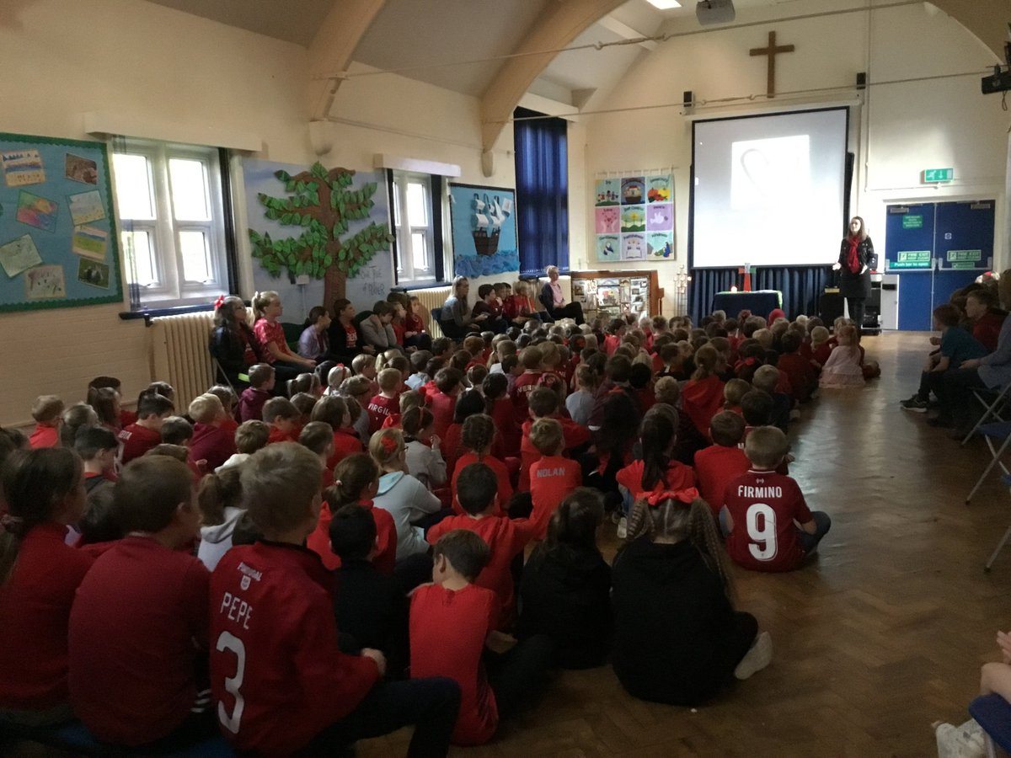
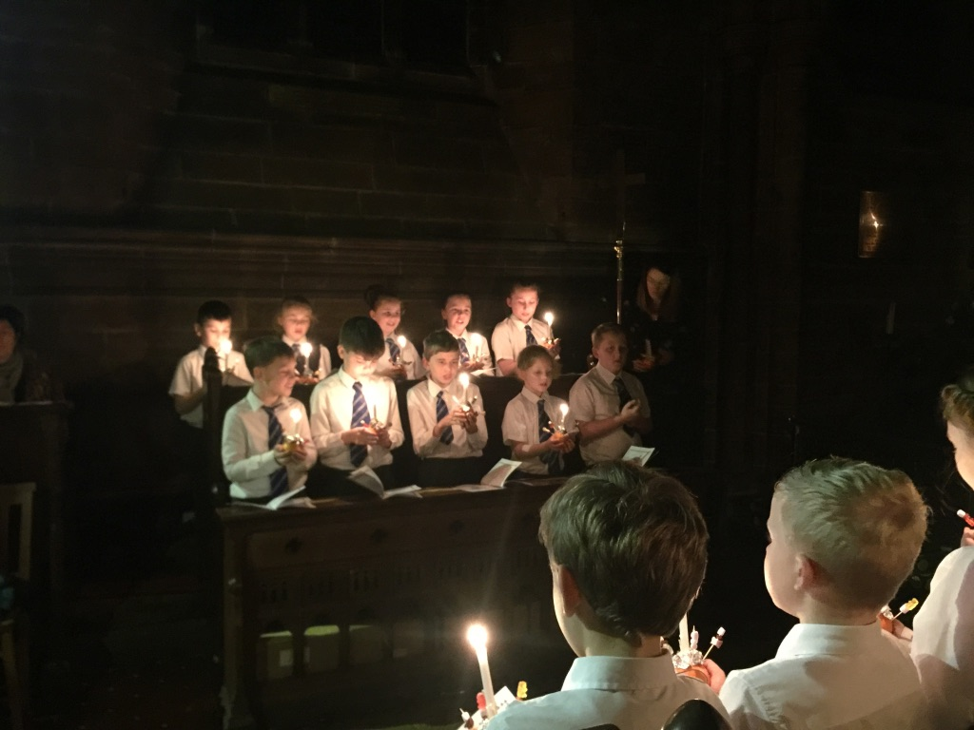
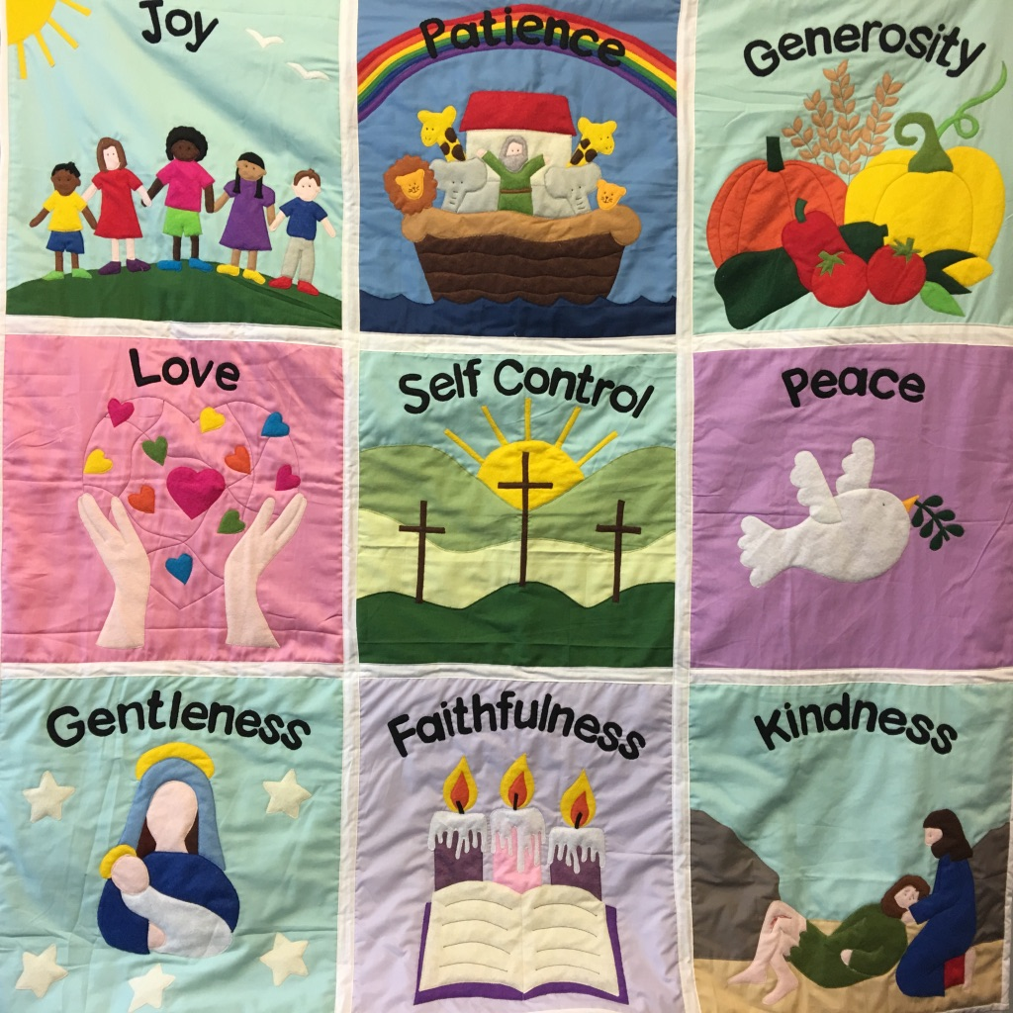
Worship
There is an Act of Worship every morning. Worship is a time where we come together to reflect on the school’s vision and values and to learn about the Person, Love & Work of Jesus which is central to the school’s vision and curriculum. The daily Act of Worship promotes the school values which permeate the ethos of the school. Worship covers such areas as:
Christian Values: Person, Love & Work of Jesus
British Values
Relationships & Health Education
Equality & Diversity
Celebration: Rewards & Certificates

Slide 14
Homework Activities
Year 6 Homework Packs
Homework will be sent out on a Thursday and is due in on a Tuesday
Homework packs contain essential support materials so please keep them safe
Weekly homework will consist of:
English:
Reading comprehension or grammar exercise.
Reading book and log to be returned each week or fortnightly if very long.
Weekly spellings and rule to be learned
Mathematics:
Task based on work done in class
Tables and or fact learning
Creative projects related to topic work (half termly)

Slide 15
Spelling Homework
Homework Activities
accommodate | ancient
accompany | apparent
according | appreciate
achieve | attached
aggressive | available
amateur | average
Nouns are words that identify a person, place, idea or thing Common – refers to things in general - dog, road Proper – a specific person/place/thing – Dawpool, Friday Abstract – intangible idea – love, friendship, time, faith Collective – groups of people or things – class, family, choir Concrete – something that exists physically – desk, chair
Remember to learn the weekly
grammar fact

Slide 16
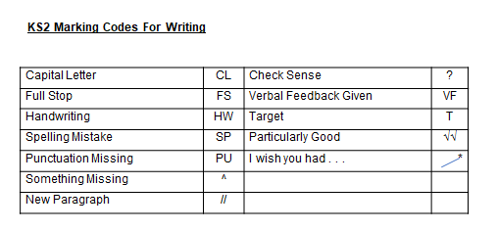
Homework Activities
The children in year 6 will have personal writing targets and will be using the KS2 marking criteria to self and peer assess.
They will be using a green response pen to improve and correct their work.
All written homework should be completed in pen using a cursive style.
Care should be taken with punctuation and grammar.
All mathematics homework should be completed in pencil.

Slide 17
Certificates and Awards
In Year 6 we have a “Roll of Honour” and give weekly awards for:
Best Thinker
Improver
Writer
Reader
Helper
Throughout the year children have individual targets but also a Personal Best (PB) system were they are rewarded for personal progress
Children have award boxes for these as well as receiving superstars
Each week a ‘Learning value’ certificate is awarded to two children in our class in recognition of demonstrating the school’s ‘Learning values.’
Each week two ‘Fruit of the Spirit’ certificates are awarded to a child in our class in recognition of demonstrating the school’s core values.
A celebration assembly takes place every Friday to acknowledge weekly achievements.
Certificates-bronze, silver, gold and Headteacher’s are awarded for superstars earned.
Role models to encourage good choices.

Slide 18
Behaviour & Anti-Bullying
At Dawpool, we believe that all people are made in the image of God and are unconditionally loved by God. Everyone is equal and we treat each other with dignity and respect. Our school is a place where everyone should be able to flourish in a loving and hospitable community. Poor behaviour and bullying of any kind will not be tolerated and will be taken seriously.
Dawpool’s Behaviour Policy can be viewed here.
Dawpool’s Anti-Bullying Policy can be viewed here.
The school’s Anti-Bullying Guide for Parents can be viewed here.
The school’s Anti-Bullying Guide for Children can be viewed here.
If parents and carers have a concern about behaviour or bullying, please share your concern with the class teacher so we can resolve the situation quickly.

Slide 19
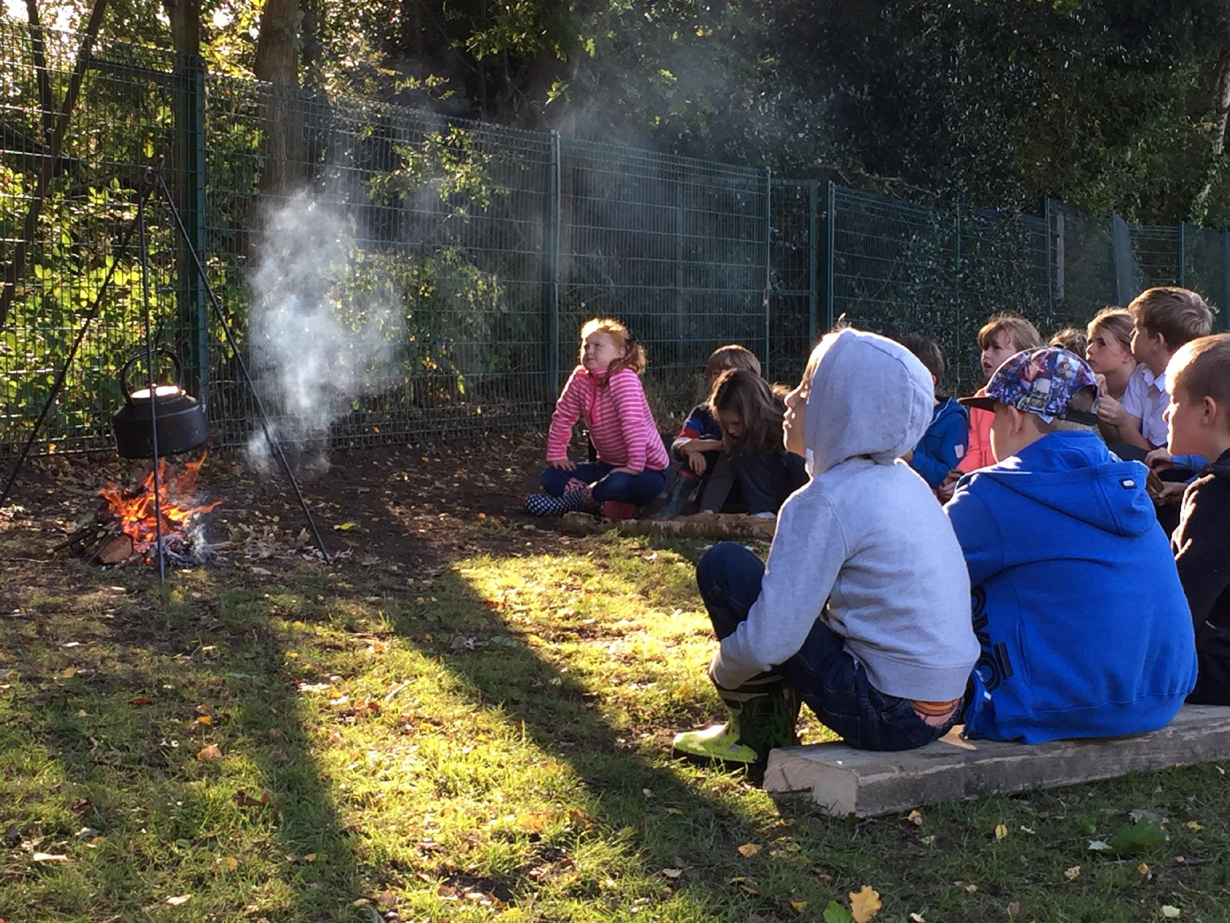
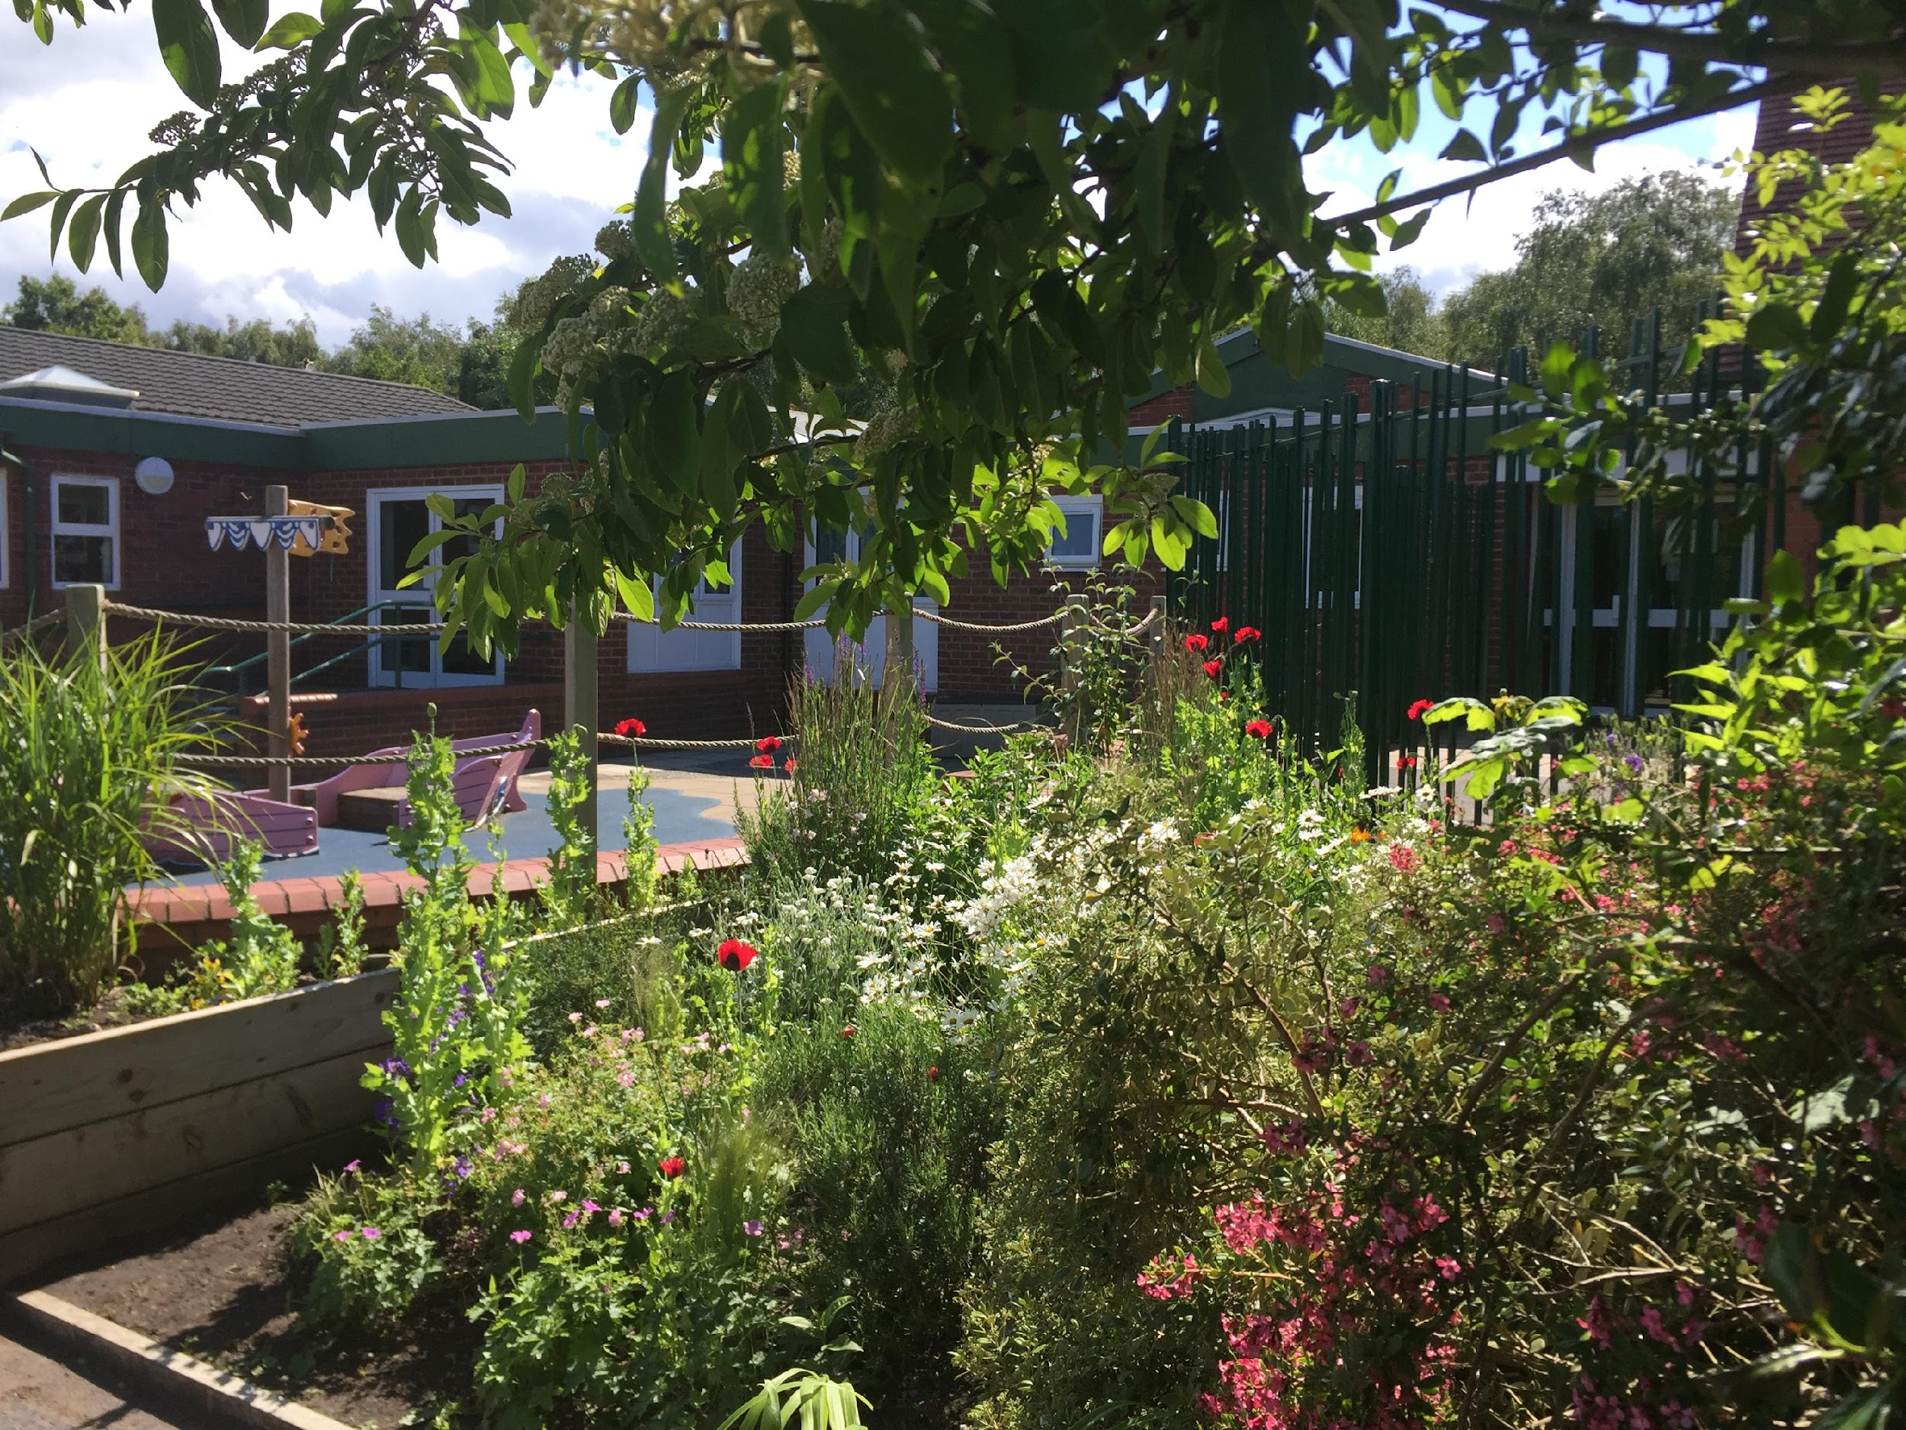
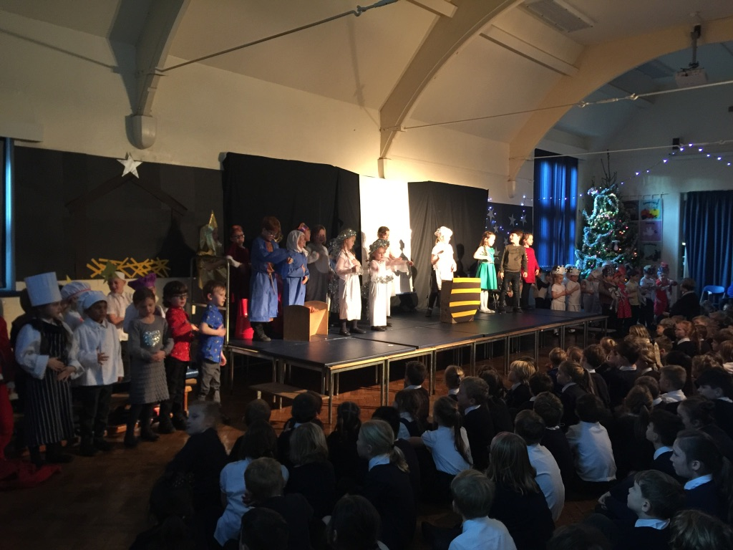
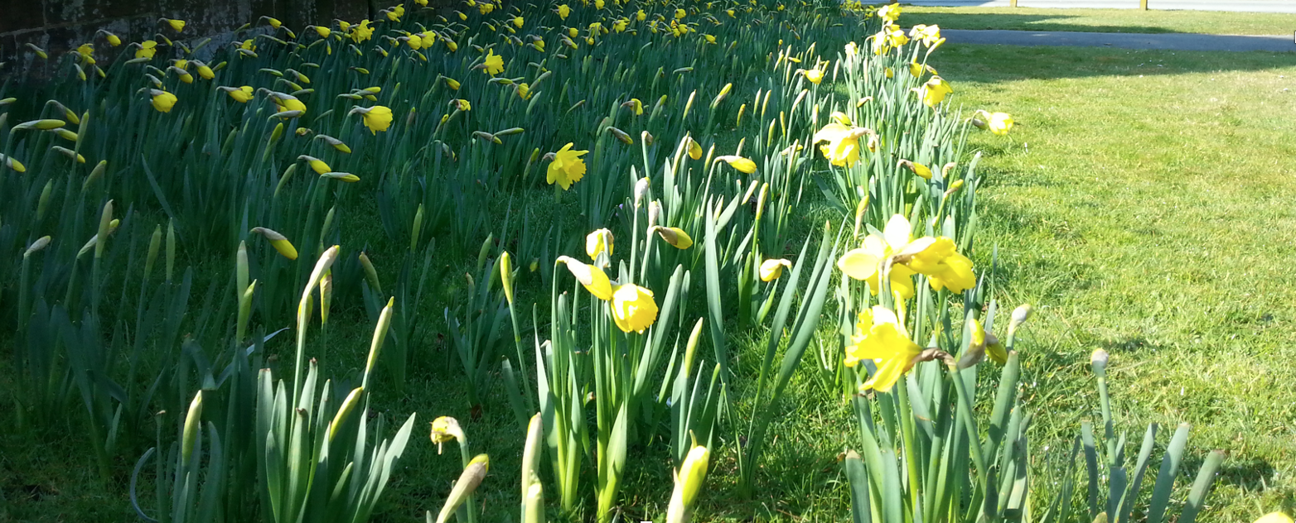
Safeguarding
We know there can be no greater importance to parents and carers than the safety of their children. It is a priority that our safeguarding procedures keep our children safe.
We have a team of staff responsible for keeping children safe and supporting those most vulnerable to harm and neglect. Our Designated Safeguarding Leads (DSL) are Mrs Griffiths (Head Teacher), Mrs McCann (Deputy Head Teacher) and Mrs Poston (EYFS lead). Our safeguarding team pays particular attention to the meticulous and systematic implementation of policies and routines.
Safeguarding involves every member of the community. If you are concerned about a child’s welfare, please record your concern and report it to one of the safeguarding team as soon as possible.
The school’s safeguarding policies and procedures can be downloaded here.

Slide 20
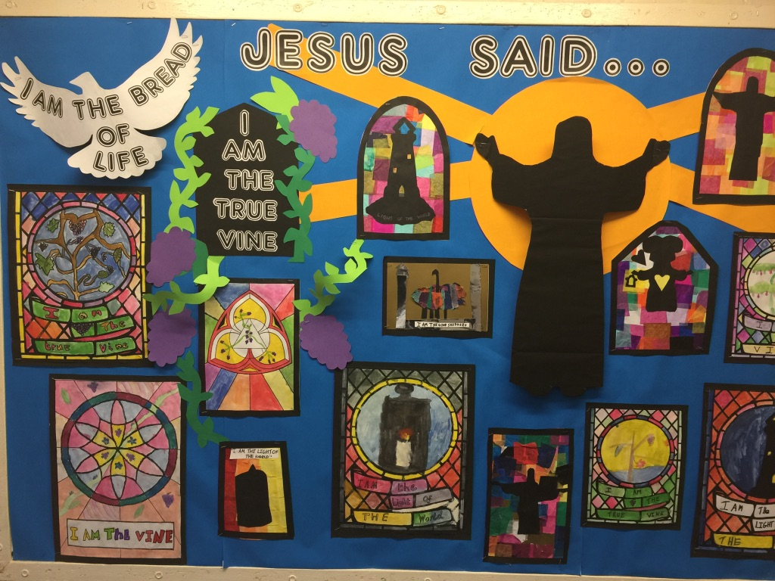
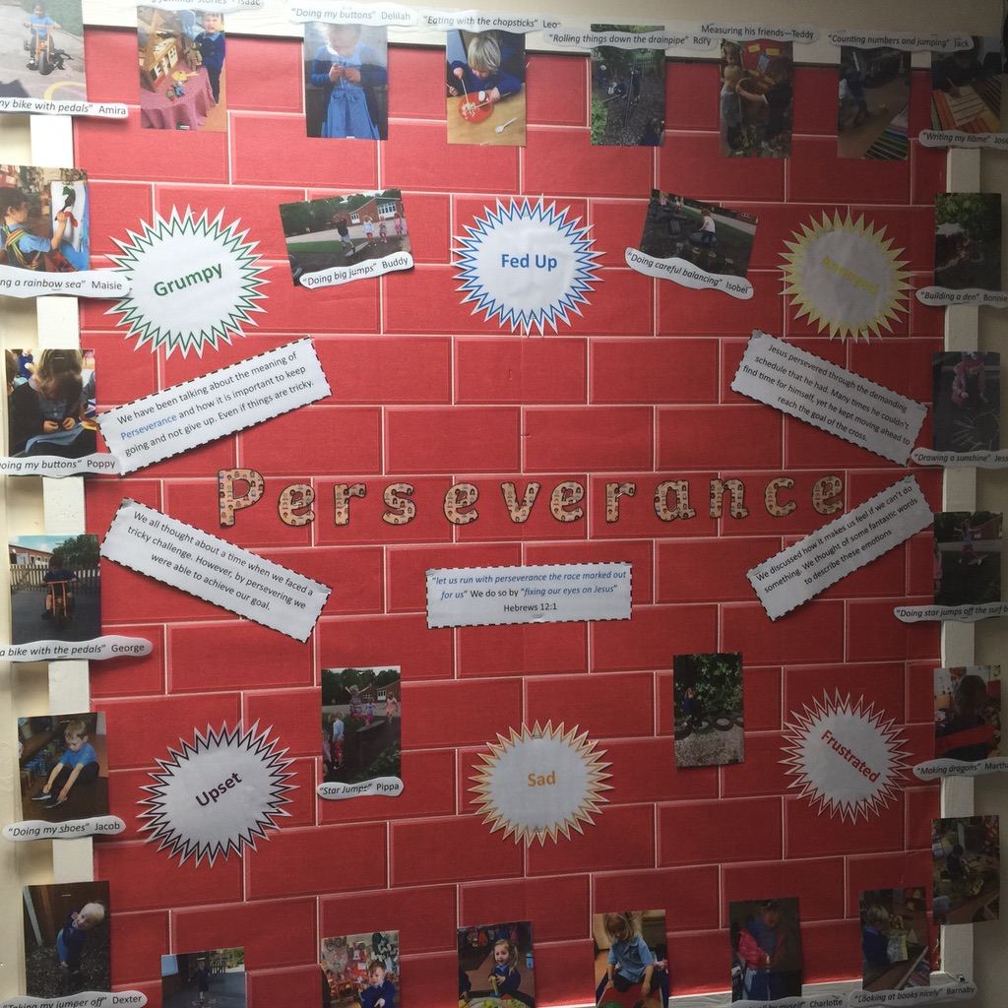
Class Pages
Each class has a webpage which provides parents and carers with an overview of the children’s learning on a week-to-week basis. Please click on your child’s Year Group to view the class page: F1, F2, Y1, Y2, Y3, Y4, Y5, Y6
Your child’s class webpage includes:
Links to important curriculum resources and online platforms
Recommended reading list
Statutory phonic / spelling lists
A timetable of lessons and objectives each week
Homework expectations

Slide 21
What makes Year 6 special?
Proposed Workshops, Trips and Events including Sats Week
Term 1
Cake sale for charity
Stall at the Christmas Fair
Christingle Service
Eucharist Service at St. Chads with Reverend Jane (May take place in Summer Term)
Term 2
Leading an assembly or workshop related to China Topic
Food tasting related to China topic
Philharmonic Trip
Term 3
Sats Test week is from: Monday 11th to Thursday 14th May 2026
Pottery workshop – plate/bowl design with afternoon tea
Year 6 Art Gallery and Open Evening
Leavers Event
Residential (Conway)
Stall at Summer Fair

Slide 22
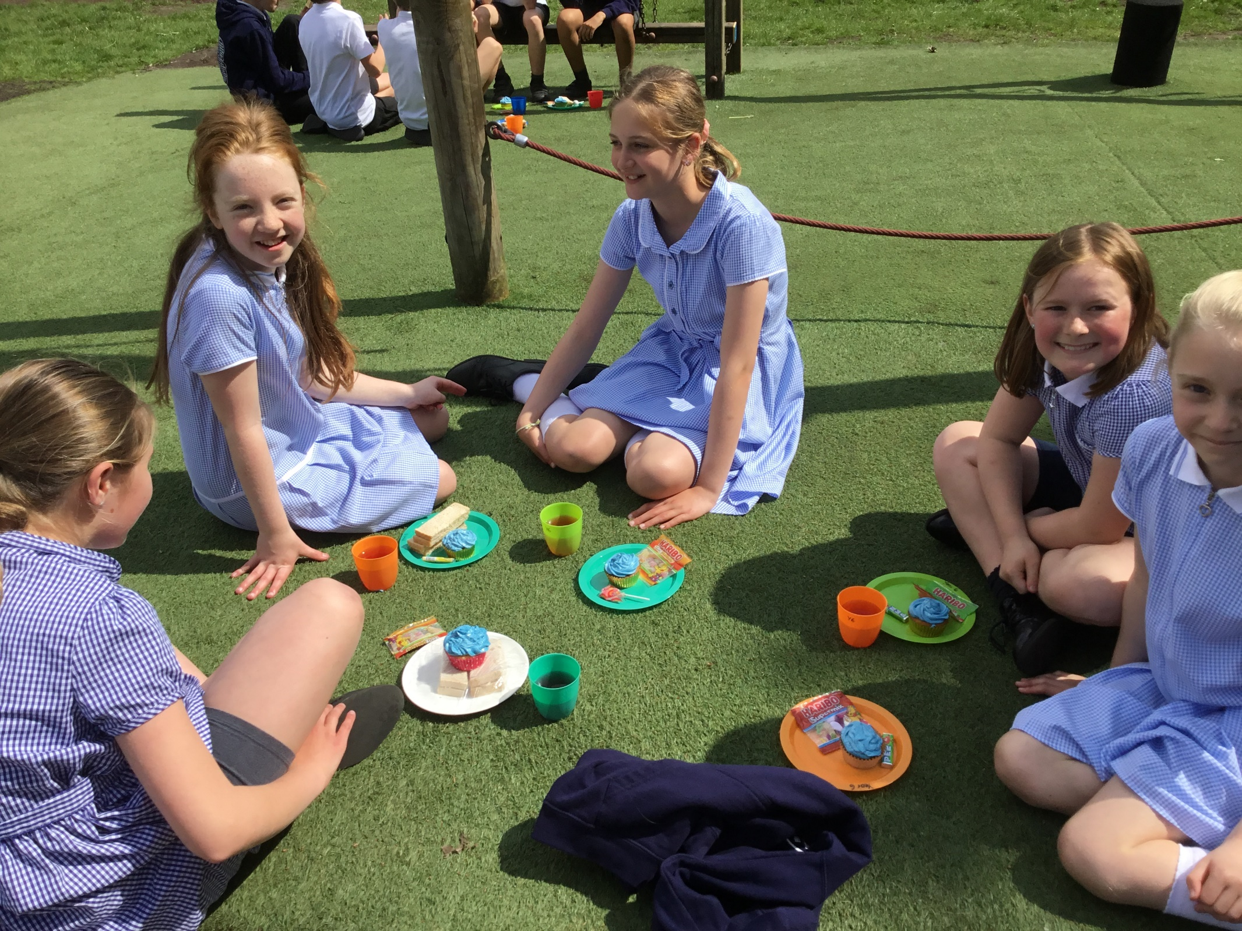
YEAR 6 SATS PARTY

Slide 23
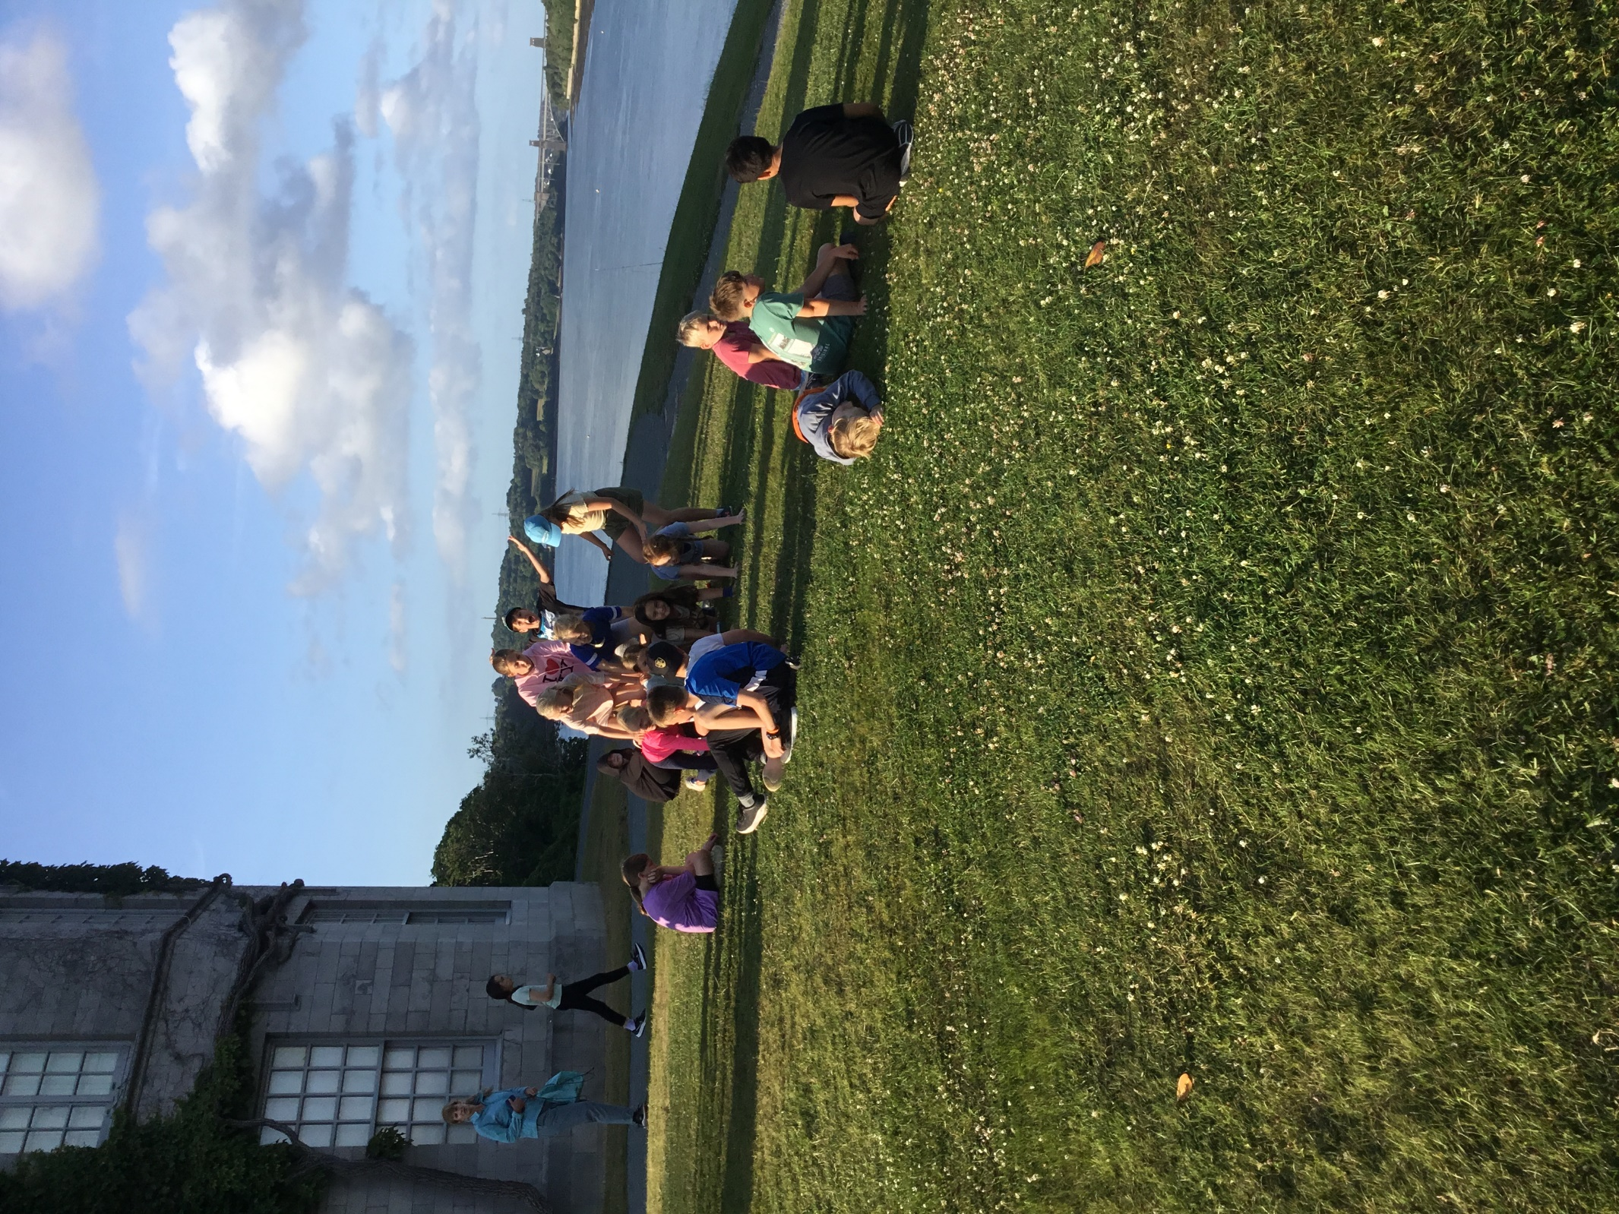
The Conway Centre

Slide 24
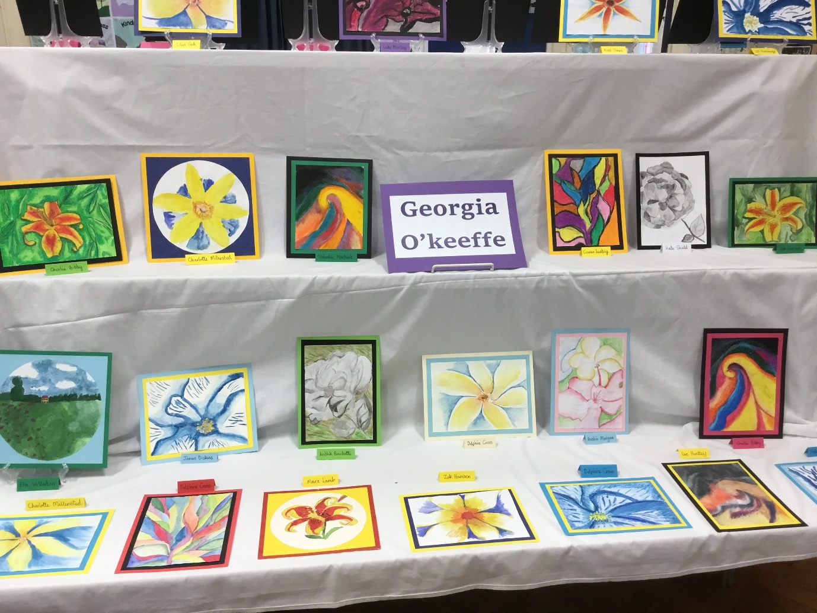
YEAR 6 ART EXHIBITION

Slide 25
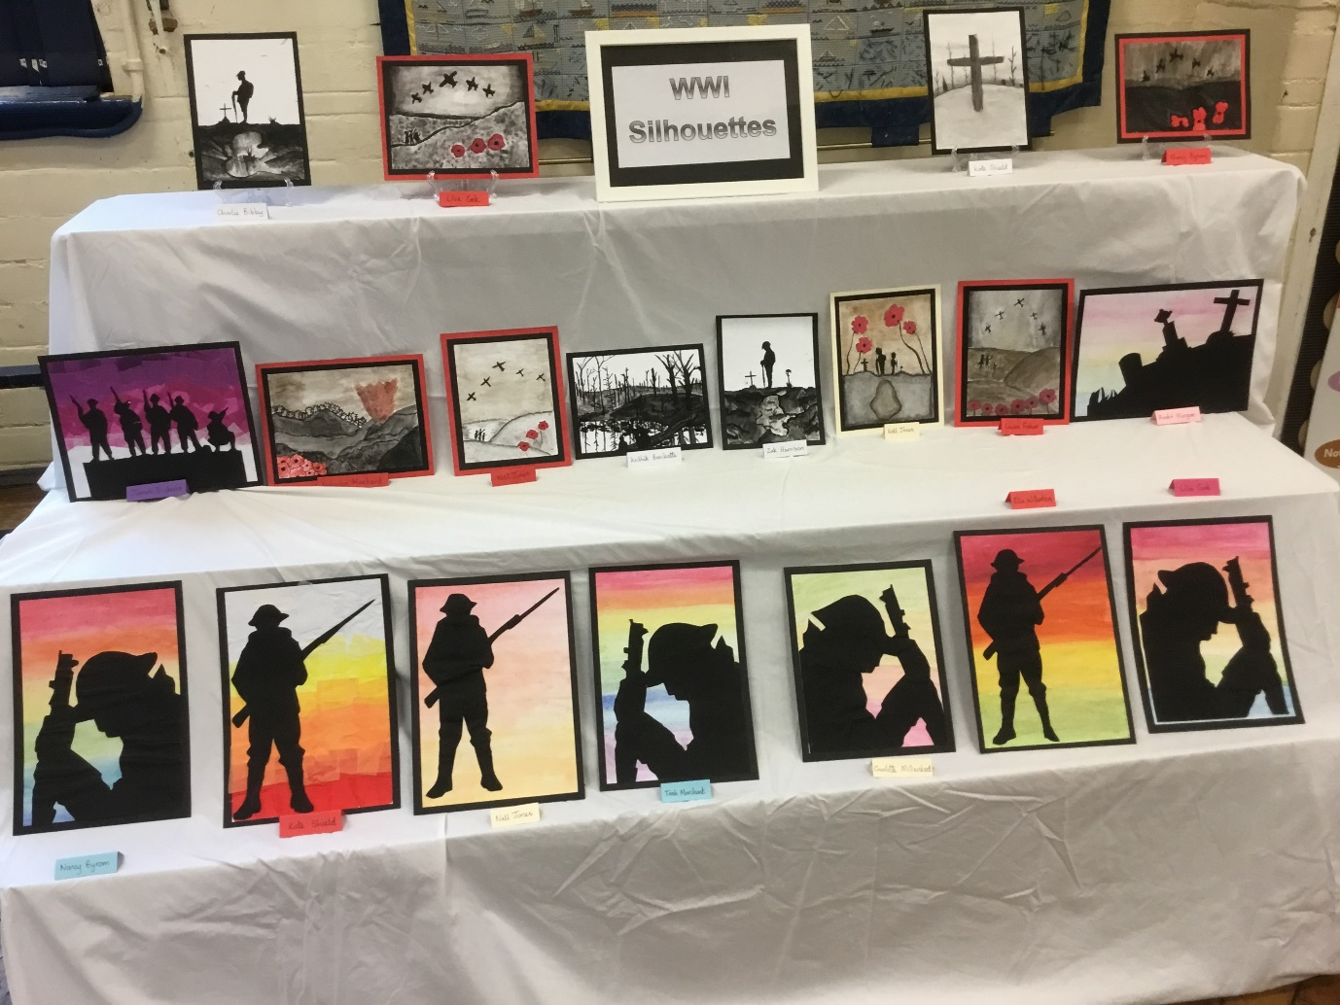

Slide 26
How to support your child
Ensure that homework is completed to a good standard
Spellings are Statutory Word Lists and will be used to track progress. Please ensure they are learned.
Be aware of your child’s current writing targets and support them with them.
All handwriting should be cursive in year 6 with appropriate use of upper and lower case. A handwriting club will take place for some children and additional handwriting may be sent home.
Revise and learn multiplication tables and Mathematics key ring facts
Read regularly.
Medical needs
If your child has medication during the year it should be taken to the school office where a request for school to administer medication form must be filled in. Please ensure that any inhalers are in date and an asthma passport has been completed.
Please make an appointment to chat to us if you have any concerns or think there is information we need to know. We have an open door and any information you can give us enables us to fully care for support your child.

Slide 27
Contact us
View our Home-School Communication Procedures here.
Initially, please contact the school office who will hopefully be able to respond to your enquiry straight away. The school office can help with all general enquiries: admin, events, attendance, school dinners, clubs, payments, wrap-around care, etc. Alternatively, the school office may direct your enquiry to another member of staff, for example:
Class teachers: For enquiries relating specifically to children (learning, progress, behaviour, wellbeing, equipment, timetables etc.)
SENCo: For enquiries relating to Special Educational Needs (SEN) and Inclusion.
Designated Safeguarding Lead (DSL): For enquiries relating to pupil welfare and safeguarding.
Deputy / Head Teacher: For enquiries that have not been previously resolved by speaking with other staff members.
Staff Availability
For enquiries that require a parent or carer to speak with a member of staff, the school office will arrange this for you. Staff will always try to speak with parents and carers as soon as their work schedule allows, but this may be difficult to organise quickly due to teaching and other commitments. The office staff will keep you informed of timescales regarding meetings and appointments. Staff are also available at the school gate at the start and end of each day.

