Slide 1
Ready-to-go Lesson Slides
Year 3
Number: Fractions
Lesson 7
Sum1

Slide 3





Success Criteria: I know that when subtracting fractions with the same denominator, the denominator does not change I can explain why denominators do not change in these calculations
Starter:
Which one is different?
?

Slide 4

Success Criteria: I know that when subtracting fractions with the same denominator, the denominator does not change I can explain why denominators do not change in these calculations
Starter:
Which one is different?
?
All of the answers to these additions have a numerator of 9 apart from this one.
The answer to three fourteenths plus five fourteenths has a numerator of 8 instead.

Slide 5

Talking time:
This diagram shows what happens when Tinaya eats part of a
cereal bar.
Can you write this as a number sentence?
Can you write this as a number story involving the words ‘first’, ‘then’ and ‘now’?

Slide 6

Talking time:
This diagram shows what happens when Tinaya eats part of a
cereal bar.
Can you write this as a number sentence?
Can you write this as a number story involving the words ‘first’, ‘then’ and ‘now’?
First, Tinaya has eight tenths of a cereal bar. Then, she eats three tenths of it.
Now, she is left with five tenths of a cereal bar.

Slide 7

Talking time:
How would you describe this subtraction as a number sentence
and using words?

Slide 8

Talking time:
How would you describe this subtraction as a number sentence
and using words?
First, there are three quarters.
Then, two quarters are taken away.
Now, there is one quarter left.

Slide 9

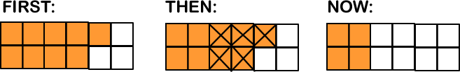
Activity 1:
Write each subtraction as a number sentence.

Slide 10


Activity 1:
Write each subtraction as a number sentence.

Slide 11
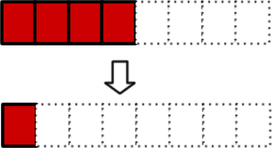

Talking time:
What do you think the missing numbers are?

Slide 12

Talking time:
What do you think the missing numbers are?

Slide 13
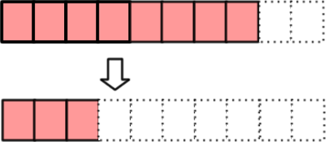


Activity 2:
Complete the subtractions.
(a)
(b)

Slide 14




Activity 2:
Complete the subtractions.
(a)
(b)
There are several possible answers to this one!

Slide 15
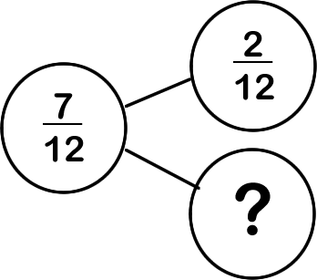
Talking time:
How would you complete this part-whole model?

Slide 16
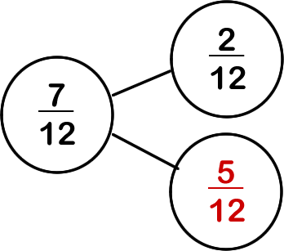
Talking time:
How would you complete this part-whole model?

Slide 17
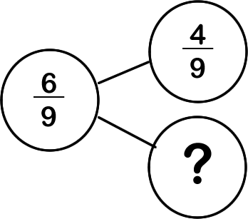
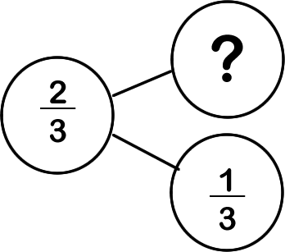
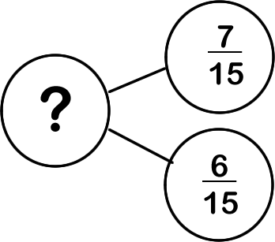
Activity 3:
Complete these part-whole models.
___
___
___

Slide 18
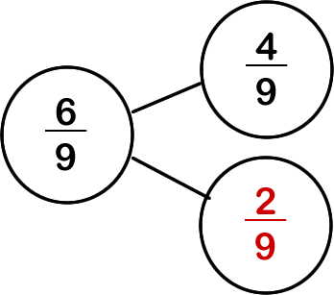
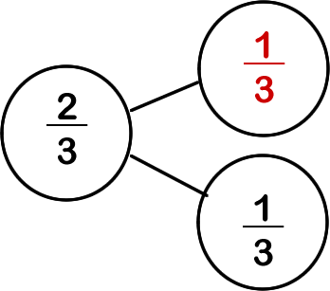
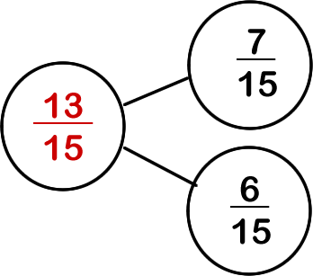
Activity 3:
Complete these part-whole models.

Slide 19



Activity 4:
Krishna says,
“9 take away 2 is 7 and 10 take away 10 is 0.
So, take away must equal “
Explain the mistake that Krishna has made.
Use maths equipment or sketches to prove to a partner what the correct answer is.

Slide 20
Activity 4:
Krishna says,
“9 take away 2 is 7 and 10 take away 10 is 0.
So, take away must equal “
Explain the mistake that Krishna has made.
Use maths equipment or sketches to prove to a partner what the correct answer is.
Krishna’s mistake is that she has subtracted the denominators as well as the numerators. If she starts with a number of tenths and then subtracts a number of tenths, her answer should be a number of tenths. So, the denominator should be 10 and her answer should be 7 tenths.

Slide 21


Success Criteria: I know that when subtracting fractions with the same denominator, the denominator does not change I can explain why denominators do not change in these calculations
Evaluation:
True or False?
Kyle has a pizza that is cut into fifths. He eats
two of the pieces and writes down a subtraction to
describe what he has done. His answer will have a
denominator of 5.
When subtracting four tenths from nine tenths, take away the denominators and keep the numerators the same.
e) 13 hundredths take away 3 hundredths equals 10 hundredths.

Slide 22
Success Criteria: I know that when subtracting fractions with the same denominator, the denominator does not change I can explain why denominators do not change in these calculations
Evaluation:
True or False?
Kyle has a pizza that is cut into fifths. He eats
two of the pieces and writes down a subtraction to
describe what he has done. His answer will have a
denominator of 5. TRUE
FALSE
FALSE
When subtracting four tenths from nine tenths, take away the denominators and keep the numerators the same. FALSE
e) 13 hundredths take away 3 hundredths equals 10 hundredths. TRUE

Slide 23


