Slide 1


Maths
Number and Place Value
Year One
Maths | Number and Place Value | Identify and Represent Numbers Using Different Representations | Lesson 2 of 2: Number Lines

Slide 2
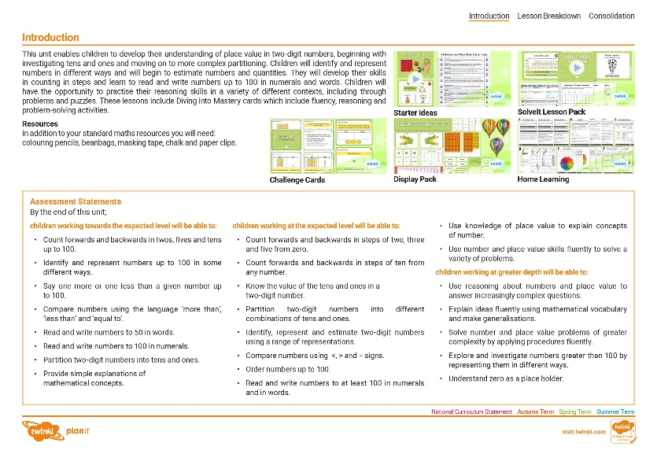
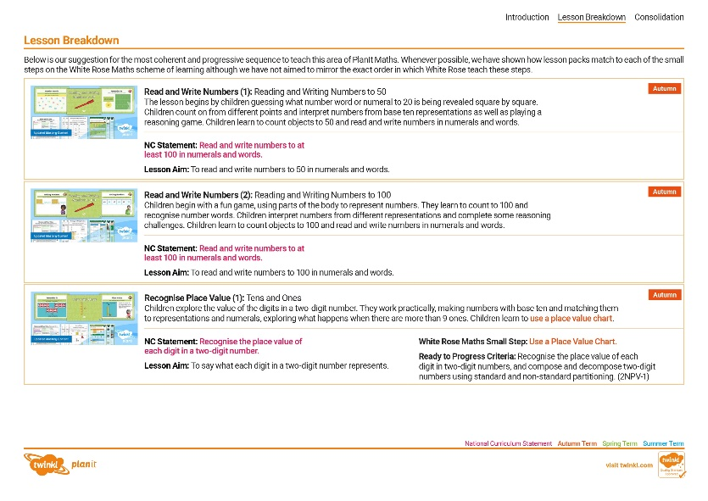
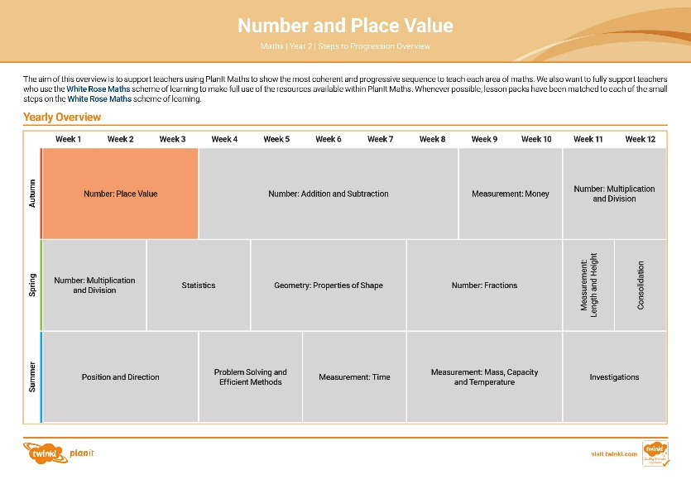

Need a coherently planned sequence of lessons to complement this resource?
See our Number and Place Value Steps to Progression document.
Twinkl PlanIt is our award-winning scheme of work with
over 4000 resources.

Slide 4
Aim
To identify numbers shown on number lines.
Success Criteria
I can find the value of each interval on a number line.
I can identify the number shown by counting the intervals on a number line.
I can estimate the position shown on an unmarked number line.

Slide 5








Remember It
Organise the cards onto the number line.
0
10

Slide 6
Remember It
Organise the cards onto the number line.
0
10
seven
one
five
nine

Slide 7
Remember It
Organise the cards onto the number line.
0
10
3 ones
6 ones
1 one
9 ones

Slide 8
Remember It
Organise the cards onto the number line.
0
10
1
1
1
1
1
1
1
1
1
1
1
1
1
1
1
1
1
1
1

Slide 9

What Number…?
What number is the arrow pointing to?
How do you know?
22
0
10
20
30
40
50
It is pointing at 22 because it is 2 more than 20.

Slide 10
What Number…?
What number is the arrow pointing to?
How do you know?
54
30
40
50
60
70
80
90
It is pointing at 54 because it is 1 less than 55 (which is half way between 50 and 60).

Slide 11




What Number…?
Where would this representation go on the number line?
Explain how you know.
0
10
20
30
40
50
60
70
80
90
100
It represents 33 so it would go on the interval that is 3 more than 30.

Slide 12
What Number…?
What number is the arrow pointing to?
How do you know?
0
20
40
60
70
80
100
It is 70 as the number line is going up in steps of 5.

Slide 13

What Number…?
Which of these representations could easily go on the number line?
How do you know?
0
20
40
60
70
80
100
?
10
10
10
10
10
20
4
1

Slide 14
What Number…?
What number is the arrow pointing to?
How do you know?
26
34
42
50
58
It is 42 as the number line is going up in steps of 2.

Slide 15


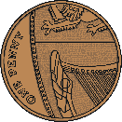
What Number…?
Why can none of these representations easily go on the number line?
Prove it!
26
34
42
50
58
seven ones plus five tens
The number line goes up in steps of 2. Each of the representations is an odd number.

Slide 16
What Number…?
What number is the arrow pointing to?
How do you know?
0
10
20
23
30
It is 23 as the number line is going up in steps of 2.
It is in between 22 and 24.

Slide 17
What Number…?
What number is the arrow pointing to?
How do you know?
46 or 47
0
20
40
60
80
It could be 46 or 47. The intervals are going up in fives and the arrow is pointing just after 45.

Slide 18

What Number…?
What number is the arrow pointing to?
This number line has no intervals so we will have to estimate!
How do you know?
20
26
30
It could be 26 as it’s just over half way (which would be 25).

Slide 19
What Number…?
What number is the arrow pointing to?
How do you know?
40
45
60
It could be 45 because it is a quarter of the way along the number line.

Slide 20
What Number…?
What number is the arrow pointing to?
How do you know?
0
75
100
It could be 75 because it is three quarters of the way along the number line.

Slide 21
What Number…?
Has this representation been placed correctly on the number line?
How do you know?
10
10
10
10
30
50
It is incorrect as 40 would be in between 30 and 50.

Slide 22
What Number…?
What multiples of 10 is the number between?
How do you know?
30
35
40

Slide 23
What Number…?
What multiples of 10 is the number between?
How do you know?
80
81
90

Slide 24
What Number…?
What multiples of 10 is the number between?
How do you know?
10
20
1
1
1
1
1
10
1

Slide 25
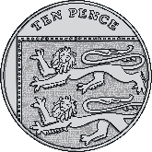

What Number…?
Do these representations correctly show the multiples
of 10 either side of the number?
How do you know?
57
The coins are correct as they represent 50. The crayons represent 61. A multiple of 10 should have no ones.

Slide 26
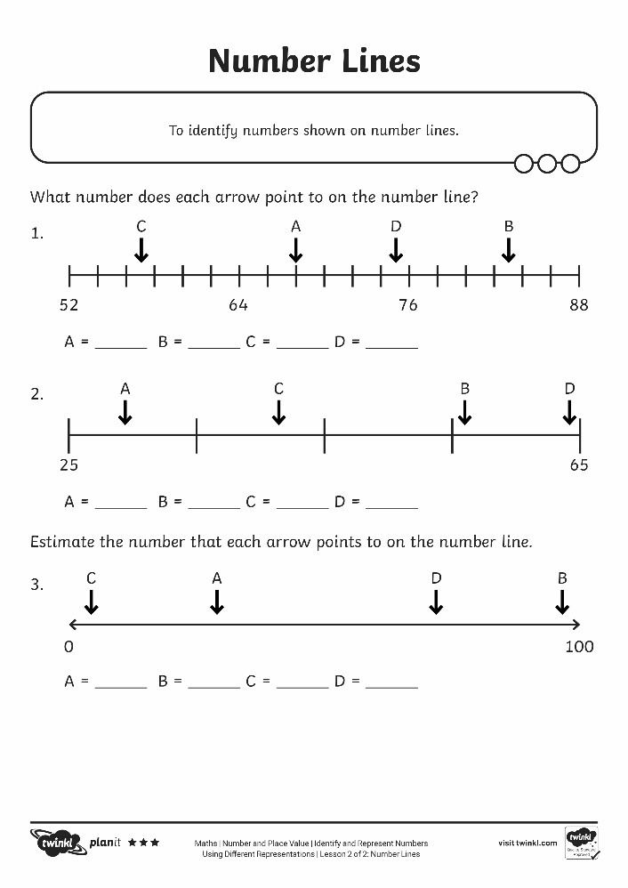
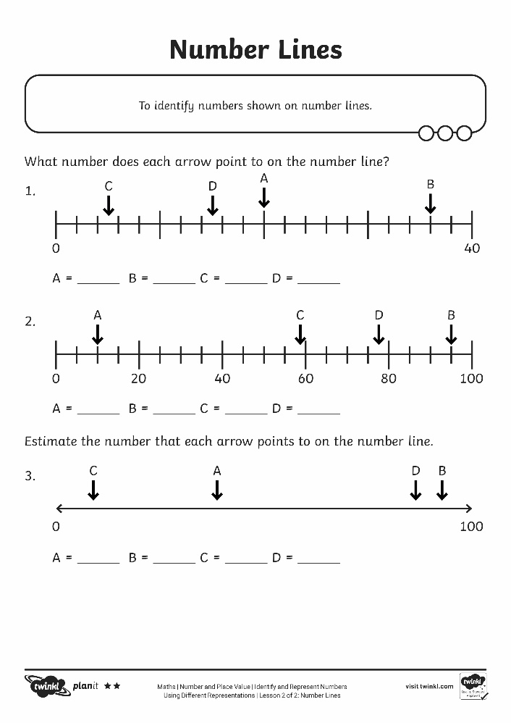
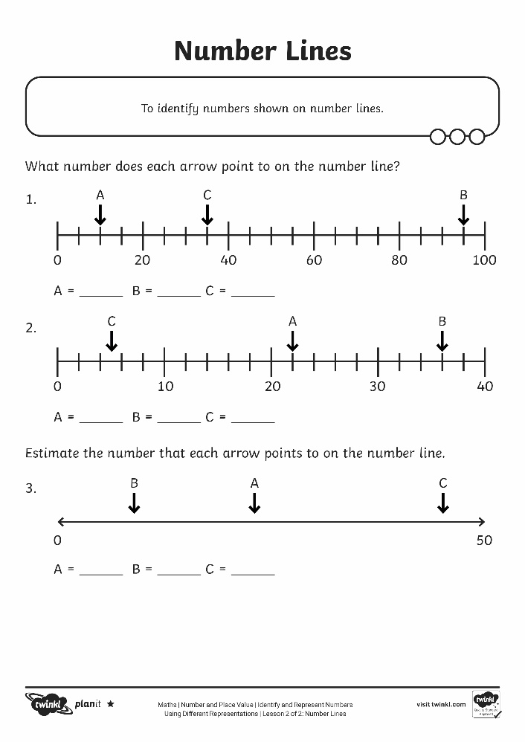
Number Lines

Slide 27
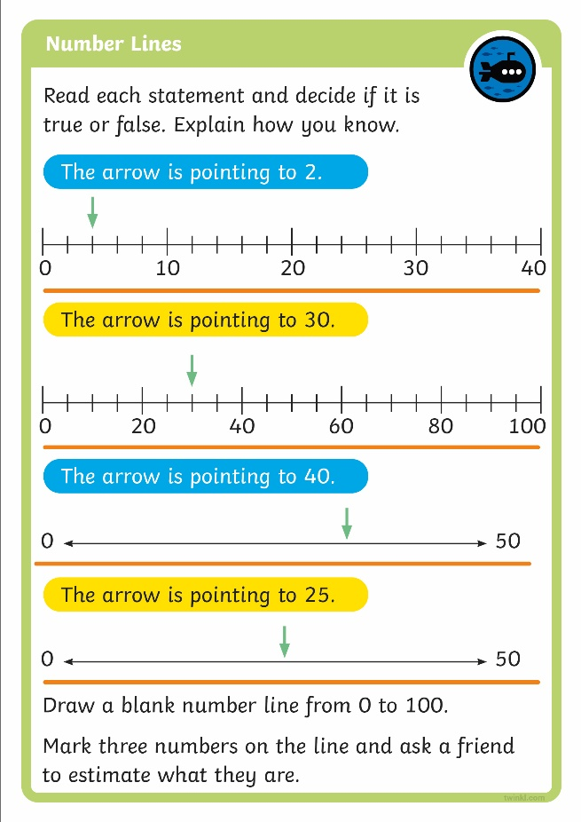
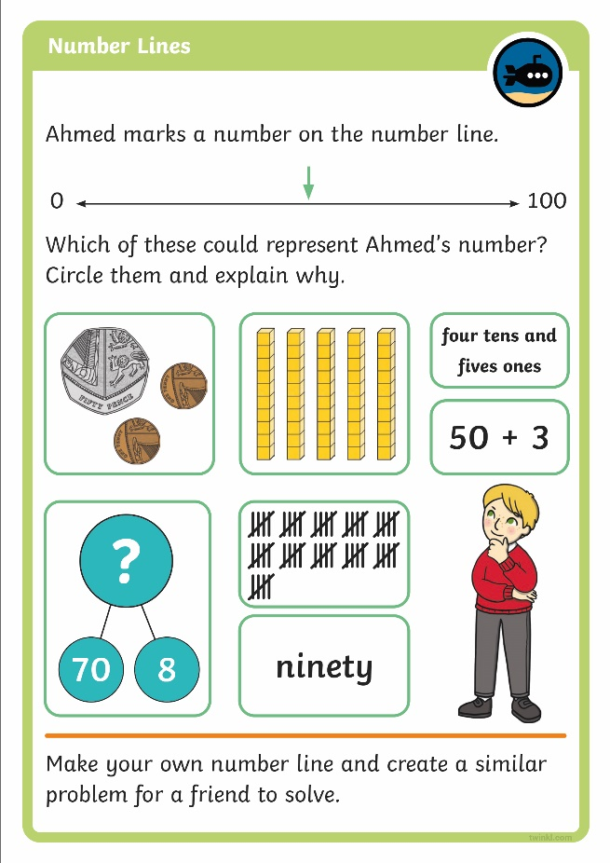
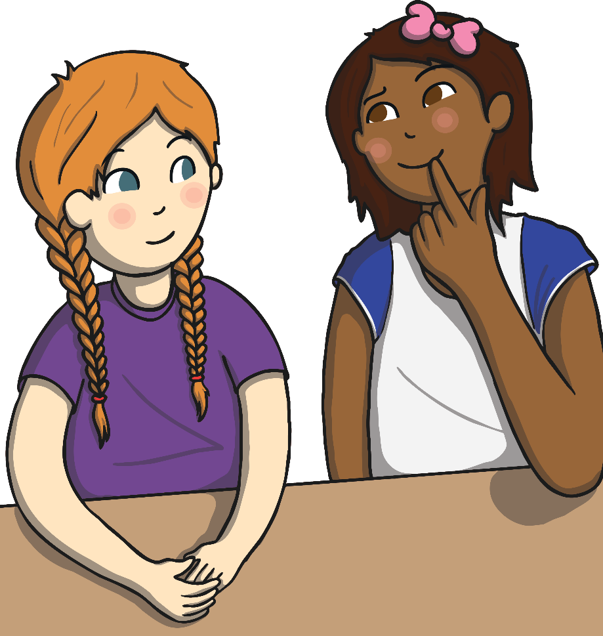
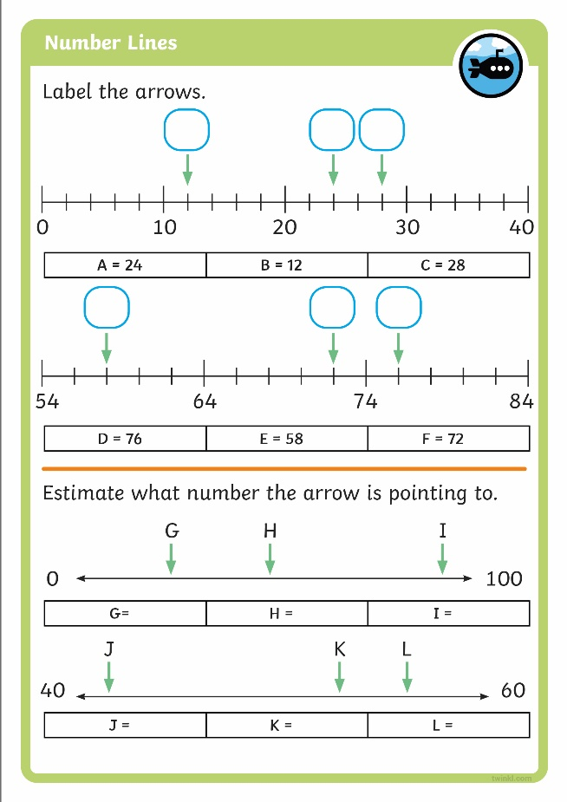
Diving into Mastery
Dive in by completing your own activity!

Slide 28



Stop the Seagull
Stop the seagull that’s carrying the number shown by the arrow.

Slide 29


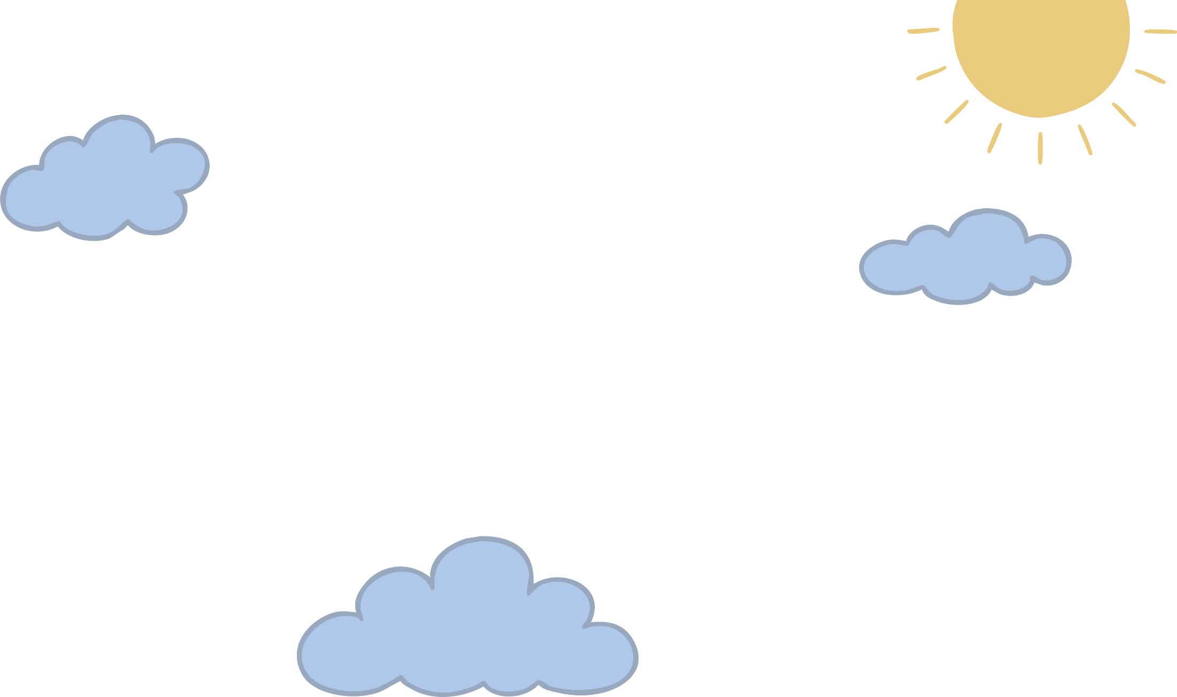





Can you select the seagull that is carrying the number shown by the arrow?
Show All Seagulls
three tens and two ones
fifty-six
10
20
30
40
50

Slide 30




Can you select the seagull that is carrying the number shown by the arrow?
three tens and two ones
fifty-six
10
20
30
40
50

Slide 31



three tens and two ones

Slide 32




Can you select the seagull that is carrying the number shown by the arrow?
Show All Seagulls
eighty-one
?
50
8
t
o
7
5
50
60
70
80
90

Slide 33




Can you select the seagull that is carrying the number shown by the arrow?
eighty-one
?
50
8
T
O
7
5
50
60
70
80
90

Slide 34



Slide 35






Can you select the seagull that is carrying the number shown by the arrow?
Show All Seagulls
three tens and four ones
?
40
3
35
40
45
50
55

Slide 36




Can you select the seagull that is carrying the number shown by the arrow?
three tens and four ones
?
40
3
35
40
45
50
55

Slide 37


?
40
3

Slide 38




Can you select the seagull that is carrying the number shown by the arrow?
Show All Seagulls
thirty-five
t
o
0
100

Slide 39




Can you select the seagull that is carrying the number shown by the arrow?
thirty-five
T
O
0
100

Slide 40


T
O

Slide 41





Can you select the seagull that is carrying the number shown by the arrow?
Show All Seagulls
eighty-two
?
50
3
62
87

Slide 42




Can you select the seagull that is carrying the number shown by the arrow?
Show All Seagulls
?
50
3
eighty-two
62
87

Slide 43

eighty-two

Slide 44
Aim
To identify numbers shown on number lines.
Success Criteria
I can find the value of each interval on a number line.
I can identify the number shown by counting the intervals on a number line.
I can estimate the position shown on an unmarked number line.

