Slide 1
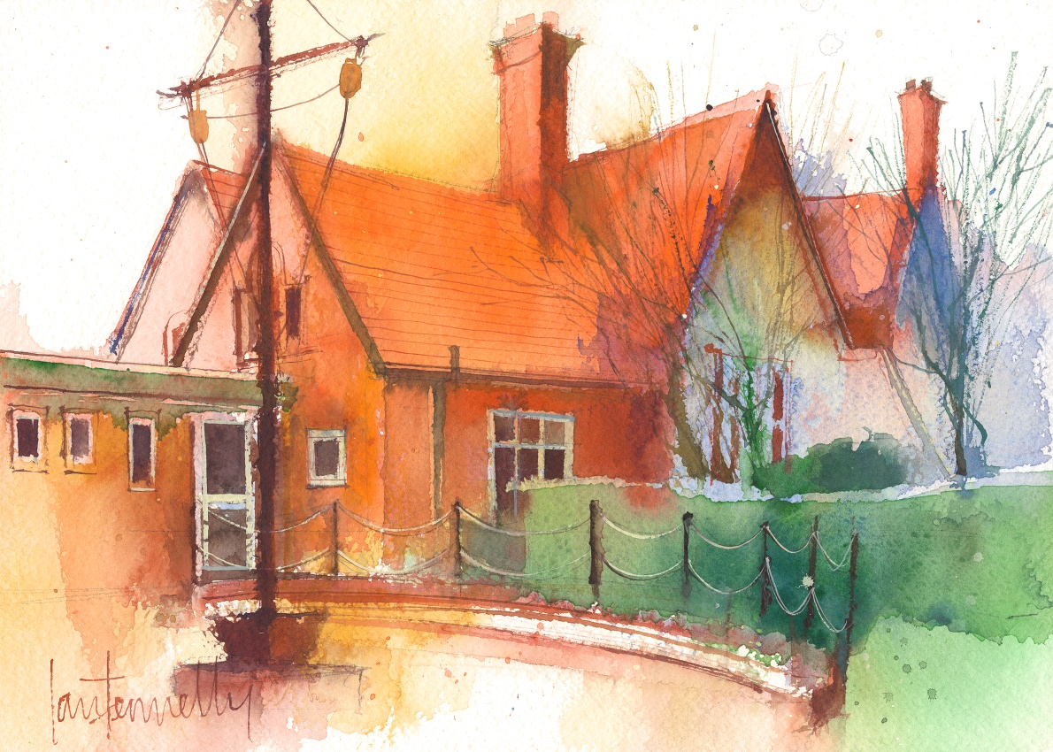
Dawpool C.E. (Aided) Primary School
'The Fruits of the Spirit are Love, Joy, Peace, Patience, Kindness, Generosity, Faithfulness, Gentleness and Self-Control.'
(Galatians 5: 22-23)
Notes:
Dawpool News
Website

Slide 2
Staff in Year 1
Mrs L Young: Teacher - Mon-Thurs
Mrs C McCann: Teacher - Wed pm, Fri
Mrs A Whibley: Teaching assistant - Tues-Fri
Mrs Thomas : Teaching assistant - Mon

Slide 3
Y1 Timetable - Autumn Term
Monday | Tuesday | Wednesday | Thursday | Friday
Phonics/handwriting practise | Phonics/handwriting practise | Phonics/handwriting practise | Maths practise | Maths practise | 8:45
Literacy | Literacy | Literacy | Literacy | Literacy | 9:00
Worship | Worship | Worship | Hymn Practise | Celebration | 10:10
BREAK
Maths | Maths | Maths | Maths | Maths | 10:50 12:10
LUNCH
P.E. | Topic (History, Geography, Art, DT) | Science | Topic (History, Geography, Art, DT) | R.E. ICT | 1:15 2:15
BREAK
PPA Music/ fruit | Story and fruit Show and Tell | Story and fruit | Story and fruit | Story and fruit | 2:30 3:30

Slide 4
Curriculum
Literacy:
Phonics, Reading, Comprehension, Grammar, Spelling, Writing, Joined handwriting, Author studies, Poetry.
Maths:
Addition and subtraction using signs. Numbers to 20, then 100 and beyond. Shape, money, time, weight, length, Direction, simple division, multiplication and fractions
Science:
Humans and other animals, Materials, Plants, Seasonal changes.

Slide 5
Wider curriculum
History: Toys, Titanic and its link to local history,
Geography: Transport, Weather, Mapping
RE: Chester Diocese Religious Education Scheme-Mrs McCann
PE: afternoon
Art/DesignTechnology: Linked with topic
Music: Charanga
Computing: Purple Mash
Building learning values: The children will be encouraged to use their learning powers and we will teach the children about them throughout the year.

Slide 6
Homework Activities
Reading – Every Friday.
Literacy
Phonics, Handwriting-when required.
Maths
Practise based on revision of core skills and current topic-when required.
History/Geography/Science
Research activities or topic related-when required
Topic and Maths homework set on Friday to be returned
Wednesday.
Home learning tab on the website has things you can do with your child to enhance their learning.

Slide 7
Certificates and Awards
In Y1Children are given instant rewards such as stickers or verbal praise.
Each week two ‘Learning Hero’ certificates are awarded to two children in each class in recognition of demonstrating the school’s ‘Learning Values.’
Each week a ‘Fruit of the Spirit’ certificate is awarded to a child in each class in recognition of demonstrating the school’s core values.
Pupils who have achieved weekly certificates have their names published in the weekly ‘Dawpool News.
A celebration assembly takes place every Friday to acknowledge weekly achievements. If a child has gained a certificate or medal in an out of school club they can bring it in to show to the class and they will receive a special mention in Friday’s celebration assembly. Their name will also be put into a special mentions book.
In July, two children are chosen from each class to receive the teacher’s special award for the year.

Slide 8
Arrivals and Departures
Arrivals
The opening times for the pupils arriving in school are 8:45 - 8:55am.
At 8.45am, the school doors will open and pupils are asked to enter the school building via the conservatory entrance on the main playground and go directly to their classroom. A member of staff will also be present at the ‘wooden gate’ to greet pupils and direct them into the school building. The doors on the main playground will close at 8:55am.
On arrival at the classroom, a member of staff will record the child’s attendance in the electronic register, which closes at 9.00am.
Children arriving after 8.55am must come into school via the front reception door and register with staff at the school office.
Pupils arriving in the classroom after 8:55am will be marked as late.
Departures.
School finish at 3:30pm for year 1. Children will be escorted to the wooden gate on the playground and asked to tell their teacher or TA when they see the person that is picking them up. Only then will they be allowed to leave the teachers care. Please let us know if someone different is going to be picking your child up as we will not let them go if we do not know the person who is picking them up.

Slide 9
Medical Needs
If a child requires medication during the course of the school day, the parent/carer will be asked to complete a Request for School to Administer Medication Form.
The medication must be prescribed by a medical professional and have the name of the child clearly marked on it. The medication will be administered by Mrs Kenney or Mrs Parr and will either be stored in the Head Teacher’s cupboard, in the fridge in the Food Technology Room or, in the case of controlled drugs, in the locked safe in the school office.
Children with chronic / serious or long-term medical issues have a sheet in the staffroom with their photograph and specific treatment required. All staff are required to be familiar with who these children are and what response is required.

Slide 10
Belongings
PE
It is a requirement that all pupils participate in PE lessons. Pupils must not miss PE lessons if they have forgotten or misplaced their PE kit. Pupils may only miss a PE lesson with written permission from parents.
Parents will be informed using the PE Kit letter if your child has forgotten or misplaced their PE kit.
Please ensure all possessions are clearly labelled!
Water
We encourage the children to bring in water bottles. Clearly labelled. No juice!
Snacks
Pupils are encouraged to bring in a healthy snack for morning break only. They will receive fruit at afternoon break supplied within school. No crisps, chocolate or fizzy drinks please. Parents may choose for their children to purchase toast as a playtime snack.

Slide 11
How to support your child
Ensure that homework is completed and returned to school
Practise phonics and read regularly.
Comparing and measuring the weight, length and capacity of objects. The children do this using non-standard units of measurements.
Estimation of measures.
Telling the time-o’ clock, half past, quarter past, quarter to. Recognising and naming days of the week, months of the year.
Coin recognition, playing shop, giving change etc.
Playing board games as this will help with number recognition and ordering.
Try to minimise long hours of screen time (xbox). Latest studies show that it has an adverse effect on behaviour and concentration and can disrupt sleep patterns.
Please make an appointment to chat to us if you have any concerns or think there is information we need to know. We have an open door and any information you can give us enables us to fully care for support your child.

Slide 12
The school website is the main platform for providing information to parents.
https://dawpool-ce.eschools.co.uk/website
Please familiarise yourself with the website and the information it contains.

Slide 13
The Dawpool News
The 'Dawpool News' is our weekly newsletter which is published every Friday and emailed directly to parents. It is important that parents take the time to read the newsletter. Please ensure the school office has the correct email address. All copies of the newsletter can be found within the ‘Dawpool News’ section of the website.
Please also visit the school's Twitter feed for further information.

Slide 14
Online Safety - Guidance for Parents
The internet is undoubtedly one of the greatest ever inventions and is an extremely useful tool for entertainment, staying in touch, sharing memories as well as finding out anything and everything. However, the internet is also full of danger which children need to be safeguarded from.
Keeping up to date with what your children are doing online can seem very daunting. Technology is constantly advancing and sometimes parents feel that their children know more about the internet than they do.
The guidance and links on the website are designed to help parents and carers to keep their children as safe as possible when online. Our best single bit of advice is to be curious about what your children are doing online, take an interest in their activities and regularly check what they are doing.

Slide 15
Pastoral Support
The Pastoral Support section of the website provides information about how to access support from the School Nursing Service and CAMHS. It also provides a range of resources to support aspects of mental health and well being and Special Educational Needs.
Anger
Anxiety
Bereavement & Sickness
Body Image
Bullying
Depression
Gender & Identity
Mindfulness
Trauma & Attachment
ADHD
Asperger's Syndrome
Autism
Dyslexia
Dyspraxia

Slide 16
Parent Information
The parent information section of the website provides further information for parents, e.g. uniform, school meals, leave of absence requests, administration of medicines, etc.
Holidays in Term Time
Parents are discouraged from withdrawing their children from school in term time for family holidays because this may impact on their progress. Head Teachers may only authorise holidays in term time in exceptional circumstances. Parents who believe their circumstances are exceptional are asked to complete an Application for Leave of Absence form which is available from the school office and can be downloaded from the parent information section of the website. This form should be returned to the school well in advance of the proposed leave and before committing to any expense. Parents who withdraw their child for unauthorised holidays in term time may be issued with a Fixed Penalty Notice.

Slide 17
The policies section of the website will enable you download many of our key policies and procedures, some examples include:
Anti-Bullying
Arrivals and Departures Procedure
Behaviour
Complaints
E-Safety
Safeguarding & Child Protection

Slide 18
Curriculum
The ‘Curriculum’ section of the website provides an overview of the curriculum expectations for all Year Groups and Classes. This will tell you what your child will be learning during the year.

Slide 19
Classes
The ‘Classes’ section of the website provides information about what the children are currently learning in each class. These pages will be updated weekly to provide the most up-to-date information. Please also visit the school's Twitter feed for further information about each class.
The class pages also provide a copy of the school’s Communication Protocol. The purpose of this document is to set out expectations for how school and home can successfully communicate and to ensure the best partnership of support for your child’s learning.
If you wish to discuss anything, please speak to your child’s class teacher in the first instance by contacting the school office or writing a note to arrange an appointment.

Slide 20
Home Learning
The ‘Home Learning’ section of the website provides information for each year group about how parents can support children at home with their learning.
Information includes:
Recommended Reading List
Statutory Spelling List
Times Tables
Recommended websites and APPs
Suggested projects and further learning opportunities
A list of 20 practical activities to complete during the year.

Slide 21
Calendar
The school calendar provides key dates during the year.
It also has all school holidays to Summer 2021. Please ensure you are aware of these dates when booking holidays.

