Slide 1


Science
Plants
Science | Plants | How Do Plants Grow in Hot, Dry or Cold Places? | Lesson 6

Slide 3


Meet Quizby!
I will appear like this, click me to reveal a key question.
Can you spot me in the
Lesson Presentation?
Hi, I’m Quizby!
The questions that appear will help
you to think about the key learning throughout the lesson.

Slide 4
Aim
To explain how plants are suited to their habitats.
Success Criteria
I can say how plants have different features that make them suited to where they live.
I can identify plants that live in hot, dry, cold or wet places.
I can explain how I know which type of habitat each plant grows in.

Slide 5
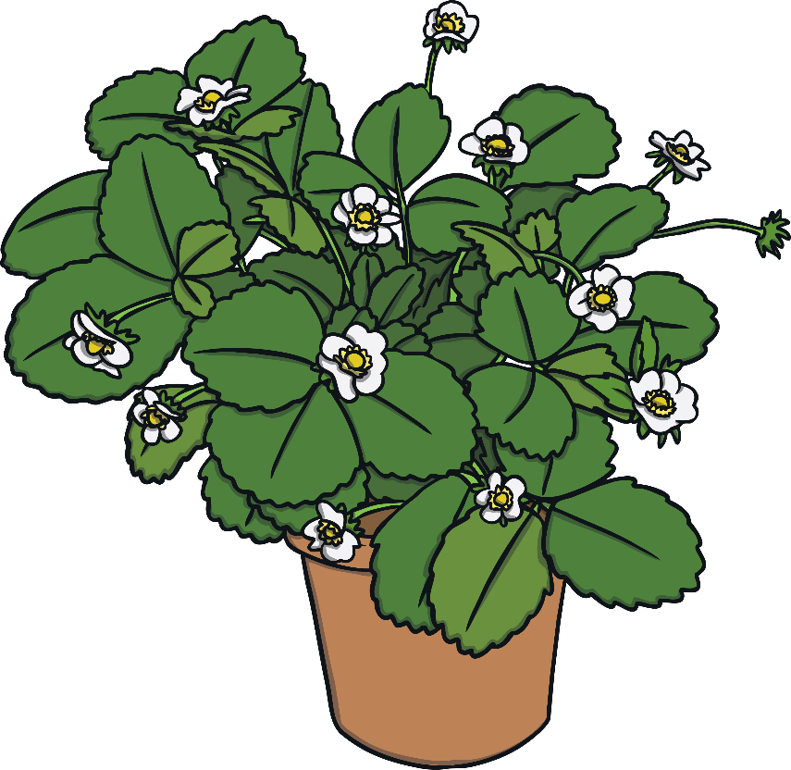
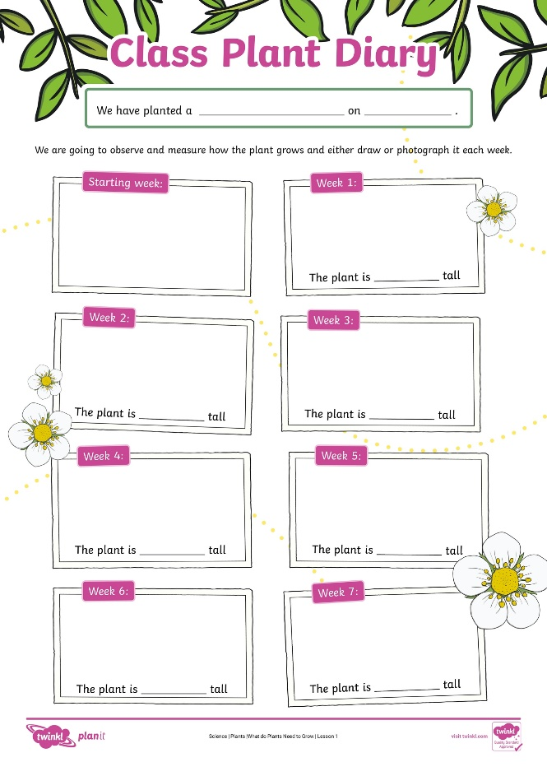
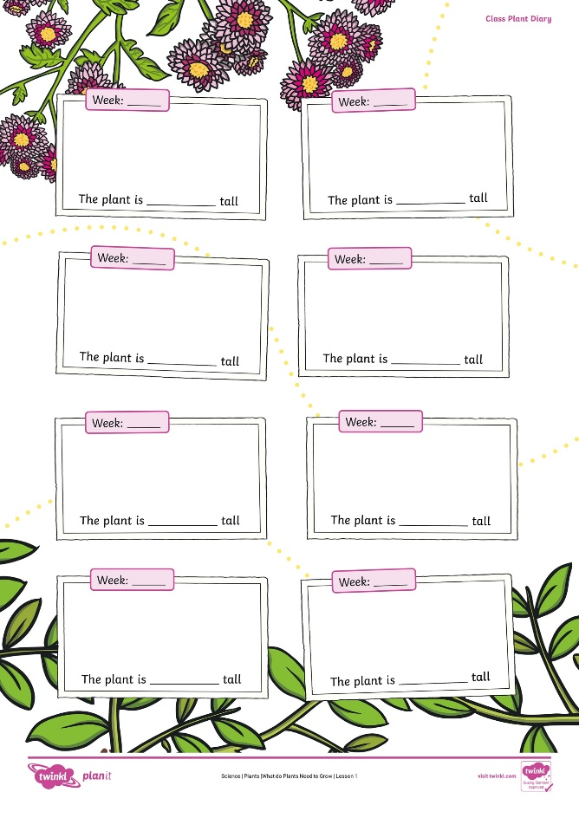

Remember It
Let’s look at our class plant and see how it is growing. We can measure its growth and draw or photograph it for our Class Plant Diary from Lesson 1!

Slide 6
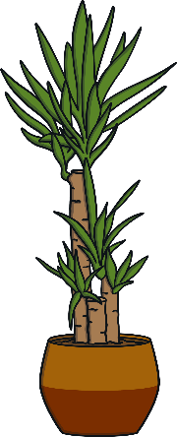
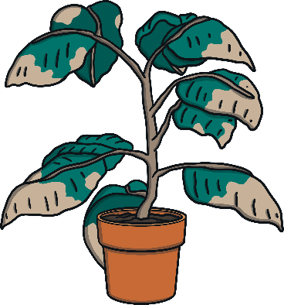
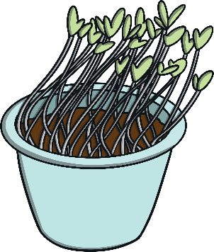

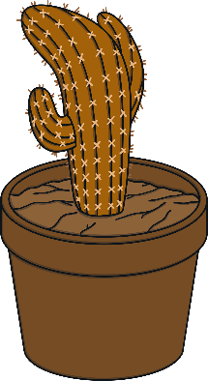
Remember It
Sort the plants into the correct place in the table below.
Healthy Plants
Plants That Need Water
Plants That Need Sunlight

Slide 7

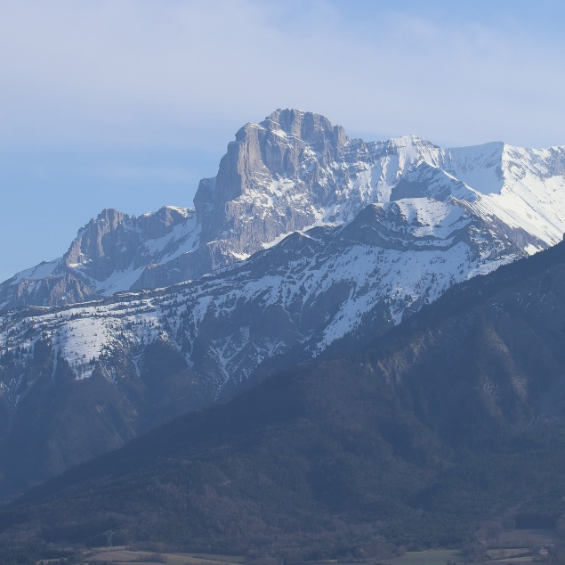


Where Do Plants Grow?
Look at these habitats.
Tell your partner whether you think plants can grow in each of these places or not.
1.
2.
3.
Can you explain why you think plants can or cannot grow here?
X

Slide 8
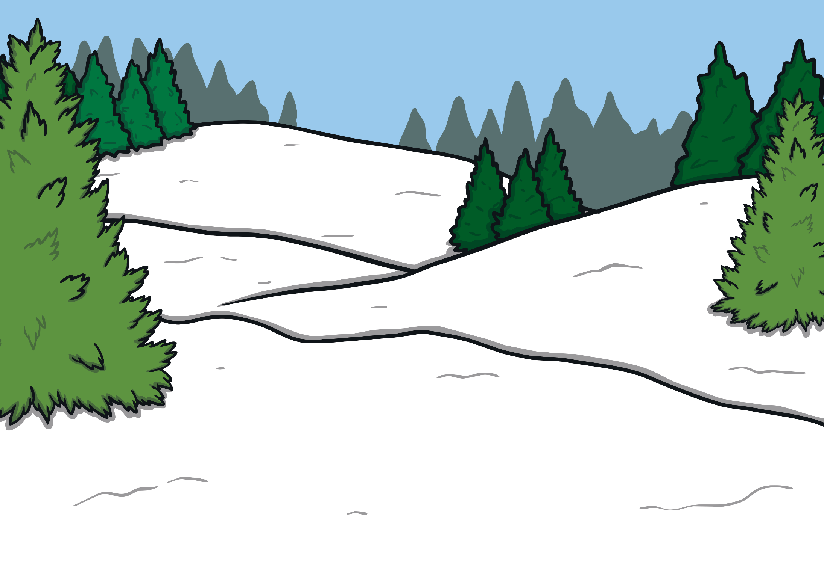
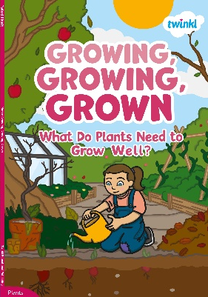
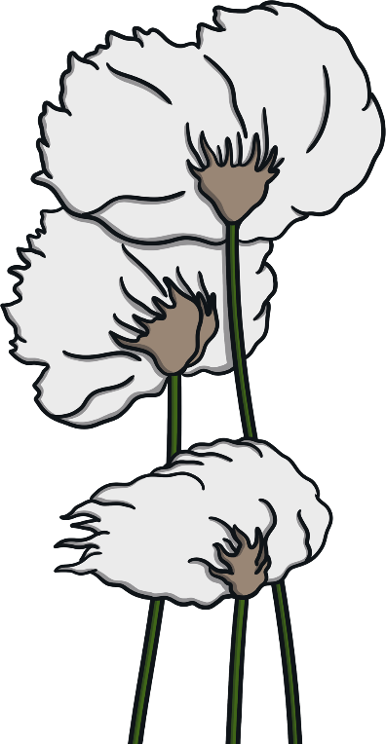


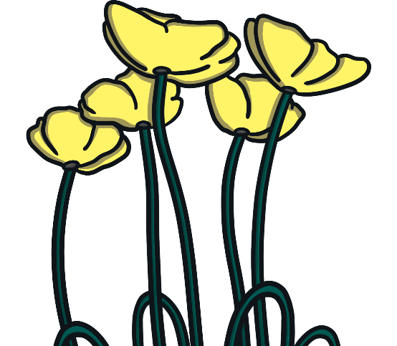


Growing, Growing, Grown
Let’s learn more about where plants grow in the Growing, Growing, Grown eBook.
Let’s read up to the end of page 30 together.

Slide 9
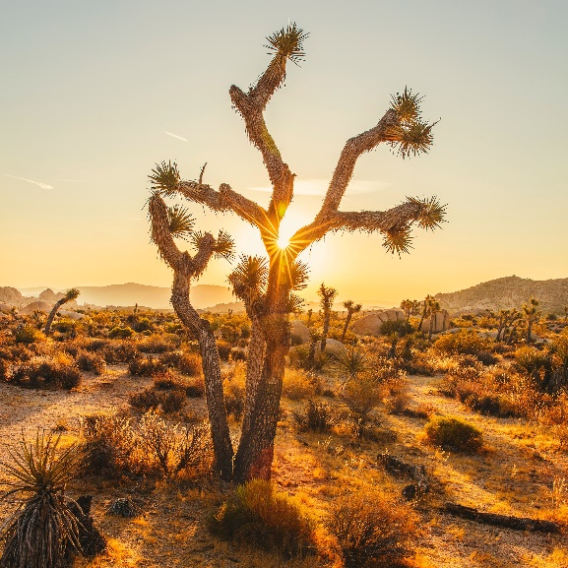
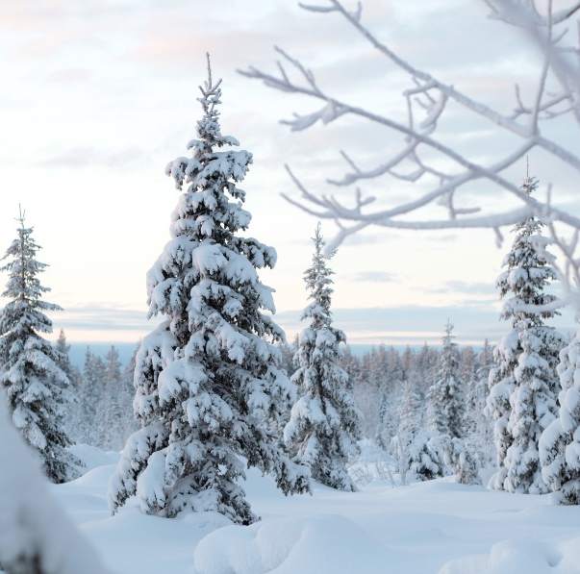
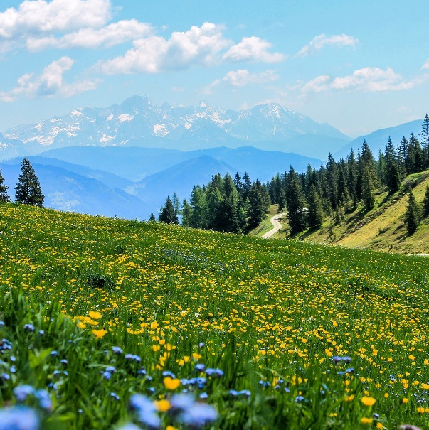
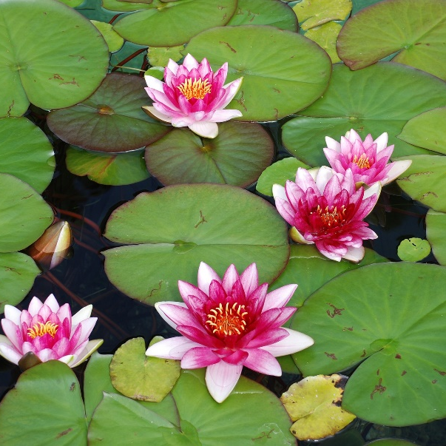
Plants Grow Almost Everywhere
Plants can grow almost anywhere on Earth.
There are plants that grow on very tall mountains.
There are plants that grow in water.
There are plants that grow in hot, dry deserts.
There are plants that grow in very cold places like the Arctic.

Slide 10
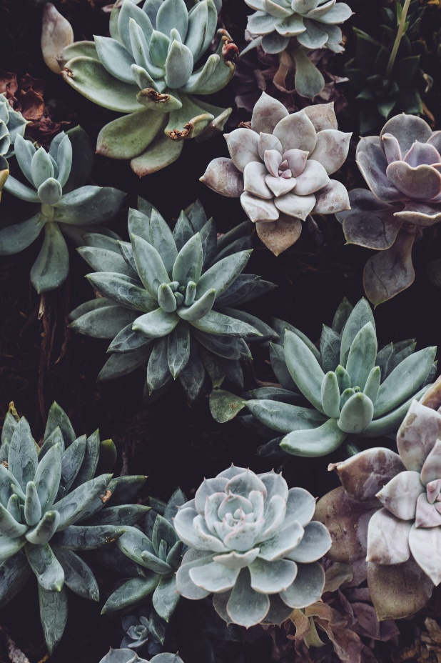
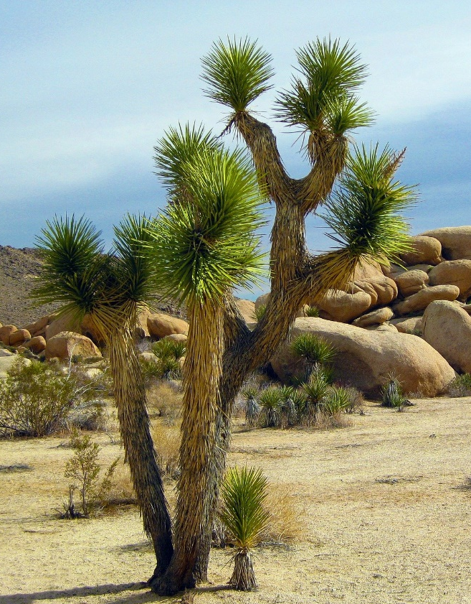
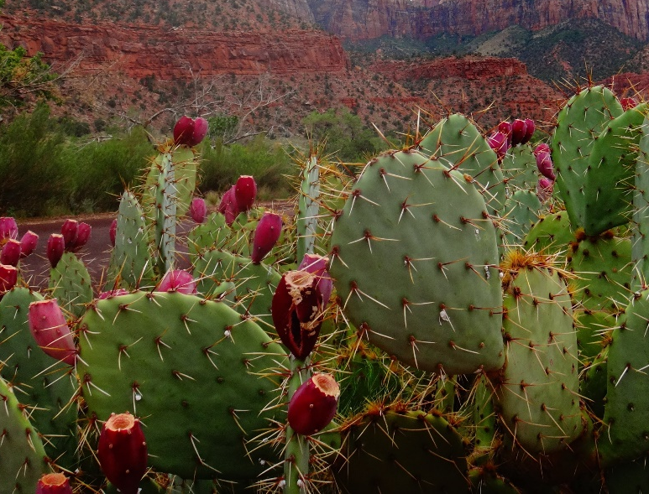
Plants Grow Almost Everywhere
These plants all grow in hot, dry places such as deserts. Look at them carefully.
Plants that grow in hot, dry places usually have small, fleshy leaves that hold water.
They also have roots that are close to the surface. This means they can soak up rainwater as soon as it falls.
Can you explain to your partner how they are similar?
The leaves often have prickles or spikes to stop animals from eating the leaves and taking the water.
succulents
prickly pear cactus
Joshua tree

Slide 11
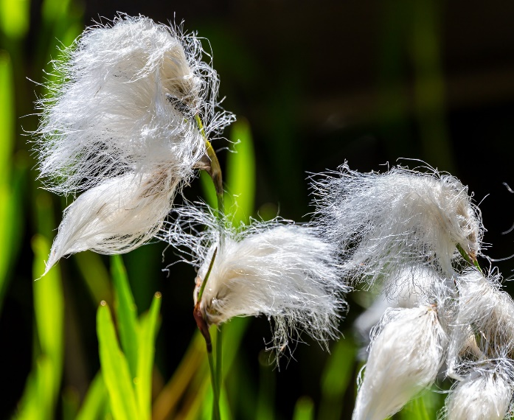
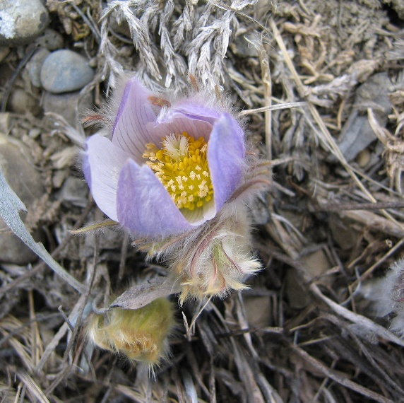
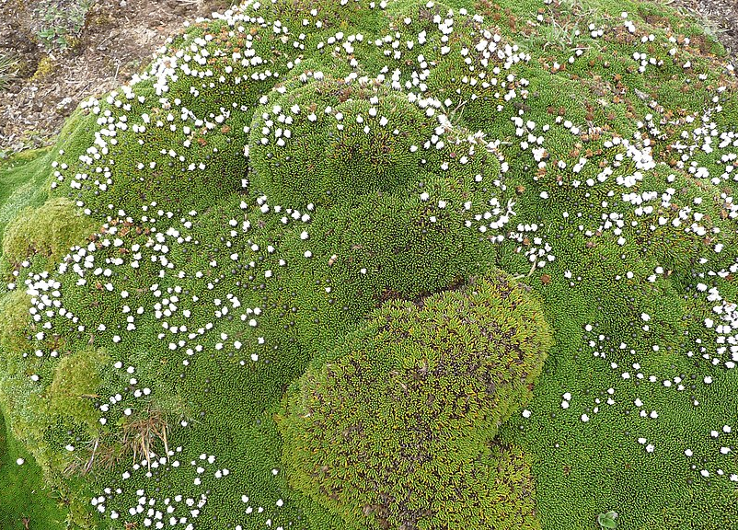
Plants Grow Almost Everywhere
These plants all grow in cold, windy places. Look at them carefully.
These plants are all small and grow close to the ground. This helps them to stay out of the cold wind.
They often grow close together, which helps them to keep warm. They sometimes also have hairy stems to help them to keep warmth in.
Can you explain to your partner how they are similar?
Plants that grow in cold places move to follow the sun with their flowers, so that they get enough sunlight.
cotton grass
prairie crocus
cushion plant

Slide 12
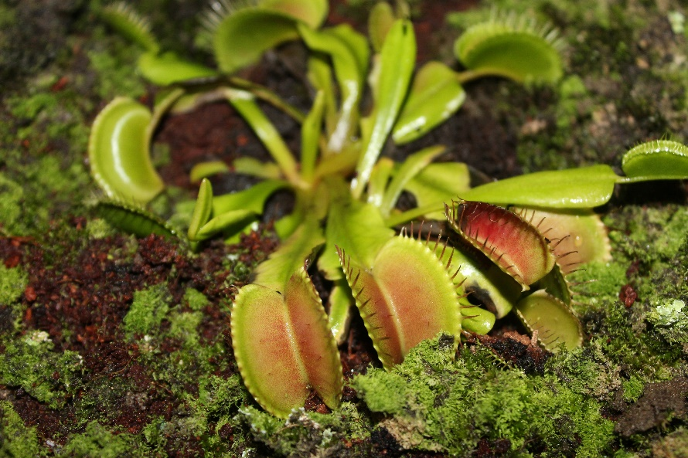
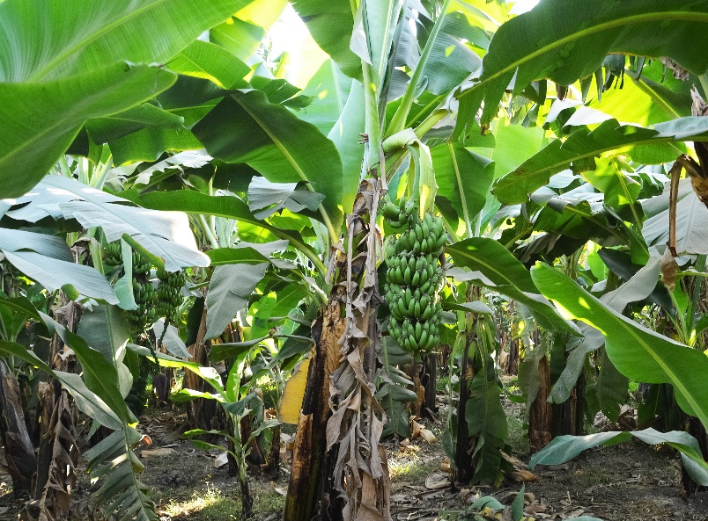
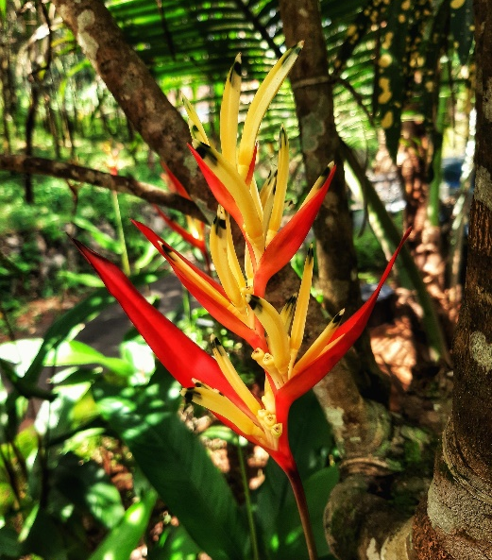
Plants Grow Almost Everywhere
Plants that grow in very wet, warm places (such as rainforests) have large, waxy leaves with pointy tips that the rain can easily run off.
These plants all grow in wet, warm places. Look at them carefully.
The soil in a rainforest can be quite poor, so plants sometimes have shallow roots to help them to get nutrients from the top of the soil.
Can you explain to your partner how they are similar?
Some plants even catch insects and small mammals to ‘eat’! This is how they get their nutrients.
Venus flytrap
banana tree
heliconia flower

Slide 13



Where Does It Live?
Use what you know about how plants are suited to their habitats to decide where you think these plants might live.
Explain why to your partner.

Slide 14
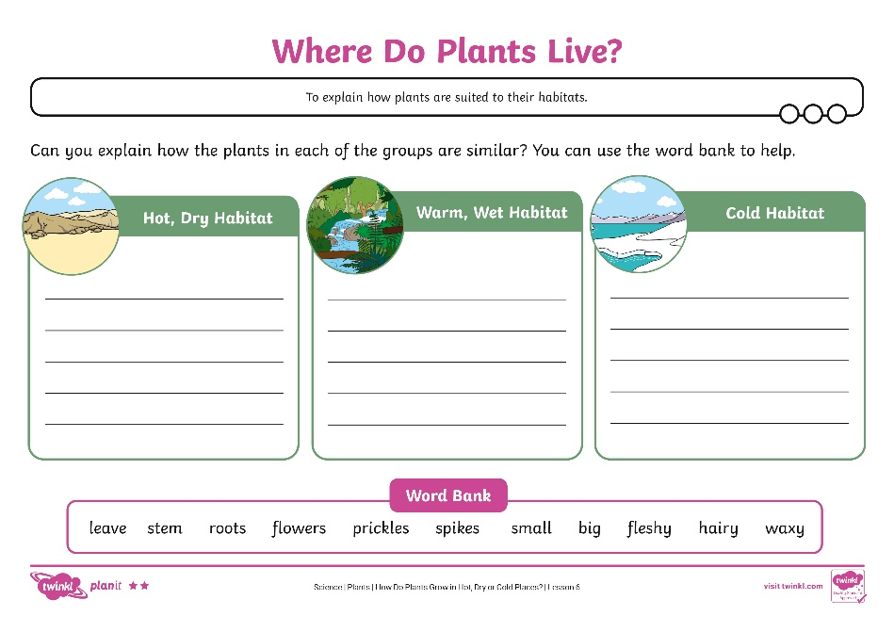
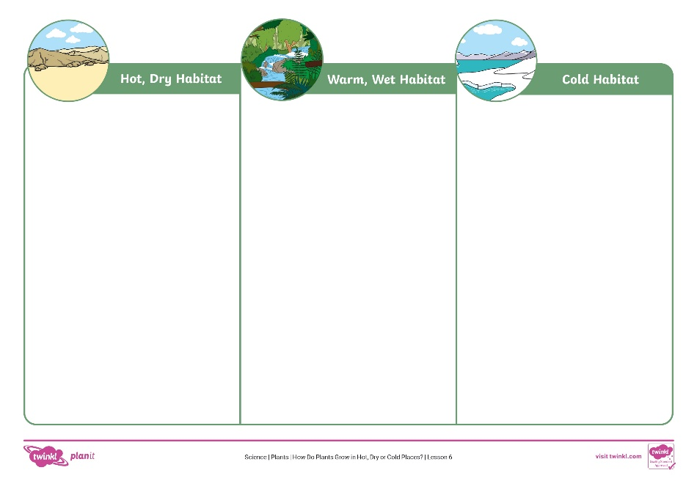
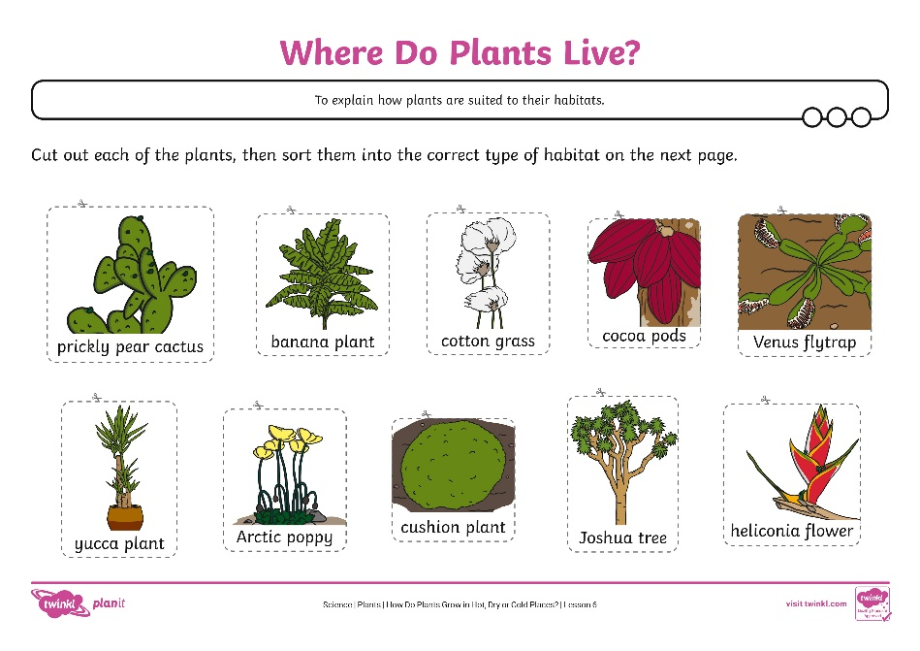
Where Do Plants Live?
Complete the Where Do Plants Live? Activity Sheet.

Slide 15
What Have You Learnt?
Let’s find out how much we have learnt about plants during all of our lessons.
What do all plants need to stay healthy?
the right amount of water, the right temperature and light
Great job!
lots of water and light
Try again!
Try again!
soil, lots of water and heat
What is inside a seed?
Try again!
Try again!
soil
a seed coat
Great job!
a baby plant and a store of food

Slide 16
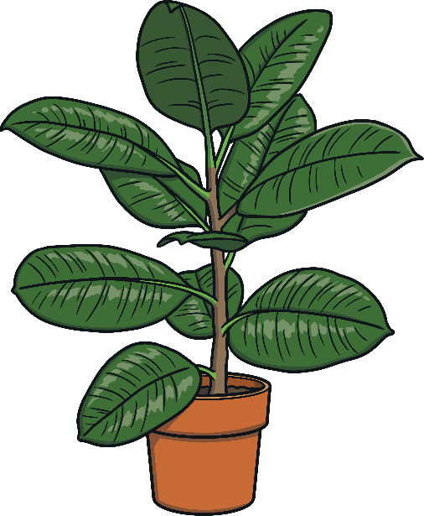
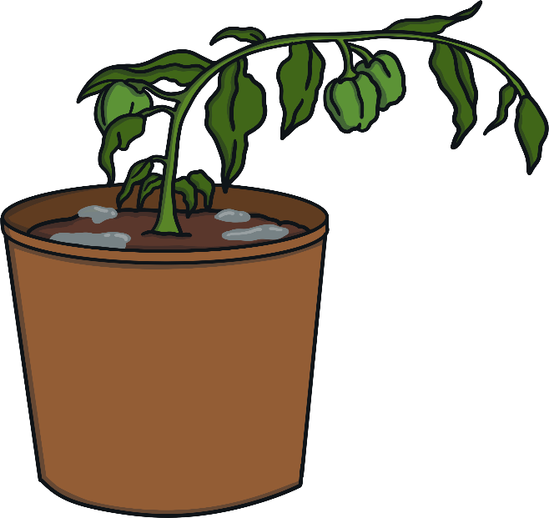


What Have You Learnt?
Let’s find out how much we have learnt about plants during all of our lessons.
Which of these plants is healthy?

Slide 17



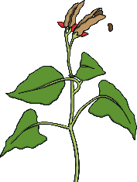

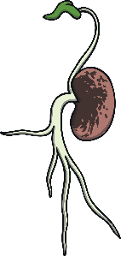

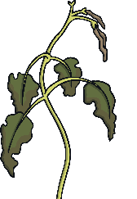
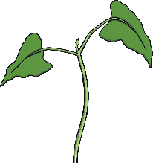
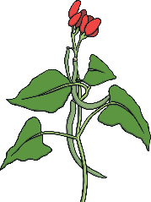
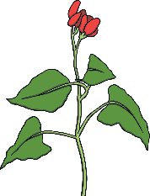
What Have You Learnt?
Can you put the life cycle of the bean plant into the correct order?
Bean
Bean
Seed Dispersal
Germination
Roots
Roots
Dies
Dies
Leaves
Seed Dispersal
Leaves
Germination
Fruit
Flowers
Fruit
Flowers

Slide 18



What Have You Learnt?
Let’s find out how much we have learnt about plants during all of our lessons.
Which of these plants needs water?

Slide 19
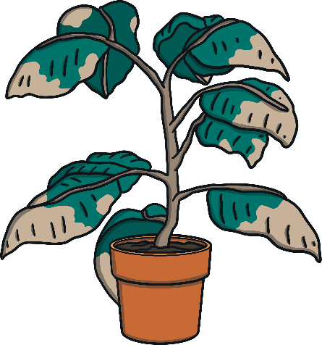

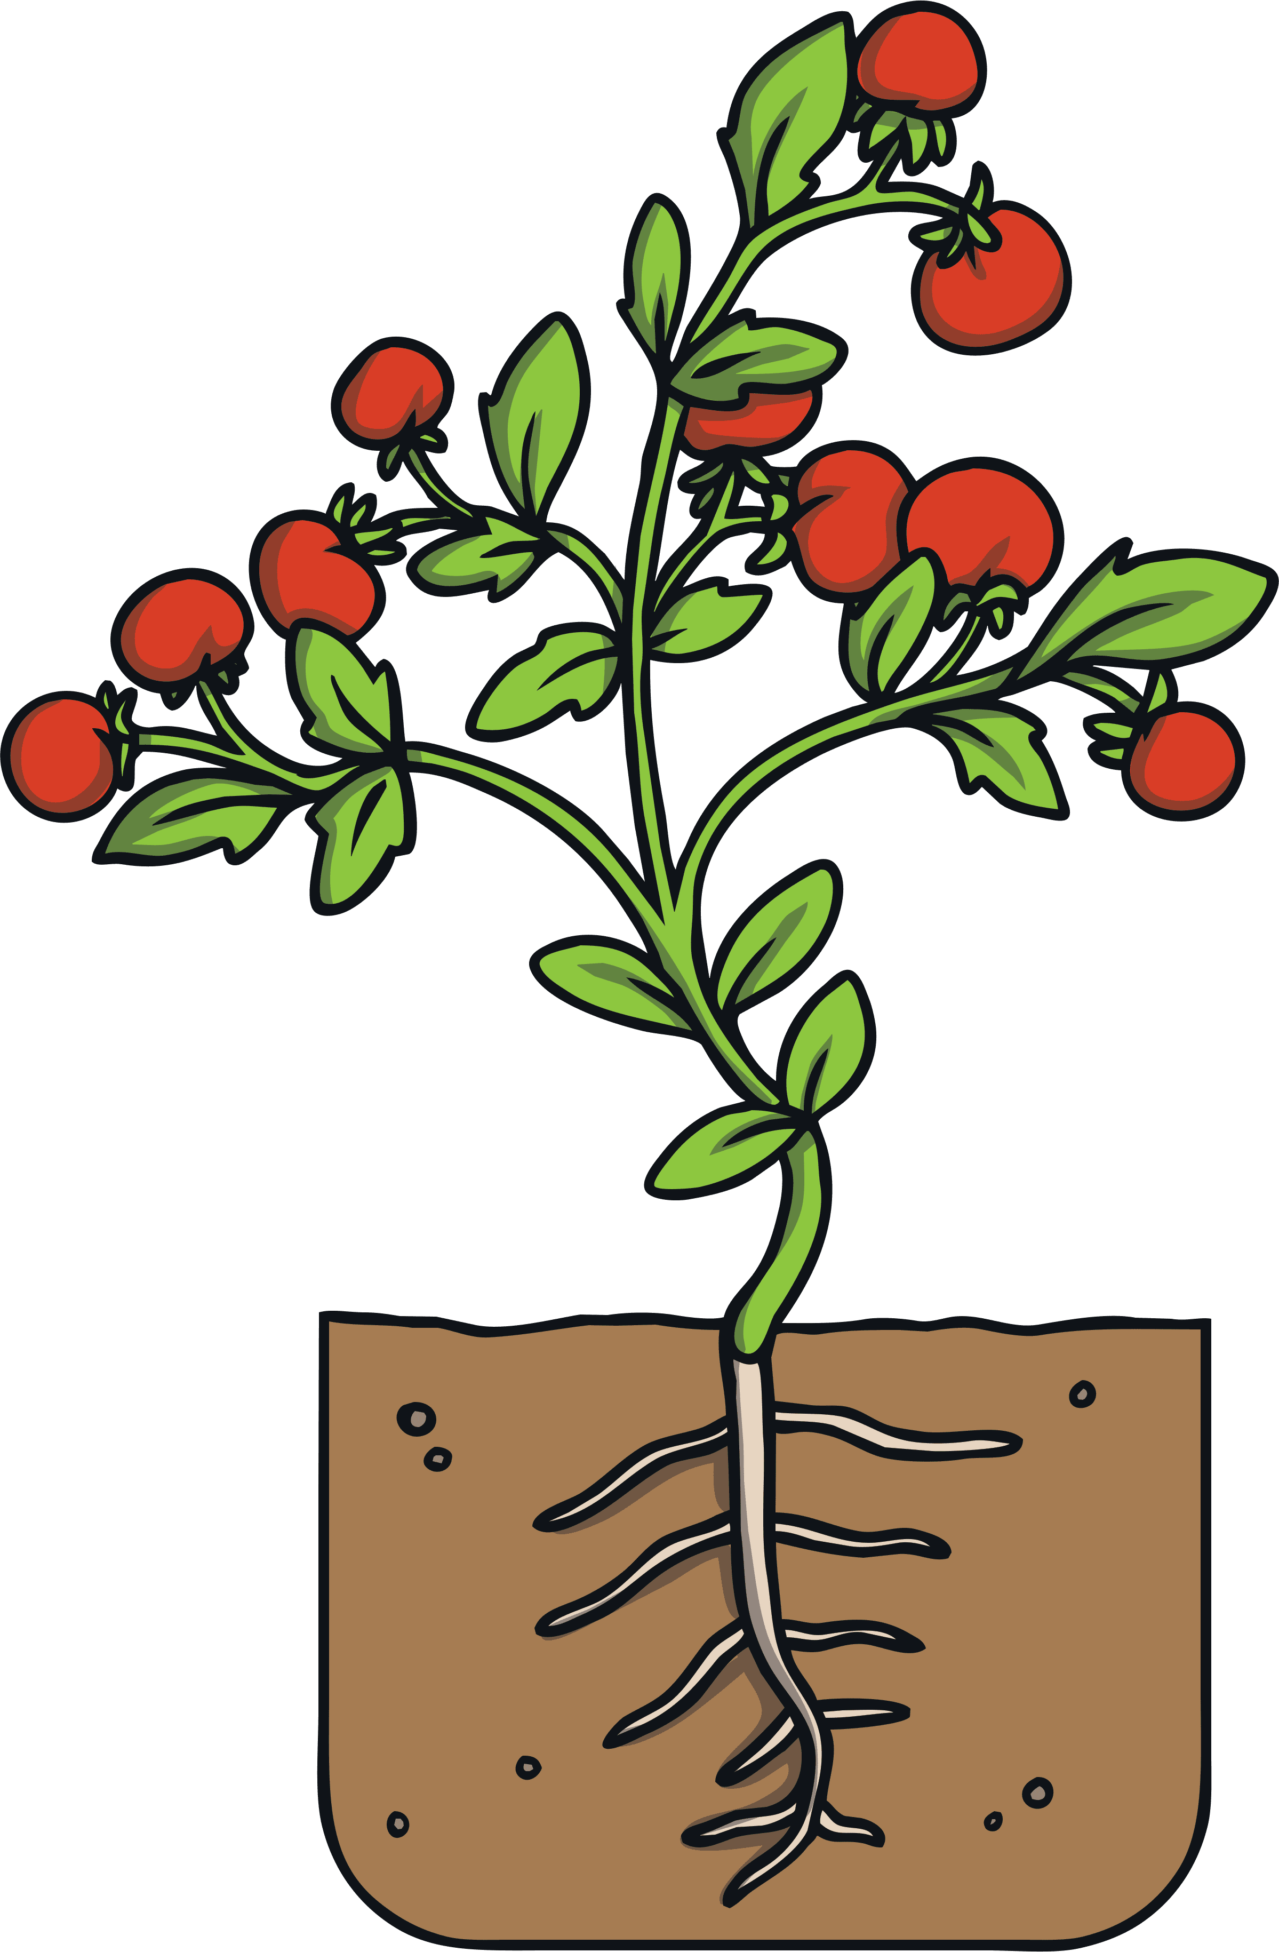
What Have You Learnt?
Let’s find out how much we have learnt about plants during all of our lessons.
Which of these plants needs light?

Slide 20
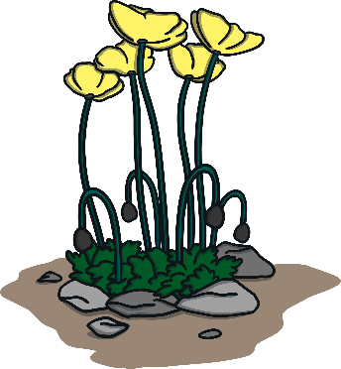

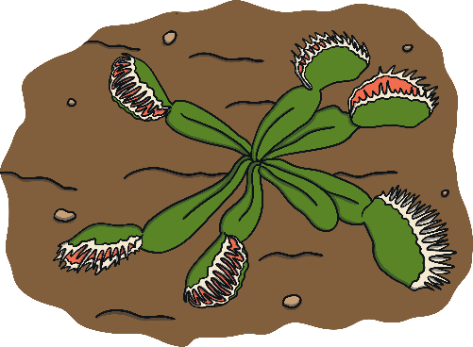


What Have You Learnt?
Which of these plants do you think would live in the rainforest and why?
What do plants that live in hot, dry places usually have in common?
They have thick, fleshy leaves with spikes.
They grow close to the ground.
Great job!
They have big waxy leaves that have a pointy tip.
Try again!
Try again!

Slide 21
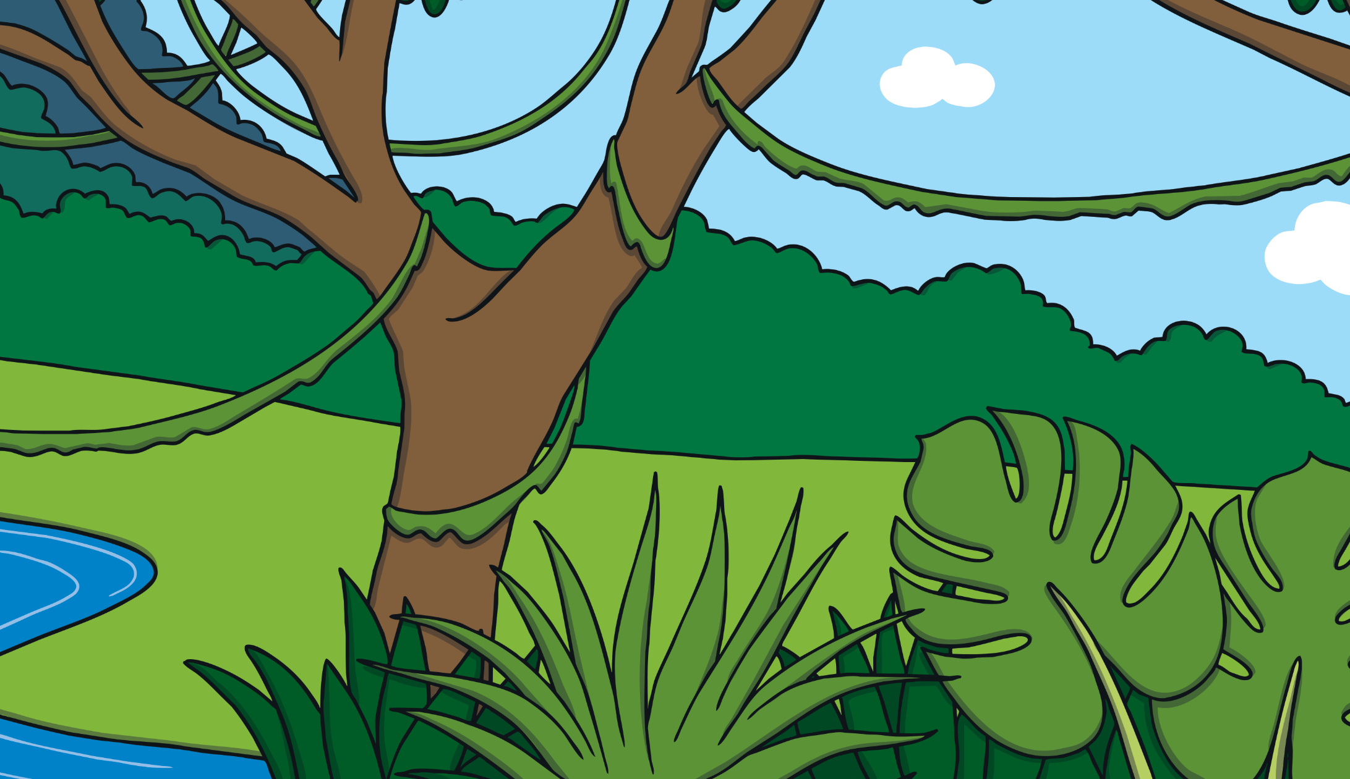


Growing, Growing, Grown
Let’s read to the end of the Growing, Growing, Grown eBook and think about everything we have learnt.
The glossary tells us the meanings of some key words.

Slide 22

Aim
To explain how plants are suited to their habitats.
Success Criteria
I can say how plants have different features that make them suited to where they live
I can identify plants that live in hot, dry, cold or wet places.
I can explain how I know which type of habitat each plant grows in.

Slide 23
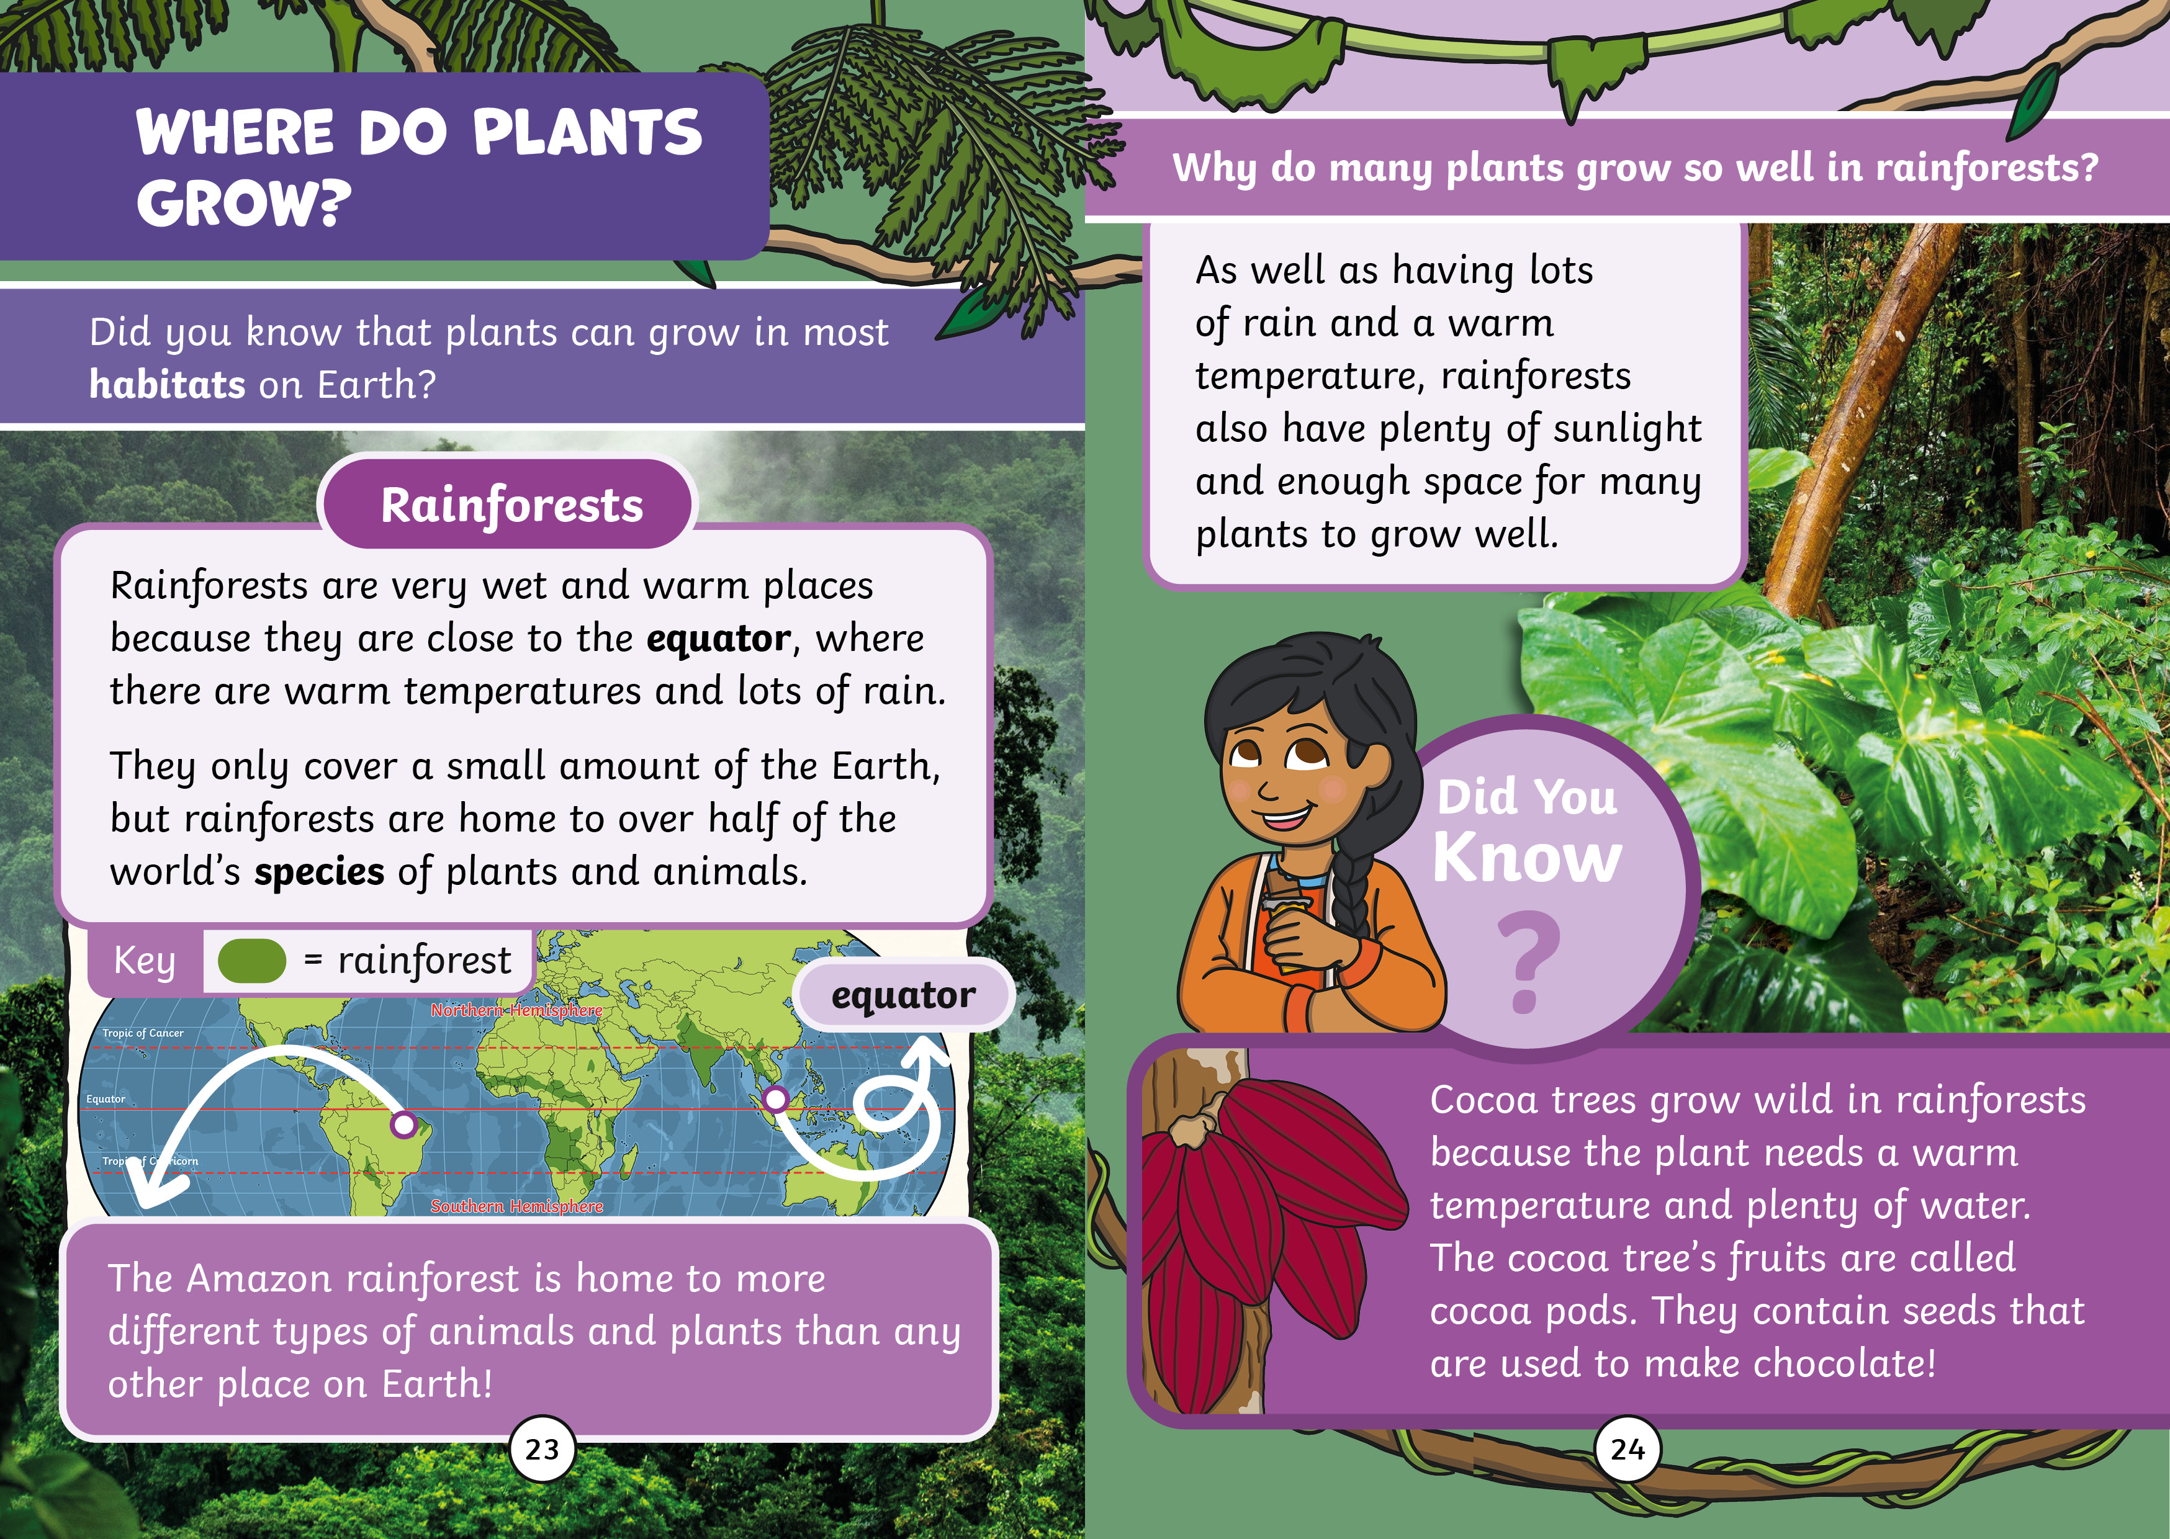

Slide 24
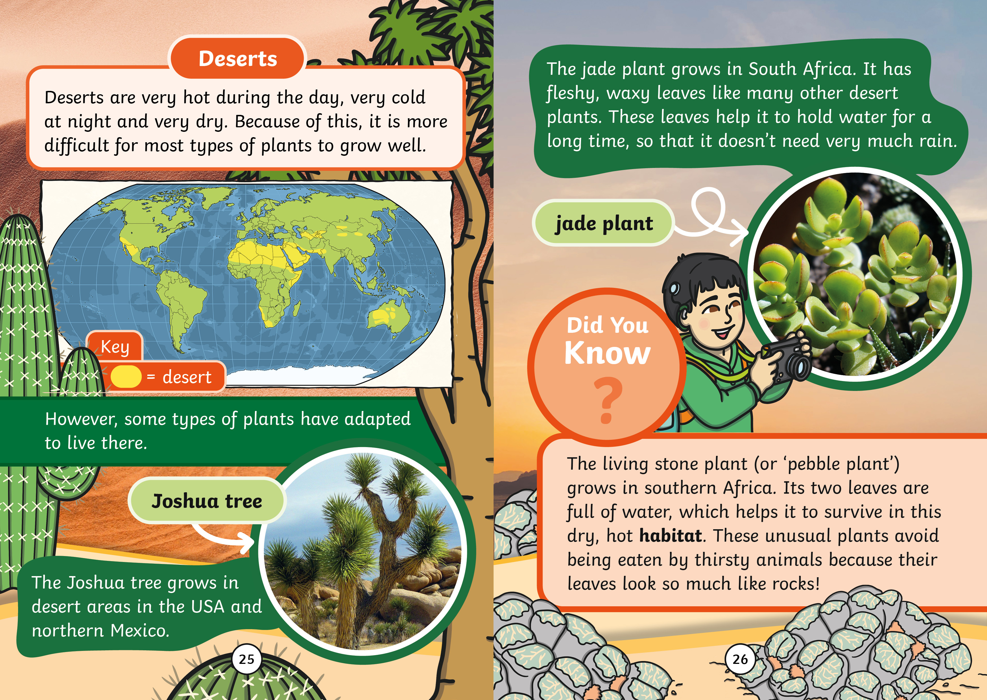

Slide 25
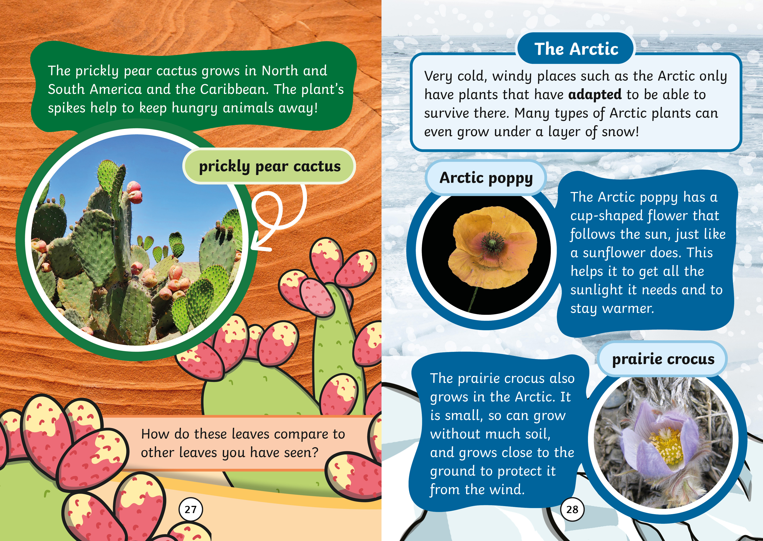

Slide 26
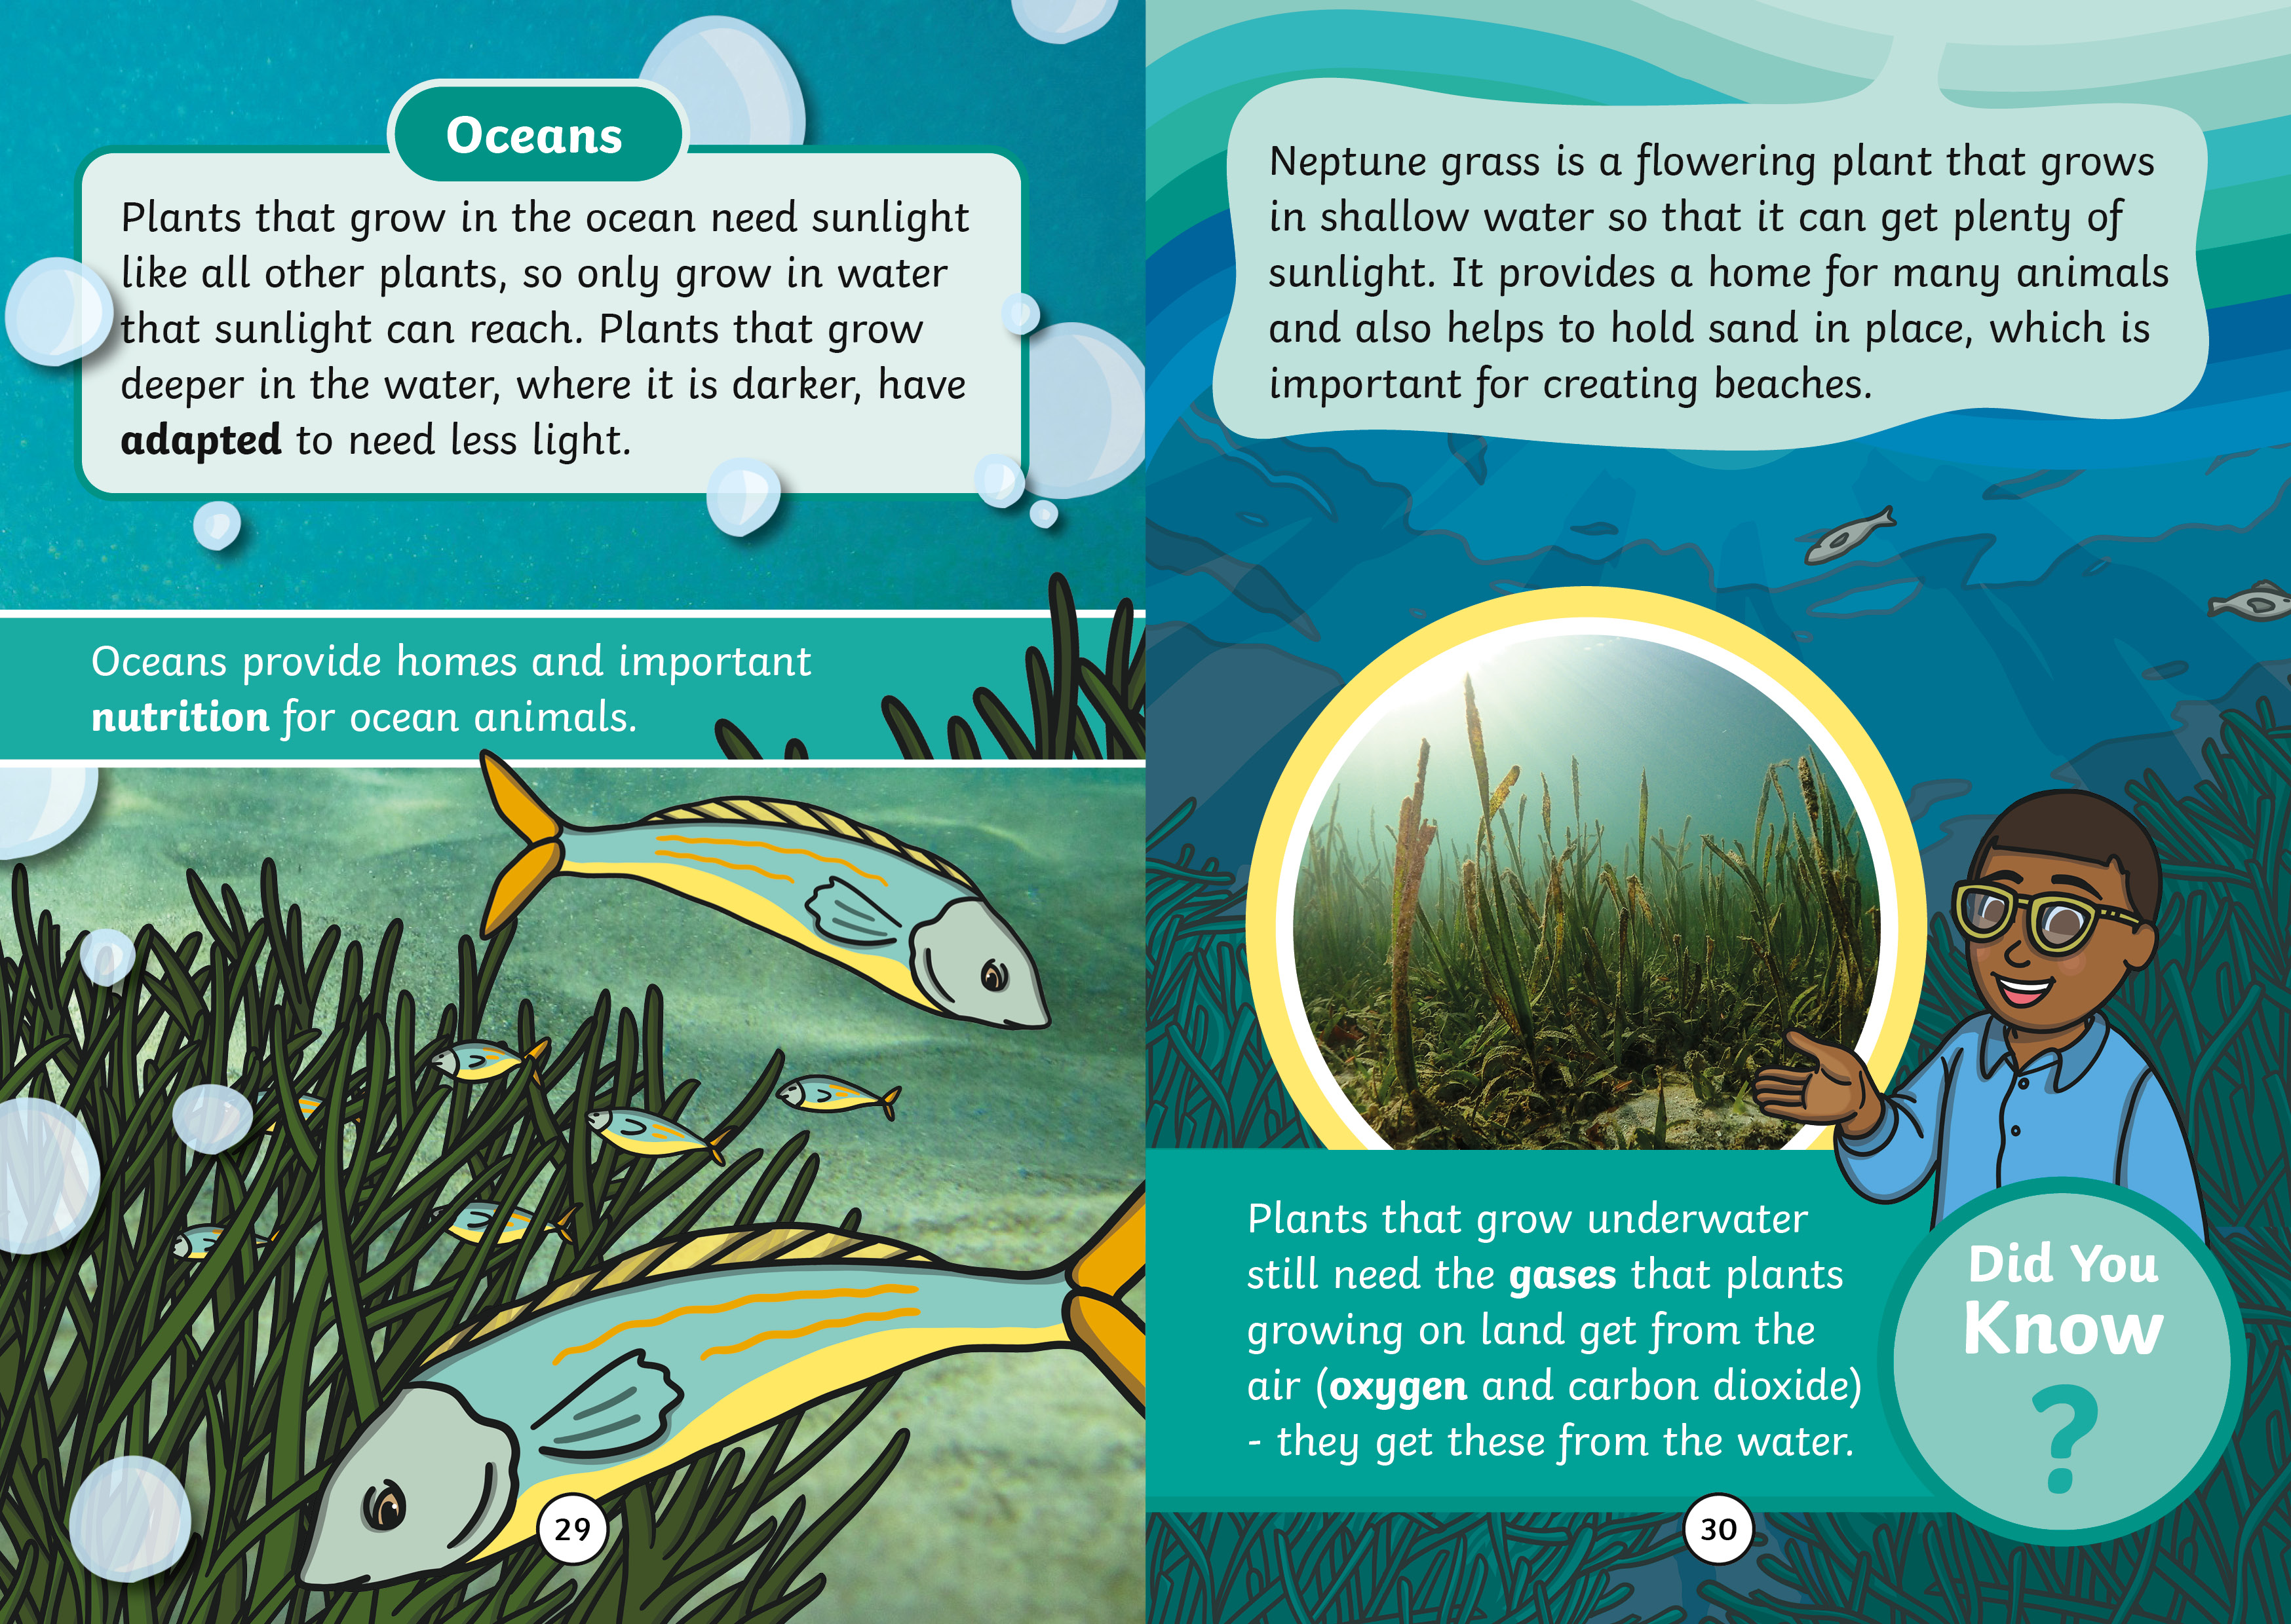

Slide 27
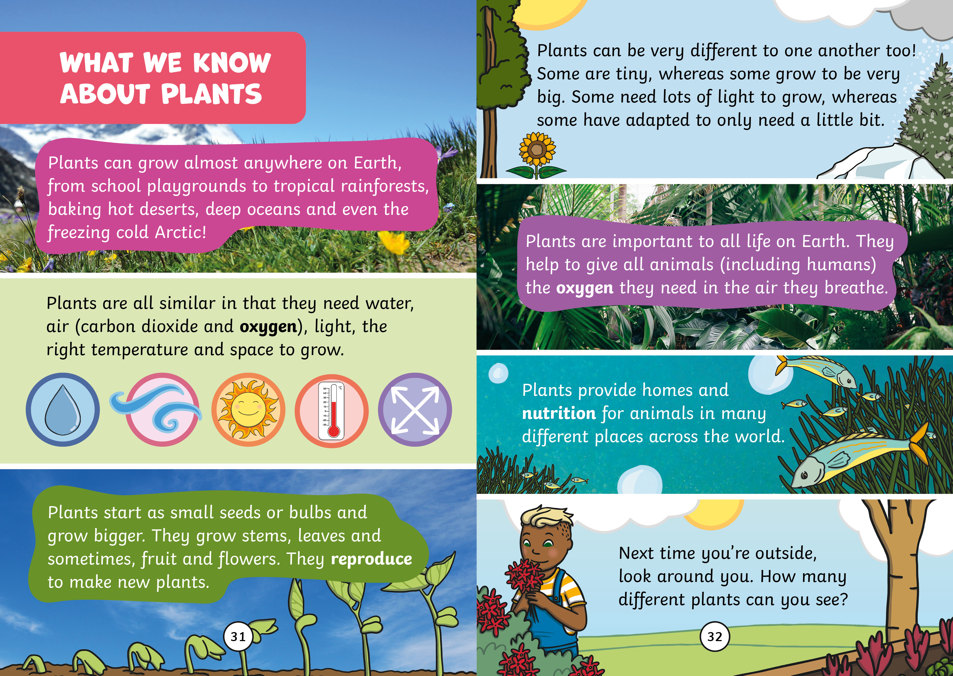

Slide 28
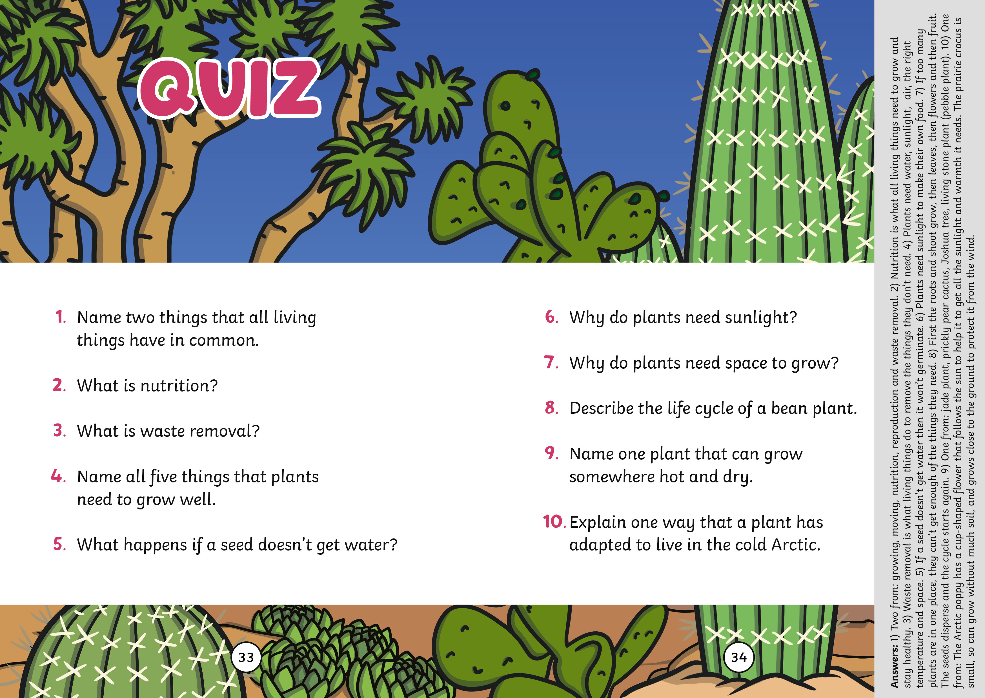

Slide 29
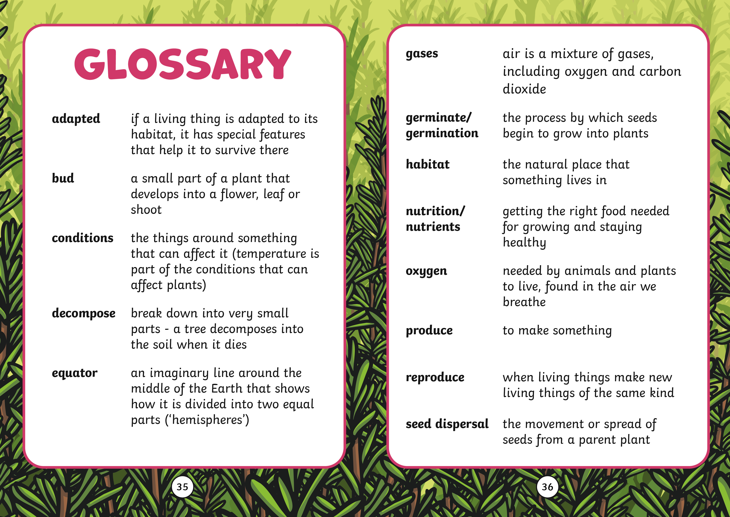

Slide 30
