Slide 1
Ready-to-go Lesson Slides
Year 3
Fractions
Lesson 3
Spr5

Slide 3
Starter:
Success Criteria: I know that one tenth ($\frac{1}{10}$) is one whole divided into 10 equal parts I can show tenths in different ways
Which one is different?
+
+

Slide 4
Starter:
Success Criteria: I know that one tenth ($\frac{1}{10}$) is one whole divided into 10 equal parts I can show tenths in different ways
Which one is different?
+
+
Each image shows a fraction that is equal to 1 whole apart from this one.
Four eighths is less than 1 whole (if it was to be the same as 1 whole, it would
need to be eight eighths).

Slide 5
Talking time:
What fraction does each box in this ten frame represent?
Explain why.

Slide 6
Talking time:
What fraction does each box in this ten frame represent?
Explain why.
If we think of the ten frame as being worth 1 whole, then it has been split into 10 equal parts.
So, each box is worth 1 out of 10 or .
1
10

Slide 7
Talking time:
Put counters to cover one tenth of this frame.

Slide 8
Talking time:
Put counters to cover one tenth of this frame.

Slide 9
Talking time:
Put counters to cover one tenth more than four tenths of this frame.

Slide 10
Talking time:
Put counters to cover one tenth more than four tenths of this frame.

Slide 11
Activity 1:
Use counters and a ten frame to show these fractions:
two tenths
eight tenths
two tenths less than eight tenths

Slide 12
Activity 1:
Use counters and a ten frame to show these fractions:
two tenths
eight tenths
two tenths less than eight tenths

Slide 13
Talking time:
This counting stick is worth 1 whole.
Label each fraction that the stick shows.

Slide 14
Talking time:
This counting stick is worth 1 whole.
Label each fraction that the stick shows.
1
10
2
10
3
10
4
10
5
10
6
10
7
10
8
10
9
10
10
10
or 1 whole

Slide 15
Activity 2:
These counting sticks are worth 1 whole.
Label each arrow with the correct fraction.

Slide 16
Activity 2:
These counting sticks are worth 1 whole.
Label each arrow with the correct fraction.
3
10
7
10
9
10
1
10
5
10
10
10
or 1 whole

Slide 17
Activity 3:
What fractions can you identify?

Slide 18
Activity 3:
What fractions can you identify?
7
10
5
10
5
10
Extension:
Choose four more fractions (tenths) and find four different ways to represent them.
8
10

Slide 19
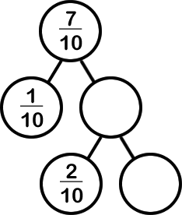
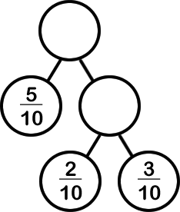
Activity 4:
Complete the missing fractions.

Slide 20
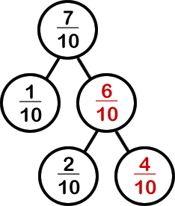
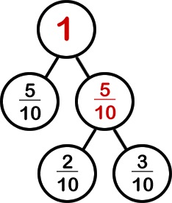
Activity 4:
Complete the missing fractions.

Slide 21
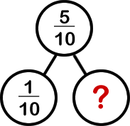
Evaluation:
Success Criteria: I know that one tenth ($\frac{1}{10}$) is one whole divided into 10 equal parts I can show tenths in different ways
True or False?
= 2
This counting stick is divided into tenths.
c) The missing fraction is 9 tenths.
d) There are 10 tenths in 1 whole.
e) Eight tenths and two tenths are the same as 1 whole.
2
10

Slide 22
Evaluation:
Success Criteria: I know that one tenth ($\frac{1}{10}$) is one whole divided into 10 equal parts I can show tenths in different ways
True or False?
= 2 FALSE
This counting stick is divided into tenths. TRUE
c) The missing fraction is 9 tenths.
FALSE
d) There are 10 tenths in 1 whole. TRUE
e) Eight tenths and two tenths are the same as 1 whole. TRUE
2
10

