Slide 1
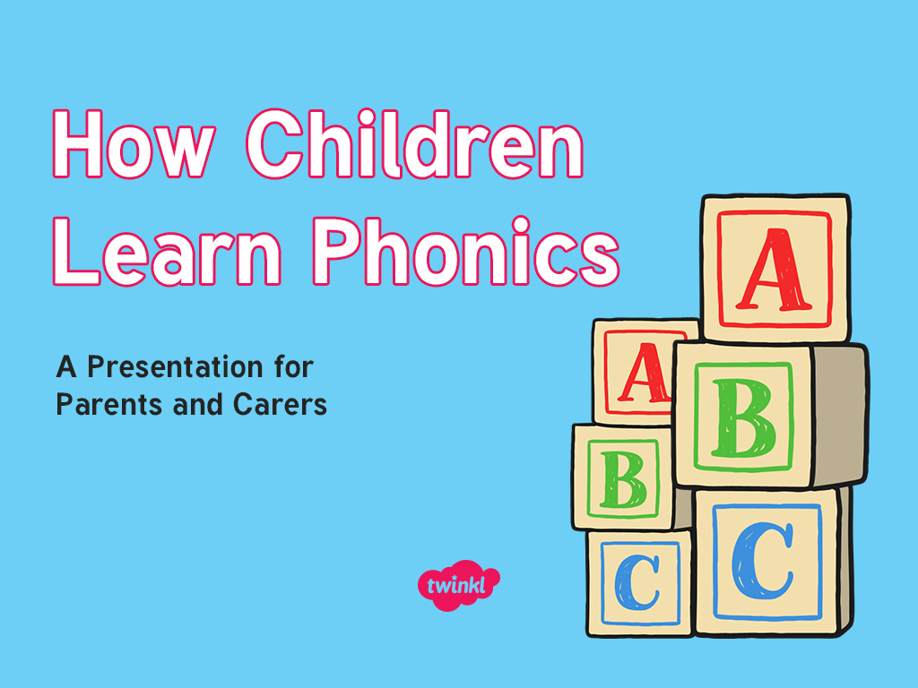

Slide 2

Did You Know…?
The English language has:
26 letters
X
Y
Z
44 sounds
over 100 ways to spell those sounds
It is one of the most complex languages to learn to read and spell.

Slide 3
The English language is one of the most complex languages to learn to read and spell.

Slide 4


Slide 5
The Jargon – A Quick Guide
phonics (also known as ‘synthetic phonics’) – The teaching of reading by developing awareness of the sounds in words and the corresponding letters used to represent those sounds.
phoneme - Any one of the 44 sounds which make up words in the English language.
grapheme – How a phoneme is written down. There can be more than one way to spell a phoneme. For example, the phoneme ‘ay’ is spelt differently in each of the words ‘way’, ‘make’, ‘fail’, ‘great’, ‘sleigh’ and ‘lady’.
blending – Putting together the sounds in a word in order to read it, e.g. ‘f – r – o – g, frog’
segmenting – Breaking a word into its constituent sounds in order to spell them, e.g. ‘frog, f – r – o – g’’
Notes:
It can be interesting to see how many ways there are to spell other sounds – try ‘igh’, ‘ee’ or ‘ow’.
A fun way to learn blending with young children is to talk to them in segmented words, for example ‘Please g – e – t’ the ‘m – i – l – k’ out of the ‘f – r – i – dge’.
When children begin to segment to spell they will often use the wrong spelling of phonemes, for example ‘I luv yoo’ or ‘Migh naym is…’. This is not a problem, as the key skill at this stage is that they can hear the sounds in the words and have a go at writing them down.

Slide 6
Why Are Children Taught Phonics?
Phonics, taught in a structured way, is generally accepted to be the most effective way to teach reading and writing.
Children learn to hear and recognise sounds in words and spell them correctly.
This assists with their confidence, accuracy and fluency.
Phonics should not be taught in isolation — children also need to learn other reading and comprehension skills alongside phonic knowledge.

Slide 7
Teaching Phonics at Dawpool
Phonics lessons take place every day. Each week four new sounds are introduced as well as consolidation of previous sounds taught.
The activities used to teach will vary and can be adapted. They are multisensory and appeal to different learning styles. They involve games and individual and group activities as well as teacher-led sessions.
Teachers will assess children’s understanding throughout each session and will also assess knowledge of sounds to see whether a child is ready to move on to the next phase.
We follow the Letters and Sounds Scheme of Work
Notes:
Assessment at the end of a phase will usually involve asking children to name sounds to check that they know all of the Phase 2 sounds before they move on to Phase 3. Teachers may also assess ability to blend sounds to read words.

Slide 8
Letters and Sounds
Letters and Sounds is a resource for the teaching of phonics which was issued by the Department for Education in 2007.
It remains the most common way to teach phonics in British primary schools.
At Dawpool School we also use strategies from other Phonics schemes, such as Jolly Phonics songs and RWI actions to support writing.

Slide 9
The Importance of Listening Skills
Phonics learning relies on children being able to hear and distinguish the sounds within words.
Children with poor listening and/or attention skills can struggle with phonics learning.
The first phase of formal phonics education (Phase 1) also focuses on key listening skills. Without these skills, children may struggle to master the next stage of their phonics learning.

Slide 10
Phase One
Phase 1 has seven aspects, with a focus on listening skills.
1: Environmental sounds
2: Instrumental sounds
3: Body percussion
4: Rhythm and rhyme
5: Alliteration
6: Voice sounds
7: Oral blending and segmenting
Notes:
Environmental sounds – sounds we hear around us every day; listening to and imitating sounds; how to be a good listener. Ideas – make sounds to copy, e.g. sh sh sh, zzzzzz, p-p-p-p; go on a ‘listening walk’ – what can you hear?; talk about how to be a good listener; sing songs that require repetition and response, e.g. ‘Old MacDonald’.
Instrumental sounds – listening to and discriminating the sounds made by different instruments. Ideas – make sounds with a range of different instruments (non-musical instruments such as pots, pans, home-made shakers will all do); play an echo game where children have to copy a rhythm; hide an instrument behind a box or screen and play it, children have to say which instrument you are playing.
Body percussion – using the body to create sounds and follow a song, rhyme or beat. Ideas – sing songs that require actions, such as ‘Wind the Bobbin Up’, ‘Heads, Shoulders, Knees and Toes’, ‘If You’re Happy and You Know It, Clap Your Hands’; pass a body percussion sound around a group, e.g. sit in a circle or opposite one another, take turns to produce a body percussion sound which is then passed on, e.g. tap on shoulders, clap hands, stamp feet.
Rhythm and rhyme – recognising rhythms and rhymes in songs, speech and nursery rhymes. Ideas – sing and chant rhyming songs; read stories with repetition and rhyme, e.g. ‘The Gingerbread Man’, ‘Each Peach Pear Plum’; play a matching game with pictures of rhyming objects, e.g. frog/dog, hat/cat, mouse/house; clap the rhythm of phrases and rhymes or the syllables in words or names; play ‘I Spy’ – ‘I spy, with my little eye, something that rhymes with….’ Example game on next slide.

Slide 11


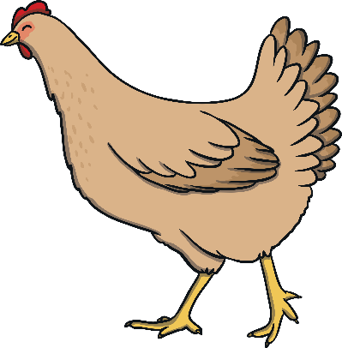

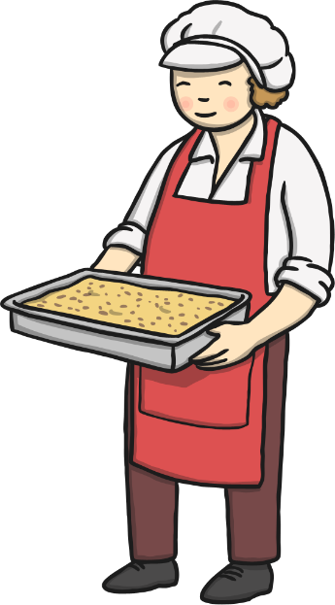




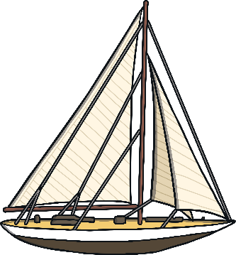
Find the Rhymes

Slide 12

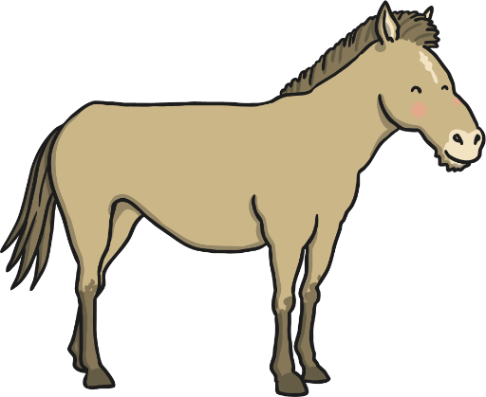
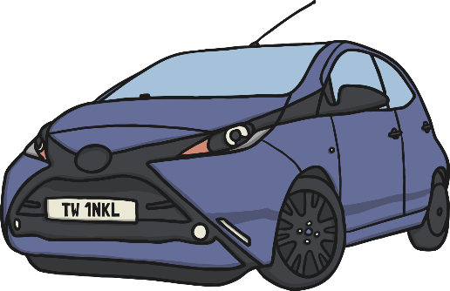


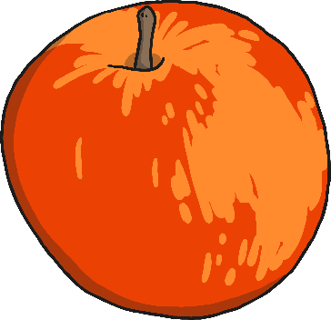

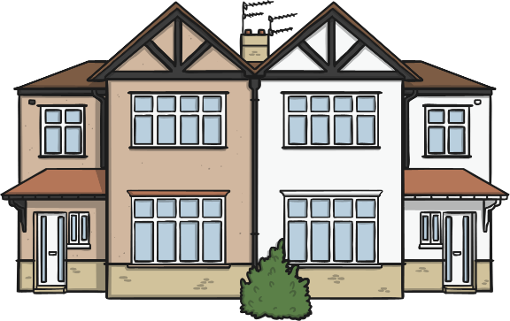
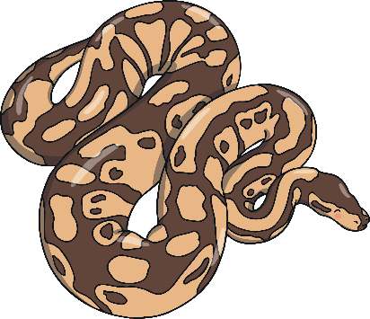
Find the Starting Sounds
Can you find three things beginning with ‘sss’?
How many things begin with ‘h’?
Notes:
Set 1: s, a, t, p
Set 2: i, n, m, d
Set 3: g, o, c, k
Set 4: ck, e, u, r
Set 5: h, b, f, ff, l, ll, ss
Phase 2 usually begins when children start their formal education in reception, though some preschools may also begin to teach letter sounds

Slide 13
Phase Two
In Phase 2 letters are introduced in sets
Set 1 : s a t p
Set 2: i n m d
Set 3: g o c k
Set 4: ck e u r
Set 5: h b f ff l ll ss
Children also begin to blend the sounds to make words. By the end of Phase 2, children will be able to read ‘consonant-vowel-consonant’ (cvc) words, e.g. up, in, cat, pin.
Children will also learn to read the ‘tricky’ words the, to, go, I, no, which cannot be read phonetically.
Notes:
Set 1: s, a, t, p
Set 2: i, n, m, d
Set 3: g, o, c, k
Set 4: ck, e, u, r
Set 5: h, b, f, ff, l, ll, ss
Phase 2 usually begins when children start their formal education in reception, though some preschools may also begin to teach letter sounds.

Slide 14
Phase Three
Set 6: j v w x
Set 7: y z zz qu
Consonant digraphs: ch, sh, th, ng
Vowel digraphs: ai, ee, igh, oa, oo, ar, or, ur, ow, oi, ear, air, ure, er
Children also continue to learn how to blend and segment CVC words using the new sounds, e.g. tail, sheet, night – note that these words still only have three sounds.
Tricky words also continue to be taught: he, she, we, me, be, was, you, they, all, are, my, her
Notes:
Set 6: j, v, w, x
Set 7: y, z, zz, qu
Consonant digraphs: ch, sh, th, ng
Vowel digraphs: ai, ee, igh, oa, oo, ar, or, ur, ow, oi, ear, air, ure, er

Slide 15
Phase Four
By Phase 4, children are able to represent each of 42 phonemes with a grapheme. Children will be able to read CVC words and begin to segment them to spell them.
Phase 4 is consolidation of children’s knowledge. Children also move on to blending and segmenting using adjacent consonants, e.g. st, sp, tr, br, spr, str in words such as string, train.
Phonics teaching continues to be regular and structured and children play games to consolidate their learning.
Notes:
Set 6: j, v, w, x
Set 7: y, z, zz, qu
Consonant digraphs: ch, sh, th, ng
Vowel digraphs: ai, ee, igh, oa, oo, ar, or, ur, ow, oi, ear, air, ure, er

Slide 16
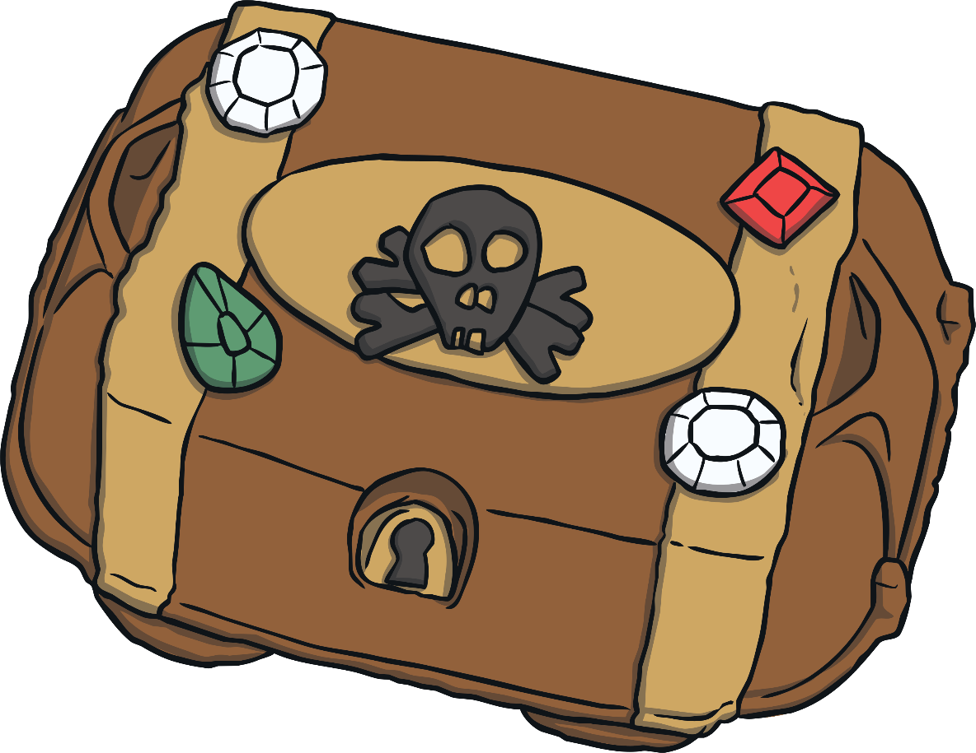
Buried Treasure
What have the pirates hidden in the chest?

Slide 17



Yes or No?
Can a clock clap hands?
Can a spoon grab a fork?
Do trains run on tracks?

Slide 18
Reading Books
In Foundation 2 one we follow the Oxford Reading Tree scheme.
Can we please ask that you don’t purchase this reading scheme yourself at home, The children become very bored of re reading the same book over and over.
We will undertake guided reading activities in the school day using this reading scheme. We will then send one reading book home every Friday.
Please note, it is recommended practice not to send out multiple books each week even if requested. This is because reading the book alone is only a small part of the reading experience. There are so many other valuable ways you can extend your child’s learning.

Slide 19
Helping Your Child at Home
Talk about the pictures using questions such as who? What? Where? Why?
Can they think of their own ending for the story?
Can they draw a picture of their favourite part of the story? Can they make up their own character?
Look for familiar sounds and words in the world around you. Can they sound out and blend words from signs?
Go through favourite home reading books and look for words they know.
Use the local library to look for new stories that interest and excite them.
Read a variety of different books to your child every day.

Slide 20
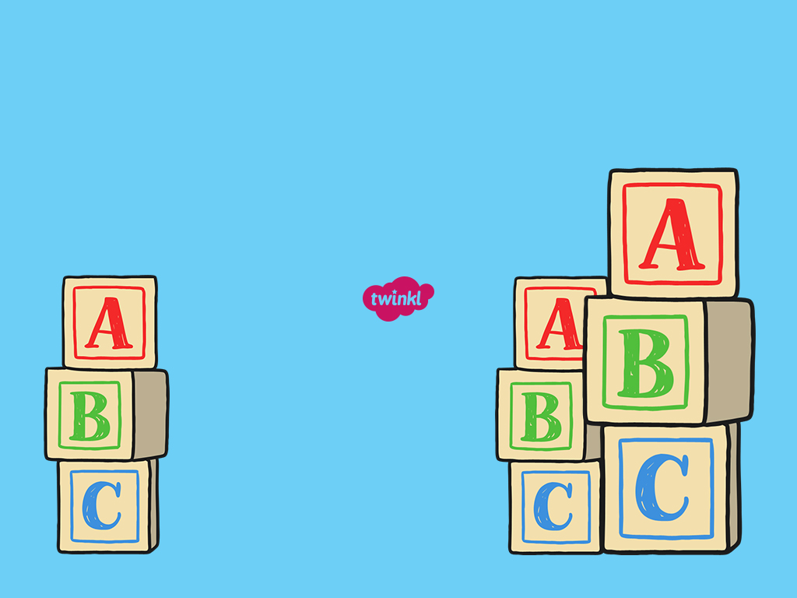
To support children’s early development in language and vocabulary.
To increase interaction between adults and children.
‘We want to improve education for every child and the early years in a child’s life are critical in laying strong foundations for future success. That is why we want to free up more time for Reception teachers to interact with their pupils, and make sure they are developing the rich vocabulary, skills and behaviours they need to thrive at school and in later life.’
Nadhim Zahawi
Children & Families Minister

