Slide 1
Ready-to-go Lesson Slides
Year 6
Ratio
Lesson 3
To understand the ratio symbol
Spring

Slide 2
Summary
Key Vocabulary and Sentence Stems
Hinge Question (Assessment Point)
Lesson Introduction Slide (Learning Objective and Success Criteria)
Starter – Ratio and fractions
Key Concept Introduction
Guided Practice – Describing images using simple ratios
Independent Practice 1 – Describing images using simple ratios
Guided Practice – Explain why Adam is correct.
Independent Practice 2 – Describing a more complex image using ratios
Guided Practice – Is this correct?
Independent Practice 3 – Draw images of the ratios described
Let’s Reflect
Support Slides – Based on previous lesson – Using ratio language

Slide 3
Key Vocabulary:
Ratio | For every
Sentence Stems:
Ratios shows the relationship between two amounts.
For every (number/ item) there are (number/ item).
- For every 3 red cubes there are 2 yellow cubes.
The notation of a ratio relates to the order of the parts.
The ratio of (item) to (item) is (number) : (number).
- The ratio of red counters to blue counters is 1 : 2.

Slide 4
Hinge Question:
Which statement describes the ratio of green blocks to orange blocks?
5 : 2
5 : 7
2 : 5
2 : 7
Notes:
Assessment point for the lesson – ask the pupils to vote for the answer they think is correct.
A – Correct answer
B – The pupil has written the ratio of orange cubes to green cubes.
C – The pupil may be confusing ratio and fractions (writing 5 cubes out of the whole are green).
D – The pupil may be confusing ratio and fractions (writing 2 cubes out of the whole are orange).
If answers B, C or D are given, pupils may require extra support through small group or 1:1 discussions. There are support slides covering previous learning end of these slides. Ratio is a new topic to Year 6.

Slide 5
To understand the ratio symbol
Success Criteria I can read a ratio out loud I can use the correct notation to write ratios I know that the order a ratio is written is important

Slide 6
Starter:
Describe these images using fractions and the sentence stems.
For every _____ blue counters there are _____ orange counters.
For every 3 blue counters there are 4 orange counters.
Blue: $\frac{\text{3}}{ \text{7} }$
Orange: $\frac{\text{4}}{ \text{7} }$
For every 2 blue counters there are 3 orange counters.
Blue: $\frac{\text{2}}{ \text{5 }}$
Orange: $\frac{\text{3}}{ \text{5 }}$
For every 1 blue counter there are 2 orange counters.
Blue: $\frac{\text{1}}{ \text{3} }$
Orange: $\frac{\text{2}}{ \text{3} }$
Answers
Notes:
This starter recaps the previous lesson on ratio and fractions.
Concrete resources – Counters
Key Questions – How many counters are there in total? How many counters are there of each colour? How does this information help you to describe the images?
Extension – Show and describe the ratio 4 to 5.

Slide 7
I can describe these counters in different ways.
I can use a sentence stem. For every 5 green counters there are 3 orange counters. OR For every 3 orange counters there are 5 green counters.
I can say the ratio of green counters to orange counters is 5 to 3. OR The ratio of orange counters to green counters is 3 to 5. I can say the ratio of green counters to orange counters is 5 : 3. OR the ratio of orange counters to green counters is 3 : 5.
Notes:
Concrete resources – Counters
Key Questions – What do you notice about each statement? How is each statement similar? What does the ‘:’ mean? How do I say 5 : 3 out loud? What is important about the order of the description and the way the ratio is written?
Misconceptions/ Common Errors – Pupils may not identify alone that the notation of the ratio relates to the order of the parts. In 5 : 3, the 5 relates to the green counters and the 3 relates to the orange counters.

Slide 8
Guided Practice:
Describe the ratio of the counters.
The ratio of blue counters to yellow counters is _____ : _____.
The ratio of yellow counters to blue counters is _____ : _____.
3
5
5
3
Answers
Notes:
Concrete resources – Counters
Key Questions – How many blue counters are there? How many yellow counters are there? Why is the order of the ratio important?
Misconceptions/ Common Errors – Pupils may not understand why the order the ratio is written in is important.
Further Practice – Show different colour counters. Complete the sentence stems for the counters.

Slide 9
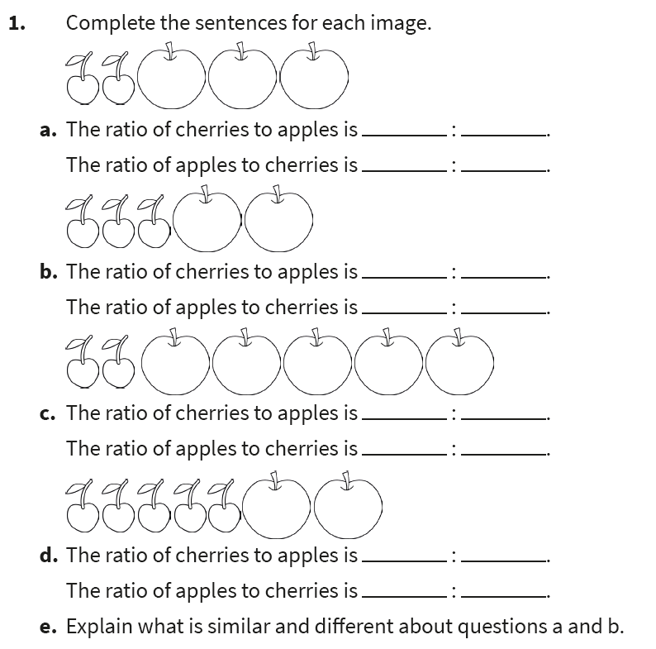
Independent Practice:
Notes:
The ratio of cherries to apples is 2 : 3. The ratio of apples to cherries is 3 : 2.
The ratio of cherries to apples is 3 : 2. The ratio of apples to cherries is 2 : 3.
The ratio of cherries to apples is 2 : 5. The ratio of apples to cherries is 5 : 2.
The ratio of cherries to apples is 5 : 2. The ratio of apples to cherries is 2 : 5.
Answers will vary. Pupils should identify that the numbers are the same but the order of the ratio determines how many cherries or apples there are.

Slide 10
Guided Practice:
Adam says the ratio of tennis balls to basket balls is 2 : 1.
Adam is correct. Explain why.
For every 2 tennis balls there is 1 basketball. This can be written as 2 : 1.
Write a statement to describe the balls.
Answers
Notes:
Statements will vary. Example answers: The ratio of footballs to basketballs is 3 : 1. The ratio of basketballs to tennis balls is 1 : 2.
Concrete resources – Balls or counters/ cubes/ blocks to represent the balls.
Key Questions – How many tennis balls are there? How many basketballs are there? Which type of ball is Adam describing first? Does the ratio reflect this? Does the number of footballs impact on the given ratio? Can you explain your answer?
Misconceptions/ Common Errors – Pupils may find the representation of three different items confusing.
Further Practice – Give a statement about the balls - is it true or false?
Extension – Is it always, sometimes or never important to notice the order of the ratio description?

Slide 11
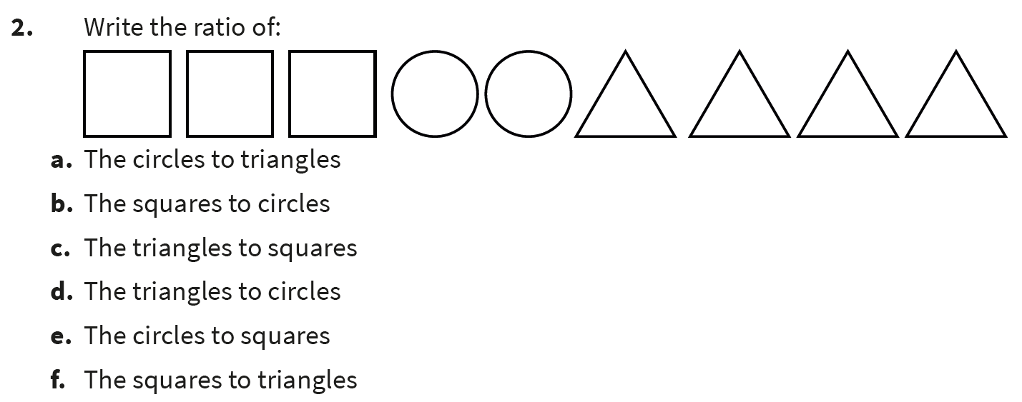
Independent Practice:
Notes:
2 : 4 (or 1 : 2)
3 : 2
4 : 3
4 : 2 (or 2 : 1)
2 : 3
3 : 4

Slide 12
Guided Practice:
Ruth says she has written a statement to describe the image.
Do you agree?
The ratio of red cubes to blue cubes is 3 : 4.
Ruth is incorrect. She has written the ratio of blue cubes to red cubes, not red cubes to blue cubes.
Answers
Notes:
Concrete resources – Cubes
Key Questions – How many blue cubes are there? How many red cubes are there? Which part of the image should Ruth have described first? Which part of the image HAS Ruth described first? Why is the order of the ratio important?
Misconceptions/ Common Errors – Pupils may believe that, as the digits are correct, Ruth is correct. They may not understand that the notation of the ratio relates to the order of the parts described.
Further Practice – Draw an image to reflect the statement.

Slide 13
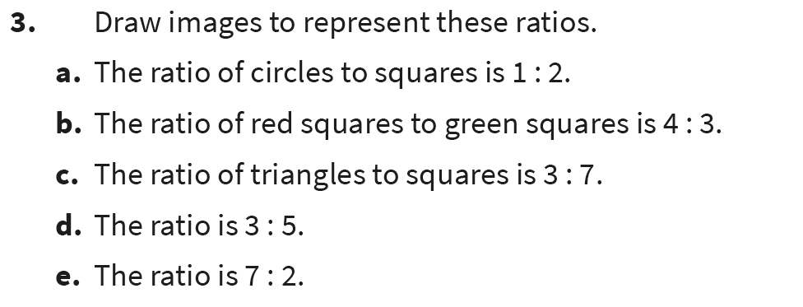
Independent Practice:
Notes:
1 circle for every 2 squares.
4 red squares for every 3 green squares.
3 triangles for every 7 squares.
Any 3 images for any 5 images.
Any 7 images for any 2 images.

Slide 14
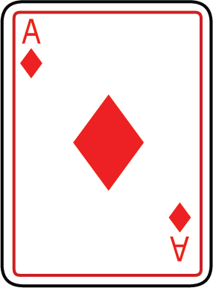
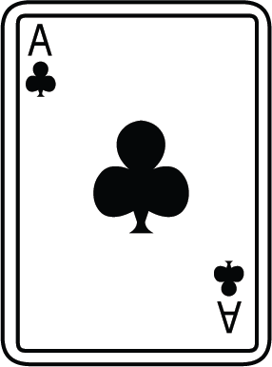
Let’s Reflect:
Which statements match the image?
The ratio of red cards to black cards is 4 : 7.
The ratio of black cards to red cards is 3 : 4.
The ratio of red cards to black cards is 4 : 3.
The ratio of black cards to red cards is 4 : 3.
Answers
Notes:
Concrete resources – Cards or counters/ cubes/ blocks to represent the cards
Key Questions – How many red cards are there? How many black cards are there? Which statements could I write about the cards? Which statements are incorrect? How do you know? Can you explain the error(s)?

Slide 15
The following slides are based on previous lesson – Using ratio language

Slide 16
Describe these images using the sentence stems.
For every _____ green cubes there are _____ orange cubes.
For every _____ tennis balls there are _____ footballs.
For every _____ bananas there are _____ cherries.
3
2
3
5
7
4
Answers
Notes:
How and when to use these slides – Ratio is a new topic to Year 6. Pupils may need to recap the language used when discussing ratio before they can move on to using the ratio symbol. These slides recap describing the relationship between items using a sentence stem.
Concrete resources – Cubes, counters, etc to represent items shown on the slide
Key Questions – How many of one item are there? How many of another item are there? How can I use this information to complete the sentence stems? What does ratio describe?
Further Practice – Using two colour of counters, describe the relationship using the sentence stem.

Slide 17
Write as many statements as you can about the fruit.
Notes:
How and when to use these slides – Ratio is a new topic to Year 6. Pupils may need to recap the language used when discussing ratio before they can move on to using the ratio symbol. These slides recap describing the relationship between items using a sentence stem.
There are lots of possible answers. Example answers: For every 12 strawberries there are 3 pineapples. For every 2 mangos there is 1 pineapple. For every 1 mango there are 2 strawberries.
Concrete resources – Counters/ cubes to represent the fruit
Key Questions – How many strawberries are there? How many mangos are there? How many pineapples are there? What is the relationship between two of the fruits? Can you simplify any of the ratios?
Misconceptions/ Common Errors – Pupils may not remember how to simplify the ratios.
Further Practice – Add 2 pineapples. How does this change the statements?

