Slide 1
Year 6
Fractions A
To understand how to compare and order fractions using the denominator

Slide 2
Summary
Key Vocabulary and Sentence Stems
Diagnostic Question
Learning Objective
Starter – Compare and order fractions less than 1
Let’s Learn
Follow Me – Using bar models to compare fractions
Your Turn (1) – Using bar models to compare fractions
Follow Me – Finding the LCM to compare fractions (2 slides)
Your Turn (2) – Finding the LCM to compare fractions
Follow Me – Ordering fractions
Your Turn (3) – Ordering fractions
Let’s Reflect
Support Slides – Based on compare and order fractions less than 1

Slide 3
Key Vocabulary
lowest common multiple | numerator
denominator | equivalent fraction
Sentence Stems
(fraction) is greater than (fraction).
½ is greater than ¼.
(fraction) is less than (fraction).
¼ is less than ½.
(denominator) and (denominator) have a lowest common multiple of (number). The fractions can both have a denominator of (lowest common multiple).
(For ½ and 1/5) 2 and 5 have a lowest common multiple of 10. The fractions can both have a denominator of 10.

Slide 4
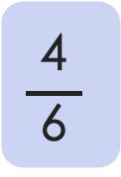
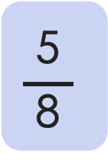
Which symbol would complete this number sentence?
$$\frac{\text{4}}{\text{ 6 }}$$
$$\frac{\text{5}}{ \text{8} }$$
>
<
=
The fractions can’t be compared
Notes:
Assessment point for the lesson – ask the pupils to vote for the answer they think is correct.
A – Correct answer
B – The pupil does not understand how to compare fractions with different denominators. They may have compared the numerators only.
C – The pupil does not understand how to compare fractions. They know both fractions are over ½ and have assumed they are the same.
D – The pupil does not know how to compare fractions.

Slide 5
To compare and order fractions using the denominator

Slide 6
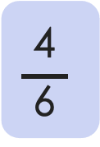
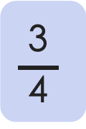
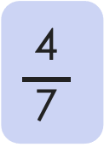
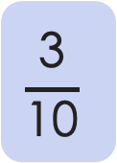
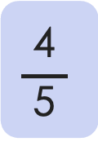
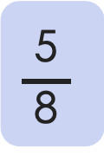
Starter
Compare these fractions using <, > or =.
$$\frac{\text{3}}{ \text{4} }$$
$$\frac{\text{5}}{ \text{8} }$$
$$\frac{\text{4}}{ \text{5} }$$
>
$$\frac{\text{3}}{\text{1}\text{0}}$$
>
$$\frac{\text{4}}{ \text{7} }$$
<
$$\frac{\text{4}}{ \text{6} }$$
Answers
Notes:
Concrete resources – Blank bar models
Key Questions – How can you compare these fractions? Do you need to use the bar models? Is there a different way to compare the fractions? Can you explain why you have given x answer?
Extension – Does the numerator alone indicate the larger or smaller fraction? Explain.

Slide 7

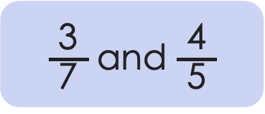





Let’s Learn
Explain how to compare these fractions using the bar model.
$\frac{\text{3}}{ \text{7} }$ and $\frac{\text{4}}{ \text{5} }$
$$\frac{\text{4}}{\text{ 5 }}$$
$$\frac{\text{3}}{\text{ 7 }}$$
_____ is greater than _____ because …
_____ is less than _____ because …
When I order the fractions _____ is before _____
$$\frac{\text{3}}{\text{ 7 }}$$
$$\frac{\text{4}}{\text{ 5 }}$$
$$\frac{\text{3}}{\text{ 7 }}$$
$$\frac{\text{4}}{\text{ 5 }}$$
Answers
Notes:
Explanations will vary. Pupils should identify that 4/5 is greater than 3/7. When ordering, pupils should recognise that 3/7 is the smaller fraction and will come first.
Concrete resources – Blank bar models
Key Questions – How do you use the bar model to compare fractions? Do the bars need to be the same length for the bar models? Why / why not? How do you know which fraction is larger? If we order the fractions from smallest to largest, which fraction comes first?
Misconceptions/ Common Errors – Pupils may say 3/7 is larger as it has a larger denominator. This shows the pupil does not understand fractions.

Slide 8

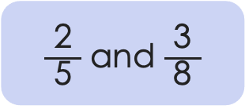
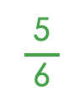

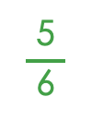
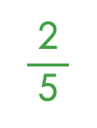
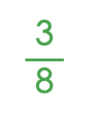
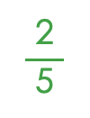
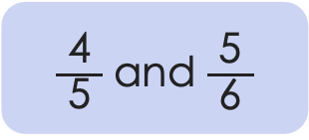
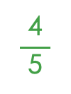
Follow Me
Compare and order the fractions using bar models.
$$\frac{\text{2}}{\text{ 5 }}$$
$$\frac{\text{3}}{\text{ 8 }}$$
_____ is greater than _____ .
_____ is less than _____ .
$\frac{\text{2}}{ \text{5} }$ and $\frac{\text{3}}{ \text{8} }$
$$\frac{\text{3}}{\text{ 8 }}$$
$$\frac{\text{2}}{\text{ 5 }}$$
$$\frac{\text{5}}{\text{ 6 }}$$
$$\frac{\text{4}}{\text{ 5 }}$$
_____ is greater than _____ .
_____ is less than _____ .
$\frac{\text{4}}{ \text{5} }$ and $\frac{\text{5}}{ \text{6} }$
$$\frac{\text{4}}{\text{ 5 }}$$
$$\frac{\text{5}}{\text{ 6 }}$$
Answers
Notes:
Concrete resources – Blank bar models
Key Questions – How can you use the bar models to compare the fractions? What do you notice about the fractions?
Further Practice – Compare different fractions using bar models (encourage pupils to draw bar models - some pupils may struggle with this. They must ensure the bars are the same size so they can be compared easily.
Extension – Explain why the bars should be the same size when comparing them.

Slide 9
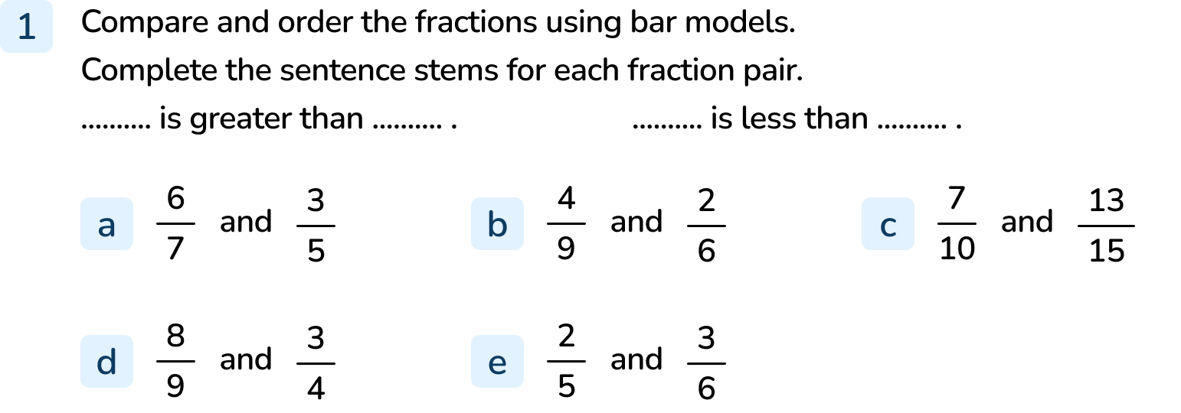
Your Turn
Notes:
6/7 is greater than ⅗. ⅗ is less than 6/7.
4/9 is greater than 2/6. 2/6 is less than 4/9.
13/15 is greater than 7/10. 7/10 is less than 13/15.
8/9 is greater than ¾. ¾ is less than 8/9.
3/6 is greater than ⅖. ⅖ is less than 3/6.

Slide 10
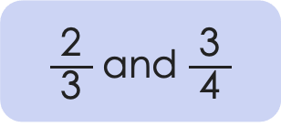
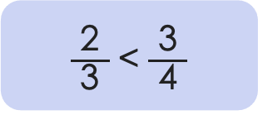
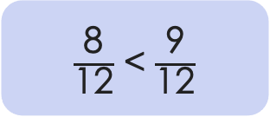
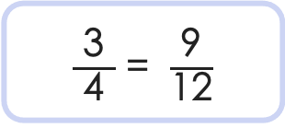
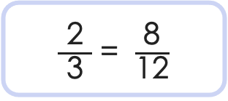
Follow Me
You can compare fractions by finding the lowest common multiple (LCM) of the denominators.
Multiples of 3: 3, 6, 9, 12, 15
Multiples of 4: 4, 8, 12, 16
LCM of 3 and 4: 12
So
$\frac{\text{2}}{ \text{3} }$ and $\frac{\text{3}}{ \text{4} }$
$\frac{\text{2}}{ \text{3} }$ = $\frac{\text{8}}{\text{1}\text{2}}$
$\frac{\text{3}}{ \text{4} }$ = $\frac{\text{9}}{\text{1}\text{2}}$
$\frac{\text{8}}{\text{12}}$ < $\frac{\text{9}}{\text{1}\text{2}}$
$\frac{\text{2}}{ \text{3} }$ < $\frac{\text{3}}{ \text{4} }$
and
Notes:
Concrete resources – Multiplication square
Key Questions – What are multiples? How can you find the lowest common multiple? Which method do you prefer (LCM or bar model)? Why?
Misconceptions/ Common Errors – Pupils could become confused when finding equivalent fractions over 12. Some pupils may multiply both fractions by the same number (e.g. multiply both fractions by 3 or both fractions by 4).
Further Practice – The following slide provides an opportunity for further practice.

Slide 11


Follow Me
Cedar has tried to use the lowest common multiple method to compare these fractions.
$\frac{\text{4}}{ \text{6} }$ and $\frac{\text{5}}{ \text{8} }$
Lowest common multiple of 6 and 8: 48
$\frac{\text{32}}{\text{48}}$ > $\frac{\text{30}}{\text{48}}$
Is it right?
Explain.
Cedar has used the correct symbol to compare the fractions, however, they have not found the lowest common multiple of the two denominators. Cedar has multiplied 6 by 8 instead of listing the lower common multiples. The lowest common multiple is 24.
Answers
Notes:
Concrete resources – Multiplication square
Key Questions – Has Cedar found the lowest common multiple? What has Cedar done to find the answer? Is the answer right or wrong? Why?
Misconceptions/ Common Errors – Pupils may make the error described above. They may not understand why finding the LCM is a more effective method.

Slide 12
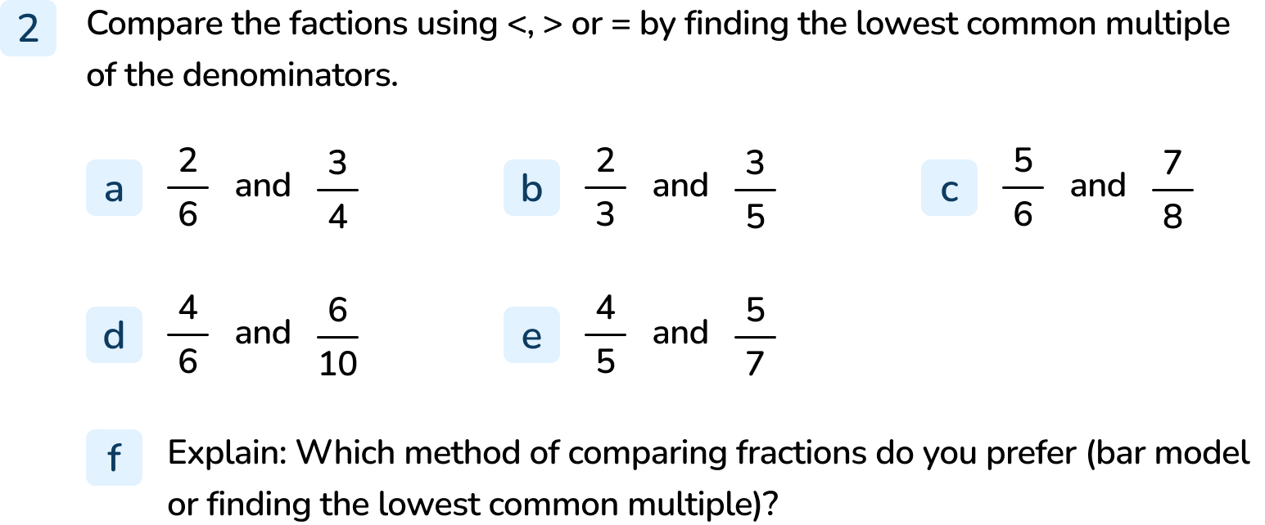
Your Turn
Notes:
< (LCM: 12)
> (LCM: 15)
< (LCM: 24)
> (LCM: 30)
> (LCM: 35)
Answers will vary depending on pupil preference.

Slide 13
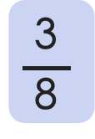

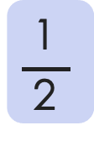
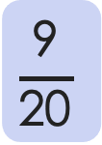

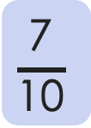

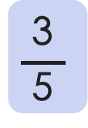

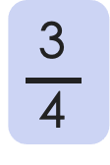


Follow Me
Put these fractions in ascending order.
$$\frac{\text{1}}{ \text{2} }$$
$$\frac{\text{3}}{ \text{4} }$$
$$\frac{\text{3}}{ \text{5} }$$
$$\frac{\text{7}}{\text{1}\text{0}}$$
$$\frac{\text{9}}{\text{2}\text{0}}$$
$$\frac{\text{3}}{ \text{8} }$$
$$\frac{\text{3}}{ \text{8} }$$
$$\frac{\text{9}}{\text{20}}$$
$$\frac{\text{1}}{ \text{2} }$$
$$\frac{\text{3}}{ \text{5} }$$
$$\frac{\text{7}}{\text{10}}$$
$$\frac{\text{3}}{ \text{4} }$$
Answers
Notes:
Concrete resources – Multiplication square or blank bar models
Key Questions – Which method will you use to order the fractions? What do you need to remember? ½ is in the list, why is this useful?
Misconceptions/ Common Errors – Pupils may struggle with ⅜. They may be tempted to find the LCM for all the fractions (40). Encourage them to consider ½ first. Is ⅜ greater or less than ½? Is it greater or less than 9/20? As they know ⅜ and 9/20 are both less than ½, they only need to compare these fractions less than ½ and compare 3/5, 7/10 and ¾ greater than 1/2.

Slide 14
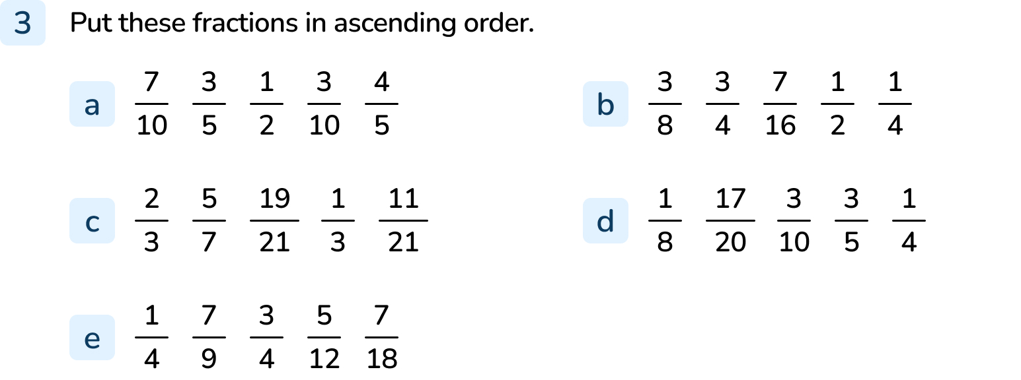
Your Turn
Notes:
3/10, ½, ⅗, 7/10, ⅘
¼, ⅜, 7/16, ½, ¾
⅓, 11/21, ⅔, 5/7, 19/21
⅛, ¼, 3/10, ⅗, 17/20
¼, 7/18, 5/12, ¾, 7/9

Slide 15

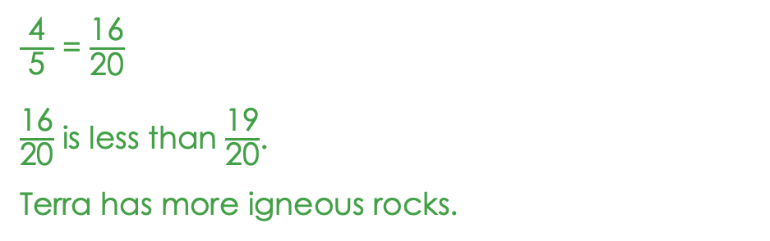
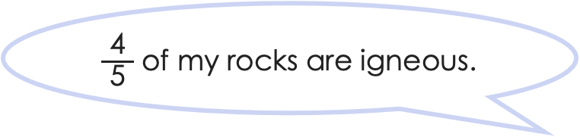
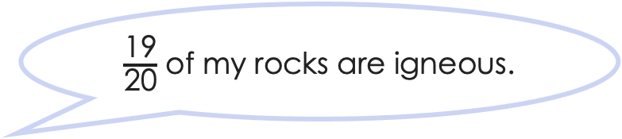
Let’s Reflect
Two Mathlings are comparing their rock collections.
Who has the most igneous rocks?
$\frac{\text{19}}{\text{20}}$ of my rocks are igneous.
$\frac{\text{4}}{\text{ 5 }}$ of my rocks are igneous.
Terra
$\frac{\text{4}}{ \text{5} }$ = $\frac{\text{16}}{\text{20}}$
$\frac{\text{16}}{\text{20}}$ is less than $\frac{\text{19}}{\text{20}}$.
Terra has more igneous rocks.
Cedar
Answers
Notes:
Concrete resources – Blank bar models
Key Questions – How can I compare these fractions? Which Mathling has more igneous rocks? How do you know? What is the difference between the two fractions? How many ways can you prove your answer is correct?

Slide 16
The following slides are based on: Comparing and ordering fractions less than 1

Slide 17
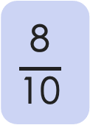
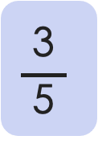
How can we use the bar models to compare $\frac{\text{3}}{ \text{5} }$ and $\frac{\text{8}}{\text{10}}$?
$$\frac{\text{3}}{ \text{5} }$$
$$\frac{\text{8}}{\text{1}\text{0}}$$
<
Answers
Notes:
How and when to use these slides – This slide provide an opportunity to revisit comparing fractions where denominators are multiples of the same number. Pupils may need to recap this before moving on to comparing fractions where the denominators are not multiples of the same number.
Concrete resources – Bar models to compare
Key Questions – How do I show each fraction on the bar model? How do I then compare the fractions using the bar model? Which fraction is larger? How do you know? Which symbol would I use to compare the fractions? Why? If a fraction has a larger number for the denominator, is this always the larger fraction?
Misconceptions/ Common Errors – Pupils may assume 8/10 is larger based on the denominator. While this is true in this case, it is not always true.
Further Practice – Compare other fractions with the same denominator using bar models.

Slide 18
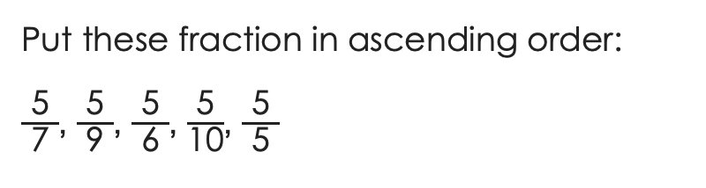
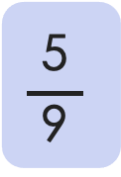
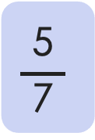
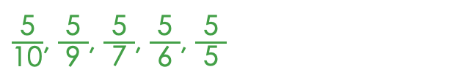
How can we compare fractions with common numerators?
$$\frac{\text{5}}{ \text{7} }$$
$$\frac{\text{5}}{ \text{9 }}$$
>
Put these fraction in ascending order:
$\frac{\text{5}}{ \text{7} }$, $\frac{\text{5}}{ \text{9} }$, $\frac{\text{5}}{ \text{6} }$, $\frac{\text{5}}{\text{10}}$, $\frac{\text{5}}{ \text{5} }$
$\frac{\text{5}}{\text{10}}$, $\frac{\text{5}}{ \text{9} }$, $\frac{\text{5}}{ \text{7} }$, $\frac{\text{5}}{ \text{6} }$, $\frac{\text{5}}{ \text{5} }$
Answers
Notes:
How and when to use these slides – This slide focuses on understanding that if the numerators are the same, the denominators can be compared. Pupils may need to recap this learning before comparing and ordering fractions where denominators are not multiples of the same number.
Concrete resources – Blank bar models
Key Questions – Do we need to find equivalent fractions with like denominators to compare these fractions? How can we compare them using the bar models? Is it important that the bars are the same size? Why/ why not?
Misconceptions/ Common Errors – Pupils may not know how to compare fractions with a common numerator.

